Slide 1

Pattern Classification
All materials in these slides were taken from
Pattern Classification (2nd ed) by R. O. Duda, P. E. Hart and D. G. Stork, John Wiley & Sons, 2000 with the permission of the authors and the publisher

Slide 2
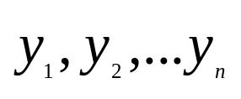
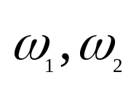
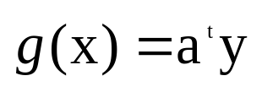
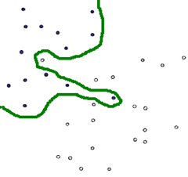
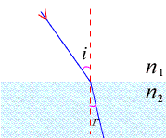
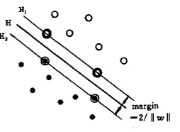
5.4 The Two-Category Linearly Separable Case
Linearly separable
n samples belong to , if there exits a linear discriminant function that classifies all of them correctly, the samples are said to be linearly separable. Weight vector a is called a separating vector or solution vector

Slide 3
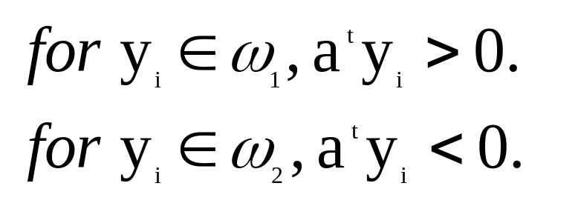


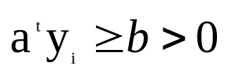
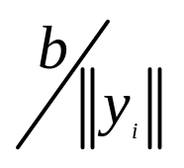
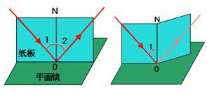
Normalization
Multiplying all samples labeled with by -1 is called normalization
with this normalization we only need to look for a weight vector a such that
Solution Region
Margin
the distance between old boundaries and new boundaries is

Slide 4
The problem of finding a linear discriminant function will be formulated as a problem of minimizing a criterion function

Slide 5

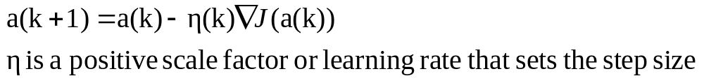
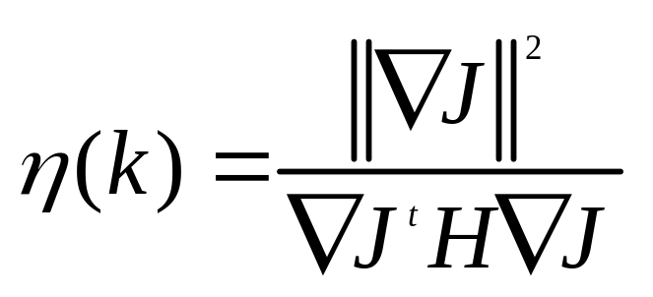
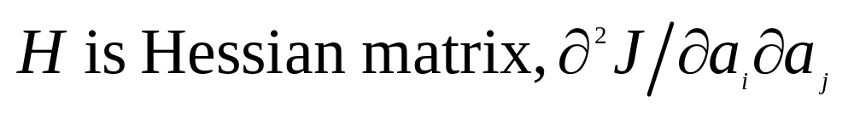
Gradient Descent Procedures
define a criterion function that is minimized if a is a solution vector. This can often be solved by a gradient descent procedure.
Using the Taylor extension, we have

Slide 6
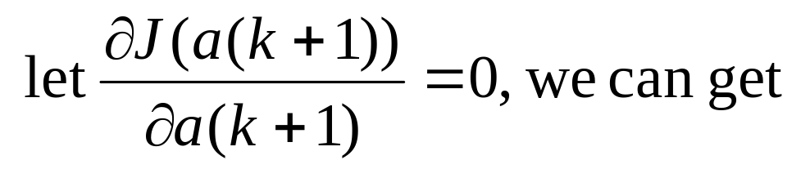
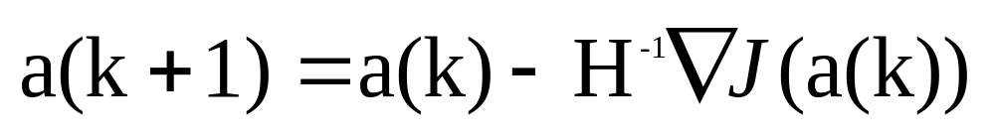
Another Algorithm
:Newton Descent Algorithm
Using the Taylor extension and
This the so-called Newton Descent Algorithm

Slide 7
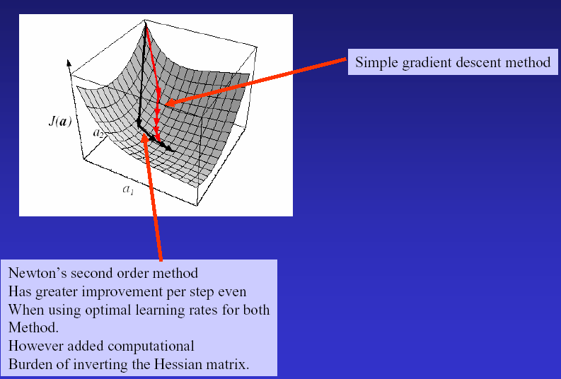
Newton’s algorithm vs the simple gradient decent algorithm 步长更大，额外的计算量何塞矩阵）

Slide 8
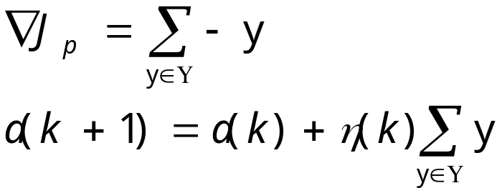
5.5 Minimizing The Perception Criterion Function
The Perception Criterion Function of the Batch Perception Algorithm

Slide 9
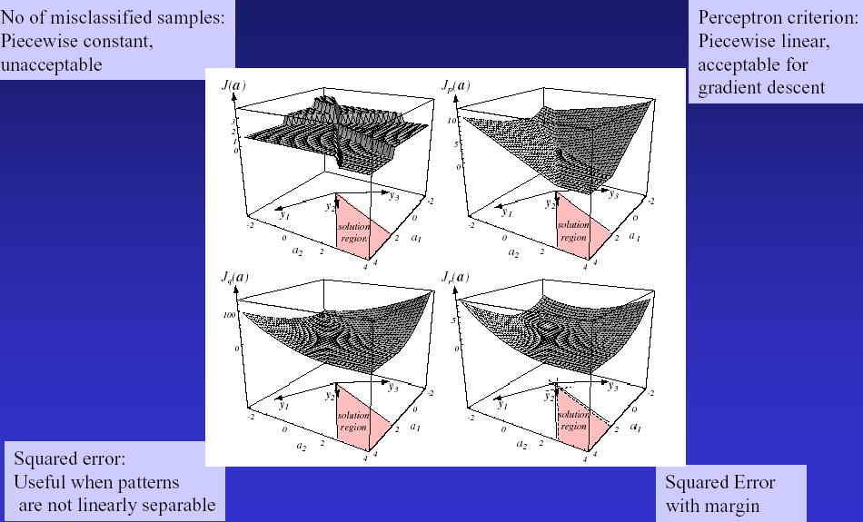
Comparison of Four Criterion functions

Slide 10
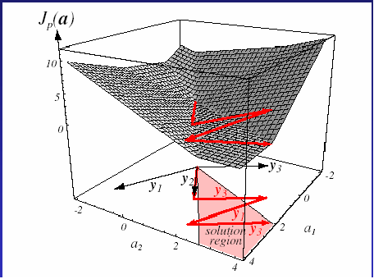
Perceptron Criterion as function of weights: Demo
Criterion function plotted as a
function of weights a1 and a2,
Starts at origin,
Sequence is y2,y3, y1, y3
Second update by y3 takes
solution farther than first update

Slide 11
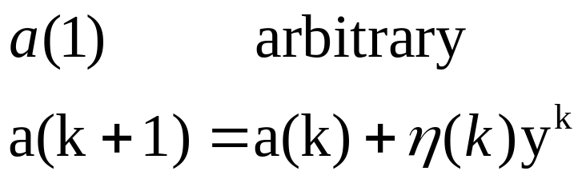
Single-Sample Correction
Interpretation of Single-Sample Correction
Single-Sample correction and batch perception
algorithm are two algorithms of perception machine.
Either of them can be used !

Slide 12
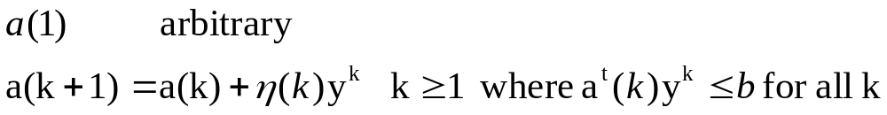
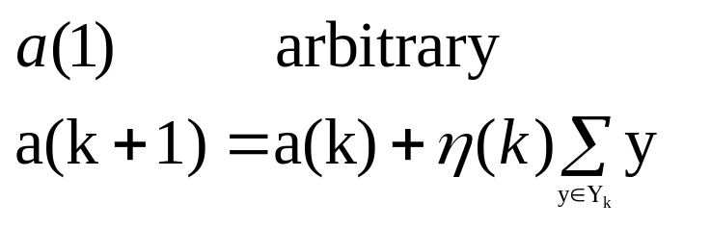
Some Direct Generalizations
  Variable-Increment Perceptron with Margin
  Algorithm Convergence
  Batch Variable Increment Perception

Slide 13
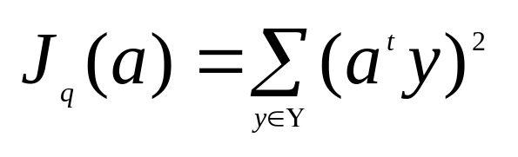
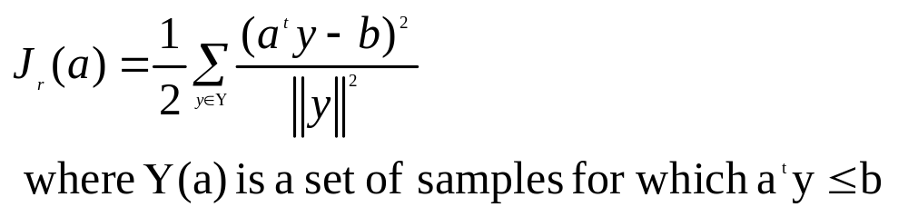
5.6 Relaxation Procedures
Decent Algorithm
  criterion function:
  two problems of this criterion function
  criterion function:

Slide 14
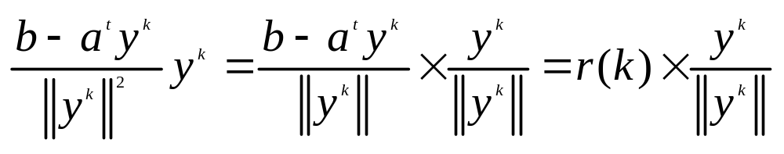
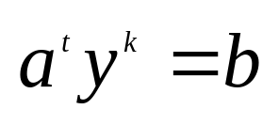
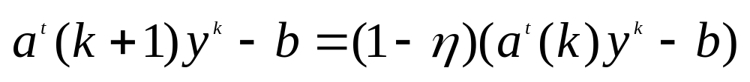
  Batch Relaxation with Margin
  Single-Sample Relaxation with margin
  Geometrical interpretation of Single-Sample Relaxation with margin algorithm
  r(k) is the distance from a(k) to the hyperplane
  From Eq.35 we obtain

Slide 15

5.7 Nonseparable Behavior
Error-correction procedure
For nonseparable data the corrections in an error-correction procedure can never cease.
By averaging the weight vector produced by the correction rule, we can reduce the risk of obtaining a bad solution.
Some heuristic methods are used in the error-correction rules. The goal is to obtain acceptable performance on nonseparable problems while preserving the ability to find a separating vector on separable problems.
Usually we let approach zero as k approaches infinity

