Slide 1
Chapter 2 (Part 1):
Bayesian Decision Theory
(Sections 2.1-2.2)
Introduction
Bayesian Decision Theory–Continuous Features
Pattern Classification Chapter2(part 1)
Notes:
hbvhmbm

Slide 2
Introduction
The sea bass/salmon example
State of nature, prior
    State of nature is a random variable
    The catch of salmon and sea bass is equiprobable
      P(ω₁) = P(ω₂) (uniform priors)
      P(ω₁) + P( ω₂) = 1 (exclusivity and exhaustivity)
Pattern Classification Chapter2(part 1)
Notes:
hbvhmbm

Slide 3
Decision rule with only the prior information
  Decide ω₁ if P(ω₁) > P(ω₂) otherwise decide ω₂
Use More Information: the class –conditional information
p(x | ω₁) and p(x | ω₂) describe the difference in lightness between populations of sea and salmon
Pattern Classification Chapter2(part 1)
Notes:
hbvhmbm

Slide 4
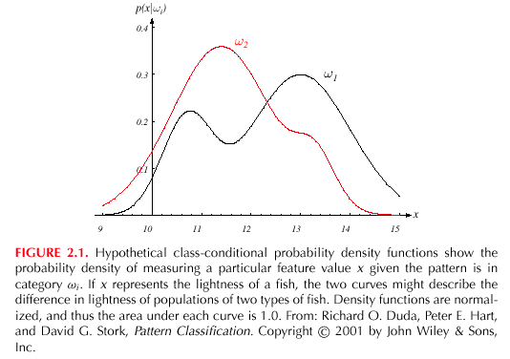
Pattern Classification Chapter2(part 1)
Notes:
hbvhmbm

Slide 5

Posterior, likelihood, evidence
  P(ω_{j} | x) = p(x | ω_{j}) . P(ω_{j}) / p(x)
  Where in case of two categories
  Posterior = (Likelihood. Prior) / Evidence
  Evidence can be viewed as a scale factor
Pattern Classification Chapter2(part 1)
Notes:
hbvhmbm

Slide 6
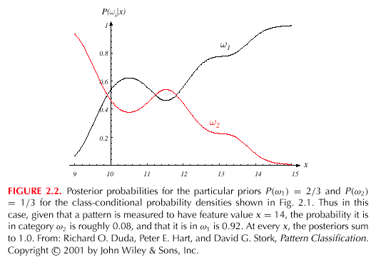
Pattern Classification Chapter2(part 1)
Notes:
hbvhmbm

Slide 7
Decision given the posterior probabilities
X is an observation for which:
if P(ω₁ | x) > P(ω₂ | x) True state of nature = ω₁
if P(ω₁ | x) < P(ω₂ | x) True state of nature = ω₂
Multi-class ?
Therefore:
whenever we observe a particular x, the probability of error is :
P(error | x) = P(ω₁ | x) if we decide ω₂
P(error | x) = P(ω₂ | x) if we decide ω₁
P(error | x) = min(P(ω₁ | x) , P(ω₂ | x) )
Pattern Classification Chapter2(part 1)
Notes:
hbvhmbm

Slide 8
Minimizing the probability of error
Decide ω₁ if P(ω₁ | x) > P(ω₂ | x);
otherwise decide ω₂
Therefore:
P(error | x) = min [P(ω₁ | x), P(ω₂ | x)]
(Bayes decision)
Decide ω₁ if p(x | ω₁) P(ω₁) > p(x | ω₂ ) P(ω₂ )
Special Case:
p(x | ω₁) = p(x | ω₂ )
P(ω₁) = P(ω₂ )
Pattern Classification Chapter2(part 1)
Notes:
hbvhmbm

Slide 9
Exercise
Problem:
A patient takes a lab test and the result is positive. The test returns a correct positive result in 98% of the cases in which the cancer disease is actually present, and a correct negative result in 97% of the cases in which the disease is not present. Furthermore, 0.8% of the entire population have this cancer disease. Does the patient suffers from the cancer?
Pattern Classification Chapter2(part 1)
Notes:
hbvhmbm

Slide 10
Solution:
  Given: P(+|cancer)=0.98
P(-|no cancer)=0.97
P(cancer)=0.008
P(-cancer)=0.992
  Compute:
P(no cancer | +) , P(cancer | +),
Pattern Classification Chapter2(part 1)
Notes:
hbvhmbm

Slide 11
  P(cancer | +)=P(+|cancer)* P(cancer)/p(+)
  P(cancer |+)=0.98X0.008/p
  P(cancer |+)= 0.00784 /p(+)
Pattern Classification Chapter2(part 1)
Notes:
hbvhmbm

Slide 12
  P(no cancer|+)=P(+|no cancer)*P(no cancer)/P(+)
  P(no cancer|+)=(1-0.97)*(1-0.008)/ P(+)
  P(no cancer|+)=0.02976 / P(+)
  Since P(no cancer | +) > P(cancer | +), we decide that the patient does not have cancer
  (Bayesian decision rule)
Pattern Classification Chapter2(part 1)
Notes:
hbvhmbm

Slide 13
Exercise
Another Problem:
A person takes a lab test of nuclear radiation and the result is positive. The test returns a correct positive result in 99% of the cases in which the nuclear radiation is actually present, and a correct negative result in 95% of the cases in which the nuclear radiation is not present. Furthermore, 30% of the entire population are radioactively contaminated. Is this person contaminated ?
Pattern Classification Chapter2(part 1)
Notes:
hbvhmbm

Slide 14
Bayesian Decision Theory – Continuous Features
Generalization of the preceding ideas
  Use of more than one feature
  Use more than two states of nature
  Allowing actions and not only decide on the state of nature
  Introduce a loss of function which is more general than the probability of error
Pattern Classification Chapter2(part 1)
Notes:
hbvhmbm

Slide 15
Allowing actions other than classification primarily allows the possibility of rejection
Refusing to make a decision in close or bad cases!
The loss function states how costly each action taken is
Pattern Classification Chapter2(part 1)
Notes:
hbvhmbm

Slide 16
Let {ω₁, ω₂,…, ω_{c}} be the set of c states of nature
(or “categories”)
Let {α₁, α₂,…, α_{a}} be the set of possible actions
Let λ(α_{i} | ω_{j}) be the loss incurred for taking
action α_{i} when the state of nature is ω_{j}
Pattern Classification Chapter2(part 1)
Notes:
hbvhmbm

Slide 17

Overall risk
R = Sum of all R(α_{i} | x) for i = 1,…,a
Minimizing R Minimizing R(α_{i} | x) for i = 1,…, a
for i = 1,…,a
Conditional risk
Pattern Classification Chapter2(part 1)
Notes:
hbvhmbm

Slide 18
Select the action α_{i} for which R(α_{i} | x) is minimum
R is minimum and R in this case is called the
Bayes risk = best performance that can be achieved!
Pattern Classification Chapter2(part 1)
Notes:
hbvhmbm

Slide 19
Two-category classification
    α₁ : deciding ω₁
    α₂ : deciding ω₂
    λ_{ij} = λ(α_{i} | ω_{j})
loss incurred for deciding ω_{i} when the true state of nature is ω_{j}
Conditional risk:
R(α₁ | x) = λ₁₁P(ω₁ | x) + λ₁₂P(ω₂ | x)
R(α₂ | x) = λ₂₁P(ω₁ | x) + λ₂₂P(ω₂ | x)
Pattern Classification Chapter2(part 1)
Notes:
hbvhmbm

Slide 20
Our rule is the following:
if R(α₁ | x) < R(α₂ | x)
action α₁: “decide ω₁” is taken
This results in the equivalent rule :
decide ω₁ if:
(λ₂₁- λ₁₁) P(ω₁ |x) >(λ₁₂- λ₂₂) P(ω₂ |x)
and decide ω₂ otherwise
Pattern Classification Chapter2(part 1)
Notes:
hbvhmbm

Slide 21
(λ₂₁- λ₁₁) P(ω₁ |x) >(λ₁₂- λ₂₂) P(ω₂ |x)
is equal to
(λ₂₁- λ₁₁) P(x|ω₁) P(ω₁) >(λ₁₂- λ₂₂) P(x|ω₂) P(ω₂)
Notes:
hbvhmbm

Slide 22

Likelihood ratio:
The preceding rule is equivalent to the following rule:
Then take action α₁ (decide ω₁)
Otherwise take action α₂ (decide ω₂)
Pattern Classification Chapter2(part 1)
Notes:
hbvhmbm

Slide 23
Optimal decision property
“If the likelihood ratio exceeds a threshold value independent of the input pattern x, we can take optimal actions”
Pattern Classification Chapter2(part 1)
Notes:
hbvhmbm

Slide 24
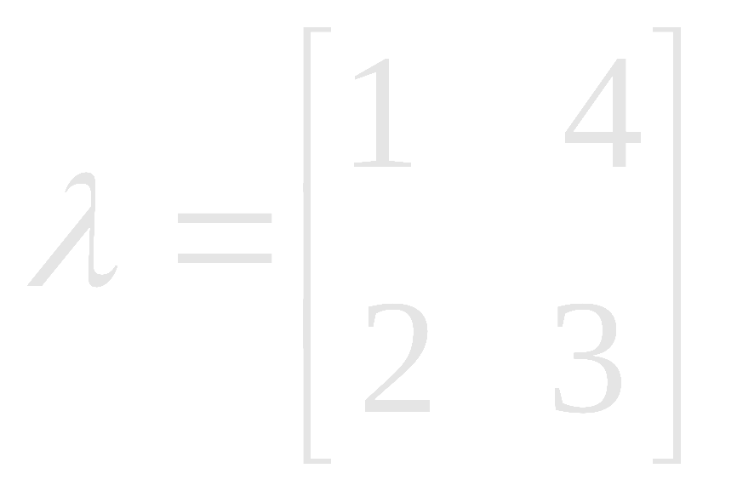
Exercise
Select the optimal decision where:
= {ω₁, ω₂}
p(+ | ω₁) 0.9
p(+ | ω₂) 0.001
P(ω₁) = 0.01
P(ω₂) = 0.99
Pattern Classification Chapter2(part 1)
Notes:
hbvhmbm

Slide 25
Chapter 2 (Part 2):
Bayesian Decision Theory
(Sections 2.3-2.5)
Minimum-Error-Rate Classification
Classifiers, Discriminant Functions and Decision Surfaces
The Normal Density
Pattern Classification Chapter 2 (Part 2)

Slide 26
2.3 Minimum-Error-Rate Classification
Actions are decisions on classes
If action α_{i} is taken and the true state of nature is ω_{j} then:
the decision is correct if i = j and in error if i ≠ j
Seek a decision rule that minimizes the probability of error which is the error rate
Pattern Classification Chapter 2 (Part 2)

Slide 27
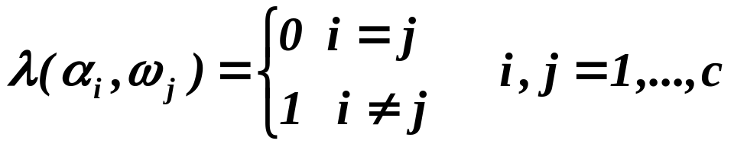
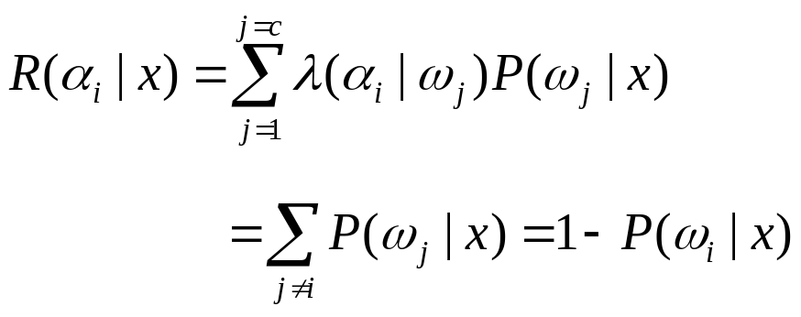
The loss function for above case is the zero-one loss function:
Therefore, the conditional risk is:
“The risk corresponding to this loss function is the average probability error”
Pattern Classification Chapter 2 (Part 2)

Slide 28
Minimize the risk requires maximize P(ω_{i} | x)
(since R(α_{i} | x) = 1 – P(ω_{i} | x))
For Minimum error rate
  Decide ω_{i} if P (ω_{i} | x) > P(ω_{j} | x) ∀j ≠ i
Pattern Classification Chapter 2 (Part 2)

Slide 29
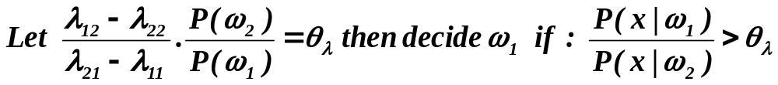
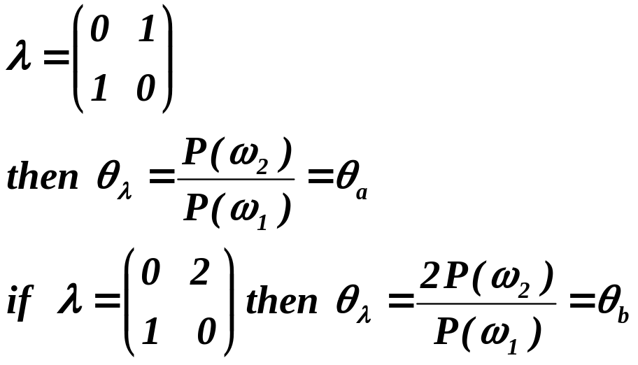
Regions of decision and zero-one loss function, therefore:
If λ is the zero-one loss function which means:
Pattern Classification Chapter 2 (Part 2)

Slide 30
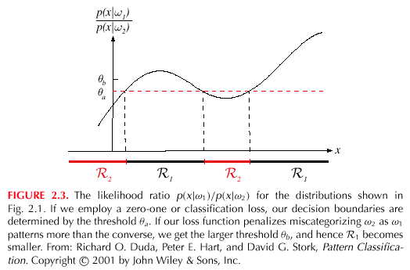
Pattern Classification Chapter 2 (Part 2)

Slide 31
2.4 Classifiers, Discriminant Functions and Decision Surfaces
The multi-category case
  Set of discriminant functions g_{i}(x), i = 1,…, c
  The classifier assigns a feature vector x to class ω_{i}
  if:
  g_{i}(x) > g_{j}(x) ∀j ≠ i
Pattern Classification Chapter 2 (Part 2)

Slide 32
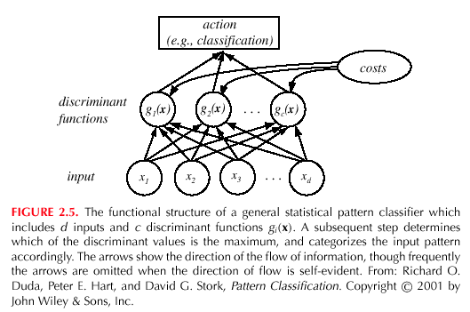
Pattern Classification Chapter 2 (Part 2)

Slide 33
For the minimum risk case
Let g_{i}(x) = - R(α_{i} | x)
(max. discriminant corresponds to min. risk!)
For the minimum error rate cae, we take
  g_{i}(x) = P(ω_{i} | x)
(max. discrimination corresponds to max. posterior!)
g_{i}(x) ≡ p(x | ω_{i}) P(ω_{i})
g_{i}(x) = ln p(x | ω_{i}) + ln P(ω_{i})
(ln: natural logarithm!)
Pattern Classification Chapter 2 (Part 2)

Slide 34
Feature space divided into c decision regions
if g_{i}(x) > g_{j}(x) ∀j ≠ i then x is in R_{i}
(R_{i} means assign x to ω_{i})
The two-category case
  A classifier is a “dichotomizer” that has two discriminant functions g₁ and g₂
  Let g(x) ≡ g₁(x) – g₂(x)
  Decide ω₁ if g(x) > 0 ; Otherwise decide ω₂
Pattern Classification Chapter 2 (Part 2)

Slide 35
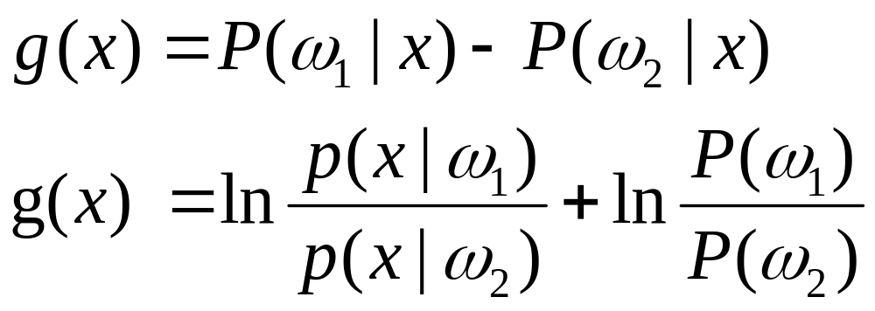
  The computation of g(x)
Pattern Classification Chapter 2 (Part 2)

Slide 36
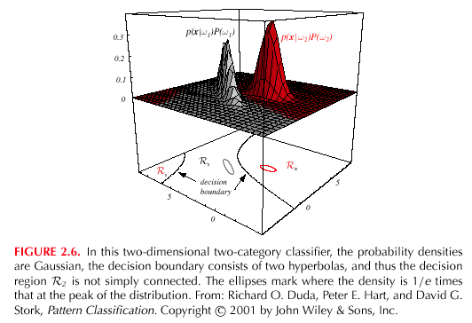
Pattern Classification Chapter 2 (Part 2)

Slide 37
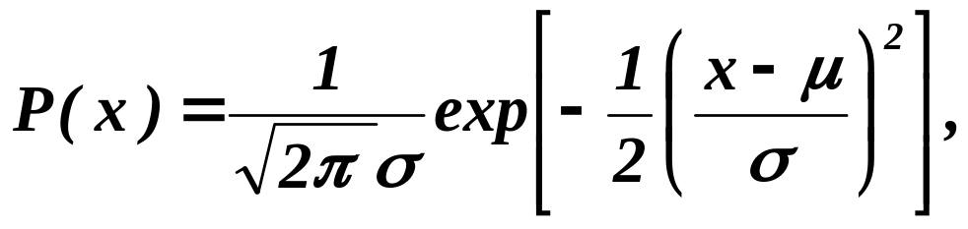
2.5 The Normal Density
Univariate density
  Continuous density
  A lot of processes are asymptotically Gaussian
  Handwritten characters, speech sounds are ideal or prototype corrupted by random process (central limit theorem)
Where:
μ = mean (or expected value) of x
σ² = expected squared deviation or variance
Pattern Classification Chapter 2 (Part 2)

Slide 38
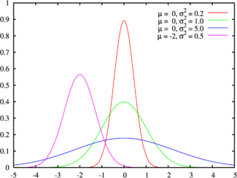
Examples of normal distributions
Pattern Classification Chapter 2 (Part 2)

Slide 39
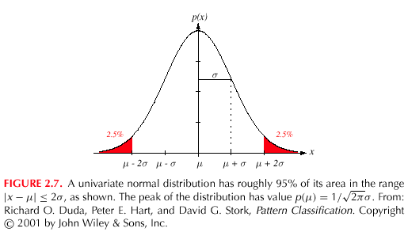
Pattern Classification Chapter 2 (Part 2)

Slide 40
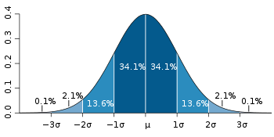
The 68-95-99.7 rule
Pattern Classification Chapter 2 (Part 2)

Slide 41
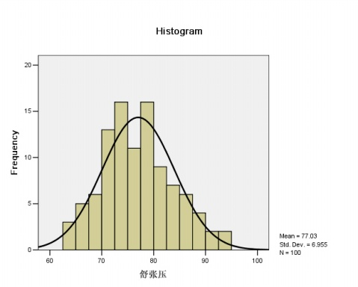
Examples in the real world
Pattern Classification Chapter 2 (Part 2)

Slide 42
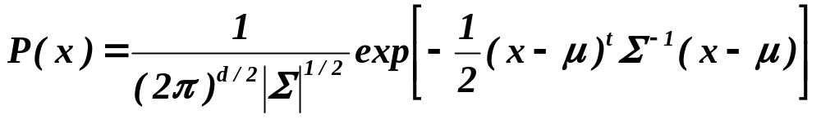
Multivariate density
  Multivariate normal density in d dimensions is:
where:
x = (x₁, x₂, …, x_{d})^{t} (t stands for the transpose vector form)
μ = (μ₁, μ₂, …, μ_{d})^{t} mean vector
Σ = d*d covariance matrix
|Σ| and Σ⁻¹ are determinant and inverse respectively
Pattern Classification Chapter 2 (Part 2)

Slide 43
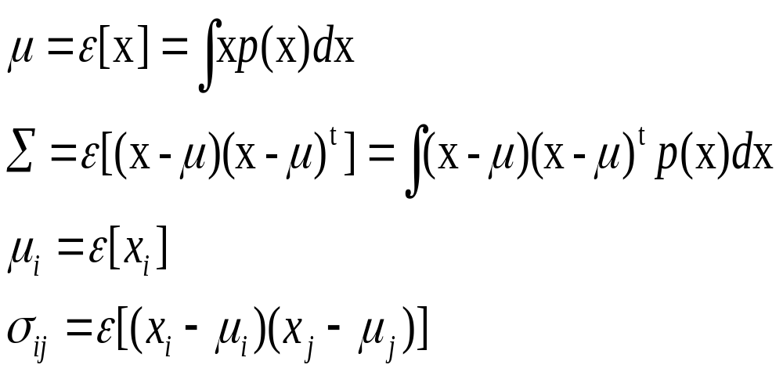
Pattern Classification Chapter 2 (Part 2)

Slide 44
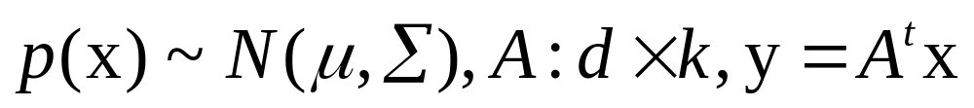
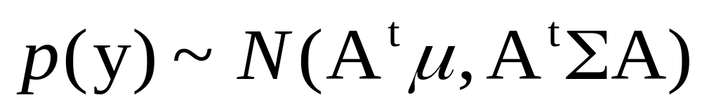
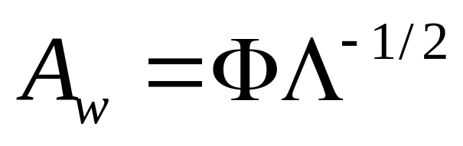



  Linear combinations of normally distributed random variables are normally distributed
  if
  then
  Whitening transform:
  :The orthonormal eigenvectors of
  :The diagonal matrix of the eigenvalues
Pattern Classification Chapter 2 (Part 2)

Slide 45
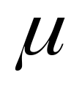
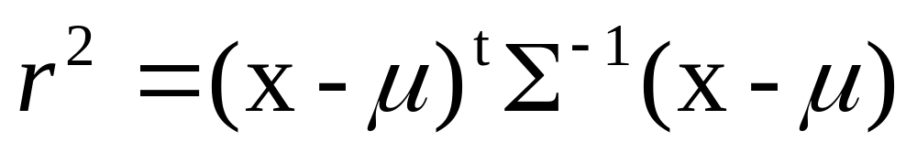
Mahalanobis distance from x to
Pattern Classification Chapter 2 (Part 2)

Slide 46
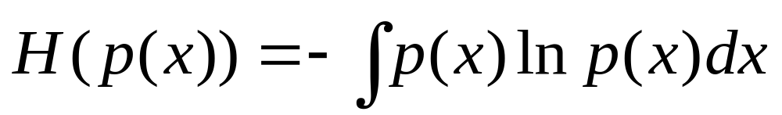
Entropy
  Measure the fundamental uncertainty in the values of points selected randomly
  Measured in nats, bit,
  Normal distribution has max entropy of all distributions having a given mean and variance
Pattern Classification Chapter 2 (Part 2)

Slide 47
Chapter 2 (part 3)
Bayesian Decision Theory (Sections 2-6,2-9)
Discriminant Functions for the Normal Density
Bayes Decision Theory – Discrete Features
Pattern Classification Chapter 2(Part 3)

Slide 48
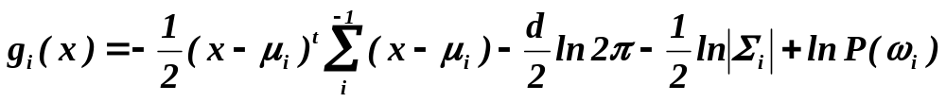
2.6 Discriminant Functions for the Normal Density
We saw that the minimum error-rate classification can be achieved by the discriminant function
g_{i}(x) = ln p(x | ω_{i}) + ln P(ω_{i})
Case of multivariate normal
Pattern Classification Chapter 2(Part 3)

Slide 49
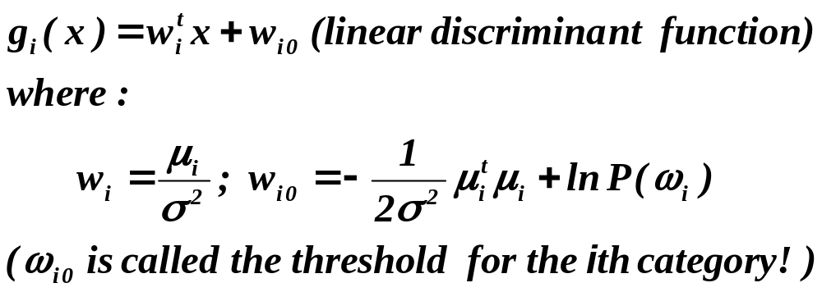
Case Σ_{i} = σ².I (I stands for the identity matrix)
Pattern Classification Chapter 2(Part 3)

Slide 50
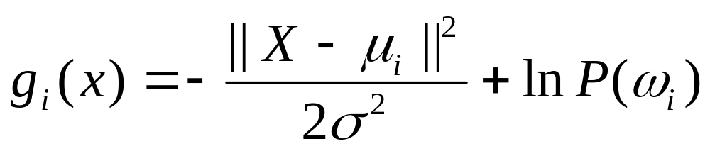
Case Σ_{i} = σ².I (I stands for the identity matrix)
Pattern Classification Chapter 2(Part 3)

Slide 51
  A classifier that uses linear discriminant functions is called “a linear machine”
  The decision surfaces for a linear machine are pieces of hyperplanes defined by:
g_{i}(x) = g_{j}(x)
Pattern Classification Chapter 2(Part 3)

Slide 52
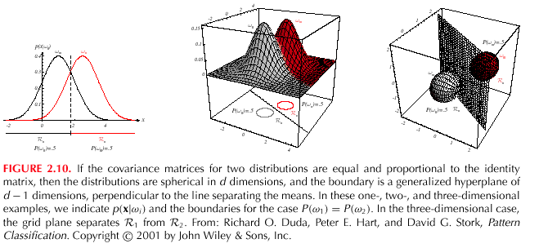
Pattern Classification Chapter 2(Part 3)

Slide 53
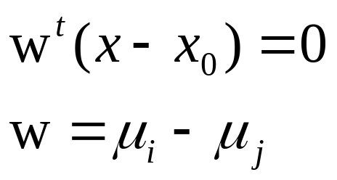
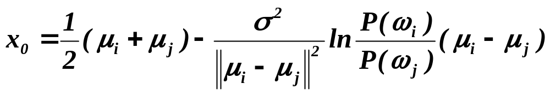
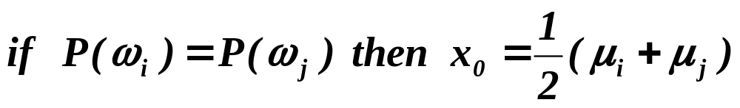
  The hyperplane separating R_{i} and R_{j}
  always orthogonal to the line linking the means!
Pattern Classification Chapter 2(Part 3)

Slide 54
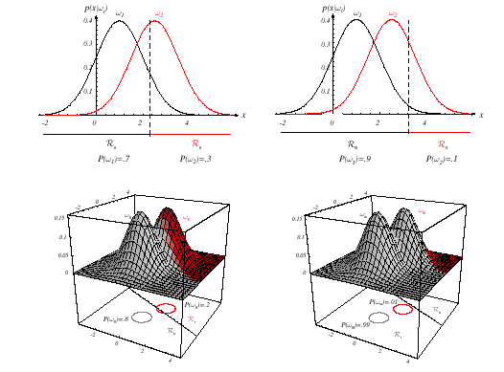
Pattern Classification Chapter 2(Part 3)

Slide 55
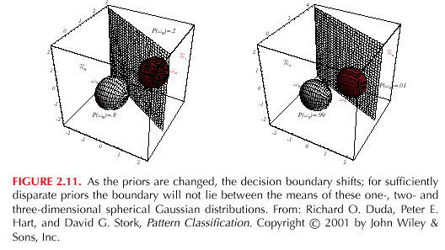
Pattern Classification Chapter 2(Part 3)

Slide 56
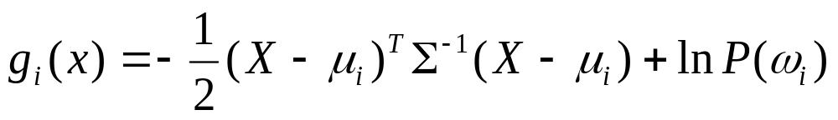
Case Σ_{i} = Σ (covariance of all classes are identical but arbitrary!)
Pattern Classification Chapter 2(Part 3)

Slide 57
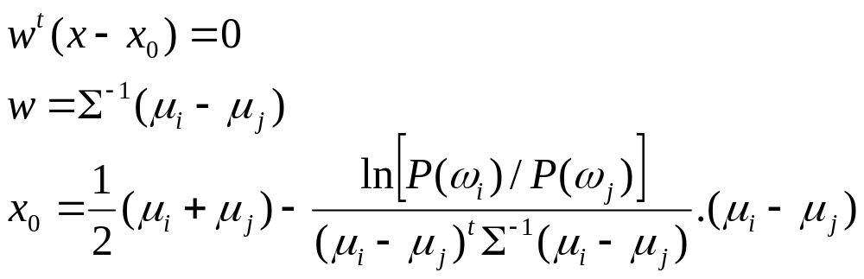
Case Σ_{i} = Σ (covariance of all classes are identical but arbitrary!)
  Hyperplane separating R_{i} and R_{j}
  (the hyperplane separating R_{i} and R_{j} is generally not orthogonal to the line between the means!)
Pattern Classification Chapter 2(Part 3)

Slide 58
Pattern Classification Chapter 2(Part 3)

Slide 59
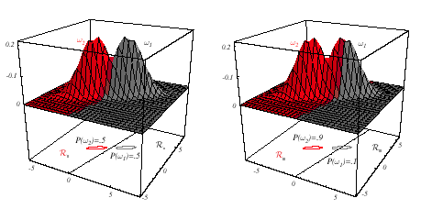
Pattern Classification Chapter 2(Part 3)

Slide 60
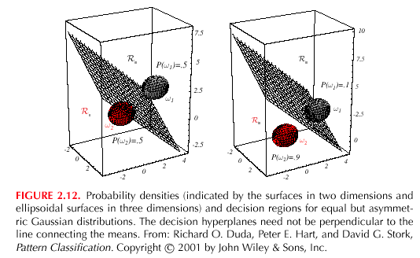
Pattern Classification Chapter 2(Part 3)

Slide 61
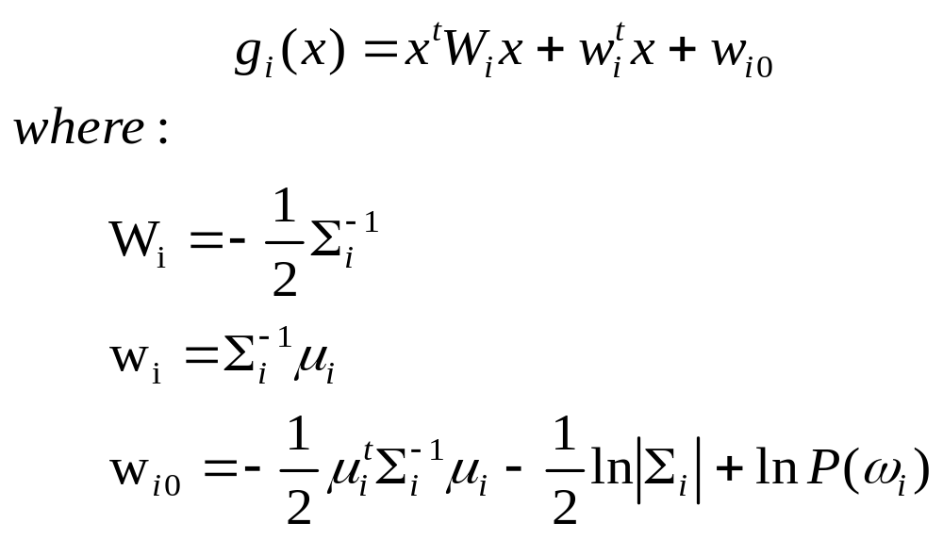
Case Σ_{i} = arbitrary
  The covariance matrices are different for each category
  (Hyperquadrics which are: hyperplanes, pairs of hyperplanes, hyperspheres, hyperellipsoids, hyperparaboloids, hyperboloids)
Pattern Classification Chapter 2(Part 3)

Slide 62
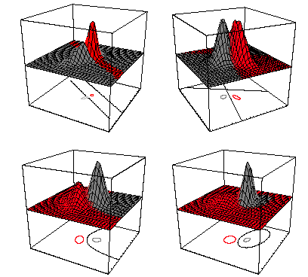
Pattern Classification Chapter 2(Part 3)

Slide 63
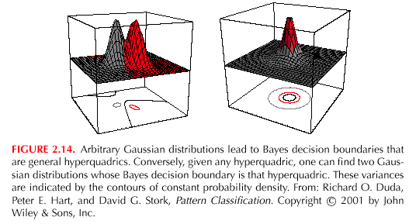
Pattern Classification Chapter 2(Part 3)

Slide 64
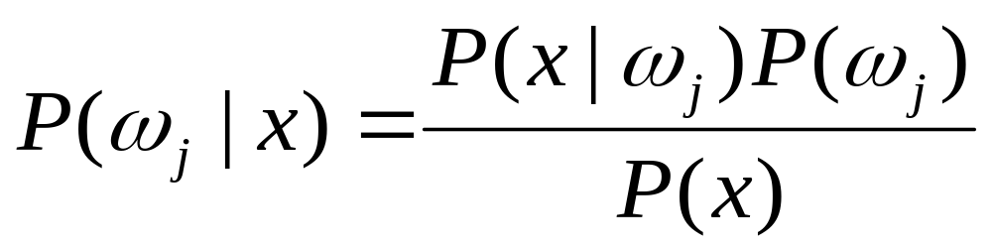
2.9 Bayes Decision Theory – Discrete Features
Components of x are binary or integer valued, x can take only one of m discrete values
v₁, v₂, …, v_{m}
Pattern Classification Chapter 2(Part 3)

Slide 65
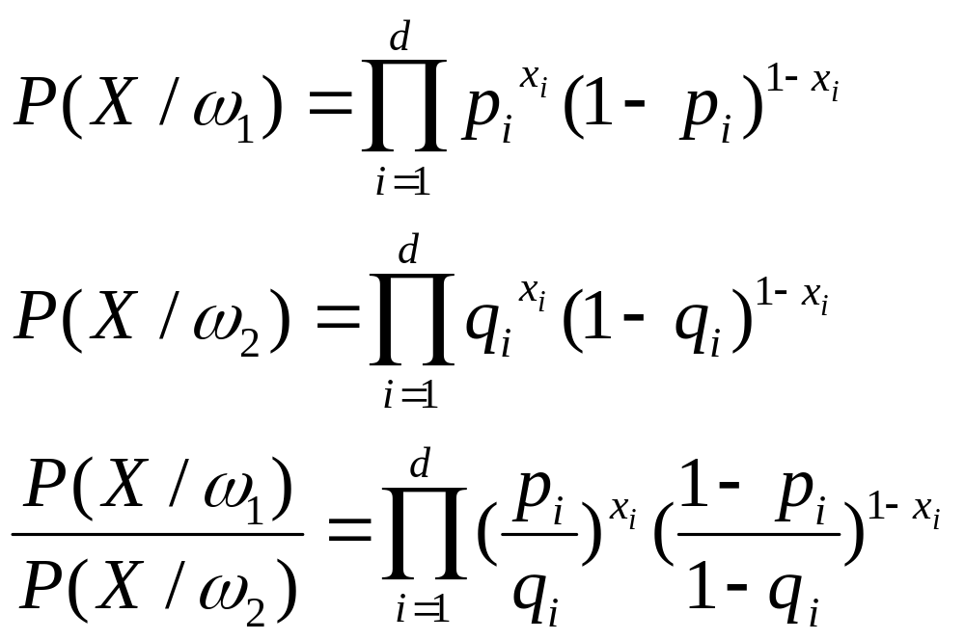
Case of independent binary features in 2 category problem
Let x = [x₁, x₂, …, x_{d} ]^{t} where each x_{i} is either 0 or 1, with probabilities:
p_{i} = P(x_{i} = 1 | ω₁)
q_{i} = P(x_{i} = 1 | ω₂)
Pattern Classification Chapter 2(Part 3)

Slide 66
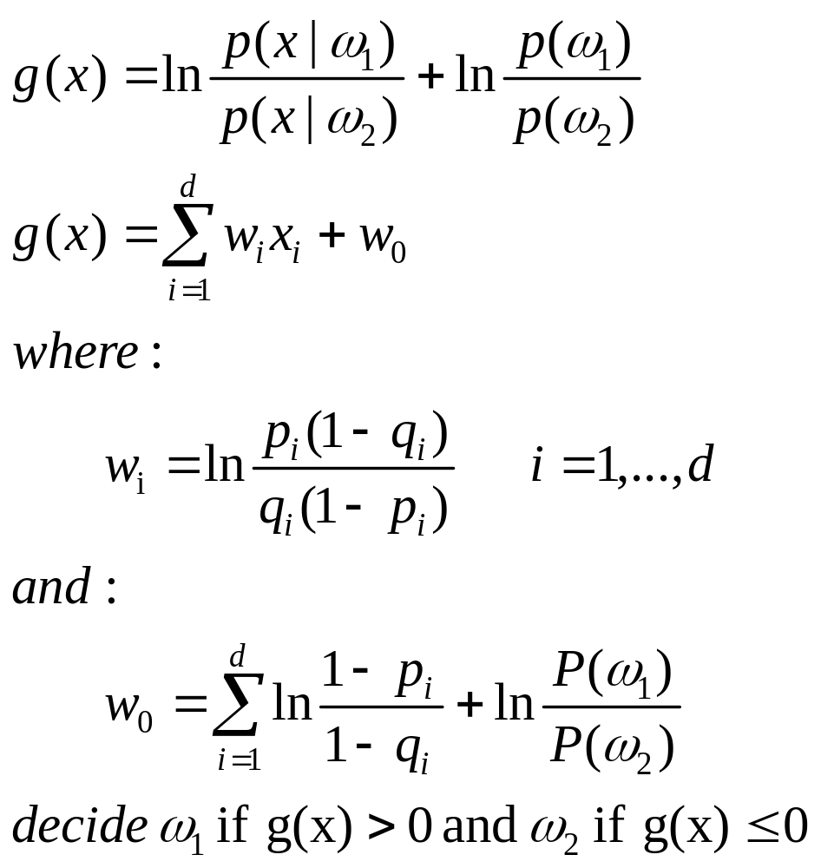
The discriminant function in this case is:
Pattern Classification Chapter 2(Part 3)

Slide 67
Naïve Bayes
V=[v₁, v₂, …, v_{m}]
P(v|w_{i})= P(v₁|w_{i})… P(v_{m}|w_{i})
For natural language processing,
v₁, v₂, …, v_{m denote different words}
Pattern Classification Chapter 2(Part 3)

Slide 68
Chapter 4 (Part 1):
Non-Parametric Classification (Sections 4.1-4.3)
Introduction
Density Estimation
Parzen Windows

Slide 69
4.1 Introduction
All Parametric densities are unimodal (have a single local maximum), whereas many practical problems involve multi-modal densities
Nonparametric procedures can be used with arbitrary distributions and without the assumption that the forms of the underlying densities are known
There are two types of nonparametric methods:
  Estimating p(x | ω_{j} )
  Go directly to a-posteriori probability P(ω_{j} | x ) estimation

Slide 70
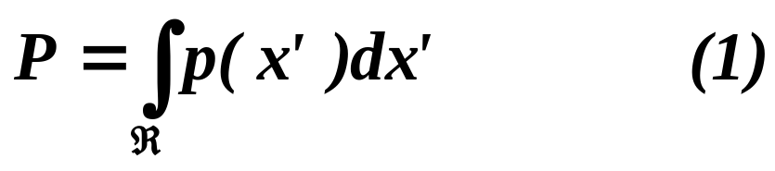
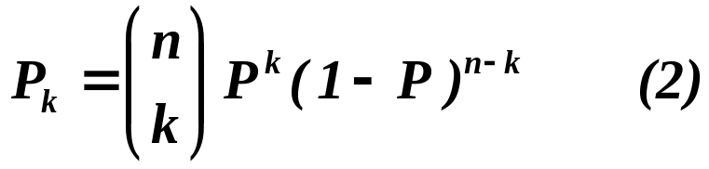
4.2 Density Estimation
Basic idea:
  Probability that a vector x will fall in region R is:
  P is a smoothed (or averaged) version of the density function p(x) .If we have a sample of size n, the probability that k points fall in R is then:
  and the expected value for k is:
  E(k) = nP (3)

Slide 71
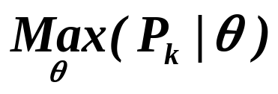
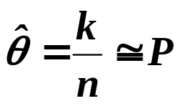
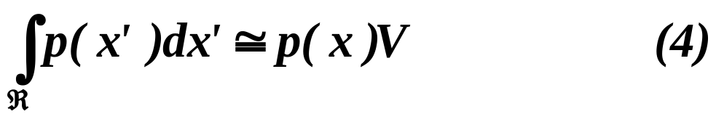
  ML estimation of P = θ
  is reached for
  Therefore, the ratio k/n is a good estimate for the probability P.
  p(x) is continuous and that the region R is so small that p does not vary significantly within it, we can write:
  where x is a point within R and V the volume enclosed by R.

Slide 72
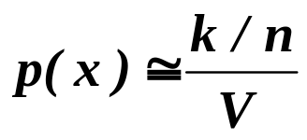
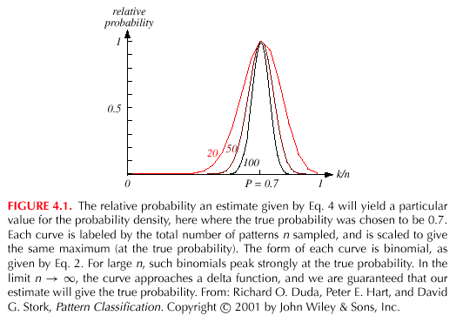
  Combining equation (1) , (3) and (4) yields:

Slide 73


Condition for convergence
  If we fix V, and take more training samples, k/n will converge, but then we only obtain an estimate of the space-averaged value (P/V) of p(x).
  If we want to obtain p(x) rather than just an average version of it, we must let V approach zero.
    This is the case where no samples are included in R: it is an uninteresting case!
    In this case, it is also an uninteresting case!

Slide 74
  The volume V needs to approach 0 anyway if we want to use this estimation
  Practically, V cannot be allowed to become arbitrarily small since the number of samples is always limited
  One will have to accept a certain amount of variance in the ratio k/n and a certain amount of averaging of p(x)
  Theoretically, if an unlimited number of samples is available, we can circumvent this difficulty
  To estimate the density of x, we form a sequence of regions R₁, R₂,…containing x: the first region contains one sample, the second two samples and so on.
  Let V_{n} be the volume of R_{n}, k_{n} the number of samples falling in R_{n} and p_{n}(x) be the n^{th} estimate for p(x):
  p_{n}(x) = (k_{n}/n)/V_{n} (7)

Slide 75


  Three necessary conditions should apply if we want p_{n}(x) to converge to p(x):
  (a)Shrink an initial region where V_{n} = 1/√n and show that
  This is called “the Parzen-window estimation method”
  (b) Specify k_{n} as some function of n, such as k_{n} = √n; the volume V_{n} is grown until it encloses k_{n} neighbors of x. This is called “the k_{n}-nearest neighbor estimation method”

Slide 76


Slide 77

4.3 Parzen Windows
  Parzen-window approach to estimate densities assumes that the region R_{n} is a d-dimensional hypercube
  ϕ((x-x_{i})/h_{n}) is equal to unity if x_{i} falls within the hypercube of volume V_{n} centered at x and equal to zero otherwise.

Slide 78


  The number of samples in this hypercube is:
  By substituting k_{n} in equation (7), we obtain the following estimate:
    P_{n}(x) estimates p(x) as an average of functions of x and the samples (x_{i}) (i = 1,… ,n). These functions ϕ can also be more general functions !

Slide 79

  Illustration
    The behavior of the Parzen-window method
      Case where p(x) →N(0,1)
    Let ϕ(u) = (1/√(2π) exp(-u²/2) and h_{n} = h₁/√n (n>1)
    (h₁: known parameter)
    Thus:
    is an average of normal densities centered at the samples x_{i}.

Slide 80

      Numerical results:
      For n = 1 and h₁=1
      For n = 10 and h = 0.1, the contributions of the individual samples are clearly observable !

Slide 81


Slide 82


Slide 83

Analogous results are also obtained in two dimensions as illustrated:

Slide 84


Slide 85

      Case where p(x) = λ₁.U(a,b) + λ₂.T(c,d) (unknown density) (mixture of a uniform and a triangle density)

Slide 86


Slide 87
  Classification example
    In classifiers based on Parzen-window estimation:
    We estimate the densities for each category and classify a test point by the label corresponding to the maximum posterior
    The decision region for a Parzen-window classifier depends upon the choice of window function as illustrated in the following figure.

Slide 88
    Power and limitations of nonparametric method
      Generality estimation
      Relations among number of samples, accuracy and complexity , curse of dimensionality

Slide 89


Slide 90
Chapter 4 (Part 1):
Non-Parametric Classification (Sections 4.1-4.3)
Introduction
Density Estimation
Parzen Windows

Slide 91
4.1 Introduction
All Parametric densities are unimodal (have a single local maximum), whereas many practical problems involve multi-modal densities
Nonparametric procedures can be used with arbitrary distributions and without the assumption that the forms of the underlying densities are known
There are two types of nonparametric methods:
  Estimating p(x | ω_{j} )
  Go directly to a-posteriori probability P(ω_{j} | x ) estimation

Slide 92
4.2 Density Estimation
Basic idea:
  Probability that a vector x will fall in region R is:
  P is a smoothed (or averaged) version of the density function p(x) .If we have a sample of size n, the probability that k points fall in R is then:
  and the expected value for k is:
  E(k) = nP (3)

Slide 93
  ML estimation of P = θ
  is reached for
  Therefore, the ratio k/n is a good estimate for the probability P.
  p(x) is continuous and that the region R is so small that p does not vary significantly within it, we can write:
  where x is a point within R and V the volume enclosed by R.

Slide 94
  Combining equation (1) , (3) and (4) yields:

Slide 95
Condition for convergence
  If we fix V, and take more training samples, k/n will converge, but then we only obtain an estimate of the space-averaged value (P/V) of p(x).
  If we want to obtain p(x) rather than just an average version of it, we must let V approach zero.
    This is the case where no samples are included in R: it is an uninteresting case!
    In this case, it is also an uninteresting case!

Slide 96
  The volume V needs to approach 0 anyway if we want to use this estimation
  Practically, V cannot be allowed to become arbitrarily small since the number of samples is always limited
  One will have to accept a certain amount of variance in the ratio k/n and a certain amount of averaging of p(x)
  Theoretically, if an unlimited number of samples is available, we can circumvent this difficulty
  To estimate the density of x, we form a sequence of regions R₁, R₂,…containing x: the first region contains one sample, the second two samples and so on.
  Let V_{n} be the volume of R_{n}, k_{n} the number of samples falling in R_{n} and p_{n}(x) be the n^{th} estimate for p(x):
  p_{n}(x) = (k_{n}/n)/V_{n} (7)

Slide 97
  Three necessary conditions should apply if we want p_{n}(x) to converge to p(x):
  (a)Shrink an initial region where V_{n} = 1/√n and show that
  This is called “the Parzen-window estimation method”
  (b) Specify k_{n} as some function of n, such as k_{n} = √n; the volume V_{n} is grown until it encloses k_{n} neighbors of x. This is called “the k_{n}-nearest neighbor estimation method”

Slide 99
4.3 Parzen Windows
  Parzen-window approach to estimate densities assumes that the region R_{n} is a d-dimensional hypercube
  ϕ((x-x_{i})/h_{n}) is equal to unity if x_{i} falls within the hypercube of volume V_{n} centered at x and equal to zero otherwise.

Slide 100
  The number of samples in this hypercube is:
  By substituting k_{n} in equation (7), we obtain the following estimate:
    P_{n}(x) estimates p(x) as an average of functions of x and the samples (x_{i}) (i = 1,… ,n). These functions ϕ can also be more general functions !

Slide 101
  Illustration
    The behavior of the Parzen-window method
      Case where p(x) →N(0,1)
    Let ϕ(u) = (1/√(2π) exp(-u²/2) and h_{n} = h₁/√n (n>1)
    (h₁: known parameter)
    Thus:
    is an average of normal densities centered at the samples x_{i}.

Slide 102
      Numerical results:
      For n = 1 and h₁=1
      For n = 10 and h = 0.1, the contributions of the individual samples are clearly observable !

Slide 105
Analogous results are also obtained in two dimensions as illustrated:

Slide 107
      Case where p(x) = λ₁.U(a,b) + λ₂.T(c,d) (unknown density) (mixture of a uniform and a triangle density)

Slide 109
  Classification example
    In classifiers based on Parzen-window estimation:
    We estimate the densities for each category and classify a test point by the label corresponding to the maximum posterior
    The decision region for a Parzen-window classifier depends upon the choice of window function as illustrated in the following figure.

Slide 110
    Power and limitations of nonparametric method
      Generality estimation
      Relations among number of samples, accuracy and complexity , curse of dimensionality

Slide 112
Chapter 4 (part 2):
Non-Parametric Classification (Sections 4.3-4.5)
Kn –Nearest Neighbor Estimation
The Nearest-Neighbor Rule

Slide 113
4.4 K_{n} - Nearest neighbor estimation
Goal: a solution for the problem of the unknown “best” window function
    Let the cell volume be a function of the training data(k_{n})
    Center a cell about x and let it grow until it captures k_{n} samples
    (k_{n} = f(n))
    k_{n} are called the k_{n} nearest-neighbors of x
Pattern Classification Chapter 4 part 2

Slide 114
  2 possibilities can occur:
    Density is high near x; therefore the cell will be small which provides a good resolution
    Density is low; therefore the cell will grow large and stop until higher density regions are reached
  We can obtain a family of estimates by setting k_{n}=k₁√n and choosing different values for k₁
Pattern Classification Chapter 4 part 2

Slide 115
Illustration
  For k_{n} = √n = 1 ; the estimate becomes:
    P_{n}(x) = k_{n} / n/V_{n} = 1 / V₁ =1 / 2|x-x₁|
Pattern Classification Chapter 4 part 2

Slide 116

Pattern Classification Chapter 4 part 2

Slide 117

Pattern Classification Chapter 4 part 2

Slide 118

Estimation of a-posteriori probabilities
  Goal: estimate P(ω_{i} | x) from a set of n labeled samples
    Let’s place a cell of volume V around x and capture k samples
    k_{i} samples amongst k turned out to be labeled by ω_{i} then:
    p_{n}(x, ω_{i}) = k_{i} /(nV)
      An estimate for p_{n}(ω_{i}| x) is:
Pattern Classification Chapter 4 part 2

Slide 119
    k_{i}/k is the fraction of the samples within the cell that are labeled ω_{i}
    For minimum error rate, the most frequently represented category within the cell is selected
    If k is large and the cell sufficiently small, the performance will approach the best value.
Pattern Classification Chapter 4 part 2

Slide 120
4.5 The Nearest-Neighbor Rule
The nearest –neighbor rule
  Let D_{n} = {x₁, x₂, …, x_{n}} be a set of n labeled prototypes
  Let x’ ∈ D_{n} be the closest prototype to a test point x then the nearest-neighbor rule for classifying x is to assign it the label associated with x’
  The nearest-neighbor rule leads to an error rate greater than the minimum possible value of the Bayes rate
  If the number of prototype is large (unlimited), the error rate of the nearest-neighbor classifier is never worse than twice the Bayes rate (it can be demonstrated!)
  If n → ∞, it is always possible to find x’ sufficiently close so that:
  P(ω_{i} | x’) ≅ P(ω_{i} | x)
Pattern Classification Chapter 4 part 2

Slide 121


  If P(ω_{m} | x) ≅ 1, then the nearest neighbor selection is almost always the same as the Bayes selection
  Convergence of the Nearest Neighbor
Pattern Classification Chapter 4 part 2

Slide 122
Example:
x = (0.68, 0.60)^{t}
^{Decision: ω}₅ ^{is the label assigned to x}
Prototypes | Labels | A-posteriori probabilities estimated
(0.50, 0.30) (0.70, 0.65) | ω₂ ω₃ ω₅ ω₆ | 0.25 0.75 = P(ω_{m} | x) 0.70 0.30
Pattern Classification Chapter 4 part 2

Slide 123

Pattern Classification Chapter 4 part 2

Slide 124
The k – nearest-neighbor rule
    Goal: Classify x by assigning it the label most frequently represented among the k nearest samples and use a voting scheme
Pattern Classification Chapter 4 part 2

Slide 125

Pattern Classification Chapter 4 part 2

Slide 126
Example:
k = 3 (odd value) and x = (0.10, 0.25)^{t}
Closest vectors to x with their labels are:
{(0.10, 0.28, ω₂); (0.12, 0.20, ω₂); (0.15, 0.35,ω₁)}
One voting scheme assigns the label ω₂ to x since ω₂ is the most frequently represented
Prototypes | Labels
(0.15, 0.35) (0.10, 0.28) (0.09, 0.30) (0.12, 0.20) | ω₁ ω₂ ω₅ ω₂
Pattern Classification Chapter 4 part 2

Slide 127



Reducing the computational complex in nearest-neighbor search
  Computing partial distance
  Create some form of search tree, for example
Pattern Classification Chapter 4 part 2

Slide 128


  Nearest-Neighbor Editing
Pattern Classification Chapter 4 part 2

Slide 129


4.6 Metrics
Properties of Metrics
  Nonnegativity:D(a,b)>=0
  Reflexivity:D(a,b)=0 if and only if a=b
  Symmetry:D(a,b)=D(b,a)
  Triangle inequality:D(a,b)+D(b,c)>=D(a,c)
Pattern Classification Chapter 4 part 2

Slide 130
Assignment
  4.4.5, 4.5.17, 4.6.19
Pattern Classification Chapter 4 part 2

Slide 131



5.4 The Two-Category Linearly Separable Case
Linearly separable
n samples belong to , if there exits a linear discriminant function that classifies all of them correctly, the samples are said to be linearly separable. Weight vector a is called a separating vector or solution vector

Slide 132





Normalization
Multiplying all samples labeled with by -1 is called normalization
with this normalization we only need to look for a weight vector a such that
Solution Region
Margin
the distance between old boundaries and new boundaries is

Slide 133
The problem of finding a linear discriminant function will be formulated as a problem of minimizing a criterion function

Slide 134




Gradient Descent Procedures
define a criterion function that is minimized if a is a solution vector. This can often be solved by a gradient descent procedure.
Using the Taylor extension, we have

Slide 135


Using the Taylor extension and
This the so-called Newton Descent Algorithm

Slide 136

Newton’s algorithm vs the simple gradient decent algorithm

Slide 137

5.5 Minimizing The Perception Criterion Function
The Perception Criterion Function of the Batch Perception Algorithm

Slide 138

Comparison of Four Criterion functions

Slide 139

Perceptron Criterion as function of weights
Criterion function plotted as a
function of weights a1 and a2,
Starts at origin,
Sequence is y2,y3, y1, y3
Second update by y3 takes
solution farther than first update

Slide 140

Single-Sample Correction
Interpretation of Single-Sample Correction

Slide 141


Some Direct Generalizations
  Variable-Increment Perceptron with Margin
  Algorithm Convergence
  Batch Variable Increment Perception

Slide 142


5.6 Relaxation Procedures
Decent Algorithm
  criterion function:
  two problems of this criterion function
  criterion function:

Slide 143



  Batch Relaxation with Margin
  Single-Sample Relaxation with margin
  Geometrical interpretation of Single-Sample Relaxation with margin algorithm
  r(k) is the distance from a(k) to the hyperplane
  From Eq.35 we obtain

Slide 144

5.7 Nonseparable Behavior
Error-correction procedure
For nonseparable data the corrections in an error-correction procedure can never cease.
By averaging the weight vector produced by the correction rule, we can reduce the risk of obtaining a bad solution.
Some heuristic methods are used in the error-correction rules. The goal is to obtain acceptable performance on nonseparable problems while preserving the ability to find a separating vector on separable problems.
Usually we let approach zero as k approaches infinity

Slide 145



5.8 Minimum Squared Error Procedures
Criterion function involves all of the samples, not just misclassified ones
Previously we were interested in making all of the inner products positive
Now try to make where are some
arbitrarily specified positive constants
Thus replace the problem of solving a set of
linear inequalities with more stringent but better understood problem of finding a solution to a set of linear equations

Slide 146




Minimum Squared Error and Pseudoinverse
For all the samples we want a weight vector a so that for some arbitrarily specified positive numbers. The matrix notation :
Error vector:

Slide 147






  Sum-of-squared-error criterion function:
  The gradient
  Set it to zero, we get
  If is nonsingular,
  The d by n matrix is call the pseudoinverse of Y.
  Remarks: For an arbitrarily fixed b, MSE solution may not be a separating vector.

Slide 148


Slide 149

The Widrow-Hoff or LMS Procedure
Need not converge to a separating hyperplane even if there exist one

Slide 150





5.9 The Ho-Kashyap Procedure
Take the criterion function as a function of two variables a and b:
If the training samples are linearly separable, then there should exist an such that:
If we knew such beforehand. We would get the separating vector using the MSE procedure

Slide 151



Slide 152
  5.12 Multicategory Generalizations
  Remark:Kesler’s construction can also be used to extend all of results for the Perceptron and relaxation procedure to the multicategory case

Slide 153





Generalization for MSE Procedure
consider multicategory case as a set of c two-class problem

Slide 154
Nonlinear Minimum Squared Error Procedures
Recently proposed new methods
Extension of Minimum Squared Error Procedures
Equivalent to the Minimum Squared Error Procedures in feature space

Slide 155

Nonlinear transform

Slide 156

Nonlinear Minimum Squared Error Procedures

Slide 157

Nonlinear Minimum Squared Error Procedures

Slide 158




Nonlinear Minimum Squared Error Procedures
Original Minimum Squared Error procedure in the original space:
Minimum Squared Error procedure in the new space:

Slide 159




Nonlinear Minimum Squared Error Procedures: KMSE
Because of
we have

Slide 160


Nonlinear Minimum Squared Error Procedures: KMSE
Kernel functions:
(1)
(2)

Slide 161




Nonlinear Minimum Squared Error Procedures: KMSE
Training phase:
Obtain
Testing phase ( is the output of testing sample ):
If is closer to 1 than -1, then the testing sample is classified into the first class;
otherwise, it is classified into the second class.

Slide 162


Disadvantage of and improvement to KMSE
The more the training samples, the higher the computational complexity !
If
Then and the computational complexity will be greatly reduced.

Slide 163

Disadvantage of and improvement to KMSE: one improvement

Slide 164

Disadvantage of and improvement to KMSE: another improvement

Slide 165
Nonlinear Minimum Squared Error Procedures : KMSE
References
Yong Xu, David Zhang, Zhong Jin, Miao Li, Jing-Yu Yang, A fast kernel-based nonlinear discriminant analysis for multi-class problems, Pattern Recognition, 2006, 39(6) : 1026-1033.
Yong Xu, J.-Y. Yang, J.-F. Lu, An efficient kernel-based nonlinear regression method for two-class classification, Proceedings of 2005 International Conference on Machine Learning and Cybernetics, Guangzhou, China, August, 2005, pp.4442-4445.
Yong Xu, David Zhang , Fengxi Song, Jing-Yu Yang, Zhong Jing , Miao Li, A method for speeding up feature extraction based on KPCA,Neurocomputing, 70, 1056-1061,2007
徐勇,张大鹏,杨健,模式识别中的核方法及其应用,北京:国防工业出版社,2010

