Slide 1

Pattern Classification
All materials in these slides were taken from
Pattern Classification (2nd ed) by R. O. Duda, P. E. Hart and D. G. Stork, John Wiley & Sons, 2000 with the permission of the authors and the publisher
Pattern Classification Chapter 2(Part 3)

Slide 2
Chapter 2 (part 3)
Bayesian Decision Theory (Sections 2-6,2-9)
Discriminant Functions for the Normal Density
Bayes Decision Theory – Discrete Features
Pattern Classification Chapter 2(Part 3)

Slide 3
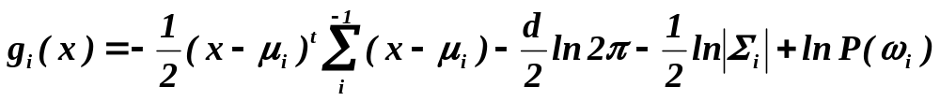
2.6 Discriminant Functions for the Normal Density
We saw that the minimum error-rate classification can be achieved by the discriminant function
g_{i}(x) = ln p(x | ω_{i}) + ln P(ω_{i})
Case of multivariate normal
Pattern Classification Chapter 2(Part 3)

Slide 4
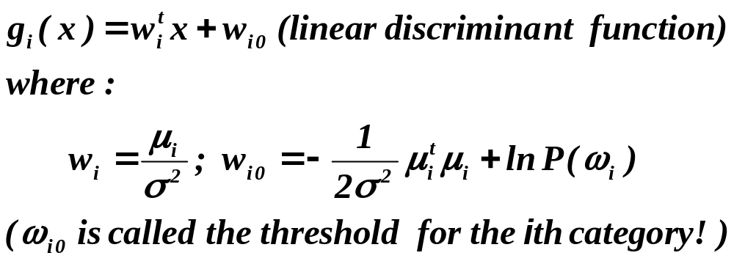
Case Σ_{i} = σ².I (I stands for the identity matrix)
Pattern Classification Chapter 2(Part 3)

Slide 5
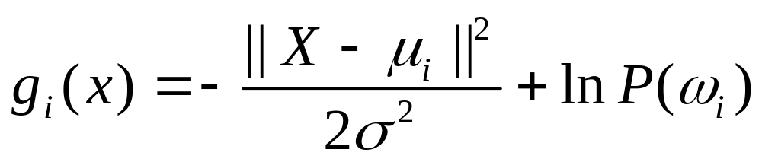
Case Σ_{i} = σ².I (I stands for the identity matrix)
Pattern Classification Chapter 2(Part 3)

Slide 6
  A classifier that uses linear discriminant functions is called “a linear machine”
  The decision surfaces for a linear machine are pieces of hyperplanes defined by:
g_{i}(x) = g_{j}(x)
Pattern Classification Chapter 2(Part 3)

Slide 7
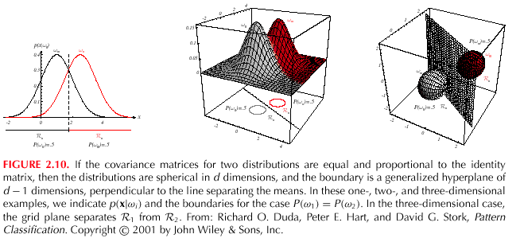
Pattern Classification Chapter 2(Part 3)

Slide 8
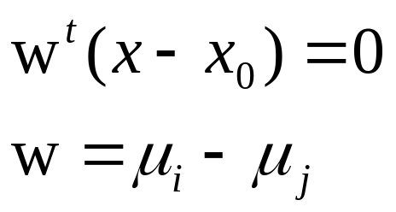
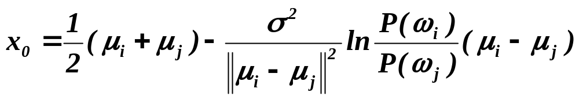
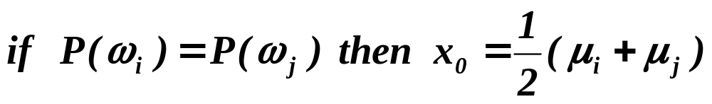
  The hyperplane separating R_{i} and R_{j}
  always orthogonal to the line linking the means!
Pattern Classification Chapter 2(Part 3)

Slide 9
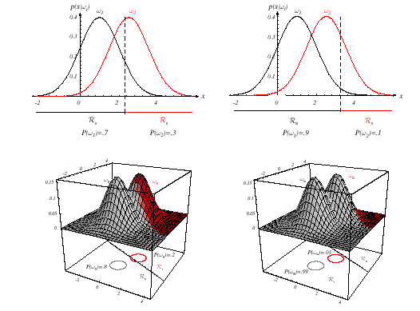
Pattern Classification Chapter 2(Part 3)

Slide 10
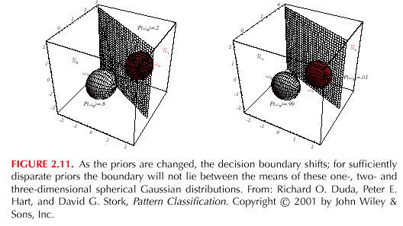
Pattern Classification Chapter 2(Part 3)

Slide 11
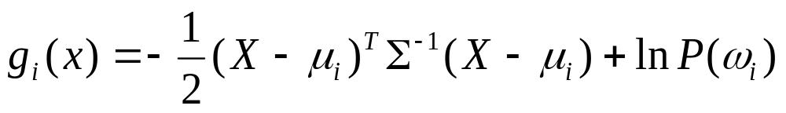
Case Σ_{i} = Σ (covariance of all classes are identical but arbitrary!)
Pattern Classification Chapter 2(Part 3)

Slide 12
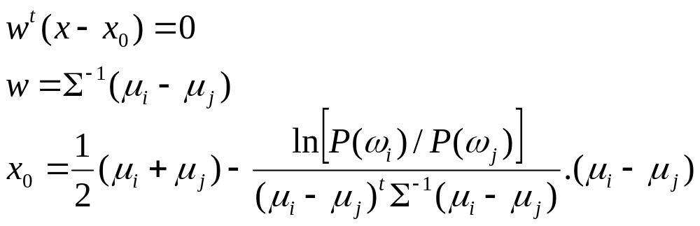
Case Σ_{i} = Σ (covariance of all classes are identical but arbitrary!)
  Hyperplane separating R_{i} and R_{j}
  (the hyperplane separating R_{i} and R_{j} is generally not orthogonal to the line between the means!)
Pattern Classification Chapter 2(Part 3)

Slide 13
Pattern Classification Chapter 2(Part 3)

Slide 14
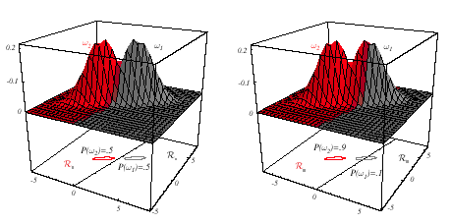
Pattern Classification Chapter 2(Part 3)

Slide 15
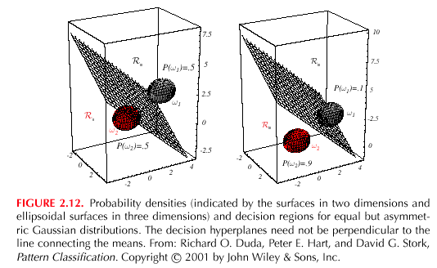
Pattern Classification Chapter 2(Part 3)

Slide 16
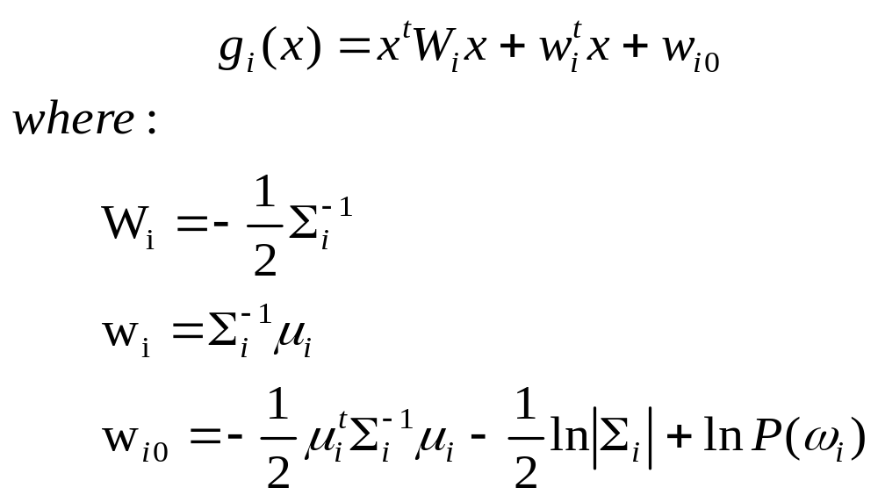
Case Σ_{i} = arbitrary
  The covariance matrices are different for each category
  (Hyperquadrics which are: hyperplanes, pairs of hyperplanes, hyperspheres, hyperellipsoids, hyperparaboloids, hyperboloids)
Pattern Classification Chapter 2(Part 3)

Slide 17
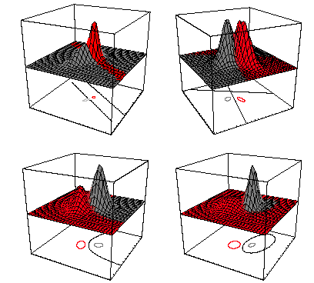
Pattern Classification Chapter 2(Part 3)

Slide 18
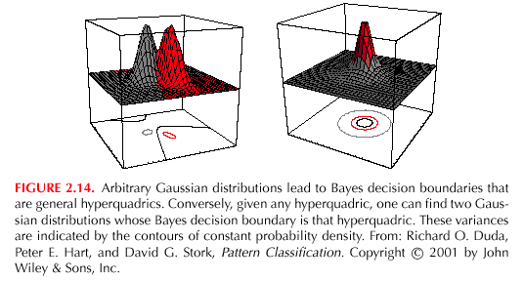
Pattern Classification Chapter 2(Part 3)

Slide 19
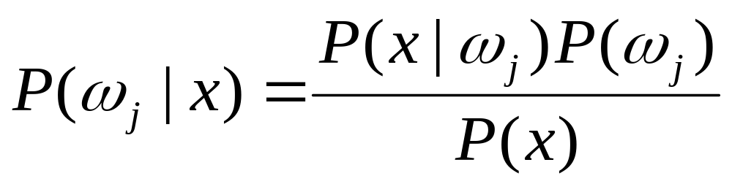
2.9 Bayes Decision Theory – Discrete Features
Components of x are binary or integer valued, x can take only one of m discrete values
v₁, v₂, …, v_{m}
Pattern Classification Chapter 2(Part 3)

Slide 20
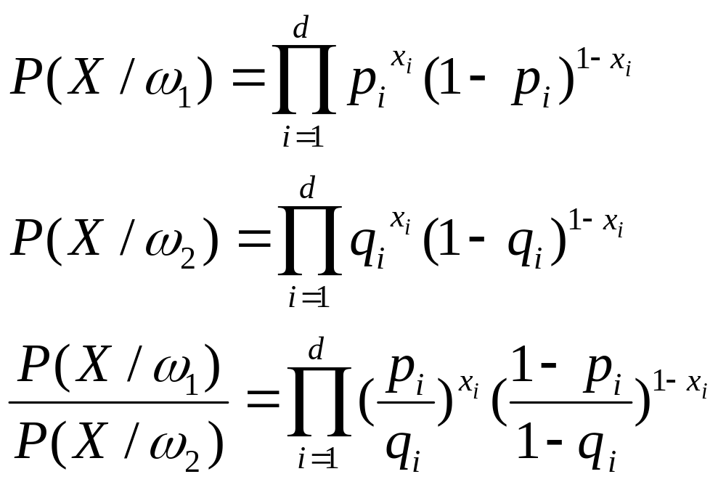
Case of independent binary features in 2 category problem
Let x = [x₁, x₂, …, x_{d} ]^{t} where each x_{i} is either 0 or 1, with probabilities:
p_{i} = P(x_{i} = 1 | ω₁)
q_{i} = P(x_{i} = 1 | ω₂)
Pattern Classification Chapter 2(Part 3)

Slide 21
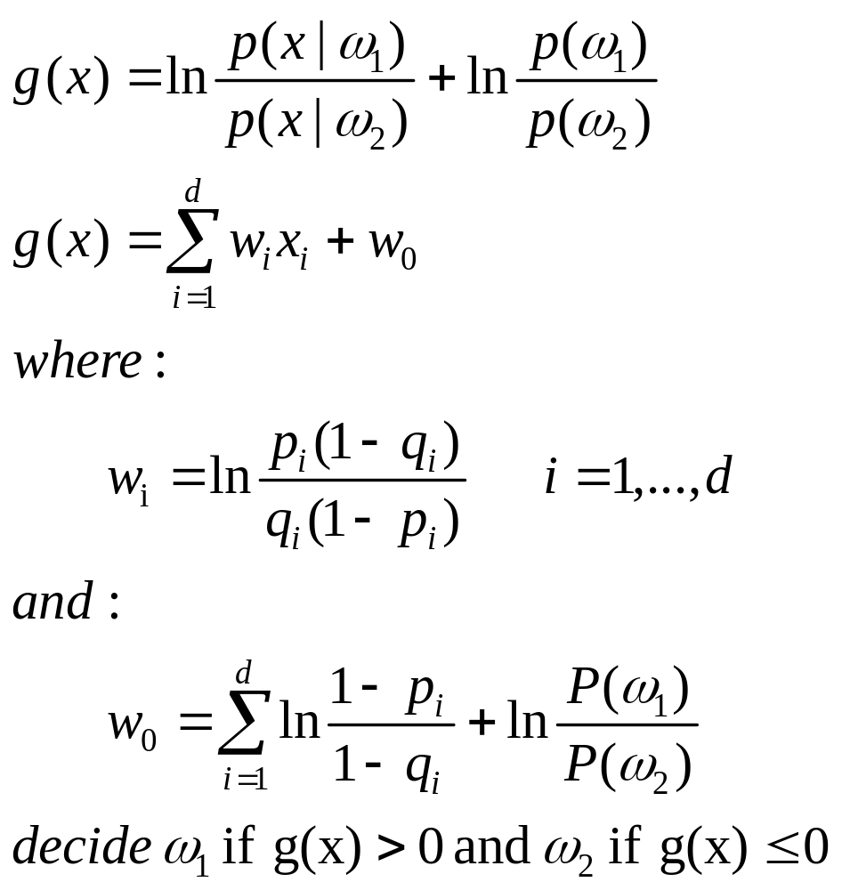
The discriminant function in this case is:
Pattern Classification Chapter 2(Part 3)

Slide 22
Naïve Bayes
V=[v₁, v₂, …, v_{m}]
P(v|w_{i})= P(v₁|w_{i})… P(v_{m}|w_{i})
For natural language processing,
v₁, v₂, …, v_{m denote different words}
Pattern Classification Chapter 2(Part 3)

