Slide 1

Pattern Classification
All materials in these slides were taken from
Pattern Classification (2nd ed) by R. O. Duda, P. E. Hart and D. G. Stork, John Wiley & Sons, 2000 with the permission of the authors and the publisher

Slide 2
Chapter 4 (Part 1):
Non-Parametric Classification (Sections 4.1-4.3)
Introduction
Density Estimation
Parzen Windows

Slide 3
4.1 Introduction
All Parametric densities are unimodal (have a single local maximum), whereas many practical problems involve multi-modal densities
Nonparametric procedures can be used with arbitrary distributions and without the assumption that the forms of the underlying densities are known
There are two types of nonparametric methods:
  Estimating p(x | ω_{j} )
  Go directly to a-posteriori probability P(ω_{j} | x ) estimation

Slide 4
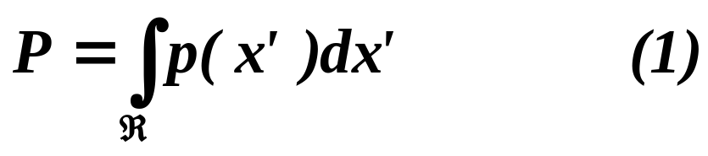
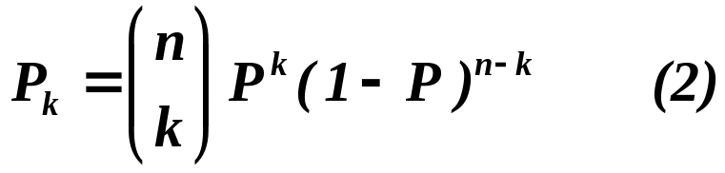
4.2 Density Estimation
Basic idea:
  Probability that a vector x will fall in region R is:
  P is a smoothed (or averaged) version of the density function p(x) .If we have a sample of size n, the probability that k points fall in R is then:
  and the expected value for k is:
  E(k) = nP (3)

Slide 5
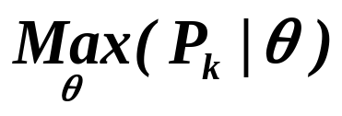
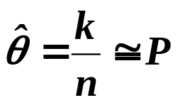
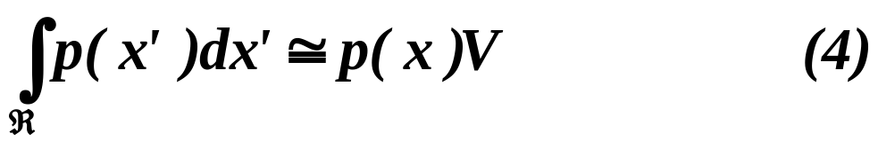
  ML estimation of P = θ
  is reached for
  Therefore, the ratio k/n is a good estimate for the probability P.
  p(x) is continuous and that the region R is so small that p does not vary significantly within it, we can write:
  where x is a point within R and V the volume enclosed by R.

Slide 6
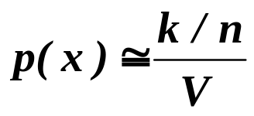
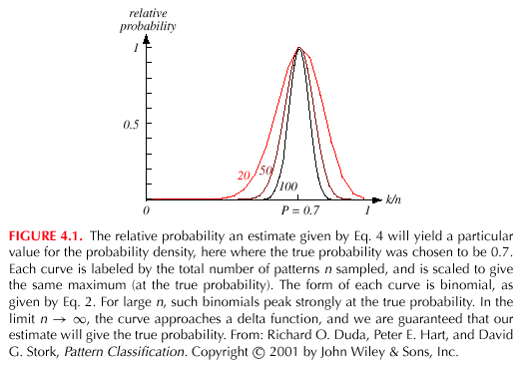
  Combining equation (1) , (3) and (4) yields:

Slide 7
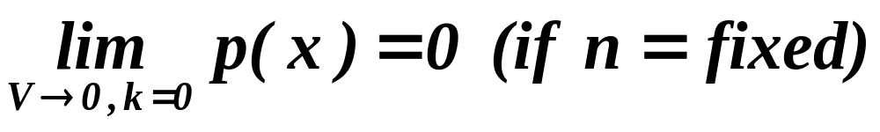
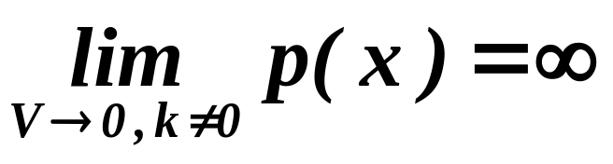
Condition for convergence
  If we fix V, and take more training samples, k/n will converge, but then we only obtain an estimate of the space-averaged value (P/V) of p(x).
  If we want to obtain p(x) rather than just an average version of it, we must let V approach zero.
    This is the case where no samples are included in R: it is an uninteresting case!
    In this case, it is also an uninteresting case!

Slide 8
  The volume V needs to approach 0 anyway if we want to use this estimation
  Practically, V cannot be allowed to become arbitrarily small since the number of samples is always limited
  One will have to accept a certain amount of variance in the ratio k/n and a certain amount of averaging of p(x)
  Theoretically, if an unlimited number of samples is available, we can circumvent this difficulty
  To estimate the density of x, we form a sequence of regions R₁, R₂,…containing x: the first region contains one sample, the second two samples and so on.
  Let V_{n} be the volume of R_{n}, k_{n} the number of samples falling in R_{n} and p_{n}(x) be the n^{th} estimate for p(x):
  p_{n}(x) = (k_{n}/n)/V_{n} (7)

Slide 9
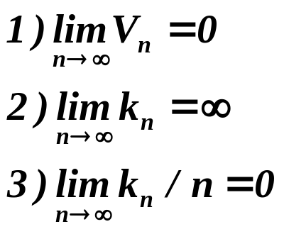
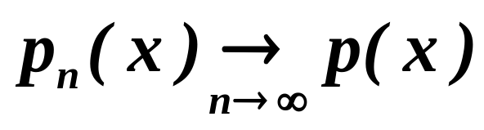
  Three necessary conditions should apply if we want p_{n}(x) to converge to p(x):
  (a)Shrink an initial region where V_{n} = 1/√n and show that
  This is called “the Parzen-window estimation method”
  (b) Specify k_{n} as some function of n, such as k_{n} = √n; the volume V_{n} is grown until it encloses k_{n} neighbors of x. This is called “the k_{n}-nearest neighbor estimation method”

Slide 10
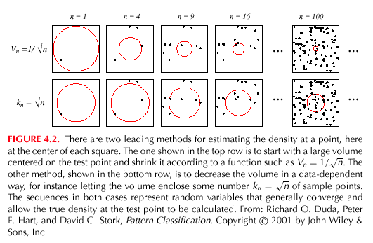

Slide 11
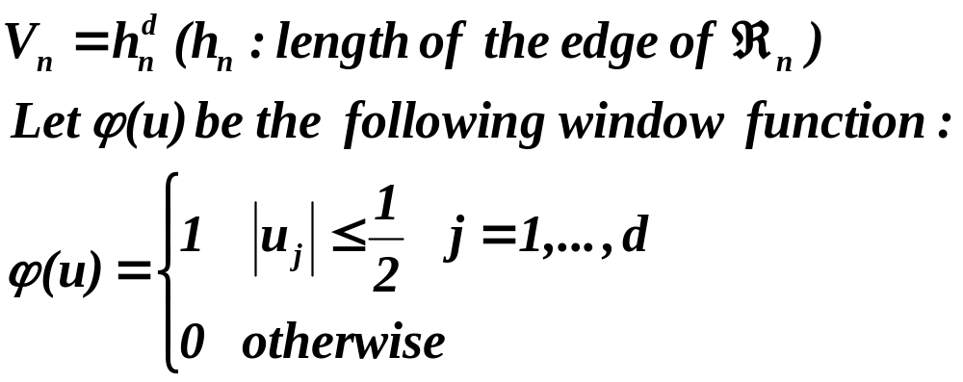
4.3 Parzen Windows
  Parzen-window approach to estimate densities assumes that the region R_{n} is a d-dimensional hypercube
  ϕ((x-x_{i})/h_{n}) is equal to unity if x_{i} falls within the hypercube of volume V_{n} centered at x and equal to zero otherwise.

Slide 12
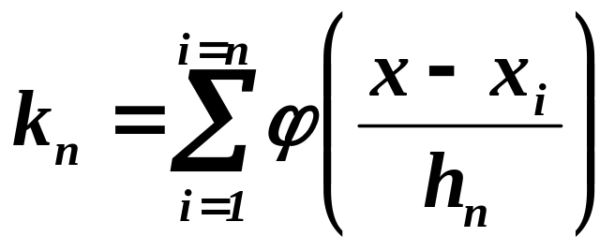
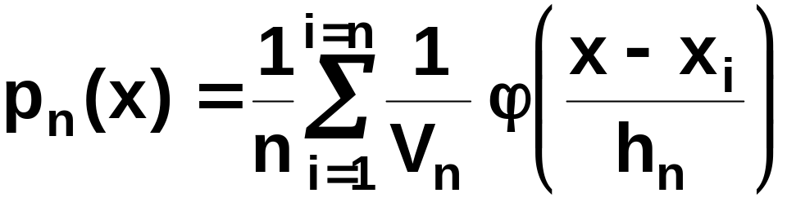
  The number of samples in this hypercube is:
  By substituting k_{n} in equation (7), we obtain the following estimate:
    P_{n}(x) estimates p(x) as an average of functions of x and the samples (x_{i}) (i = 1,… ,n). These functions ϕ can also be more general functions !

Slide 13
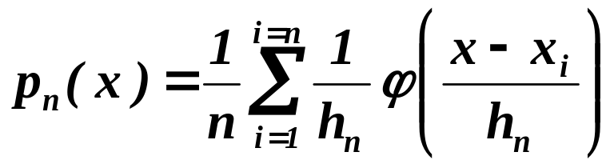
  Illustration
    The behavior of the Parzen-window method
      Case where p(x) →N(0,1)
    Let ϕ(u) = (1/√(2π) exp(-u²/2) and h_{n} = h₁/√n (n>1)
    (h₁: known parameter)
    Thus:
    is an average of normal densities centered at the samples x_{i}.

Slide 14
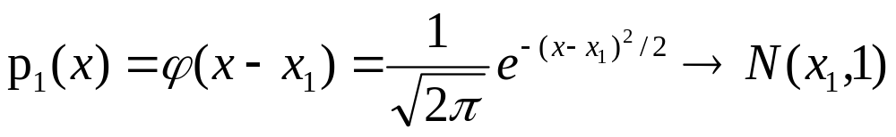
      Numerical results:
      For n = 1 and h₁=1
      For n = 10 and h = 0.1, the contributions of the individual samples are clearly observable !

Slide 15
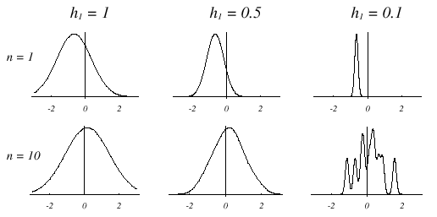

Slide 16
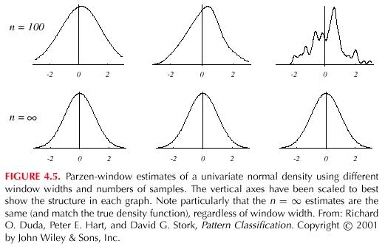

Slide 17
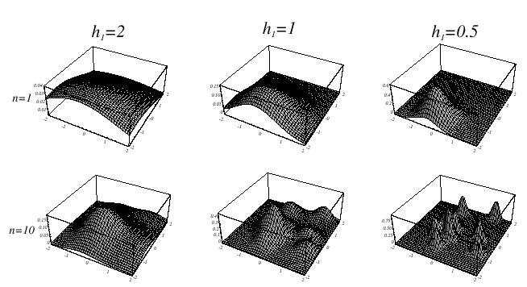
Analogous results are also obtained in two dimensions as illustrated:

Slide 18
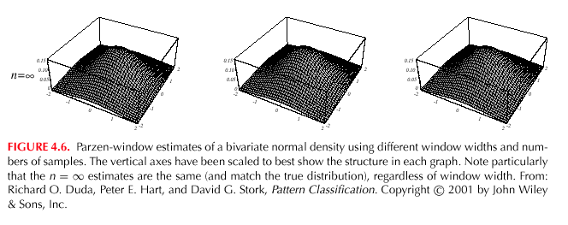

Slide 19
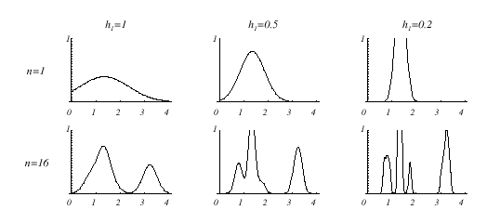
      Case where p(x) = λ₁.U(a,b) + λ₂.T(c,d) (unknown density) (mixture of a uniform and a triangle density)

Slide 20
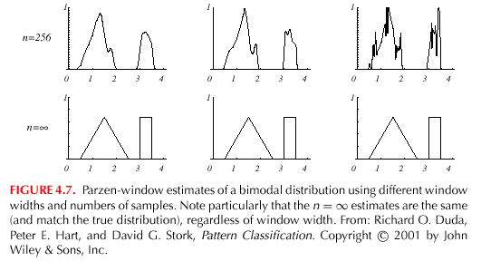

Slide 21
  Classification example
    In classifiers based on Parzen-window estimation:
    We estimate the densities for each category and classify a test point by the label corresponding to the maximum posterior
    The decision region for a Parzen-window classifier depends upon the choice of window function as illustrated in the following figure.

Slide 22
    Power and limitations of nonparametric method
      Generality estimation
      Relations among number of samples, accuracy and complexity , curse of dimensionality

Slide 23
