Slide 1
Apollo: Automated Routing-Informed Placement for Large-Scale Photonic Integrated Circuit
Published in ICCAD’25
2026-01-08
Presenter: Zhih-Chi Huang
The Electronic Design Automation Laboratory
Graduate Institute of Electronics Engineering
National Taiwan University
Taipei 106, Taiwan
Notes:
亞利桑那州立大學（ASU）倫斯勒理工學院（RPI）跟NV合作

Slide 2
Outline
Introduction
Preliminaries
Problem Formulation
Methodology
Experimental Results
Conclusion

Slide 3
Outline
Introduction
Preliminaries
Problem Formulation
Methodology
Experimental Results
Conclusion

Slide 4
Photonic Integrated Circuit (PIC)
Large-scale integration of thousands of components for high-bandwidth demands
Stringent physical constraints on single-layer routing and minimum bend radii
Routing-informed placement is essential to:
Maximize routability
Maintain signal integrity
Enable scalability
Notes:
高速連接需求 太多元件因此需要自動繞
單層居多且滿足最小彎曲半徑
光訊號在元件之間傳遞時不被失真、衰減、或互相干擾

Slide 5
Previous Work
Force-directed placement for photonic circuits [von Beuningen et al., ISPD’16]
DREAMPlace GPU-accelerated analytical placement frameworks [Lin et al., TCAD’20]
Electrostatics-based density model in ePlace [Lu et al., TODAES’15]
LiDAR automated curvy waveguide routing [Zhou et al., ISPD’25]
[Lin et al., TCAD’20] Y. Lin et al., "DREAMPlace: Deep Learning Toolkit-Enabled GPU Acceleration for Modern VLSI Placement," IEEE TCAD, 2020.
[Lu et al., TODAES’15] J. Lu et al., "ePlace: Electrostatics-based placement using fast Fourier transform and Nesterov's method," ACM TODAES, 2015.
[Zhou et al., ISPD’25] H. Zhou et al., "LiDAR: Automated Curvy Waveguide Detailed Routing for Large-Scale Photonic Integrated Circuits," ISPD, 2025.
[von Beuningen et al., ISPD’16] A. von Beuningen et al., "PLATON: A force-directed placement algorithm for 3D optical networks-on-chip," ISPD, 2016.
Notes:
交叉看作點而過度簡化
Differential engine和pytorch進行加速
把macro視為電荷進行移動 適合處理mixed size
建立光子繞線基準(預留空間)並提供驗證方式

Slide 6
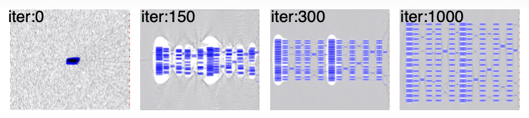
Contribution
Propose the first GPU-accelerated analytical placement framework for routing-informed PIC synthesis
Propose novel physical models to implicitly account for port orientation, bending radii, and waveguide crossings
Enhance optimization stability and constraint satisfaction, achieving 94.7% routability
Placement animation of Apollo on ADEPT_16x16

Slide 7
Outline
Introduction
Preliminaries
Problem Formulation
Methodology
Experimental Results
Conclusion

Slide 8
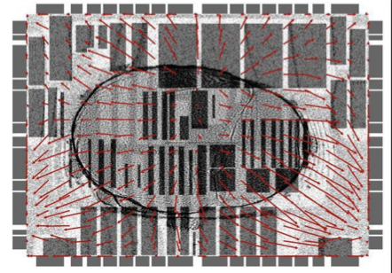
Analytical Mixed-Size Photonic Circuit Placement
Electrostatics-based global placement via ePlace density modeling
Routing-aware constraint satisfaction for bend and crossing overhead
Electrostatic potential field used for smooth density gradient optimization
Notes:
確保了不同尺寸（Mixed-size）的組件能在滿足物理約束的前提下，達到最優的分佈與佈線可行性。
依靠人工根據邏輯位置放置元件，這在系統規模擴大時非常耗時且難以擴展

Slide 9
Outline
Introduction
Preliminaries
Problem Formulation
Methodology
Experimental Results
Conclusion

Slide 10
Problem Formulation
Given
Netlist, components, and port orientation
Minimum bend radii
Output
Overlap-free layout compliant with all designer constraints
Objective
Minimize total waveguide loss, waveguide crossings, and runtime
Maximize routability

Slide 11
Outline
Introduction
Preliminaries
Problem Formulation
Methodology
Experimental Results
Conclusion

Slide 12
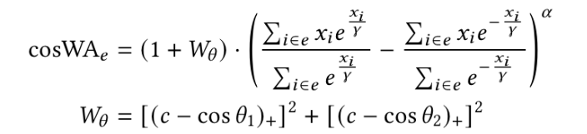
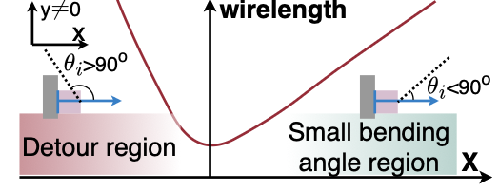


Photonic-Specific Placement Objective
Propose asymmetric bending-aware wirelength (cosWA) to penalize port misalignment
Propose a routing-informed spacing model (NS)
to pre-reserve layout area for congestion
Formulate a quardratic density function to achieve
smooth overlap-free distribution
Wirelength cost in different angle
$W_{θ}:$Bending penalty
$c:$ Threshold constant
${\left(.\right)}_{+}$​: ReLU function
$S_{i}:$​ Required spacing
$dx,dy:$ Relative displacement
$D\left(x,y\right):$ Potential density field
$λ_{D}:$Density Weight
$ρ:$ Penalty coefficient
Notes:
提出 cosWA 與 NS 模型，將原本離散的光學角度損耗與佈線擁塞問題，轉化為連續可微的懲罰項。
高效地在「最短路徑」與「最高佈線可行性」之間取得最佳平衡。

Slide 13


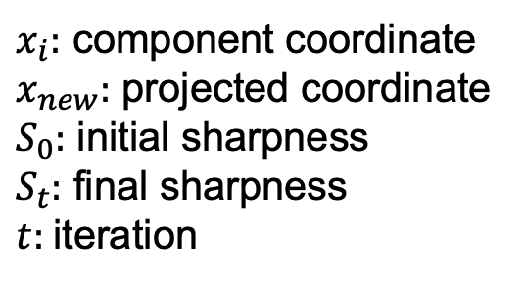
Conditional Projected Gradient Descent (CPGD)
Project components toward target locations (e.g., group centroids) to satisfy regularity constraints
Apply a progressive sharpness schedule to balance
global optimization and constraint enforcement
Incorporate cell inflation to mitigate thermal crosstalk and secure routing corridors
$x_{i}:$ component coordinate
$x_{new}:$ projected coordinate
$S_{0}:$ initial sharpness
$S_{t}:$ final sharpness
$t:$iteration
Notes:
核心行為：利用 CPGD 投影機制將組件引導至理想座標（如群組質心），確保光子電路陣列的規律性與對齊。
優化策略：透過漸進式銳利度參數 st​ 達成「先全局優化、後精確對齊」，在滿足設計約束的同時維持 97% 以上的高佈線成功率。
物理考量：結合組件膨脹技術（Cell Inflation）來增加物理間距，有效降低熱串擾並為波導轉彎預留所需的佈線路權。

Slide 14
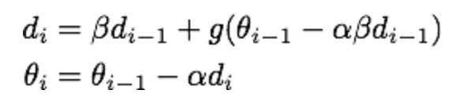
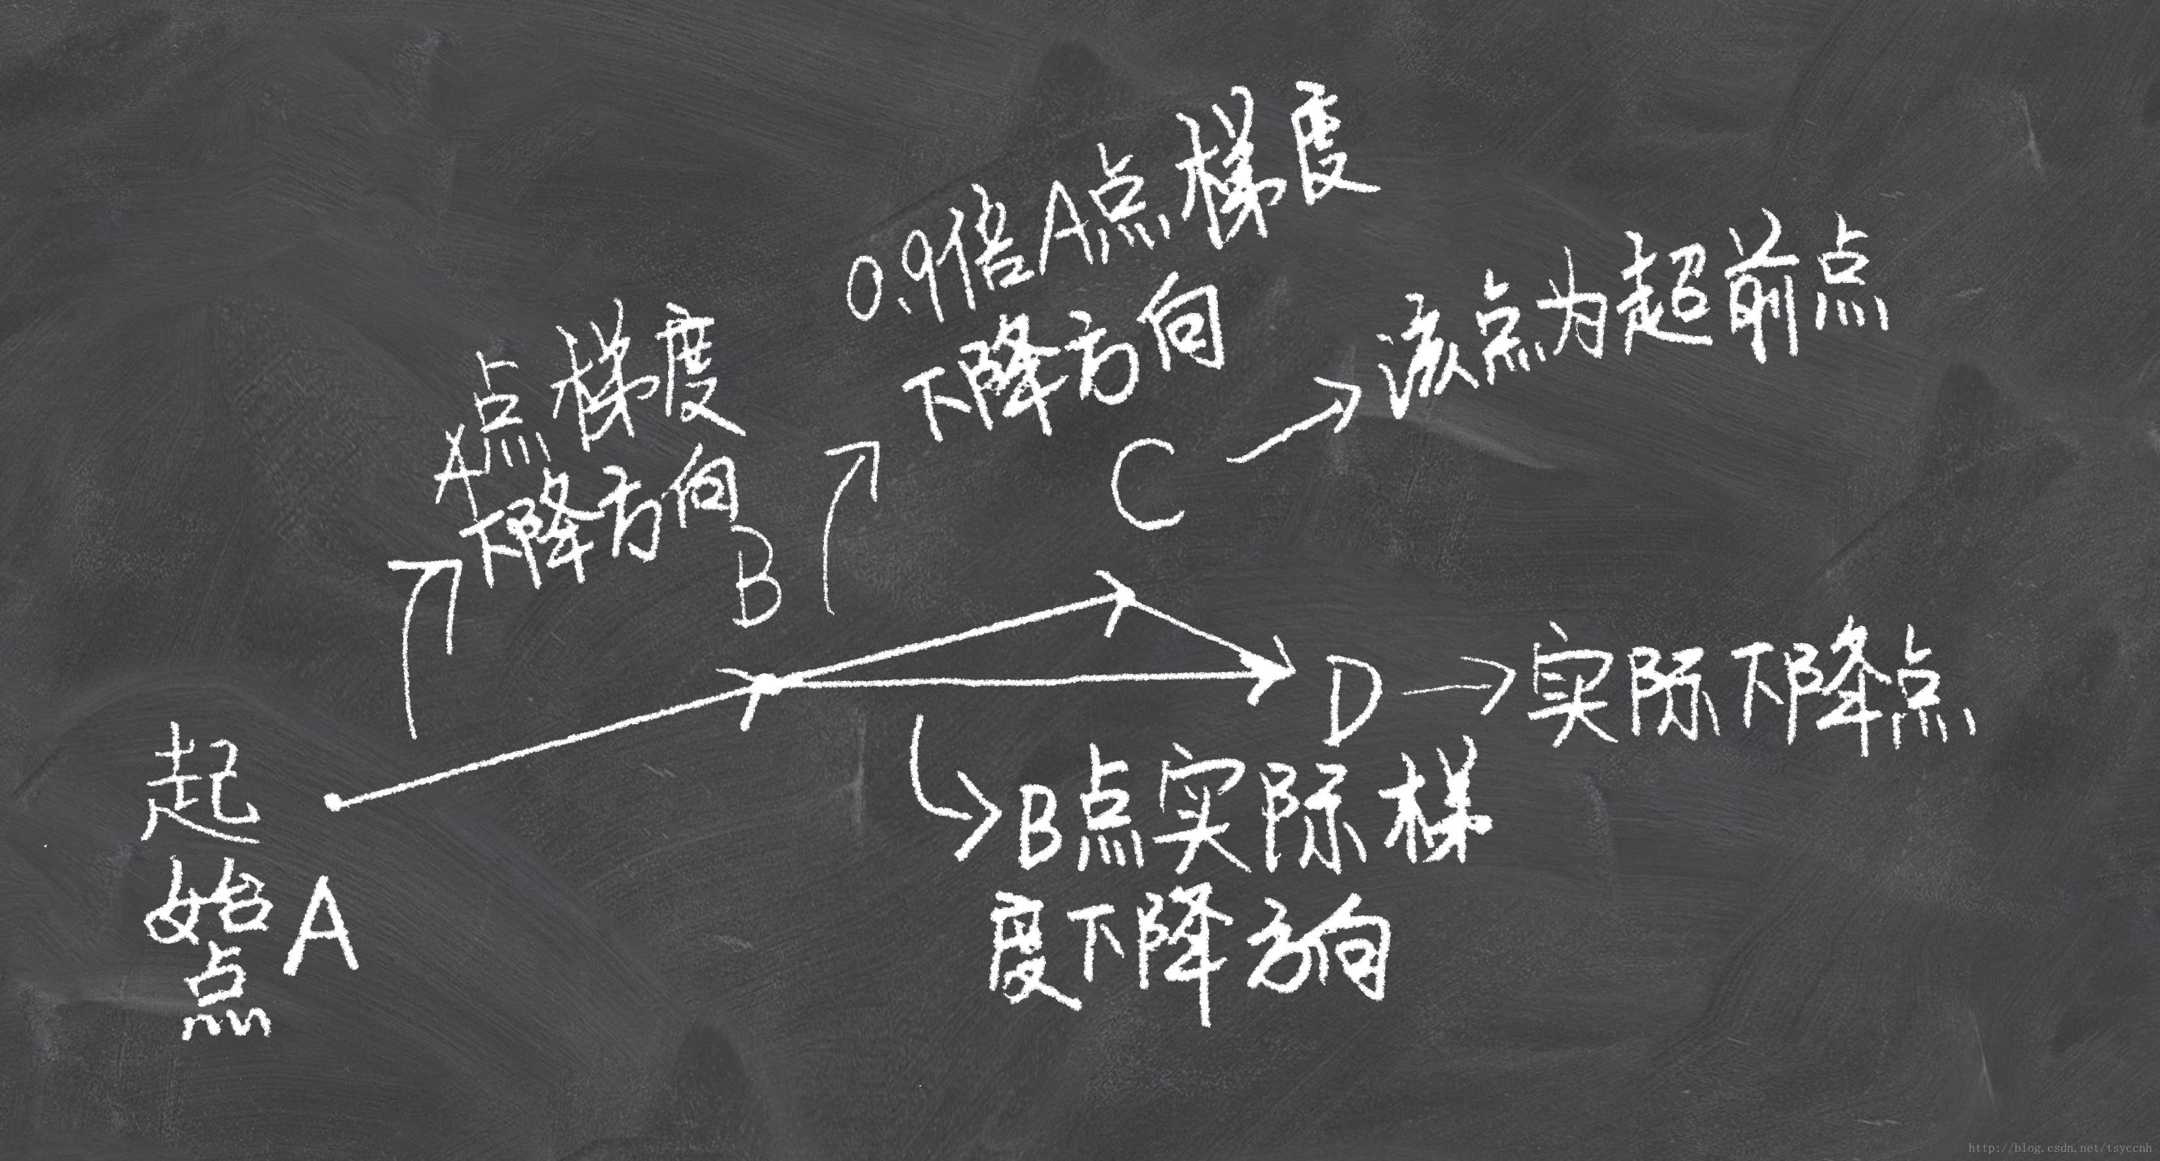

Blockwise Adaptive Nesterov-Accelerated Gradient (BNAG)
Propose a blockwise adaptive learning rate to stabilize the optimization of mixed-size components
Utilize Nesterov-Accelerated Gradient (NAG) to achieve fast and smooth convergence for large-scale PIC placement
$d_{i}:$ velocity/ momentum
$θ_{i}:$ weight
$α:$ learning rate
$β:$ momentum factor
$g:$ gradient function
NAG iteration process
Notes:
歷史梯度跟當前梯度

Slide 15
Outline
Introduction
Preliminaries
Problem Formulation
Methodology
Experimental Results
Conclusion

Slide 16
Experimental Setup
Machine
AMD EPYC 7763 Linux server with a 2.9GHz CPU
NVIDIA RTX A6000 GPU
Baseline
DREAMPlace + Routability Optimization (RO) augmented with RUDY-based node inflation for routability optimization
Cypress: A PCB placement tool that minimizes net crossings to improve routability
Benchmark
Clements-style Mach-Zehnder Interferometer (MZI) arrays
An auto-searched photonic tensor core design (ADEPT) at two different scales (S/L)
Implementation
Python, PyTorch (DREAMPlace-based)
Benchmark statistics

Slide 17
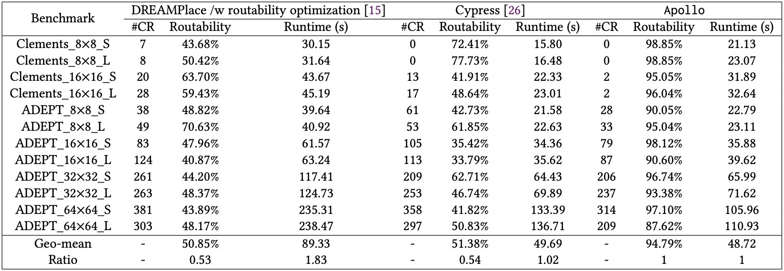
Experiment Results
Achieve 94.79% average routability across benchmarks
Minimize crossings (#CR) to reduce optical loss
Ensure faster runtimes than electronic EDA baselines

Slide 18
Outline
Introduction
Preliminaries
Problem Formulation
Methodology
Experimental Results
Conclusion

Slide 19
Conclusion
Propose Apollo, a GPU-accelerated analytical placement framework that enables scalable optimization for 1,000+ photonic components
Integrate photonic-specific models (cosWA, NS) and progressive constraints (CPGD) to optimize signal integrity and design regularity simultaneously
Achieve superior performance with 94.79% average routability and significantly reduced waveguide crossings compared to state-of-the-art baselines

Slide 20
Remarks
Pros
Propose comprehensive evaluation across diverse benchmarks and configurations
Propose a placement framework aligned with industrial photonic design requirements
Cons
Provide detailed algorithmic descriptions but lack in-depth explanation
Lack notation table for quick symbol reference
My comments
Potential improvement in performance could be explored by integrating LiDAR 2.0 for validation

Slide 21

Thank You!

