Slide 1
AMS595 HW2
Jinsheng Pan

Slide 2
Result
The implementation successfully approximates the upper boundary of the Mandelbrot set using 1200 sample points across x ∈ [-2, 1]. The bisection method converges to boundary points with tolerance 1e-6, typically requiring 20-30 iterations per point.

Slide 3
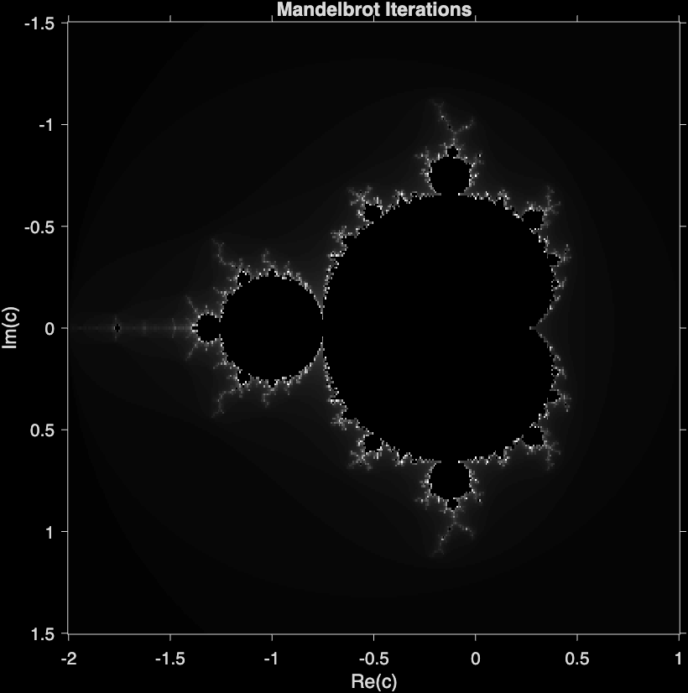
Result
Visualization
Grayscale visualization showing escape iterations for the complete Mandelbrot set. Black regions indicate points that remain bounded (inside the set), while gray regions show points that escape quickly. The characteristic cardioid body and circular bulb are clearly visible, along with intricate self-similar structures at the boundary.

Slide 4
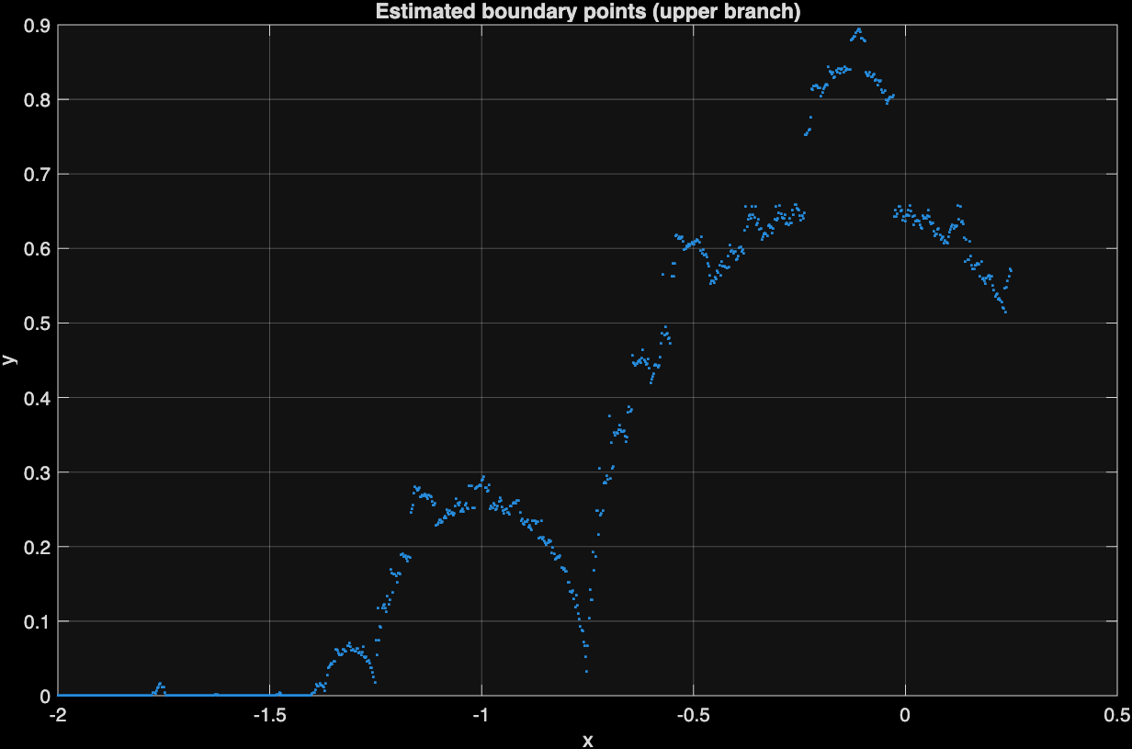
Result
Visualization
Scatter plot of 1200 boundary points found using bisection along vertical lines. The plot reveals the fractal structure of the upper boundary, showing fine-scale variations and self-similar patterns. Notable features include the smooth cardioid section (x ∈ [-1, -0.5]) and the more complex regions near the circular bulb connection point.

Slide 5
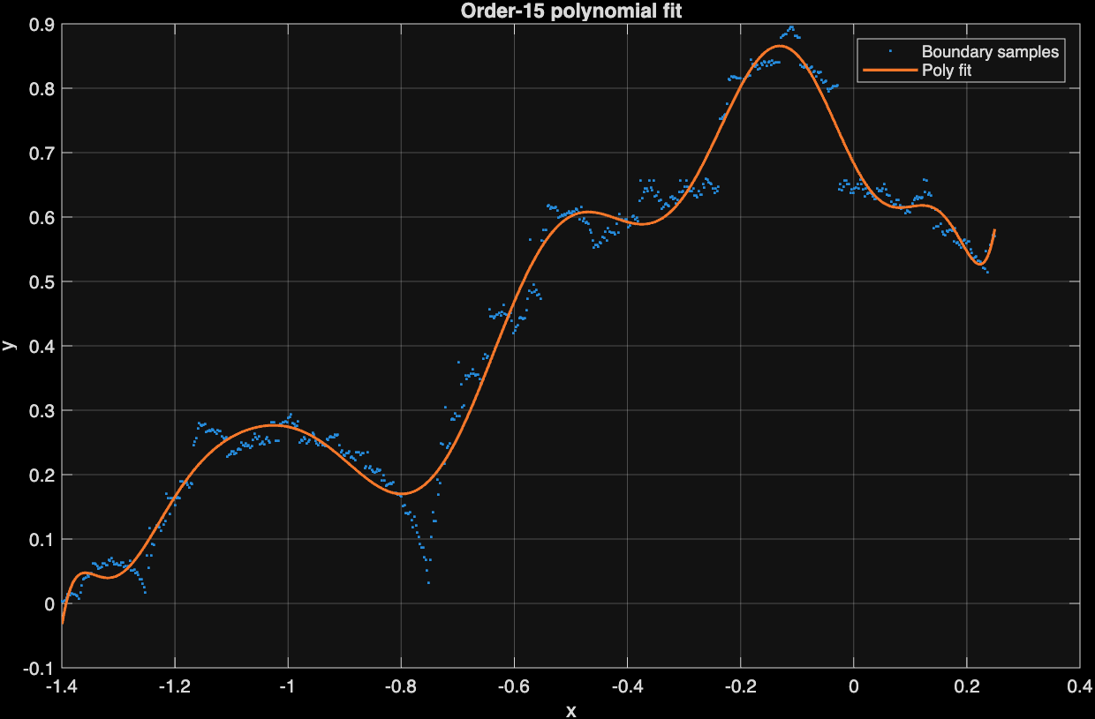
Result
Visualization
Order-15 polynomial approximation (orange curve) fitted to boundary samples (blue points). The polynomial captures major trends but smooths over small-scale fractal details. Visible deviations between fit and data points demonstrate the limitation of polynomial approximation for fractal curves.

Slide 6
Discussion
The results demonstrate Mandelbrot's coastline paradox: the measured length depends critically on measurement resolution. Our polynomial approximation smooths over the fractal's fine structure, yielding a finite length.
However, the true Mandelbrot boundary is infinitely detailed—using higher-resolution measurements (more points, higher-order polynomials, or direct point-to-point distances) would yield progressively longer lengths.
This exercise illustrates why fractals require special mathematical treatment. Traditional calculus tools (polynomials, derivatives, integrals) provide approximations but fail to capture infinite complexity. The "true" length of the Mandelbrot boundary, like Britain's coastline, is undefined—it depends on the ruler's size. This fundamental insight launched fractal geometry as a field.

Slide 7
Prerequisites
MATLAB R2016b or later, or GNU Octave 4.0+
All `.m` files must be in the same directory

Slide 8
Execution Steps
Unit test (in matlab command window)
test_functions
This verifies that all three core functions (fractal, bisection, poly_len) work correctly.
Run (in matlab command window)
main
This will output visualization result and approximate boundary length on [-1.4,0.4] on command window

Slide 9
Github Code

