Slide 1
AMS595 Project1
Jinsheng Pan
117369342

Slide 2
User Guide
Github Repo: https://github.com/Victor-lol/AMS595/tree/main/595HW1
How-to-run is written in README.md

Slide 3
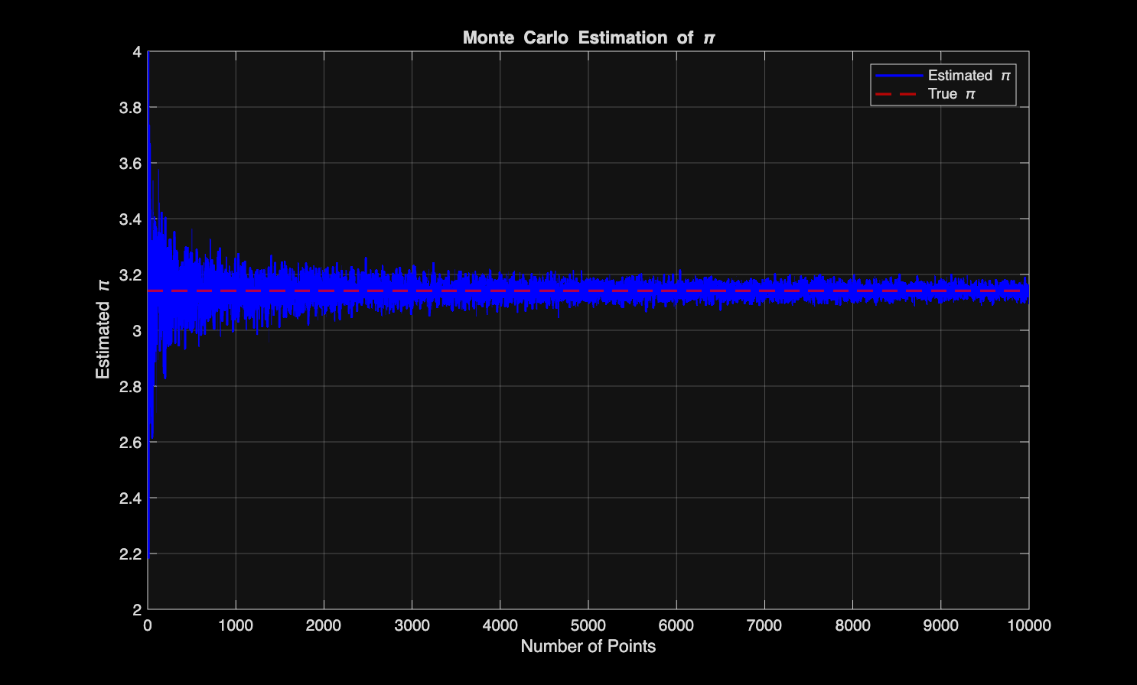
Task1
Plot of computed value of π
Comment: The estimate converges toward the true value as number of points increases.

Slide 4
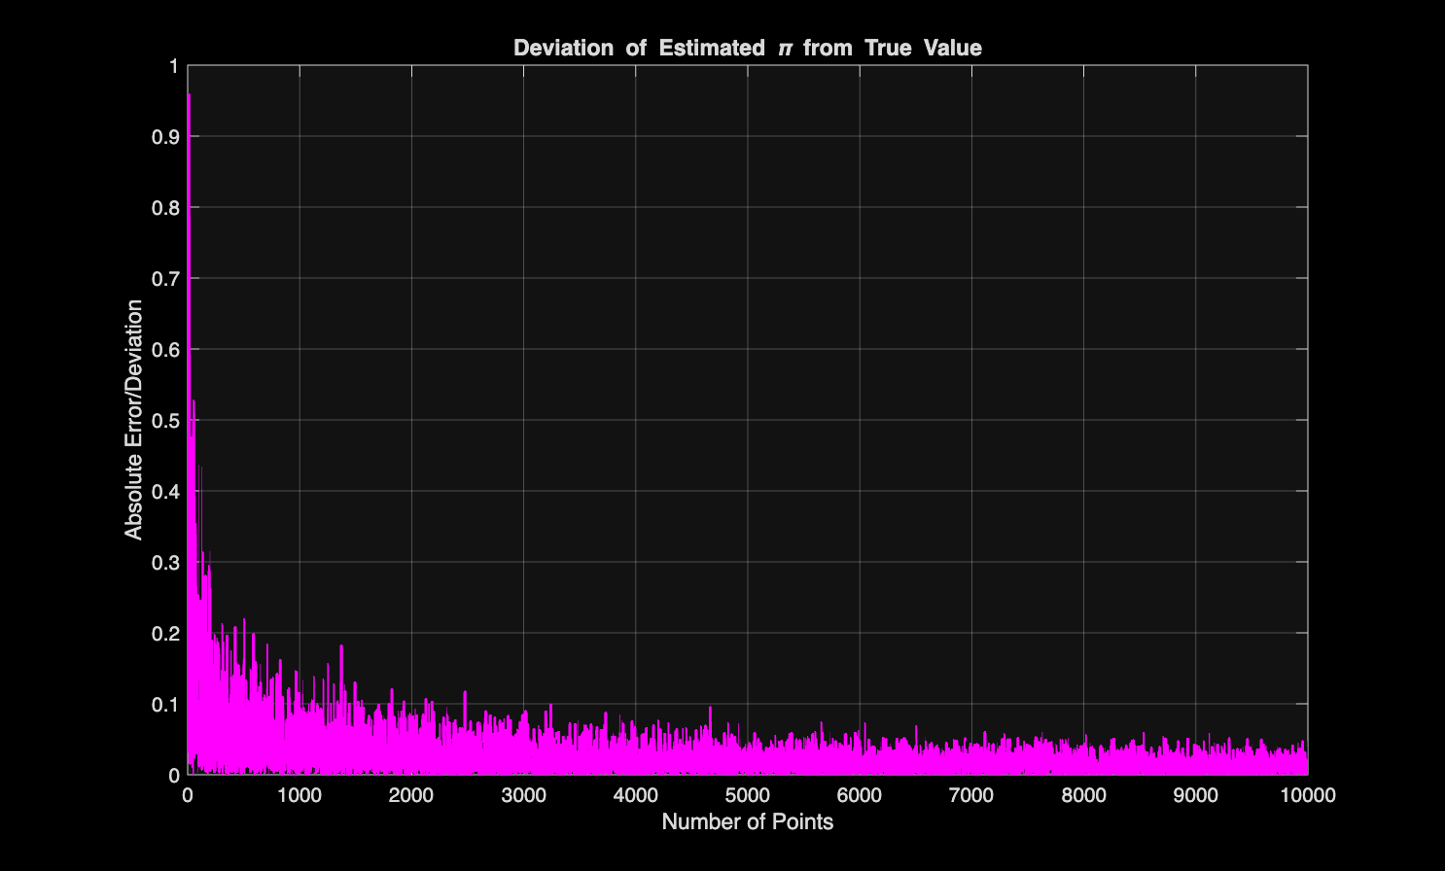
Task1
Deviation from the true value
Comment: The deviation tends to 0 as the number of points increase

Slide 5
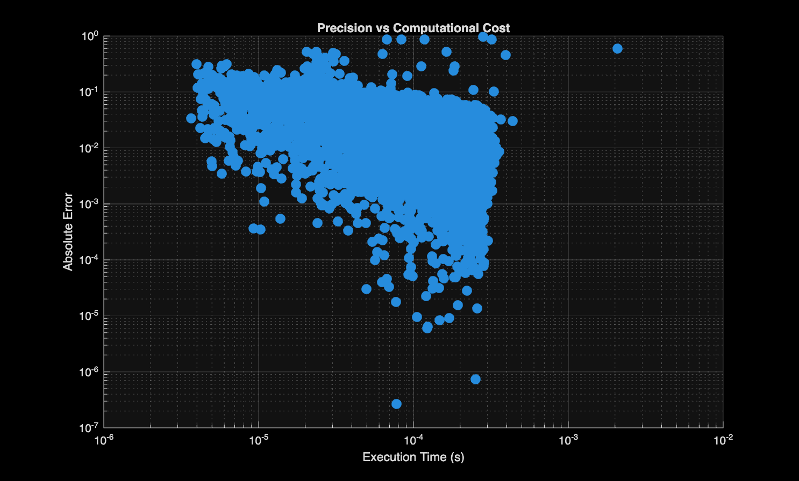
Task1
Precision to the computational cost
Comment: The error tends to be zero as the number of execution time increase

Slide 6
Task1
Guide:
Call
In compute_pi.m, add this file to path
Write compute_pi in command window
Output:
Errors: deviation from the true value, will show in command window
Pi_ests: estimated pi, will show in command window
Times: cost of time to each, will show in command window
3 graphs listed above

Slide 7
Task2
Precision | Estimated pi | Iterations | Execution time
2 significant figure | 3.128713 | 101 | 0.0309 s
3 significant figure | 3.183374 | 818 | 0.0226 s
4 significant figure | 3.131997 | 8682 | 0.0464 s
5 significant figure | 3.138872 | 86115 | 0.0037 s
Comment: As the precision increases, the more iterations are needed but it not necessarily take more time to execute. Perhaps MATLAB has inner mechanism to optimize it.

Slide 8
Task2
Guide
Call
In modified_compute_pi.m, add this file to path
Write modified_compute_pi in command window
Output
sigfigs: significant figure
pi_est_curr: Estimated pi
Iter: Iterations required
Elapsed: Execution time

Slide 9
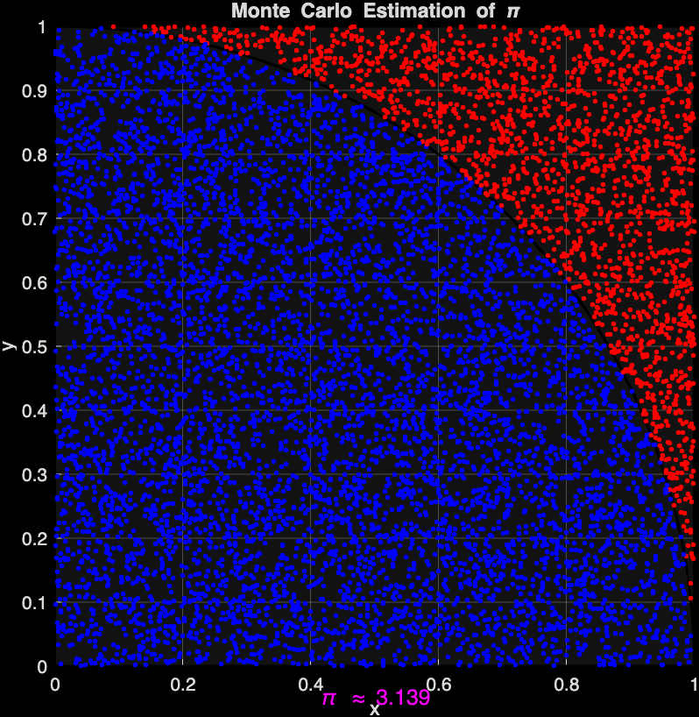
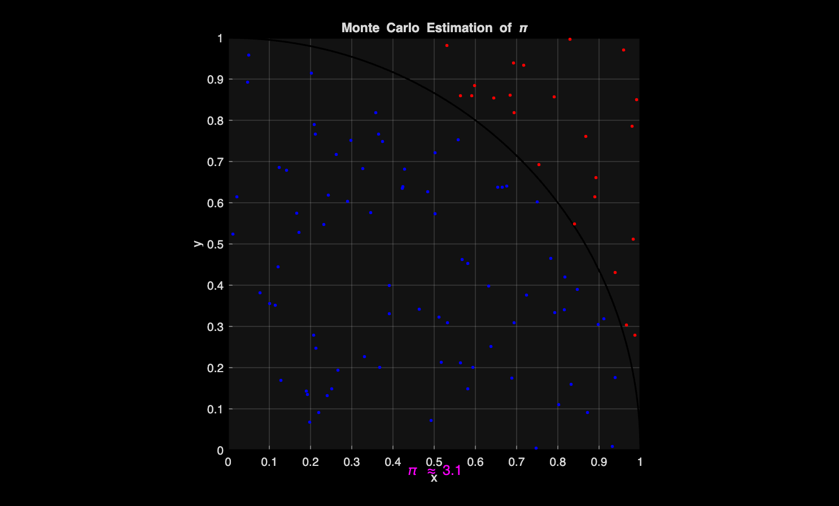
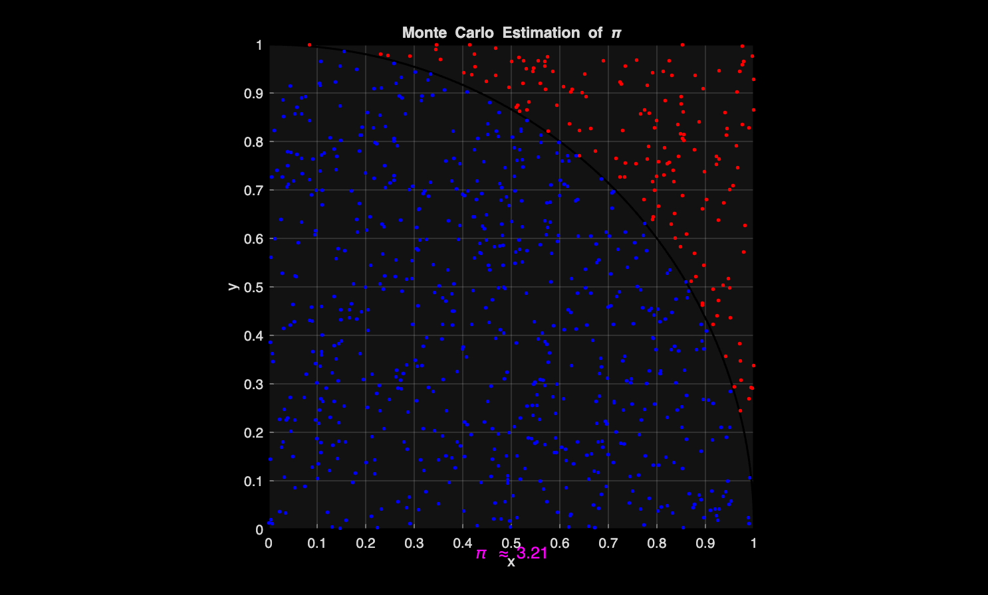
Task3
2 significant figure
3 significant figure
4 significant figure
Comment: The estimated pi is shown in the figure, more precision needed, more clear the boundary of circle is

Slide 10
Task3
Guide
Call
In function_compute_pi.m, add this file to path
Write function_compute_pi(<Your precision level>)in command window
Output
pi_est: Estimate pi
A graphical display should plot the random points

