Slide 1
An Auxiliary Rehabilitation Device for Parkinson’s Patients with Finger Muscle Tremors and Stiffness
ENBM015
Liyang(Victor) Han
Brookfield Central High School
Brookfield, WI, US
Notes:
1. PD – Parkinson Disease
Be more consistent
2. Intentions of the device – how is its
3. Principles – not much detaik – enigneers know / non-engineer don’t care
Wanna know how u make it, talk about something not on the slides
Intent to improve the project –
Implications and aplications

Slide 2
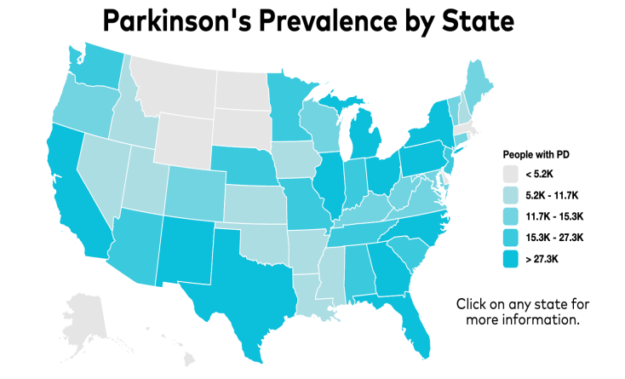

Introduction
Severe challenge – Parkinson’s Disease(PD)
Second-most common neurodegenerative disorder in US
Approximately 1 million Americans have PD, Patient number will double by 2040.
$14 billion annual cost of treating PD is estimated.
--(NIH, 2023)
PD Symptoms
PD distribution and concentration, 2023
Tremors in hands, arms, legs
Muscle Stiffness
Slowness of movement
Impaired balance and coordination
Problems Statement
Parkinson’s patients often face challenges such as irregular tremors and finger stiffness, resulting in diminished normal finger functionality.
Existing rehabilitation devices have problems as:
1) having complex structures, yet posing safety hazards;
2) Systems lacking adaptive design based on the level of patient rehabilitation training;
3) providing single functionality.
PD Research Status/Treatments
Neuroprotection and Disease Modification
Gene Therapy
Deep Brain stimulation
Drug
External assistance
Notes:
04/06/2024 Gu
1. 产品模型号 – specify 出一个product – 答辩

Slide 3
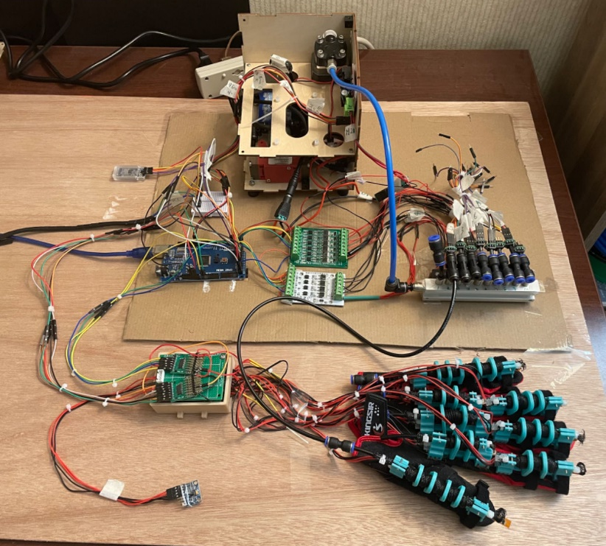
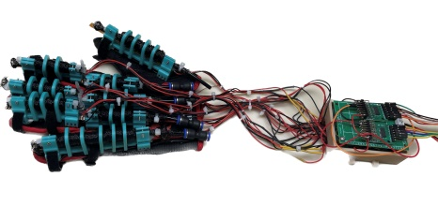
Innovations of my project
System Adaptive Training: Personalized rehabilitation training programs are designed for each patient; program allows user to set up according to personal condition.
Data Analysis of Key Rehabilitation Progress Reflective Parameters: The storage and analysis of patients’ bending training and tremor rating data in cloud enable an efficient tracking and management of the rehabilitation progress.
Multi-functions: 1) Finger Bending Training; 2) Finger Tremor Rating; 3) Life Motion Assistance.
Safety: Safety protection mechanism to emergency stop air pump
Portability: 1) Device operated using a mobile App utilizing Bluetooth protocol 2) Whole device can be compact and fit into a box with very limited space, thus can be carried around.
Notes:
What symptom is the device focused on
Finger tremors
Finger lost control
Add overview device picture
With three separate picture for each of the features
Be more casual tone, simpler terminolgy with help with better undertstandings
做成表格
每个功能对应不同的工作
System flow

Slide 4
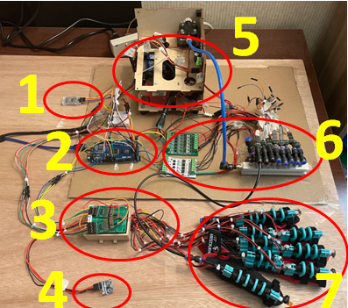

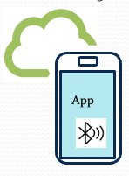

Method: System Architecture
Execution Unit
(Finger module)
EPM Muscle
Muscle Bracket
Flex/Pressure Sensors
Flex/Pressure sensors
Control Unit
Actuating Unit
Sensor data acquisition Board
Electromagnetic valve
Accelerometer
(MPU6050)
Signal transmission Board
The hardware’s composed of three main units: Control Unit, Actuating Unit and Execution Unit.
Trend of max bending angle and tremor rate
Data processing (Arduino) Board
BLE
Module
Actuating Unit
5. Air Pumps
6. Electromagnetic valve
Triple-axis Accelerometer data
Sensor data signal
BLE Data
Control Signal
Air Flow
Control Unit
1. Bluetooth Module: Enables communciation between mobile APP and device
2. Microcontroller: Processes sensor data and passes out commands
3. Data Acquisition Board: Collects sensor data and performs AD convertion.
4. Accelerometer: A sensor used for motion detection.
Execution Unit
7. Finger modules
Individual extensive pneumatic muscles with “muscle brackets” that form the glove.
Notes:
McKibben Muscle change to EPM Yellow color to blue / other obvious color

Slide 5
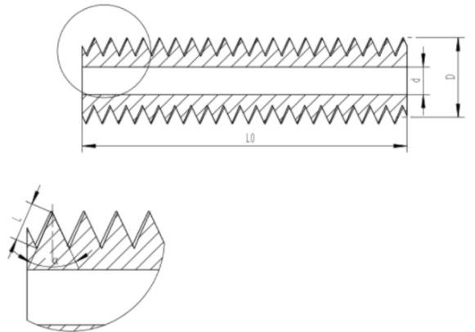
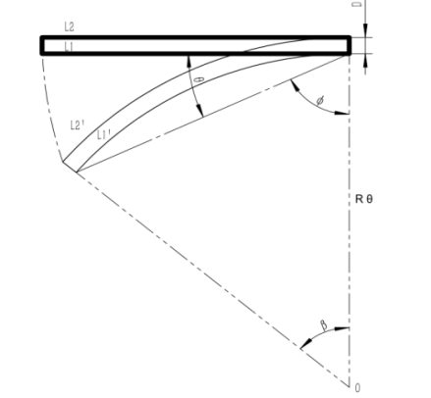

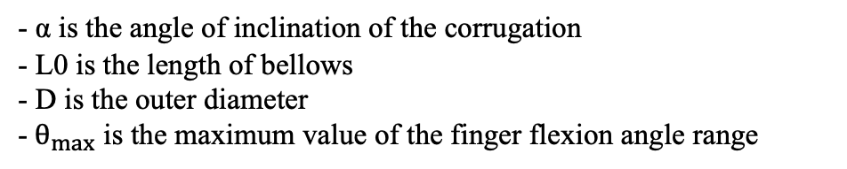

Method: Theoretical Research
Execution Unit - EPM
Reason: The muscle structure flexes with finger so the the muscle structure has to be designed to be able to reach a designed angle.
Model built:
c) Model of the bellows changing as the finger bends
a) EPM (Extensible Pneumatic Muscle)
b) Structure of the bellows
- α is the angle of inclination of the corrugation
- L0 is the length of bellows
- D is the outer diameter
-${ θ}_{max}$ is the maximum value of the finger flexion angle range
$α ≤2 \sin^{−1}{\frac{L_{0}}{L_{0}+2Dθ_{max}}}$
Conclusion: Using this equation, I’m able to determine the design of the bellows so that it enables flexion to a certain angle.
Notes:
(Real picture of bellow here)
This black piece ….
The air gets pumped into this piece which caused it to bend
Here’s the forumula: to make it
Picture sequence
Reason: 加上 70 degree – citations source
理想情况 和 真实手指点弯曲过程对比

Slide 6
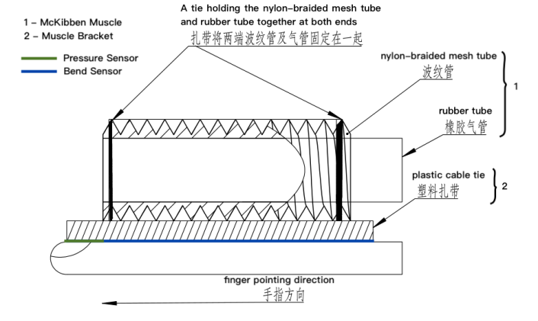
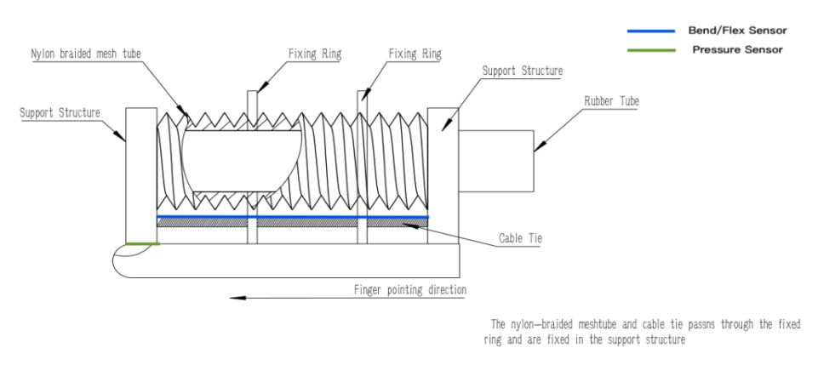
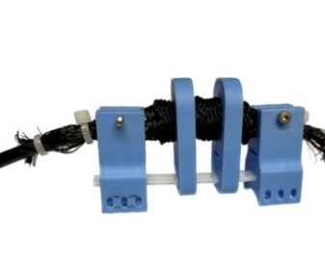
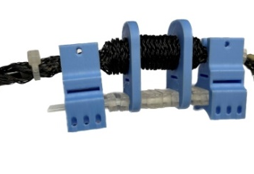
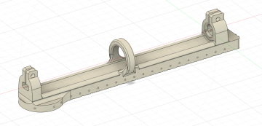
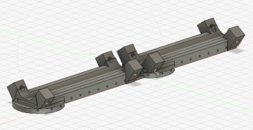

Method: Mechanical Design
Execution Unit - Finger Module
Design iteration description
Finger Module | Muscle Bracket | finger module/finger | Sensors / finger | Space between EPM and Muscle Bracket | Other Distinctive features
V 1.0 | V0 | 1 | 2 | EPM is tightly affixed to Muscle Bracket | Conceptual prototype
 | V1.0 | 1 | 2 | EPM is tightly affixed to Muscle Bracket | Testing prototype
 | V1.5 | 2 | 4 | EPM is tightly affixed to Muscle Bracket | Close to true finger structure and fine control
V 2.0 | V2.0 | 2 | 4 | EPM is lifted from Muscle Bracket | Lift the muscle and get bigger force arm
 | V2.5 | 2 | 4 | EPM is lifted from Muscle Bracket | Lighten muscle bracket weight
1) Finger Module V 1.0
Bend/Flex Sensor
Pressure Sensor
2) Finger Module V 2.0
3) Muscle Bracket V1.0
4）Muscle Bracket V1.5
5）Muscle Bracket V2.0
6）Muscle Bracket V2.5
Notes:
Add pictures for each of the iterations
Limitation of Finger module v1 -→ reason to start v2
Progressive thinking

Slide 7
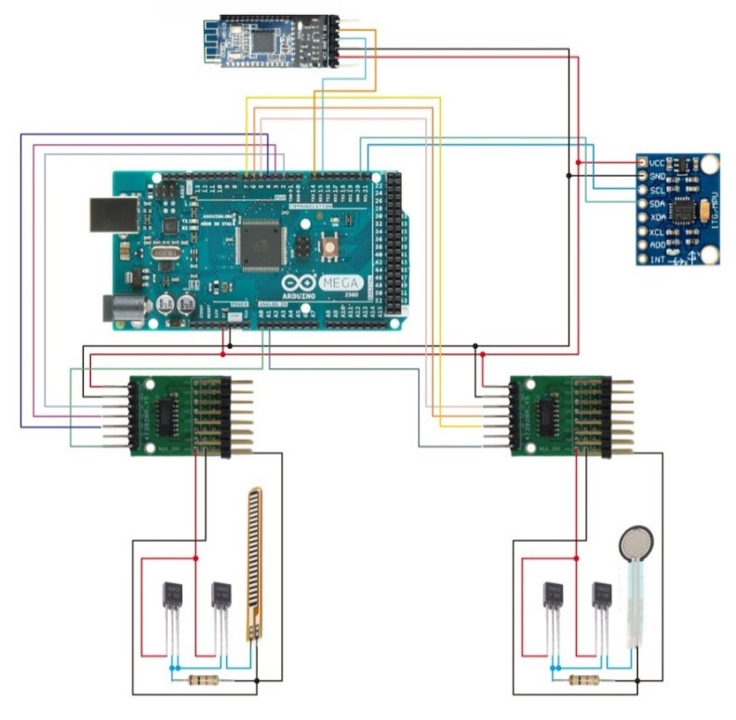
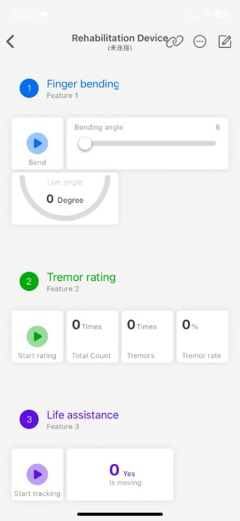
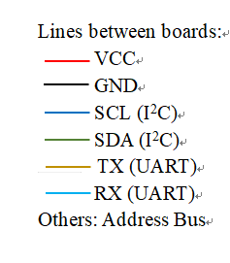
Method: Electronic and Software Design
Control Unit
Software Design
5
Software Developing Environment: C++, Processing, Blinkers
THREE perspective of software features:
System adaptive design:
Personalized rehabilitation training programs are designed for each patient, and the program can be adjusted based on the training progress
Device functions:
Finger Bending training
Finger Tremor Rating
Life Motion Assistance
Portability:
Device can be operated on a
mobile APP developed using
Bluetooth protocol for
communication
4
3
2
2
1
1
Electronic System Design Diagram
Components Description:
AD convertion circuits – welded on Sensor Data Acquisition Board
Signal Transmission Board
Accelerometer
Microcontroller (Arduino Mega)
Bluetooth Module
Mobile UI for operating the device
Notes:
1.left - Flex sensor
Bend with finger that tells the real-time finger angle.
1.Right - Pressure sensor
Attach to the finger nail that tells the real-time pressure the finger module has on finger.
2. AD extender
By utilizing pin-select, it extends a limited amount of ad pin on the electronic microcontroller.
3. Accelerometer
Attach to the finger/back of the hand that tells if the hand is moving or the frequency of finger tremors
4. Arduino Mega Microcontroller
Script: explain a logic sequence
More in depth??
User interface flow:
User → hardware → software
What’s used in between

Slide 8
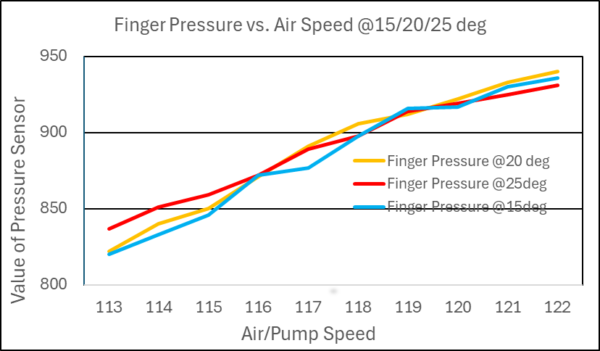
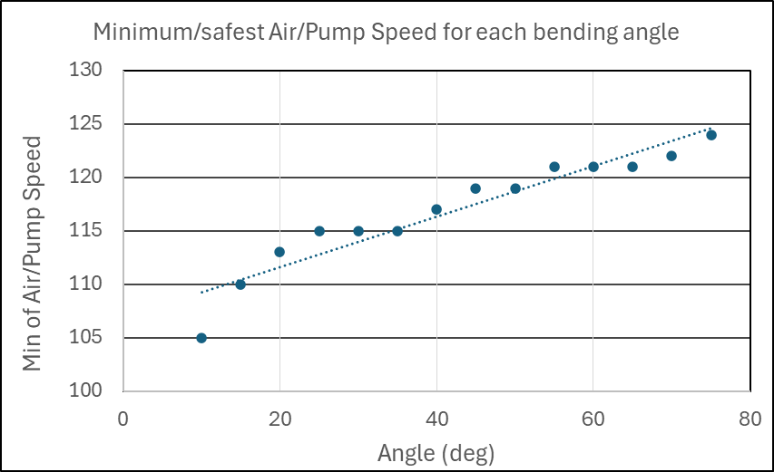
Safety Setting Experiments
Experiment 1: Finger Pressure in Relation to Air Speed
Experiment 2: Minimum/safest air speed for each bending angle
Discussion:
Discussion:
The pressure on finger gets larger as air speed increases → need to find the safest air/pump speed in each angle to ensure user safety
The difference in bending angle has no significant impact on the finger pressure.
The minimum air speed for each angle has been found
The minimum/safest speed of air/pump speed get larger with the increase of the bending angle
The minimum/safest air speed is set as the default value when bending.
The user is able to adjust the air speed starting with the default(safest) value based on their feelings.

Slide 9
Device Functions Experiments
Experiment 1: Finger Flexion Angle Accuracy and Repeatability
Flex sensor values in relation to finger actual flexion angles
Accuracy of the finger flexion angles
Trend of rehabilitation via the maximum flexion angle that the patient can do intentionally
[2.1%, 7.6%]
[0.2^{O}, 3.7^{O}]
Discussion 1:
High accuracy: within ±10%. Relative deviation of the flexion angles ranging between 2.1% and 7.6%.
The actual finger bend angle and flex sensor value exhibit a strong linear relationship.
High R-squared value 0.9859 indicates a relatively reliable relationship and less error.
Monitoring the trend of the maximum angle to which the fingers can flex over time seems to be a solution in proving insights into the rate of rehabilitation progress.
Notes:
Graph x,y axis meanings – script presentation
Be more simple what it shows, emphasize the data more
Why important

Slide 10
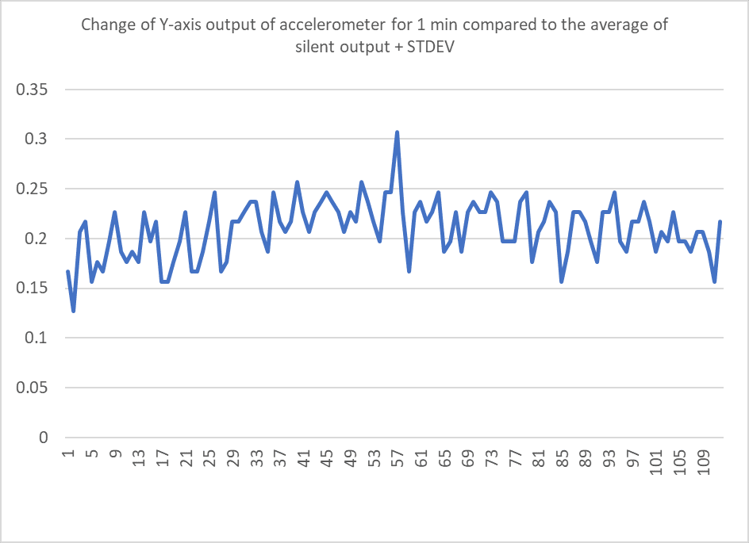
Device Functions Experiments
Experiment 2: finger tremor rating
Experiment 3: life assistance -assisting mouse clicks for Parkinson patient
The device can prevent unintentional finger movements during hand motion
The device can enable finger movement after the hand has been stationary for more than 2 seconds
84 out of 157 readings (54%) exceed the threshold
Sensor value
Sensor value
Number of data collected
Number of data collected
Discussion 2:
Discussion 3:
This device can differentiate finger with and without tremors.
This device can rate the scale of Parkinson to provide diagnosis suggestions, deploying the “Constancy of Rest Tremor” method.
The device can effectively detect the hand motion through accelerometer and assist patients with Parkinson's in effectively operating the mouse.
The device can achieve the designed features and functionalities which meet the intended user needs well; Multifunction can help users in daily life. 🌹🌹
Notes:
Should be way more concise
Graph x,y axis meanings – presentation script
分级-parameters
UPDRS

Slide 11
Conclusion
References
Function efficiency:
Experiments of three device functions show that the Auxiliary Rehabilitation device is effective.
Device Safety & Adaptive Training:
Experiments have been conducted to figure out the correlation between the device bending angle and air speed, and the force applied to the patient's fingers, ensuring user safety. User is allowed for personal training setup.
Portability:
Incorporating a mobile app, this compact device allows users to operate on mobile, leveraging the portability to enhance overall convenience and efficiency of the rehabilitation process for patients.
"Guidelines for management of is chaemic stroke and transient is chaemic attack 2008", 2008.
N. Norouzi-Gheidari, P. S. Archambault and J. Fung, "Effects of robot-assisted therapy on stroke rehabilitation in upper limbs: Systematic review and meta-analysis of the literature", J. Rehabil. Res. Develop., vol. 49, no. 4, pp. 479-496, 2012.
Ryan Kabir, et al., “Hand Rehabilitation Devices: A Comprehensive Systematic Review”, Micromachines 2022, 13, 1033.
Motor, Linear: Sandison, M.; Phan, K.; Casas, R., et al, HandMATE: Wearable Robotic Hand Exoskeleton and Integrated Android App for at Home Stroke Rehabilitation. In Proceedings of the Annual International Conference of the IEEE Engineering in Medicine and Biology Society (EMBS), Montreal, QC, Canada, 20–24 July 2020; pp. 4867–4872. https://doi.org/10.1109/EMBC44109.2020.9175332.
Polygerinos P, et al, Soft robotic glove for combined assistance and at-home rehabilitation. Robotics and Autonomous Systems. 2015; 73:135–43.
Christopher G. Goetz, et al., “Movement Disorder Society-Sponsored Revision of the Unified Parkinson’s Disease Rating Scale (MDS-UPDRS): Scale Presentation and Clinimetric Testing Results”, Movement Disorders Vol. 23, No. 15, 2008, pp. 2129–2170.
Future Steps
Enhance the comfort and conveniency of the device.
Lighter
Easier to wear
Clinical trail to verify its effectiveness with more real-world data.
Notes:
手套现场演示 很重要
Safety test: 现场测试 *******
Device functions
多维度演示Device – 多套演示方式
数据产生一个report –- feedback

