Slide 1
Routing Base
Computer Network Design
Qiu Jinsong
Computer Institute of Zhejiang University
Mail: jinsongqiu@hotmail.com

Slide 2
（1）Router

Slide 3
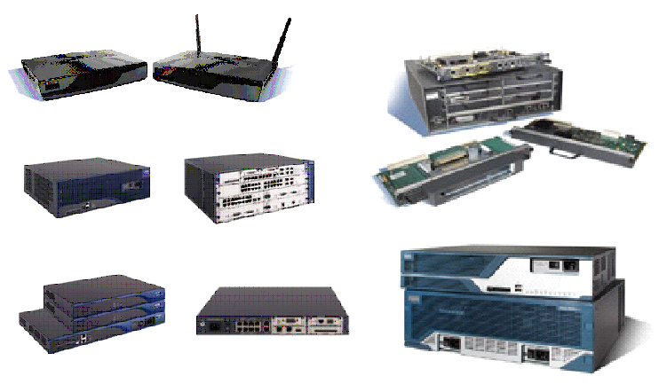
Router Show

Slide 4
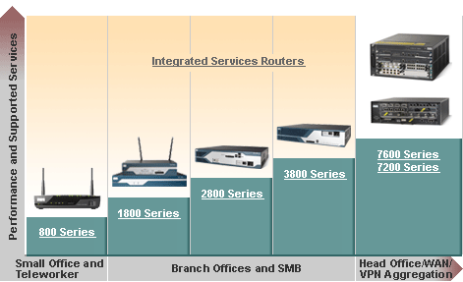
Cisco Router Serial

Slide 5
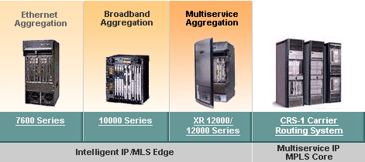
Cisco Router Serial

Slide 6
Cisco Router 3D Show
800系列
1800系列
2800系列
3800系列
7200系列
7600系列
10000/12000系列

Slide 7
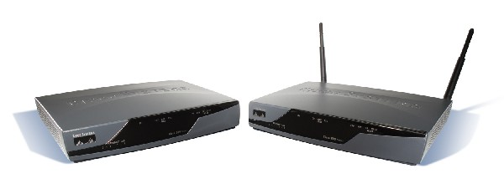
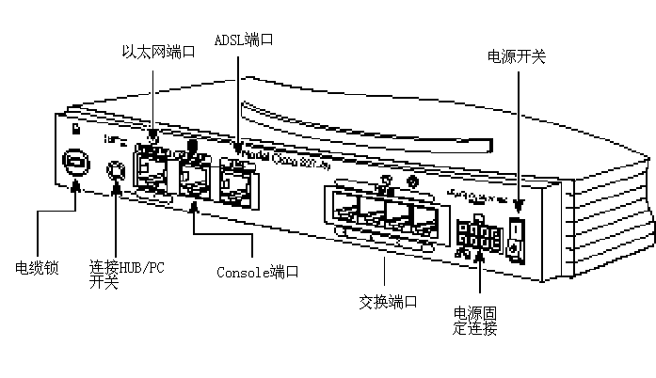
800 Serial

Slide 8
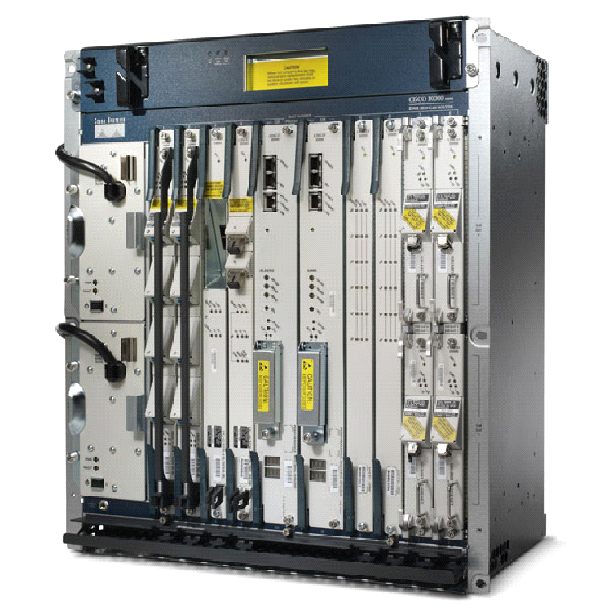
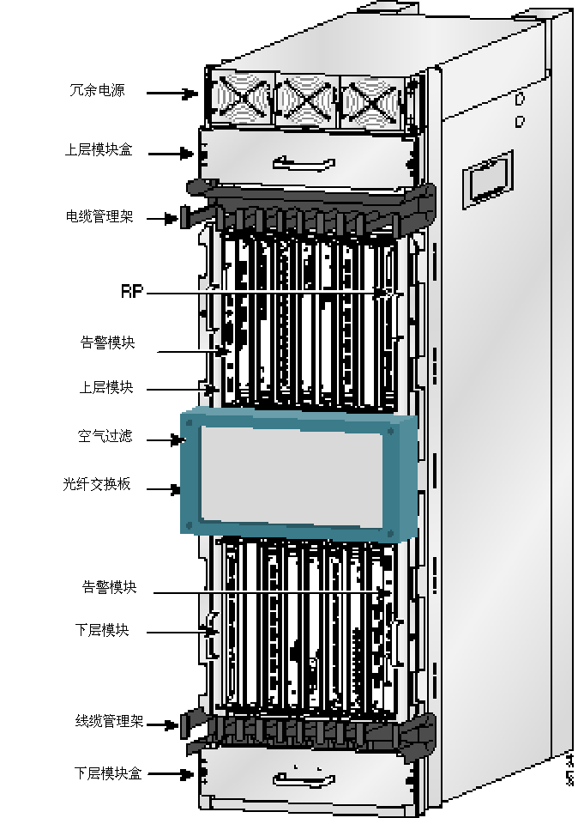
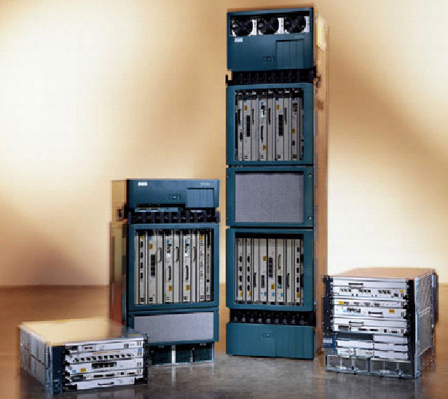
10000/12000 Serial

Slide 9
Router Elements
路由器操作系统软件
路由器主设备
路由器接口模块
3D展示

Slide 10
Router Interface
物理接口：真实存在、有对应器件支持的端口
  局域网接口
    Ethernet、FastEthernet
  广域网接口
    同步串口、异步串口、AUX端口、CE1/PRI 端口
逻辑接口：能够实现数据交换功能但物理上并不存在、需要通过配置来建立的端口
  Loopback端口、Dialer端口
  子接口
  NULL接口

Slide 11




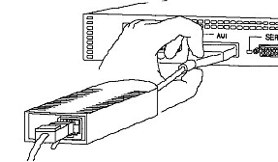
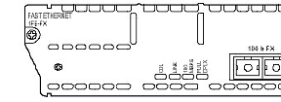
LAN Interface
AUI 10Base-5
RJ-45 10Base-T
RJ-45 100Base-T
AUI转RJ45
SC接口 100BaseF

Slide 12
LAN Interface
Fast Ethernet: 快速以太口
  分为电接口和光接口两种，分别符合100Base-T/100Base-F物理层规范
  工作速率上可选择10/100 Mbit/s
  工作方式上支持半双工和全双工两种模式
  能够接收帧格式为Ethernet_II或Ethernet_SNAP的以太网帧，并能自动辨认其格式，对于发送的帧则采用Ethernet_II格式

Slide 13
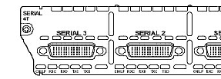
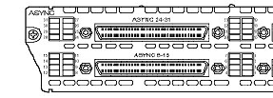
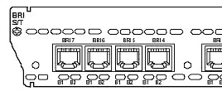
WAN Interface
同步串口 DDN / X.25 / FR / PSTN
异步串口 PSTN
ISDN BRI接口

Slide 14
Synchronous Serial Interface
接口名称为Serial
最大支持2.048M的E1速率
通过软件配置，该种端口可以连接
  DDN，帧中继（Frame Relay），X.25，PSTN（模拟电话线路）
  如果用该同步端口连接电话线路，要求Modem必须支持V.25
同步串口可以工作在DTE和DCE两种方式下，一般情况下，作为DTE使用时，接受DCE设备提供的时钟
同步串口的链路层协议可以为：
  PPP、LAPB、HDLC、Frame Relay
在路由器中所能支持的同步串行端口类型比较多，如：
  EIA/TIA-232接口、EIA/TIA-449接口、V.35接口、X.21串行电缆和EIA-530接口

Slide 15





Synchronous Serial Interface Type
DTE
DCE
EIA/TIA-232接口
EIA/TIA-449接口
V.35接口
X.21接口
EIA-530接口

Slide 16
Asynchronous Serial
接口名称为为Async
端口可以设为专线方式和拨号方式
在应用中更常用的是拨号方式，异步串口外接Modem可作为拨号接口使用
链路层协议可以为SLIP、PPP、HDLC

Slide 17
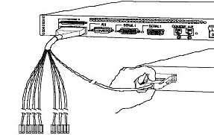
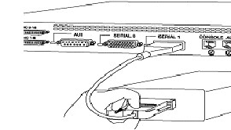
Asynchronous Connector
异步串口连接Modem
同步串口连接CSU/DSU

Slide 18
Loopback: 回环端口
可以用来接收所有发送给本机的数据包
有些应用需要在不影响物理接口配置的情况下，配置一个带有指定IP地址的的本地接口
出于节约IP地址的需要，需要配置32位掩码的IP地址，并需要将这个端口上的地址通过路由协议发布出去。
Loopback端口就是为了满足这种需要而设计的

Slide 19

Console Port and AUX Port
AUX端口
  该端口为异步端口，最大支持28400的速率，主用于远程配置或拨号备份
Console端口
  主要连接终端或运行终端仿真程序的计算机，在本地配置路由器

Slide 20
（2）Router Interface

Slide 21
Interface Configure Task
配置底层封装协议
  局域网接口一般不需要配置
  广域网接口需要配置链路层协议或广域网协议
配置IP地址
  Router(config)# interface type num
    接口类型(type)：ethernet、fastethernet、serial
    接口编号(num)：由两部分组成Slotnum/Unitnum
  Router(config-if)# ip address 192.168.1.1 255.255.255.0

Slide 22
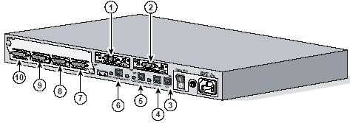
Cisco Interface Number Rule
Serial 0/0
Serial 0/1
Serial 1/3
Ethernet 0/0
Serial 1/2
Serial 1/0
Ethernet 0/1
Serial 1/1
FastEthernet 0/0
FastEthernet 0/1

Slide 23
LAN Interface
举例：配置以太网接口
  Router(config)# interface ethernet 0/0
  Router(config-if)# ip address 192.168.1.1 255.255.255.0
举例：配置快速以太网接口
  Router(config)# interface fastethernet 0/0
  Router(config-if)# ip address 192.168.1.1 255.255.255.0

Slide 24
Serial Interface
举例：封装协议为HDLC
  Router(config)# interface Serial 0/0
  Router(config-if)# encapsulation hdlc
举例：封装协议为FR
  Router(config)# interface Serial 0/0
  Router(config-if)# encapsulation frame-relay
举例：封装协议为PPP
  Router(config)# interface Serial 0/0
  Router(config-if)# encapsulation ppp
最后配置接口IP地址
  Router(config-if)# ip address 192.168.1.1 255.255.255.0

Slide 25
Interface State
State | Protocol | Meaning
administratively down | down | 接口被手工关闭
up | down | 电缆已连接，但数据链路层协议没有建立
down | down | 电缆问题，或DCE侧未设置时钟，或者对方端口已关闭
up | up | 正常状态

Slide 26
（3）Routing

Slide 27
Routing
Router forward IP packet by searching routing table
  IP packet include only IP address, not include subnet mask
  Subnet mask is stored in routing table
How to establish routing table
  Static Routing
    Set Table by manual
  Dynamic Routing
    Set table by routing protocol

Slide 28
Set Static Routing
Cisco Router Command
  Add Static Route
    Router(Config)# IP route 10.0.0.0 255.0.0.0 10.0.0.1
    Router(Config)# IP route 10.0.0.0 255.0.0.0 s 0/0
  Set Default route
    Router(Config)# IP route 0.0.0.0 0.0.0.0 10.0.0.1
    Router(Config)# IP route 0.0.0.0 0.0.0.0 s 0/0
  Show routing table
    Router# show ip route

Slide 29
Static Routing Demo
Using PacketTrace or NetSim

Slide 30
Classless Routing
CIDR
  Classless Inter-Domain Routing
  206.13.1.48/25
    same as 206.13.1.48 mask 255.255.255.128
Benefit
  Route Aggregation / supernetting
  More flexible
  Less wasteful address
  More Efficient Routing
  Reduce number of CPU cycles when search from routing table or recalculating routing table
  Reduce router memory requirements

Slide 31
Route Aggregation: 路由收敛
网络地址/掩码 | 字节1 | 字节2 | 字节3 | 字节4
172.24.0.0/16 | 10101100 | 00011000 | 00000000 | 00000000
172.25.0.0/16 | 10101100 | 00011001 | 00000000 | 00000000
172.26.0.0/16 | 10101100 | 00011010 | 00000000 | 00000000
172.27.0.0/16 | 10101100 | 00011011 | 00000000 | 00000000
172.28.0.0/16 | 10101100 | 00011100 | 00000000 | 00000000
172.29.0.0/16 | 10101100 | 00011101 | 00000000 | 00000000
172.30.0.0/16 | 10101100 | 00011110 | 00000000 | 00000000
172.31.0.0/16 | 10101100 | 00011111 | 00000000 | 00000000
CIDR: 172.24.0.0/13 | 10101100 | 00011000 | 00000000 | 00000000
Mask: 255.248.0.0 | 11111111 | 11111000 | 00000000 | 00000000
路由收敛后，在路由表中原来需要8条记录，现在只需要1条记录

Slide 32
Supernetting and Address Allocation
Problem: Company XYZ requires addresses for 400 hosts
  Under the classful addressing system
    Allocate 1 Class B address from central Internet address authority
      Tens of thousands of address Wasted
    Allocate 2 Class C addresses
      XYZ company have to route between its own 2 networks
      All Internet routers need to maintain 2 routing table entries for XYZ’s network
  Under the CIDR
    ISP is a supernet
      All Internet router keep only one summary route to the ISP’s network (supernet)
    XYZ allocate an address block from its ISP
      Address is not wasted

Slide 33
Address Allocation Example
Net Number | 1st Octet | 2nd Octet | 3rd Octet | 4th Octet
207.21.54.0 | 11001111 | 00010101 | 00110110 | 00000000
207.21.55.0 | 11001111 | 00010101 | 00110111 | 00000000
Address Allocated for XYZ: 207.21.54/23
has 2⁹ (512) hosts
Internet
ISP Supernet
207.21.54.0/23
207.21.0.0/16
R
R
R
XYZ
R
R
ABC

Slide 34
VLSM
Variable-Length Subnet Masking
  Subnet a subnet
  Maximize addressing efficiency
See Example

Slide 35
VLSM Example
Network 172.16.0.0/16 is divided into Subnets 172.16.x.0 using mask: /24
  Network 172.16.14.0/24 is divided into:
    Subnets 172.16.14.0-172.16.14.224 with mask: /27
      Subnets 172.16.14.128/27 is divided into:
        subnets 172.16.14.128-172.16.14.156 with mask: /30
172.16.1.0/24
172.16.14.32/27
172.16.14.132/30
RA
172.16.14.136/30
R
172.16.0.0/16
172.16.14.64/27
RB
172.16.2.0/24
172.16.14.96/27
RC
172.16.14.140/30

Slide 36
Using VLSM to Address Point to Point Link
Class C address: 207.21.24.0, we has 8 subnet of 30 hosts each when using mask /27 (borrowing 3 bits from the host portion)
We have 4 remote offices, which connected by 4 routers using 3 point-to-point WAN link
The 3 WAN Link need 1 subnet each, but using mask /27 will waste address
201.21.24.32/27
201.21.24.0/27
201.21.24.96/27
RA
RB
RC
RD
201.21.24.64/27

Slide 37
Using VLSM to Address Point to Point Link
Subnet 0 | 207.21.24.0/27
Subnet 1 | 207.21.24.32/27
Subnet 2 | 207.21.24.64/27
Subnet 3 | 207.21.24.96/27
Subnet 4 | 207.21.24.128/27
Subnet 5 | 207.21.24.160/27
Subnet 6 | 207.21.24.192/27
Subnet 7 | 207.21.24.224/27
Subnets Used for WAN Link
Each has 2 usable host address
(except all 0 and all 1 address )
Subnet 0 | 207.21.24.192/30
Subnet 1 | 207.21.24.196/30
Subnet 2 | 207.21.24.200/30
Subnet 3 | 207.21.24.204/30
Subnet 4 | 207.21.24.208/30
Subnet 5 | 207.21.24.212/30
Subnet 6 | 207.21.24.216/30
Subnet 7 | 207.21.24.220/30

