Slide 1
Routing Protocol
Computer Network Design
Qiu Jinsong
Computer Institute of Zhejiang University
Mail: jinsongqiu@hotmail.com

Slide 2
（1）
Routing Protocol Base

Slide 3
Routing Protocol
路由选择协议的作用
  路由器之间关于路由信息的交换协议，使路由器能自动建立路由表
距离向量路由选择协议
  路由器之间交换的信息：本路由器到达各已知目的网络的距离
  例子：RIP、EIGRP、BGP
链路状态路由选择协议
  路由器之间交换的信息：本路由器各端口直接连接的网络的地址及状态
  例子：OSPF

Slide 4
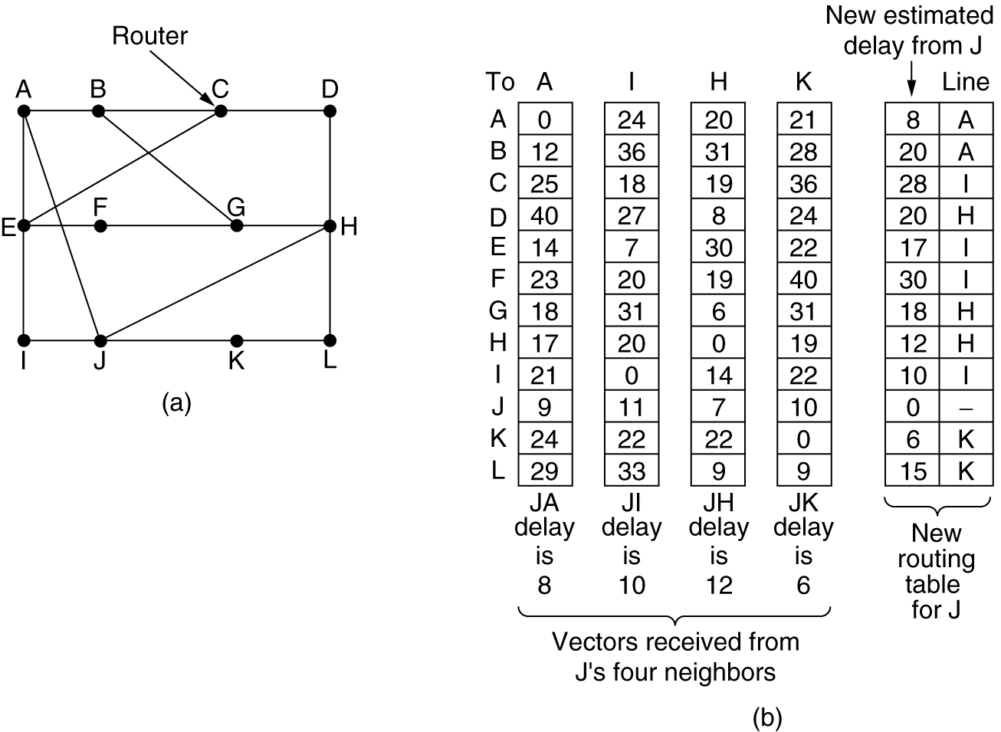
Distance Vector Routing Protocol
(a) 子网拓扑 (b) 路由器J从A, I, H, K收到的路由更新分组，以及据此经计算的新路由表

Slide 5
Link State Routing Protocol
步骤
  发现邻居，学习网络地址
  测量到每个邻居的延迟和开销
  构建一个分组，关于其到每个邻居的链路信息
  把这个分子发给所有其他路由器
  计算到每个其他路由器的最短路径
  周期性的循环此过程

Slide 6
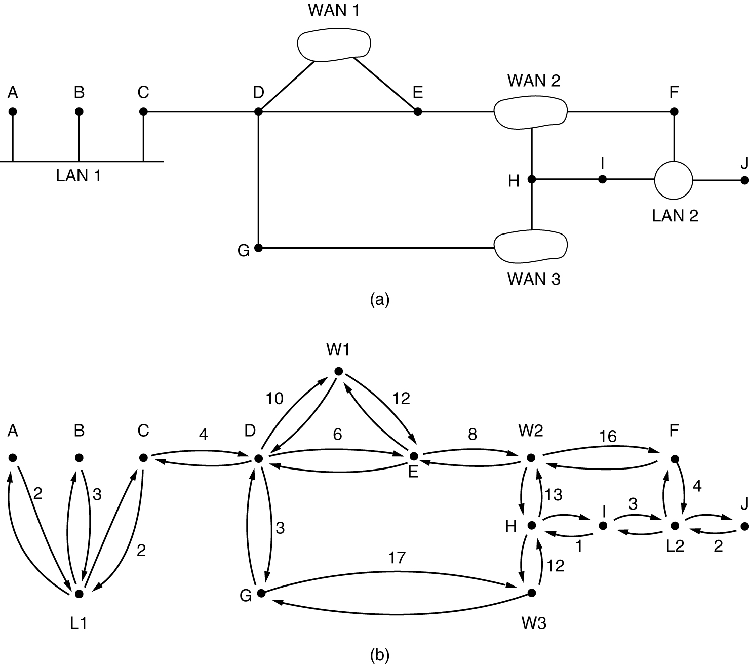
Network Topology Graph
(a)一个网络系统 (b)该网络系统的图形表示

Slide 7
Routing Protocol
Classful Routing Protocol (Not send subnet mask) (Not Support VLSM) (IP-Class based on IP-Address received) | Classless Routing Protocol (send subnet mask) (Support VLSM) (IP-Class based on subnet mask received)
RIP v1 | RIP v2
IGRP | EIGRP
EGP | OSPF
BGP v3 | BGP v4
 | IS-IS

Slide 8
Route Auto Summarization
Classful routing protocol automatically summarize routes on the classful network boundary
Classless routing protocol summarize based on subnet addresses
200.199.48.0/24
200.199.49.0/24
200.199.50.0/24
200.199.51.0/24
RA
200.199.48.0/22
200.199.48.0/20
200.199.52.0/24
200.199.53.0/24
200.199.54.0/24
200.199.55.0/24
200.199.52.0/22
R
RR
RB
200.199.56.0/24
200.199.57.0/24
…….
200.199.63.0/24
RC
200.199.56.0/21

Slide 9
Route Auto Summarization
Benefit
  Reduces the burden on upstream routers
  Prevents route flapping (up and down rapid)
200.199.48.0/24
200.199.49.0/24
200.199.50.0/24
200.199.51.0/24
RA
200.199.48.0/22
200.199.48.0/20
200.199.52.0/24
200.199.53.0/24
200.199.54.0/24
200.199.55.0/24
Upstream
router
200.199.52.0/22
R
RB
200.199.56.0/24
200.199.57.0/24
…….
200.199.63.0/24
RC
200.199.56.0/21

Slide 10
Route Auto Summarization Problem
Summarization in router R may be invalid (because other subnets of 172.16.0.0 maybe existed elsewhere)
172.16.28.0/24
172.16.25.0/24
RX
172.16.26.0/24
RA
R
Routing Table
172.16.25.0/24
172.16.26.0/24
172.16.27.0/24
Routing Table
172.16.0.0/16
172.16.27.0/24

Slide 11
Summarization Within an Octet
The number of addresses can be summarized is a power of 2
If not, divide into groups and summarize separately
172.16.168.0/24 | 10101100 | 00010000 | 10101 000 | 00000000
172.16.169.0/24 | 10101100 | 00010000 | 10101 001 | 00000000
172.16.170.0/24 | 10101100 | 00010000 | 10101 010 | 00000000
172.16.171.0/24 | 10101100 | 00010000 | 10101 011 | 00000000
172.16.172.0/24 | 10101100 | 00010000 | 10101 100 | 00000000
172.16.173.0/24 | 10101100 | 00010000 | 10101 101 | 00000000
172.16.174.0/24 | 10101100 | 00010000 | 10101 110 | 00000000
172.16.175.0/24 | 10101100 | 00010000 | 10101 111 | 00000000
Summary: 172.16.168.0/21

Slide 12
Summarization with Discontiguous Network
Classful routing protocol summarize automatically at network boundaries
  Subnets are not advertised to a different major network
  Discontiguous subnets are not visible to each other
Router C cannot make a correct routing decision because receives routes about 172.16.0.0 from two different directions
Classless routing protocol can resolve this situation because they advertise actual subnet masks
192.168.14.16/28
172.16.5.0/24
RA
RC
RB
172.16.6.0/24
Advertise network
172.16.0.0
Advertise network
172.16.0.0

Slide 13
（2）
RIP Routing Protocol

Slide 14
RIP
Use hop-count metric (maximum 15 hops, 16 hops is infinite distance)
Use hold-down timers (default 180 seconds)
Use split horizon (advertise routes out only on those interfaces which the route were not learned from)
Send updated information every 30 seconds
Version 1
  Does not send subnet mask in its updates
  Its updates are broadcast
  Does not support authentication
  when receive information about a network, the router applies the subnet mask that is configured on the receiving interface, or the default (by class) subnet mask if the network address is not the same as the receiving interface
Version 2
  Sends subnet mask in its updates
  Multicast routing updates (address=224.0.0.9)
  Provides for authentication in its updates (MD5 or clear text)

Slide 15
Configuring RIP
Assign network or subnet addresses and subnet mask to interface
Enable RIP
  Router(config)# router rip
Select a version (default is version 1)
  Router(config-router)# version 2
Assign IP network numbers which will be included in RIP update packets (directly connected network)
  Router(config-router)# network 10.0.0.0
Verify RIP
  Router# show ip protocols
  Router# show ip route
Troubleshooting RIP
  Router# debug ip rip

Slide 16
RIP Configuration Example
Show ip protocols (router RA)
  Gateway Distance Last Update
  this router 120 02:12:15
  10.1.1.2 120 01:09:01
Show ip route (router RA)
  R 10.2.2.0/24 [120/1] via 10.1.1.2 00:00:07 serial 2
  R 192.168.1.0/24 [120/1] via 10.1.1.2 00:00:07 serial 2
E1:192.168.1.1
E0:172.16.1.1
S2:10.1.1.1
S3:10.2.2.2
RA
RC
RD
S0:10.1.1.2
S1:10.2.2.3
Network 172.16.0.0
Network 10.0.0.0
Network 192.168.1.0
Network 10.0.0.0
Network 10.0.0.0

Slide 17
Dynamic Default Route
Set static default route in gateway router
  Router(config)# ip route 0.0.0.0 0.0.0.0 192.168.20.1
Set dynamic default route in other routers
  Router(config)# ip default-network 192.168.20.0
Set
Dynamic
Default
Route
RA
S0:192.168.17.1
S0:192.168.19.1
RC
R
S2:192.168.19.2
S1:192.168.20.1
Set
Dynamic
Default
Route
RB
S1:192.168.18.1
Internet

Slide 18
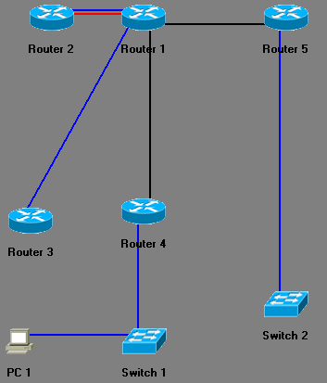
R
I
P配置拓扑
E0:
12.1.1.2/8
E0:
12.1.1.1/8
S0:
192.168.1.2/24
S1:
192.168.1.1/24
S0:
172.16.10.1/24
E0:
10.2.1.1/24
E1:
11.0.1.1/8
S0:
172.16.10.2/24
E0:
11.0.1.2/8
E0:
10.1.1.1/24
10.1.1.2/24

Slide 19
RIP配置内容
第1部分
  在各路由器上启用RIP路由协议
    设定版本1（默认设置）
    指定直接连接网络
  显示自动建立的路由表内容
  显示RIP内部信息
  用Ping命令测试到达各网络的连通性，特别是到10.2.1.1和10.1.1.1的连通性
第2部分
  在路由器1、4、5上修改RIP版本为2，再查看路由表，并测试到10.2.1.1和10.1.1.1的连通性

Slide 20
（3）
OSPF Routing Protocol

Slide 21
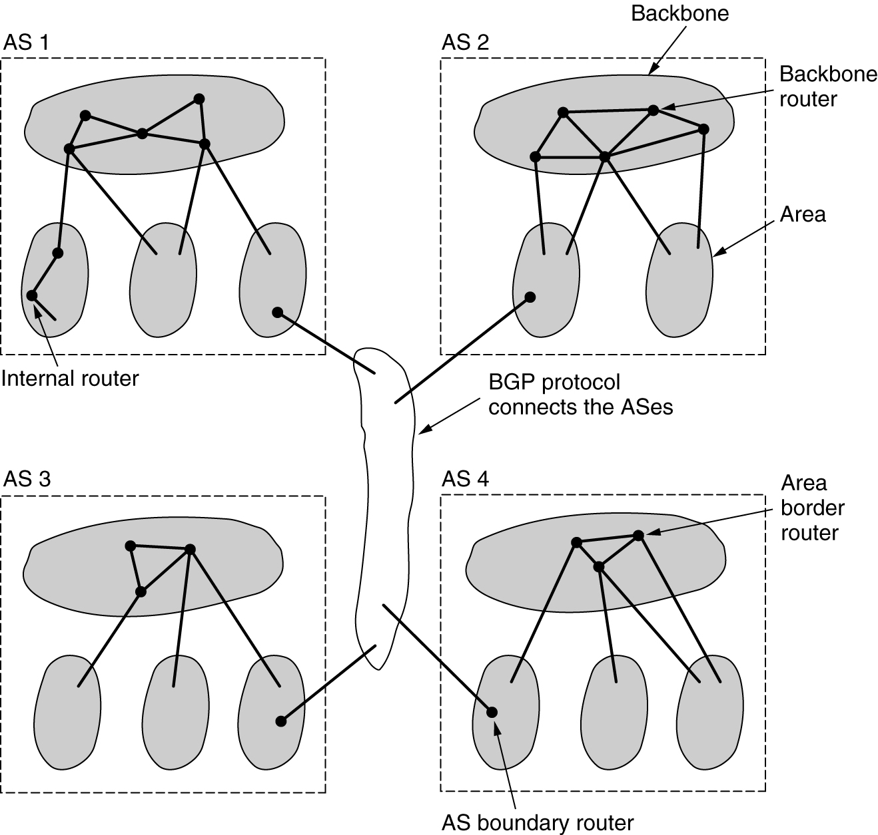
OSPF：AS、Area
AS中的区域边界路由器
AS内部的路由器
AS之间的边界路由器
OSPF中关于自治系统（AS）、主干（Backbone）、区域（Area）的关系

Slide 22
Single-Area OSPF
Area 0: backbone
Designated router, backup designated router
  To reduce number of information exchanges on the same network
Area 1
R
Area 0
R
Link
R
Cost=1785
R
R
LAN
R
Adjacencies
Database
Topological
Database
Routing
Table

Slide 23
OSPF States
Packet Type
  Hello
  Database description packet (DBD)
  Link State Request
  Link State Update
  Link State Acknowledgement
States
  Down: No exchanged
  Init: send Hello every 10 seconds to neighbor
  Two-way: confirm neighbor exist
  ExStart: exchange DBD packet, and elect the master and slave
  Exchange: exchange DBD packet
  Loading: exchange Link State
  Full adjacency: after loading state complete

Slide 24
OSPF versus RIP
RIP has a limit of 15 hops, OSPF has not
RIPv1 cannot handle VLSM, RIPv2 and OSPF can
Periodic broadcasts of the full routing table will consume a large amount of bandwidth. OSPF uses IP multicast to send link-state updates.
RIP converges slower than OSPF.
RIP has no concept of network delays and link costs.
RIP networks are flat networks. There is no concept of areas or boundaries. OSPF allows for a logical definition of networks where routers can be divided into areas.
OSPF allows for better load balancing.
OSPF allows for routing authentication by using different methods of password authentication.

Slide 25
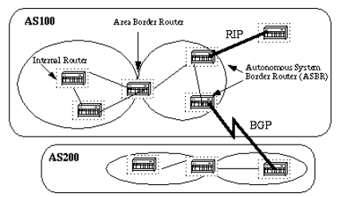
Areas and Border Routers

Slide 26
OSPF Network Types
Broadcast multiacess: Need to elect a designated Router and backup designated Router
Nonbroadcast multiacess: Need to elect a designated Router and backup designated Router
Point-to-point
R
R
R
R
DR
BDR
X.25
R
R
R
R
R

Slide 27
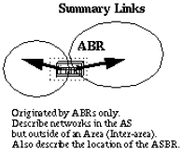
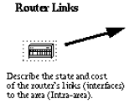
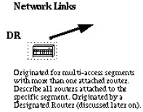
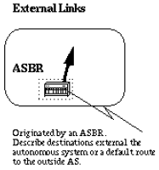
OSPF Link Type
Area内部
路由器直连链路
Area间链路
AS外部链路
网络链路

Slide 28
Neighbors and Adjacencies
Neighbors：邻居关系
  连在同一个网段
  Area ID相同
  认证通过
  保持着Hello分组的通信（收到Hello分组，就开始建立了邻居关系，一定时间内没有收到Hello分组，就消除了邻居关系）
Adjacencies：邻接关系
  在邻居关系的基础上进一步发展为可交换信息的关系
  双方交换已经知道的链路信息
  在一个广播式网络中，虽然所有路由器之间的关系是邻居，但每个路由器只和DR/BDR建立邻接关系

Slide 29
OSPF Operation
Steps
  Establish router adjacencies
  Elect a DR and BDR (if necessary)
  Discover routes
  Select the appropriate routes to use
  Maintain routing information

Slide 30
Establish Router Adjacency
Multicast Hello packet to 224.0.0.5 every 10 or 30 seconds
When receive Hello packet, add the router ID to the list
Area 0
10.4.0.1
10.5.0.2
RA
RB
RC
10.6.0.1
10.6.0.2
10.5.0.1

Slide 31
Electing a DR and BDR
The highest RID and priority is selected as DR
Default priority is 1
Point-Point Link No Need to Elect
10.4.0.1
BDR
10.5.0.2
RA
RB
RC
DR
DR
10.6.0.1
10.6.0.2
10.5.0.1

Slide 32
Discovering Routes
172.68.5.1
172.68.5.3
R
R
ExStart State
I will start exchange, my router ID=172.68.5.1
Hello
No, I will start exchange, my router ID higher
Hello
Exchange State
Here is a summary of my link-state database
DBD
DBD
Here is a summary of my link-state database
LsAck
LsAck
Loading State
I need the entry for network 172.68.6.0/24
LsR
LsU
Here is the entry for network 172.68.6.0/24
LsAck
Full Adjacency

Slide 33
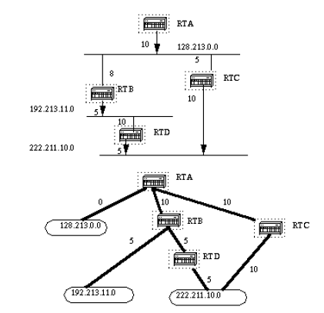
Select the Best Route
Shortest Path
Cost based
on bandwidth

Slide 34
Maintain Route Information
On Point-Point Link:
  New link-state information sent to 224.0.0.5
On Multiaccess Network:
  New link-state information sent to DR or BDR using address 224.0.0.6
  DR or BDR send New link-state information to all other routers using address 224.0.0.5

Slide 35
Single-Area OSPF Configuration
Configure a Loopback Address
  OSPF need a Process-id and a router-id, if interface failed, the IP address is unavailable
    Router(config)# interface loopback number
    Router(config-if)# ip address ip-addr mask
  Using 255.255.255.255 mask
  If no loopback address assigned, Cisco router will select a interface ip address to be used as router-id
Enable OSPF
  Router(config)# router ospf process-id
Identify IP networks
  Router(config-router)# network ip-addr mask area area-id
  More than one IP network can belong to same area

Slide 36
Modify OSPF Default
Priority
  Router(config)# interface e0
  Router(config-if)# ip ospf priority value
Cost Metric
  Router(config)# interface serial 0/0
  Router(config-if)# bandwidth value

Slide 37
OSPF Default Costs
Medium | Cost
56-kbps Serial Link | 1785
T1 (1.544Mbps) | 64
E1 (2.048Mbps) | 48
10 Mbps Ethernet | 10
16 Mbps Token Ring | 6
100 Mbps FE, FDDI | 1

Slide 38
OSPF Cost Example
Cost=1
Router A
Switch
FastEth
Cost=10
Router B
Cost=48
FrameRelay
Ethernet
Cost=48
Cost=1785
Router C
Serial
Ethernet
RouterA到10.0.1.0的Cost
1) 1+48+10+10
2) 1+1785+10
选择1为最短路径
Router D
Cost=10
Cost=10
Ethernet
10.0.1.0

Slide 39
Configure OSPF Authentication
Set Password (if not use message-digest)
  Router(config)# interface s0/0
  Router(config-if)# ip ospf authen password
Enable authentication
  Router(config-router)# area number authen [message-digest]
Set message-digest-key
  Router(config-if)# ip ospf message-digest-key key md5 [encryption-type] password

Slide 40
Propagating Default Routes
Set static default route in a border router
  Router(config)# ip route 0.0.0.0 0.0.0.0 [interface | next-hop address]
Propagate the default route to all routers in a OSPF area
  Router(config-router)# default-information originate

Slide 41
Verifying OSPF Configuration
Display parameters
  show ip protocol
Display routes known by the router
  show ip route
Display interfaces configured with OSPF
  show ip ospf interface
Display SPF executed information
  show ip ospf
Display detailed list of neighbors
  show ip ospf neighbor detail
Display the contents of topological database
  show ip ospf database
Debug OSPF operations
  debug ip ospf

Slide 42
Configure OSPF over NBMA
NBMA: Non Broadcast Multi Access
Cannot receive multicast Hello Packets
S0:3.1.1.1
S0:3.1.1.3
RA
RC
DLCI 22
DLCI 33
We are all on the same subnet, but I can’t send hello to RA
Frame Relay
PVC
PVC
DLCI 200
DLCI 300
RB
S0:3.1.1.2

Slide 43
Full-Mesh Topology
Set neighbor manually
  Router(config)# router ospf 1
  Router(config-router)# network 3.1.1.0 0.0.0.255 area 0
  Router(config)# neighbor 3.1.1.2
  Router(config)# neighbor 3.1.1.3
S0:3.1.1.1
RA
RC
S0:3.1.1.3
DLCI 44
DLCI 400
PVC
DLCI 33
DLCI 22
Frame Relay
PVC
PVC
DLCI 200
DLCI 300
RB
S0:3.1.1.2

Slide 44
Full-Mesh Topology
Configure subinterface to create point-point networks
No need to elect DR and BDR
But, need more IP address
S0.2:3.2.2.1
S0.1:3.2.2.2
RA
RC
DLCI 44
DLCI 400
PVC
DLCI 33
DLCI 22
S0.1:3.1.1.1
Frame Relay
S0.2:3.3.3.1
PVC
PVC
Subnet PVC
3.1.1.0/24 RA-RB
3.2.2.0/24 RA-RC
3.3.3.0/24 RB-RC
DLCI 200
DLCI 300
S0.1:3.2.2.2
RB
S0.2:3.3.3.2

Slide 45
Partial Mesh Topology（1）
设定一个HUB路由器，每个子接口与其他路由器分别形成点对点关系
  在Hub路由器上物理接口上设置封装协议为FrameRelay，并激活
  在 Hub 路由器上配置子接口 (S0.1，S0.2)，分别配置不同子网的IP地址
  在其他路由器上配置相应连接的子网IP地址，并配置相应的路由
S0:3.0.0.2
S0:4.0.0.2
RA
RC
DLCI 22
DLCI 33
(config)#interface serial 0
(config-if)#encap frame-relay
(config-if)#ip addr 4.0.0.2 255.0.0.0
(config-if)#frame-relay interface-dlci 33
(config-if)#no shutdown
(config)#interface serial 0
(config-if)#encap frame-relay
(config-if)#ip addr 3.0.0.2 255.0.0.0
(config-if)#frame-relay interface-dlci 22
(config-if)#no shutdown
Frame Relay
S0.1:3.0.0.1
S0.2:4.0.0.1
DLCI 200
DLCI 300
(config)#interface serial 0
(config-if)#encap frame-relay
(config-if)#no shutdown
RB
(config)#Interface serial 0.2 point-to-point
(config-subif)#ip address 4.0.0.1 255.0.0.0
(config-subif)#frame-relay interface-dlci 300
(config)#Interface serial 0.1 point-to-point
(config-subif)#ip address 3.0.0.1 255.0.0.0
(config-subif)#frame-relay interface-dlci 200
HUB Router

Slide 46
Partial Mesh Topology（2）
各路由器形成一点对多点连接关系
  Router(config-if)# ip ospf network point-to-multipoint
各路由器接口属于同一个子网地址
S0:3.1.1.1
S0:3.1.1.3
RA
RC
DLCI 22
DLCI 33
Frame Relay
PVC
PVC
DLCI 200
DLCI 300
(config)#interface serial 0
(config-if)#encap frame-relay
(config-if)#ip ospf network point-to-multipoint
(config-if)#no shutdown
RB
S0:3.1.1.2
HUB Router

Slide 47
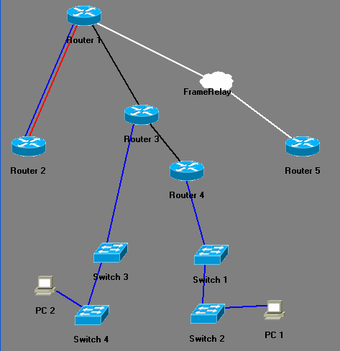
单域
OSPF
配置实验拓扑
S1:
170.10.1.1/24
DLCI: 105
E0:
160.10.1.1/24
S0:
175.10.1.1/24
S0:
175.10.1.2/24
S0:
170.10.1.2/24
DLCI: 501
FE0/0:
160.10.1.2/24
S1:
180.10.1.2/24
E0:
197.10.1.1/24
S0: 180.10.1.1/24
E0: 195.10.1.1/24
197.10.1.2/24
195.10.1.2/24

Slide 48
OSPF单域配置实验内容
为路由器1-4启用OSPF路由协议
  配置Loopback接口（不配会怎么样？）
  区域为0
  进程号统一设为1（各路由器的进程号是否需要一致？）
查看OSPF邻居信息
查看OSPF链路状态
查看OSPF路由表
用PC1和PC2来Ping网络中其他地址，验证网络是否通达

Slide 49
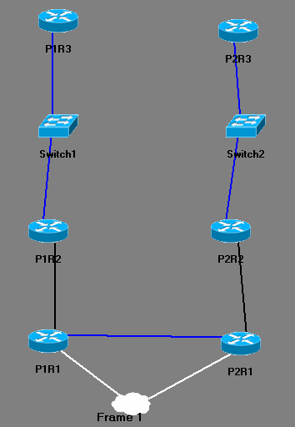
A
R
E
A
1
A
R
E
A
2
多域
OSPF
配置实验拓扑
FE0/0:
192.168.1.50/28
FE0/0:
192.168.2.50/28
FE0:
192.168.1.49/28
FE0:
192.168.2.49/28
Loopback:
192.168.1.17/28
Loopback:
192.168.2.17/28
S0/0:
192.168.1.34/28
S0/0:
192.168.2.34/28
Area 0
S0/0:
192.168.1.33/28
FE0/0:
10.100.100.1/24
S0/0:
192.168.2.33/28
FE0/0:
10.100.100.2/24
Loopback:
192.168.1.1/28
Loopback:
192.168.2.1/28

Slide 50
多域OSPF试验内容
为各路由器启用OSPF
指定网络接口属于相应的Area
用show ip ospf database查看OSPF已经学习到的链路
用show ip route查看OSPF自动建立的路由
用Ping测试到各网络的联通性
假设Area1包括了子网192.168.1.16/28和192.168.1.0/28，请在路由器P1R1上进行路由合并
  Router(config-router)#area <area_id> range <ip_net> <subnet_mask>
用show ip route查看路由合并效果，并用ping测试路由合并后的联通性
假设Area2包括了子网192.168.2.0/28和192.168.1.16/28，请在路由器P2R1上进行路由合并

Slide 51
（4）
EIGRP Routing Protocol

Slide 52
EIGRP
Enhanced Interior Gateway Routing Protocol
Overview
  Based on IGRP, by Cisco
  Classless routing protocol
  Can replace RIP
  Hybrid routing protocol, offers the best of distance-vector and link-state algorithms
  As an advanced distance-vector routing protocol, acts like a link-state protocol
  Easier to configure than OSPF

Slide 53
EIGRP Overview
Metric calculation
  = [K1 * bandwidth + (K2 * bandwidth)/(256-load)+(K3 * delay)] * [k5 / (reliability + K4)]
  Where (by default),
  K1 = 1, K2 = 0, K3 = 1, K4 = 0, K5 = 0
  So, by default, metric = bandwidth + delay
  bandwidth = 10,000,000 / interface bandwidth * 256
  delay = real delay / 10 * 256
Hop Count
  Maximum 224

Slide 54
EIGRP Overview
Benefits
  Rapid convergence
  Efficient use of bandwidth
    Partial, bounded updates
      only send those routers that need the information
    Minimal consumption of bandwidth when the network is stable
      Instead of using timed updates
  Support for VLSM and CIDR
  Multiple network-layer support
    IP, IPX, Appletalk

Slide 55
EIGRP Terminology
Routing Table
Neighbor Table
  List of adjacent routers, which include:
    Neighbor address
    Hold time
    Smooth round-trip timer (time of send and receive from a neighbor
    Queue count (normally is 0)
    Sequence number (the seq of the last packet received from neighbor)

Slide 56
EIGRP Terminology
Topology Table
  Feasible distance (FD)
    lowest calculated metric
  Route source
    via xxx.xxx.xxx.xxx
  Reported distance (RD)
    an adjacent neighbor report (FD/RD)
  Interface information
    through which the destination is reached
  Route status
    Passive (route is stable), active (route is in the process of being recomputed)

Slide 57
EIGRP Topology Table
Example
  Router# show ip eigrp topology
codes: P – Passive, A – Active, U-update, Q – Query, R – Reply, R – Reply Status
P 32.0.0.0/8, 1 successors, FD is 2195456
via 200.10.10.10 (2195456/281600), Serial1
P 170.32.0.0/16/8, 1 successors, FD is 2195456
via 199.55.32.10 (2195456/2169856), Ethernet0
via 200.10.10.5 (2195456/281600), Serial0

Slide 58
EIGRP Terminology
Successor
  Primary route to use to reach destination
  Can be up to 4 successor routes for any particular route
  Kept in the routing table & topology table
Feasible Successor
  Backup route
  Kept in the topology table only
Network Z
RB
RA
I have a route to Net Z
with a metric of 5
RB is successor to Net Z

Slide 59
EIGRP Terminology
Selection of Successors and Feasible Successors
I have a route to Net Z
with a metric of 5
RX is feasible successor
to Net Z
RB is successor to Net Z
RC is successor to Net Z
RB
Network Z
RA
RC
I have a route to Net Z, with a metric of 5
I have a route to Net Z, with a metric of 6
RD
RX

Slide 60
EIGRP Technologies
Neighbor Discovery and Recovery
  Unlike simple distance-vector router, EIGRP establish a relationship with their neighbors
  Send Hello packet every
    5 sec on high-bandwidth links
    60 sec on low-bandwidth links
Reliable Transport Protocol
  Does not rely on TCP/IP to exchange routing information

Slide 61
EIGRP Technologies
DUAL Finite-State Machine
  Tracks all the routes advertised by neighbors
  Guarantees each path is loop free
  Insert lowest-cost paths into routing table
  If a link goes down, look for an alternative route path (feasible successor) in topology table

Slide 62
EIGRP Technologies
Protocol-dependant modules (PDM)
  IP-EIGRP
  IPX-EIGRP
  ….
Packet Types
  Hello Packet
  Acknowledgment Packet
  Update Packet
  Query Packet
  Reply Packet

Slide 63
EIGRP Convergence
Cost=10
Cost=20
Network 24
RX
Cost=1
RA to net 24:
Find lowest computed cost path
RY is successor, FD=31
Find RD < FD and lowest path
RX is feasible successor
RY
RA
Cost=10
RA’s composite metric for net 24
Cost=10
Cost=100
Cost=100
Neighbor | Computed Cost | Reported Distance
RY | 31 | 21
RZ | 230 | 220
RX | 40 | 30
RZ

Slide 64
Configuring EIGRP
Enable EIGRP
  Router(config)# router eigrp AS-number
Indicate networks belongs to the AS
  Router(config-router)# network network-number
Set interface bandwidth
  Router(config-if)# bandwidth kilobits
Verify
  Router(config)# show ip eigrp neighbors
  Router(config)# show ip eigrp interfaces
  Router(config)# show ip eigrp topology
  Router(config)# show ip eigrp traffic
  Router(config)# debug eigrp fsm
  Router(config)# debug eigrp packet

Slide 65
Configure EIGRP Summarization
RTC(config)# router eigrp 2446
RTC(config-router)# no auto-summary
RTC(config)# interface serial 0/0
RTC(config-if)# ip summary-address 2446 2.1.1.0 255.255.255.0
2.1.1.0/24
EIGRP: I’m connected to 2.0.0.0/8
2.2.2.0/24
RTC
RTD
Auto-summary
Ignore your route because I’m directly connected to 2.0.0.0/8
2.1.1.0/24
EIGRP: I’m connected to 2.1.1.0/24
2.2.2.0/24
RTC
RTD
No Auto-summary
Accept your route to 2.1.1.0/24

