Slide 1
IP Scaling
Computer Network Design
Qiu Jinsong
Computer Institute of Zhejiang University
Mail: jinsongqiu@hotmail.com

Slide 2
（1）Access Control List

Slide 3
路由器ACL配置
ACL：访问控制列表
  作用：防止未授权数据流入/流出
配置方式
  标准ACL
  扩展ACL
  命名ACL

Slide 4
标准ACL
步骤
  设定访问列表
    router(config)# access-list access-list-number [permit | deny] source [source-mask]
  指定接口使用的访问列表
    router(config)# interface type num
    router(config-if)# ip access-group access-list-number [in | out]
  access-list-number 范围：
    1～99标准ACL；800～899标准IPX ACL

Slide 5
扩展ACL
步骤
  设定访问列表
    router(config)# access-list access-list-number [permit | deny] [protocol | protocol-number] source source-wildcard [source-port ] destination destination-wildcard [destination-port] [established]
  指定接口使用的访问列表
    router(config)# interface type num
    router(config-if)# ip access-group access-list-number [in | out]
  access-list-number 范围：
    100～199扩展ACL；900～999扩展IPX ACL

Slide 6
命名ACL
步骤
  设定ACL名字
    router(config)# ip access-list [standard | extended] acl-name
  设定ACL规则：允许或禁止
    router(config[std-|ext-]nacl)# [permit | deny] [IP-Access-List-Test-Conditions]
    router(config[std-|ext-]nacl)# no [permit | deny] [IP-Access-List-Test-Conditions]
  设定接口使用的ACL
    router(config)# interface type num
    router(config-if)# ip access-group [acl-name | 1~199] [in | out]

Slide 7
（2）
Network Address Translate

Slide 8
Private Address
10.0.0.0/8
  10.0.0.0 – 10.255.255.255
172.16.0.0/12
  172.16.0.0 – 172.31.255.255
192.168.0.0/16
  192.168.0.0 – 192.168.255.255
NAT作用：在私网地址和公网地址之间进行转换，达到隔离网络、多个私网地址共享1个或几个公网地址的目的

Slide 9
NAT Principle
内部网
128.23.2.2
10.1.1.10
Internet
外部
主机
主机1
源=179.9.8.80
目的=128.23.2.2
源=128.23.2.2
目的=10.0.0.2
边界
路由器
源=128.23.2.2
目的=179.9.8.80
源=10.0.0.2
目的=128.23.2.2
主机2
内部地址 | 外部地址
10.0.0.2 | 179.9.8.80
10.1.1.10 | 179.9.8.81
10.0.0.2

Slide 10
NAT Principle（二）
内部网
128.23.2.2
10.1.1.10
Internet
外部
主机
主机1
源=10.1.1.10
目的=128.23.2.2
源=179.9.8.81
目的=128.23.2.2
边界
路由器
源=128.23.2.2
目的=179.9.8.81
源=128.23.2.2
目的=10.1.1.10
主机2
内部地址 | 外部地址
10.0.0.2 | 179.9.8.80
10.1.1.10 | 179.9.8.81
10.0.0.2

Slide 11
PAT（Port Address Translate）
只有1个外部地址时，多个内部地址需要通过不同的源端口地址区分
128.23.2.2
10.1.1.10
Internet
外部
主机
主机1
源=179.9.8.80:1444
目的=128.23.2.2:80
源=128.23.2.2:80
目的=10.0.0.2:1234
边界
路由器
源=128.23.2.2:80
目的=179.9.8.80:1444
源=10.0.0.2:1234
目的=128.23.2.2:80
主机2
内部地址:端口 | 外部地址:端口
10.0.0.2:1234 | 179.9.8.80:1444
10.0.0.2:1789 | 179.9.8.80:1456
10.1.1.10:1444 | 179.9.8.80:1555
10.0.0.2

Slide 12
Static NAT/PAT
128.23.2.2
10.1.1.10 DNS Server
Internet
外部
主机
主机1
源=128.23.2.2 : 133
目的=10.0.0.2 : 25
Router
源=128.23.2.2 : 133
目的=179.9.8.80 : 25
主机2
内部地址 | 外部地址 | 类型
10.0.0.2:25 | 179.9.8.80:25 | S
10.1.1.10:29 | 179.9.8.81:29 | S
10.0.0.2 Email Server

Slide 13
Configure Static NAT
Steps
  Establish static translation
    Router(config)# ip nat inside source static local-ip global-ip
  Specify the inside interface
    Router(config)# interface interface-num
    Router(config-if)# ip nat inside
  Specify the outside interface
    Router(config)# interface interface-num
    Router(config-if)# ip nat outside

Slide 14
Configure Dynamic NAT
动态 NAT：地址转换表由路由器动态指定
Steps
  Define a pool of global addresses
    Router(config)# ip nat pool name start-ip end-ip netmask mask
  Create a access list to identify hosts
    Router(config)# access-list accesss-list-number permit source
  Configure dynamic NAT based on source address
    Router(config)# ip nat inside source list access-list-number pool name
  Specify the inside interface (see previous)
  Specify the outside interface (see previous)

Slide 15
Configure Dynamic NAT Example
定义外部地址池：179.9.8.80-179.9.9.95
  Router(config)# ip nat pool nat-pool 179.9.8.80 179.9.8.95 netmask 255.255.255.0 255.255.255.240
设定访问列表
  Router(config)# access-list 1 permit 10.0.0.0 0.0.255.255
设定访问列表使用的地址池
  Router(config)# ip nat inside source list 1 pool nat-pool
设定接口s0为外部接口
  Router(config)# interface serial 0
  Router(config-if)# ip nat outside
设定接口e0为内部接口
  Router(config)# interface ethernet 0
  Router(config-if)# ip nat inside

Slide 16
Configure PAT (Overloading NAT)
Stepss
  Define a access list
    Router(config)# access-list access-list-number permit source-ip [source-ip-wildcard]
  Establish dynamic source translation
    Router(config)# ip nat inside source list access-list-number interface interface-num overload
  Specify the global address to be used for overloading
    Router(config)# ip nat pool name ip-address netmask mask
    Router(config)# ip nat inside source list access-list-number pool name overload
  Specify the inside interface (see previous)
  Specify the outside interface (see previous)

Slide 17
Configure PAT Example
允许10.0.0.0-10.0.255.255转换为外部地址
  Router(config)# access-list 1 permit 10.0.0.0 0.0.255.255
指定接口Serial0/0使用的访问列表（即：允许访问列表中的源地址以接口Serial0/0的IP地址身份访问外部网络）
  Router(config)# ip nat inside source list 1 interface serial0/0 overload
设定转换后的外部地址为179.9.8.20
  Router(config)# ip nat pool nat-pool2 179.9.8.20 netmask 255.255.255.240
  Router(config)# ip nat inside source list 1 pool nat-pool2 overload
设定s0为外部接口，e0为内部接口
  Router(config)# interface serial 0
  Router(config-if)# ip nat outside
  Router(config)# interface ethernet 0
  Router(config-if)# ip nat inside

Slide 18
Verifying NAT/PAT Configuration
Router(config)# show ip nat translations
Router(config)# show ip nat statistics
Router(config)# clear ip nat translation
Router# debug ip nat
NAT: s=192.168.1.95->172.31.233.209, d=172.31.2.132 [6825]
NAT: s=172.32.2.132, d=172.31.233.209->192.168.1.95 [21852]
NAT: s=192.168.1.95->172.31.233.209, d=172.31.1.161 [6826]
NAT: s=172.32.1.161, d=172.31.233.209->192.168.1.95 [23311]
NAT: s=192.168.1.95->172.31.233.209, d=172.31.1.161 [6827]
NAT: s=172.32.1.161, d=172.31.233.209->192.168.1.95 [23313]
NAT: s=192.168.1.95->172.31.233.209, d=172.31.1.161 [6828]

Slide 19
Disadvantage of NAT
Increase delay
Loss of end-to-end IP traceability
Some application may not work because NAT hides end-to-end IP address
NAT only support TCP/UDP traffic that does not carry source or destination IP address in the application data stream
  NAT can support these application: ICMP, FTP, Netbios over TCP/IP, DNS, H.323, IP multicast, Netmeeting, etc
  Does not support: routing table updates, DNS zone transfer, BOOTP, SNMP, NetShow, etc

Slide 20
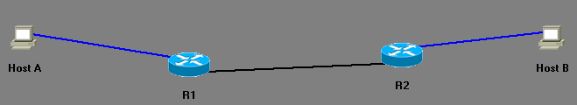
NAT/PAT实验内容
将内部一源地址静态转换成一外部地址
将内部源地址动态转换成地址池中的外部地址
将内部源地址动态转换成某一个外部地址
在主机上用telnet 连接外部设备后，用show ip nat trans检查转换记录，在外部路由器上可用show users查看连接源地址已被转换
将内部目的地址转换成另外一个外部地址，在主机上用telnet连接该内部目的地址，查看是否连接到对应的外部地址
10.0.0.2
12.0.0.2
E0: 12.0.0.1
S0: 11.0.0.1
E0: 10.0.0.1
S0: 11.0.0.2

Slide 21
（3）
Dynamic Host Configure Protocol

Slide 22
DHCP
Configuring a host, including:
  IP address
  Subnet mask
  Default gateway
  DNS server address
A
SRC MAC: MAC A
DST MAC: FFFFFFFFFF
SRC IP: ?
DST IP: 255.255.255.255
Server
UDP
67
CIADDR: ? GIADDR: ?
Mask: ? CHADDR: MAC A
SRC MAC: MAC Server
DST MAC: MAC A
SRC IP: Server IP
DST IP: 192.168.1.10
UDP
68
CIADDR: 192.168.1.10 GIADDR: ?
Mask: 255.255.255.0 CHADDR: MAC A

Slide 23
DHCP Features
Automatic Allocation
  DHCP assign a permanent IP address to a client
Manual Allocation
  Administrator assigned
Dynamic allocation
  DHCP assign an IP address to a client for a limited period of time (lease)

Slide 24
DHCP Operation
Allocation Steps
  Client send DHCP Discover (Broadcast)
  Server send DHCP Offer (Unicast)
  Client send DHCP Request (Broadcast), because maybe several server will receive the discover packet, so let every server know which offer was accepted
  Server send DHCP ACK or NAK (Unicast)
Address Duplicate
  Client send DHCP DECLINE if it detect the IP address is in use by other hosts
Address Release
  Client send DHCP Release when no longer need the IP address

Slide 25
Configure DHCP Operation
Define a pool
  Router(config)# ip dhcp pool name1
Specify the subnet of the pool
  Router(config-dhcp)# network ip-address mask
Specify the domain name for the client
  Router(config-dhcp)# domain-name domain
Specify the DNS server address for the client
  Router(config-dhcp)# dns-server address1 [address2 …. address8]
  Router(config-dhcp)# netbios-name-server address1 [address2 … address8]

Slide 26
Configure DHCP Operation(2)
Specify the default router
  Router(config-dhcp)# default-router address1 [address2 …. address8]
Specify the duration of the lease
  Router(config-dhcp)# lease days1|hours|minutes | infinite

Slide 27
Verify DHCP Operation
IOS Command
  Router> show ip dhcp binding
  Router> show ip dhcp conflict
  Router# show ip dhcp database
  Router> show ip dhcp server statistics
  Router# debug ip dhcp server events|packets|linkage

Slide 28
DHCP Relay
Let Router relay DHCP broadcast
  IOS Command: ip helper-address
  Forward following UDP service
    Time
    TACAS
    DNS
    DHCP Server
    DHCP Client
    TFTP
    NetBIOS Name Service / Datagram Service

Slide 29
DHCP Relay
A
SRC MAC: MAC A
DST MAC: FFFFFFFFFF
SRC IP: ?
DST IP: 255.255.255.255
UDP
67
CIADDR: ? GIADDR: ?
Mask: ? CHADDR: MAC A
Gateway 192.168.1.1/24
E0: ip helper-address 192.168.2.254
Gateway 192.168.2.1/24
Router
SRC MAC: MAC Router
DST MAC: MAC Server
SRC IP: 192.168.2.1
DST IP: 192.168.2.254
DHCP
Server
UDP
67
CIADDR: ? GIADDR: 192.168.1.1
Mask: ? CHADDR: MAC A
192.168.2.254/24

Slide 30
DHCP Relay
A
SRC MAC: MAC Router
DST MAC: MAC A
SRC IP: 192.168.2.254
DST IP: 192.168.1.10
UDP
68
CIADDR: 192.168.1.10 GIADDR: 192.168.1.1
Mask: 255.255.255.0 CHADDR: MAC A
Gateway 192.168.1.1/24
E0: ip helper-address 192.168.2.254
Gateway 192.168.2.1/24
Router
SRC MAC: MAC Server
DST MAC: MAC Router
SRC IP: 192.168.2.254
DST IP: 192.168.1.10
DHCP
Server
UDP
68
CIADDR: 192.168.1.10 GIADDR: 192.168.1.1
Mask: 255.255.255.0 CHADDR: MAC A
192.168.2.254/24

Slide 31
（4）
Point-to-Point Protocol

Slide 32
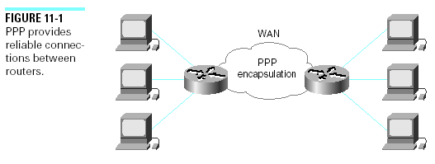
PPP Overview
PPP offers all the following features:
  - Provides for dynamic assignment of IP addresses
  - Network protocol multiplexing
  - Link configuration (data compression, MTU) and link quality testing, multilink binding
  - Error detection
  - Negotiation options such as network-layer address

Slide 33
PPP Components
Three main components resolve the problems of Internet connectivity
  A method for encapsulating datagrams over serial links.
  A Link Control Protocol (LCP) for establishing, configuring, and testing the data-link connection.
  A family of Network Control Protocols (NCPs)
    establishing and configuring different network-layer protocols.
    to allow the simultaneous use of multiple network-layer protocols. Fig. in next page

Slide 34
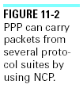
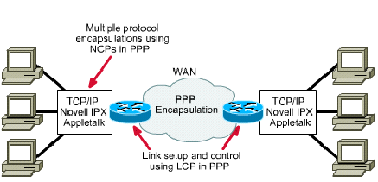
As shown in Figure below, PPP uses its NCP component to encapsulate multiple protocols.

Slide 35
PPP Layer Functions
With its lower-level functions, PPP can use
  Synchronous physical media, such as ISDN, T1, DDN.
  Asynchronous physical media, such as modem dialup connections.
Higher-layer protocols
  BCP -- Bridge Control Protocol
  IPCP -- Internet Protocol Control Protocol
  IPXCP -- Internetwork Packet Exchange Control Protocol

Slide 36
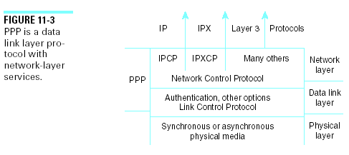
PPP Layered Architecture

Slide 37
PPP Session Establishment
The four phases through which PPP establishes a point-to-point connection
  1. Link establishment and configuration negotiation
  2. Link-quality determination
  3. Network-layer protocol configuration negotiation
  4. Link termination

Slide 38
Phase 1: Link Establishment and Configuration Negotiation
In this phase, each PPP device sends LCP packets to configure and establish the data link.
configuration option field: to negotiate the use of options, such as
  the maximum receive unit,
  compression of certain PPP fields,
  which authentication protocol to use.
If a configuration option is not included in an LCP packet, the default value for that configuration option is assumed.
This phase is complete when a configuration acknowledgment frame has been sent and received.

Slide 39
Phase 2: Link-Quality Determination
Each link is tested to determine whether the link quality is good enough to bring up network-layer protocols
the client or user workstation can be authenticated.
PPP supports two authentication protocols: (RFC 1334)
  Password Authentication Protocol (PAP)
  Challenge Handshake Authentication Protocol (CHAP).

Slide 40
Phase 3: Network-Layer Protocol Configuration Negotiation
The PPP devices send NCP packets
  to choose and configure one or more network-layer protocols (such as IP).
When a network-layer protocols has been configured, datagrams from that network-layer protocol can be sent over the link.
Check LCP and NCP states by using the show interfaces command.

Slide 41
Phrase 4: Link Termination
LCP can terminate the link at any time.
This is usually done at the request of a user;
It can also happen because of a physical event, such as the loss of a carrier or a timeout.

Slide 42
PPP Authentication
Authentication takes place before the network-layer protocol configuration phase begins.
you can select Password Authentication Protocol (PAP) or Challenge Handshake Authentication Protocol (CHAP).
In general, CHAP is the preferred protocol.

Slide 43
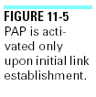
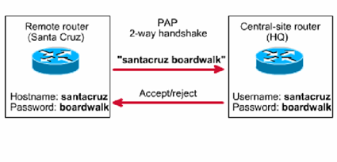
PAP
After the PPP link establishment phase is complete, a username/password pair is repeatedly sent by the remote node across the link until authentication is acknowledged or the connection is terminated
Passwords are sent across the link in clear text, and there is no protection from playback or repeated trial-and-error attacks.
------------------------------- configuration -----------------------------------
  Hostname santacruz; hostname HQ
  username HQ password username santacruz password boardwalk boardwalk
  interface s0 interface s0
  ppp authentication PAP; ppp authentication PAP

Slide 44
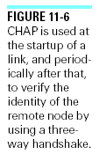
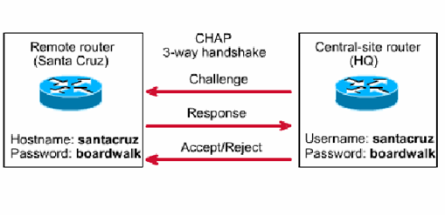
CHAP
After the PPP link establishment phase is complete, the host sends a challenge message to the remote node.
The remote node responds with a value.
The host checks the response against its own value.
If the values match, the authentication is acknowledged. Otherwise, the connection is terminated.

Slide 45
--------------------- CHAP configuration -------------Hostname santacruz; hostname HQ
  username HQ password username santacruz password boardwalk boardwalk
  interface s0 interface s0
  ppp authentication CHAP; ppp authentication CHAP

Slide 46
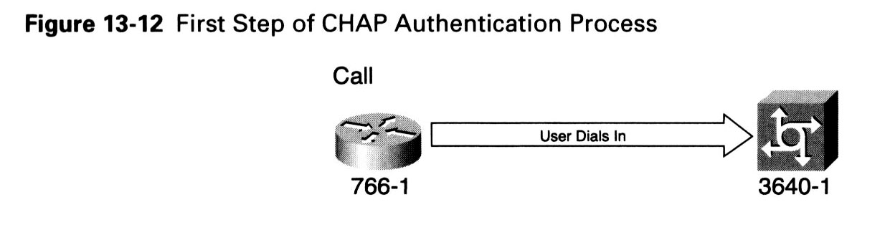
Procedure of CHAP Authentication
The call of router 766-1 comes in to 3640-1.
  766-1 and 3640-1 are router or access server.

Slide 47
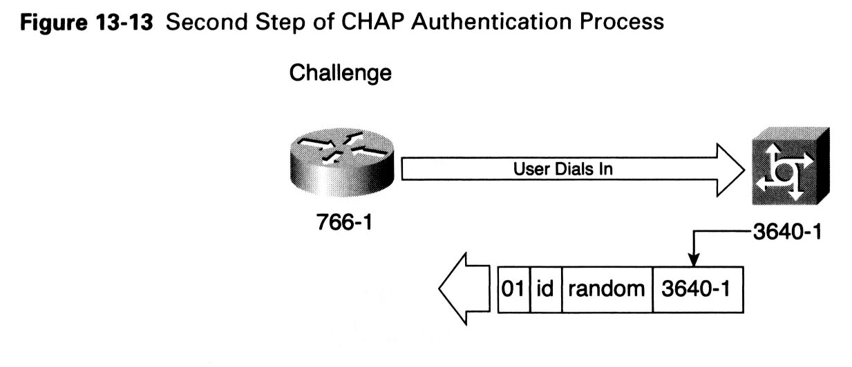
packet 1: A challenge packet is sent to the calling router.
  01 = type identifier of Challenge packet
  id = Sequential number of packet
  random = A random number that the router 3640-1 generates
  3640-1 = The host name of the challenger

Slide 48
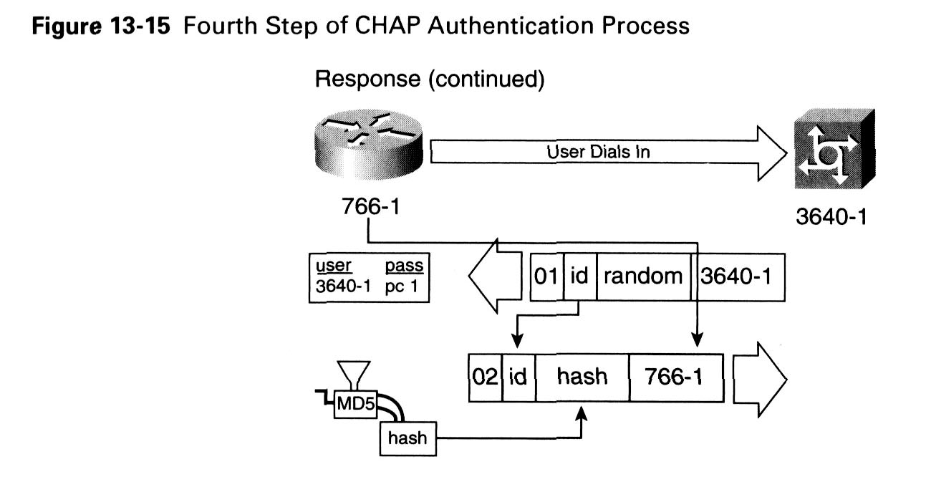
packet 2: The response packet is then sent to the 3640-1.
  02 = type identifier of CHAP response packet .
  id = Copied from the challenge packet.
  hash = The output of MD5 (id, random, pc1), pc1 is the password from CHAP configuration statement in 766-1:
    username 3640-1 password pc1

Slide 49
Router 3640-1 receives the response packet;
it then calculates hash value of itself:
  hash = MD5 (id, random, pc1), pc1 is the password from CHAP configuration statement in 3640-1:
    username 766-1 password pc1
  above “766-1” is obtained from response packet .
  above “id, random” is obtained from challenge packet.
It compares its hash value to the received hash value;
If they matches, the authentication is successful;
Otherwise, the authentication is failed.

Slide 50
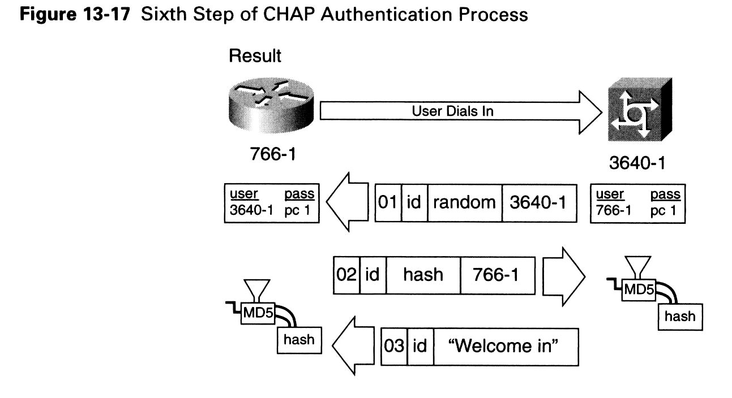
packet 3: The authentication success packet is sent to the 766-1.
  03 = CHAP success message type.
  id = Copied from the response packet (the second one).
  "Welcome in" = indicating success.

Slide 51
Comparison of CHAP and PAP
CHAP provides protection against playback attacks through the use of a variable challenge value that is unique and unpredictable.
  CHAP can be repeated any time.
  CHAP is more effective than PAP. PAP verifies only once, which makes it vulnerable to hacks and playback attacks.
PAP allows the caller to attempt authentication at will.
  CHAP does not allow a caller to attempt authentication without a challenge. A better feature.

Slide 52
Configure PPP Authentication
Step 1 define the username and password on each router
  Router(config)#username name password secret
    Name - the hostname of the remote router.
    Secret - the secret password must be the same
Step 2 Enter interface configuration mode for the desired interface
Step 3 Configure the interface for PPP encapsulation
  Router(config-if)# encapsulation ppp
Step 4 Configure PPP authentication
  Router(config-if)# ppp authentication {chap | chap pap | pap chap | pap}
Step 5 If CHAP and PAP are enabled, the first method specified is requested.
Step 6 In Cisco IOS Release 13.1 or later, PAP is disabled by default; to enable PAP, use the following command:
  Router(config-if)# ppp pap sent-username username password password

Slide 53
Suppose router HQ connects to two remote routers: santacruz (via s0) and chicago (via s1)
------------------- PAP configure examples ----------------
  Hostname santacruz; hostname HQ
  username HQ password username santacruz password boardwalk boardwalk
  username chicago password abc
  interface s0 interface s0
  encapsulation ppp encapsulation ppp
  ppp authentication PAP; ppp authentication PAP
  interface s1
  encapsulation ppp
  ppp authentication PAP

Slide 54
Suppose router HQ connects to two remote routers: santacruz (via s0) and chicago (via s1)
------------------- CHAP configure examples ----------------
  Hostname santacruz; hostname HQ
  username HQ password username santacruz password boardwalk boardwalk
  username chicago password abc
  interface s0 interface s0
  encapsulation ppp encapsulation ppp
  ppp authentication CHAP; ppp authentication CHAP
  interface s1
  encapsulation ppp
  ppp authentication CHAP

Slide 55
Configuring CHAP Authentication
we can use the same hostname on multiple routers
  Router(config-if)# ppp chap hostname hostname
we can use a password to authenticate to an unknown host
  Router(config-if)# ppp chap password secret
  This password will be sent to hosts that want to authenticate the router. (路由器只会被动使用本口令）
  This password is not used when the router authenticates a remote device. . (不会主动使用本口令）

Slide 56
Suppose router HQ connects to two remote routers: santacruz (via s0) and chicago (via s1)
------------------- CHAP configure examples ----------------
  Hostname santacruz; hostname HQ
  interface s0 interface s0
  encapsulation ppp encapsulation ppp
  ppp authentication CHAP; ….
  ppp chap hostname allhost interface s1
  ppp chap password xyz encapsulation ppp
  ppp authentication CHAP
  ppp chap hostname allhost
  ppp chap password xyz

Slide 57
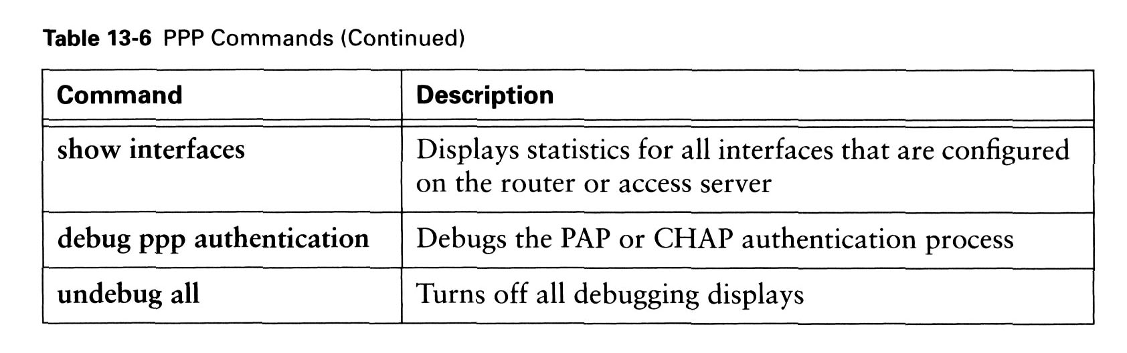
Verifying PPP Configuration
config command to indicate which protocol of data link layer to use:
  encapsulation HDLC
  encapsulation PPP
show and debug command

Slide 58
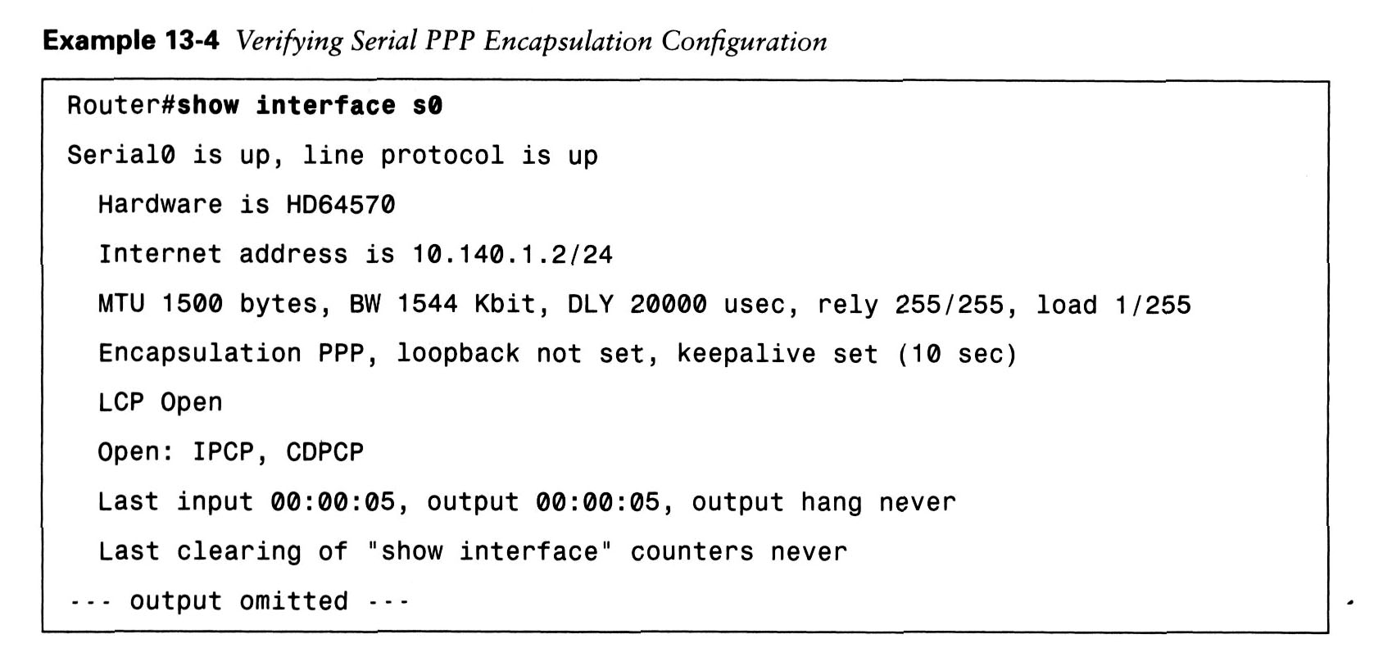
Use the show interface command
  to verify proper configuration of HDLC or PPP encapsulation, as shown in Example 13-4.

