Slide 1
Chapter 3: The Datalink Layer
Qiu Jinsong
Computer Department
Zhejiang University
jinsongqiu@hotmail.com

Slide 2
Design Issues
Service Interface
Framing
Error Control
Flow Control

Slide 3
Functions of the Data Link Layer
Provide service interface to the network layer
Dealing with transmission errors
Regulating data flow
  Slow receivers not swamped by fast senders

Slide 4
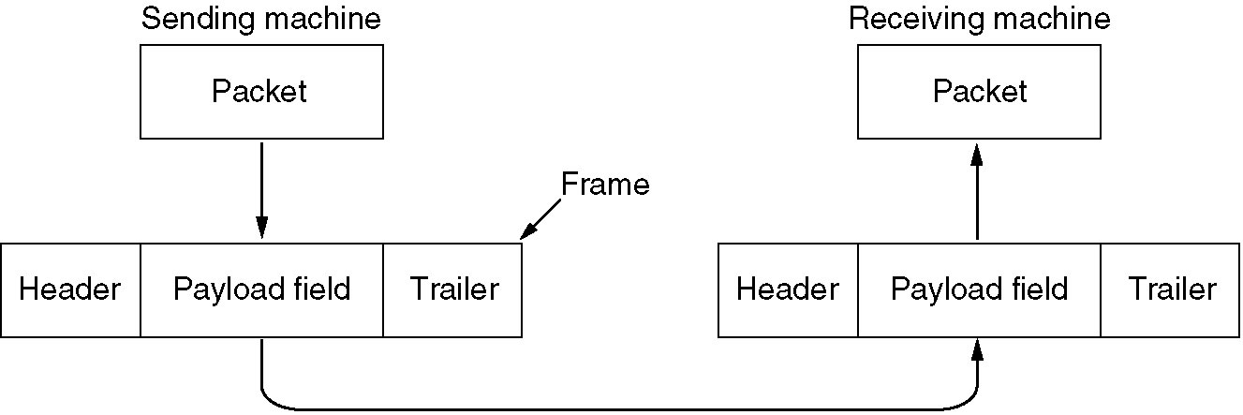
Relationship between packets and frames
.

Slide 5
Services Provided to Network Layer
Unacknowledged Connectionless Service
Acknowledged Connectionless Service
Acknowledged Connection-oriented Service

Slide 6
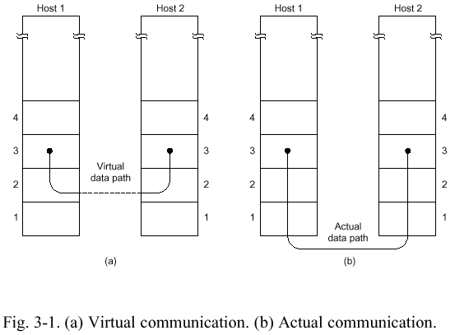
Virtual Communcaiton

Slide 7
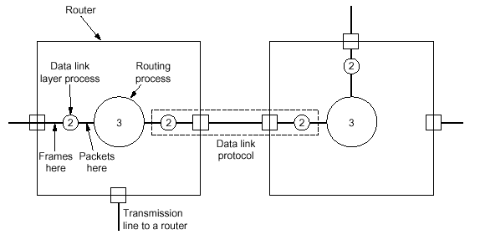
Placement of Datalink Protocol

Slide 8
Framing
Character Count
Starting and ending character, with character stuffing
Starting and ending flags, with bit stuffing
Physical layer coding violations

Slide 9
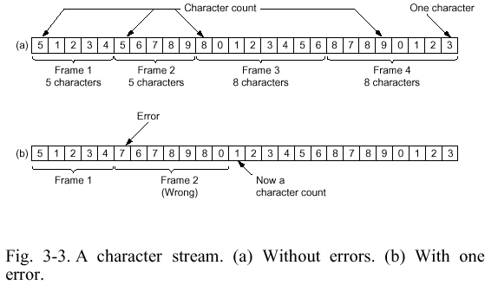
Character Count

Slide 10
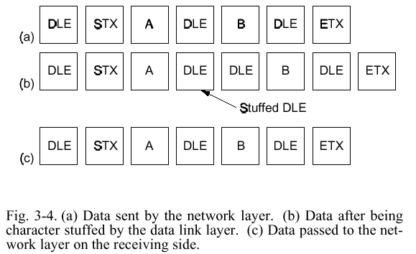
Starting and ending character, with character stuffing

Slide 11
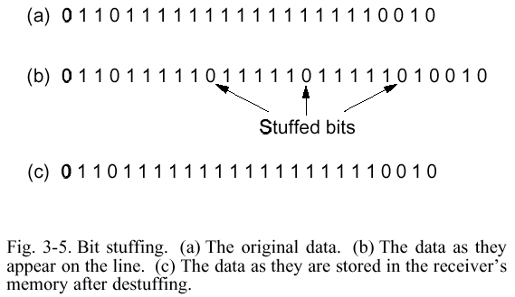
Starting and ending flags, with bit stuffing

Slide 12
Error Control
Error Correcting
Error Detecting, With Retransmission
Duplicate
Lost

Slide 13
Error Correcting Code
Single Error
Burst Error
Hamming Distance
  Codeword
  Dectect d bits error, need d+1 distance coding
  Correct d bits error, need 2d+1 distance coding
Parity Check
Hamming Code
10001001
Xor 10110001
00111000 d=3
Even: 10001100 0 Odd:100011001

Slide 14
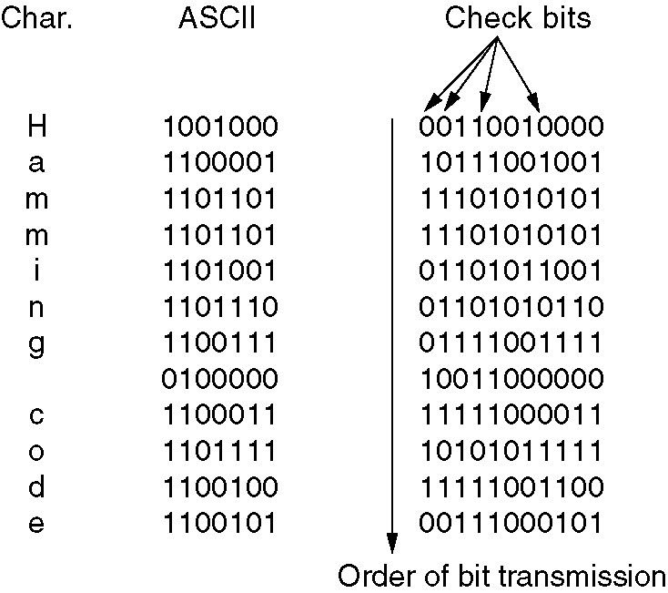
Hamming Code
1 2 3 4 5 6 7 8 9 10 11
x1 x2 d1 x3 d2 d3 d4 x4 d5 d6 d7
D7(11=1+2+8) checked by x1,x2,x4
Data: 1001000
x1 x2 1 x3 0 0 1 x4 0 0 0
Use of a Hamming code to correct burst errors
.

Slide 15
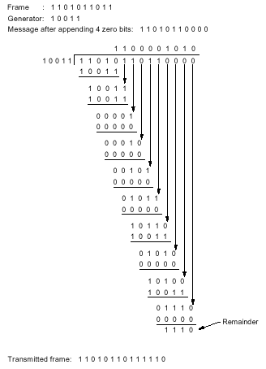
Cyclic Redundancy Check(CRC)
Modulo 2 Division
Check Remainder
Polynomial Representation
543210
||||||
110101 = x⁵+x⁴+x²+1
1101 1001 0011 = x¹¹+x¹⁰+x⁸+x⁷+x⁴+x+1
11 10 9 8 1 0

Slide 16
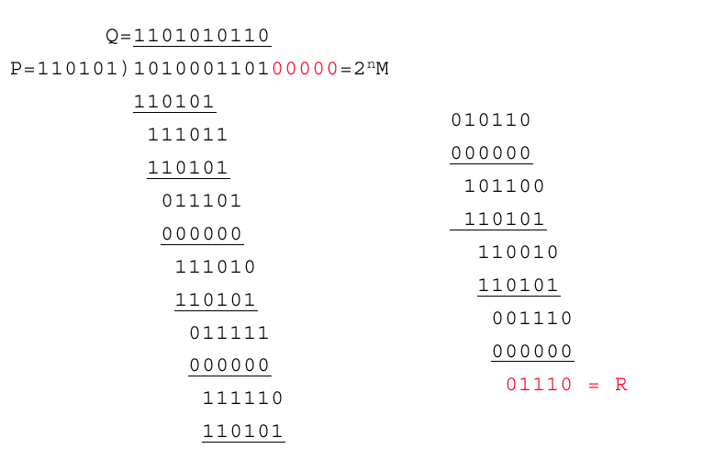
Modulo 2 Division

Slide 17
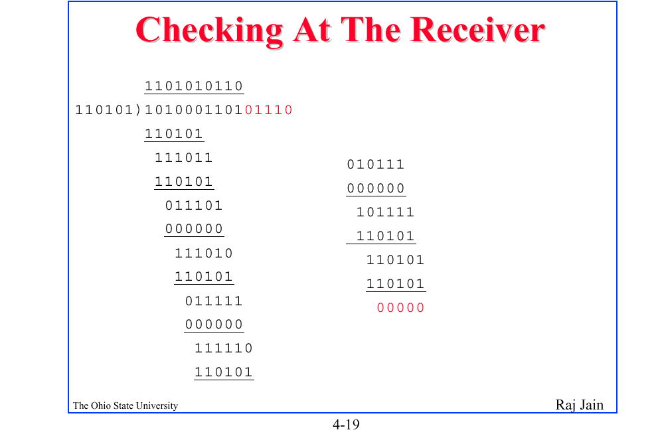
Checking at the receiver

Slide 18
Popular Generator Polynomials
CRC-12 = x¹²+x¹¹+x³+x²+x¹+1
CRC-16 = x¹⁶+x¹⁵+x²+1
CRC-CCITT = x¹⁶+x¹²+x⁵+1

Slide 19
Stop-and-Wait(Normal)
A
B
Data
ACK
Data next
ACK
Data following

Slide 20
Stop-and-Wait(Data Error)
A
B
Data
NAK
Data(Retransmission)
ACK
Data next

Slide 21
Stop-and-Wait(Data Lost)
A
B
Data
Data(Retransmission)
Time Out
ACK
Data next

Slide 22
Stop-and-Wait(ACK Lost)
A
B
Data
ACK
Data(Retransmission)
Time Out
Discard this Data
ACK
Data next

Slide 23
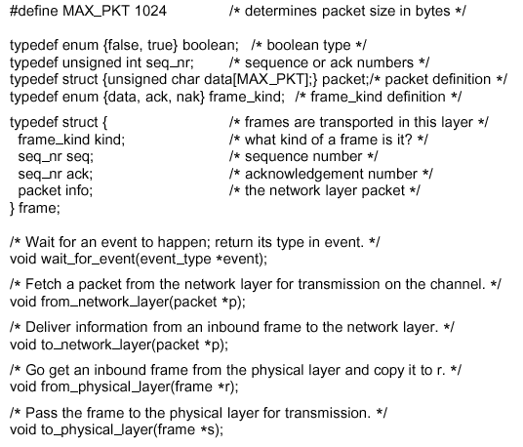
Protocol Programing

Slide 24
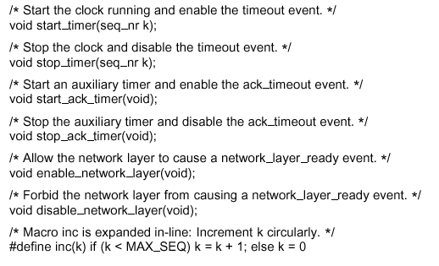
Protocol Programing

Slide 25
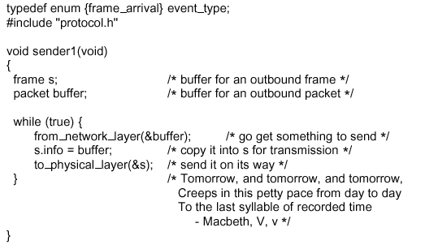
Unrestricted Simplex Protocol
---Sender

Slide 26
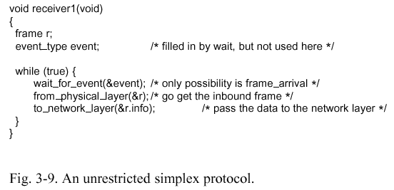
Unrestricted Simplex Protocol
---Receiver

Slide 27
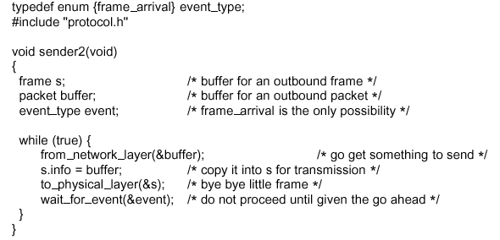
Simplex Stop-and-Wait Protocol
---Sender

Slide 28
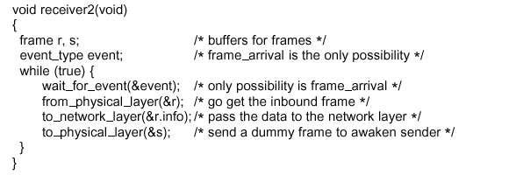
Simplex Stop-and-Wait Protocol
---Receiver

Slide 29
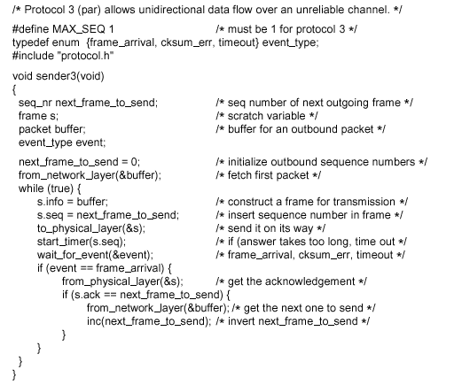
ARQ Protocol---Sender
Automatic Repeat Request(ARQ)

Slide 30
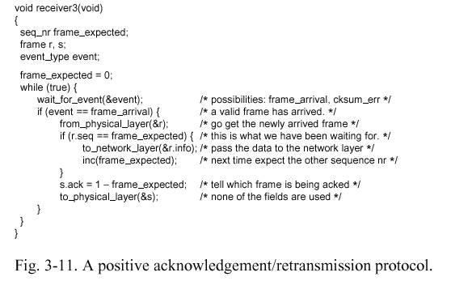
ARQ Protocol---Receiver

Slide 31
Utlization of Stop-and-wait
A
B
T_{frame}
Data
T_{prop}
ACK
Utilization =
T_{frame}
－－－－－－－－－
2 T_{prop} + T_{frame}
T_{prop} =
Distance
--------------------
Speed of Signal
Data next
ACK
= T_{prop} / T_{frame}
T_{frame} =
Frame size
---------------
Bit rate
Utilization = 1 / (2 α + 1)

Slide 32
Utilization Sample
Satellite Link: Propagation Delay t_{prop} = 270 ms
  Frame Size = 4000 bits
  Data rate = 56 kbps ⇒ t_{frame} = 4/56 = 71 ms
α = t_{prop} /t_{frame} = 270/71 = 3.8
  U = 1/(2α +1) = 0.12
Short Link(1 km) : t_{prop} = 5 μs
  Frame Size= 4000 bits
  Data rate=10 Mbps ⇒ t_{frame} = 4k/10M= 400 μ s
  α = t_{prop} /t_{frame} =5/400=0.012
  U = 1/(2α+1) = 0.98

Slide 33
Sliding Window Protocols
A
B
Data 1
Data 2
ACK 1
Data 3
ACK 2
Data 4
ACK 3
Data 5
ACK 4
Data 6
ACK 5
ACK 6

Slide 34
Utlization of Sliding-window
A
B
T_{frame}
Data 1
T_{prop}
Data …
Utilization =
N T_{frame}
－－－－－－－－－
2 T_{prop} + T_{frame}
Data N
Data
Data
Data
Utilization =
N / (2 α + 1)
1 (if N > (2 α + 1))

Slide 35
Sliding Window
Window = Set of sequence numbers to send/receive
Sender window
  Sender window increases when ack received
  Packets in sender window must be buffered at Source
  Sender window may grow in some protocols

Slide 36
Piggybacking
A
B
Data 1
Data 2
Data 3
ACK 1
ACK +Data
Data

Slide 37
Sliding Window (Transmitter)
Frames already transmitted
Frames may be transmitted
…
0
1
2
3
4
5
6
7
0
1
2
3
4
5
6
7
…
Frame
Sequence
Number
Frame
Sequence
Number
Window shrinks
from trailing edge
as frames are sent
Window expands
from leading edge as
acknowledgments
are received
Last
Frame
Transmitted
…
0
1
2
3
4
5
6
7
0
1
2
3
4
5
6
7
…

Slide 38
Sliding Window (Receiver)
Frames already received
Frames may be received
…
0
1
2
3
4
5
6
7
0
1
2
3
4
5
6
7
…
Frame
Sequence
Number
Frame
Sequence
Number
Window shrinks
from trailing edge
as frames are received
Window expands
from leading edge as
acknowledgments
are sent
Last
Frame
acknowledged

Slide 39
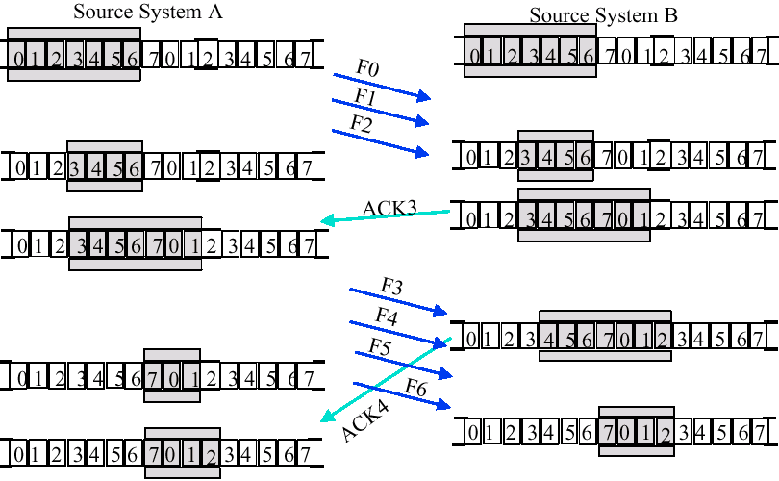
Sliding Window Example

Slide 40
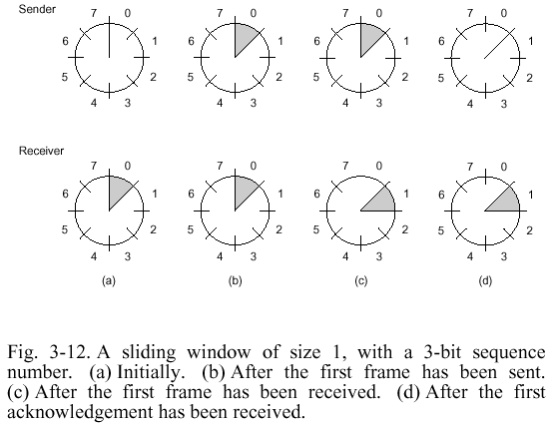
Sliding Window

Slide 41
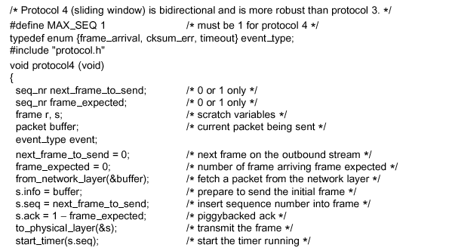
Programing of 1 Bit Sliding Window Protocol

Slide 42
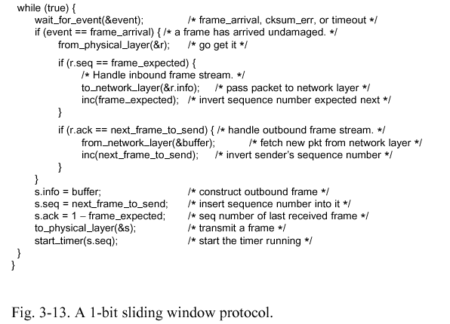
Programing of 1 Bit Sliding Window Protocol

Slide 43
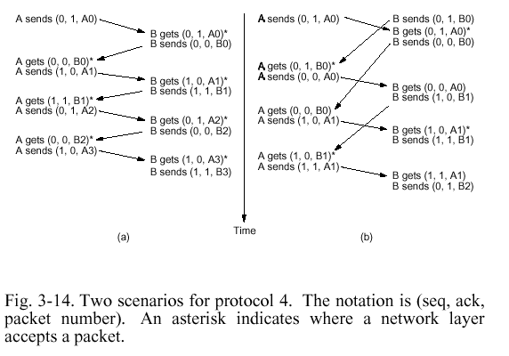
Problem of Protocol 4
Normal Scenarios
(seq, ack, packet number)
Not Simultaneously →
duplicate send packet

Slide 44
Go-back-N ARQ(Data Error)
A
B
Data 1
1 buffer
Data 2
ACK 1
Time Out
Data 3
Discard 2
Discard 3
Data 4
Resend Data 2
Discard 4
Resend Data 3
ACK 2
ACK 3

Slide 45
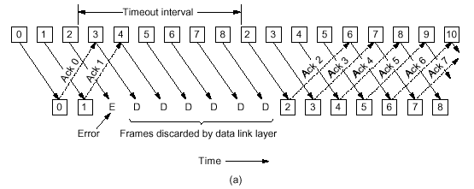
Go-Back-N ARQ

Slide 46
Window Size of Go-Back-N
Receive Window Size=1
Send Window Size <= MAX_SEQ (0…N)
0
0
1
1
2
Time Out
2
3
3
4
4
5
5
lost
ACK 5
ACK 5
0
0
new
Send to
Network layer
resend
discard

Slide 47
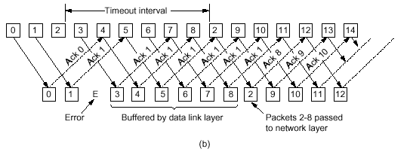
Selective Repeat ARQ

Slide 48
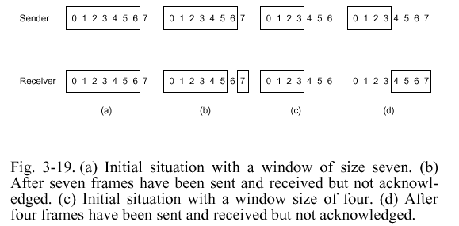
Window Size of Selective Repeat ARQ
Send Window Size <= (MAX_SEQ+1)/2
Receive Window Size = Send Window Size
Receive Buffer Number = Window Size
Send 7 packets
Time out resend
Ack all lost
Get 7 packets
Is new or resend?
Init window
New window

Slide 49
HDLC
Bit-Oriented Protocol
Family
  Synchronous Data Link Control (SDLC): IBM
  High-Level Data Link Control (HDLC): ISO
  Link Access Procedure-Balanced (LAPB): X.25
  Link Access Procedure for the D channel (LAPD): ISDN
  Point-to-Point Protocol (PPP): Internet
  Logical Link Control (LLC): IEEE
  Advanced Data Communications Control Procedures (ADCCP): ANSI

Slide 50
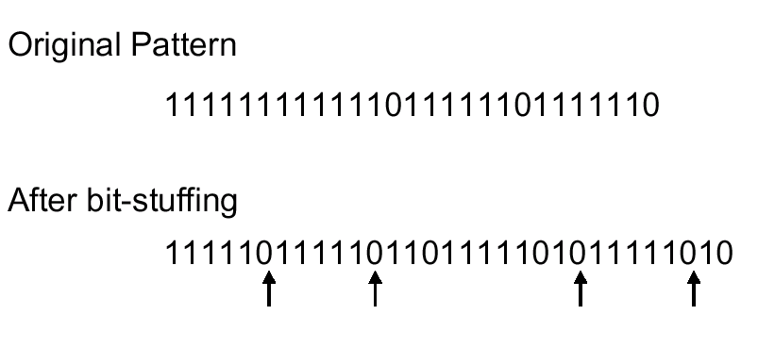
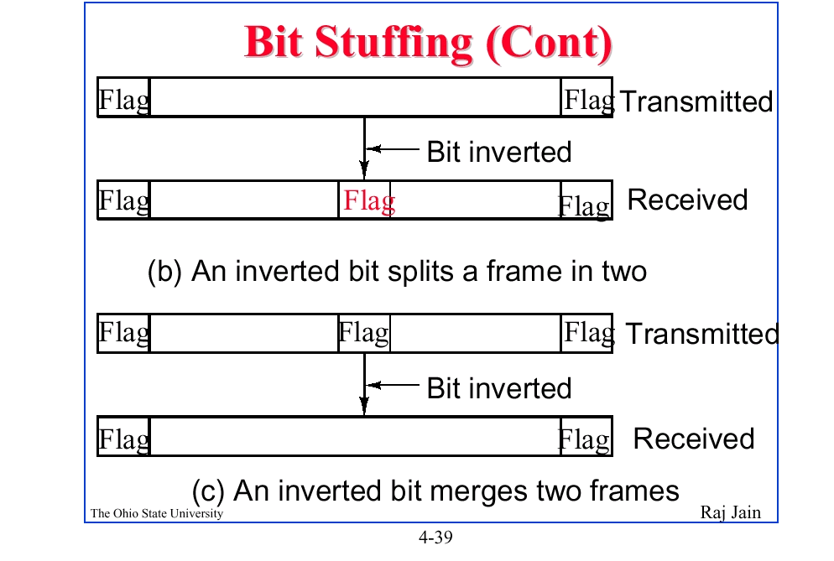
Bit Stuffing

Slide 51
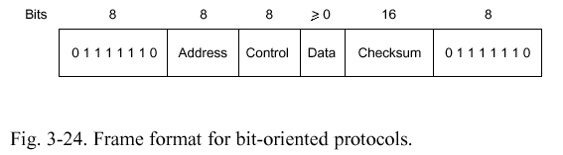
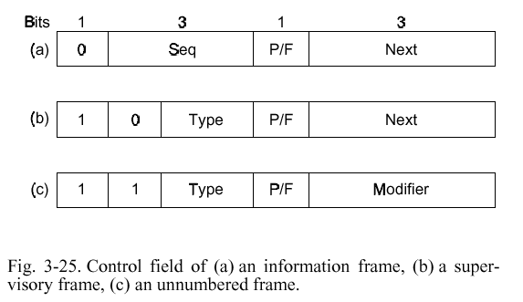
HDLC Frame Format
Information
Frame
Supervisory
Frame
Unnumbered
Frame

Slide 52
HDLC Frames
Information Frames: User data
  Piggybacked Acks: Next frame expected
  Poll/Final = Command/Response
Supervisory Frames: Flow and error control
  Go back N and Selective Reject
  Final → No more data to send
  Recieve Ready (RR)、Recieve Not Ready (RNR)
  Reject (REJ)、Selective Reject (SREJ)
Unnumbered Frames: Control
  DISConnect、Frame Reject、Unumbered Ack
  Mode setting commands and responses, …

Slide 53
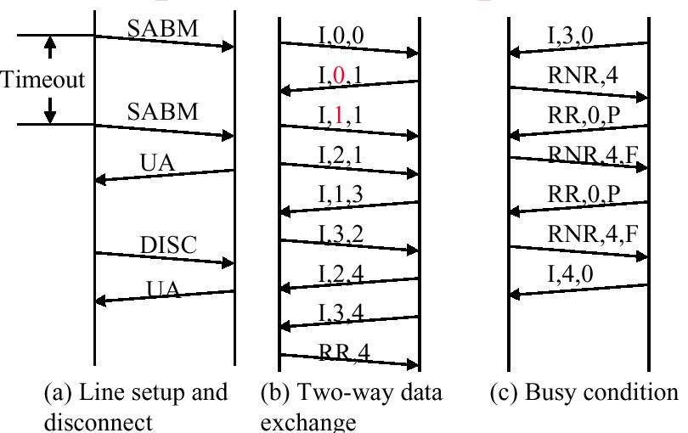
HDLC Example
RR,

Slide 54
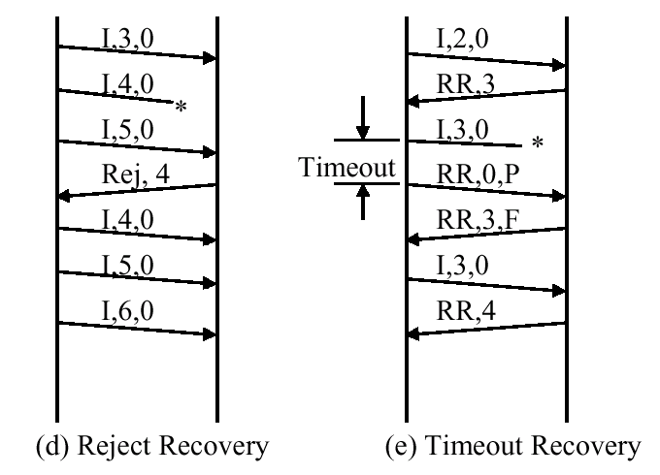
HDLC Example (cont)

Slide 55
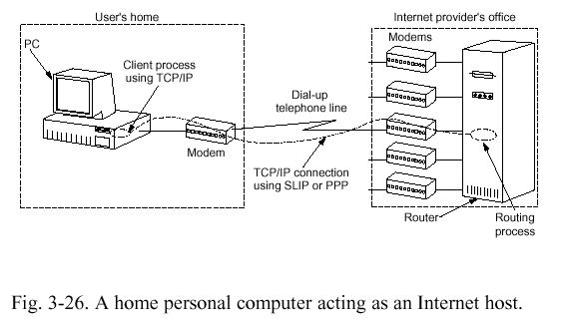
Data Link Layer in Internet

Slide 56
SLIP
Seial Line IP
Problems
  No Error Detection and Correction
  Support Only IP
  Each Side Must Know Peer’s IP Address Advance
  No Dynamically Assigned During Setup
  No Authentication
  Not An Approved Internet Standard

Slide 57
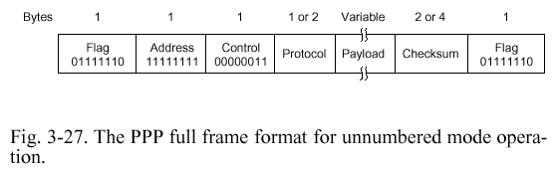
PPP
Point-to-Point Protocol
Authentication During Connection Time
Support Multiple Network Protocols (IP, IPX)
Error Detection
Dynamically Assigned IP Address During Setup
Character-Oriented Protocol
Link Control Protocol
Network Control Protocol

Slide 58
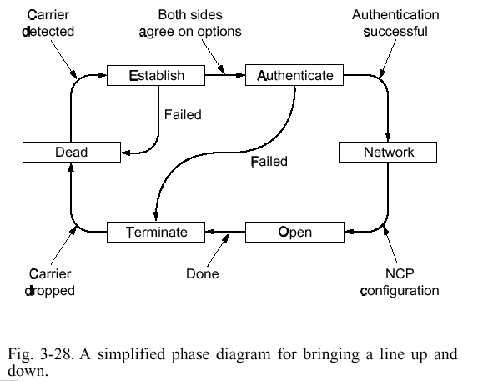
PPP State

Slide 59
Summary
Framing
Flow Control
Error Control
Sliding Window
  Go-Back-N
  Selective Repeat
Protocol Programing
HDLC
PPP

Slide 60
Exercise
5. A bit string, 0111101111101111110, needs to be transmitted at the data link layer. What is the string actually transmitted after bit stuffing?
6. When bit stuffing is used, is it possible for the loss, insertion, or modification of a single bit to cause an error not detected by the checksum? If not, why not? If so, how? Does the checksum length play a role here?

Slide 61
Exercise
15. A bit stream 10011101 is transmitted using the standard CRC method described in the text. The generator polynomial is x³+1. Show the actual bit string transmitted. Suppose the third bit from the left is inverted during transmission. Show that this error is detected at the receiver’s end.

Slide 62
Exercise
16. Data link protocols almost always put the CRC in a trailer rather than in a header. Why?
17. A channel has a bit rate of 4 Kbps and a propagation delay of 20 msec. For what range of frame sizes does stop-and-wait give an efficiency of at least 50 percent?
  Transmit time (T1) = frame size / 4000
  Round trip propagation delay (T2) = 2 * 20 ms
  Efficiency = T1 / (T2 + T1) = 50%
  So, T1 should equal T2, the frame size > 160 bits

