Slide 1
Chapter 4:
The Medium Access Sublayer
Qiu Jinsong
Computer Department
Zhejiang University
jinsongqiu@hotmail.com

Slide 2
Channel Type
Point-to-Point Connection
Broadcast Channel
  Multiaccess Channel
  Random Access Channel
Medium Access Control sublayer

Slide 3
Channel Allocation
Static Channel Allocation(FDM/TDM)
Dynamic Channel Allocation

Slide 4
Static Channel Allocation
Simple and efficient when: small and fixed number of users, heavy load of traffic
Spectrum wasted、Inefficient when: large and varying number of users, bursty traffic
Mean delay of frames for single channel : T=1/(C- )
   = arrival rate of frames (frames/sec)
  1/ = mean length of frames (bits/frame)
  C = capacity of channel (bits/sec)
If the channel divide into N subchannel using FDM, then T_{FDM} = 1/((C/N) – (/N)) = N/(C- ) = NT

Slide 5
Dynamic Channel Allocation
5 key assumptions
  Station model: N Station, generate frame, send frame
  Single Channel Assumption: All Stations using same one
  Collision: Frame overlap in time will be garbled
  Continuous Time vs Slotted Time
    No master clock dividing time into discrete interval
    Time is divided into discrete interval (time slots)
  Carrier Sense vs No Carrier Sense
    Stations can tell if the channel is in use before trying to use
    Stations cannot sense the channel before trying to use it, only later can determine whether successful

Slide 6
Multiple Access Protocols
ALOHA
Carrier Sense Multiple Access Protocols
Collision-Free Protocols
Limited-Contention Protocols
Wavelength Division Multiple Access Protocols
Wireless LAN Protocols
Digital Cellular Radio

Slide 7
ALOHA
Pure ALOHA
  Frames send at arbitrary times
  Not require global time synchronization
Slotted ALOHA
  Time is divided into discrete slots
  All frames must send at start of slot
  Require global time synchronization

Slide 8
Pure ALOHA
A
B
C
D
E
Collision
resend

Slide 9
Efficiency of Pure ALOHA
S = Ge^{-2G}
  Frame Time T: Time needed to send frame
  Throughput S: Frames sended successful per T
  Load G : Frames generated (new + resend) per T
S
0.18
0.10
0
0.5
1.0
1.5
2.0
G

Slide 10
Slotted ALOHA
A
B
C
D
E
Time slot
collision
resend

Slide 11
Efficiency of Slotted ALOHA
S=Ge^{-G}
S(Throughput per frame time)
0.368
0
1.0
1.5
2.0
G(Attempts per frame time)

Slide 12
CSMA
CSMA
  Listen to the channel before send data
  If collison, wait a random time and try again
1-persistent CSMA
  If channel idle, send data
  If channel busy, wait until channel idle
Nonpersistent CSMA
  If channel idle, send data
  If channel busy, wait random time and try again
p-persistent CSMA: for slotted channel
  If channel idle, send data with probability p, or defer until next slot with probability 1-p, and try again
  If channel busy, wait next slot and try again

Slide 13
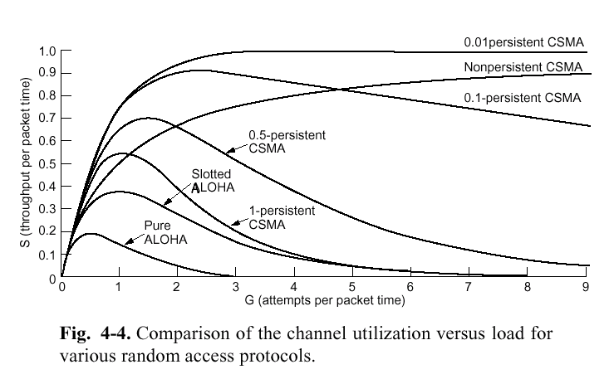
Efficiency of CSMA

Slide 14
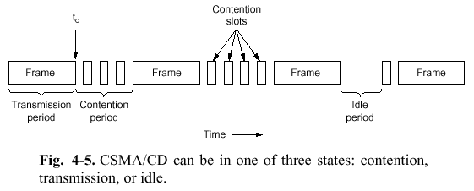
CSMA/CD
CSMA with Collision Detected
  Detect collision when sending
  If collision detected, abort tranmission, wait random time, and try again
States: Contention, Transmission, Idle

Slide 15
Collision Detecting
Seize: when a station sending, others wait
Collision detect: Read back to check if different from what sended
To detect collision, sending time must > 2 , otherwise if sending has finished before data coming back, sender cannot detect collision
collision
Sending time
1km
Propagate time in cable is 

Slide 16
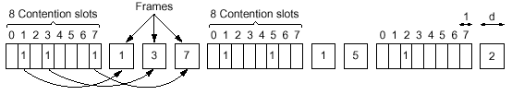
Collison-Free Protocols
Bit-Map Protocol

Slide 17
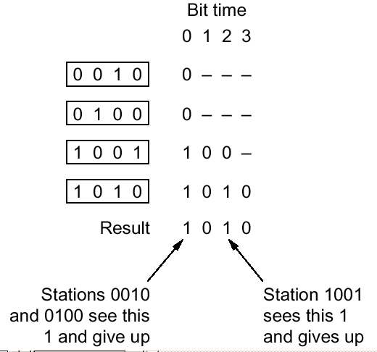
Collison-Free Protocols
Binary Countdown

Slide 18
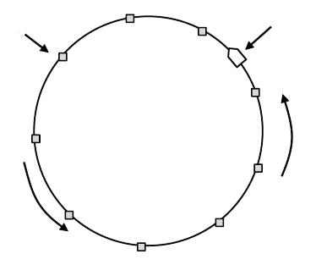
Collision-Free Protocols
Token
Station
Direction of
transmission
Token ring

Slide 19
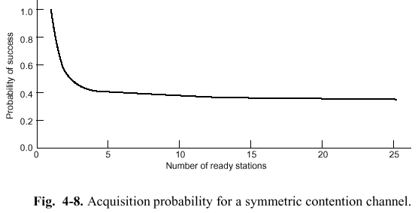
Limited-Contention Protocols
Asymmetric Protocols vs Symmetric Protocols

Slide 20
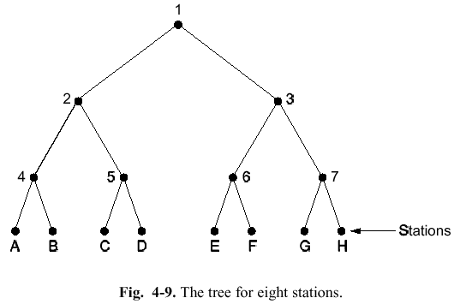
Limited-Contention Protocols
Adaptive Tree Walk Protocol

Slide 21
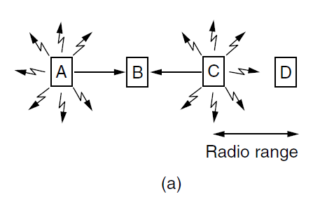
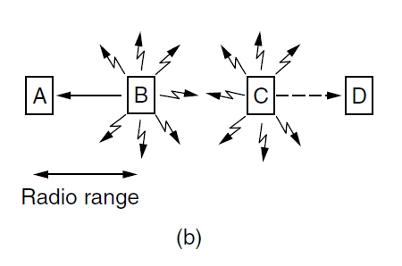
Wireless LAN Protocols
Hidden station problem
Exposed station problem

Slide 22
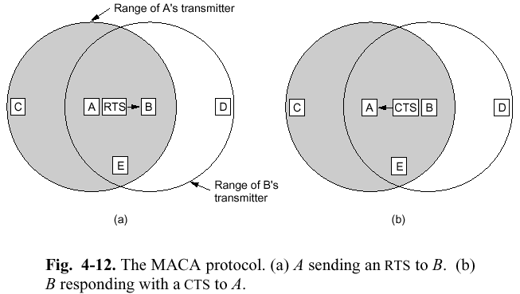
MACA
Multiple Access with Collision Avoidance

Slide 23
802.3 and Ethernet
1-persistent CSMA/CD
Ethernet (10Mbps) : by Xerox, DEC and Intel
Differ between 802.3 and Ethernet
  802.3 is a whole family 1-persistent CSMA/CD running at speeds from 1-10Mbps on various medias
  The 802.3 length field is used for packet type in Ethernet

Slide 24
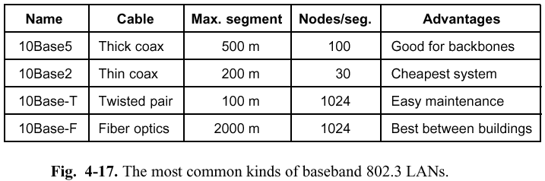
802.3 Cabling

Slide 25
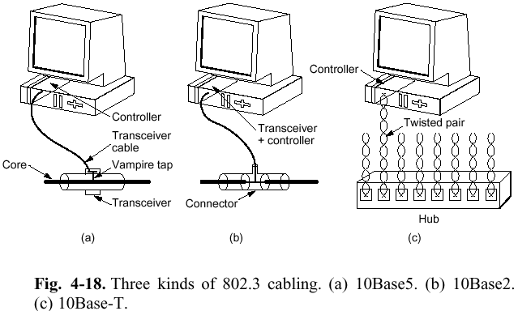
10Base5 10Base2 10Base-T

Slide 26
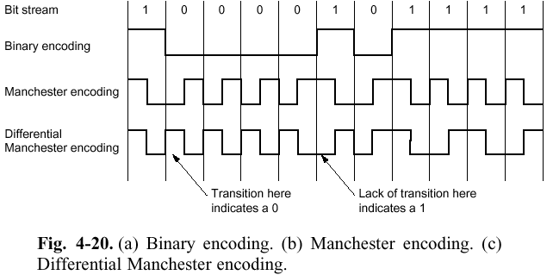
Binary Encoding in 802.3

Slide 27
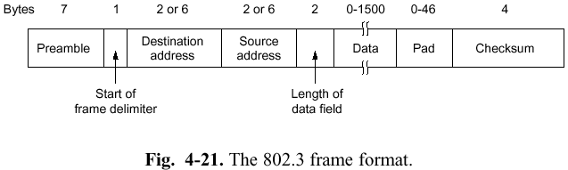
802.3 Frame Format
Filled if data length
< 46bytes
10101010
*7
10101011
0-1500,
if >1500, is packet type (DIX Ethernet)
(DIX: 10101010)
All 1 bits: broadcast address
Address Space: 2⁴⁸⁻², about 7 * 10¹³

Slide 28
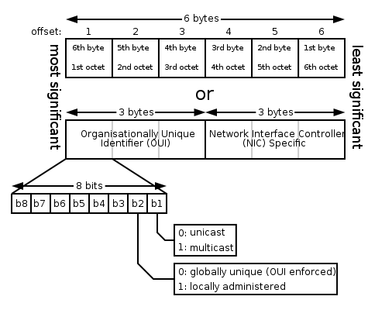
MAC Address
high-order bit

Slide 29
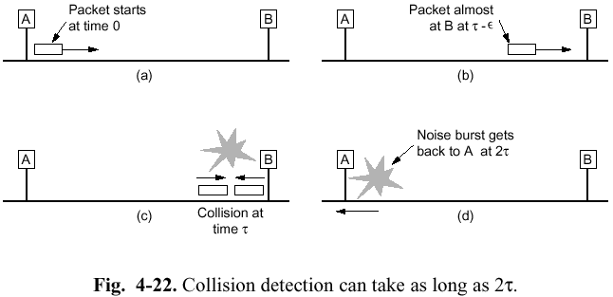
Collision Detection

Slide 30
Binary Exponential Backoff Algorithm
Longest path allowed in 802.3
  2.5km and 4 repeaters
After collision, time is divided into slot time
  In 802.3 is 51.2µsec
After i collision, random number slot time is chosen between {0～2^{i}-1}
  After 10 collision, 0～1023
  After 16 collision, failed and report

Slide 31
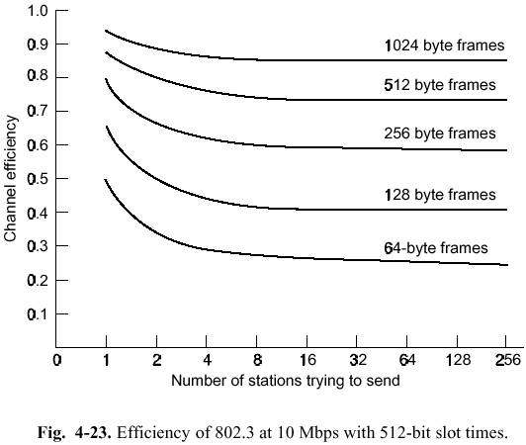
Efficiency of 802.3
(10Mbps, 512bits slot times)

Slide 32
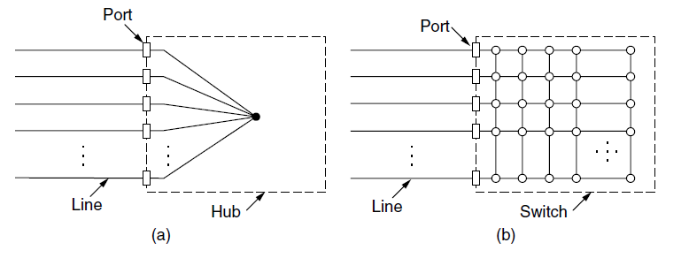
Switched Ethernet (1)
(a) Hub. (b) Switch.

Slide 33
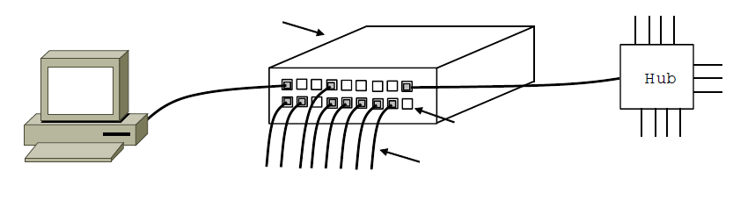
Switched Ethernet (2)
Switch
Hub
Switch ports
Twisted pair
An Ethernet switch.

Slide 34
How the LAN Switch Works
Retransmission according table
Establish the table via auto learn
  Record which source address input from which port
Cut-through
  Only check destination address
Whole buffered
  Check frame length, checksum

Slide 35
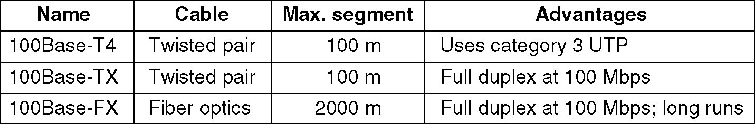
Fast Ethernet (802.3u)
The original fast Ethernet cabling.
Backward compatible with existing Ethernet LANs
Using CSMA/CD as 802.3
Encoding scheme: 4B/5B, signal rate needed is 100M*5/4=125M

Slide 36
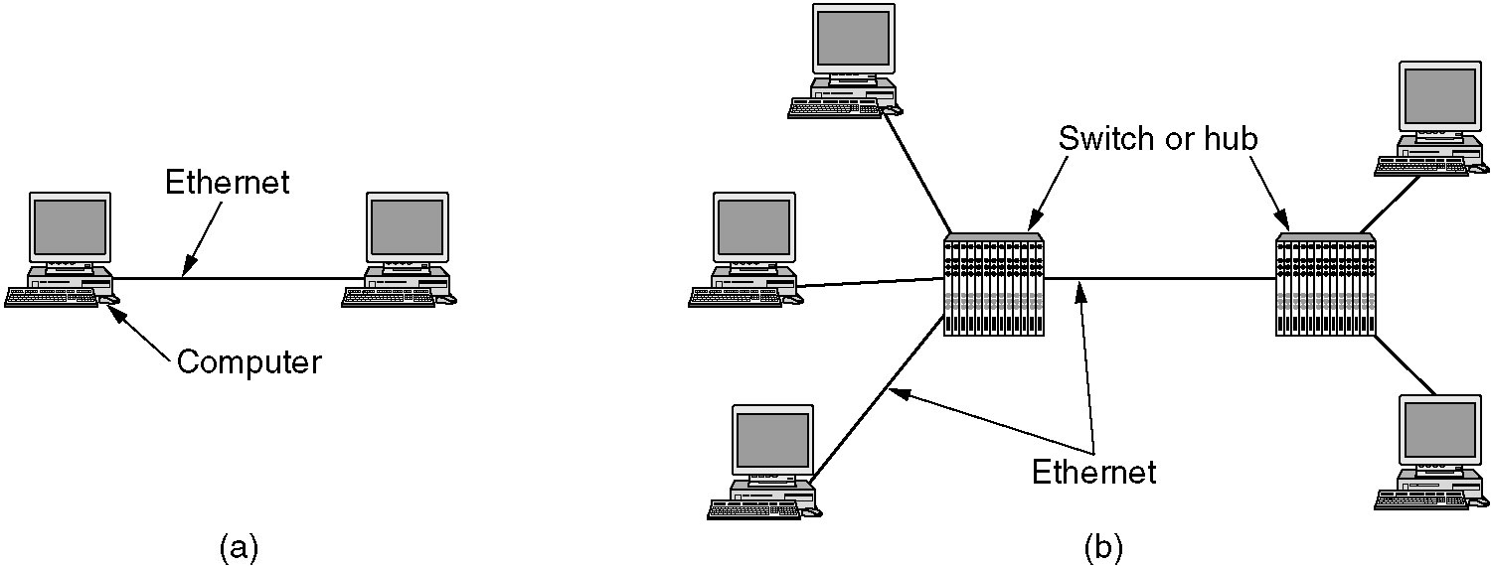
Gigabit Ethernet (802.3z)
Two configuration (Point-to-point)
  A two-station Ethernet
  A multistation Ethernet
Two operation mode
  Full-duplex: no contention, CSMA/CD not used
  Half-duplex: min frame: 64bytes, max distance: 25m
    How to get 2500 meter distance with 64bytes-min-frame required
      Carrier extension
      Frame bursting
Flow control (type of 0x8808 frame used to tell sender pause)

Slide 37
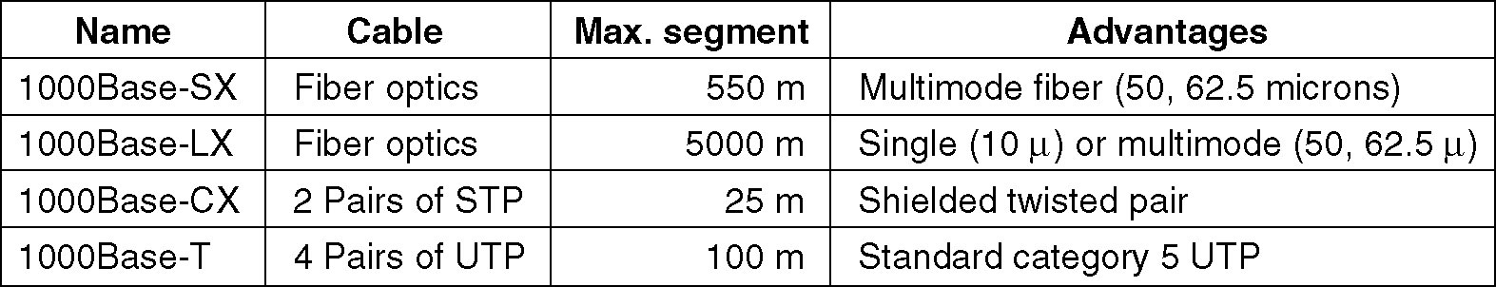
Gigabit Ethernet Cabling
Encode Scheme:
Fiber: 8b/10b encoding scheme, each codeword not more than six 1s or 0s, so signal rate needed is only 1G*10/8=1.25G,
not 1G*2=2G(Mancherster encoding scheme)
UTP: 4 symbol transmitted in parallel, each symbol has one of 5 voltage levels, each encode 2 bits or 1 control signal, so data rate is 125M*4*2=1Gbps

Slide 38
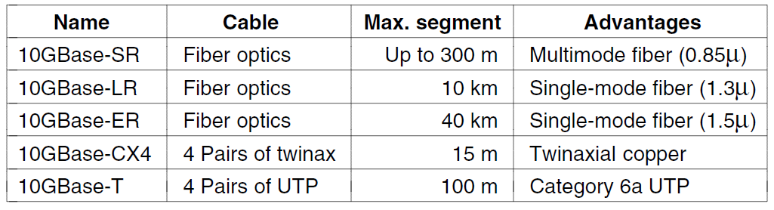
10 Gigabit Ethernet
Encode Scheme: 64B/66B
No CSMA/CD
Full-duplex only
…More: 40G, 100G

Slide 39
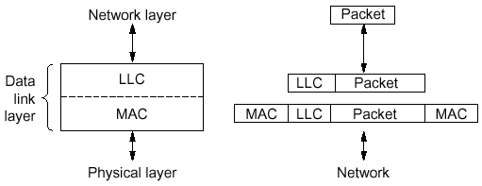
802.2 and LLC
Three Services:
  unreliable datagram,
  acknowledged datagram,
  reliable connection-oriented
Hide difference between
various 802 networks, provide
single interface to network layer

Slide 40
Wireless LANs
The 802.11 Protocol Stack
The 802.11 Physical Layer
The 802.11 MAC Sublayer Protocol
The 802.11 Frame Structure
Services

Slide 41
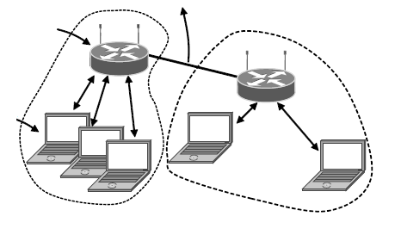
802.11 Architecture and Protocol Stack (1)
To Network
Access
Point
Client
802.11 architecture – infrastructure mode

Slide 42
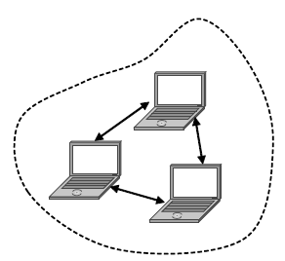
802.11 Architecture and Protocol Stack (2)
802.11 architecture – ad-hoc mode

Slide 43
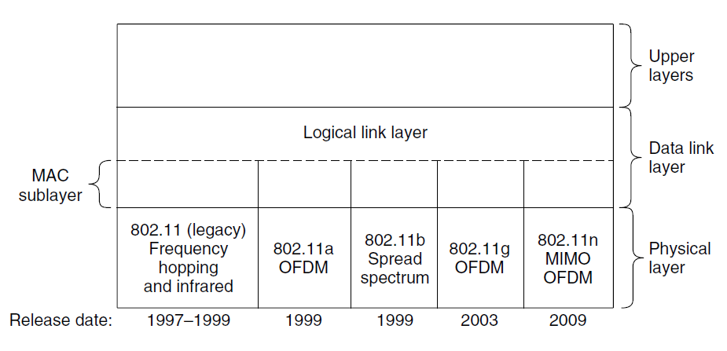
The 802.11 Protocol Stack
Infrared option use diffused transmission at 0.85-0.95 microns, data rate 1M-2M bps
FHSS, DSSS use 2.4GHz ISM (Industrial, Scientific, Medical) band (not require licensing)
802.11a OFDM use 5Ghz ISM band, data rate 54Mbps
802.11g OFDM use 2.4GHz ISM band, data rate 54Mbps in theory

Slide 44
The 802.11 Physical Layer
FHSS: Frequency Hopping Spread Spectrum (跳频扩频), 79 channel, 1Mhz interval, each 1Mhz, data rate: 1Mbps-2Mbps
DSSS: Direct Sequence Spread Spectrum (直接序列扩频), each bit transmit 11 chips like CDMA, data rate: 1Mbps-2Mbps
OFDM: Orthogonal Frequency Division Multiplexing (正交频分复用), 52 FDM channel, complex encoding
HR-DSS: High Rate DSS, data rate 11Mbps

Slide 45
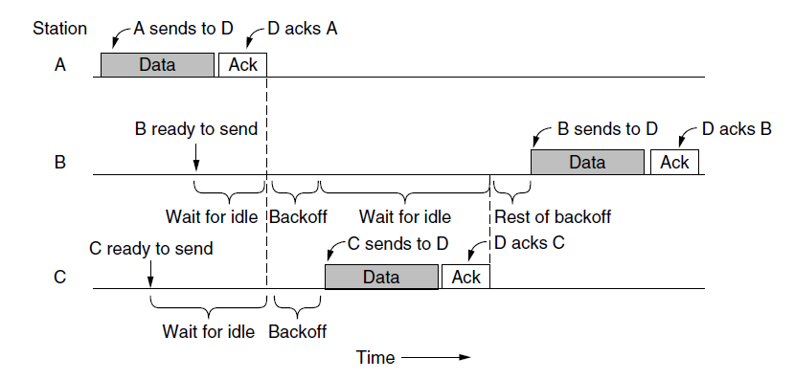
The 802.11 MAC Sublayer Protocol (1)
Sending a frame with CSMA/CA.
DCF: Distributed Coordination Function

Slide 46
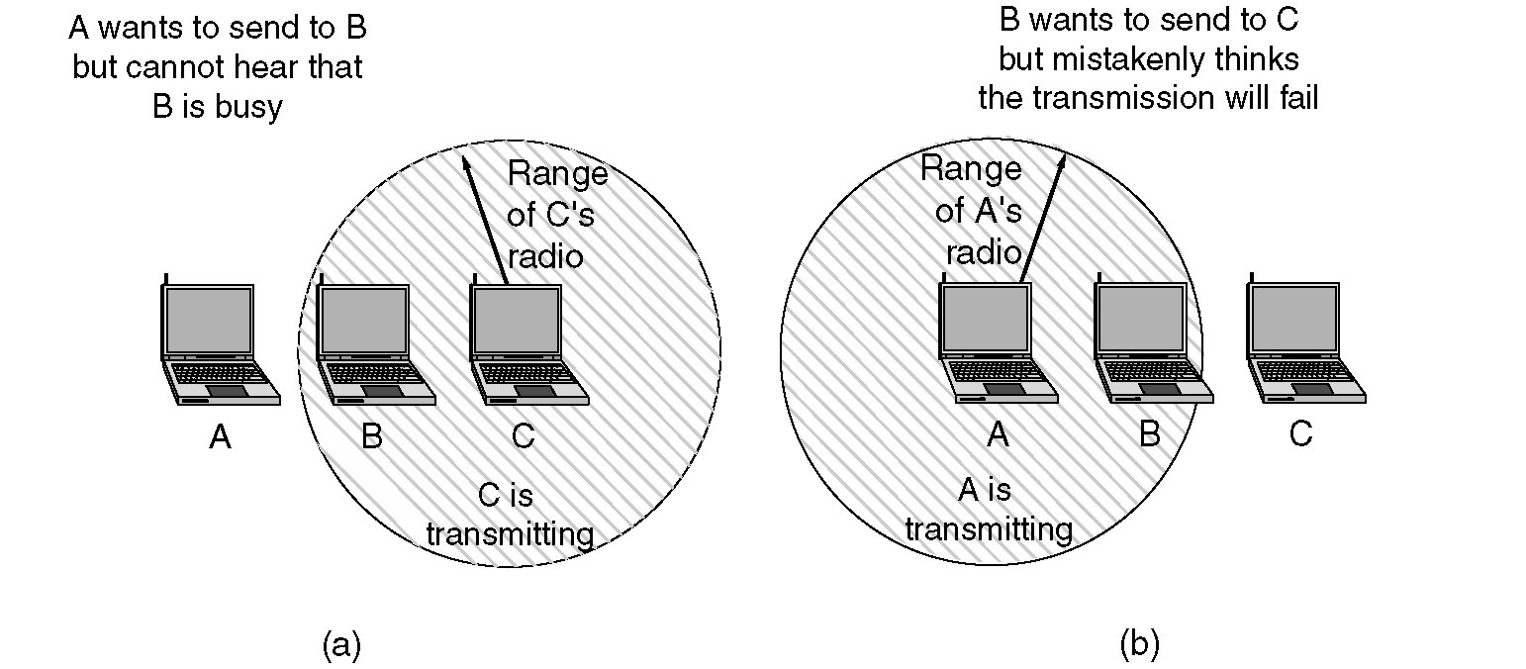
The 802.11 MAC Sublayer Protocol
(a) The hidden station problem.
(b) The exposed station problem.

Slide 47
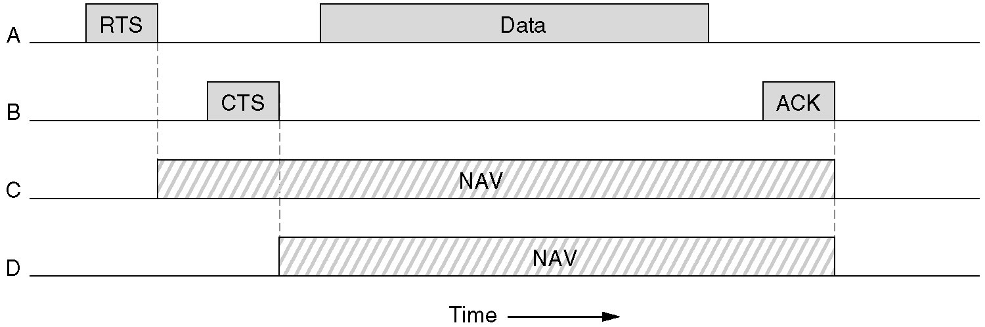
The use of virtual channel sensing using CSMA/CA
How to Save Power
Beacon frames: if client want to sleep, send a flag to AP, then AP will buffer traffic. AP send broadcast frames period with a traffic map, client check if it has traffic buffered, then send a poll request to AP
APSD(Automatic Power Save Delivery): AP buffer traffic, send it to client just after the client send frames to AP

Slide 48
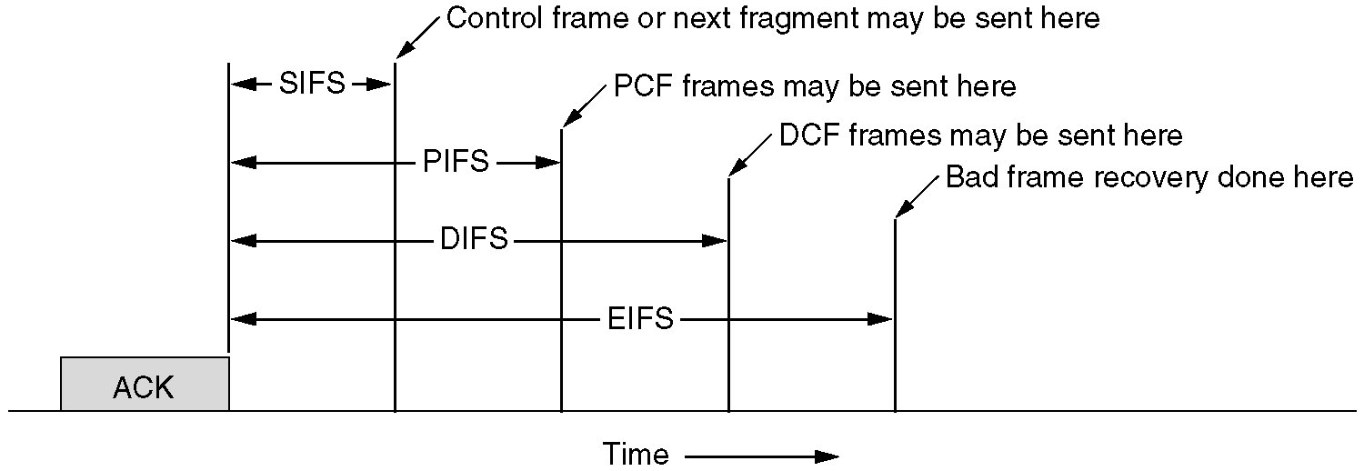
Interframe spacing in 802.11
Before any station send next frame, time interval required to allow sending control information

Slide 49
Usage of IFS
DIFS
SIFS
SIFS
RTS
Data
A源站
CTS
ACK
B目的站
有数据要发送
争用失败，延迟接入
DIFS
C其他站
争用成功
D其他站
不允许发送数据
ok
Data
DIFS
DIFS
DIFS
DIFS
延迟接入
有数据要发送
争用窗口

Slide 50
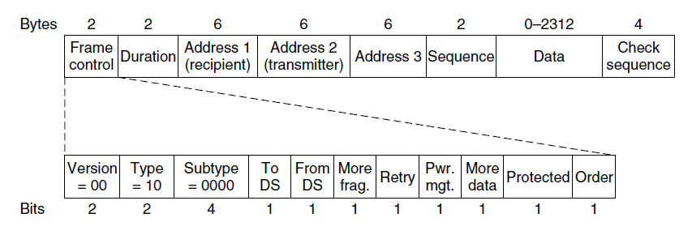
The 802.11 Frame Structure
The 802.11 data frame.

Slide 51
802.11 Services
Distribution Services
For base station to deal with station mobility as they enter or leave cells
  Association: connect a station and base station
  Disassociation: disconnect
  Reassociation: connect to another base station
  Distribution: how to route frame
  Integration: translate frame format to other network

Slide 52
802.11 Services (2)
Intracell Services
  Authentication
  Deauthentication
  Privacy: for encrypted
  Data Delivery: for reliable

Slide 53
Broadband Wireless
802.16 (WiMAX)
  Worldwide Interoperability for Microwave Access
Comparison of 802.16 with 802.11 and 3G
  802.11 is for mobile, 802.16 is for building
  802.11 is for single notebook, keep the cost of the radio low, 802.16 is for multi-terminal, keep better radio service
  802.11 is for short distance, 802.16 runs over part of a city
  802.11 not designed for telephony and real-time multimedia usage, 802.16 supports that
  802.16 more like a 4G technology

Slide 54
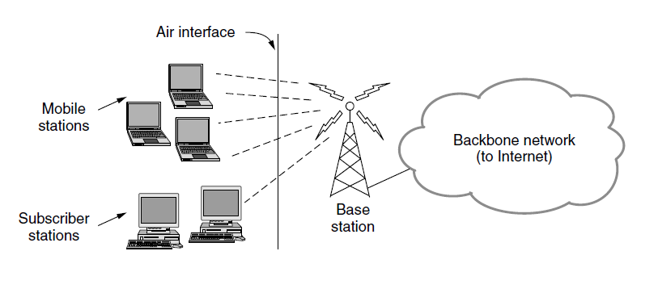
The 802.16 architecture

Slide 55
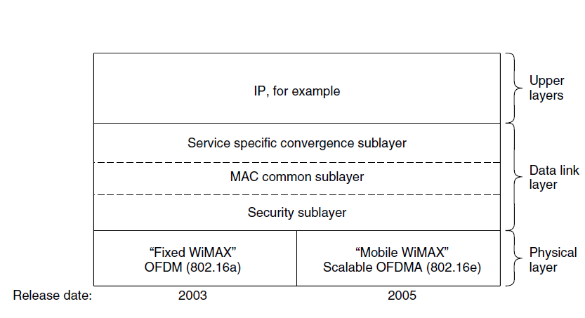
802.16 Protocol Stack

Slide 56
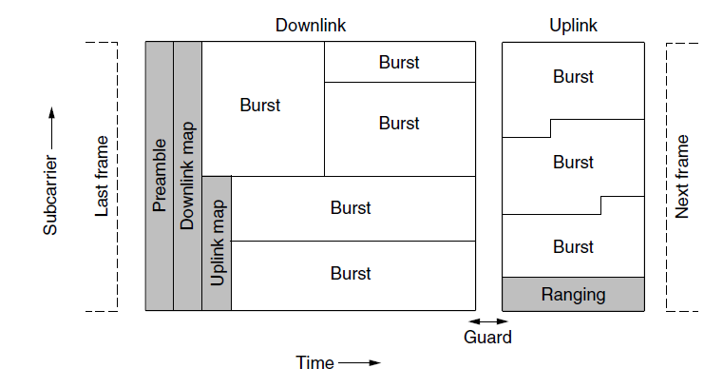
802.16 Physical Layer
Frames structure for OFDMA with time division duplexing.

Slide 57
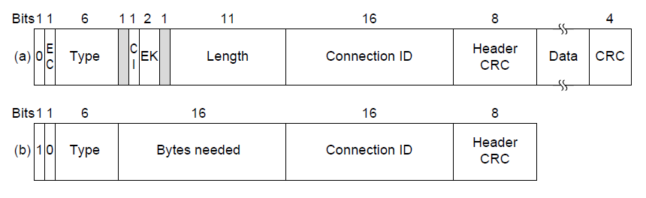
802.16 Frame Structure
(a) A generic frame. (b) A bandwidth request frame.

Slide 58
802.16 MAC Layer
4 classes of service
  Constant bit rate service
    Ex. Uncompressed voice
    Fixed time slots allocated
  Real-time variable bit rate service
    Ex. Multimedia
    Base station polls at a fixed interval to ask bandwidth needed
  Non-real-time variable bit rate service
    Ex. File transfer
    Base station polls often
  Best-efforts service
    No polling is done, users need contend for bandwidth
    Check the downstream map to see the contend result
All service is connection-oriented

Slide 59
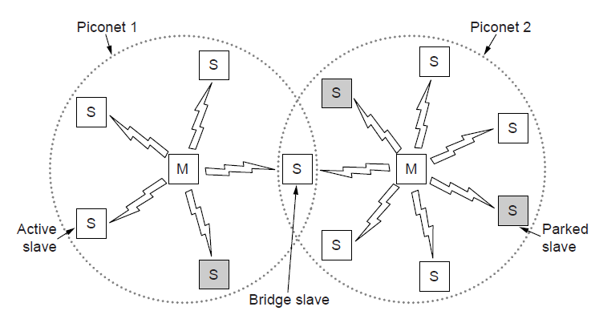
Bluetooth Architecture
Two piconets can be connected to form a scatternet

Slide 60
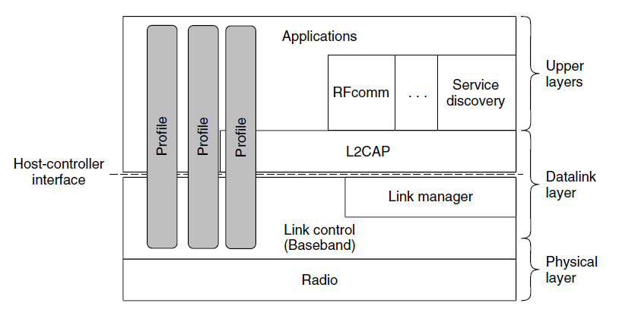
Bluetooth Protocol Stack
The Bluetooth protocol architecture.

Slide 61
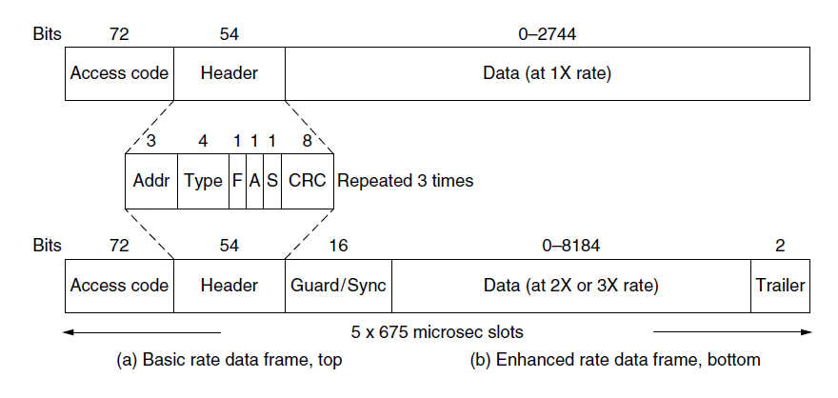
Bluetooth Frame Structure
Typical Bluetooth data frame at (a) basic, and
(b) enhanced, data rates.

Slide 62
RFID
EPC Gen 2 architecture
EPC Gen 2 physical layer
EPC Gen 2 tag identification layer
Tag identification message formats

Slide 63
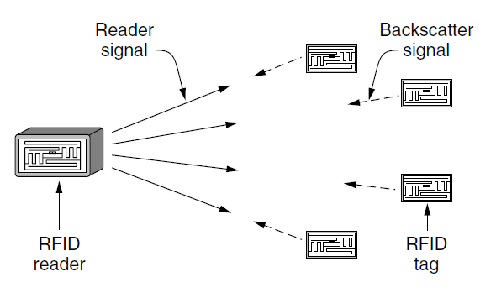
EPC Gen 2 Architecture
RFID architecture.

Slide 64
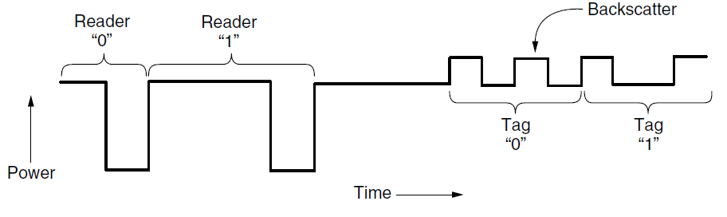
EPC Gen 2 Physical Layer
Reader and tag backscatter signals.

Slide 65
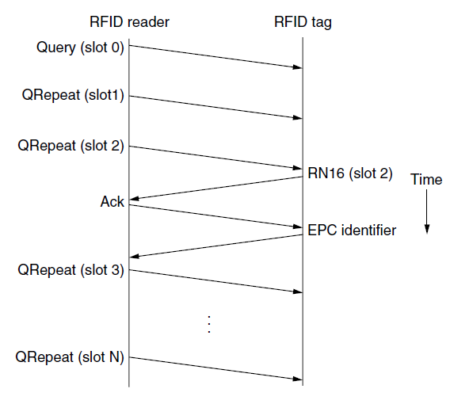
EPC Gen 2 Tag Identification Layer
Example message exchange to identify a tag.

Slide 66
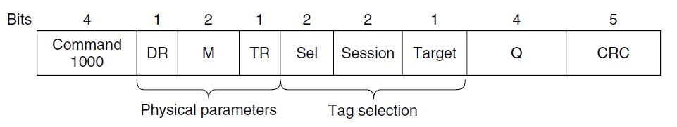
Tag Identification Message Formats
Format of the Query message.

Slide 67
Data Link Layer Switching
Learning bridges
Spanning Tree Bridges
Repeaters, Hubs, Bridges, Switches, Routers, Gateways
Virtual LANs

Slide 68
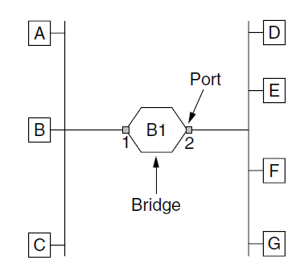
Learning Bridges (1)
Bridge connecting two multidrop LANs

Slide 69
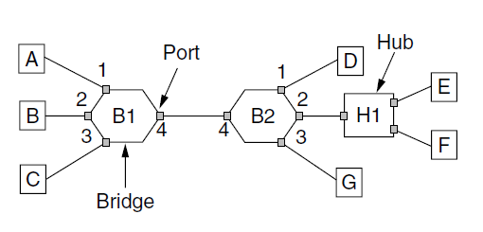
Learning Bridges (2)
Bridges (and a hub) connecting seven point-to-point stations.

Slide 70
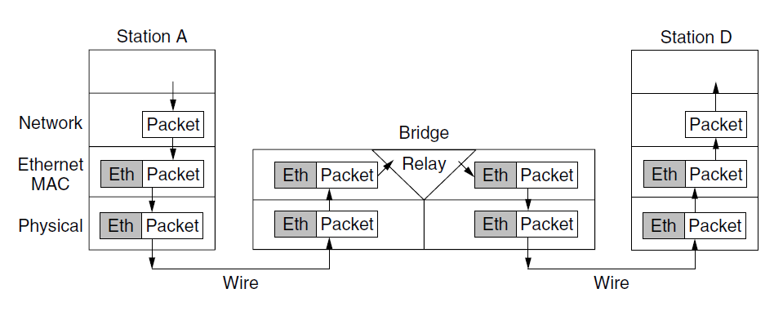
Learning Bridges (3)
Protocol processing at a bridge.

Slide 71
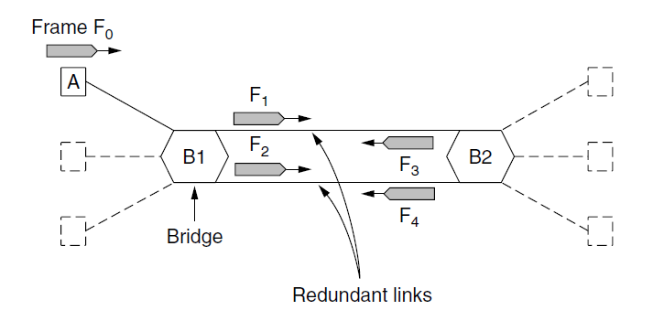
Spanning Tree Bridges (1)
Bridges with two parallel links

Slide 72
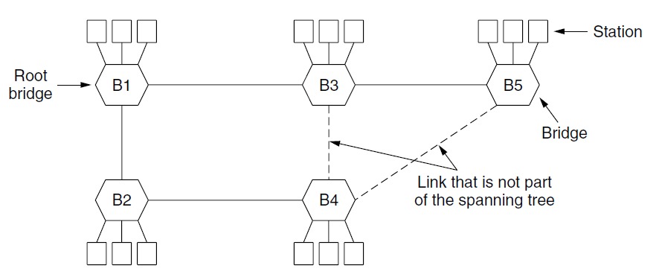
Spanning Tree Bridges (2)
A spanning tree connecting five bridges. The dotted lines are links that are not part of the spanning tree.

Slide 73
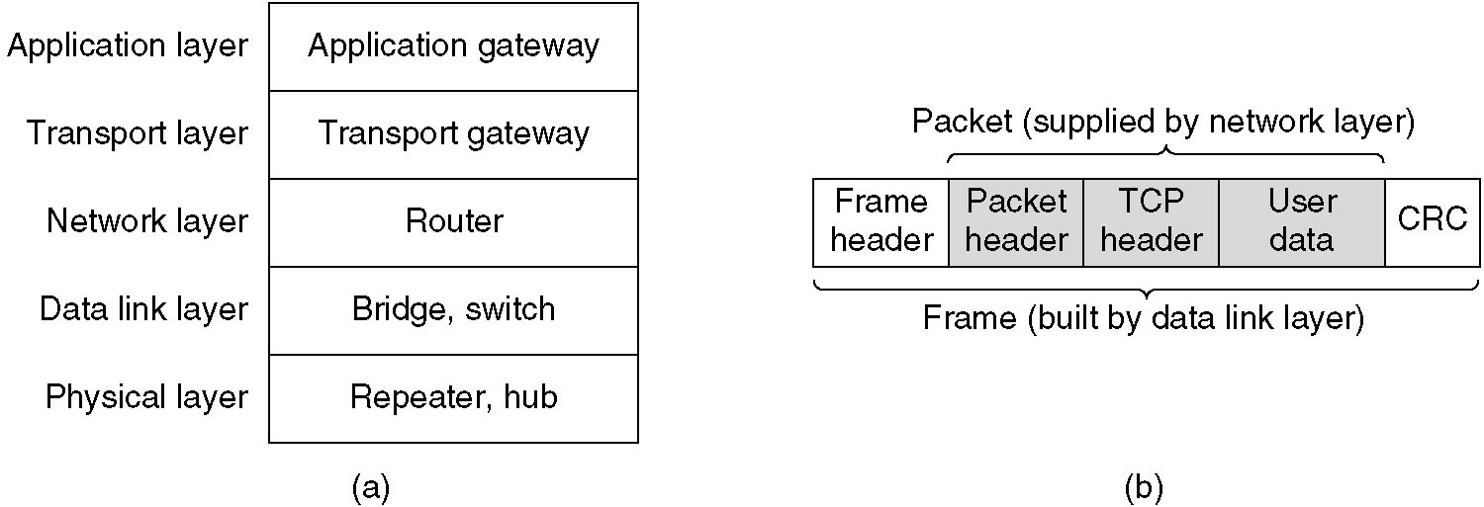
Repeaters, Hubs, Bridges, Switches, Routers and Gateways
(a) Which device is in which layer.
(b) Frames, packets, and headers.

Slide 74
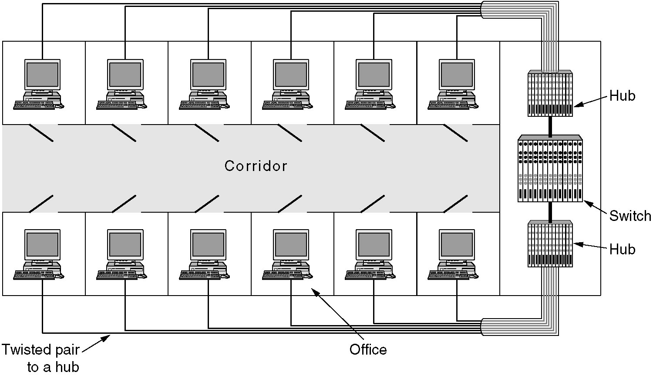
Virtual LANs
A building with centralized wiring using hubs and a switch.

Slide 75

Virtual LANs (2)
Two VLANs, gray and white, on a bridged LAN.

Slide 76

The IEEE 802.1Q Standard (1)
Bridged LAN that is only partly VLAN-aware. The shaded symbols are VLAN aware. The empty ones are not.

Slide 77

The IEEE 802.1Q Standard (2)
The 802.3 (legacy) and 802.1Q Ethernet frame formats.

Slide 78
Exercise
16. What is the baud rate of the standard 10-Mbps Ethernet?
21. Consider building a CSMA/CD network running at 1Gbps over a 1-km cable with no repeaters. The signal speed in the cable is 200,000 km/sec. What is the minimum frame size?
  Propagation time = 1/200000=5μs
  Minimum frame size=1Gbps*(2*5μs)=10000bits

Slide 79
Exercise
22. An IP packet to be transmitted by Ethernet is 60 bytes long, including all its headers. If LLC is not in use, is padding needed in the Ethernet frame, and if so, how many bytes?
  Frame size=head size + ip size =18+60=78
  Head size =6+6+2+4
  Minimum frame size=64

Slide 80

Exercise
41. Consider the network of Fig. 4-49(a). If machine J were to suddenly become white, would any changes be needed to the labeling? If so, what?
The port on B1 to LAN 3 would need to be relabeled as GW
(Gray + White)

