Slide 1
Course Overview & Architectural Patterns
Lecture 1
主讲教师：王灿
Email: wcan@zju.edu.cn
TA: 李奇平 liqiping1991@gmail.com
Course FTP: ftp://sa:sa@10.214.51.13

Slide 2

Textbooks & References
Textbook:
  [BCK13] L. Bass, P. Clements, and R. Kazman, Software Architecture in Practice, 3/e, Pearson, 2013 清华大学出版社(2013)
Reference:
  [CBB+03] P. Clements, F. Bachmann, L. Bass, et al., Documenting Software Architectures: Views and Beyond, Addison-Wesley, 2003 清华大学出版社(2003)
  [SG96] M. Shaw and D. Garlan, Software Architecture : Perspectives On an Emerging Discipline, Prentice Hall, 1996 清华大学出版社(1998), 科学出版社(2003)
http://www.amazon.cn/%E5%9B%BE%E4%B9%A6/dp/B00BMK4FWG
Notes:
POSA series:
1. A system of patterns
2. Patterns for concurrent and networked objects
3. Patterns for resource management
4. A pattern language for distributed computing
5. On patterns and pattern languages

Slide 3
Grading Policy
Assignments (30%)
  2~4 written assignments
Final exam (70%)
Notes:
POSA series:
1. A system of patterns
2. Patterns for concurrent and networked objects
3. Patterns for resource management
4. A pattern language for distributed computing
5. On patterns and pattern languages

Slide 4
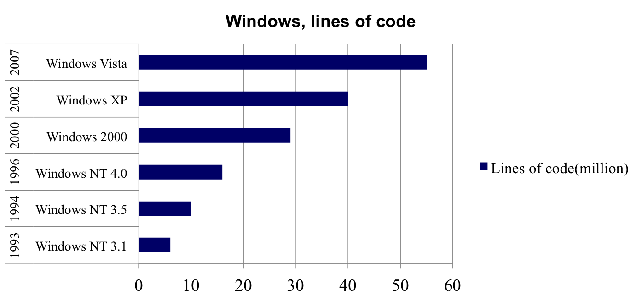
Challenge
Ever increasing size and complexity of software systems
Design
Design
Requirements
Design
Code
Notes:
Technical perspective: (non-technical perspectives, including business and social implications of software architecture are left to the next lecture.)
Ever increasing size and complexity of software systems are widening the gap between requirements and implementation
A system of 55m lines of code. Can we understand, manage, design it, with the very limited human mind power?

Slide 5
Software Development Methods
Jackson Structured Programming (JSP)
Design
Requirements
Code
System Analysis and Design Technique (SADT)
Object Oriented Design(OOD)
Notes:
To bridge the ever increasing gap between requirements and implementation

Slide 6
Design Levels
Computer hardware design levels
  Circuit
  Logic design level
  Programming level
  PMS level
Software design levels
  Executable
  Code
  Architecture
Notes:
PMS-Processor Memory Switch

Slide 7
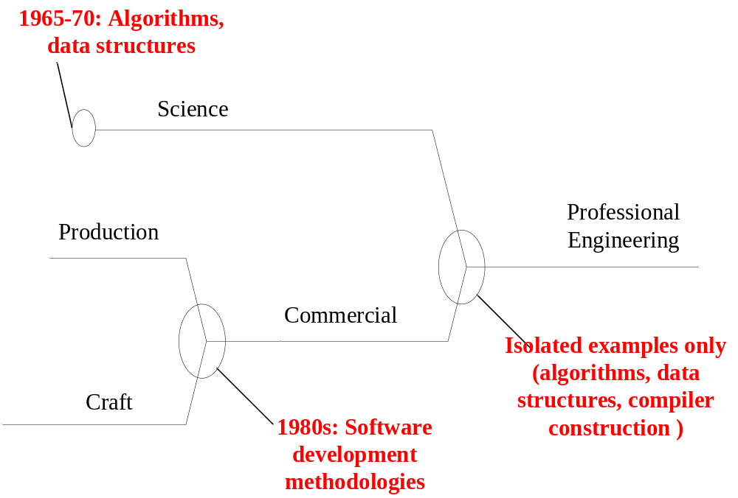
Evolution of Software Engineering

Slide 8
Why are We Now in Software Architecture
Integrated product lines
Component-based systems
2000
Software architecture
Packages
1990
Pipes and filters
Architecture
Software development environments
Inheritance
Abstract data types
1980
objects
Programming-in-the-large
Information hiding
Modules, system
organization
1970
NATO SE conference
Separate compilation
Data structures,
algorithm
1960
Subroutines
1950
High-level
languages
Sequence of
instructions

Slide 9
What Is Software Architecture?
[BCK13] The software architecture of a system is the set of structures needed to reason about the system, which comprise software elements, relations among them, and properties of both.

Slide 10
Implications (1)
Architecture is a set of software structures
  No single structure holds claim to being the architecture
Three important categories of architecture:
  Module structures
  Component-and-connector structures
  Allocation structures
Notes:
When is a structure architectural?

Slide 11
Implications (2)
Architecture is an abstraction
  It suppresses the internal information of the elements
Every Software System Has a Software Architecture
  Software architecture VS. the representation
Architecture includes behavior
Not all architectures are good architectures

Slide 12
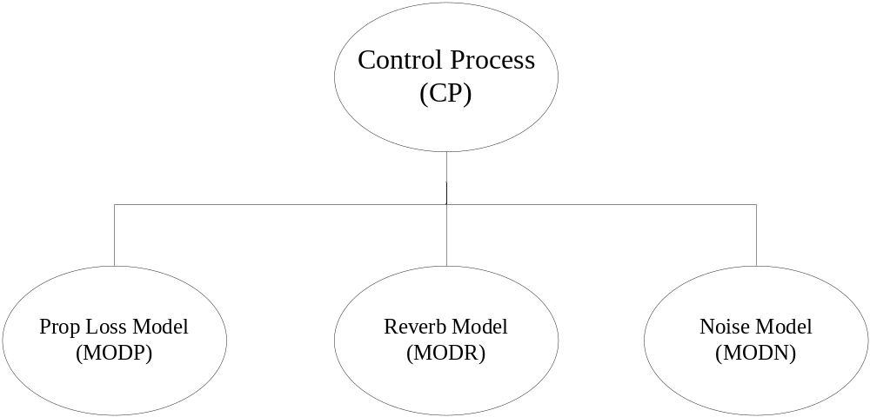
Is This a Software Architecture?

Slide 13
The Role of Software Architecture
Design
Requirements
Code
Software
architecture
Composition of large-scale components
System-level abstractions
Reuse of system-level design idioms
At this moment, software architecture can be simply defined as the computational components in a system and interactions among those components.
Notes:
Abstraction is a powerful weapon for tackling complexity. To address the issues just mentioned, intuitively we need fundamental building blocks of larger granularity, with which we can get away from the complexities of underlying details.
This leads to another problem, namely the level of abstractions in system construction.

Slide 14
Structural Issues
Structural issues are the major concerns of software architecture
  Organization of the systems as in the composition of components
  Assignment of functionality to design elements
  Composition of design elements
  Global control structures
  Protocols for communication, synchronization and access
  Physical distribution
  Scaling and performance
  Dimensions of evolutions

Slide 15
Some Common Architectural Patterns
An architectural pattern is a description of elements and relation types together with a set of constraints on how they may be used.
We approach specific architectural styles by following features:
  The types of elements
  The underlying computational model
  Advantages and disadvantages
  Some common examples of its use

Slide 16
Pipes and Filters: Model (1)
Filter
Pipe
A structure for systems that process a stream of data
  Each processing step is encapsulated in a filter component
  Data is passed through pipes between adjacent filters (single direction)
Notes:
Compiler: parser->scanner->semantic analyser->code generator

Slide 17
Pipes and Filters: Model (2)
Elements: filters and pipers
  Filter components are the processing units of the pipeline
    Filters must be independent entities
  Pipes denote the connections between filters
Examples
  Compilers
  Unix shell programs (pipe)
  A degenerate case: when each filter processes all of its input data as a single entity (a batch sequential system)

Slide 18
Pipes and Filters: An Example
ASCII program text
Lexical Analysis / Scanner
token stream
Syntax Analysis / Parser
abstract syntax tree
Semantic Analysis
augmented abstract syntax tree
Intermediate Code Generation
Intermediate language
Optimization
MIPS Backend
Intel Backend
SPARC Backend
Interpreter

Slide 19
Pipes and Filters: Pros and Cons
Pros:
  Clean design
  Flexibility by filter exchange
  Flexibility by recombination
  No intermediate files necessary
  Reuse of Filter components
  Rapid prototyping of pipelines
  Efficiency by parallel processing
Cons:
  Sharing state information is expensive or inflexible
  Error handling
  Data transformation overhead
  Efficiency gain by parallel processing is often an illusion

Slide 20
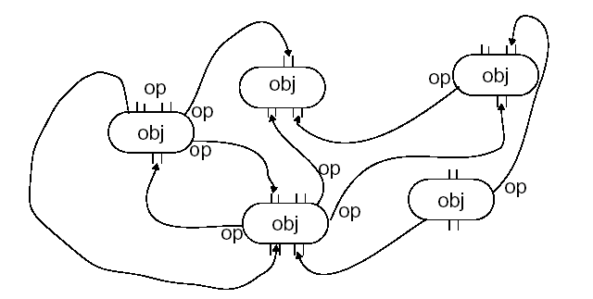
Data Abstraction/Object Oriented
Object Oriented: Model
  Encapsulation
  Inheritance
  Polymorphism
  Reuse/Maintenance: encapsulation/abstraction promotes separation of concerns

Slide 21
Object Oriented: Pros
Problem decomposition
  Natural correspondence with real-world entities
  Inheritance allows shared definitions
Maintenance and reuse
  Decreased coupling (change propagation)
  Increased reusability (especially frameworks)
Protection of internal representations
  Encapsulation allows data/state integrity to be preserved

Slide 22
Object Oriented: Cons
Design is harder: forces more up-front brain-work
Inheritance: often non-intuitive
Maintenance: need additional structure—one level of objects is too flat
Side effects: many objects can access a single resource
Identity: need to know (import) an object/method’s name (explicit invocation)

Slide 23
Event Based Systems: Model
Components: objects or processes
  Interface defines allowable incoming events
  Interface defines allowable outgoing events
Connections: event-procedure bindings
  Procedures are registered with events
  Components interact by “announcing” events
  Upon receiving an event, its associated procedures are implicitly invoked
  Order of invocation is non-deterministic

Slide 24
Event Based Systems: Pros
Problem decomposition
  Computation and coordination are separate: objects are more independent
System maintenance and reuse
  No hard-wired (static) name dependencies
  Eases system evolution: use new objects simply by registering them
  eases integration
Performance
  Invocations can be parallelized

Slide 25
Event Based Systems: Cons
Problem decomposition
  No control over order of invocation
  Correctness difficult to ensure
  Exchange of data
System Maintenance and Reuse
  Requires a centralized “yellow pages” of who knows what: events, registrations, dispatch policies
Performance
  Indirection/communication imply some performance penalty

Slide 26
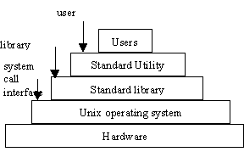
Layered Systems: Model
A hierarchical organization, with each layer
  Providing service to the layer above it
  Serving as a client to the layer below
A "virtual machine"
  Encapsulation of layer implementations
The connectors are defined by the protocols that determine how the layer will interact
  Topological constraints: limiting interactions to adjacent layers
Unix:

Slide 27
Layered Systems: Pros
Support designs based upon increasing levels of abstraction
Aids in portability
  each layer is an abstract “virtual machine”
Aids in modifiability
  each layer interacts with at most 2 others
Support reuse
  Maintaining the same interface to the adjacent layers

Slide 28
Layered Systems: Cons
Performance penalty
May be the wrong model
  e.g. user may need to control low-level functionalities
Finding the right levels of abstractions is difficult
  Esp. in a standardized layered model. e.g. ISO OSI reference model VS. TCP/IP
  If the abstractions are wrong, layers need to be bridged
    “Layer bridging” often ruins the model

Slide 29
Interpreters: Model
Memory
Program being
interpreted
Inputs
Data
(program
state)
Computation (State machine)
Simulated
Interpretation
engine
Internal
Interpreter
state
Selected instruction
Outputs
Selected data
Data Access (fetch/store)

Slide 30
Interpreters: Model (2)
Execution engine in software
  A virtual machine to close the gap between the computing engine expected by the semantics of the program and the computing engine available in hardware.
Data:
  Program being interpreted
  Program state data
  Interpreter state data
Control:
  Interpretation engine state
  Simulated system state

Slide 31
Interpreters: Pros and Cons
Advantages
  Functionality:
    can simulate non-native functionality
  Testing:
    can simulate “disaster” modes (e.g. for safety-critical applications)
  Flexibility:
    very general-purpose tool
Disadvantages
  Efficiency:
    much, much slower than hardware
    much slower than compiled system
  Testing:
    additional layer of software to be verified

Slide 32
Assignment
Read Chapter 1 & 3 of the textbook.
Read the story of the Vasa (Wikipedia entry:
http://en.wikipedia.org/wiki/Vasa_(ship) )

