Slide 1
Tactics for Security (2)
主讲教师：王灿
Email: wcan@zju.edu.cn
TA: 李奇平 liqiping1991@gmail.com
Course FTP: ftp://sa:sa@10.214.51.13

Slide 2
Some Proverbs
No fortress is impregnable
A chain is only as strong as its weakest link
The easiest way to capture a fortress is from within

Slide 3
Security Tactics Hierarchy
Security
Resist
Attacks
Detect
Attacks
React to
attacks
Recover
from Attacks
Detect intrusion
Detect service denial
Verify message integrity
Detect message delay
Identify actors
Authenticate actors
Authorize actors
Limit access
Limit exposure
Encrypt data
Separate entities
Change default settings
Revoke access
Lock computer
Inform actors
Attack
System
Detects,
Resists,
Reacts,
or
Recovers
Maintain
Audit trail
Restore
See
availability

Slide 4
Recover from Attacks
Systems attacked need to recover:
  Restoring data and service
    Tactics from availability: backups, passive redundancy, checkpoints etc.
  Attacker identification
    Audit trails for
      Trace the action of the attacker
      Help identify intruder and support non-repudiation
      Should be protected/hidden
Notes:
An audit trail is a copy of each transaction applied to the data in the system together with identifying information.

Slide 5
Architectural Design Support for Security
We check the architectural design and analysis process for security from the following 7 aspects:
  Allocation of responsibilities
  Coordination model
  Data model
  Management of resources
  Mapping among architectural elements
  Binding time decisions
  Choice of technology

Slide 6
Allocation of Responsibilities
Identify responsibilities need to be secure and ensure the following supports for them:
  Identify/authenticate/authorize/grant access to/revoke access from actors
  Record & notify
  Encrypt and verify data
  Recovery

Slide 7
Coordination Model
For system communication and coordination:
  Authenticate/authorize actors for connections
  Encrypted transmission
  Monitor and identify connections with unexpectedly high demands for resources, and capability to restrict or terminate these connections
Notes:
Browser-based interaction, traditional application window VS. command line interaction

Slide 8
Data Model
Identify sensitive data fields and for these data:
  Ensure that data of different sensitivity is separated and has different access
  Audit trail for access
  Encrytion with keys stored separately
  Can be restored

Slide 9
Mapping among Architectural Elements
Check how alternative mappings may affect security by checking:
  Data/service access
  Audit trail
  Recognition of anomaly
  Ensure the responsibilities for security support

Slide 10
Resources Management
Determine the system resources for
  Identify/monitor/authenticate/authorize an actor
  Encrypt data
  Log & notify
Ensure shared resources are not used for passing sensitive data

Slide 11
Binding Time Decisions
Determine cases where an instance of a late-bound component may be untrusted and ensure security check for them

Slide 12
Choice of Technology
Your choice of tech. shall support authentication, data access rights, resource protection, and data encryption.

Slide 13
Tactics for Testability

Slide 14
Software Testing
40% of the cost of developing systems is taken up by testing
  If the architect can reduce this cost through design then the payoff is substantial
Software testability refers to the ease with which the software can be made to demonstrate its faults through testing
  Probability that a fault will be revealed on its next execution

Slide 15
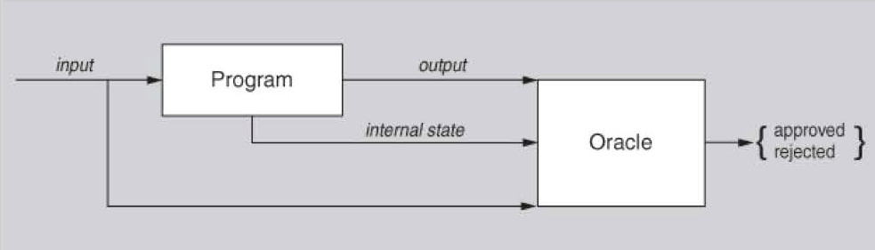
A Model of Testing
Output = computational results + some QAs (e.g. response time)
The internal state provides the oracle more insights

Slide 16
Testability
Controllability
  Be able to control each component’s inputs
  Sometimes also need to manipulate its internal state
Observability
  Be able to observe its outputs
  Sometimes also need to observe its internal state
Operability, decomposability, stability, understandability
Testing is usually performed using a test harness

Slide 17
Testability General Scenario (1)
Stimulus
  A milestone in the development process is met
    The completion of a coding increment (e.g. a class layer or service), integration completed, system delivered etc.
Source of stimulus
  The testing is performed by unit testers, integration testers, system testers, acceptance testers, or end users
Environment
  Design/ development /compile /deployment /integration/ run time

Slide 18
Testability General Scenario (2)
Artifact
  The portion of the system being tested: design, a piece of code, or the whole system etc.
Response
  Execute test suite and capture results, capture activity that resulted in the fault, control and monitor the state of the system
Response Measure
  Coverage
  Time to prepare the test environment and perform tests
  Length of the longest dependency chain in a test

Slide 19
Testability Tactics
Tactics
to Control
Testability
Tests
executed
Faults detected
Architectural techniques for improving testability
  Control and observe system state
    Adding controllability and observability to the system
  Limit complexity
    Limiting complexity in the system's design

Slide 20
Testability Tactics Hierarchy
Testability
Control and observe
system state
Limit complexity
Tests
Executed
Specialized interface
Record/playback
Localize state storage
Abstract data sources
Sandbox
Executable assertions
Faults
Detected
Limit structural complexity
Limit non-determinism

Slide 21
Specialized Interfaces (1)
component
component
A component with normal interface to provide required functionality
A component with specialized interface
Allows the capturing or specification of variable values for a component through a test harness or through its normal execution.

Slide 22
Specialized Interfaces (2)
Some common examples:
  A set and get method for important variables, modes, or attributes
  A report method that returns the full state of the object
  A reset method to set the internal state
  A method to turn on verbose output, various levels of event logging, performance instrumentation, or resource monitoring

Slide 23
Record/Playback
The state that caused a fault is often difficult to re-create
  Recording the state when it crosses an interface allows that state to be used to "play the system back" and to recreate the fault
component
component
Capturing information from here
Notes:
Recording this information allows test input for one of the components to be generated and test output for later comparison to be saved.

Slide 24
Localize State Storage
If the state control is distributed for a module (or system), the state setting in testing will be difficult
  Localize state storage thus makes testing convenient
  May use a state machine object to more effectively manipulate, track and report a module state

Slide 25
Abstract Data Sources
Flexibly controlling input data will make testing easier
Abstracting the data source interfaces lets you substitute test data easily
  E.g. a system with a database of customer transactions, flexible data source connection means it can easily connects to files of test data

Slide 26
Sandbox
Sandboxes are a specific example of virtualization that isolates untested code changes and experimentation from the production environment or repository
  E.g. The Spring framework supports running tests as a "transaction", which is rolled back at the end
The sandbox typically provides a tightly controlled set of virtualized resources for running tests
  Network access, the ability to inspect the host system or read from input devices are usually disallowed or heavily restricted

Slide 27
Executable Assertions
An assertion is a predicate (a true–false statement) placed in a program, where the checking code is automatically executed, and warnings are generated if any conditions are violated
x = 1;
assert (x > 0);
x++;
assert (x > 1);

Slide 28
Replacement Techniques for Testability
Component replacement: (used with "separate interface from implementation") replace component with a different implementation
c2
new
c2
System
c2
c1
c1
c1
System
System
c4
c3
c4
c3
c4
c3
c5
c5
c5
Preprocessor macros: when activated, will enable state-reporting or probe statements that return or display information, or return control to a testing console

Slide 29
Reading Assignment
Read Chapter 10 & 11 of the textbook.

