Slide 1
Tactics for Testability (2)
主讲教师：王灿
Email: wcan@zju.edu.cn
TA: 李奇平 liqiping1991@gmail.com
Course FTP: ftp://sa:sa@10.214.51.13

Slide 2
Testability Tactics Hierarchy
Testability
Control and observe
system state
Limit complexity
Tests
Executed
Specialized interface
Record/playback
Localize state storage
Abstract data sources
Sandbox
Executable assertions
Faults
Detected
Limit structural complexity
Limit non-determinism

Slide 3
Limit Structural Complexity (1)
Avoiding cyclic dependencies between components
Isolating and encapsulating dependencies on the external environment
Reducing dependencies between components in general
c1
c2
c1
c2
c4
c4
c5
c3
c3
c5

Slide 4
Limit Structural Complexity (2)
In object-oriented systems
  Inheritance hierarchy:
    Number of classes derived from (multiple inheritance)
    Number of classes derived
    Depth of the inheritance tree
  Polymorphism and dynamic calls
  Method invocation: response of a class
    The number of methods of a class plus the number of methods of other classes that invoked by this class

Slide 5
Limit Structural Complexity (3)
Using modifiability tactics such as high cohesion, loose coupling, and separation of concerns etc. can effective reduce the complexity of the architectural elements
  Giving each element a focused task with limited interaction with other elements

Slide 6
Limit Non-determinism
Nondeterministic systems are harder to test than deterministic systems
  This tactic involves finding all the sources of non-determinism, such as unconstrained parallelism, and weeding them out as much as possible

Slide 7
Architectural Design Support for Testability
We check the architectural design and analysis process for testability from the following 3 aspects:
  Allocation of responsibilities
  Coordination model
  Data model
  Management of resources
  Mapping among architectural elements
  Binding time decisions
  Choice of technology

Slide 8
Allocation of Responsibilities
Make sure the allocation of functionality provides high cohesion, low coupling, strong separation of concerns, and low structural complexity
Support in system responsibilities include:
  Execute test suite and capture results
  Capture (log) the activity that resulted in a fault or that resulted in unexpected behavior
  Control and observe relevant system state for testing

Slide 9
Coordination Model
Execution of a test suite, capturing the results within a system or between systems
  Capturing activity that resulted in a fault
Injection and monitoring of state into the communication channels for use in testing, within a system or between systems
Do not introduce needless non-determinism

Slide 10
Data Model
Capturing the values of instances of the data abstractions
The values of instances of the data abstractions can be set when state is injected into the system
The creation, initialization, persistence, manipulation, translation, and destruction of instances of these data abstractions can be exercised and captured

Slide 11
Resources Management
Ensure sufficient resources available to execute a test suite and capture the results
Ensure system supports for:
  Test resource limits
  Capture detailed resource usage
  Provide virtualized resources for testing

Slide 12
Binding Time Decisions
Ensure that components that are bound later than compile time can be tested in the late-bound context
Ensure that late bindings can be captured in the event of a failure, so that you can re-create the system's state leading to the failure
Ensure that the full range of binding possibilities can be tested

Slide 13
Tactics for Usability

Slide 14
Usability
Usability is about how easy it is for the user to accomplish a desired task and the kind of support the system provides to the user.
Dimensions of usability:
  Learning system features
  Using the system efficiently
  Minimizing the impact of errors
  Adapting the system to the user’s needs
  Increasing confidence and satisfaction
Notes:
What can the system do to…

Slide 15
Usability General Scenario (1)
Stimulus
  An end user tries to use a system efficiently, learn to use the system, minimize the impact of errors, adapt the system, or configure the system
Source of stimulus
  End user, possibly in a specialized role
Response
  The system should either provide the user with the features needed or anticipate the user's needs

Slide 16
Usability General Scenario (2)
Response Measure
  Task time, number of errors, number of tasks accomplished, user satisfaction…
Artifact
  System, or a specific portion of the system with which the user is interacting
Environment
  At runtime or configuration time

Slide 17
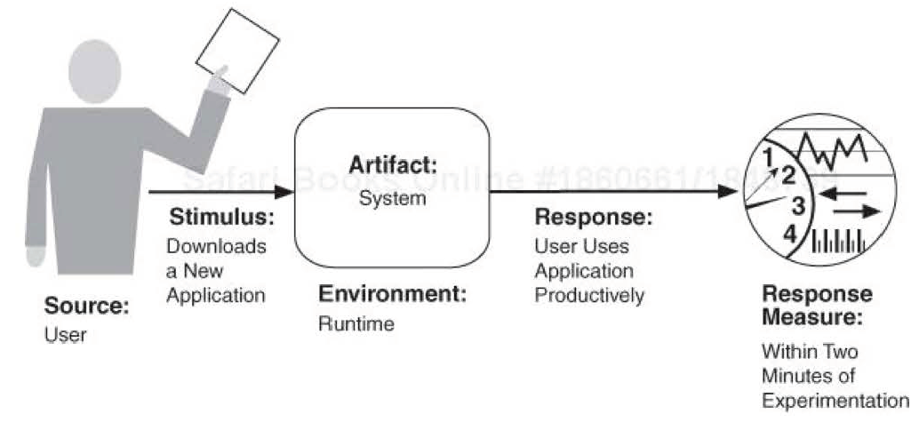
A Sample Concrete Usability Scenario

Slide 18
Human Computer Interactions
User initiative – user leads system by issuing requests
  Command interfaces
System initiative – system leads the user; asking for input
  “Wizards”
Mixed initiative - dialog systems
  E.g. a user cancels an operation
    When canceling a command, the user issues a cancel---user initiative
    During the cancel, the system may put up a progress indicator---system initiative

Slide 19
Usability Tactics
Tactics
to Control
Usability
User
Request
User given
Appropriate feedback
And Assistance
Support user initiative: correcting user errors or improving user efficiency
Support system initiative: rely on a model of the user, the task or the system state itself

Slide 20
Usability Tactics Hierarchy
Usability
Support User
Initiative
Support System
Initiative
User
Request
Maintain Task Model
Maintain User Model
Maintain System Model
User
Given
Appropriate
Feedback
And
Assistance
Cancel
Undo
Pause/Resume
Aggregate

Slide 21
Cancel
When the user issues a cancel command:
  The system must be listening for it
    A constant listener that is not blocked by the actions of whatever is being canceled
  The command being canceled must be terminated
  Any resources being used by the canceled command must be freed
  Components that are collaborating with the canceled command must be informed so that they can also take appropriate action

Slide 22
Undo
To support undo, the system must maintain a sufficient amount of information about system state so that an earlier state may be restored
  E.g. using checkpoints + rollback to reverse operations
Not all operations can be easily reversed
Some operations cannot be undone, such as ringing a bell

Slide 23
Pause/Resume & Aggregate
Pause/resume: In a long-running operation, provide the ability to pause and resume the operation can improve usability
  Effectively pausing a long-running operation requires the ability to temporarily free resources
Aggregate: when performing repetitive operations, or operations that affect a large number of objects in the same way, aggregate the objects into a group and apply the operation to the group
  Decrease error and improve efficiency

Slide 24
Usability Tactics Hierarchy
Usability
Support User
Initiative
Support System
Initiative
User
Request
User
Given
Appropriate
Feedback
And
Assistance
Cancel
Undo
Pause/Resume
Aggregate
Maintain Task Model
Maintain User Model
Maintain System Model

Slide 25
Support System Initiative (1)
When the system takes the initiative, it relies on models of the user, the task or the system its self so as to predict either its own behavior or the user's intention
Maintain task model: Model the context of the task being undertaken by the user so as to learn user’s attempts and provide assistance
  E.g. knowing that sentences start with capital letters would allow an application to correct a lowercase letter in that position

Slide 26
Support System Initiative (2)
Maintain user model: modeling different aspects of the user
  User’s knowledge of the system
  User behavior in terms of expected response time
  User preference…
  E.g. a model can control the amount of assistance and suggestions automatically provided to a user
Maintain system model: the system maintains an explicit model of itself
  Modeling system behavior so that appropriate feedback can be given to the user
  E.g. a progress bar

Slide 27
Architectural Design Support for Usability
We check the architectural design and analysis process for modifiability from the following 5 aspects:
  Allocation of responsibilities
  Coordination model
  Data model
  Management of resources
  Mapping among architectural elements
  Binding time decisions
  Choice of technology

Slide 28
Allocation of Responsibilities
Ensure system responsibilities to assist users in:
  Learning how to use the system
  Efficiently achieving the task at hand
  Adapting and configuring the system
  Recovering from user and system errors

Slide 29
Coordination Model
Determine how coordination model's properties affect usability
  E.g., can the system respond to mouse events and give semantic feedback in real time?
  Can long-running events be canceled in a reasonable amount of time?

Slide 30
Data Model
Focus on data abstractions involved with user-perceivable behaviors
  E.g., can the data abstractions support undo and cancel operations?
  Should the transaction granularity be so great that canceling or undoing an operation takes an excessively long time?

Slide 31
Resources Management
Pay attention to resource management involved with user-controlled configurations
  E.g., avoid configurations that would result in excessively long response times

Slide 32
Choice of Technology
The chosen technology shall aid in the creation of online help and tutorial, and the collection of user feedback

Slide 33
Reading Assignment
Browse through Chapter 16 to learn practices of gathering ASRs
Read Chapter 17 of the textbook.

