Slide 1
Designing an Architecture (1)
主讲教师：王灿
Email: wcan@zju.edu.cn
TA: 李奇平 liqiping1991@gmail.com
Course FTP: ftp://sa:sa@10.214.51.13

Slide 2
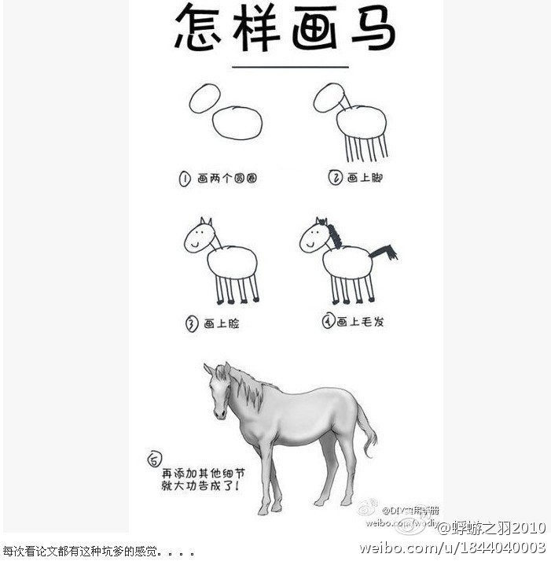

Slide 3
Designing an Architecture
Architecturally Significant Requirements
Design Strategy
Attribute Driven Design

Slide 4
Evolutionary Delivery Life Cycle
Software
Concept
Deliver
The Final
Version
Preliminary
Requirements
Analysis
Design of
Architecture
And System
Core
Develop
A Version
Incorporate
Customer
Feedback
Deliver
The Version
Elicit
Customer
Feedback

Slide 5
When Do We Start Designing the Software Architecture?
Requirements come first
  But not all requirements are necessary to get started
An architecture shaped by some:
  Functional requirements
  Quality requirements
  Business requirements
We call these requirements “architecturally significant requirements (ASRs)
  Requirements that will have profound effects on the architecture
  Often takes the form of quality attribute requirements

Slide 6
Gathering ASRs from Requirements Documents
Requirements specification focused on the required features and functionality of a system
  Most of the requirements does not affect the architecture
  Architectures are mostly driven or "shaped" by quality attribute requirements
Architects have to excavate ASRs out of requirements documents
  Allocation of responsibilities, coordination model, data models... (Table 16.1)

Slide 7
Gathering ASRs by Interviewing Stakeholders
The results of stakeholder interviews should include a list of architectural drivers and a set of QA scenarios that the stakeholders (as a group) prioritized.

Slide 8
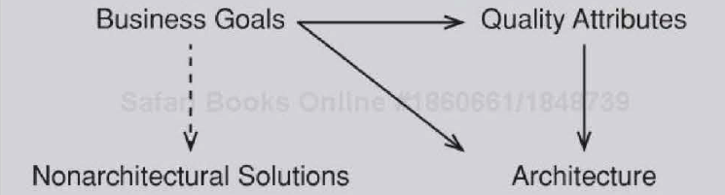
Gathering ASRs by Understanding the Business Goals
Business goals will
  Frequently lead directly to ASRs
    Often lead to quality attribute requirements.
  May directly affect the architecture without precipitating a quality attribute requirement at all

Slide 9
Capturing ASRs in a Utility Tree (1)
A utility tree begins with the word "utility" as the root node
  Utility is an expression of the overall "goodness" of the system
Listing under the root the major quality attributes that the system is required to exhibit
Under each quality attribute, record a specific refinement of that QA
  E.g., performance -- "data latency" and "transaction throughput
Under each refinement, record the appropriate ASRs (usually expressed as QA scenarios).
Evaluate the business value of the candidate ASR and the architectural impact of including it

Slide 10
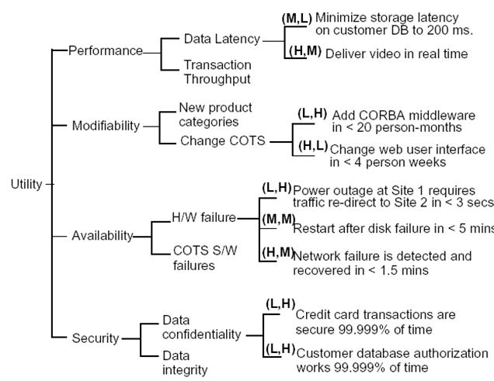
Capturing ASRs in a Utility Tree (2)

Slide 11
Designing an Architecture
Architecturally Significant Requirements
Design Strategy
Attribute Driven Design

Slide 12
Decomposition
Quality attributes refer to the system as a whole. So the design will begin with the system as a whole.
  As it is decomposed, the quality attribute requirements can also be decomposed and assigned to the elements of the decomposition
Constraints such as preexisting components on the design shall be accommodated by a decomposition strategy
  The design shall accommodate the constraints and achieves the quality and business goals for the system.

Slide 13
Decomposition: Motivation
Motivations for decomposition includes:
  Semantic coherence
  Functionality support for quality attributes
  For achieving quality attributes
  Existing components
  …

Slide 14


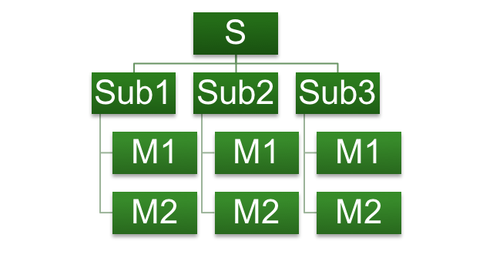
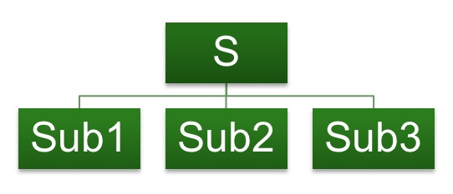
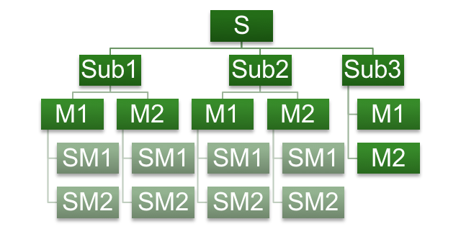



Decomposition: Appropriate Level of Abstraction
System
……

Slide 15
Designing to ASRs
ASRs are the requirements that drive the architectural design
  You must design to satisfy these requirements
What about the non-ASR requirements?
  Met by the current design
  Met by slightly adjusting current design
  Not met by the current design
Design for all of the ASRs or one at a time?
  Experienced architects can catch multiple ASRs

Slide 16
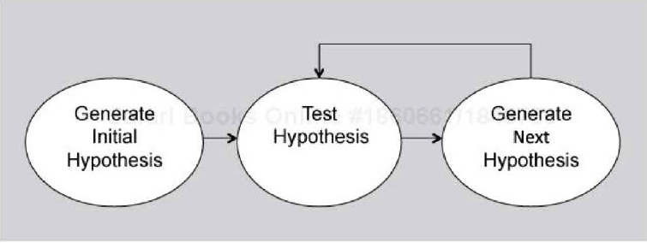
Generate and Test
The generate-and-test approach
  Creating the initial hypothesis
  Choosing the tests
  Generating the next hypothesis
  Terminating the process

Slide 17
Where Does the Initial Hypothesis Come From?
Existing systems
  It is likely that systems already exist that are similar to the system being constructed
Frameworks available to the project
  E.g. Web applications, decision support systems etc. Note that the framework may constrain your initial design hypothesis
Known architectural patterns and tactics
Domain decomposition
Design checklists
  The point of using a checklist is to ensure completeness

Slide 18
Designing an Architecture
Architecturally Significant Requirements
Design Strategy
Attribute Driven Design

Slide 19
Attribute Driven Design (ADD)
An iterative, "divide and conquer” approach aims to satisfy architecturally significant requirements
At each iteration, ADD will
  Choose a part of the system to design
  Marshal all the architecturally significant requirements for that part
  Create and test a design for that part

Slide 20
Input to ADD
A set of ASRs
  Functional requirements as use cases
  Quality requirements expressed as system-specific quality scenarios
  Constraints
A context description
  What are the boundaries of the system being designed?
  What are the external systems, devices, users, and environmental conditions with which the system being designed must interact?

Slide 21
Output of ADD
A set of sketches of architectural views
  Module view + other views as appropriate
  These views together will identify a collection of architectural elements and their relationships or interactions
The system is described as a set of containers for functionality and the interactions among them
  The resulted design is critical for achieving the desired qualities and provides a framework for achieving the functionality

Slide 22
Case Study---Garage Door Opener
Task: design a product line architecture for a garage door opener within a home information system

Slide 23
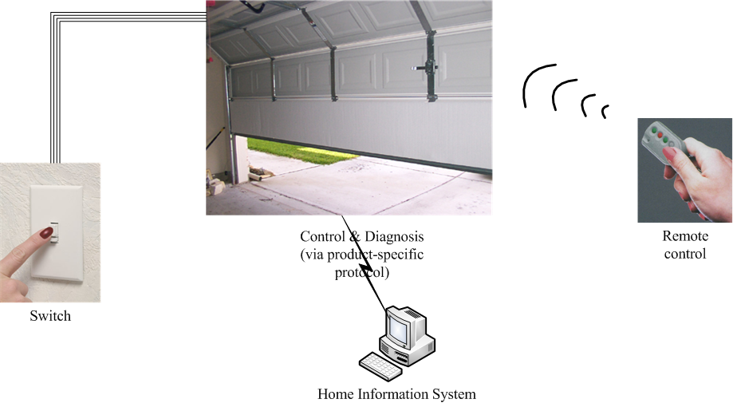
The Garage Door Opener---Product Line Design

Slide 24
ASRs (1)
The device and controls for opening and closing the door are different for the various products in the product line.
  Various devices (various actuators, etc.)
  Various controls
    Controls from within a home information system
    Various switches
    Various remote controls
  The product architecture for a specific set of controls should be directly derivable from the product line architecture.

Slide 25
ASRs (2)
The processor used in different products will differ
  The product architecture for each specific processor should be directly derivable from the product line architecture

Slide 26
ASRs (3)
If an obstacle (person or object) is detected by the garage door during descent, it must halt (alternately re-open) within 0.1 second

Slide 27
ASRs (4)
The garage door opener should be accessible for diagnosis and administration from within the home information system using a product-specific diagnosis protocol.
  It should be possible to directly produce an architecture that reflects this protocol

Slide 28
The Steps of ADD
ADD is a five-step method:
  Choose an element of the system to design
  Identify the ASRs for the chosen element
  Generate a design solution for the chosen element
  Inventory remaining requirements and select the input for the next iteration
  Repeat steps 1-4 until all the ASRs have been satisfied

Slide 29
Step 1: Choose an Element of the System to Design (1)
Start with entire system
  Inputs for this element need to be available
    Constraints, functional and quality requirements
1st iteration: create a collection of elements that together constitute the entire system
2nd iteration: take one of these elements and design it, resulting in still finer-grained elements
3rd iteration: which one to choose?

Slide 30
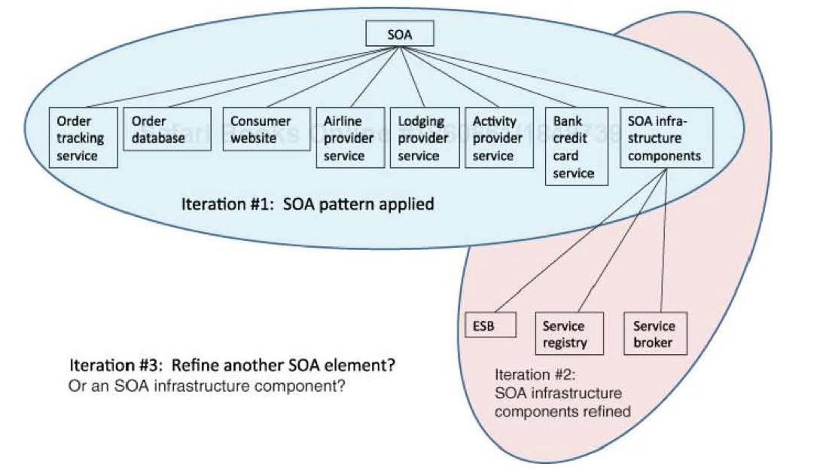
Step 1: Choose an Element of the System to Design (2)

Slide 31
Step 1: Choose an Element of the System to Design (3)
Two main refinement strategies to pursue with ADD: breadth first and depth first
Factors affecting the order to work through ADD:
  Personnel availability: usually depth first
  Risk mitigation: usually depth first
    E.g., prototyping for the risky part
  Deferral of some functionality or quality attribute concerns
All else being equal, a breadth-first refinement strategy is preferred for it allows for
  apportion the most work to the most teams soonest
  consideration of the interaction among the elements at the same level

Slide 32
Step 2: Identify the ASRs for This Element
If the chosen element for design in step 1 is the whole system, then a utility tree can be a good source for the ASRs
  Otherwise, construct a utility tree specifically focused on this chosen element, using the quality attribute requirements that apply to this element
In our case study, the ASRs are as listed

Slide 33
Step 2: Identify the ASRs for This Element
In our case, requirements to be addressed at this level of design include:
  Real-time performance requirement *
  Modifiability requirements
  Support online diagnose via product-specific protocol
Requirements are not treated as equals
  Less important requirements are satisfied within constraints obtained by satisfying more important requirements
    This is a difference of ADD from other SA design methods

Slide 34
Reading Assignment
Read Chapter 17 of the textbook

