Slide 1
Designing an Architecture (2)
主讲教师：王灿
Email: wcan@zju.edu.cn
TA: 李奇平 liqiping1991@gmail.com
Course FTP: ftp://sa:sa@10.214.51.13

Slide 2
Case Study---Garage Door Opener
Task: design a product line architecture for a garage door opener within a home information system

Slide 3
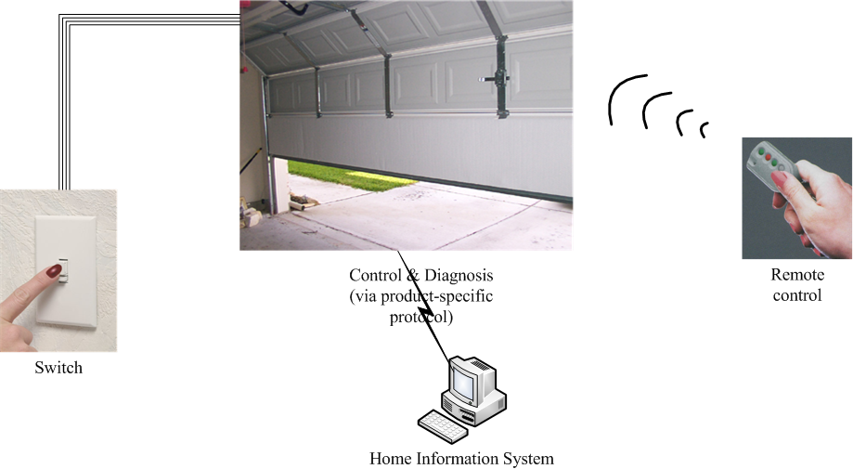
The Garage Door Opener

Slide 4
ASRs (1)
The device and controls for opening and closing the door are different for the various products in the product line
  Various devices (various actuators, etc.)
  Various controls
    Controls from within a home information system
    Various switches
    Various remote controls
  The product architecture for a specific set of controls should be directly derivable from the product line architecture

Slide 5
ASRs (2)
The processor used in different products will differ
  The product architecture for each specific processor should be directly derivable from the product line architecture

Slide 6
ASRs (3)
If an obstacle (person or object) is detected by the garage door during descent, it must halt (alternately re-open) within 0.1 second

Slide 7
ASRs (4)
The garage door opener should be accessible for diagnosis and administration from within the home information system using a product-specific diagnosis protocol.
  It should be possible to directly produce an architecture that reflects this protocol

Slide 8
The Steps of ADD
ADD is a five-step method:
  Choose an element of the system to design
  Identify the ASRs for the chosen element
  Generate a design solution for the chosen element
  Inventory remaining requirements and select the input for the next iteration
  Repeat steps 1-4 until all the ASRs have been satisfied

Slide 9
Step 2: Identify the ASRs for the Chosen Element
In our case, requirements to be addressed at this level of design include:
  Real-time performance requirement *
  Modifiability requirements
  Support online diagnose via product-specific protocol
Requirements are not treated as equals
  Less important requirements are satisfied within constraints obtained by satisfying more important requirements
    This is a difference of ADD from other SA design methods

Slide 10
Step 3: Generate a Design Pattern for the Chosen Element (1)
For each quality requirement there are identifiable tactics to achieve it
  Or patterns that implement these tactics
Patterns or tactics usually have an impact on multiple quality attributes.
  E.g. Using intermediary (modifiability/performance)
In an architecture design, a composition of many such tactics is used to achieve a balance between the required multiple qualities
  Achievement of the quality and functional requirements is analyzed during the refinement step

Slide 11
Step 3: Generate a Design Pattern for the Chosen Element (2)
The goal of this step is to establish an overall architectural pattern consisting of module types
  Satisfies the ASRs
  Constructed by composing selected tactics
Two factors involved in selecting tactics:
  ASRs themselves
  Side effects of a tactic has on other requirements

Slide 12
Step 3: Generate a Design Pattern for the Chosen Element (3)
Examples:
  To achieve modifiability, a classic tactic is to use the “Interpreter” pattern (new functions achieved by modifying input---interpreted language)
    E.g. HTML
  Note the use of interpreters will have a strong negative effect on performance
  The decision to use an interpreter depends on the relative importance of modifiability versus performance
    Or use an interpreter for a portion of the pattern and use other tactics for other portions

Slide 13
Step 3: Generate a Design Pattern for the Chosen Element (4)
In our garage door opener, we re-examine modifiability tactics
  Modifiability Tactic categories
    Reduce size of a module
    Increase cohesion
    Reduce coupling
    Defer binding
  Since our modifiability scenarios are primarily concerned with design time changes and module size at this point is not an issue → we primarily use “increase cohesion” and “reduce coupling” categories

Slide 14
Step 3: Generate a Design Pattern for the Chosen Element (5)
Re-examine performance tactics
  Performance Tactic categories
    Control resource demand
    Manage resources
  We will use both “control resource demand” and “manage resources” tactics to achieve the real-time requirement

Slide 15
Step 3: Generate a Design Pattern for the Chosen Element (6)
we select tactics from above-mentioned categories
  Increase semantic coherence
    Separate responsibilities dealing with user interface, communication and sensors into their own module
  Encapsulate
    “Virtual machines” will be used for communication and sensors because we expect them to vary within product line
  Increase resource efficiency
    Improve the algorithm used in the part with real-time requirement
  Schedule resources
    Use a scheduler that guarantees deadlines

Slide 16
Step 3: Generate a Design Pattern for the Chosen Element (7)
One architectural pattern that utilizes tactics to achieve garage door ASRs
User Interface
Non-performance Critical Computation
Performance Critical Computation
Scheduler that Guarantees Deadlines
Virtual Machines

Slide 17
Step 3: First level Decomposition
User Interface
Non-performance-critical computation
  Applications running on top of virtual machine
    E.g. normal raising/lowering the door
Virtual machines
  Managing communication and sensor interactions
Performance-critical computation
  e.g., Managing obstacle detection
Scheduler that guarantees deadlines

Slide 18
Step 3: Allocate Functionality & Instantiate Modules (1)
The criterion for allocating functionality
  In a concrete system, we will have one module for each "group" of functionality
  Theses will be instances of types shown in our pattern
Functionalities to be provided
  Raising/lower door (no deadline, non-performance critical)
  Diagnosis (non-performance critical)
  Managing obstacle detection (with a deadline, performance-critical)

Slide 19
Step 3: Allocate Functionality & Instantiate Modules (2)
User Interface
Diagnosis
Raising-Lowering Door
Obstacle Detection
Scheduler that Guarantees Deadlines
Communication Virtual Machine
Sensor/Actuator Virtual Machine

Slide 20
Step 3: Allocate Functionality & Instantiate Modules (3)
Applying use cases pertaining to the parent module
  Completeness: every use case of the parent module must be representable by a sequence of responsibilities within the child modules
  May lead to adding or removing child modules
    E.g. the scheduler in our example
  Discovery of necessary information exchange
    A producer/consumer relationship between those modules
    Prototype of interface documentation

Slide 21
Step 3: Allocate Functionality & Instantiate Modules (4)
  Some tactics introduce specific patterns of interaction between module types
    To be recorded, later to be translated into responsibilities for the affected modules
    E.g. using publish-subscribe style
The above steps ensure the desired functionalities to be delivered
What about quality attributes?
  Will deadlock occur during system execution?
  Are there data consistency issue?
  How shall the functionality be deployed?
Notes:
Besides module decomposition information, dynamic and runtime deployment information is also required to analyze the achievement of qualities.

Slide 22
Step 3: Represent the Architecture with Multiple Views (1)
At least one view from each viewtype
  Module decomposition view
    Allocation of functionality + major data flow among modules
  Concurrency view
    Revealing resource contention, deadlock, data consistency issue etc.
    Likely leading to new responsibilities (to be added in module views)
      E.g. a resource manager

Slide 23
Step 3: Represent the Architecture with Multiple Views (2)
  To understand concurrency in our example, consider:
    Two users doing similar things at the same time
      Resource contention, data integrity
    One user performing multiple activities simultaneously
      Data exchange, activity control
    Starting up & shutting down the system
    Synchronization in the sensor/actuator virtual machine: performance critical area & raising/lowering door
      Introduction of a new module: scheduler

Slide 24
Step 3: Represent the Architecture with Multiple Views (3)
  Deployment view
    Additional responsibilities, multiple instances etc.
    The derivation of the deployment view and the achievement of quality attributes
      e.g. replication → performance or reliability
      e.g. a real-time scheduling mechanism actually prohibit deployment on different processors
  In our example, deployment view presents the problem of dividing responsibility between the door opener system and the HIS
    E.g. authentication of a remote request

Slide 25
Step 3: Define Interfaces of the Child Modules (1)
At this level by “Interface to module” we mean document the services and properties provided and required, not the more detailed “signature” of a method.
  It documents what others can use and on what they can depend.
Analyzing the decomposition into the three views provides interaction information for the interface
  Module view
  Concurrency view
  Deployment view

Slide 26
Step 3: Define Interfaces of the Child Modules (2)
The three viewtypes provide:
  Decomposition view
    Producers/consumers relations; patterns of interactions
  Concurrency view
    Interactions among threads
    A component is active
    Synchronization information
  Deployment view
    Hardware requirements
    Timing requirements
    Communication requirements
All the above should be available in the modules’ interface documentation

Slide 27
Step 4: Verify and Refine Requirements and Generate Input for the Next Iteration
Analyzing the previous design “proposal”
  Verifying the design by “running” the parent’s ASRs
Preparing the child modules for further decomposition
  Inheriting use cases/constraints/QAS from the parent
We will examine this by looking at:
  Functional requirements
  Constraints
  Quality attribute requirements

Slide 28
Step 4: Verify Functional Requirements (1)
The Garage door system responsibilities can be assigned to the child modules
  User Interface:
    handle user requests,
    translate for raising/lowering module
    display responses
  Raising/Lowering door module
    Control actuators to raise/lower door
    Stop when completed opening or closing
  Obstacle detection:
    Recognize when object is detected
    Stop or reverse the closing of the door

Slide 29
Step 4: Verify Functional Requirements (2)
Garage door system responsibilities assigned (continued)
  Communication virtual machine
    manage communication with Home Information System (HIS)
  Sensor/Actuator virtual machine
    manage interactions with sensors/actuators
  Scheduler
    Guarantee that deadlines are met when obstacle is detected
  Diagnosis:
    manage diagnosis interaction with HIS

Slide 30
Step 4: Verify Constraints
In our example, a constraint is to communicate with the HIS using product-specific protocol
  Delegated to the communication VM

Slide 31
Step 4: Verify Quality Attribute Requirements
The devices and controls for opening and closing are different in the products of the product line
  Scenario delegated to user-interface and sensor/actuator virtual machine module
The processor used in different products will differ
  Delegated to all modules “don’t use processor specific code”
If an obstacle is detected, closing must stop within .1 second
  Delegated to scheduler and obstacle-detection modules

Slide 32
Step 4: What Requirements Are Left?
Four possibilities that an ASR (the quality attribute requirement, functional requirement, or constraint) is or is not met by the current round of design:
  Satisfied
    The design W.R.T. that ASR will is complete, i.e. it will not be considered in the next round of design
  Delegated to one of the children
  Distributed among the children
  Cannot be satisfied with the current design

Slide 33
Summary of ADD
ADD is a five-step method:
  Choose an element of the system to design
  Identify the ASRs for the chosen element
  Generate a design solution for the chosen element
  Inventory remaining requirements and select the input for the next iteration
  Repeat steps 1-4 until all the ASRs have been satisfied

Slide 34
Reading Assignment
Read the case study of the World Wide Web, which has been uploaded to the FTP server

