Slide 1
The World Wide Web
A Case Study
主讲教师：王灿
Email: wcan@zju.edu.cn
TA: 李奇平 liqiping1991@gmail.com
Course FTP: ftp://sa:sa@10.214.51.13

Slide 2
What is the World Wide Web?
A system of interlinked hypertext documents accessed via the Internet
The largest Internet application
An application platform for Web applications
A virtual graphical layer of the Internet
Notes:
HTTP+HTML+URI

Slide 3
The Original Web
1989 Proposal from Tim Berners-Lee “Information management: A Proposal” at European Lab for Particle Physics (CERN)
  Inspiration: the human “web” formed by the researchers at CERN.
  Approved Oct., 1990
  Named as the World Wide Web

Slide 4
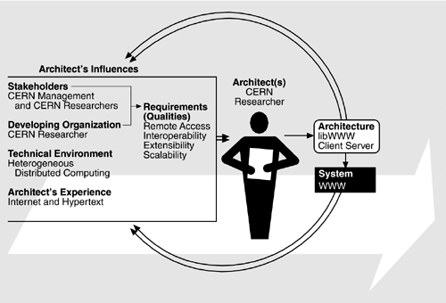
Requirements & Solution

Slide 5
Requirements and Qualities
Business goals: promoting interaction and allowing heterogeneous computing
Consequent quality goals:
  Remote access
  Interoperability
  Extensibility
  Scalability
What are the major design challenges given the existing techs at that time?

Slide 6
The Solution
Berners-Lee's breakthrough was to marry hypertext to the Internet
  Origins: 1940’s Vannevar Bush “hypertext”
  HyperText Markup Language (HTML) and Uniform Resource Locators (URLs)
libWWW – the original library that supported Web-based development using C/S architecture and layered design.

Slide 7
The Original Requirements (1)
Remote access across network
  Any info shall be accessible from any machine on a CERN network
Heterogeneity
  Heterogeneous hardware and software platform
Non-centralization
  No constraints on the Web’s growth
Access to existing data
Ability for users to add data
  Allow user to publish data
Private Links

Slide 8
The Original Requirements (2)
Bells and Whistles – 24x80 display (graphics optional)
  Scholars generally agree, that the turning point for WWW began with the introduction of the Mosaic Web browser in 1993, a graphical browser
Data analysis
Live links
Other requirements explicitly mentioned but not dealt with in original proposal
  Copyright enforcement
  Data security (encryption of sensitive data SSL and HTTPS)

Slide 9
Web Growth Statistics
Date | Number of Web Sites | Percentage of .com Sites | Hosts per Web Server
6/93 | 130 | 1.5 | 13,000
12/93 | 623 | 4.6 | 3,475
6/94 | 2,738 | 13.5 | 1,095
12/94 | 10,022 | 18.3 | 451
6/95 | 23,500 | 31.3 | 270
1/96 | 100,000 | 50 | 94
6/96 | 252,000 | 68 | 41
1/97 | 646,162 | 62.6 | 40
1/98 | 1,834,710 |  | 16.2
1/99 | 4,062,280 |  | 10.6
1/00 | 9,950,491 |  | 7.3
1/01 | 27,585,719 | 54.68 | 4
Notes:
Hosts per Web Server：多少台Internet中有一台Web服务器

Slide 10
Stay Simple
---The Key to the Explosive Growth
Weak notion of central control
  Unregulated style of interaction
Features missing for hypertext systems design in the Web proposal
  Controlling topology
  Navigational techniques and user interface requirements
  Having different types of links to express differing relationships among nodes
Missing features in the original implementation: URL, HTML…

Slide 11
Original Architectural Solution
Architectural approach first proposed at CERN and later by the World Wide Web Consortium (W3C):
  The library libWWW hides all hardware, operating system and protocol dependencies
  Using client-servers architecture
    Client side “browser” that knows how to display HTML
    Server – that knows how to interpret requests for pages and return the HTML pages
  HTTP protocol – network protocol for transferring data packets (built on top of TCP/IP)

Slide 12
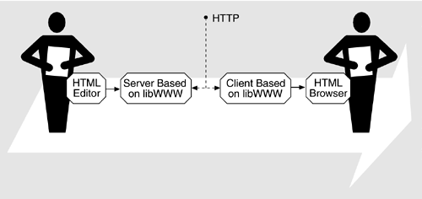
Content Producers←→Consumers
libWWW is a library of software for creating applications that run on either the client or the server

Slide 13
A Layered View of libWWW
Application Module
Access Modules (protocol-aware modules)
Stream Modules
Core (a standard interface for a Web app.)
Generic Utilities (portability layer)
Notes:
1. Generic Utilities (portability layer): network management, data types, string manipulations etc.
2. Core (a standard interface for a Web app.): plug-ins and call-out functions, further customization on generic utilities for Web apps.
3. Stream Modules
4. Access Modules (protocol-aware modules)
HTTP
NNTP (network news),
WAIS (wide area information server),
FTP,
Telnet,
Gopher,
rlogin,
local file system,
TN3270
HTTPS.
5. Application Module

Slide 14
Generic Utilities Layer
A portability layer
  Masks platform difference
  All higher layer can then be platform independent
Functionalities provided in this layer
  Network management
  String manipulation
  Data type extension

Slide 15
Core Layer
Containing the skeletal functionality of a Web application
  Network access
  Data management and parsing
  Logging
Providing a standard interface for a Web application
  Actual functionalities provided by plug-in modules and call-out functions

Slide 16
Stream Layer
The stream layer provides the abstraction of a stream of data used by all data transported between the application and the network.

Slide 17
The Access Layer
Providing a set of network-protocol-aware modules
  HTTP, NNTP, WAIS, TELNET, Gopher, rlogin etc.
  Protocols are built upon the abstractions of the lower layers

Slide 18
Application Layer
A set of functionality useful for writing applications
  caching
  logging
  registering proxy servers
  gateways
  history maintenance, etc.

Slide 19
Lessons From libWWW (1)
Allowing the features of Web-based apps to grow has driven many decision in libWWW and led to the following lessons:
  Formalized application programming interfaces (APIs) are required
    Supporting application development in a variety of platforms and languages
  Layered functionality and APIs
    Providing access to different levels of service abstraction

Slide 20
Lessons From libWWW (2)
  The library must support a dynamic, open-ended set of features
    Including run-time replacement of features
  Processes built on top of library must be thread safe to allow concurrent functionality
    E.g. downloading large file over a slow communication link may take a considerable amount of time

Slide 21
How the WWW Achieved Its Initial Quality Goals
Goal | How Achieved | Tactics Used
Remote access | Build Web on top of Internet | Adherence to defined protocols
Interoperability | Use libWWW to mask platform details | Abstract Common Services Hide Information (Encapsulate)
Extensibility of software | Isolate protocol and data type extensions in libWWW; Plug-ins | Abstract Common Services, Hide Information, replace components (Defer binding), config files (Defer binding)
Extensibility of data | Make each data item independent except for references it controls | Restrict Dependencies
Scalability | Use client-server architecture and keep references to other data local to the referring data location | Introduce concurrency Reduce computational overhead

Slide 22
Evolution of Web-Based E-Commerce
“Web of documents” VS. “Web of data”
New requirements for e-commerce:
  High performance
  High availability
  Scalability
  Security
  Modifiability
System architecture versus software architecture
  Frequently use COTS as system components

Slide 23
A Simple E-commerce Reference Architecture
Browser/User
Interaction
Business Rules
and Applications
Data
Services
Key: Component Data Flow

Slide 24
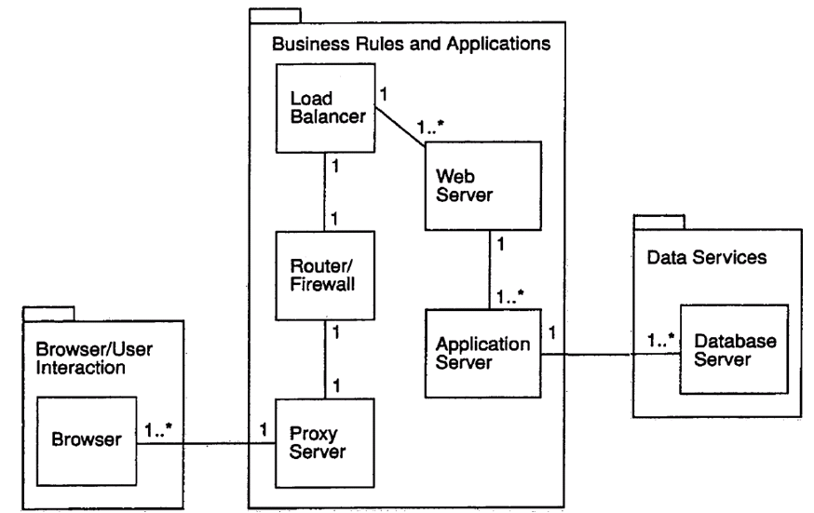

A Typical E-commerce System

Slide 25
Achieving Qualities (1)
Web browsers for modifiability
  The browser-based user interface is not hardwired, but specified via HTML
    User interface is naturally separated from the rest of the application
HTTPS for security
  Using port 443 instead of the standard port 80 to request TCP/IP services in an encrypted form
  Using a 128-bit public/private key pair to encrypt the data
    Sensitive data such as credit card or ID numbers

Slide 26
Achieving Qualities (2)
Proxy Servers for Performance
  Caching frequently accessed Web pages so that users may retrieve them without having to access the Web site
  Typically located close to the users
Routers and firewalls for security
  Routers may perform NAT transformation
  Packet filters examine the TCP and IP headers to detect bad behavior
  Application proxy to filter traffic based on known patterns of behavior

Slide 27
Achieving Qualities (3)
Load balancing for performance, scalability and availability
  Distributing the "load" among a pool of computers running Web servers
  Horizontal scaling (adding more instances of a given resource)
  Active redundancy by monitoring the aliveness of each of its computers
Web servers for performance
  Multithread
  Multithread (Vertical scaling, i.e. adding more powerful instances of a given resource)

Slide 28
Achieving Qualities (4)
Application servers for modifiability, performance and scalability
  Separating business logic from "fat client" and DB
  Load balancing, horizontal scaling
Databases for performance, scalability and availability
  Multi-layer architecture
  Internal replication

Slide 29
How the E-Commerce Architecture achieves its Quality Goals
Goal | How Achieved | Tactics
High Performance | Load balancing, proxy servers | Introduce concurrency, increase resources, multiple copies
High Availability | Redundant processors, networks, databases, load balancing | Active redundancy, transactions, introduce concurrency
Scalability | Allow for horizontal and vertical scaling | Abstract common services, introduce concurrency
Security | Firewalls, public/private key encryption, NAT | Limit access, integrity, limit exposure
Modifiability | Separation of functionality: (browser), DB design, business logic (3 tiers) | Abstract common services, intermediary, interface stability

Slide 30
Reading Assignment
Read chapter 23: Economic Analysis of Architectures. The next lecture will present CBAM

