Slide 1
The CBAM
Economic Analysis of Architectures
主讲教师：王灿
Email: wcan@zju.edu.cn
TA: 李奇平 liqiping1991@gmail.com
Course FTP: ftp://sa:sa@10.214.51.13

Slide 2
ATAM
A risk-mitigation process used early in the software development life cycle
  A means of evaluating technical tradeoffs
    Architectural tradeoffs occur when a decision affects multiple attributes at once
  How well the architecture has been designed with respect to quality attributes

Slide 3
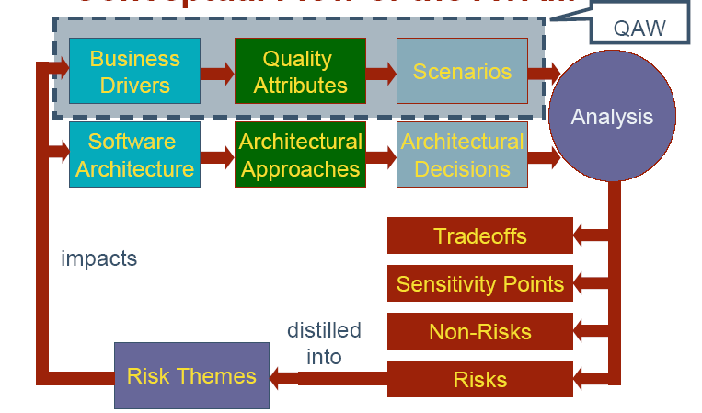
Conceptual Flow of the ATAM

Slide 4
What is CBAM?
Cost Benefit Analysis Method
Provides assessments of the technical and economic issues and architectural decisions
Starts where ATAM ends

Slide 5
Motivations
The biggest tradeoffs in large systems usually have to do with economics
We need a process that helps us choose among architectural options, given that the resources for building and maintaining a system are limited
  Maximize gains and minimize risks (financially)

Slide 6
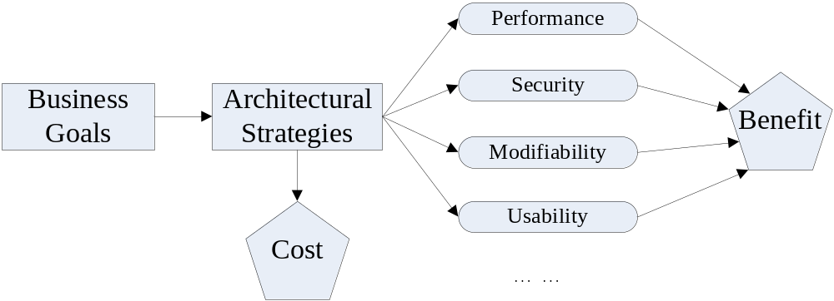
Decision-Making Context (1)
Goal: to maximize the difference between the benefit derived and the cost of implementation

Slide 7
Decision-Making Context (2)
The budget for a project is always limited.
  Every architectural choice is competing with every other one for inclusion
  CBAM allows the stakeholders to judge whether the costs for different decisions are worthwhile or not
CBAM elicits the costs and benefits associated with the architectural decisions

Slide 8
Decision-Making Context (3)
Architectural strategies (collections of architectural tactics) affect the quality attributes of the system, which in turn provides the stakeholders with some benefit (utility)
  E.g. to improve system performance, one can choose to add more servers or have developing team to come up with better algorithms
These strategies also have cost and take time to implement
  Cost in purchasing and deploying new servers, or in design, implement, test and deploy new modules.
VFC (Value of Cost, previously known as ROI, Return on Investment) - the ratio of benefit to cost

Slide 9
The Basis for CBAM---Utility
We consider how scenarios differ in the values of their projected responses and then assign utility to those values
  Side effects of strategies must also be taken into account (other quality attributes that are affected other than the one intended)
  Calculating all of these utilities together is necessary for the VFC

Slide 10
Utility: Variations of Scenarios
The CBAM uses scenarios, similar to ATAM, to represent specific quality attributes
To create a utility-response curve, the CBAM uses a set of scenarios that vary the values of the responses (scenario = stimulus, environment, and response)

Slide 11






Variations of Scenarios---an example
You submit an order in an e-commerce website by clicking on “Proceed to checkout” button, and the response page is displayed in:
0.5 second
2 seconds
5 seconds
10 seconds
15 seconds
30 seconds

Slide 12
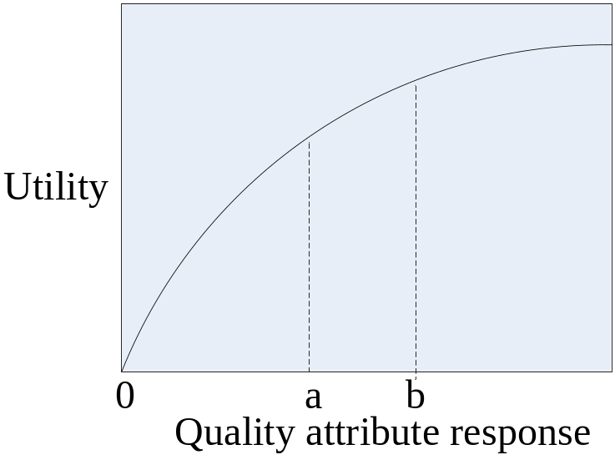
Utility: Utility-Response Curves (1)
Utility is shown as a function of response value
Determine the following points for a UR curve
  Best case: e.g. value 100
  Worst case: e.g. value 0
  Current case
    Value proposed by stakeholders
  Desired case
    Value proposed by stakeholders

Slide 13
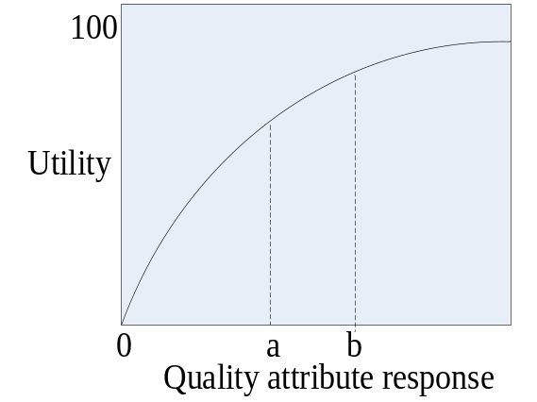
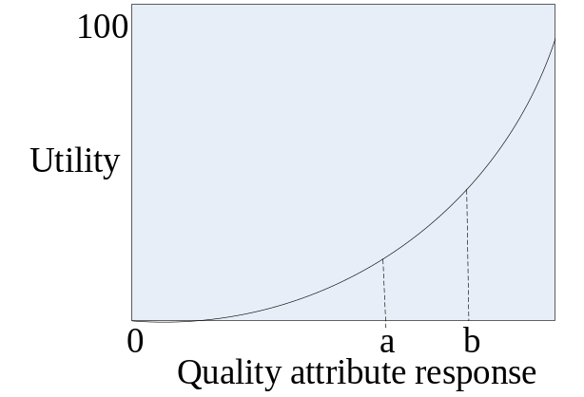
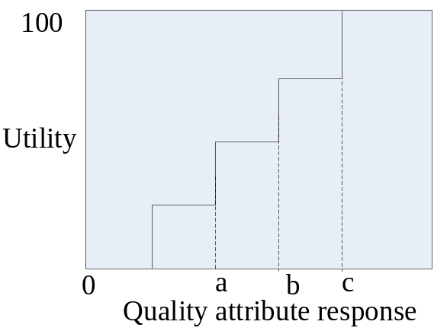
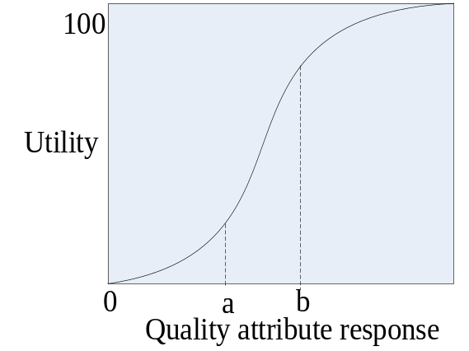
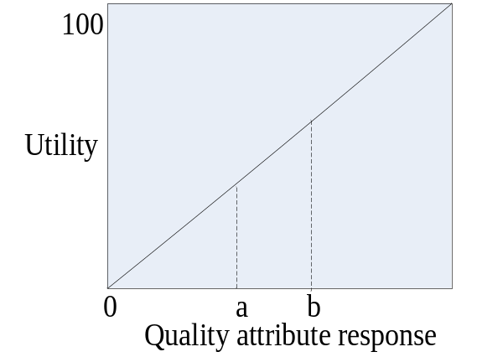
Utility: Utility-Response Curves (2)
UR curves may take various forms.
P440 FIGURE 23.2

Slide 14
Utility: Priorities of Scenarios
Two-step voting process to establish relative importance of a scenario
  Stakeholders vote to establish an order to scenarios
  Stakeholders then assign a weight of 1 to the highest-rated and a fraction to each additional one
For the additional scenarios added in the future, the stakeholders make sure the weights are correct through consensus.

Slide 15
Utility: Architectural Strategies (1)
One responsibility of the architect is to move from current to expected (or best-case) on the curve
This is done with architectural strategies, for each strategy we can derive:
  The expected value of the response in each scenario (utility found on curve)
  The effect of the architectural strategy on other attributes of interest
  A cost estimate for implementing the strategy

Slide 16
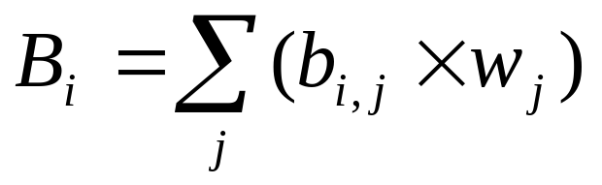
Utility: Architectural Strategies (2)
Also need to determine utility of tradeoffs/side effects
  The expected utility for a particular attribute may be negative
  At worst case, we need to develop a whole new curve for this side effect
Calculate the overall utility of an architectural strategy across scenarios
  Summing the utility associated with each one, weighted by the importance of the scenario

Slide 17
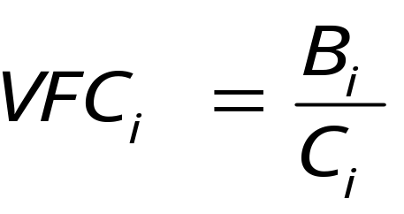
Calculating VFC
The VFC value for each architectural strategy is the ratio of the total benefit, B_{i}, to the cost, C_{i}, of implementing it. (C_{i} can be derived from the cost models)
  VFC VS. slope of the utility-responsive curve
Using VFC score, architectural strategies can be rank ordered to determine optimal order for implementation

Slide 18
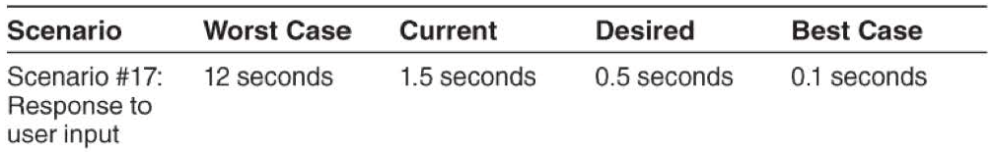
CBAM Steps (1)
Step 1: Collate scenarios
  Prioritize these scenarios based on satisfying the business goals of the system and choose the top one-third for further study
Step 2: Refine scenarios
  Elicit the worst-case, current, desired, and best-case quality attribute response level for each scenario
Step 3: Prioritize scenarios
  Prioritize scenarios using the two-step voting process; eliminate half of the scenarios

Slide 19
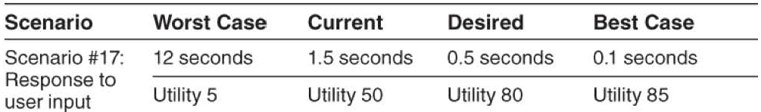
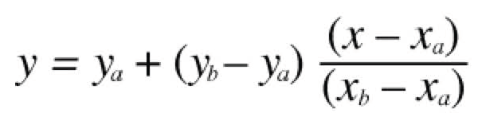
CBAM Steps (2)
Step 4: Assign utility
  Determine the utility for each quality attribute response level (worst-case, current, desired, best-case) for the scenarios from step 3
Step 5: Map architectural strategies to scenarios and determine their expected quality attribute response levels
Step 6: Determine the utility of the "expected" quality attribute response levels by interpolation

Slide 20
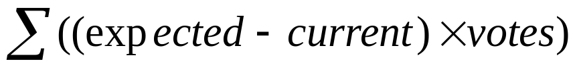
CBAM Steps (3)
Step 7: Calculate the total benefit obtained from an architectural strategy
Step 8: Choose architectural strategies based on VFC subject to cost and schedule constraints
  Determine the cost and schedule implications of each architectural strategy; choose the top ones until the budget or schedule is exhausted
Step 9: Confirm results with intuition
  Check whether the architectural strategies satisfy the organization's business goals

Slide 21
Case Study: The NASA ECS Project
The Earth Observing System is a constellation of NASA satellites that gathers data for the U.S. Global Change Research Program and other scientific communities worldwide
The Earth Observing System Data Information System (EOSDIS) Core System (ECS) collects data from various satellite downlink stations for further processing
  ECS's mission is to process the data into higher-form information and make it available to scientists in searchable form
  Performance
  Availability
  Modifiability
The ECS project manager had a limited annual budget to maintain and enhance his current system

Slide 22
Step 1: Collate Scenarios
Scenario | Scenario Description
1 | Reduce data distribution failures that result in hung distribution requests requiring manual intervention.
2 | Reduce data distribution failures that result in lost distribution requests.
3 | Reduce the number of orders that fail on the order submission process.
4 | Reduce order failures that result in hung orders that require manual intervention.
5 | Reduce order failures that result in lost orders.
6 | There is no good method of tracking ECS Guest failed/canceled orders without much manual intervention (e.g., spreadsheets).
7 | Users need more information on why their orders for data failed.
8 | Because of limitations, there is a need to artificially limit the size and number of orders.
9 | Small orders result in too many notifications to users.
10 | The system should process a 50-GB user request in one day, and a 1-TB user request in one week.

Slide 23
Step 2: Refine Scenarios
 | Response Goals
Scenario | Worst | Current | Desired | Best
1 | 10% hung | 5% hung | 1% hung | 0% hung
2 | > 5% lost | < 1% lost | 0% lost | 0% lost
3 | 10% fail | 5% fail | 1% fail | 0% fail
4 | 10% hung | 5% hung | 1% hung | 0% hung
5 | 10% lost | < 1% lost | 0% lost | 0% lost
6 | 50% need help | 25% need help | 0% need help | 0% need help
7 | 10% get information | 50% get information | 100% get information | 100% get information
8 | 50% limited | 30% limited | 0% limited | 0% limited
9 | 1/granule | 1/granule | 1/100 granules | 1/1,000 granules
10 | < 50% meet goal | 60% meet goal | 80% meet goal | > 90% meet goal

Slide 24
Step 3: Prioritize Scenarios
 |  | Response Goals
Scenario | Votes | Worst | Current | Desired | Best
1 | 10 | 10% hung | 5% hung | 1% hung | 0% hung
2 | 15 | > 5% lost | < 1% lost | 0% lost | 0% lost
3 | 15 | 10% fail | 5% fail | 1% fail | 0% fail
4 | 10 | 10% hung | 5% hung | 1% hung | 0% hung
5 | 15 | 10% lost | < 1% lost | 0% lost | 0% lost
6 | 10 | 50% need help | 25% need help | 0% need help | 0% need help
7 | 5 | 10% get information | 50% get information | 100% get information | 100% get information
8 | 5 | 50% limited | 30% limited | 0% limited | 0% limited
9 | 10 | 1/granule | 1/granule | 1/100 granules | 1/1,000 granules
10 | 5 | < 50% meet goal | 60% meet goal | 80% meet goal | > 90% meet goal

Slide 25
Step 4: Assign Utility
 |  | Utility Scores
Scenario | Votes | Worst | Current | Desired | Best
1 | 10 | 10 | 80 | 95 | 100
2 | 15 | 0 | 70 | 100 | 100
3 | 15 | 25 | 70 | 100 | 100
4 | 10 | 10 | 80 | 95 | 100
5 | 15 | 0 | 70 | 100 | 100
6 | 10 | 0 | 80 | 100 | 100
7 | 5 | 10 | 70 | 100 | 100
8 | 5 | 0 | 20 | 100 | 100
9 | 10 | 50 | 50 | 80 | 90
10 | 5 | 0 | 70 | 90 | 100

Slide 26
Step 5: Map Architectural Strategies to Scenarios & Determine Their Expected Quality Attribute Response Levels
Strategy | Name | Description | Scenarios Affected | Current Response | Expected Response
1 | Order persistence on submission | Store an order as soon as it arrives in the system. | 3 5 6 | 5% fail <1% lost 25% need help | 2% Fail 0% lost 0% need help
2 | … | …… | … | ....... | .......
3 | Order bundling | Combine multiple small orders into one large order. | 9 10 | 1 per granul 60% meet goal | 1 per 100 55% meet goal
...... totally 10 scenarios, see P320 Table 12.5 for more details

Slide 27
Step 6: Determine the Utility of the "Expected" Quality Attribute Response Levels by Interpolation
Strategy | Strategy | Scenarios Affected | Current Utility | Expected Utility
1 | Order persistence on submission | 3 5 6 | 70 70 80 | 90 100 100
2 | Order chunking | 8 | 20 | 60
3 | Order bundling | 9 10 | 50 70 | 80 65
4 | Order segmentation | 4 | 80 | 90
……

Slide 28
Step 7: Calculate the Total Benefit Obtained From an Architectural Strategy
Strategy | Scenario Affected | Scenario Weight | Raw Architectural Strategy Benefit | Normalized Architectural Strategy Benefit | Total Architectural Strategy Benefit
1 | 3 | 15 | 20 | 300
1 | 5 | 15 | 30 | 450
1 | 6 | 10 | 20 | 200 | 950
2 | 8 | 5 | 40 | 200 | 200
3 | 9 | 10 | 30 | 300
3 | 10 | 5 | -5 | -25 | 275

Slide 29
Step 8: Choose Architectural Strategies Based on VFC Value Subject to Cost Constraints
Strategy | Cost | Total Strategy Benefit | Strategy VFC | Strategy Rank
1 | 1200 | 950 | 0.79 | 1
2 | 400 | 200 | 0.5 | 3
3 | 400 | 275 | 0.69 | 2
4 | 200 | 100 | 0.5 | 3
5 | 400 | 120 | 0.3 | 7
6 | 200 | 50 | 0.25 | 8
7 | 200 | 70 | 0.35 | 6
8 | 300 | 150 | 0.5 | 3
9 | 1000 | 225 | 0.22 | 10
10 | 100 | 25 | 0.25 | 8

