Slide 1
Contexts of Software Architecture & Architectural Structures
Lecture 2
主讲教师：王灿
Email: wcan@zju.edu.cn
TA: 李奇平 liqiping1991@gmail.com
Course FTP: ftp://sa:sa@10.214.51.13

Slide 2
What Is Software Architecture?
[BCK13] The software architecture of a system is the set of structures needed to reason about the system, which comprise software elements, relations among them, and properties of both.
Notes:
Review the structures;
Comments on architectural and non-architectural issues;

Slide 3
Where Do Architectures Come From?
What Determines an Architecture?
Technical
requirements
?
Architecture
design
System
Given the same requirements specification to two different architects, will they produce the same architecture?
Notes:
Explain the classical course management system and its evolution.

Slide 4
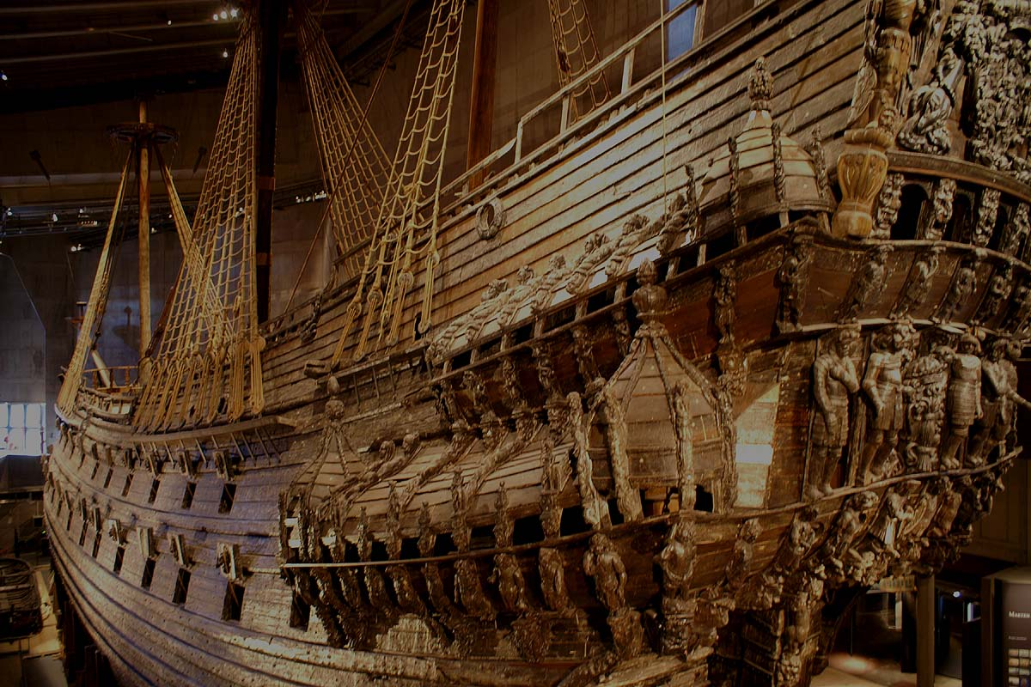
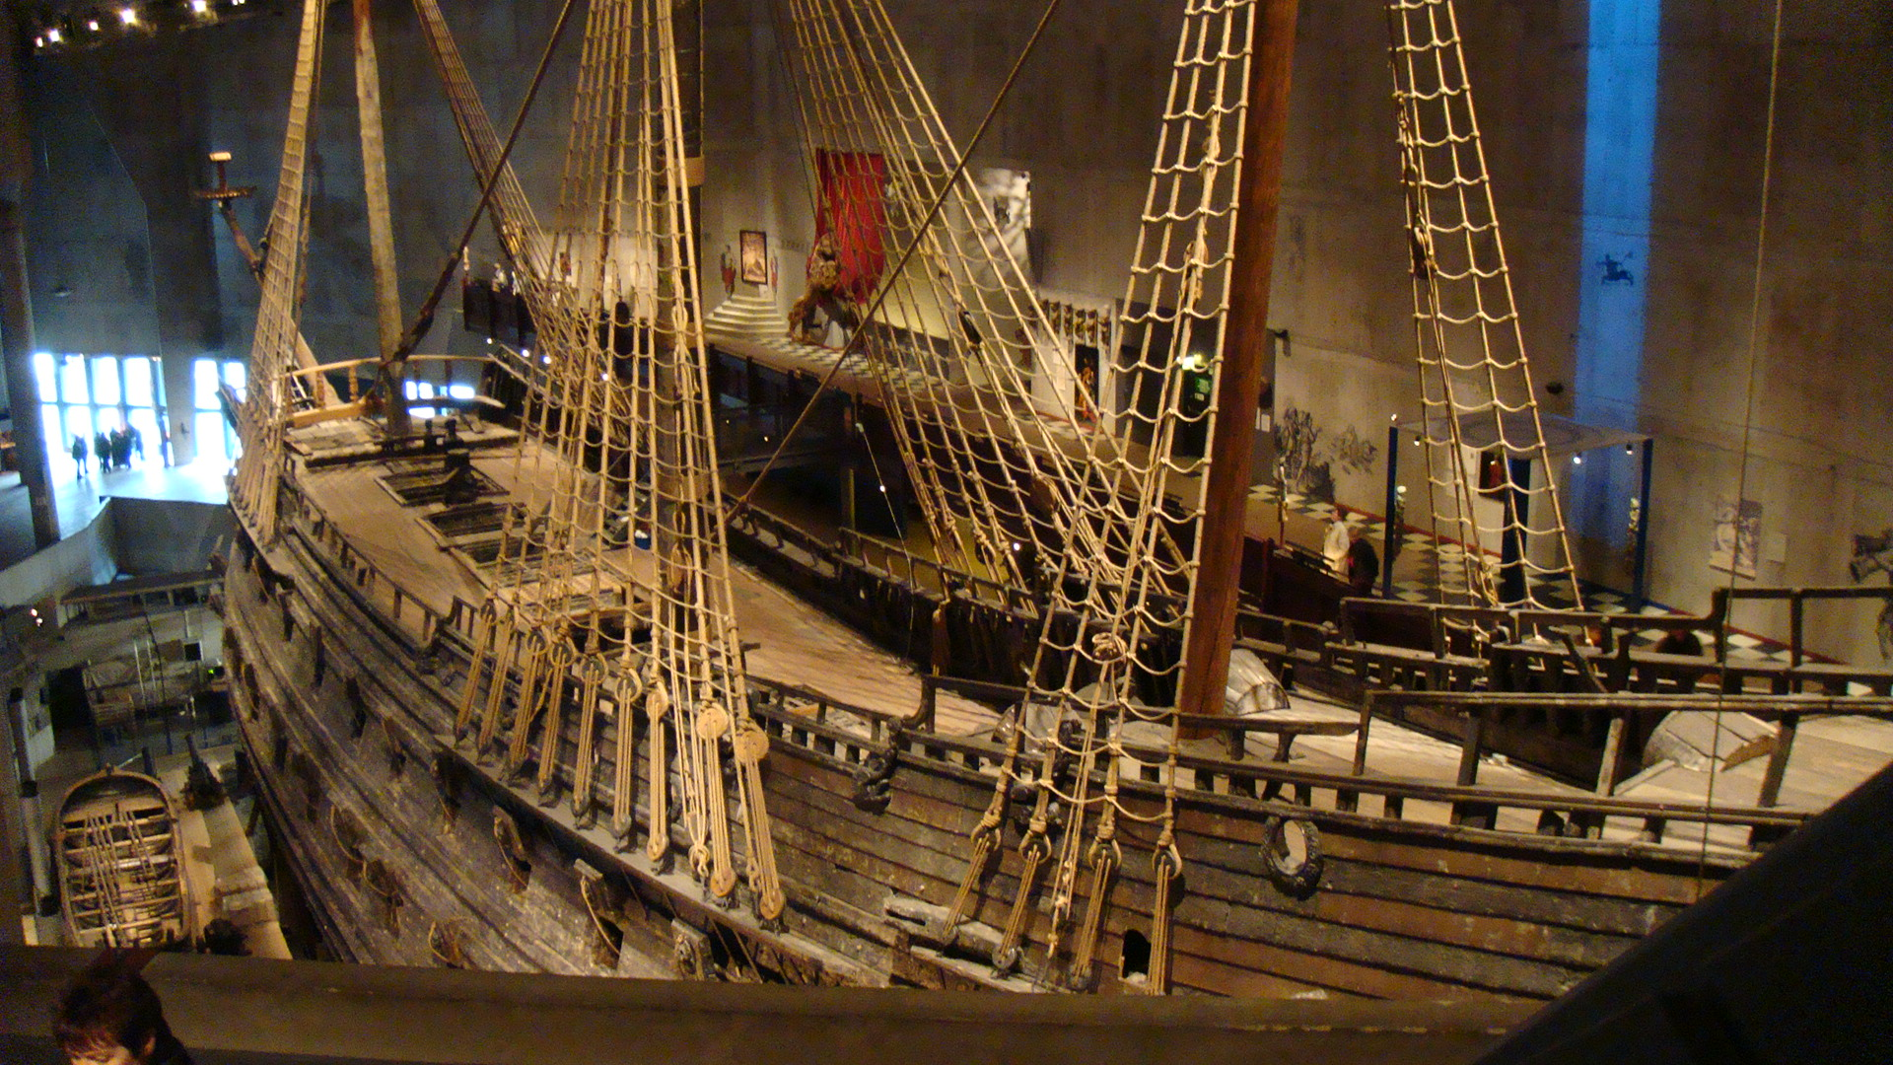
The Swedish Warship Vasa (1)
Notes:
The story of Vasa will give you an insightful illustration.

Slide 5
The Swedish Warship Vasa (2)
Built from 1626 to 1628, the Vasa was to be the world’s largest war ship
  70 meters long
  carrying 300 soldiers
  two gun decks with an astonishing 64 heavy guns mounted on
The Vasa foundered and sank after sailing less than 2km into her maiden voyage on 10 August 1628.

Slide 6
Contexts of Software Architecture
Architecture supports and is influenced by the various contexts in which it plays a role. These contexts include:
  Technical
  Project life cycle
  Business
  Professional

Slide 7
Architecture in a Technical Context
Architecture inhibit or enable the achievement of quality attributes
Technical environment will influence the architecture
  e.g. popular design for an information system nowadays: Web-based, object-oriented, service-oriented, mobility-aware, cloud-based, social networking-friendly

Slide 8
Architecture in a Project Life-Cycle Context
Four dominant software development processes
  Waterfall
  Iterative
  Agile
  Model-driven development

Slide 9
Evolutionary Delivery Life Cycle
Software
Concept
Deliver
The Final
Version
Preliminary
Requirements
Analysis
Design of
Architecture
And System
Core
Develop
A Version
Incorporate
Customer
Feedback
Deliver
The Version
Elicit
Customer
Feedback

Slide 10
Activities Involving Software Architecture in a Development Process
1. Making a business case for the system
2. Understanding the architecturally significant requirements
3. Creating or selecting the architecture
4. Documenting and communicating the architecture
5. Analyzing or evaluating the architecture
6. Implementing and testing the system based on the architecture
7. Ensuring that the implementation conforms to the architecture

Slide 11
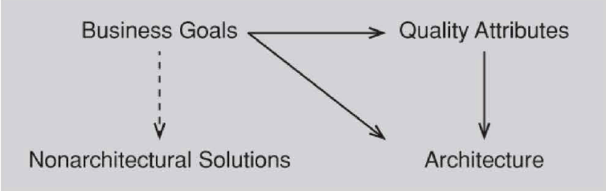
Architecture in a Business Context

Slide 12
Architecture in a Professional Context
Architecture is influenced by the architects’ background and experience.

Slide 13
Stakeholders
Name | Interest in architecture
Architect | Negotiating and making tradeoffs among competing requirements and design approaches. A vessel for recording design decisions. Providing evidence that the architecture satisfies its requirements
Deployer | Understanding the architectural elements that are delivered and to be installed at the customer or end user's site, and their overall responsibility toward system function.
Designer | Resolving resource contention and establishing performance and other kinds of runtime resource consumption budgets. Understanding how their part will communicate and interact with other parts of the system.
Implementer | Understanding inviolable constraints and exploitable freedoms on development activities.
Integrator | Producing integration plans and procedures, and locating the source of integration failures
Maintainer | Understanding the ramifications of a change
Project Manager | Helping to set budget and schedule, gauging progress against established budget and schedule, identifying and resolving development-time resource contention
Tester | Creating tests based on the behavior and interaction of the software elements.
User | Users, in the role of reviewers, might use architecture documentation to check whether desired functionality is being delivered. Users might also use the documentation to understand what the major system elements are, which can aid them In emergency field ma1ntenance.
See Table 3.1 in P54

Slide 14
Architectural Structures
In a house, there are plans for
  rooms
  electrical wiring
  plumbing
  ventilation
Each of these constitutes a “view” of the house.
  used by different people
  used to achieve different qualities in the house
  serves as a description and prescription
So it is with software, a structure is a view of architecture.

Slide 15
Groups of Software Architectural Structures
Module structures:
  How is the system to be structured as a set of code units (modules)?
Component-and-connector structures
  How is the system to be structured as a set of elements that have runtime behavior (components) and interactions (connectors)?
Allocation structures
  How is the system to relate to non-software structures in its environment

Slide 16
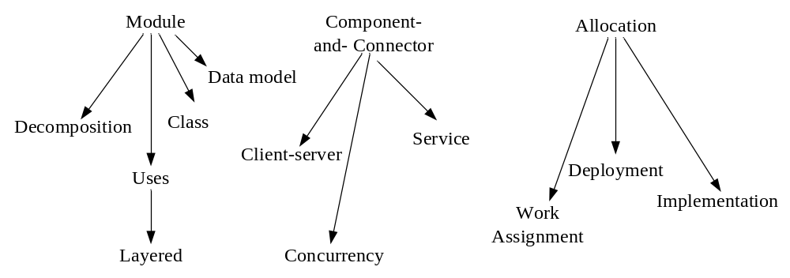
Common Software Architecture Structures
Process

Slide 17
Decomposition Structure
Units: modules
Relations: “is a sub-module of”
Used: as a basis for development project's organization, including the structure of the documentation, and its integration and test plans.
Affected attributes include: modifiability, understandability

Slide 18
Uses Structure
Units: modules or procedures or resources on the interfaces of modules
Relations: uses (“assumes the correct presence of”)
Used: to engineer subsets, supersets
Affected attributes include: reusability, testability, incremental development

Slide 19
Layered Structure
Units: layers (a coherent set of related functionality)
Relations: layer n only uses the services of layer n-1
Used: to hide implementation details, to provide design abstraction (virtual machine)
Affected attributes include: portability

Slide 20
Class Structure (Generalization)
Units: classes
Relation: “inherits from,” “is an instance of”
Used: to exploit similarity among classes
Affected attributes include: reusability, incremental addition of functionality

Slide 21
Data Model
Units: data entities
Relation: relationship between data entities
Used: to describe static information structure

Slide 22
Service Structure
Components: services
Connectors: service coordination mechanism such as SOAP
Used: analyze and engineer service-oriented system
Affected attributes include: performance, modifiability

Slide 23
Concurrency Structure
Components: “logical threads of execution”
Connectors: corresponding communication mechanisms
Used: to identify locations where resource contention exists, where threads may fork, join, be created or be killed
Affected attributes includes: parallelism, performance

Slide 24
Process Structures (communicating process)
Units: processes or threads
Relations: “synchronizes with,” “excludes,” “preempts”
Used: to tune system runtime performance, exploit multiprocessing hardware
Affected attributes include: performance
Notes:
e.g. mpu

Slide 25
Client-Server Structure
Components: clients and servers
Connectors: request/reply, the asymmetric invocation of server’s services by a client
Used: to separate concerns, to distribute operations and to balance load
Affected attributes include: performance, modifiability

Slide 26
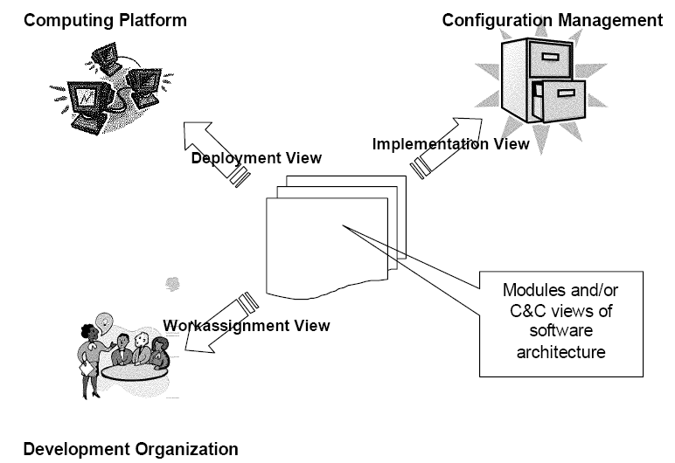
The Allocation Viewtype Overview
The allocation viewtypes show the mapping of the software architecture onto its environment (hard ware, file system, team structure).
  Deployment style
    onto hardware (performance analysis)
  Implementation style
    file system (system development management)
  Work assignment style
    team structure (project management)

Slide 27
Deployment Structures
Units: software, hardware and communication pathways
Relations: “allocated to”, “migrates to”
Used: to reason about performance, data integrity, availability, and security.

Slide 28
Implementation Structures
Units: modules, files
Relations: mapping, stored in
Used: to manage development activity, to configure, integrate and test software modules

Slide 29
Work Assignment Structures
Units: modules, development teams
Relations: “assigned to”
Used: to assist project management, to enable best use of expertise and to manage commonality

Slide 30
Example of Using Multiple Views: Concurrency Design
Module decomposition view
  Providing containers for functionality
  Discover major data flow relationships among modules
Concurrency view
  Presenting “logical threads of execution”
  Uncovering resource contention, deadlock, data consistency issues, thus revealing synchronization points in the design
Process view
  Revealing the concurrency infrastructure at the OS level
Deployment view

Slide 31
Relate Structures to Each Other
Though each of these structures provides a different system perspective, they are interrelated with each other.
In most cases, the dominant structure of a software system is module decomposition.
Not all systems warrant consideration of many architectural structures.
Structures represent the primary engineering leverage points of an architecture.

Slide 32
Reading Assignment
Read Chapter 4 & 5 of the textbook.

