Slide 1
Tactics for Availability (1)
主讲教师：王灿
Email: wcan@zju.edu.cn
TA: 李奇平 liqiping1991@gmail.com
Course FTP: ftp://sa:sa@10.214.51.13

Slide 2
Availability
Availability = reliability + recovery
  Availability is about minimizing system failure time by mitigating faults
Failure VS fault:
  A “system failure” is observable by the system’s user.
  A system fault may cause a “system failure” or it might be masked.
α = MTBF / (MTBF + MTTR)

Slide 3
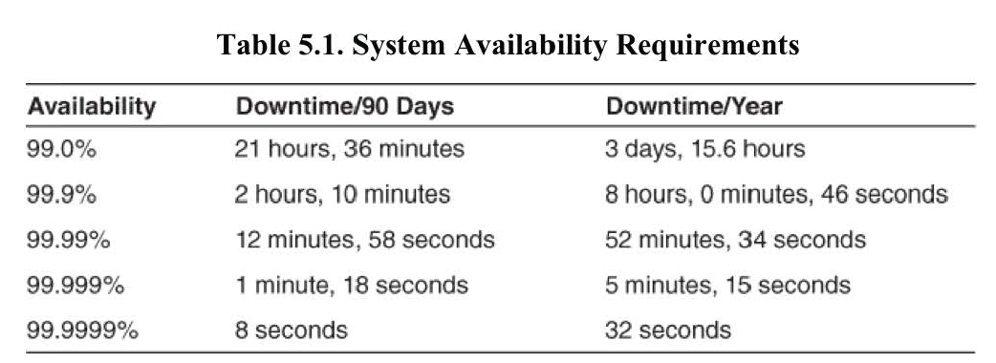

System Availability Requirements

Slide 4
Availability General Scenario (1)
Stimulus---a fault of following classes:
  Omission
  Crash
  Incorrect timing
  Incorrect response
Source of stimulus
  Internal/external: people, hardware, software, physical infrastructure…

Slide 5
Availability General Scenario (2)
Response: reactions to a system fault
  Detect and isolate the fault
    Log and notify
  Recover from the fault
    Disable the faulty source
    Fix the fault and contain damage or
    Operate in a degraded mode at meantime
Response measure
  Availability percentage (e.g., 99.999%)
  Time to detect and repair the fault, time in degraded mode

Slide 6
Availability General Scenario (3)
Artifact
  System’s processors, communication channels, persistent storage, processes
Environment
  Normal operation, startup, shutdown, repair mode, degraded operation, overloaded operation

Slide 7
Availability Tactics
Tactics to
Control
Availability
Fault
Fault Masked
or Repaired
How to build a highly available system
  Keep faults from becoming failures
  Limit the effects of a fault and make repair
Approaches to maintain availability include:
  Monitoring or detecting faults
  Recovering from failure
  Preventing faults

Slide 8
Availability Tactics Hierarchy
Availability
Fault detection
Recover from faults
Prevention
Ping/echo
Monitor
Heartbeat
Timestamp
Sanity checking
Condition monitoring
Voting
Exception detection
Selftest
Recovery
Preparation
and repair
Recovery
Reintroduction
fault
Removal from Service
Transactions
Predictive model
Exception prevention
Increase competence set
Fault
Masked
Or
repaired
Active red.
Passive red.
Spare
Exception handling
Rollback
Retry
Ignore faulty behavior
Degradation
Reconfiguration
Shadow
State resync.
Escalating restart
Non-stop forwarding

Slide 9
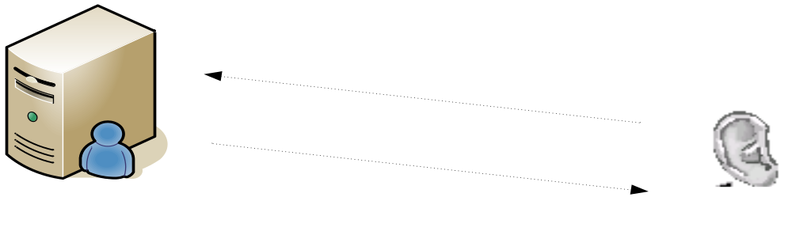
Ping/Echo
Ping/echo determines the reachability and the round-trip delay
  Sometimes also check whether the pinged component is alive and responding correctly
Often sent by a system monitor
Ping/echo requires a time threshold to be set

Slide 10
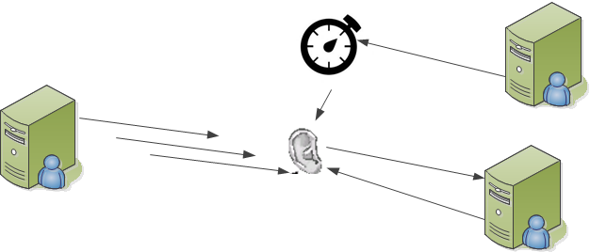
Monitor, Watchdog and Heartbeat (1)
A system monitor watches the running state of other system components: processors, processes, I/O, memory, detect failure or congestion in the network or other shared resources
  E.g. Process monitor in Oracle
  Detect failure or congestion in the network or other shared resources

Slide 11

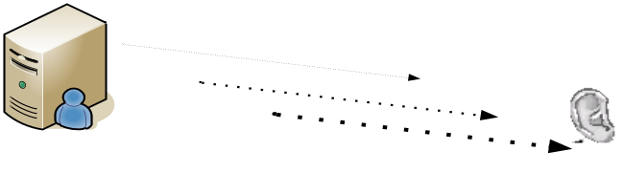
Monitor, Watchdog and Heartbeat (2)
Watchdog: the detection mechanism is implemented using a counter or timer that is periodically reset by the process being monitored ("petting the watchdog")
  The expiration of the timer indicates to the system monitor of a fault occurrence in the process
Heartbeat: a periodic message exchange between a system monitor and a process being monitored
  Reducing overhead by piggybacking heartbeat messages on to other control messages being exchanged between the process being monitored and the distributed system controller.

Slide 12
Time Stamp
Time stamp detects incorrect sequences of events, primarily in distributed message-passing systems
  Assigning a sequence number or local clock to the event immediately after it occurs

Slide 13
Sanity Checking & Condition Monitoring
Sanity checking checks the validity or reasonableness of specific operations or outputs of a component
Condition monitoring involves checking conditions in a process or device, or validating assumptions made during the design
  E.g. checksums
Notes:
Sanity check is usually a quick test to ensure SUD is stable and reasonable before starting the detailed test. (satisfies basic assumptions)

Slide 14
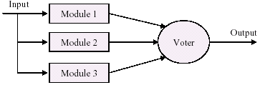

Voting (1)
Processes running on redundant processors each take the equivalent input, compute and report a simple output to a “voter”
  Majority rules
  Preferred component

Slide 15
Voting (2)
Replication: multiple copies of identical components
  Effective in protecting against random failures of hardware, but this cannot protect against design or implementation errors
Functional redundancy
  Components must always give the same output given the same input
  But they are diversely designed and diversely implemented: separate processors, separate implementation teams, … dissimilar platforms

Slide 16
Voting (3)
Analytic redundancy: Functional redundancy + diversity among the components' inputs and outputs
  E.g. avionics programs use multiple ways to compute aircraft altitude: barometric pressure, the radar altimeter, and geometrically using the straight-line distance and look-down angle of a point ahead on the ground.

Slide 17
Exception Detection
System exception
  System raises an exception when it detects a fault (divide by zero, bus and address faults, il-legal program instructions)
Parameter fence
  A special data pattern placed immediately after any variable-length parameters of an object to detect memory overwriting
Parameter typing
  TLV, Strong typing
Timeout
  Exceptions raised when time constraints fail

Slide 18
Self-test
Components run procedures to test themselves for correct operation
  Can be initiated by the component itself or invoked from time to time by a system monitor

Slide 19
Availability Tactics Hierarchy
Availability
Fault detection
Recover from faults
Prevention
Ping/echo
Monitor
Heartbeat
Timestamp
Sanity checking
Condition monitoring
Voting
Exception detection
Selftest
Recovery
Preparation
and repair
Recovery
Reintroduction
fault
Removal from Service
Transactions
Predictive model
Exception prevention
Increase competence set
Fault
Masked
Or
repaired
Active red.
Passive red.
Spare
Exception handling
Rollback
Retry
Ignore faulty behavior
Degradation
Reconfiguration
Shadow
State resync.
Escalating restart
Non-stop forwarding

Slide 20
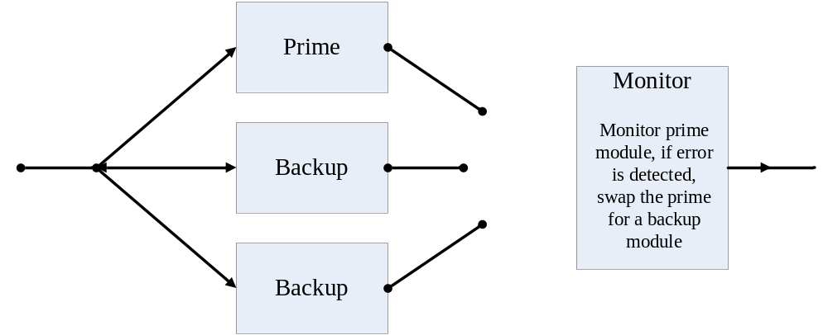
Active Redundancy (Hot Spare) (1)
Redundant components synchronized at start and respond to events in parallel, usually the first component to return is accepted as the correct answer.
input
output

Slide 21
Active Redundancy (2)
Synchronization
  Ensuring that all messages to any redundant component are sent to all redundant components.
Downtime is switching time
  Usually only milliseconds (switching to another component).
E.g. highly available LANs, DB

Slide 22
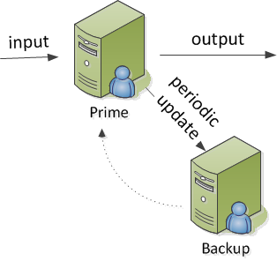
Passive Redundancy (Warm Spare)
One component responds to events and informs the standbys of state updates.
Synchronization is the responsibility of the primary component
  May use atomic broadcasts to the secondaries to guarantee synchronization.
Upon failure the system must:
  Ensure that the backup is sufficiently fresh (checkpoint + log).
  The standby components take over from the primary.

Slide 23
Spare (Cold Spare)
A standby spare computing platform is configured to replace many different failed components.
The spare must be rebooted to the appropriate software configuration and have its state initialized when a failure occurs.
Synchronization and taking over: checkpoint + logging
  A checkpoint is an event that flushes the modified data from the buffer cache to the disk, resulting in a consistent snapshot.

Slide 24
Exception Handling
Information return from an captured exception depends on development environment
  Error codes
  Exception classes
    Containing helpful information such as the name of the exception thrown, the origin of the exception, and the cause of the exception thrown etc.
Exception information can be used to mask the fault by correcting the cause of the exception and retrying the operation

Slide 25
Rollback
In case of failure, rollback reverts the system to a previous known good state, referred to as the "rollback line"
  A copy of a previous good state can be saved by making a checkpoint of the system
  Usually combines with active or passive redundancy
    After a rollback, a standby version of the failed component is promoted to active status

Slide 26
Retry
In networks and in server farms where failures are common and usually transient, the retry tactic will retry the failed operation which usually lead to success
  A limit on the number of retries shall also be placed

Slide 27
Ignore Faulty Behavior
Ignoring messages sent from a particular source when we determine that those messages are spurious
  E.g. ignoring the message from a specific source in an DOS attack

Slide 28
Degradation
Maintaining the most critical system functions in the presence of component failures, dropping less critical functions

Slide 29
Reconfiguration
Recovering from component failures by reassigning responsibilities to the (potentially restricted) resources left functioning, while maintaining as much functionality as possible

Slide 30
Reading Assignment
Read Chapter 5 of the textbook.

