Slide 1
Tactics for Interoperability
主讲教师：王灿
Email: wcan@zju.edu.cn
TA: 李奇平 liqiping1991@gmail.com
Course FTP: ftp://sa:sa@10.214.51.13

Slide 2
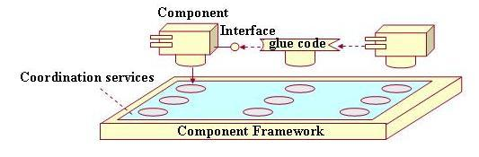
Component-based Development
A component is a self-contained software construct that has a defined use, has a run-time interface and can be autonomously deployed
Appealing reasons behind OTS: economical, specialized, time to market….
Notes:
Operation Dessert Storm…

Slide 3
Service-Oriented Computing (SOC)
SOC is the computing paradigm that utilizes services as fundamental elements for developing applications
  Discrete pieces of software providing application functionality as services to other applications
A service is a set of capabilities that is accessible via some kind of interface
  Technology neutral
  Loosely coupled
  Support location transparency
Notes:
Explain the key difference from component-based development in that the interface in SOC may not be known before the interaction.

Slide 4
Web Service
Web service: a special case of SOC that use the Internet as the communication medium and open Internet-based standards
  SOAP calls carries XML data content
  WSDL expresses the service descriptions of the web-services using XML(ports, port types, bindings)
  UDDI provides directory service containing service publications and enables web-service clients to locate candidate services and discover their details

Slide 5
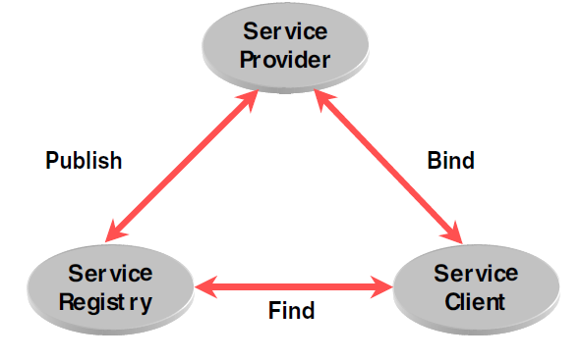
The Basic Service Oriented Architecture (SOA)

Slide 6
System of Systems (SoS)
Systems of systems are large-scale concurrent and distributed systems that are comprised of complex systems
  A group of systems that are interoperating to achieve a joint purpose
  Independent and useful systems are integrated into a larger system that delivers unique capabilities

Slide 7
Taxonomy of Systems of Systems
Type | Description
Directed | SoS objectives, centralized management, funding, and authority for the overall SoS are in place. Systems are subordinated to the SoS.
Acknowledged | SoS objectives, centralized management, funding, and authority in place. However, systems retain their own management, funding, and authority in parallel with the SoS
Collaborative | There are no overall objectives, centralized management, authority, responsibility, or funding at the SoS level. Systems voluntarily work together to address shared or common interests
Virtual | Like collaborative, but systems don't know about each other

Slide 8
Issues in Components/Services/Systems Interoperability
Architectural issues
  Enforce architectural assumptions
  Compatibility issues
Other issues
  Vendor support issues
  Configuration management
  Documentation issues
  Unknown technical features etc.

Slide 9
Architectural Mismatch
Not all components/services/systems work together, problems might occur at different time
  Compile, integration, run time
Quality attributes usually not (fully) specified for components/services/systems
  Then what are specified?
Architectural mismatch
  Reflects a mismatch between assumptions embodied in separately developed components

Slide 10
Interface Mismatch (1)
A generalized definition of interface
  The standard concept of interface in current practice: a component's API
  The generalized concept concerns what we assume about interface in practical use: the assumptions that components can make about each other
    side effects
    consumption of global resources
    coordination requirements...

Slide 11
Interface Mismatch (2)
Architectural assumptions
  Provides assumptions
    the services a components/services/systems provides to its users or clients.
  Requires assumptions
    the services or resources that a components/services/systems must have in order to correctly function.
Architectural mismatch is treated as a special case of interface mismatch.

Slide 12
Techniques for Repairing Interface Mismatch
Repairing the interface mismatch
  Change the code of offending component
  Use an alternative component
    Sometimes not feasible options
  Insert code for reconciliation
    Wrappers
    Bridges
    Mediators
Notes:
A direct approach is to change the code of the component. (code unavailable; used in more than one place.)

Slide 13
Wrappers
Wrappers yield an alternative interface to the component, i.e. interface translation
  Translating an element of an interface into an alternative element
  Hiding an element of an interface
  Preserving an element of a component's base interface without change
Notes:
As an encapulation

Slide 14
Bridges
A bridge translates some requires assumptions of one arbitrary component to some provides assumptions of another.
Difference between a bridge and a wrapper
  the repair code constituting a bridge is independent of any particular component.
  the bridge must be explicitly invoked by some external agent
  bridges address specific assumptions, which means they focus on a narrower range of interface translations than wrappers
Notes:
The definition from Design Pattern: Decouple an abstraction from its implementation so that the two can vary independently.

Slide 15
Mediators
A mediator encapsulates how a set of objects interact
  It incorporate a planning function that in effect results in runtime determination of the translation
    Intelligence and dynamic behaviors can be implemented in mediators
  e.g. high-fidelity data producer VS. low-fidelity data consumer VS. users with different throughput requirement
Notes:
The definition from Design Pattern: Define an object that encapsulates how a set of objects interact. Mediator promotes loose coupling by keeping objects from referring to each other explicitly, and it lets you vary their interaction
independently.

Slide 16
Interoperability (1)
Interoperability is about the degree to which two or more systems can usefully exchange meaningful information via interfaces in a particular context
  Syntactic interoperability: the ability to exchange data
  Semantic interoperability: the ability to correctly interpret the data being exchanged

Slide 17
Interoperability (2)
Two important aspects of interoperability
  Discovery: the consumer of a service must discover the location, identity, and the interface of the service
  Handling of the response:
    The service reports back to the requester with the response
    The service sends its response on to another system
    The service broadcasts its response to any interested parties

Slide 18
Interoperability General Scenario (1)
Stimulus
  A request to exchange information among system(s)
Source of stimulus
  A system initiates a request to interoperate with another system
Response
  The request is accepted and the information is understood by the receiving party both syntactically and semantically, or
  the request is rejected and appropriate entities are notified
  The request may be logged

Slide 19
Interoperability General Scenario (2)
Response measure
  The percentage of information exchanges correctly processed or rejected
Artifacts
  The systems that wish to interoperate
Environment
  The systems that wish to interoperate are discovered at runtime or are known prior to runtime

Slide 20
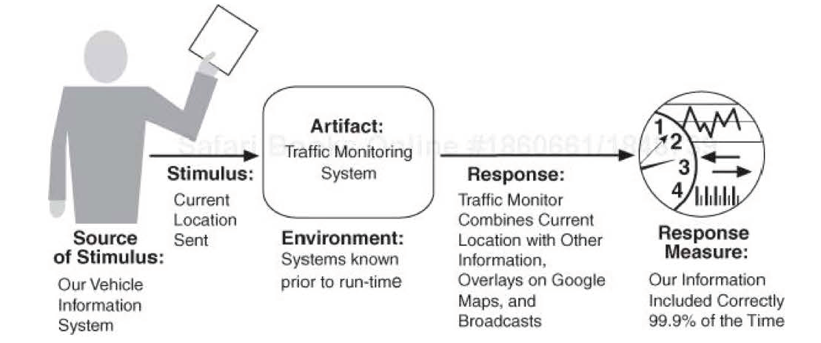
A Sample Concrete Interoperability Scenario

Slide 21
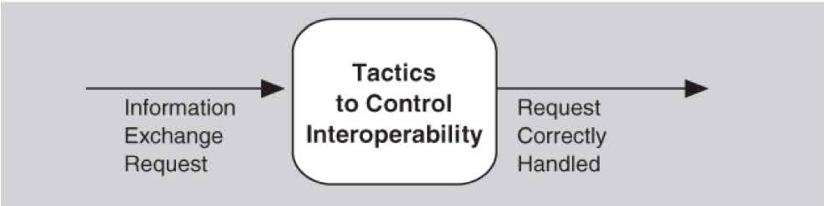
Tactics for Interoperability
Two categories of interoperability tactics
  Locate
  Manage interfaces

Slide 22
Locate: Discover Service
Used when the systems that interoperate must be discovered at runtime
Locate a service through searching a known directory service
  May be multiple levels of indirection in this location process
  The service can be located by type of service, by name, by location, or by some other attribute

Slide 23
Manage Interfaces: Orchestrate
Coordinating, managing and sequencing the invocation of particular services
Orchestration is used when the interoperating systems must interact in a complex fashion to accomplish a complex task
  E.g. Workflow engines
  The mediator design pattern can serve this function for simple orchestration
  Complex orchestration can be specified in a language such as BPEL
Notes:
BPEL4WS(Business Process Execution Language For Web Services)

Slide 24
Manage Interfaces: Tailor interface
Adding or removing capabilities to an interface
  Capabilities such as translation, adding buffering, or smoothing data can be added
  Capabilities may be removed as well
    E.g. removing capabilities is to hide particular functions from untrusted users

Slide 25
Architectural Design Support for Interoperability
We check the architectural design and analysis process for interoperability from the following aspects:
  Allocation of responsibilities
  Coordination model
  Data model
  Management of resources
  Mapping among architectural elements
  Binding time decisions
  Choice of technology

Slide 26
Allocation of Responsibilities
The following system responsibilities are to be allocated to ensure system interoperability
  Detect a request to interoperate with known or unknown external systems
  Accept the request
  Exchange information
  Reject the request
  Notify appropriate entities (people or systems)
  Log the request (support for nonrepudiation)

Slide 27
Coordination Model
Ensure that the coordination mechanisms can meet the critical quality attribute requirements
Special considerations for performance:
  Network traffic
  Jitter in network transmission
  ...

Slide 28
Data Model
Determine the syntax and semantics of the major data abstractions that may be exchanged among interoperating systems
Ensure that these major data abstractions are consistent with data from the interoperating systems

Slide 29
Mapping among Architectural Elements
Focus on components → processors mapping
  Ensure communication among interoperating components
  Ensure the communication meet other quality requirements

Slide 30
Resources Management
Ensure the interoperation with other systems will not exhaust critical system resource
The resource load imposed by the communication requirements of interoperation shall be acceptable
Arbitration policy for resource contention among participating systems

Slide 31
Choice of Technology
For any of your chosen technologies, are they "visible" at the interface boundary of a system?
Consider the quality attributes of technologies that are used in your design, such as web services.

Slide 32
Reading Assignment
Read Chapter 7 of the textbook.

