Slide 1
Design for Modifiability
主讲教师：王灿
Email: wcan@zju.edu.cn
TA: 李奇平 liqiping1991@gmail.com
Course FTP: ftp://sa:sa@10.214.51.13
Notes:
Encourage the students to think creatively by asking the question again: what is computer software? Emphasize its connection with people.

Slide 2
Modifiability (1)
Software change is constant and ubiquitous
Modifiability is about change
Four major concerns:
  What can change?
    The function the system computes
    The platform it exists on
      Portability
    Qualities of the system
    Capacity of the system
Notes:
Read carefully the corresponding passage in the textbook, which certainly will deepen your understanding of a software system.

Slide 3
Modifiability (2)
  When is the change made and who makes it?
Architect
System design
Implementation (source code)
Developer
Compile (compiling options)
Build (libraries)
Administrator
System configuration (parameter setting)
User
Execution (parameter setting)
  Once a change has been specified, the new implementation must be designed, implemented, tested, and deployed.

Slide 4
Modifiability (3)
  What is the likelihood of the change?
    Architectural supports shall go to the parts most likely to change, or more precisely, supports the parts whose changes will incur the highest costs.
  What is the cost of the change?
    The cost of introducing the change-handling mechanism(s)
    The cost of making the modification using the change-handling mechanism(s)
Notes:
Read carefully the corresponding passage in the textbook, which certainly will deepen your understanding of a software system.

Slide 5

Two Ends of the Modifiability Spectrum
Cost of the change-handling mechanism
Cost of completing the change requests
MAX
MAX
MIN
MIN
No modifiability tactics applied
Maximum support for modifiability, such as app. generator; a Web browser's support for UI

Slide 6
A Simple Equation for Planning Change-handling Mechanism
For N similar modifications, a simplified justification for a change-handling mechanism:
  N x Cost of making the change without the mechanism < Cost of installing the mechanism + (N x Cost of making the change using the mechanism)
  N is the expected number of modifications
Change-planning equation

Slide 7
Modifiability General Scenario (1)
Stimulus: changes to be made
  Functions
  Quality attributes
  Capacities
  …
Source of stimulus
  End user
  System administrator
  Developer
  …

Slide 8
Modifiability General Scenario (2)
Response
  Make, test and deploy the change
Response
  Time and money
  Number of elements (modules, defects) affected,
Artifact
  Any aspect of a system
Environment
  Design, compile, build time
  Initiation time
  Runtime

Slide 9
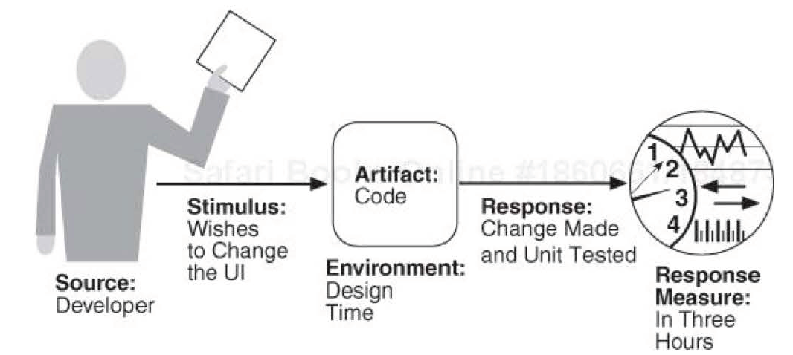
A Sample Concrete Modifiability Scenario

Slide 10
Coupling
Coupling measures the overlap of two modules by measuring the probability that a modification to one module will propagate to the other
  If two modules' responsibilities overlap in some way, then a single change may well affect them both
  Tight coupling is an enemy of modifiability

Slide 11
Cohesion
Cohesion measures how strongly the responsibilities of a module are related
  Cohesion is the probability that a change scenario that affects a responsibility will also affect other (different) responsibilities
  “Unity of purpose”

Slide 12
Parameters for Controlling Modifiability
Size of a module
Coupling
Cohesion

Slide 13
Modifiability Tactics (1)
Tactics
to Control
Modifiability
Change
Arrives
Changes made
Changes tested
Changes deployed
within budget
Goals: controlling the time and cost to implement, test, and deploy changes.

Slide 14
Modifiability Tactics (2)
Modifiability Tactics
Reduce Size
of a Module
Increase
Cohesion
Reduce
Coupling
Defer
Binding
Change
Arrives
Changes
Made,
Tested,
And
Deployed
Split
Module
Increase Semantic
Coherence
Encapsulate
Use an
Intermediary
Restrict Dependencies
Refactor
Abstract Common
Services

Slide 15
Reduce the Size of a Module: Split Module
If the module being modified includes a great deal of capability, the modification costs will likely be high
  Refining the module into several smaller modules should reduce the average cost of future changes

Slide 16
Increase Cohesion: Increase Semantic Coherence
Semantic coherence: the relationships among responsibilities in a module
  Keep things that are related together (serve the same purpose)
If the responsibilities A and B in a module do not serve the same purpose, they should be placed in different modules
  Creating a new module
  Moving a responsibility to an existing module

Slide 17
Reduce Coupling: Encapsulate
Encapsulate: visible API + transparent implementation
Interface limits the ways in which external responsibilities can interact with the module
  The external responsibilities can now only directly interact with the module through the exposed interface

Slide 18
Reduce Coupling: Use an Intermediary
Intermediaries are used to break a dependency between responsibility A and responsibility B, e.g.:
  Directory service in service invocation
  Data repository separates readers of a piece of data from writers of that data
  Memory handles for runtime memory location
  Resource manager for resource contention
  Publish-subscribe pattern removes the data producer's knowledge of its consumers

Slide 19
Reduce Coupling: Restrict Dependencies
Restricts the modules that a given module interacts with or depends on
  Restricting a module's visibility
  Restricting access to only authorized modules
Examples
  In layered pattern, a layer is only allowed to use lower layers
  In the use of wrappers, external entities can only see (and hence depend on) the wrapper and not the internal functionality that it wraps

Slide 20
Reduce Coupling: Refactor
Refactoring disciplined technique for restructuring an existing body of code, altering its internal structure without changing its external behavior
Code refactoring avoids duplicative or overly complex code using a series techniques
  Extract method, generalize type, encapsulate field, pull up...

Slide 21
Reduce Coupling: Abstract Common Services
Keep a service required by multiple clients in one place
  Modifications need not be made separately
Parameterizing module's activities to introduce abstraction
  Simple parameters VS. specialized language

Slide 22
Defer Binding (1)
The later in the life cycle we can bind values, the more flexibility we have to handle modification
  Late binding usually are more expensive to implement
Defer binding tactics at compile time or build time:
  Component replacement (for example, in a build script or make file)
  Compile-time parameterization

Slide 23
Defer Binding (2)
Tactics to bind values at deployment time include:
  Configuration-time binding
Tactics to bind values at startup or initialization time include:
  Resource files

Slide 24
Defer Binding (3)
Tactics to bind values at runtime include these:
  Runtime registration
  Dynamic lookup (e.g., for services)
  Interpret parameters
  Startup time binding
  Name servers
  Plug-ins
  Publish-subscribe
  Shared repositories
  Polymorphism

Slide 25
Architectural Design Support for Modifiability
We check the architectural design and analysis process for modifiability from the following 7 aspects:
  Allocation of responsibilities
  Coordination model
  Data model
  Management of resources
  Mapping among architectural elements
  Binding time decisions
  Choice of technology

Slide 26
Allocation of Responsibilities
Determine the changes that are likely to occur
  The responsibilities affected by the change
  The corresponding responsibilities to be added/modified/deleted
  Responsibility allocation shall put responsibilities likely to be changed together in one place

Slide 27
Coordination Model
Similar to responsibility considerations, we determined coordination that are likely to be affected by the change, esp. those occur at runtime
Consider coordination models that reduce coupling for these parts whose modifiability is a concern
Notes:
Browser-based interaction, traditional application window VS. command line interaction

Slide 28
Data Model
Determine likely changes to the data model (abstractions/operations/properties)
Determine the changes to data abstractions that will involve their creation, initialization, persistence, manipulation, translation, or destruction.
Determine who will make these changes and check whether they have been granted proper privileges

Slide 29
Mapping among Architectural Elements
Determine how the mapping between functionality and computational elements (e.g., processes, threads, processors) supports modifiability (at runtime, compile time, design time, or build time)

Slide 30
Resources Management
Determine how the addition, deletion, or modification of a responsibility or quality attribute will affect resource usage

Slide 31
Binding Time Decisions
Determine the late binding mechanisms that can accommodate the change request
Choose a defer-binding mechanism using the change-planning equation

Slide 32
Choice of Technology
Determine how the technology helps to make, test, and deploy modifications
Determine the cost of switching between alternative technologies

Slide 33
Reading Assignment
Read Chapter 8 of the textbook.

