Slide 1
Tactics for Security (1)
主讲教师：王灿
Email: wcan@zju.edu.cn
TA: 李奇平 liqiping1991@gmail.com
Course FTP: ftp://sa:sa@10.214.51.13

Slide 2
Some Proverbs
No fortress is impregnable
A chain is only as strong as its weakest link
The easiest way to capture a fortress is from within

Slide 3
Security and Attack
Security is about system’s ability to protect data and information from unauthorized access while still providing access to people and systems that are authorized
Attack – is an attempt to breach security
  Unauthorized login
  Sniffing data on communication channel
  Unauthorized access/modification of data
  Denial of services attacks – crash the system
  ……
Notes:
The difficulty with security is to allow access to legitimate users
Simply preventing access to a system is a trivial issue

Slide 4
Security: Confidentiality
Confidentiality
Data or services are protected from unauthorized access
Confidentiality
Integrity
Availability
Authentication
Nonrepudiation
Authorization

Slide 5
Security: Integrity
Confidentiality
Data or services are not subject to unauthorized manipulation
Confidentiality
Integrity
Availability
Authentication
Nonrepudiation
Authorization

Slide 6
Security: Availability
Confidentiality
Integrity
The system will be available for legitimate use
Availability
Authentication
Nonrepudiation
Authorization

Slide 7
Security: Authentication
Confidentiality
Integrity
Availability
Verifying the identities of the parties to a transaction and checking if they are truly who they claim to be
Authentication
Nonrepudiation
Authorization

Slide 8
Security: Nonrepudiation
Confidentiality
Integrity
Availability
Authentication
The sender of a message cannot later deny having sent the message and that the recipient cannot deny having received the message
Nonrepudiation
Authorization

Slide 9
Security: Authorization
Confidentiality
Integrity
Availability
Authentication
Nonrepudiation
Granting a user the privileges to perform a task
Authorization

Slide 10
Security General Scenario (1)
Stimulus
  Unauthorized attempts to display/modify/delete data or access system services, change service behavior or reduce availability
Source of stimulus
  Human/system
  Identified/unknown
  Internal/external
  Limited access/access to vast resource
Response
  Ensure CIA, authentication, nonrepudiation, authorization, track activities & notify
Notes:
An attack is an attempt to break CIA, and the leaves of attack trees would be the stimulus in the scenario
The response to the attack is to preserve CIA or deter attackers through monitoring of their activities

Slide 11
Security General Scenario (2)
Response Measure
  How much of a system is compromised when a particular component or data value is compromised
  Time passed before an attack was detected
  Number of attacks resisted
  Time to recover from an attack
  How much data was vulnerable to a particular attack
Artifact
  System services; data within, produced or consumed by the system; vulnerable parts in a system
Environment
  Online/offline, fire-walled/open, fully/partially/not operational

Slide 12
Security Tactics
Tactics
to Control
Security
Attacks
arrive
System detects,
resists, reacts to or
recovers from attacks
Security tactics can be divided into four groups
  Resisting attacks
  Detecting attacks
  Reacting to attacks
  Recovering from attacks

Slide 13
Security Tactics Hierarchy
Security
Resist
Attacks
Detect
Attacks
React to
attacks
Recover
from Attacks
Detect intrusion
Detect service denial
Verify message integrity
Detect message delay
Identify actors
Authenticate actors
Authorize actors
Limit access
Limit exposure
Encrypt data
Separate entities
Change default settings
Revoke access
Lock computer
Inform actors
Attack
System
Detects,
Resists,
Reacts,
or
Recovers
Maintain
Audit trail
Restore
See
availability

Slide 14
Detect Attacks: Detect Intrusion
Comparing network traffic or service request patterns within a system to a set of signatures or known patterns of malicious behavior stored in a database
  The signatures can be based on protocol, TCP flags, payload sizes, applications, source or destination address, or port number
  Typically done with the help of an intrusion detection system (IDS)

Slide 15
Detect Attacks: Detect Service Denial
Comparing the pattern or signature of network traffic coming into a system to historic profiles of known denial-of-service (DOS) attacks
Typical forms of DOS attack
  Local DOS against hosts
    fork() bomb; intentionally generate errors to fill logs, consuming disk space, crashing
  Network-based DOS
    Flood attack, ping of death (PoD), smurf attack, DDOS

Slide 16
Detect Attacks: Verify Message Integrity
Using techniques such as checksums or hash values to verify the integrity of messages, resource files, deployment files, and configuration files

Slide 17
Detect Attacks: Detect Message Delay
Detecting message interception by checking the time it takes to deliver a message
  When there are more variation in delivery time, such as in case of network congestion, more false alerts will result

Slide 18
Resist Attacks: Identify Actors
Identifying the source of any external input to the system
  User IDs, access codes, IP addresses, protocols, ports etc.

Slide 19
Resist Attacks: Authenticate & Authorize Actors
Authenticate actors– assuring that an actor is actually who or what it says it is
  Passwords
  One-time passwords
  Digital certificates
  Biometric identification
  ……
Authorize actors– ensuring that an authenticated actor has the right to access/modify data or services
  Access control by privileges or by roles

Slide 20
Resist Attacks: Limit Access
Memory protection, blocking a host, closing a port, or rejecting a protocol etc.
Firewalls (source, destination port)
  But it is not always possible to limit access to known sources, e.g. a public Web site.
DMZ – demilitarized zone: access to Web but not to the rest of the LAN

Slide 21
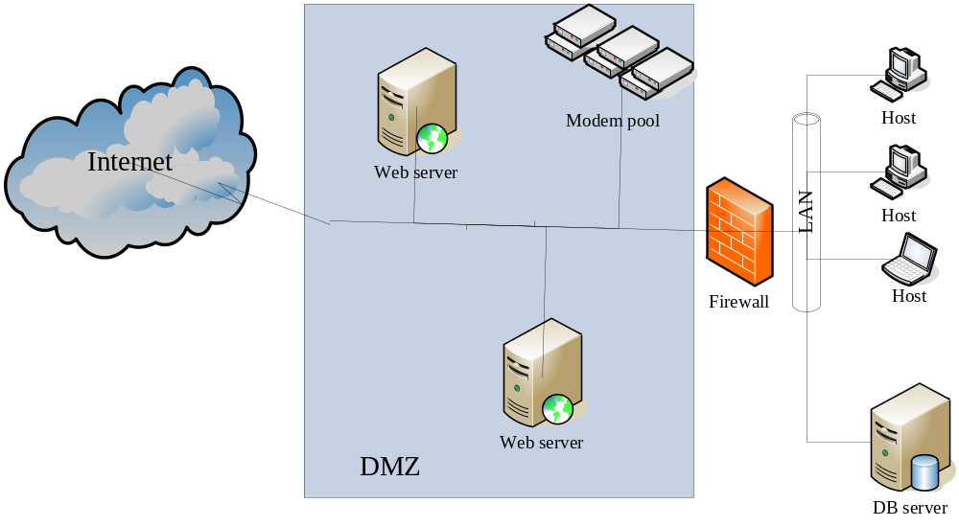
DMZ

Slide 22
Resist Attacks: Limit Exposure
Attacks typically exploit a single weakness on a host to get access to all of its data
Limit exposure is typically realized by having the least possible number of access points
  The architect can minimize risk by allocation of services/data to hosts and limit exposure on each host

Slide 23
Resist Attacks: Encrypt Data
Data should be protected from unauthorized access by applying some form of encryption to data and to communication
Encryption of data
  Symmetric key: DES→AES
  Public-key encryption: RSA
Encryption of communication links
  SSL (Secure Sockets Layer)
  VPN – virtual private networks

Slide 24
Resist Attacks: Separate Entities
Physical separation on different servers that are attached to different networks
Virtual machines
"Air gap"
Separate sensitive data from non-sensitive data

Slide 25
Resist Attacks: Change Default Settings
Forcing the user to change default settings will prevent attackers from gaining access to the system through settings that are publicly available

Slide 26
React to Attacks: Revoke Access
Revoke a system's or a user's access to sensitive resources when an attack is detected or expected. E.g.
  When a computer is infected with virus, access to certain resources may be limited
  Revoke the access of a user account when attack using this accout is detected

Slide 27
React to Attacks: Lock Computer
Limit access from a particular computer if there are repeated failed attempts to access an account from that computer
  E.g. Lock a computer when encountered with repeated failed login attempts
  Usually only lock for a certain time period

Slide 28
React to Attacks: Inform Actors
Ongoing attacks may require action by operators, other personnel, or cooperating systems
  Notify these actors when a system attack is detected

Slide 29
Reading Assignment
Read Chapter 9 & 10 of the textbook.

