Slide 1
PRINCIPLES OF BIG DATA
Shunpu Zhang

Slide 2
The Age of Big Data
“Data is a new class of economic asset, like currency and gold.”
Source: World Economic Forum 2012

Slide 3
What is big data?
“A massive volume of both structured and unstructured data that is so large that it's difficult to process with traditional database and software techniques.”

Slide 4

Big Data are everywhere!
Large amounts of data are being collected and warehoused
Web data, e-commerce
purchases at department/ grocery stores
Bank/Credit Card transactions
Social Network

Slide 5
3
Air Bus A380
- 1 billion line of code
- each engine generate 10 TB every 30 min
640TB per Flight
Twitter Generate approximately 12 TB of data per day
New York Stock Exchange 1TB of data everyday
storage capacity has doubled roughly every three years since the 1980s

Slide 6
Big data is big!
It is a fundamental fact that data that is too big to process conventionally is also too big to transport anywhere.
IT is undergoing an inversion of priorities: it’s the program that needs to move, not the data. If you want to analyze data from the U.S. Census, it’s a lot easier to run your code on Amazon’s web services platform, which hosts such data locally, and won’t cost you time or money to transfer it.

Slide 7
Even if the data isn’t too big to move, locality can still be an issue, especially with rapidly updating data. 、
Financial trading systems crowd into data centers to get the fastest connection to source data, because that millisecond difference in processing time equates to competitive advantage.

Slide 8
Big data is messy！
It’s not all about infrastructure.
Big data practitioners consistently report that 80% of the effort involved in dealing with data is cleaning it up in the first place.
As Pete Warden observes in his Big Data Glossary: “I probably spend more time turning messy source data into something usable than I do on the rest of the data analysis process combined.”

Slide 9
THE MOST COMMON PURPOSE OF BIG DATA IS TO PRODUCE SMALL DATA

Slide 10
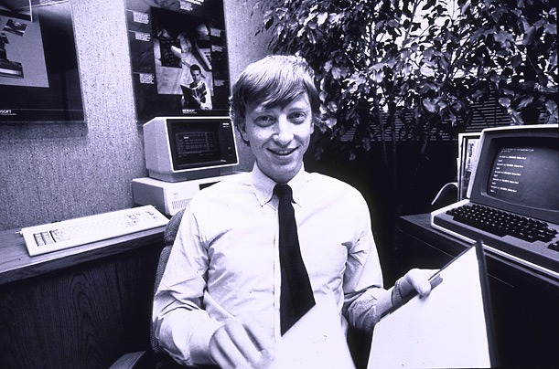
How big are the data?
Google processes 20 PB a day (2008)
Wayback Machine has 3 PB + 100 TB/month (3/2009)
Facebook has 2.5 PB of user data + 15 TB/day (4/2009)
eBay has 6.5 PB of user data + 50 TB/day (5/2009)
CERN’s Large Hydron Collider (LHC) generates 15 PB a year
640K ought to be enough for anybody.

Slide 11
Definition - What does Petabyte (PB) mean?
A petabyte (PB) is a unit of digital information storage used to denote the size of data. It is equivalent to 1,024 terabytes or 1,000,000,000,000,000 bytes.

Slide 12
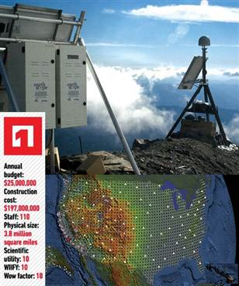
A big data example-The Earthscope
1.
The Earthscope is the world's largest science project.
Designed to track North America's geological evolution, this observatory records data over 3.8 million square miles, amassing 67 terabytes of data.
It analyzes seismic slips in the San Andreas fault, sure, but also the plume of magma underneath Yellowstone and much, much more.
(http://www.msnbc.msn.com/id/44363598/ns/technology_and_science-future_of_technology/#.TmetOdQ--uI)

Slide 13
Type of Data
Relational Data (Tables/Transaction/Legacy Data)
Text Data (Web)
Semi-structured Data (XML)
Graph Data
Social Network, Semantic Web (RDF), …
(The Resource Description Framework (RDF) is a family of World Wide Web Consortium (W3C) specifications originally designed as a metadata data model. )
Streaming Data
You can only scan the data once

Slide 14
What to do with these data?
Aggregation and Statistics
Data warehouse and online analytical processing (OLAP)
Indexing, Searching, and Querying
Keyword based search
Pattern matching (XML/RDF)
Knowledge discovery
Data Mining
Statistical Modeling

Slide 15
OLAP (online analytical processing) is computer processing that enables a user to easily and selectively extract and view data from different points of view.
For example, a user can request that data be analyzed to display a spreadsheet showing all of a company's beach ball products sold in Florida in the month of July, compare revenue figures with those for the same products in September, and then see a comparison of other product sales in Florida in the same time period.
An OLAP database does not need to be as large as a data warehouse, since not all transactional data is needed for trend analysis.

Slide 16
Big Data Characteristics
6
- What is big today maybe not big tomorrow
Any data that can challenge our current technology in some manner can consider as Big Data
Volume
Communication
Speed of Generating
Meaningful Analysis

Slide 17
Big Data Vectors (3Vs)
"Big Data are high-volume, high-velocity, and/or high-variety information assets that require new forms of processing to enable enhanced decision making, insight discovery and process optimization” Gartner 2012

Slide 18
More recently,
Veracity (or value) has been added as another characteristic of big data-4Vs

Slide 19
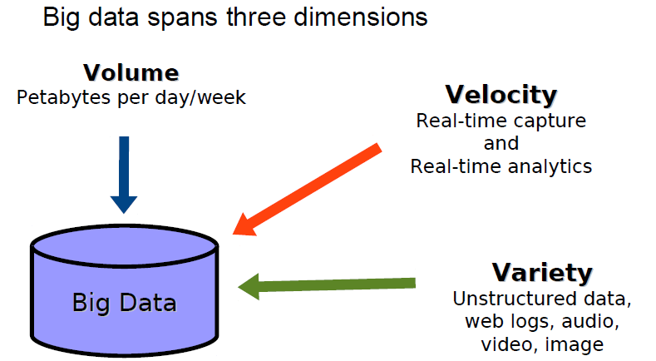
4Vs
Value
Value

Slide 20
At SAS, two additional dimensions when thinking about big data:
Variability. In addition to the increasing velocities and varieties of data, data flows can be highly inconsistent with periodic peaks. Is something trending in social media? Daily, seasonal and event-triggered peak data loads can be challenging to manage. Even more so with unstructured data involved.
Complexity. Today's data comes from multiple sources. And it is still an undertaking to link, match, cleanse and transform data across systems. However, it is necessary to connect and correlate relationships, hierarchies and multiple data linkages or your data can quickly spiral out of control.

Slide 21
Importance of Big Data
9
Government
In 2012, the Obama administration announced the Big Data Research
and Development Initiative
84 different big data programs spread across six departments
Private Sector
- Walmart handles more than 1 million customer transactions every hour,
which is imported into databases estimated to contain more than
2.5 petabytes of data
- Facebook handles 40 billion photos from its user base.
- Falcon Credit Card Fraud Detection System protects 2.1 billion active
accounts world-wide
Science
- Large Synoptic Survey Telescope will generate
140 Terabyte of data every 5 days.
- Large Hardon Colider 13 Petabyte data produced in 2010
- Medical computation like decoding human Genome
- Social science revolution
- New way of science (Microscope example)

Slide 22
Importance of Big Data
10
Job
The U.S. could face a shortage by 2018 of 140,000 to 190,000 people with "deep analytical talent" and of 1.5 million people capable of analyzing data in ways that enable business decisions. (McKinsey & Co)
Big Data industry is worth more than $100 billion
Growing at almost 10% a year (roughly twice as fast as the software business)
Technology Player in this field
Oracle
Exadata
Microsoft
HDInsight Server
IBM
Netezza

Slide 23
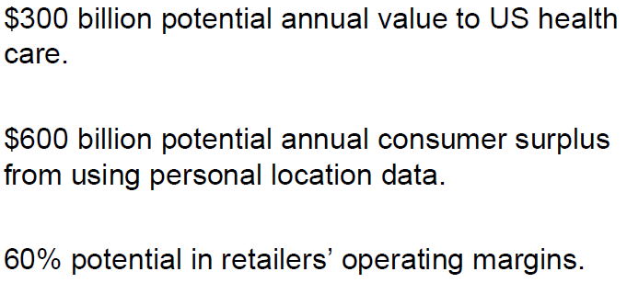
Potential value of big data

Slide 24


Usage Example in Big Data
11
Moneyball: The Art of Winning an Unfair Game
Oakland Athletics baseball team and its general manager Billy Beane
- Oakland A's' front office took advantage of more analytical gauges
of player performance to field a team that could compete
successfully against richer competitors in MLB
- Oakland approximately $41 million in salary,
New York Yankees, $125 million in payroll that same season.
Oakland is forced to find players undervalued by the market,
- Moneyball had a huge impact in other teams in MLB
And there is a moneyball movie!!!!!

Slide 25


Usage Example of Big Data
12
US 2012 Election
- predictive modeling
- mybarackobama.com
- drive traffic to other campaign sites
Facebook page (33 million "likes")
YouTube channel (240,000 subscribers
and 246 million page views).
- a contest to dine with Sarah Jessica Parker
- Every single night, the team ran 66,000
computer simulations!!!
- Amazon web services
- data mining for
individualized ad targeting
- Orca big-data app
- YouTube channel( 23,700 subscribers
and 26 million page views)
- Ace of Spades HQ

Slide 26
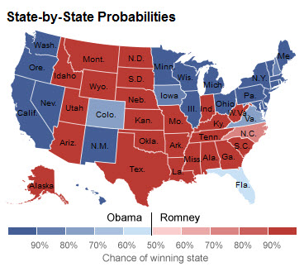
Usage Example in Big Data
13
Data Analysis prediction for US 2012 Election
Drew Linzer, June 2012
332 for Obama,
206 for Romney
media continue reporting the race as very tight
Nate Silver’s, Five thirty Eight blog
Predict Obama had a 86% chance of winning
Predicted all 50 state correctly
Sam Wang, the Princeton Election Consortium
The probability of Obama's re-election
at more than 98%

Slide 27
Ten big data case studies
1. Macy's Inc. and real-time pricing. The retailer adjusts pricing in near-real time for 73 million (!) items, based on demand and inventory, using technology from SAS Institute.
2. Tipp24 AG, a platform for placing bets on European lotteries, and prediction. The company uses KXEN software to analyze billions of transactions and hundreds of customer attributes, and to develop predictive models that target customers and personalize marketing messages on the fly. That led to a 90% decrease in the time it took to build predictive models. SAP is in the process of acquiring KXEN.

Slide 28
Ten big data case studies
3. Wal-Mart Stores Inc. and search. The mega-retailer's latest search engine for Walmart.com includes semantic data. Polaris, a platform that was designed in-house, relies on text analysis, machine learning and even synonym mining to produce relevant search results. Wal-Mart says adding semantic search has improved online shoppers completing a purchase by 10% to 15%. "In Wal-Mart terms, that is billions of dollars," Laney said.
4. Fast food and video. This company (Laney wasn't giving up who) is training cameras on drive-through lanes to determine what to display on its digital menu board. When the lines are longer, the menu features products that can be served up quickly; when the lines are shorter, the menu features higher-margin items that take longer to prepare.

Slide 29
Ten big data case studies
5. Morton's The Steakhouse and brand recognition. When a customer jokingly tweeted the Chicago-based steakhouse chain and requested that dinner be sent to the Newark airport, where he would be getting in late after a long day of work, Morton's became a player in a social media stunt heard 'round the Interwebs. The steakhouse saw the tweet, discovered he was a frequent customer (and frequent tweeter), pulled data on what he typically ordered, figured out which flight he was on, and then sent a tuxedo-clad delivery person to serve him his dinner. Sure, the whole thing was a publicity stunt (that went viral), but that's not the point. The question businesses should be asking themselves: "Is your company even capable of something like this?" Laney said.

Slide 30
Ten big data case studies
6. PredPol Inc. and repurposing. The Los Angeles and Santa Cruz police departments, a team of educators and a company called PredPol have taken an algorithm used to predict earthquakes, tweaked it and started feeding it crime data. The software can predict where crimes are likely to occur down to 500 square feet. In LA, there's been a 33% reduction in burglaries and 21% reduction in violent crimes in areas where the software is being used.

Slide 31
Ten big data case studies
7. Tesco PLC and performance efficiency: The supermarket chain collected 70 million refrigerator-related data points coming off its units and fed them into a dedicated data warehouse. Those data points were analyzed to keep better tabs on performance, gauge when the machines might need to be serviced and do more proactive maintenance to cut down on energy costs.
8. American Express Co. and business intelligence. Hindsight reporting and trailing indicators can only take a business so far, AmEx realized. "Traditional BI [business intelligence] hindsight-oriented reporting and trailing indicators aren't moving the needle on the business," Laney said. So AmEx started looking for indicators that could really predict loyalty and developed sophisticated predictive models to analyze historical transactions and 115 variables to forecast potential churn. The company believes it can now identify 24% of Australian accounts that will close within the next four months.

Slide 32
Ten big data case studies
9. Express Scripts Holding Co. and product generation. Express Scripts, which processes pharmaceutical claims, realized that those who most need to take their medications were also those most likely to forget to take their medications. So they created a new product: Beeping medicine caps and automated phone calls reminding patients it's time to take the next dose.
10. Infinity Property & Casualty Corp. and dark data. Laney defines dark data as underutilized information assets that have been collected for single purpose and then archived. But given the right circumstances, that data can be mined for other reasons. Infinity, for example, realized it had years of adjusters' reports that could be analyzed and correlated to instances of fraud. It built an algorithm out of that project and used the data to reap $12 million in subrogation recoveries.

Slide 33
大数据在中国的应用（微软亚洲研究院常务副院长 马维英）
空气质量
北京只有15个空气检测站点，非常稀疏，每个站点的投入和花费与运营非常高。这些站点在任何时刻给的数据都是非常不一样的，说明一个城市里面空气质量分布是不均匀的。
问题是能不能用大数据，用机器学习或其他方法预测那些没有空气站点的地点的空气质量。利用大数据把历史上所有这些我们可以收集到的，关于侦测带里的历史的数据、气象数据、交通数据、人员流动等数据，建一个大模型，包含空间和时间的预测，能够在有限的15个站点之上，进一步预测所有的位置。

Slide 34
大数据在中国的应用（亚马逊副总裁 方淦）
美国的70、80、90年代，是美国线下的零售巨头出现的时间，沃尔马等有名的线下零售公司崛起。但沃尔玛也是在90年代末才在美国变成最大的零售巨头，它的股价在1999年才爆发上涨。
？？？

Slide 35
大数据在中国的应用（亚马逊副总裁 方淦）
在这个阶段，沃尔马做了一些事情，首先，它建了“大数据”，它的大数据是把供应链全部IT化，这样便可以实现全国调货。它实现了在48个小时之内全美国任何一个店都可以供货，这是一个很有价值的供应链系统。

Slide 36
大数据在中国的应用（亚马逊副总裁 方淦）
从1997年到2005年，沃尔玛实现了快速扩张，股价上涨。
但是，在2000年的时候成长速度又平稳了。？
从1997年开始，美国的电商在互联网里就开始了进攻。亚马逊是1997年上市的，此后把电商攻势做了起来。

Slide 37
大数据在中国的应用（亚马逊副总裁 方淦）
仅把线下的方式移到线上还不够，因为线下跟线上消费不一样。1999年的互联网付款不是很方便，配送也不像现在这么方便。网上消费从头疼两个事，第一是付款，第二是配送。
从亚马逊的股价走势图可以看到，亚马逊1995年成立，1997年上市，刚刚开始的几年都在亏钱。

Slide 38
大数据在中国的应用（亚马逊副总裁 方淦）
2000年左右，亚马逊做了一个决定，建立自己的库房，并把沃尔马最强的IT人才请到公司当CIO，建立起了供应链，客户体验方面也做了调整，把线下与线上客户体验的概念融合到电商的模型里去。

Slide 39
Some Challenges in Big Data
14
Big Data Integration is Multidisciplinary
Less than 10% of Big Data world are genuinely relational
Meaningful data integration in the real, messy, schema-less and complex Big Data world of database and semantic web using multidisciplinary and multi-technology methode
The Billion Triple Challenge
Web of data contain 31 billion Resource Description Framework (RDf ) triples, that 446million of them are RDF links, 13 Billion government data, 6 Billion geographic data, 4.6 Billion Publication and Media data, 3 Billion life science data
The Linked Open Data Ripper
Mapping, Ranking, Visualization, Key Matching, Snappiness
Demonstrate the Value of Semantics: let data integration drive database management system (DBMS) technology
Large volumes of heterogeneous data, like link data and RDF

Slide 40
Resource Description Framework (RDF)
RDF is a standard model for data interchange on the Web. RDF has features that facilitate data merging even if the underlying schemas differ, and it specifically supports the evolution of schemas over time without requiring all the data consumers to be changed.
RDF extends the linking structure of the Web to use Uniform Resource Identifiers (URI)s to name the relationship between things as well as the two ends of the link (this is usually referred to as a “triple”). Using this simple model, it allows structured and semi-structured data to be mixed, exposed, and shared across different applications.

Slide 42
Some Challenges in Big Data: Cost Problem
8
Cost of processing 1 Petabyte of data with 1000 node ?
1 PB = 10¹⁵ B = 1 million gigabytes = 1 thousand terabytes
9 hours for each node to process 500GB at rate of 15MB/S
15*60*60*9 = 486000MB ~ 500 GB
1000 * 9 * 0.34$ = 3060$ for single run
1 PB = 1000000 / 500 = 2000 * 9 = 18000 h /24 = 750 Day
The cost for 1000 cloud node each processing 1PB
2000 * 3060$ = 6,120,000$

Slide 43
Other Aspects of Big Data
Five Big Question about big Data:
1- What happens in a world of radical transparency, with data widely available?
2- If you could test all your decisions, how would that change the way you compete?
3- How would your business change if you used big data for widespread, real time customization?
4- How can big data augment or even replace Management?
5-Could you create a new business model based on data?

Slide 44
Implementation of Big Data
Platforms for Large-scale Data Analysis
Parallel Database Management System (DBMS) technologies
Proposed in late eighties
Matured over the last two decades
Multi-billion dollar industry: Proprietary DBMS Engines intended as Data Warehousing solutions for very large enterprises
Map Reduce
pioneered by Google
popularized by Yahoo! (Hadoop)

Slide 45
Implementation of Big Data
18
Parallel DBMS technologies
MapReduce
Popularly used for more than two decades
Research Projects: Gamma, Grace, …
Commercial: Multi-billion dollar industry but access to only a privileged few
Relational Data Model
Indexing
Familiar SQL interface
Advanced query optimization
Well understood and studied
Overview:
Data-parallel programming model
An associated parallel and distributed
implementation for commodity clusters
Pioneered by Google
Processes 20 PB of data per day
Popularized by open-source Hadoop
Used by Yahoo!, Facebook,
Amazon, and the list is growing …

Slide 46
Implementation of Big Data
19
MapReduce
Raw Input: <key, value>
MAP
<K1, V1>
<K2,V2>
<K3,V3>
REDUCE

Slide 47
A MapReduce program is composed of a Map() procedure that performs filtering and sorting (such as sorting students by first name into queues, one queue for each name).
A Reduce() procedure that performs a summary operation (such as counting the number of students in each queue, yielding name frequencies).

Slide 48
Implementation of Big Data
20
MapReduce Advantages
Automatic Parallelization:
Depending on the size of RAW INPUT DATA ➔ instantiate multiple MAP tasks
Similarly, depending upon the number of intermediate <key, value> partitions ➔ instantiate multiple REDUCE tasks
Run-time:
Data partitioning
Task scheduling
Handling machine failures
Managing inter-machine communication
Completely transparent to the programmer/analyst/user

Slide 49
Implementation of Big Data
21
Map Reduce vs Parallel DBMS
 | Parallel DBMS | MapReduce
Schema Support | ✓ | Not out of the box
Indexing | ✓ | Not out of the box
Programming Model | Declarative Structured Query Language (SQL) | Imperative (C/C++, Java, …) Extensions through Pig and Hive
Optimizations (Compression, Query Optimization) | ✓ | Not out of the box
Flexibility | Not out of the box | ✓
Fault Tolerance | Coarse grained techniques | ✓

Slide 50
SQL
SQL (Structured Query Language) is a special-purpose programming language designed for managing data held in a relational database management system (RDBMS).

Slide 51
Zeta-Byte Horizon
22
As of 2009, the entire World Wide Web was estimated to contain close to 500 exabytes. This is a half zettabyte
the total amount of global data is expected to grow to 2.7 zettabytes during 2012. This is 48% up from 2011
x50
2012
2020

Slide 52
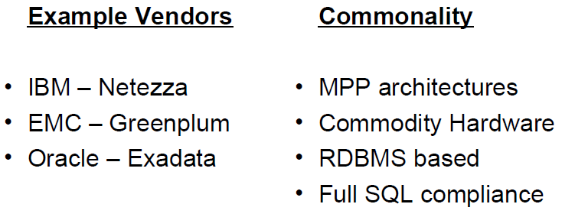

Slide 53
Apache Hadoop
Apache Hadoop is an open-source software framework for storage and large-scale processing of data-sets on clusters of commodity hardware.
Hadoop is an Apache top-level project being built and used by a global community of contributors and users.

Slide 54

Apache Hadoop
Developer(s) Apache Software Foundation
Written inJava
Operating system Cross-platform
Type Distributed file system
License Apache License 2.0
Website: hadoop.apache.org

Slide 55
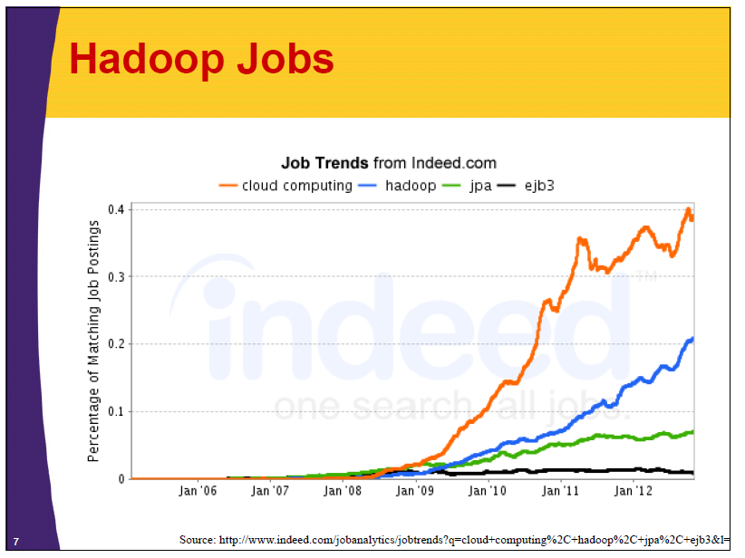
Notes:
The Java Persistence Architecture
Enterprise Java Beans (EJB) 3.0

Slide 56
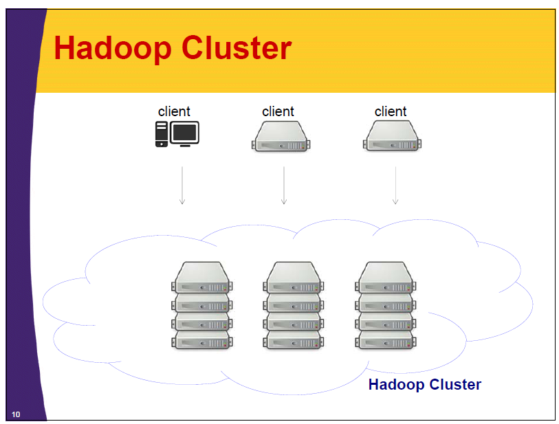

Slide 57
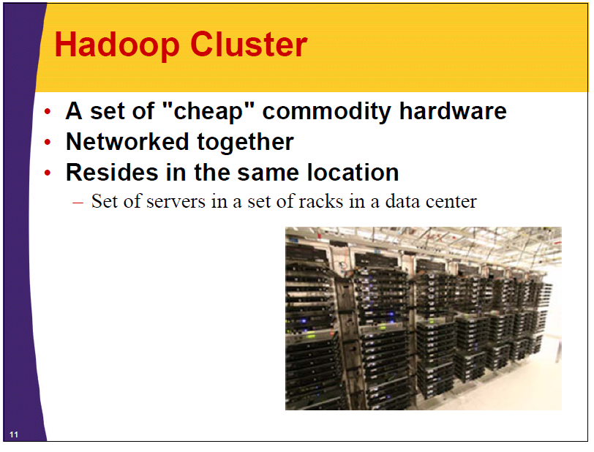

Slide 58
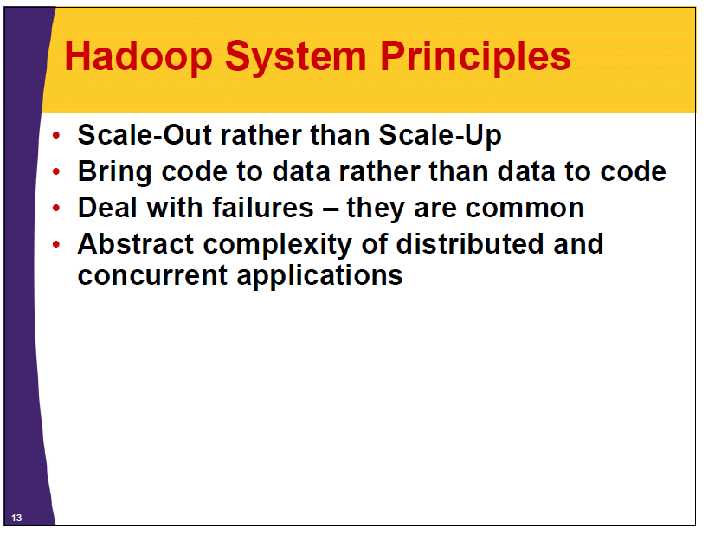

Slide 59
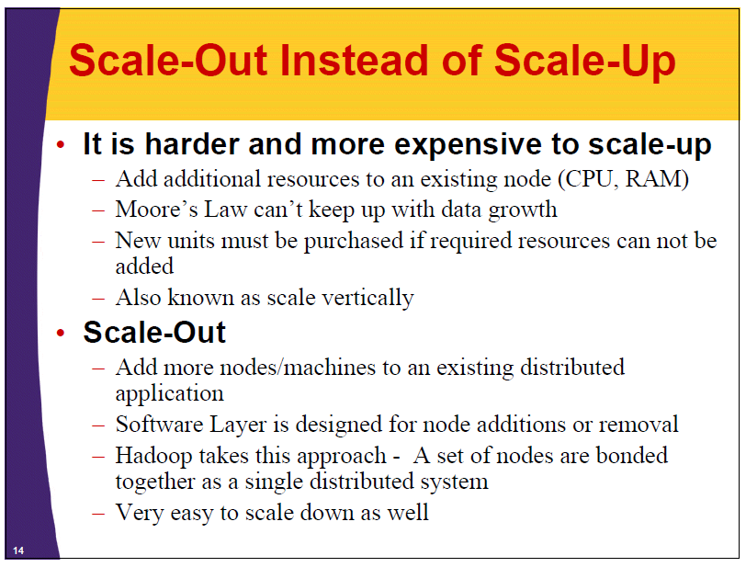

Slide 60
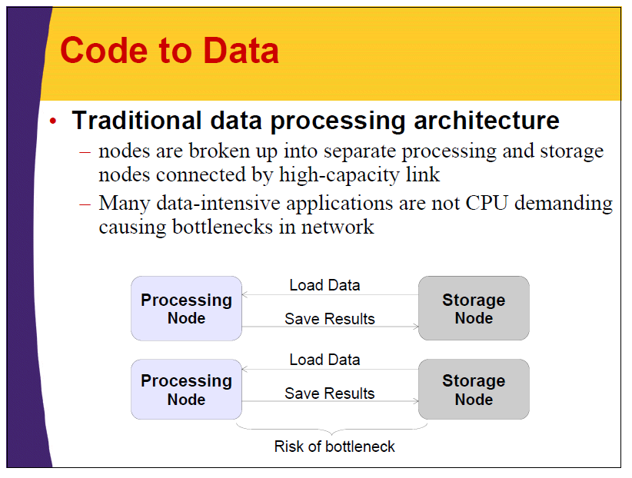

Slide 61
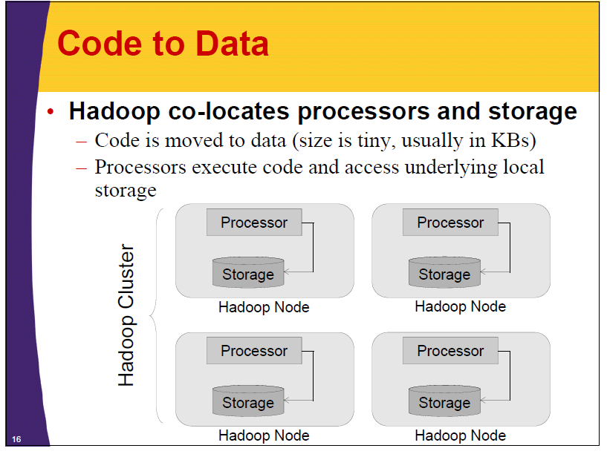

Slide 62
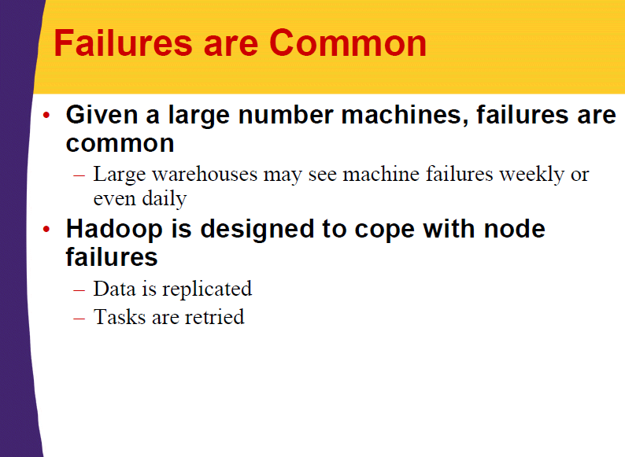

Slide 63
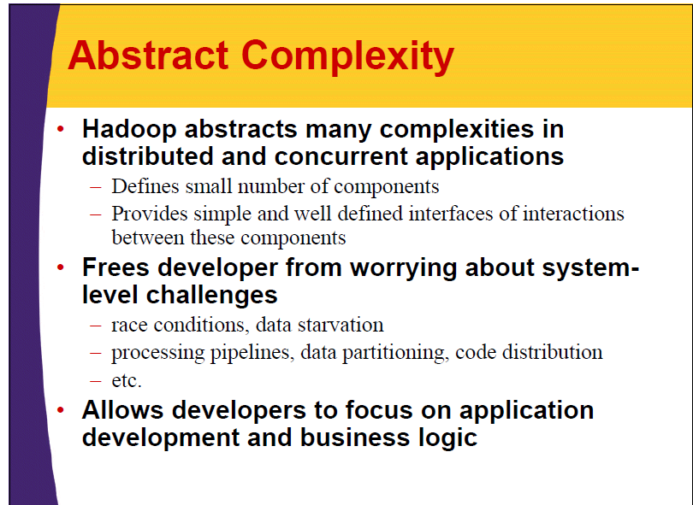

Slide 64
Race condition
A race condition occurs when two or more threads can access shared data and they try to change it at the same time. Because the thread scheduling algorithm can swap between threads at any time, you don't know the order in which the threads will attempt to access the shared data. Therefore, the result of the change in data is dependent on the thread scheduling algorithm, i.e. both threads are "racing" to access/change the data.

Slide 65
Race condition
Problems often occur when one thread does a "check-then-act" (e.g. "check" if the value is X, then "act" to do something that depends on the value being X) and another thread does something to the value in between the "check" and the "act".
E.g: if (x == 5) // The "Check" { y = x * 2; // The "Act" // If another thread changed x in between "if (x == 5)" and "y = x * 2" above, // y will not be equal to 10. }
The point being, y could be 10, or it could be anything, depending on whether another thread changed x in between the check and act. You have no real way of knowing.

Slide 66
Starvation
Starvation refers to the use of all resources. In a poorly constructed database, poor concurrency controls will result in DBMS starvation.
Notes:
analytical query systems such as Hive and Pig remain a high-latency

Slide 67
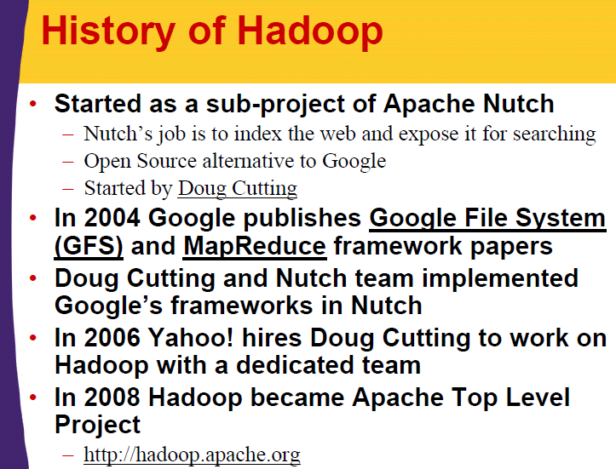

Slide 68
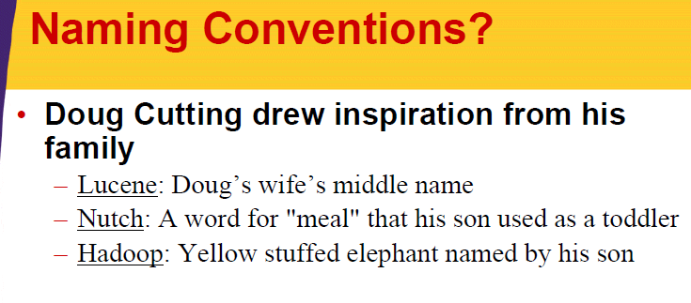

Slide 69
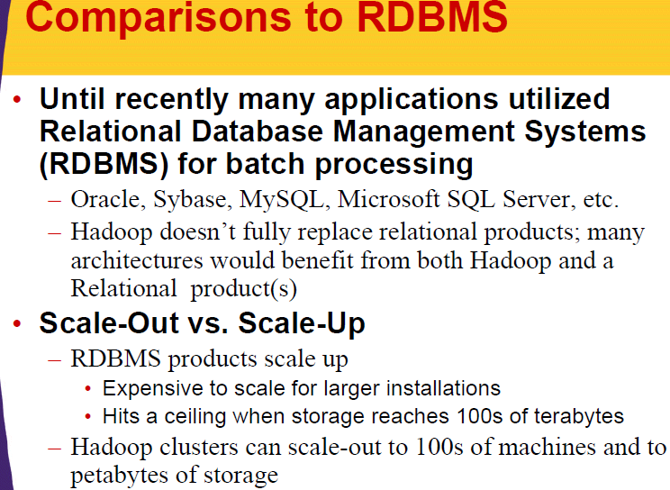

Slide 70
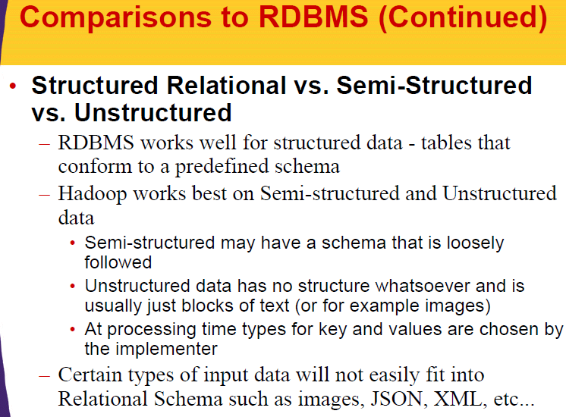

Slide 71
Comparison to RDBMS
Offline batch vs. online transactions
– Hadoop was not designed for real-time or low latency queries
– Hadoop performs best for offline batch processing on large amounts of data
– RDBMS is best for online transactions and low-latency queries
– Hadoop is designed to stream large files and large amounts of data
– RDBMS works best with small records

Slide 72
Low latency
Low latency allows human-unnoticeable delays between an input being processed and the corresponding output providing real time characteristics. This can be especially important for internet connections utilizing services such as Trading, online gaming and VOIP.

Slide 73
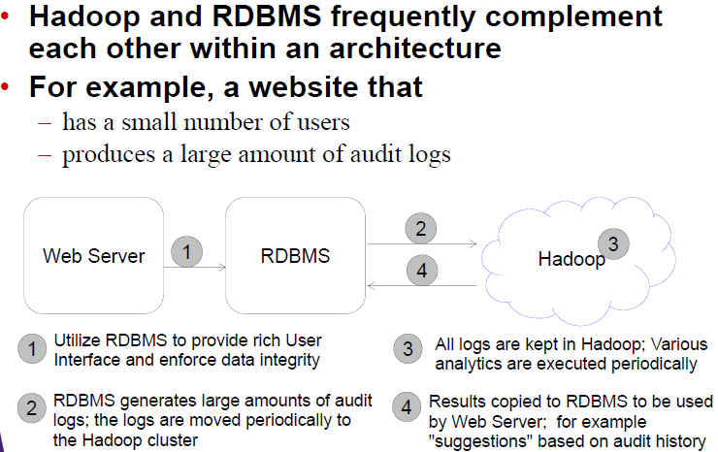

Slide 74
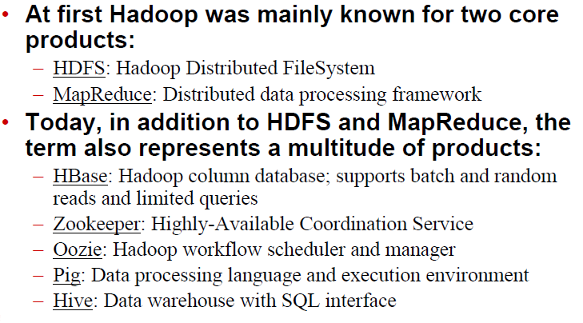
Hadoop Eco System

Slide 75
Is a supercomputer +Map Reduce or Parallel DBMS enough for big data analysis?

Slide 76
Is a supercomputer +Map Reduce or Parallel DBMS enough for big data analysis?
NIH example: Funded investigators are using high-throughput molecular methods that produce mountains of data for every tissue sample in a matter of minutes.
There is only one solution: we must acquire supercomputers and a staff of talented programmers who can analyze all our data and tell us what it all means!

Slide 77
Is a supercomputer +Map Reduce or Parallel DBMS enough for big data analysis?
Then we can diagnose all cancers and cure them! Hooray!

Slide 78
Is a supercomputer +Map Reduce or Parallel DBMS enough for big data analysis?
The NIH leadership believed it and hence supercomputers are given to researchers at NIH and universities around the country.

Slide 79
Is a supercomputer +Map Reduce or Parallel DBMS enough for big data analysis?
But what is the current status of cancer diagnosis and treatment?

Slide 80
Big data has no big brother.
It is still really young! We (human beings) are still exploring!

Slide 81
Big data has no big brother.
It is still really young! We (human beings) are still exploring!
Despite the obstacles and the risks, the potential value of Big Data is inestimable.

Slide 82
BIGDATA NSF12499
The NSF aims to advance the core scientific and technological means of managing, analyzing, visualizing, and extracting useful information from large, diverse, distributed and heterogeneous data sets so as to:
accelerate the progress of scientific discovery and innovation;
lead to new fields of inquiry that would not otherwise be possible; encourage the development of new data analytic tools and algorithms;

Slide 83
BIGDATA NSF12499
facilitate scalable, accessible, and sustainable data infrastructure; increase understanding of human and social processes and interactions;
and promote economic growth and improved health and quality of life.
The new knowledge, tools, practices, and infrastructures produced will enable breakthrough discoveries and innovation in science, engineering, medicine, commerce, education, and national security.

Slide 84
Payoffs from Big Data Analysis
The NSF envisions a Big Data future with the following pay-offs:
Responses to disaster recovery empower rescue workers and individuals to make timely and effective decisions and provide resources where they are most needed;
Complete health/disease/genome/environmental knowledge bases enable biomedical discovery and patient-centered therapy; the full complement of health and medical information is available at the point of care for clinical decision-making;

Slide 85
Payoffs from Big Data Analysis
Accurate high-resolution models support forecasting and management of increasingly stressed watersheds and eco-systems;
Access to data and software in an easy-to-use format are available to everyone around the globe;
Consumers can purchase wearable products using materials with novel and unique properties that prevent injuries;

Slide 86
Payoffs from Big Data Analysis
Students and researchers have intuitive real time tools to view, understand, and learn from publicly available large scientific data sets on everything from genome sequences to astronomical star surveys, from public health databases to particle accelerator simulations and their teachers and professors use student performance analytics to improve that learning;
And accurate predictions of natural disasters, such as earthquakes, hurricanes, and tornadoes, enable life-saving and cost-saving preventative actions.

Slide 87
Payoffs from Big Data Analysis
All the above are possible only if we manage our Big Data resources WISELY.

Slide 88
Payoffs from Big Data Analysis
All the above are possible only if we manage our Big Data resources WISELY.
We introduce a number of principles in big data analysis.

Slide 89
Big data in life sciences
Building the big data platform - gaining maximum value from innovative technology trends
Data acquisition – new and forward thinking methods for collecting data generated at all stages of the value chain, from discovery to real-world use
Data integration - creating datasets that are consistent, reliable, and well related. From cloud to data centres – exploring the latest hi-tech trends in data storage
Predictive analytics - achieving the ‘golden triangle’ of treatment: the right target, the right chemistry, and the right patient

