Slide 1
Big data in life sciences
标准化困境
不同系统和科研机构之间难以实现标准化的数据共享和分析，这令很多科学家无所适从。

Slide 2
1. Providing Structure to Unstructured Data
In the early days of computing, data was always highly structured. All data was divided into fields, the fields had a fixed length, and the data entered into each field was constrained to a predetermined set of allowed values.

Slide 3
1. Providing Structure to Unstructured Data
Today, most data entered by humans is unstructured, in the form of free text. The free text comes in e-mail messages, tweets, documents, and so on.
Structured data has not disappeared, but it sits in the shadows cast by mountains of unstructured text.

Slide 4
1. Providing Structure to Unstructured Data
To get much informational value from free text, it is necessary to impose some structure.
This may involve
translating the text to a preferred language,
parsing the text into sentences,
extracting and normalizing the conceptual terms contained in the sentences,
mapping terms to a standard nomenclature,

Slide 5
1. Providing Structure to Unstructured Data
5. annotating the terms with codes from one or more standard nomenclatures,
6. extracting and standardizing data values from the text,
7. assigning data values to specific classes of data belonging to a classification system,
8. assigning the classified data to a storage and retrieval system (e.g., a database),
9. indexing the data in the system.

Slide 6
All of these activities are difficult to do on a small scale and virtually impossible to do on a large scale.
Nonetheless, every Big Data project that uses unstructured data must deal with these tasks to yield the best possible results with the resources available.

Slide 7
MACHINE TRANSLATION
Machine translation is one of the better known areas in which computational methods have been applied to free text unstructured data).

Slide 8
MACHINE TRANSLATION
The process of machine translation begins with extracting sentences from text, parsing the words of the sentence into grammatical parts, and arranging the grammatical parts into an order that imposes logical sense on the sentence.
Once this is done, each of the parts can be translated by a dictionary that finds equivalent terms in a foreign language to be reassembled by applying grammatical positioning rules appropriate for the target language.

Slide 9
MACHINE TRANSLATION
It sounds simple! But wait a second, is it?

Slide 10
MACHINE TRANSLATION
It sounds simple! But wait a second, is it?
As many other languages, English words are polymorphous.

Slide 11
MACHINE TRANSLATION
It sounds simple! But wait a second, is it?
As many other languages, English words are polymorphous.
“A bandage wound around a wound.”
“don’t object to the data object,”
etc.

Slide 12
MACHINE TRANSLATION
“Husband named person of interest in slaying of mother.”
What does this sentence mean?

Slide 13
MACHINE TRANSLATION
Accurate machine translation is beyond being difficult.
It is simply impossible. It is impossible because computers cannot understand nonsense, but human beings can (is this good or bad?)!
The expectation that sentences can be reliably parsed into informational units is fantasy.

Slide 14
INDEXING
Knowledge can be public, yet undiscovered, if independently created fragments are logically related but never retrieved, brought together, and interpreted.
Don R. Swanson (October 10, 1924 - November 18, 2012) was an American information scientist, most known for his work in literature-based discovery in the biomedical domain. His particular method has been used as a model for further work, and is often referred to as Swanson linking.

Slide 15
Books are indexed by author names, subjects, etc.
A zoology book might include an index specifically for animal names, with animals categorized according to their taxonomic order.
A geography index might list the names of localities subindexed by country, with countries subindexed by continent.

Slide 16
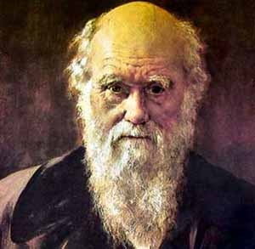
Who is this guy?

Slide 17
Indexes can serve as surrogates for the Big Data resource. In some cases, all the data user really needs is the index. A telephone book is an example of an index that serves its purpose without being attached to a related data source

Slide 18
2. Identification, Deidentification, and Reidentification
Data identification is certainly the most underappreciated and least understood Big Data issue.
A good information system is, at its heart, an identification system: a way of naming data objects so that they can be retrieved by their name and a way of distinguishing each object from every other object in the system.

Slide 19
An example
You show up for treatment in the hospital where you were born and in which you have been seen for various ailments over the past three decades. One of the following events transpires.

Slide 20
1. The hospital has a medical record of someone with your name, but it’s not you. After much effort, they find another medical record with your name. Once again, it’s the wrong person. After much time and effort, you are told that the hospital cannot produce your medical record. They deny losing your record, admitting only that they cannot retrieve the record from the information system.

Slide 21
2. The hospital has a medical record of someone with your name, but it’s not you. Neither you nor your doctor is aware of the identity error. The doctor provides inappropriate treatment based on information that is accurate for someone else, but not for you. As a result of this error, you die, but the hospital information system survives the ordeal, with no apparent injury.

Slide 22
3. The hospital has your medical record. After a few minutes with your doctor, it becomes obvious to both of you that the record is missing a great deal of information, relating to tests and procedures done recently and in the distant past. Nobody can find these missing records. You ask your doctor whether your records may have been inserted into the electronic chart of another patient or of multiple patients. The doctor shrugs his or her shoulders.

Slide 23
4. The hospital has your medical record, but after a few moments, it becomes obvious that the record includes a variety of tests done on patients other than yourself. Some of the other patients have your name. Others have a different name. Nobody seems to understand how these records pertaining to other patients got into your chart.

Slide 24
5. You are informed that the hospital has changed its hospital information system and your old electronic records are no longer available. You are asked to answer a long list of questions concerning your medical history. Your answers will be added to your new medical chart. Many of the questions refer to long-forgotten events.

Slide 25
6. You are told that your electronic record was transferred to the hospital information system of a large multihospital system. This occurred as a consequence of a complex acquisition and merger. The hospital in which you are seeking care has not yet been deployed within the information structure of the multihospital system and has no access to your records. You are assured that your records have not been lost and will be accessible within the decade.

Slide 26
7. You arrive at your hospital to find that the once-proud office has been demolished and replaced by a shopping mall. Your electronic records are gone forever, but you console yourself with the knowledge that J.C. Penney has a 40% off sale on jewelry.

Slide 27
FEATURES OF AN IDENTIFIER SYSTEM
An object identifier is an alphanumeric string associated with the object. For many Big Data resources, the objects that are of greatest concern to data managers are human beings.
Why are we so interested in human beings?

Slide 28
Before we answer that question, what is the difference between human and human being?

Slide 29
Before we answer that question, what is the difference between human and human being?
Human: a human being, especially a person as distinguished from an animal or (in science fiction) an alien.
Human being: a man, woman, or child of the species Homo sapiens, distinguished from other animals by superior mental development, power of articulate speech, and upright stance.

Slide 30
Why are we so interested in human beings?
One reason for this is that many Big Data resources are built to store and retrieve information about individual humans.

Slide 31
Why are we so interested in human beings?
One reason for this is that many Big Data resources are built to store and retrieve information about individual humans.
Another reason for the data manager’s preoccupation with human identifiers relates to the paramount importance of establishing human identity, with absolute certainty (e.g., banking transactions, blood transfusions).

Slide 32
Consequently, one of the most important tasks for data managers is the creation of a dependable identifier system.

Slide 33
The properties of a good identifier system are the following:
1. Completeness. Every unique object in the Big Data resource must be assigned an identifier.
2. Uniqueness. Each identifier is a unique sequence.
3. Exclusivity. Each identifier is assigned to a unique object, and to no other object.
4. Authenticity. The objects that receive identification must be verified as the objects that they are intended to be. For example, if a young man walks into a bank and claims to be Richie Rich, then the bank must ensure that he is, in fact, who he says he is.

Slide 34
The properties of a good identifier system are the following:
5. Aggregation. The Big Data resource must have a mechanism to aggregate all of the data that is properly associated with the identifier (i.e., to bundle all of the data that belong to the uniquely identified object). In the case of a bank, this might mean collecting all of the transactions associated with an account.

Slide 35
The properties of a good identifier system are the following:
5. In a hospital, this might mean collecting all of the data associated with a patient’s identifier: clinic visit reports, medication transactions, surgical procedures, and laboratory results. If the identifier system performs properly, aggregation methods will always collect all of the data associated with an object and will never collect any data that is associated with a different object.

Slide 36
The properties of a good identifier system are the following:
6. Permanence. The identifiers and the associated data must be permanent. In the case of a hospital system, when the patient returns to the hospital after 30 years of absence, the record system must be able to access his identifier and aggregate his data. When a patient dies, the patient’s identifier must not perish.

Slide 37
The properties of a good identifier system are the following:
7. Reconciliation. There should be a mechanism whereby the data associated with a unique, identified object in one Big Data resource can be merged with the data held in another resource, for the same unique object. This process, which requires comparison, authentication, and merging, is known as reconciliation.

Slide 38
The properties of a good identifier system are the following:
8. Immutability. In addition to being permanent (i.e., never destroyed or lost), the identifier must never change.

Slide 39
The properties of a good identifier system are the following:
8. In the event that two Big Data resources are merged, or that legacy data is merged into a Big Data resource, or that individual data objects from two different Big Data resources are merged, a single data object will be assigned two identifiers—one from each of the merging systems.
In this case, the identifiers must be preserved as they are, without modification. The merged data object must be provided with annotative information specifying the origin of each identifier (i.e., clarifying which identifier came from which Big Data resource).

Slide 40
The properties of a good identifier system are the following:
9. Security. The identifier system is vulnerable to malicious attack. A Big Data resource with an identifier systemcan be irreversibly corrupted if the identifiers are modified. In the case of human-based identifier systems, stolen identifiers can be used for a variety of malicious activities directed against the individuals whose records are included in the resource.

Slide 41
The properties of a good identifier system are the following:
10. Documentation and quality assurance. A system should be in place to find and correct errors in the patient identifier system. Protocols must be written for establishing the identifier system, for assigning identifiers, for protecting the system, and for monitoring the system.

Slide 42
The properties of a good identifier system are the following:
10. Every problem and every corrective action taken must be documented and reviewed. Review procedures should determine whether the errors were corrected effectively, and measures should be taken to continually improve the identifier system. All procedures, all actions taken, and all modifications of the system should be thoroughly documented. This is a big job.

Slide 43
The properties of a good identifier system are the following:
11. Centrality. Whether the information system belongs to a savings bank, an airline, a prison system, or a hospital, identifiers play a central role. You can think of information systems as a scaffold of identifiers to which data is attached. For example, in the case of a hospital information system, the patient identifier is the central key to which every transaction for the patient is attached.

Slide 44
The properties of a good identifier system are the following:
12. Autonomy. An identifier system has a life of its own, independent of the data contained in the Big Data resource. The identifier system can persist, documenting and organizing existing and future data objects even if all of the data in the Big Data resource were to suddenly vanish (i.e., when all of the data contained in all of the data objects are deleted).

Slide 45
Some organizations that issue identifiers are:
DOI, Digital object identifier
PMID, PubMed identification number
LSID (Life Science Identifier)
HL7 OID (Health Level 7 Object Identifier)
DICOM (Digital Imaging and Communications in Medicine) identifiers
ISSN (International Standard Serial Numbers)
Social Security Numbers (for U.S. population)
NPI, National Provider Identifier, for physicians
Clinical Trials Protocol Registration System
Office of Human Research Protections Federal Wide Assurance number
Data Universal Numbering System (DUNS) number
International Geo Sample Number
DNS, Domain Name Service

Slide 46
DEIDENTIFICATION
Deidentification is the process of stripping information from a data record that might link the record to the public name of the record’s subject.
Why would we want to do that?

Slide 47
DEIDENTIFICATION
In the case of a patient record, this would involve stripping any information from the record that would enable someone to connect the record to the name of the patient.
The most obvious item to be removed in the deidentification process is the patient’s name (as well as address, etc.).

Slide 48
DEIDENTIFICATION
Deidentification may not be so much different from identification.

Slide 49
A dual identification/deidentification system
1. Collect data on unique object: “Joe Ferguson’s bank account contains $100.”
2. Assign a unique identifier: “Joe Ferguson’s bank account is 7540038947134.”
3. Substitute name of object with its assigned unique identifier: “754003894713 contains $100.”
4. Consistently use the identifier with data.
5. Do not let anyone know that Joe Ferguson owns account “754003894713.”

Slide 50
A dual identification/deidentification system
The dual use of an identifier/deidentifier is a tried-and-true technique.
Swiss bank accounts are essentially unique numbers (identifiers) assigned to a person. You access the bank account by producing the identifier number. The identifier number does not provide information about the identity of the bank account holder (i.e., it is a deidentifier).

Slide 51
It is important to understand that the process of deidentification can succeed only when each record is properly identified (i.e., there can be no deidentification without identification).

Slide 52
Deindentification Algorithm
1. The data analyst submits a query requesting a record from a Big Data resource. The resource contains confidential records that must not be shared, unless the records are deidentified.
2. The Big Data resource receives the query and retrieves the record.
3. A copy of the record is parsed, and any of the information within the data record that might link the record to the public name of the subject of the record (usually the name of an individual) is deleted from the copy. This might include the aforementioned name, address, date of birth, social security number, and so on.

Slide 53
Deindentification Algorithm
4. A pseudo-identifier sequence is prepared for the deidentified record. The pseudoidentifier sequence might be generated by a random number generator, or it might be generated by encrypting the original identifier, or through a one-way hash algorithm, or by other methods chosen by the Big Data manager.
5. A transaction record is attached to the original record that includes the pseudo-identifier, the deidentified record, the time of the transaction, and any information pertaining to the requesting entity (e.g., the data analyst who sent the query) that is deemed fit and necessary by the Big Data resource data manager.

Slide 54
Deindentification Algorithm
6. A record is sent to the data analyst that consists of the deidentified record and the unique pseudo-identifier created for the record.

Slide 56
Knowledge discovery Data Mining Statistical Modeling

Slide 57
Simple but Powerful Big Data Techniques
Looking at the data
1. Find a free ASCII editor.
2. Download and study the “readme” or index files, or their equivalent.
3. Assess the number of records in the Big Data resource.
4. Determine how data objects are identified and classified.

Slide 58
Simple but Powerful Big Data Techniques
5. Determine whether data objects contain self-descriptive information.
6. Assess whether the data is complete and representative.
7. Plot some of the data.

Slide 59
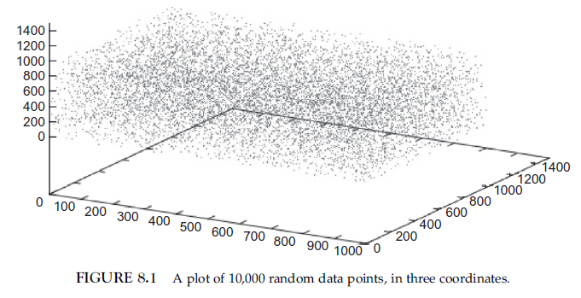
Simple but Powerful Big Data Techniques

Slide 60
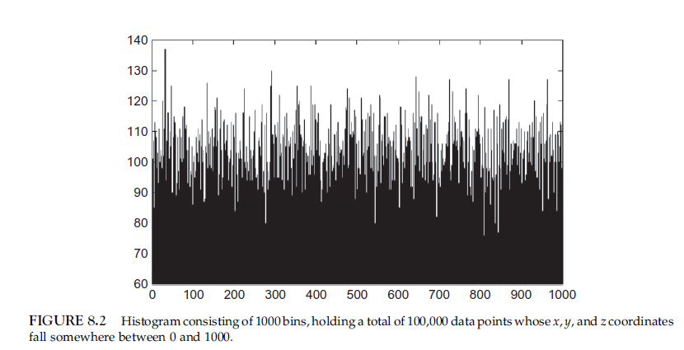
Simple but Powerful Big Data Techniques

Slide 61
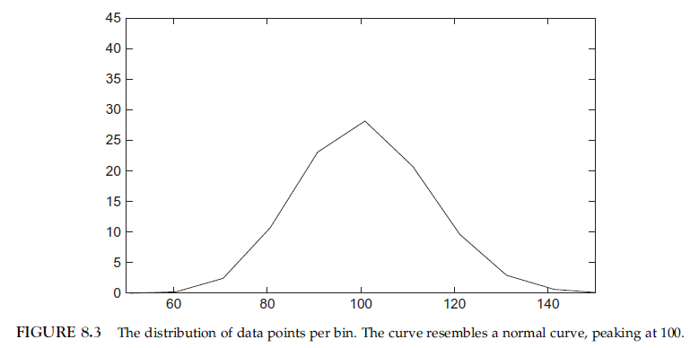
Simple but Powerful Big Data Techniques

Slide 62
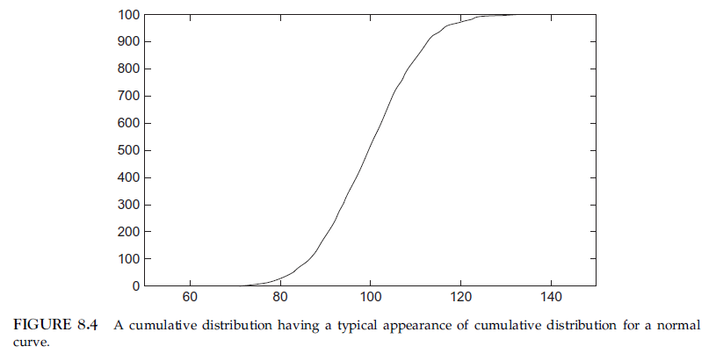
Simple but Powerful Big Data Techniques

Slide 63
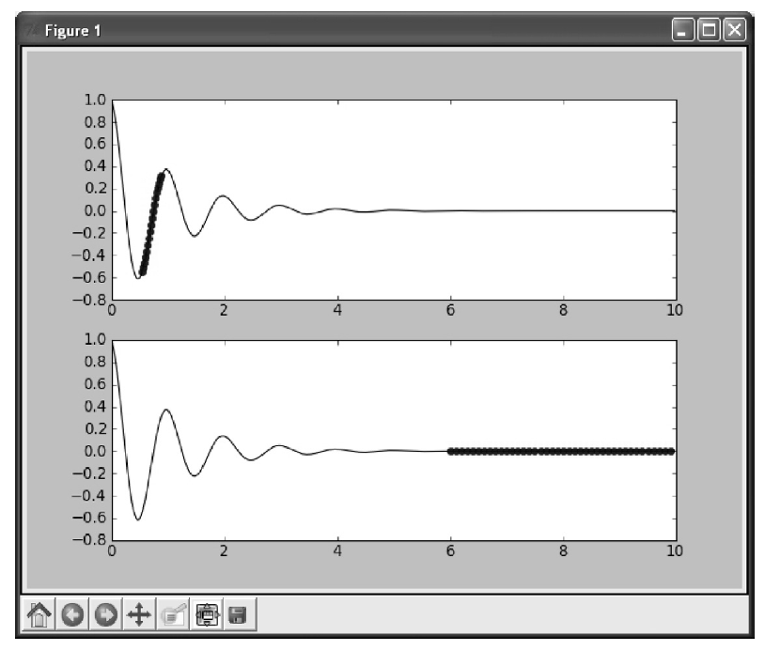
Simple but Powerful Big Data Techniques

Slide 64
DATA RANGE

Slide 65
DATA RANGE
Looking at human subject data that includes weights. The minimum weight is a pound (the round-off weight of a viable but premature newborn infant).
You find that the maximum weight in the data set is 300 pounds, exactly. There are many individuals in the data set who have a weight of 300 pounds, but no individuals with a weight exceeding 300 pounds. You also find that the number of individuals weighing 300 pounds is much greater than the number of individuals weighing 290 pounds.
What does this tell you?

Slide 66
Age of the universe
Look at the distance from the earth to various cosmic objects (e.g., stars, black holes, nebulae), you will quickly find that there is a limit for the distance of objects from earth. Of the many thousands of cataloged stars and galaxies, none of them have a distance that is greater than 13 billion light years.

Slide 67
Age of the universe
By looking at the distribution of distances of observed stars and noting that the distances never exceed about 13 billion years, we can infer that the universe must be at least 13 billion years old.
You can also infer that the universe does not have an infinite age and size; otherwise, we would see stars at a greater distance than 13 billion light years.

Slide 68
The Human Journey: Migration Routes
When humans first ventured out of Africa some 60,000 years ago, they left genetic footprints still visible today. By mapping the appearance and frequency of genetic markers in modern peoples, we create a picture of when and where ancient humans moved around the world. These great migrations eventually led the descendants of a small group of Africans to occupy even the farthest reaches of the Earth.

Slide 69
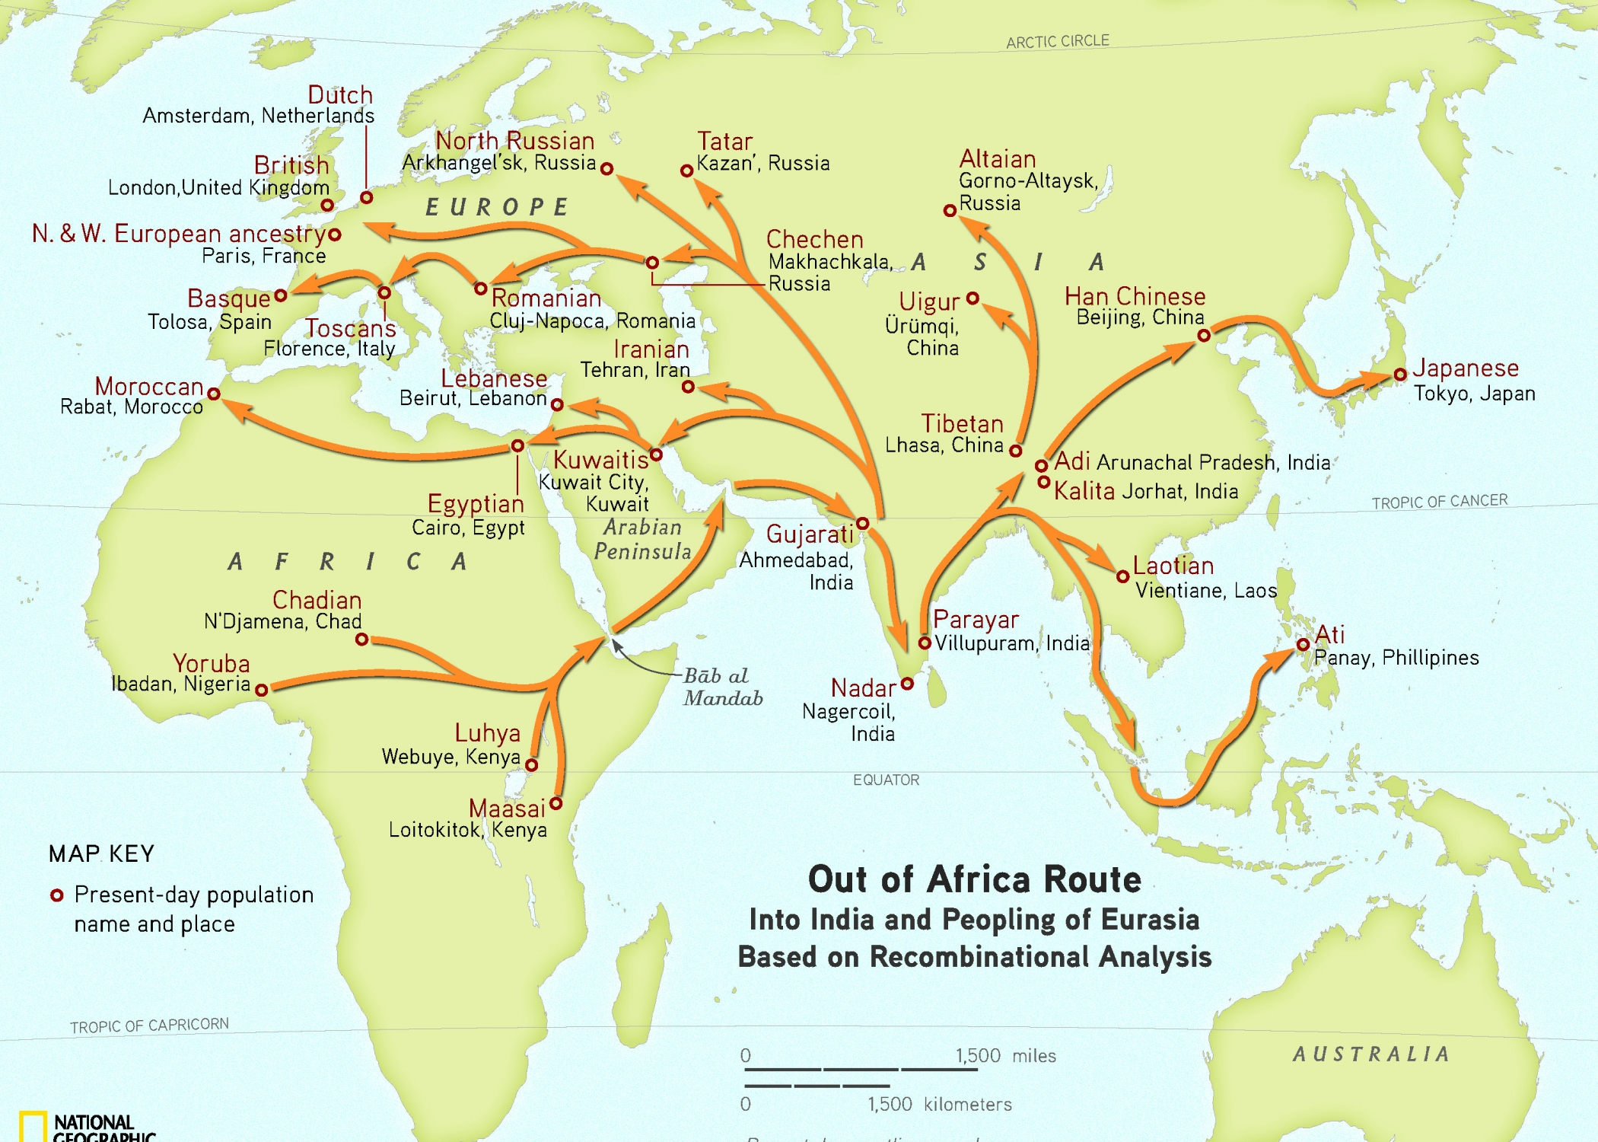
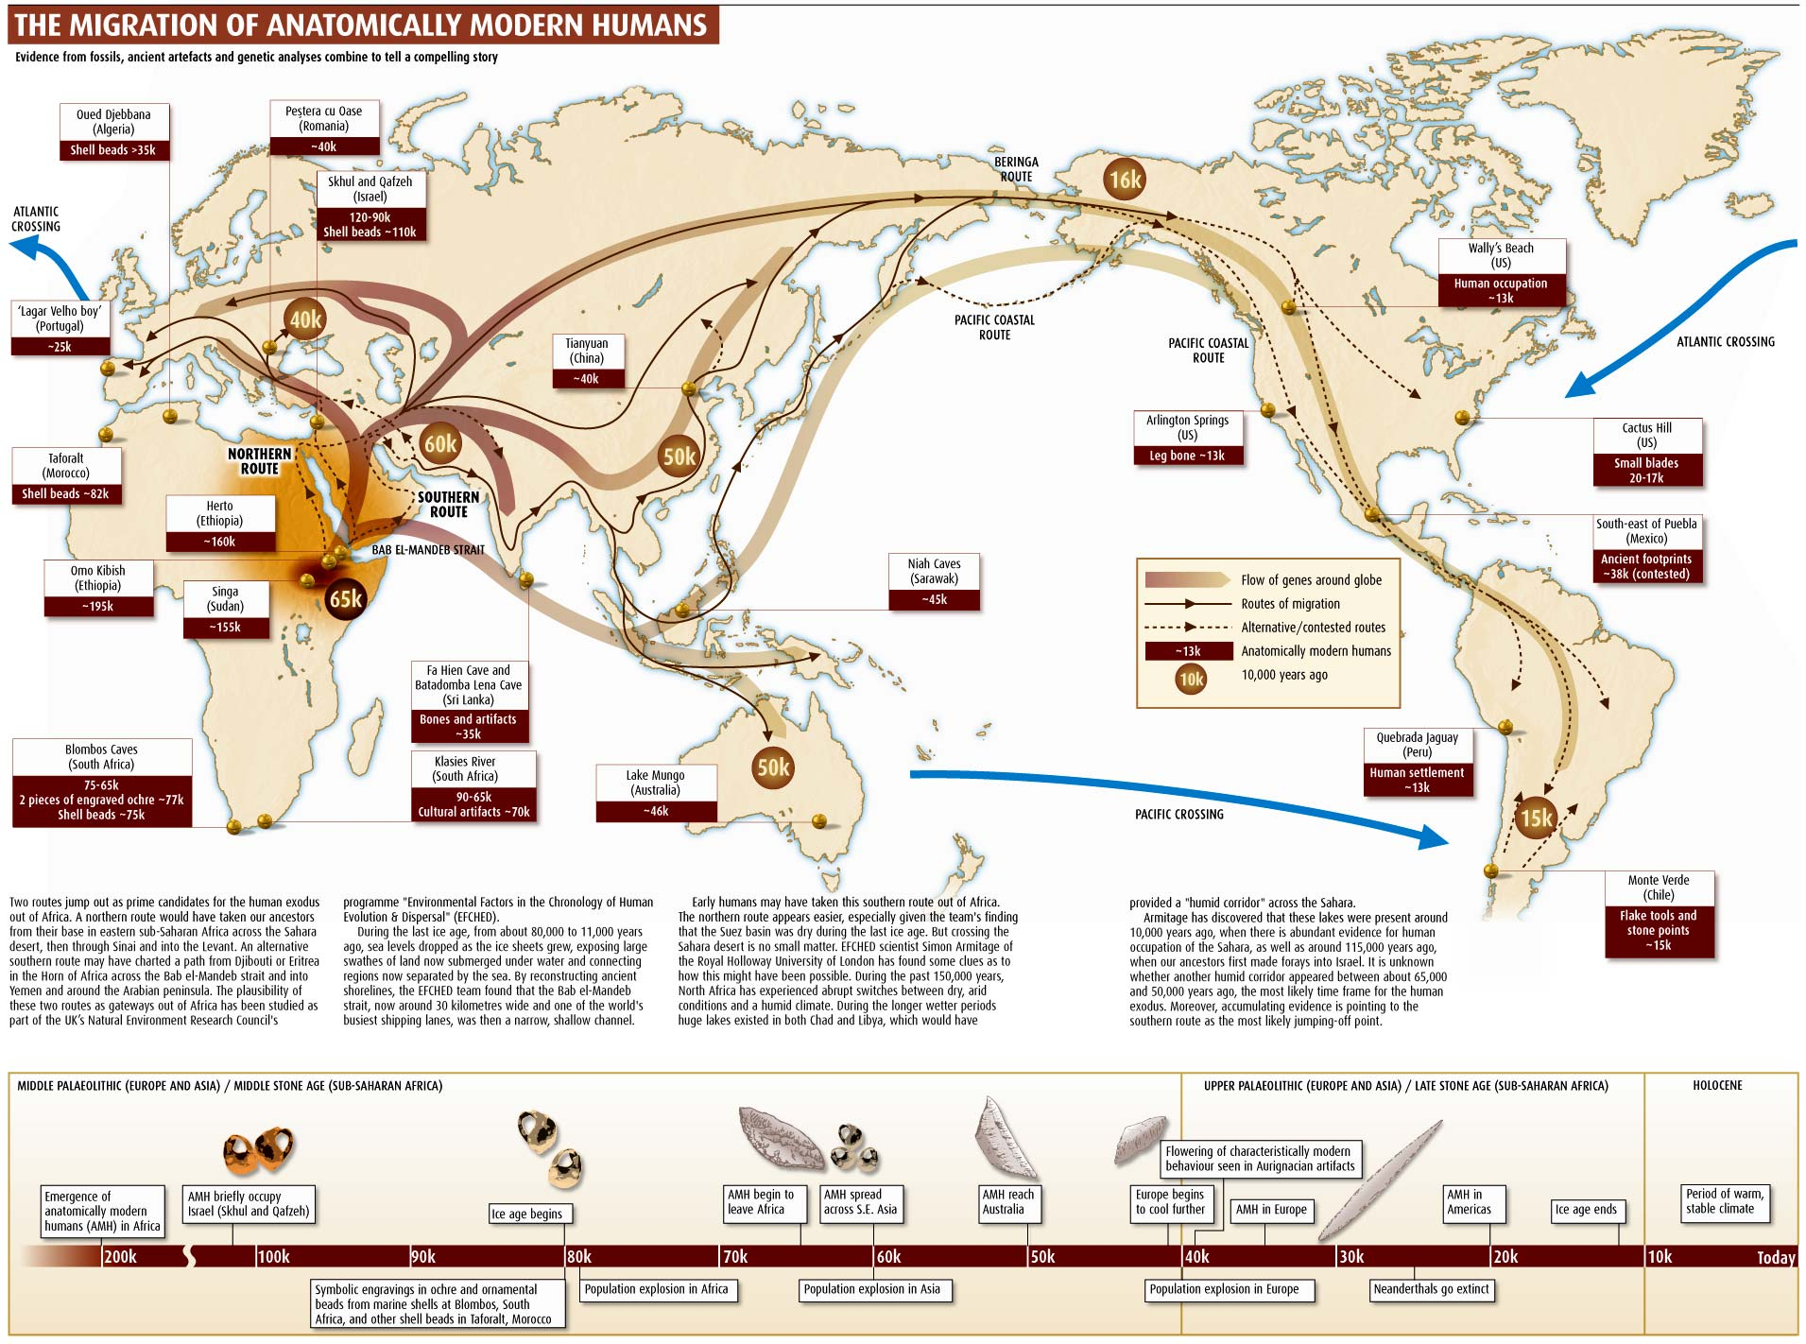

Slide 71
DENOMINATOR
Denominators are the numbers that provide perspective to other numbers.

Slide 72
DENOMINATOR
If you are informed that 10,000 persons die each year in the United States from a particular disease, then you might want to know the total number of deaths, from all causes.
When you compare the death from a particular disease with the total number of deaths from all causes (the denominator), you learn something about the relative importance of your original count (e.g., an incidence of 10,000 deaths/350 million persons).

Slide 73
DENOMINATOR
If you are using Big Data collected from multiple sources, your histograms will need to be represented as fractional distributions for each source’s data, not as value counts.
The reason for this is that a histogram from one source will probably not have the same total
number of distributed values compared with a histogram created from another source.

Slide 74
FREQUENCY DISTRIBUTIONS
Let’s take a look at the frequency distribution of words appearing in a book. Here is the list of the 30 most frequent words in the book and the number of occurrence of each word:
01 003977 the
02 001680 and
03 001091 class
04 000946 are
05 000925 chapter
06 000919 that
07 000884 species
08 000580 virus
09 000570 with
10 000503 disease
11 000434 for
12 000427 organisms…

Slide 75
ZIPF DISTRIBUTION
George Kingsley Zipf (1902–1950) was an American linguist who demonstrated that, for most languages, a small number of words account for the majority of occurrences of all the words found in prose. Specifically, he found that the frequency of any word is inversely proportional to its placement in a list of words, ordered by their decreasing frequencies in text. The first word in the frequency list will occur about twice as often as the second word in the list, three times as often as the third word in the list, and so on.

Slide 76
ZIPF DISTRIBUTION
As Zipf would predict, the most frequent word, “the,” occurs 3977 times, roughly twice as often as the second most frequently occurring word, “and,” which occurs 1689 times. The third most frequently occurring word, “class,” occurs 1091 times, or very roughly one-third as frequently as the most frequently occurring word.

Slide 77
What can we learn about the text from which these word frequencies were calculated?
As discussed in Chapter 1, “stop” words are high-frequency words that separate terms and tell us little or nothing about the informational content of text.

Slide 78
Let us look at this same list with the “stop” words removed:
03 001091 class
05 000925 chapter
07 000884 species
08 000580 virus
10 000503 disease
12 000427 organisms
14 000412 hierarchy
16 000329 humans
18 000319 proteobacteria
19 000309 human
21 000264 fever
22 000263 group
24 000225 infections
25 000219 viruses
26 000219 infectious
27 000216 organism
28 000216 host

Slide 79
What kind of text could have produced this list?

Slide 80
What kind of text could have produced this list?
Classification of organisms causing human disease-infectious disease taxonomy

Slide 81
MEAN AND STANDARD DEVIATION
In the Big Data realm, computing the mean and the standard deviation is often a waste of time.
Big Data is seldom distributed as a normal curve. The mean and standard deviation have limited value outside of normal distributions. The reason for the non-normality of Big Data is that Big Data is observational, not experimental.

Slide 82
MEAN AND STANDARD DEVIATION
Big Data distributions are sometimes multimodal, with several peaks and troughs.
Multimodality always says something about the data under study. It tells us that the population is somehow nonhomogeneous.
Hodgkin lymphoma is an example of a cancer with a bimodal age distribution. There is a peak in occurrences at a young age, and another peak of occurrences at a more advanced age.
This two-peak phenomenon can be found whenever Hodgkin lymphoma is studied in large populations.

Slide 83
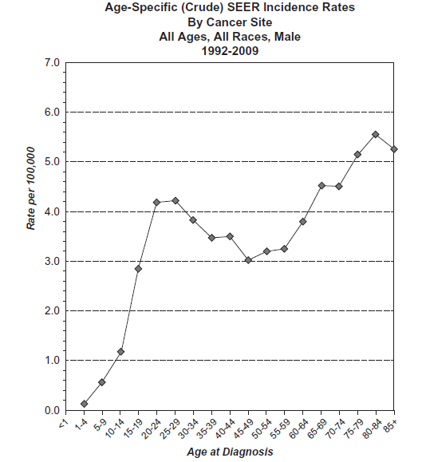
MEAN AND STANDARD DEVIATION

Slide 84
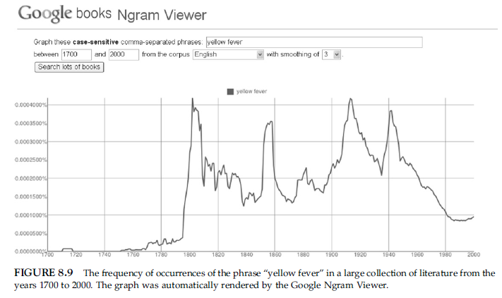
WATCHING DATA TRENDS WITH GOOGLE NGRAMS

Slide 85
WATCHING DATA TRENDS WITH GOOGLE NGRAMS
We see that the term “yellow fever” (a mosquito-transmitted hepatitis) appeared in the literature beginning about 1800 (shortly after an outbreak in Philadelphia), with several subsequent peaks (around 1915 and 1945).

Slide 86
WATCHING DATA TRENDS WITH GOOGLE NGRAMS
The dates of the peaks correspond roughly to outbreaks of yellow fever in Philadelphia (epidemic of 1793), New Orleans (epidemic of 1853), with U.S. construction efforts in the Panama Canal (1904–1914), and World War II Pacific outbreaks (about 1942).
Following the 1942 epidemic, an effective vaccine was available, and the incidence of yellow fever, as well as the occurrences of the “yellow fever” 2-gram, dropped precipitously. In this case, a simple review of ngram frequencies provides an accurate chart of historic yellow fever outbreaks.

Slide 87
USE CASE: ESTIMATING MOVIE PREFERENCES

Slide 88
USE CASE: ESTIMATING MOVIE PREFERENCES
Imagine you have all the preference data for every user of a large movie subscriber service, such as Netflix. You want to develop a system whereby the preference of any subscriber, for any movie, can be predicted.

Slide 89
USE CASE: ESTIMATING MOVIE PREFERENCES
1. Ignore your data and use experts.
2. Use all of your data, as it comes in, to produce an average subscriber score.
3. Lump people into preference groups based on shared favorites.
If Ann’s personal list of top-favored movies is the same as Fred’s top-favored list, then it’s likely that their preferences will coincide. For movies that Ann has seen but Fred has not, use Ann’s score as a predictor.

Slide 90
USE CASE: ESTIMATING MOVIE PREFERENCES
In a large data set, find an individual’s top 10 movie choices and add the individual to a group of individuals who share the same top 10 list.
Use the average score for members of the group, for any particular movie, as that movie’s predictor for each of the members of the group.

