Slide 1
9. Analysis
Analysis in the Big Data realm is fundamentally different from analysis for small data.

Slide 2
9 Analysis
Big Data performs many computational tasks, some of which are not directly involved in analytics (e.g., searching for specific data, searching for patterns of data, retrieving data, organizing the retrieved data by a ranking system).
Data analysis involves drawing conclusions based on reviewing sets of data. These tasks can be somewhat arbitrarily divided into three areas: statistical analysis, modeling, and predictive analysis.

Slide 3
9 Analysis
Statistical analysis is closely associated with hypothesis testing. The prototypical hypothesis question is, “If I have a control group and a treated group, how do I know when the treatment results in an effect that makes the treatment group measurably different from the control group?”
Though statisticians cannot answer this fundamental question definitively, they provide some measure of confidence in an answer.

Slide 4
Modeling
Modeling is a description, using a mathematical equation or some logical language, to describe the behavior of a system or its objects.
Examples would be a model for planetary motion, a model for interstate traffic, a model for enzymatic reactions, a model for cancer growth, and so on.
In many cases, modeling equations will need to describe how different variables change, in relation to one another, over increments of time. Hence, many modeling equations involve differential calculus.

Slide 5
Predictive analysis
Predictive analysis is concerned with guessing how an individual, group, or data object will behave based on past outcomes or on the observed behaviors of similar individuals or groups.
Predictive analytics relies on one concept: if thing A is similar to thing B, then thing A will most likely behave like thing B.
Predictive analytics includes three types of algorithms: recommenders, classifiers, and clustering

Slide 6
CLUSTERING, CLASSIFYING, RECOMMENDING, AND MODELING
Reality is merely an illusion, albeit a very persistent one. (Albert Einstein)

Slide 7
Clustering Algorithms
Clustering algorithms are currently very popular. They provide a way of taking a large set of data objects that seem to have no relationship to one another and producing a visually simple collection of clusters wherein each cluster member is similar to every other member of the same cluster.

Slide 8
The k-means algorithm
The k-means algorithm assigns any number of data objects to one of k clusters.
The number k of clusters is provided by the user. The algorithm is easy to describe and to understand, but the computational task of completing the algorithm can be difficult when the number of dimensions in the object (i.e., the number of attributes associated with the object) is large.

Slide 9
The k-means algorithm
1. The program randomly chooses k objects from the collection of objects to be clustered. We’ll call each of these k objects a focus.
2. For every object in the collection, the distance between the object and all of the randomly chosen k objects (chosen in step 1) is computed.
3. A round of k clusters is computed by assigning every object to its nearest focus.
4. The centroid focus for each of the k clusters is calculated. The centroid is the point that is closest to all of the objects within the cluster. Another way of saying this is if you sum the distances between the centroid and all of the objects in the cluster, this summed distance will be smaller than the summed distance from any other point in space.

Slide 10
The k-means algorithm
5. Steps 2, 3, and 4 are repeated, using the k centroid foci as the points for which all distances are computed.
6. Step 5 is repeated until the k centroid foci converge on a nonchanging set of k centroid foci (or until the program slows to an interminable crawl).

Slide 11
Drawbacks to the algorithm
1. The final set of clusters will sometimes depend on the initial, random choice of k data objects. This means that multiple runs of the algorithm may produce different outcomes.
2. The algorithms are not guaranteed to succeed. Sometimes, the algorithm does not converge to a final, stable set of clusters.
3. When the dimensionality is very high, distances between data objects (i.e., the square root of the sum of squares of the measured differences between corresponding attributes of two objects) can be ridiculously large and of no practical meaning (Curse of dimensionality).
4. The clustering algorithm may succeed, producing a set of clusters of similar objects, but the clusters may have no practical value. They may miss important relationships among the objects or might group together objects whose similarities are totally noninformative.

Slide 12
Classifier Algorithms
These algorithms assign a class (from a preexisting classification) to an object whose class is unknown.

Slide 13
The k-nearest neighbor algorithm
From a collection of data objects whose class is known, the algorithm computes the distances from the object of unknown class to the objects of known class.
This involves a distance measurement from the feature set of the objects of unknown class to every object of known class (the test set). The distance measure uses the set of attributes that are associated with each object.
After the distances are computed, the k-classed objects with the smallest distance to the object of unknown class are collected. The most common class in the nearest k-classed objects is assigned to the object of unknown class. If the chosen value of k is 1, then the object of unknown class is assigned the class of its closest classed object (i.e., the nearest neighbor).

Slide 14
Classifier algorithms differ fundamentally from clustering algorithms and from recommender algorithms in that they begin with an existing classification. Their task is very simple: assign an object to its proper class within the classification.

Slide 15
Classifier algorithms carry the assumption that similarities among class objects determine class membership.
This may not be the case. For example, a classifier algorithm might place cats into the class of small dogs because of the similarities among several attributes of cats and dogs (e.g., four legs, one tail, pointy ears, average weight 8 pounds, furry, carnivorous, etc.).
The similarities are impressive, but irrelevant.

Slide 16
Like clustering techniques, classifier techniques are computationally intensive when the dimension is high and can produce misleading results when the attributes are noisy (i.e., contain randomly distributed attribute values) or noninformative (i.e., unrelated to correct class assignment).

Slide 17
Recommender Algorithms
When a data object is very similar to another data object, the two objects are likely to behave similarly.
Recommender techniques typically measure the distance between one data object (e.g., a potential customer) and other data items (e.g., customers who have bought a particular product or who have indicated a product preference).

Slide 18
Recommender Algorithms
The data objects that are closest to one another will tend to have the same preferences and can serve as recommenders.
Distances between data objects are measured with feature-by-feature comparisons using the Euclidean distance, the Mahalanobis distance, or whichever type of distance measurements seem appropriate.

Slide 19
Modeling Algorithms
Modeling involves explaining the behavior of a system, often with a formula, sometimes with descriptive language.
The formula for the data describes the distribution of the data and often predicts how the different variables will change with one another.
Consequently, modeling comes closer than other Big Data techniques to explaining the behavior of data objects and of the system in which the data objects interact.

Slide 20
DATA REDUCTION
Gravitational attraction is a Big Data problem.

Slide 21
DATA REDUCTION
Gravitational attraction is a Big Data problem.
The point here is that when Big Data is analyzed, it is seldom necessary to include every point of data in your system model. In the Big Data field, the most successful analysts will often be those individuals who are adept at simplifying the system model, thus eliminating unnecessary calculations.

Slide 22
High dimensionality
Because Big Data is complex, you will often find that your data objects have high dimensionality; each data object is annotated with a large number of values.
The types of values that are shared among all the different data objects are usually referred to as parameters. It is very difficult to make much sense of high dimensional data. It is always best to develop a filtering mechanism that expunges useless parameters.

Slide 23
A useless parameter will often have one of these two properties.
1. Redundancy. If a parameter correlates perfectly with some other parameter, you know that you can safely drop one of the two parameters.
For example, you may have some physiologic data on a collection of people, and the data may include weight, waist size, body fat index, weight adjusted by height, density, and so on.
These measurements seem to be measuring about the same thing; are they all necessary? If several attributes closely correlate with one another, you might want to drop a few.

Slide 24
A useless parameter - Redundancy
If a parameter correlates perfectly with some other parameter, you know that you can safely drop one of the two parameters.
For example, you may have some physiologic data on a collection of people, and the data may include weight, waist size, body fat index, weight adjusted by height, density, and so on.
These measurements seem to be measuring about the same thing; are they all necessary? If several attributes closely correlate with one another, you might want to drop a few.

Slide 25
Random noise in the data

Slide 26
How to reduce the dimensionality of the data?
One popular method for transforming data to reduce the dimensionality of data objects is multidimensional scaling, which employs principal component analysis.

Slide 27
An example
>Anhui/1/05_{2.3.4}
GATCAGATTTGCATTGGTTACCATGCAAACAACTCGACAGAGCAGGTTGACACAATAATG
GAAAAGAACGTTACTGTTACACATGCCCAAGACATACTGGAAAAGACACACAACGGGAAG
CTCTGCGATCTAGATGGAGTGAAGCCTCTGATTTTAAGAGATTGTAGTGTAGCTGGATGG
CTCCTCGGAAACCCAATGTGTGACGAATTCATCAATGTGCCGGAATGGTCTTACATAGTG
GAGAAGGCCAACCCAGCCAATGACCTCTGTTACCCAGGGAATTTCAACGACTATGAAGAA
CTGAAACACCTATTGAGCAGAATAAACCATTTTGAGAAAATTCAGATCATCCCCAAAAGT
TCTTGGTCCGATCATGAAGCCTCATCAGGGGTGAGCTCAGCATGTCCATACCAGGGAACG
CCCTCCTTTTTCAGAAATGTGGTATGGCTTATCAAAAAGAACAATACATACCCAACAATA
AAGAGAAGCTACAATAATACCAACCAGGAAGATCTTTTGATACTGTGGGGGATTCATCAT
TCTAATGATGCGGCAGAGCAGACAAAGCTCTATCAAAACCCAACCACCTATATTTCCGTT
GGGACATCAACACTAAACCAGAGATTGGTACCAAAAATAGCTACTAGATCCAAAGTAAAC
GGGCAAAGTGGAAGGATGGATTTCTTCTGGACAATTTTAAAACCGAATGATGCAATCAAC
TTCGAGAGTAATGGAAATTTCATTGCTCCAGAATATGCATACAAAATTGTCAAGAAAGGG
GACTCAGCAATTGTTAAAAGTGAAGTGGAATATGGTAACTGCAACACAAAGTGTCAAACT
CCAATAGGGGCGATAAACTCTAGTATGCCATTCCACAACATACACCCTCTCACCATCGGG
GAATGCCCCAAATATGTGAAATCAAACAAATTAGTCCTTGCGACTGGGCTCAGAAATAGT
CCTCTAAGAGAAAGAAGAAGAAAA---AGAGGACTATTTGGAGCTATAGCAGGGTTTATA
GAGGGAGGATGGCAGGGAATGGTAGATGGTTGGTATGGGTACCACCATAGCAATGAGCAG
GGGAGTGGGTACGCTGCAGACAAAGAATCCACTCAAAAGGCAATAGATGGAGTCACCAAT
AAGGTCAACTCGATCATTGACAAAATGAACACTCAGTTTGAGGCCGTTGGAAGGGAATTT
AATAACTTAGAAAGGAGAATAGAGAATTTAAACAAGAAAATGGAAGACGGATTCCTAGAT
GTCTGGACTTATAATGCTGAACTTCTGGTTCTCATGGAAAATGAGAGAACTCTAGACTTC
CATGATTCAAATGTCAAGAACCTTTACGACAAGGTCCGACTACAGCTTAGGGATAATGCA
AAGGAGCTGGGTAACGGTTGTTTCGAGTTCTATCACAAATGTGATAATGAATGTATGGAA
AGTGTAAGAAACGGAACGTATGACTACCCGCAGTATTCAGAAGAAGCAAGATTAAAAAGA
GAGGAAATAAGTGGAGTAAAATTGGAATCAATAGGAACTTACCAAATACTGTCAATTTAT
TCAACAGTTGCGAGTTCTCTAGCACTGGCAATCATGGTGGCTGGTCTATCTTTGTGGATG
TGCTCCAATGGGTCGTTACAATGCAGAATTTGCATTTAA

Slide 28
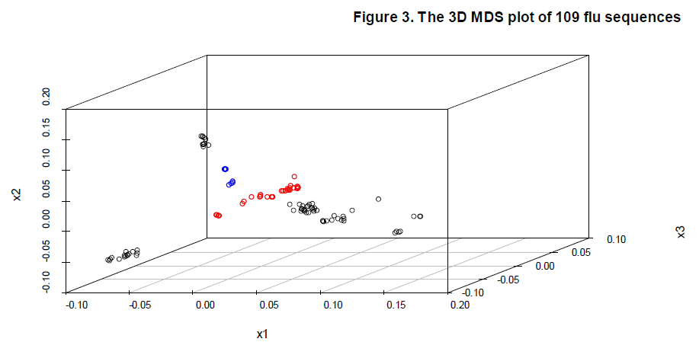

Slide 29
An application
The winter monthly SLP over the Northern Hemisphere
The data come from the National Center for Atmospheric Research and National
Center for Environmental Prediction (NCAR/NCEP) from 1948 to 2000 on a regular horizontal grid with 2.5o × 2.5o resolution.
The winter season is defined by December to February (DJF). The seasonal cycle is first calculated as monthly averaged values then removed from the data.

Slide 30
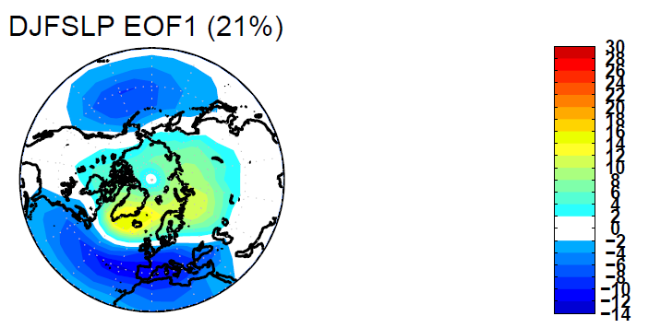
The figure shows the spectrum of the covariance matrix along with their uncertainties.

Slide 31
EOF 1 shows a high over the North Pole and two low centres over the Mediterranean-North East Atlantic and over the North Pacific. This is the familiar AO mode (Thompson and Wallace 1998; 2000).

Slide 32
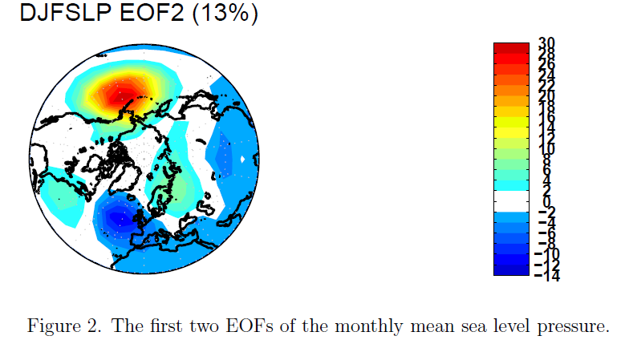

Slide 33
The second pattern EOF2 shows two separated centres over the North Pacific and North East Atlantic respectively.

Slide 34
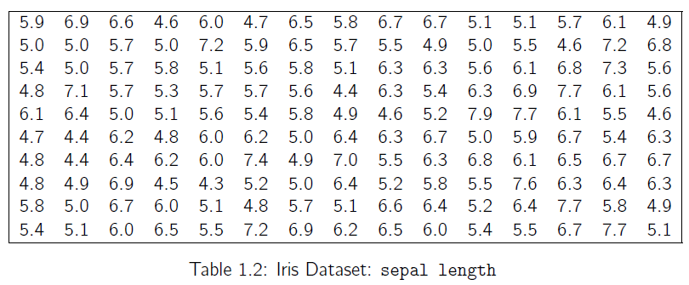
Random Sample and Statistics
Population: is used to refer to the set or universe of all entities under study.
However, looking at the entire population may not be feasible, or may be too expensive.
Instead, we draw a random sample from the population, and compute appropriate statistics from the sample, that give estimates of the corresponding population parameters of interest.

Slide 35
Statistic
Let Si denote the random variable corresponding to data point xi , then a statistic ˆθ is a function ˆθ : (S1, S2, · · · , Sn) → R.
If we use the value of a statistic to estimate a population parameter, this value is called a point estimate of the parameter, and the statistic is called as an estimator of the parameter.

Slide 36
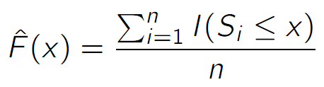
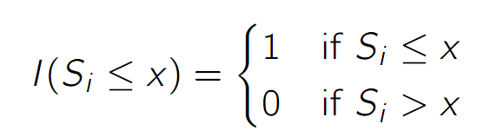
Empirical Cumulative Distribution Function
Where
Inverse Cumulative Distribution Function

Slide 37
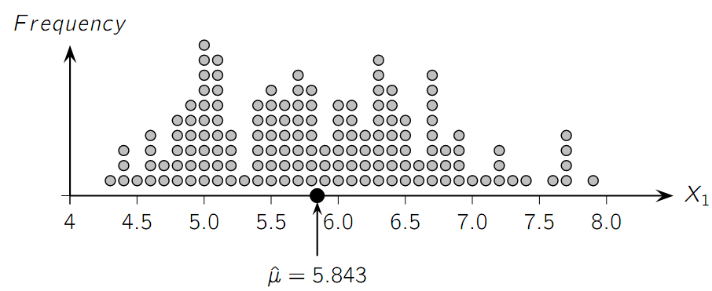
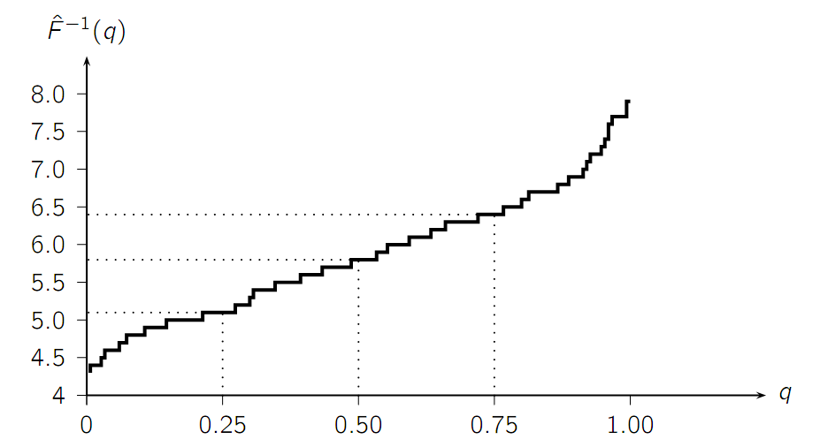
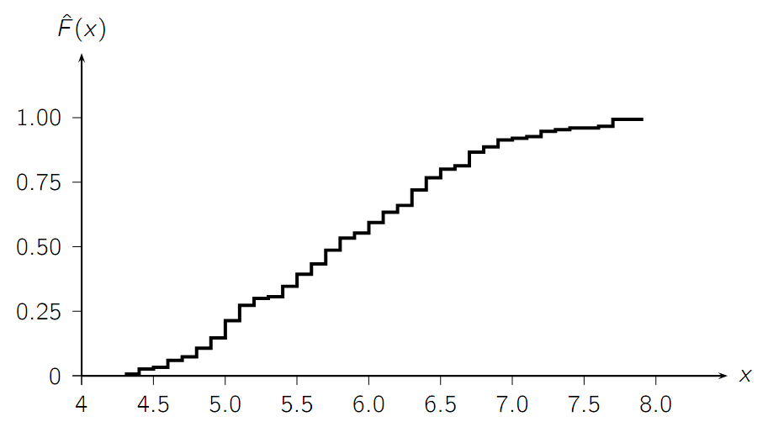
Example

Slide 38
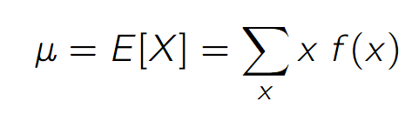
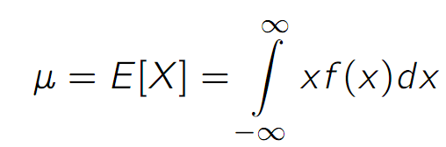
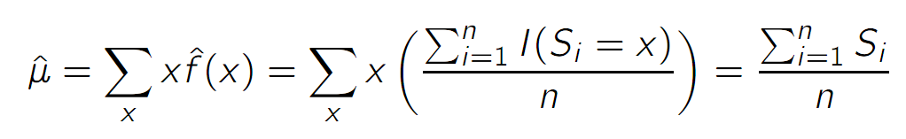
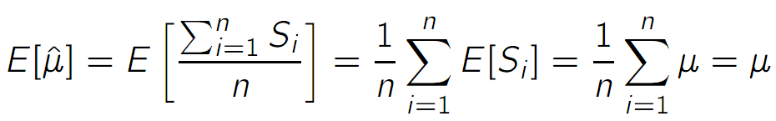
Measures of Central Tendency (Mean)
Population Mean:
Sample Mean (Unbiased, not robust):

Slide 39
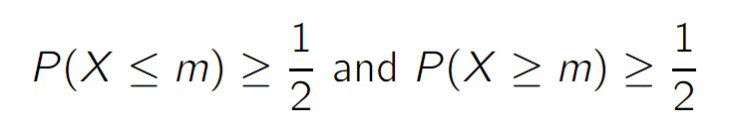
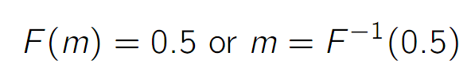
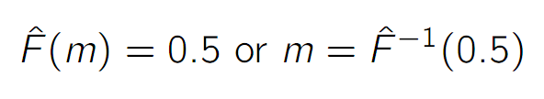
Measures of Central Tendency (Median)
Population Median:
or
Sample Median:

Slide 40
Example

Slide 41

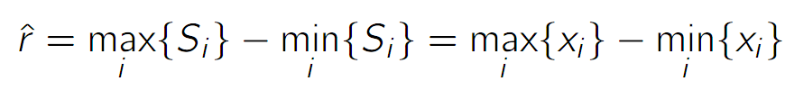
Measures of Dispersion (Range)
Range:
Sample Range:
Not robust, sensitive to extreme values

Slide 42




Measures of Dispersion (Inter-Quartile Range)
Inter-Quartile Range (IQR):
Sample IQR:
More robust

Slide 43
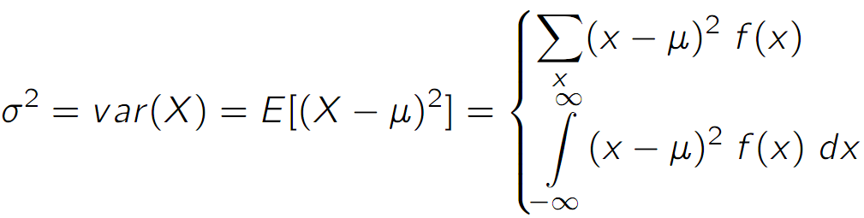
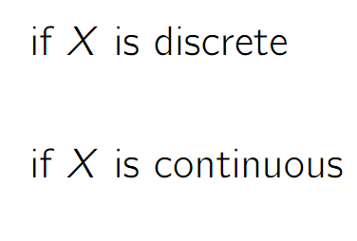
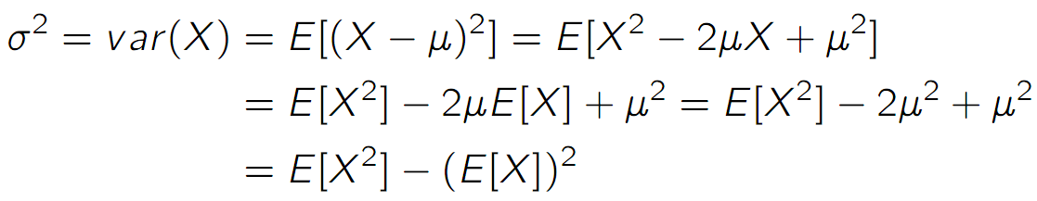
Measures of Dispersion (Variance and Standard Deviation)
Variance:
Standard Deviation:

Slide 44
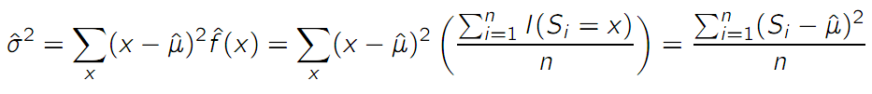
Measures of Dispersion (Variance and Standard Deviation)
Variance:
Standard Deviation:
Sample Variance & Standard Deviation:

Slide 45
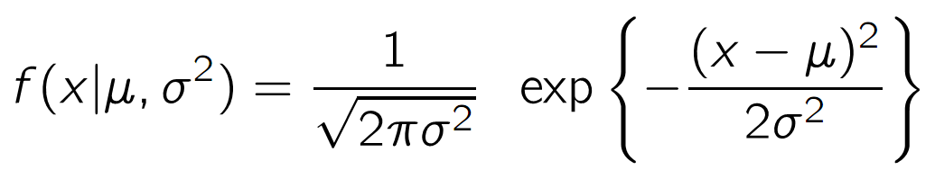
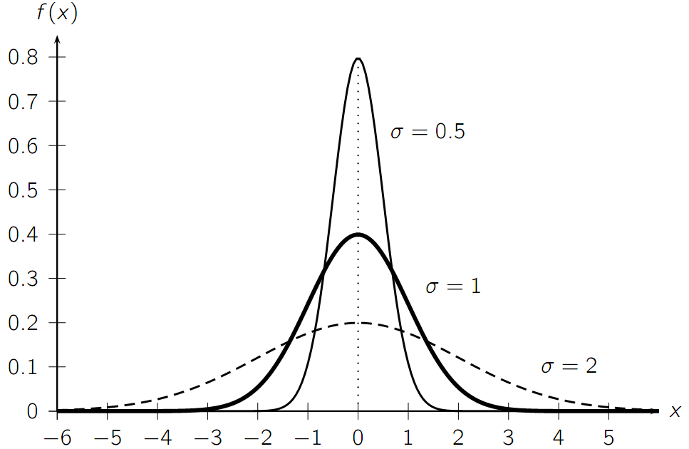
Univariate Normal Distribution

Slide 46
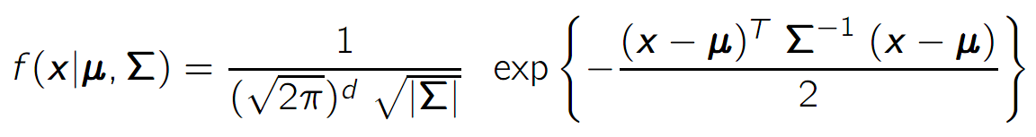
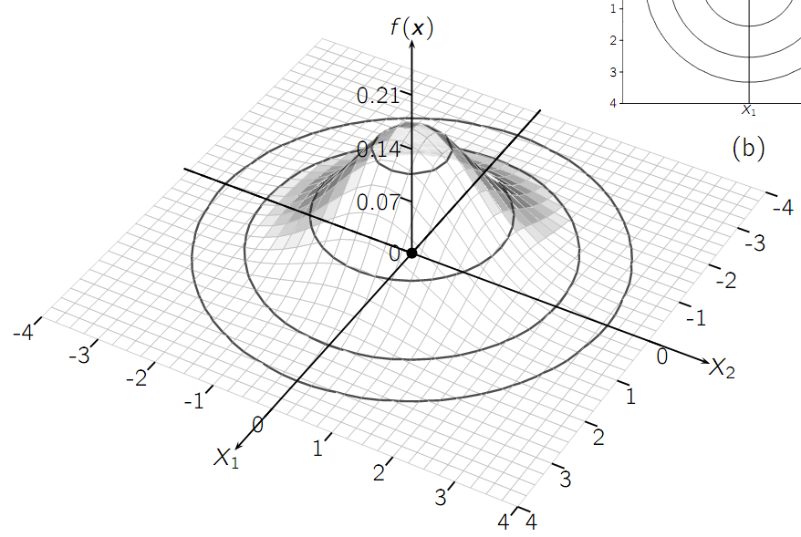
Multivariate Normal Distribution

Slide 47
OLAP and Data Mining

Slide 48
Warehouse Architecture
Client
Client
Query & Analysis
Metadata
Warehouse
Integration
Source
Source
Source

Slide 49
Star Schemas
A star schema is a common organization for data at a warehouse. It consists of:
Fact table : a very large accumulation of facts such as sales.
Often “insert-only.”
Dimension tables : smaller, generally static information about the entities involved in the facts.

Slide 50
Terms
Fact table
Dimension tables
Measures

Slide 51
Star

Slide 52
Cube
Fact table view:
Multi-dimensional cube:
dimensions = 2

Slide 53
3-D Cube
Fact table view:
Multi-dimensional cube:
day 2
day 1
dimensions = 3

Slide 54
ROLAP vs. MOLAP
ROLAP: Relational On-Line Analytical Processing
MOLAP: Multi-Dimensional On-Line Analytical Processing

Slide 55
Aggregates
Add up amounts for day 1
In SQL: SELECT sum(amt) FROM SALE
WHERE date = 1
81

Slide 56
Aggregates
Add up amounts by day
In SQL: SELECT date, sum(amt) FROM SALE
GROUP BY date

Slide 57
Another Example
Add up amounts by day, product
In SQL: SELECT date, sum(amt) FROM SALE
GROUP BY date, prodId
rollup
drill-down

Slide 58
Aggregates
Operators: sum, count, max, min, median, ave
“Having” clause
Using dimension hierarchy
average by region (within store)
maximum by month (within date)

