Slide 1
The Whole System
Multi-layer PCA
Auto Encoder
K-means

Slide 2
Multi-layer PCA
What is multi-layer PCA
PCA is commonly used in data preprocessing, and here I expand it to multi-layer shown as follow.
Multi-layer PCA is just try to run PCA several times on the subset of each training data.
Main Step of it ……
0.98
F

Slide 3
Multi-layer PCA
Some mathematically proof
In common PCA, our goal is maximize the function J as follow:
When we denote X as X=[a b], then
Which means that we has the same optimization goal, though in real situation, we may have different U, but it can still be regarded as a good approximation to directly running PCA on X.

Slide 4
Multi-layer PCA
Why do I introduce multi-layer PCA here
1. The dimension of features in the given data set is almost 20,000, while the number of sample is about 200, which makes it highly prone to be trapped into the over-fitting problem.
2. Computer resource restriction: in order to run PCA, you need to compute the covariance matrix, and run SVD on it. But our covariance matrix here is a 20,000-by-20,000, which is HUGE, and my computer fail to find a proper answer on it.
I tried it on a computer with 8 cores and 16G memory, but still it couldn’t work.[Alibaba cloud computing platform]

Slide 5
Multi-layer PCA
Multi-layer PCA result (GBM only)
Data Type | CNV | Methylation | miRNA | mRNA
Formal | 106 | 16383 | 533 | 17813
First layer | 74 | 738 | 133 | 710
Second layer | 73 | 189 | 131 | 180

Slide 6
Auto Encoder
Structure of the auto encoder part
Detected Feature
For each node in the left graph (except the second layer), I train a special BP neural network, also known as auto encoder, with classical gradient decent method.
Concatenated features
Detected Feature
Data processed by PCA

Slide 7
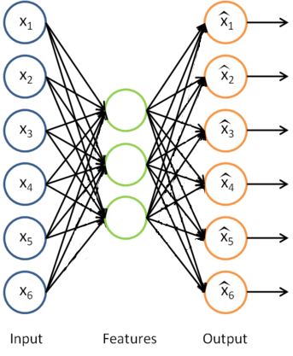
Auto Encoder
From Andrew Ng’s Deep learning course
In many deep learning algorithms, such as de-noise auto encoder and stack auto encoder, they learn features from huge amount of unlabeled data, in which auto encoder plays a very important role.
When you take the output the same as input or train a function: f(x) = x, it seems that it is a bit senseless, but when the number of hidden layer is lower than the input layer, then we can find that we get a compressed representation of our data. So here I use auto encoder to detect the underlying features of our data set.

Slide 8
Auto Encoder
How do I choose the number of hidden layer
Cross validation set
With the help of MATLAB, the data set will be divided into 3 parts: training set, test set and cross validation set. And the picked parameters are these who performed well on cross validation set.
Train error on the each hidden layer number
Mean Error:
Iteration
To avoid the initialization problem, for every candidate number, I repeated training for about 100 times, and choose W with the minimum mean error.

Slide 9
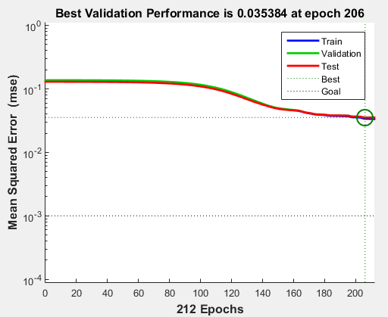
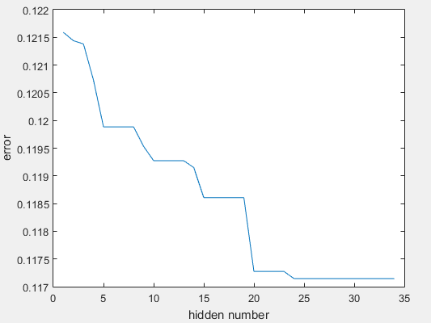
Auto Encoder-performance
Learning Curve at thefirst iteration
Error curve with different hidden layer number

Slide 10
Auto Encoder-result
● result of auto encoder (GBM only)
Data Type | CNV | methylation | miRNA | mRNA
Input layer | 74 | 189 | 133 | 180
Hidden layer | 37 | 47 | 66 | 45
Mean Error | 0.1101 | 0.1233 | 0.1170 | 0.1208

Slide 11
Auto Encoder
The experimental verification part(also update version)
I run multi-layer PCA and auto-encoder on KIRC and GBM data set,
and I use this two group of data to train a classifier, and here is my training
result. (repeated 10 times)
(1) Neural network
(2) SVM: 0 error on both test data and training data.
 | Neural network size | Train data | Error number | Test data | Error number
Non-randomized data | 100/10/2 | 300 | 5(2%) | 153 | 20(13%)
Randomized data | 100/10/2 | 300 | 2(0.6%) | 153 | 12(7.8%)

Slide 12
K-means Algorithm
K-means is kind of easy but very useful method in clustering.
Here I use it to find subtypes in the GBM cancer
The code(the update version in this presentation) I used is written by Deng Cai, prof in ZJU CAD lab.
http://www.cad.zju.edu.cn/home/dengcai/Data/Clustering.html
I use his code for the reason that it is the fastest k-means code so far

Slide 13
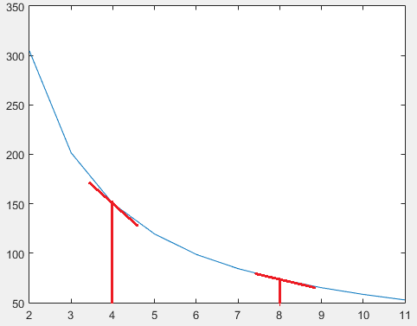
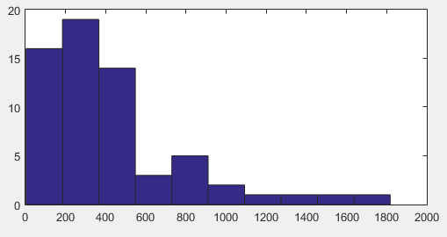
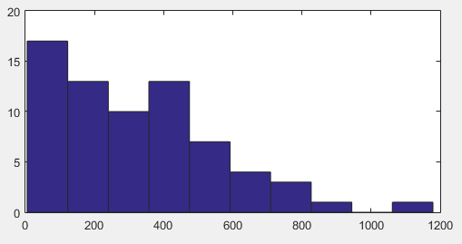
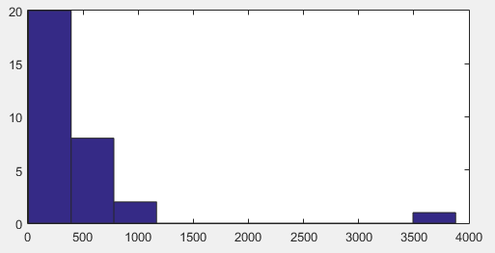
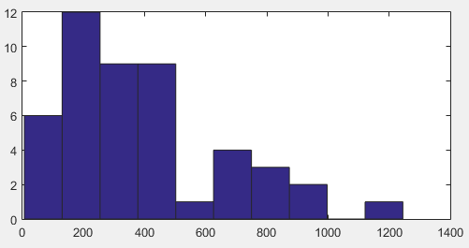
K-means Algorithm---how to choose k
Average Radius:
As the histogram shown above, different subtype may has different mean value and variance on survival time.

Slide 14
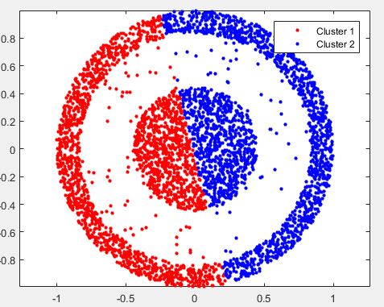
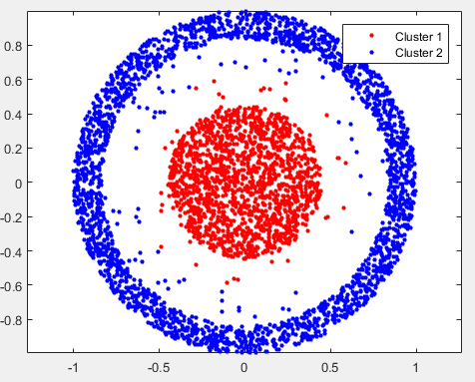
Improvement---Spectral Clustering
Spectral clustering is a clustering method based on dimension reduction. when it’s hard to cluster on the original features space, we need to find a method to project it to a lower(may be higher space just like some kernel method) dimension space, and make it easier to be clustered.
Though at the last step of spectral clustering,I applied the k-means method, but It becomes much more stable(center doesn’t change much as I experimented).
K-means algorithm is sort of unstable with different initial centroids. And for some special structure of data, it can’t works well
So I turned to spectral clustering.
k-means
spectral clustering
from my homework on prof. Deng Cai’ s class

Slide 15
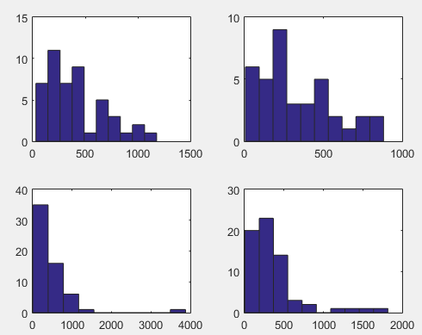
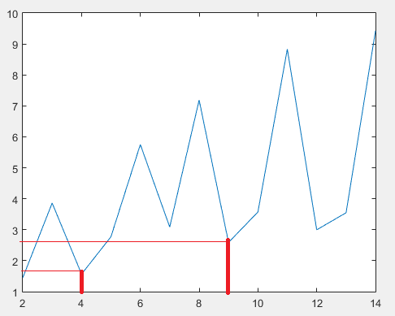
Improvement---Spectral Clustering
Then How do I choose k here

