Slide 1
TRAVLENDAR Víctor Álvaro González 897700 Planem Pasliev

Slide 2
INDEX:
What is TravLendar?
UML Diagrams
Alloy Modelling
Architectural Design

Slide 3
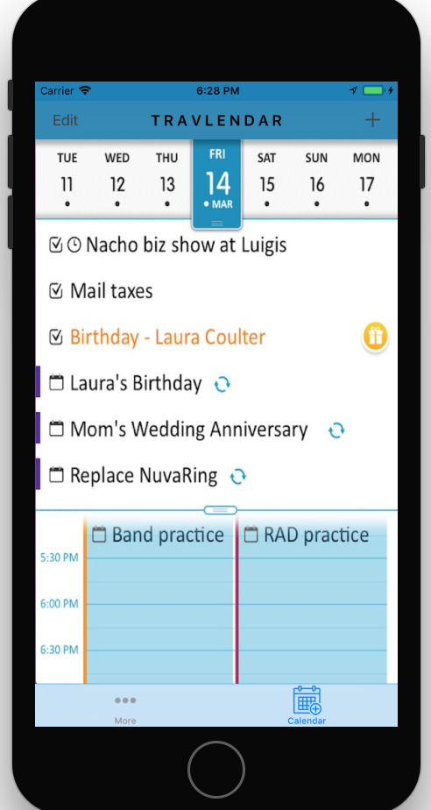


What is TravLendar?
Manage appointments
Travel preferences
Directions to the
destination
Define breaks
Weather alerts
Minimize carbon
footprint

Slide 4
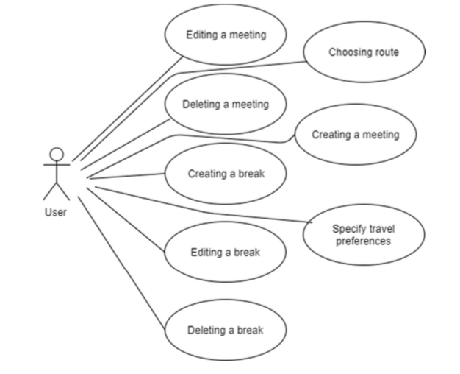
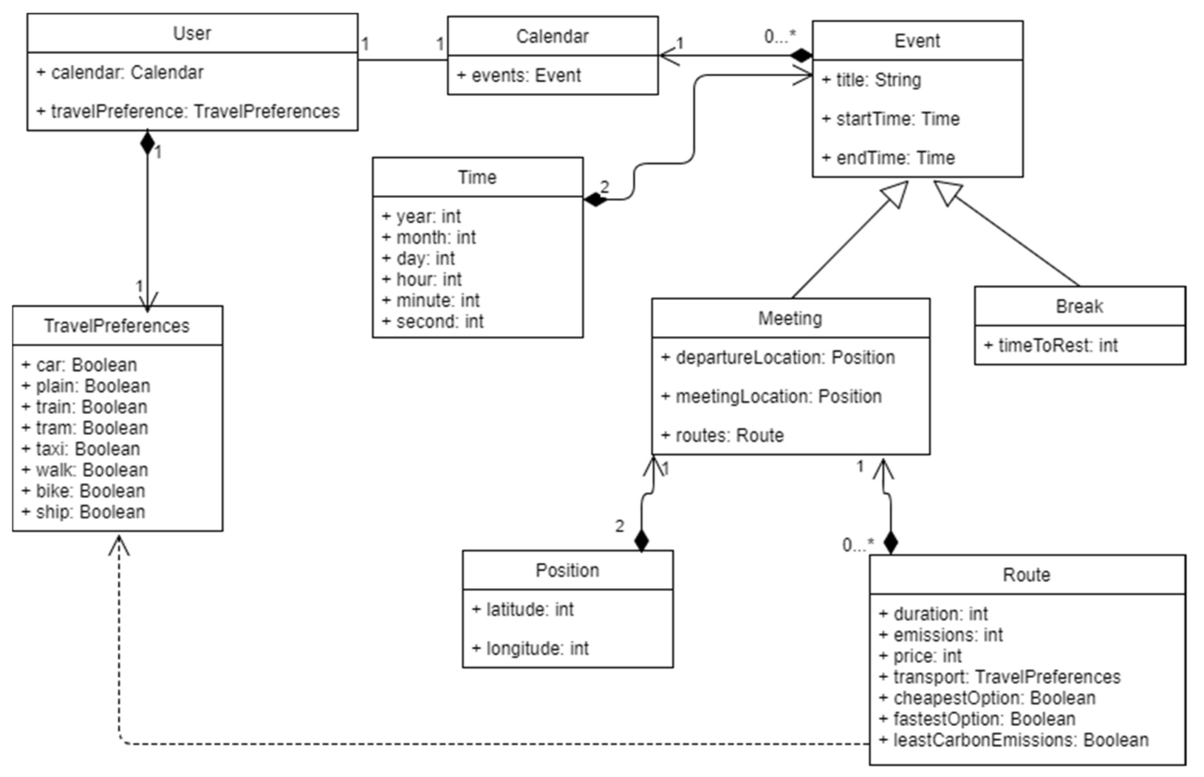
UML Diagrams:

Slide 5
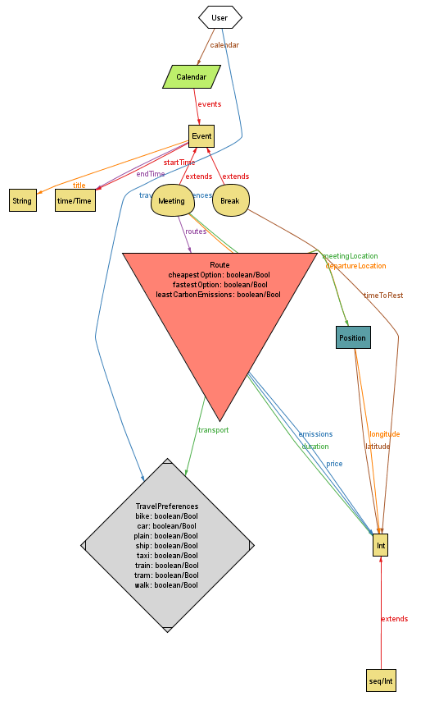
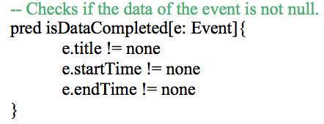
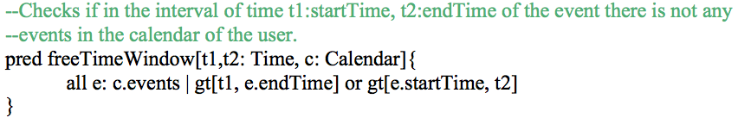
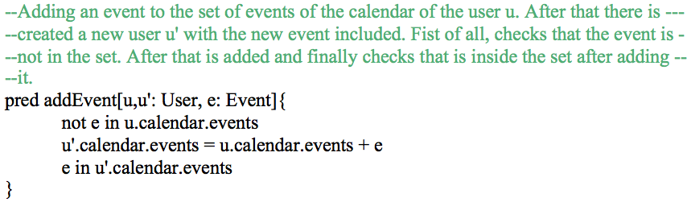
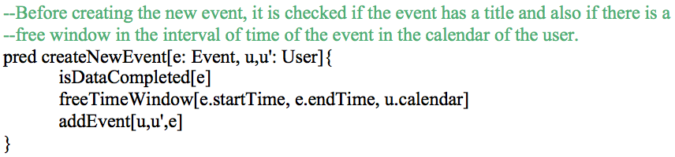
ALLOY MODELLING

Slide 6




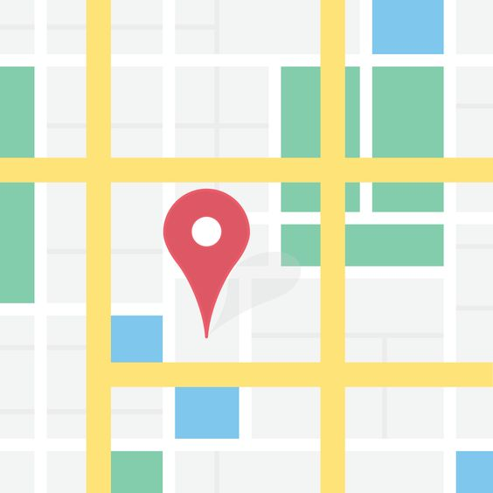
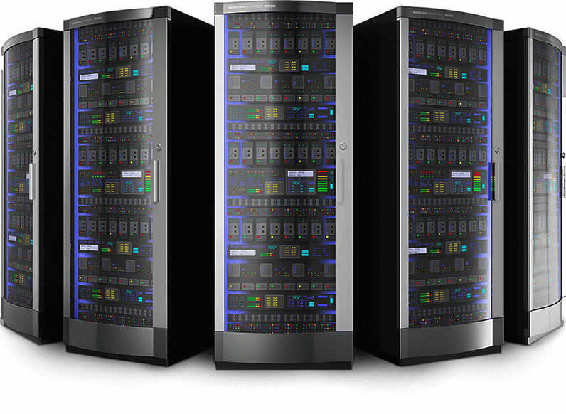

ARCHITECTURAL DESIGN
YahooWeather API Request
YahooWeather API Response
Yahoo Server
Firebase API Request
Firebase API Response
User
TravLendarAPP
Firebase
GoogleMaps API Request
GoogleMaps APIResponse
GoogleCalendar API Request
GoogleCalendar API Response
Google Servers

Slide 7
Quotations are commonly printed as a means of inspiration and to invoke philosophical thoughts from the reader.

Slide 8
THIS IS A SLIDE TITLE
Here you have a list of items
And some text
But remember not to overload your slides with content
Your audience will listen to you or read the content, but won’t do both.

Slide 9
BIG CONCEPT
Bring the attention of your audience over a key concept using icons or illustrations

Slide 10
YOU CAN ALSO SPLIT YOUR CONTENT
White
Is the color of milk and fresh snow, the color produced by the combination of all the colors of the visible spectrum.
Black
Is the color of coal, ebony, and of outer space. It is the darkest color, the result of the absence of or complete absorption of light.

Slide 11
IN TWO OR THREE COLUMNS
Yellow
Is the color of gold, butter and ripe lemons. In the spectrum of visible light, yellow is found between green and orange.
Blue
Is the colour of the clear sky and the deep sea. It is located between violet and green on the optical spectrum.
Red
Is the color of blood, and because of this it has historically been associated with sacrifice, danger and courage.

Slide 12

A PICTURE IS WORTH A THOUSAND WORDS
A complex idea can be conveyed with just a single still image, namely making it possible to absorb large amounts of data quickly.

Slide 13

WANT BIG IMPACT?
Use big image.

Slide 14
OR USE DIAGRAMS TO EXPLAIN COMPLEX IDEAS
Diagram featured by http://slidemodel.com
Sample Text
Sample Text
Sample Text
Sample Text

Slide 15
AND TABLES TO COMPARE DATA
 | A | B | C
Yellow | 10 | 20 | 7
Blue | 30 | 15 | 10
Orange | 5 | 24 | 16

Slide 16

MAPS
our office

Slide 17
89,526,124
Whoa! That’s a big number, aren’t you proud?

Slide 18
89,526,124$
185,244 users
100%
That’s a lot of money
And a lot of users
Total success!

Slide 19
LET’S REVIEW SOME CONCEPTS
Yellow
Is the color of gold, butter and ripe lemons. In the spectrum of visible light, yellow is found between green and orange.
Blue
Is the colour of the clear sky and the deep sea. It is located between violet and green on the optical spectrum.
Red
Is the color of blood, and because of this it has historically been associated with sacrifice, danger and courage.
Yellow
Is the color of gold, butter and ripe lemons. In the spectrum of visible light, yellow is found between green and orange.
Blue
Is the colour of the clear sky and the deep sea. It is located between violet and green on the optical spectrum.
Red
Is the color of blood, and because of this it has historically been associated with sacrifice, danger and courage.

Slide 20
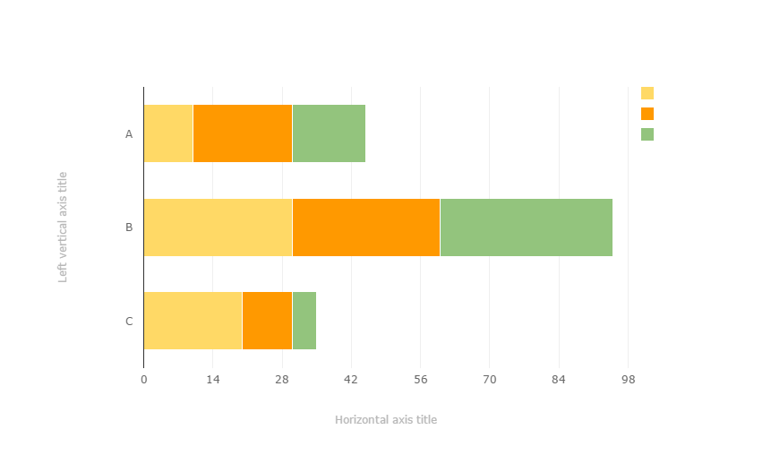
You can copy&paste graphs from Google Sheets

Slide 21
ANDROID PROJECT
Place your screenshot here
Show and explain your web, app or software projects using these gadget templates.

Slide 22
IPHONE PROJECT
Place your screenshot here
Show and explain your web, app or software projects using these gadget templates.

Slide 23
TABLET PROJECT
Place your screenshot here
Show and explain your web, app or software projects using these gadget templates.

Slide 24
DESKTOP PROJECT
Place your screenshot here
Show and explain your web, app or software projects using these gadget templates.

Slide 25
THANKS!
Any questions?
You can find me at @username & user@mail.me

Slide 26
CREDITS
Special thanks to all the people who made and released these awesome resources for free:
Presentation template by SlidesCarnival
Photographs by Death to the Stock Photo (license)

Slide 27

PRESENTATION DESIGN
You don’t need to keep this slide in your presentation. It’s only here to serve you as a design guide if you need to create new slides or download the fonts to edit the presentation in PowerPoint®
This presentations uses the following typographies and colors:
Titles: Montserrat
Body copy: Karla
You can download the fonts on this page:
http://www.google.com/fonts/#UsePlace:use/Collection:Montserrat:400,700|Karla:400,400italic,700,700italic
Click on the “arrow button” that appears on the top right
Red #F44336 Deep orange #FF5722 Orange #FF9800 Amber #FFC107
Yellow #FFEB3B Lime #CDDC39 Green #8BC34A Dark green #4CAF50
Teal #009688 Cyan #00BCD4 Blue #03A9F4 Dark blue #2196F3
Indigo #3F51B5 Deep Purple #673AB7 Purple #9C27B0 Magenta #E91E63
Blue gray #607D8B

Slide 28
SlidesCarnival icons are editable shapes.
This means that you can:
Resize them without losing quality.
Change line color, width and style.
Isn’t that nice? :)
Examples:

Slide 29
😉
Now you can use any emoji as an icon!
And of course it resizes without losing quality and you can change the color.
How? Follow Google instructions https://twitter.com/googledocs/status/730087240156643328
✋👆👉👍👤👦👧👨👩👪💃🏃💑❤😂😉😋😒😭👶😸🐟🍒🍔💣📌📖🔨🎃🎈🎨🏈🏰🌏🔌🔑 and many more...

