Slide 1
TRAVLENDAR Víctor Álvaro González, 897700 Plamen Pasliev, 898793

Slide 2
INDEX:
Problem
Goals of the system
Our solution
UML Diagrams
Alloy Modelling
Architectural Design
Component diagram
JEE implementation

Slide 3
The problem
Many people have difficulties managing their appointments
Its hard to go from one meeting to another without proper knowledge of the means of travel
Difficult to figure out the best mobility option
It needs much effort to take into account travelling time
Etc.

Slide 4
Goals of the system
[G1] Allow a User to manage appointments.
[G2] Allow a User to specify their own travel preferences.
[G3] Allow a User to introduce the breaks that he requires during the day and the temporal range in which he wants to do the rest.
[G4] User should receive alerts.
[G5] The user should receive directions from his current location to the location of the event.
[G6] The system must consider days in which the public transport or the transport chosen by the user is not available or delayed.
[G7] The system must consider the weather when an event takes place.
[G8] The system must allow users to log in.

Slide 5
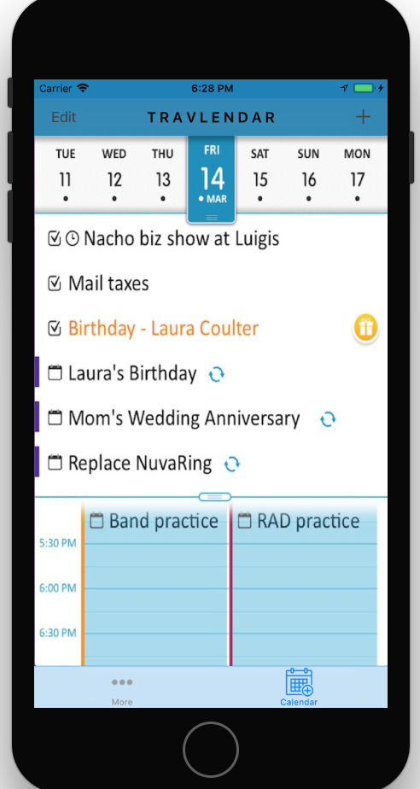


TravLendar
Our solution:
Manage appointments
Travel preferences
Directions to the
destination
Define breaks
Weather alerts
Minimize carbon
footprint

Slide 6
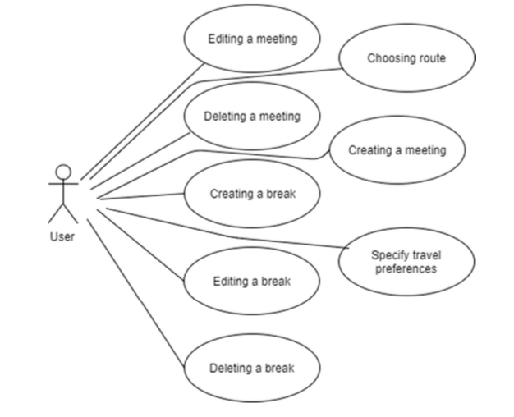
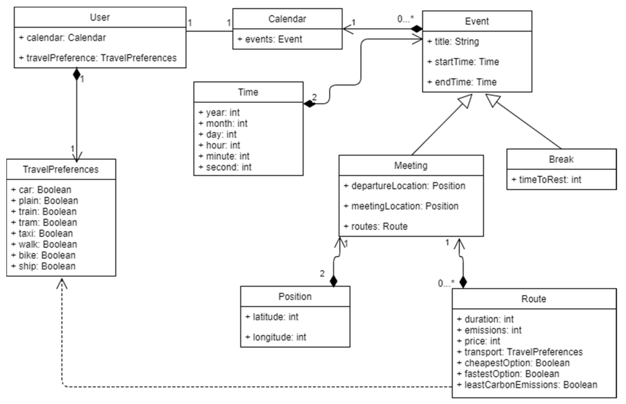
UML Diagrams:

Slide 7
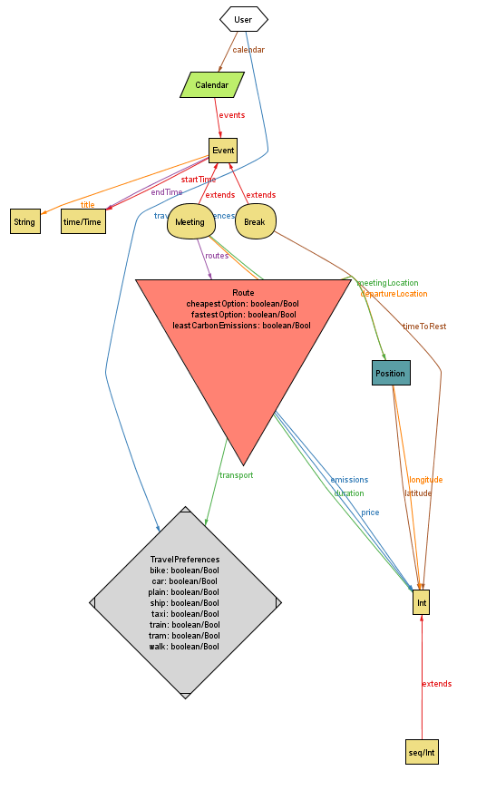
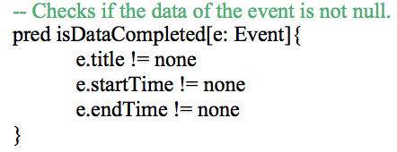
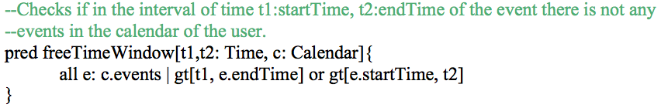
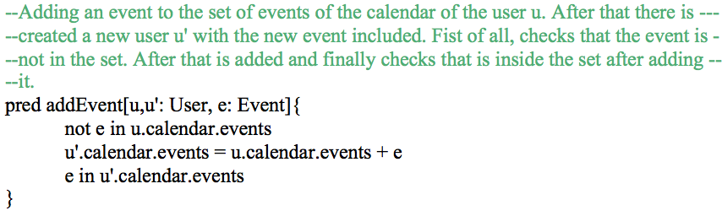
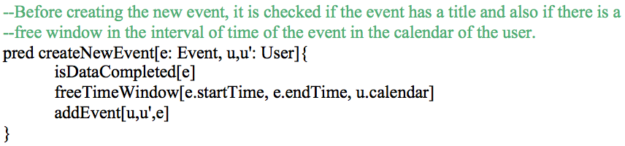
ALLOY MODELLING

Slide 8




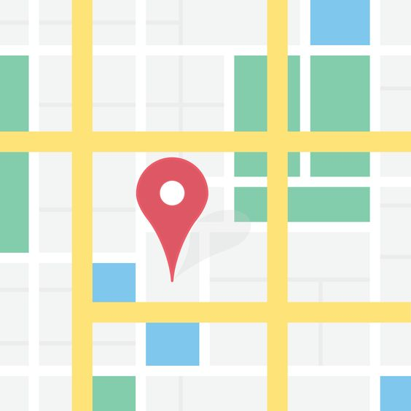
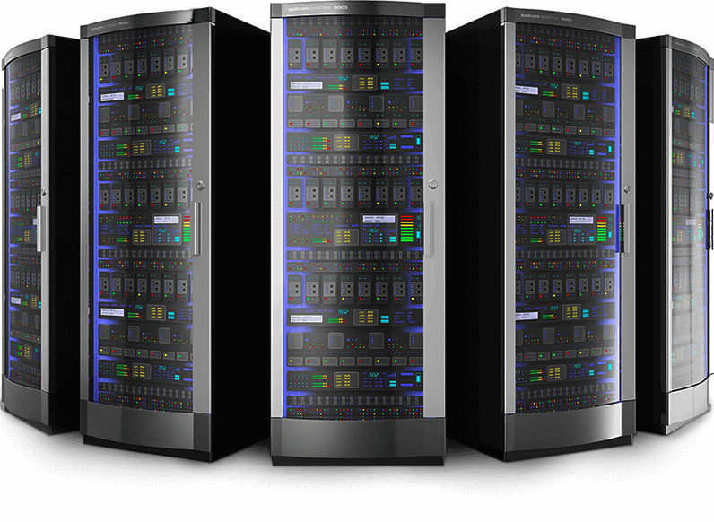

ARCHITECTURAL DESIGN
YahooWeather API Request
YahooWeather API Response
Yahoo Server
Firebase API Request
Firebase API Response
User
TravLendarAPP
Firebase
GoogleMaps API Request
GoogleMaps APIResponse
GoogleCalendar API Request
GoogleCalendar API Response
Google Servers

Slide 9
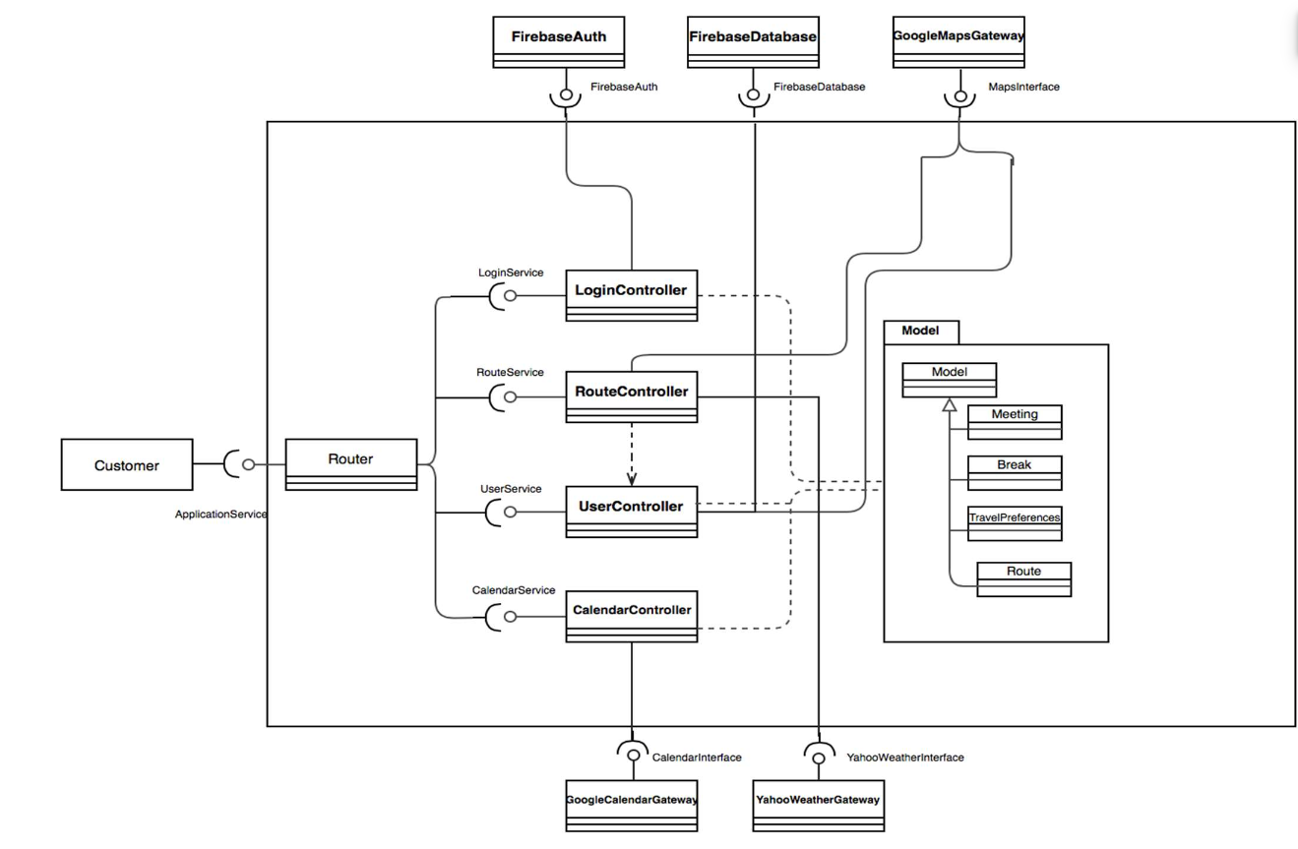
BIG CONCEPT
Component diagram
Bring the attention of your audience over a key concept using icons or illustrations

Slide 10
JEE implemetation
- getMeeting(String title)
- checkTimeSlot(Time startTime, Time endTime)
- getRoutes(String departureLocation, String meetingLocation, Time endTime)
- etc.

Slide 11
Questions?

