Slide 1

Head of data science
XAI/UX
Model performance and explanation audit
Group 12: Rasmus, Victor, Magnus & Louise
1 Data science / 1
Notes:
L
TID: 20 sekunder.
Formål: vise hvad der virker, hvor modellen fejler, og hvad forklaringerne kan dokumentere. Denne version har 10 slides på i alt 10 minutter. Resten er backup til Q&A. Brug samme case 57608 gennem alle lokale sammenligninger.
Source: neural_network.ipynb, uploaded 19 Oct 2026. Saved outputs, not a new model run.
Source: decision_tree.ipynb, uploaded 19 Oct 2026. Saved outputs, not a new model run.

Slide 2
Data and validation design
 | Neural network | Decision tree
Inputs / target | 21 features / current (pre)diabetes | Same inputs and target
Weight fitting / training | 45,242 people | 56,553 people
Validation | 11,311 people | No separate validation split
Held-out test | 14,139 people | Same 14,139 people
1 Data science / 2
Notes:
L
TID: 40 sekunder.
70.692 BRFSS-personer med bevidst 50/50 klassefordeling. Opgaven er status ved spørgeskemaet, ikke fremtidig incidens. Test: 14.139 identiske personer. Træet trænes på 56.553, netværkets vægte på 45.242 og valideres på 11.311. Preprocessing er fit før det indre split: valideringsstatistik lækker ind i skaleringen, men testsættet er uberørt.
Source: neural_network.ipynb, uploaded 19 Oct 2026. Saved outputs, not a new model run.
Source: decision_tree.ipynb, uploaded 19 Oct 2026. Saved outputs, not a new model run.

Slide 3
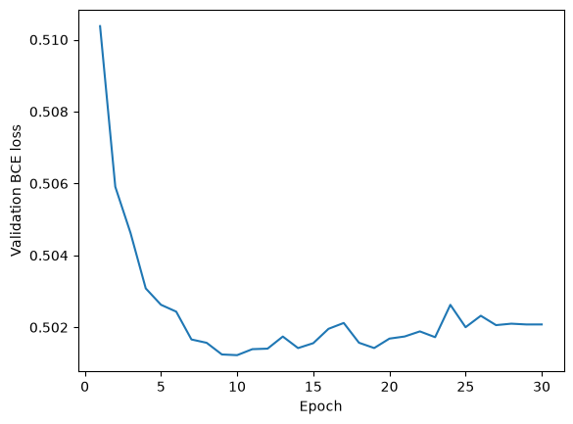
Model architecture and training
21 inputs → 32 hidden units → 1 logit
ReLU in the hidden layer. Sigmoid gives the final score.
Training | NN
Optimizer / loss | Adam / BCEWithLogits
Epochs / batch | 30 / 256
Learning rate / decay | 0.001 / 0.0001
Parameters | 737
Tree: depth ≤ 4, ≥ 100 samples per leaf
1 Data science / 3
Notes:
V
TID: 60 sekunder.
Netværket: 21 standardiserede inputs, 32 skjulte neuroner, ReLU, 1 logit. Sigmoid anvendes ved prediction. 737 parametre. Adam optimerer BCEWithLogitsLoss i 30 epoker, batch 256, lr 0.001, weight decay 0.0001. Ingen early stopping. Træ: max_depth=4, min_samples_leaf=100, random_state=42. Figur fra NN-celle 5.
Source: neural_network.ipynb, uploaded 19 Oct 2026. Saved outputs, not a new model run.
Source: decision_tree.ipynb, uploaded 19 Oct 2026. Saved outputs, not a new model run.

Slide 4
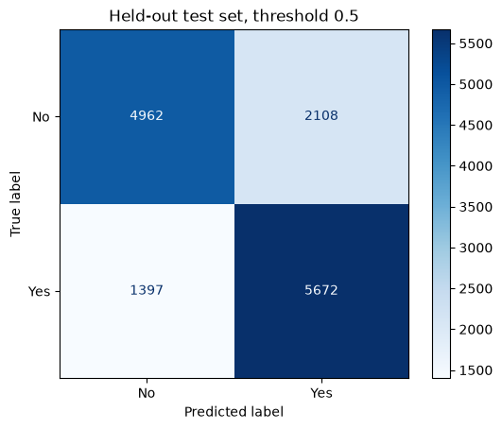

Held-out performance and error costs
Neural network
Decision tree
Accuracy 75.21% ROC-AUC 0.830
Accuracy 72.68% ROC-AUC 0.795
Threshold 0.5. Rows = actual label. Columns = predicted label.
1 Data science / 4
Notes:
R
TID: 80 sekunder.
Figurer: NN-celle 7, DT-celle 8. NN TN4962 FP2108 FN1397 TP5672. DT TN4781 FP2289 FN1574 TP5495. Accuracy beregnet fra disse matricer er 75.21 og 72.68 procent. NN ROC-AUC .830, DT .795. Ved tærskel .5 overser NN 19.76 procent af positive og giver alarm hos 29.82 procent af negative. Fejlomkostninger og tærskel skal aftales før drift. Ingen CI eller parret signifikanstest: forskel er observeret, ikke dokumenteret signifikant.
Source: neural_network.ipynb, uploaded 19 Oct 2026. Saved outputs, not a new model run.
Source: decision_tree.ipynb, uploaded 19 Oct 2026. Saved outputs, not a new model run.

Slide 5
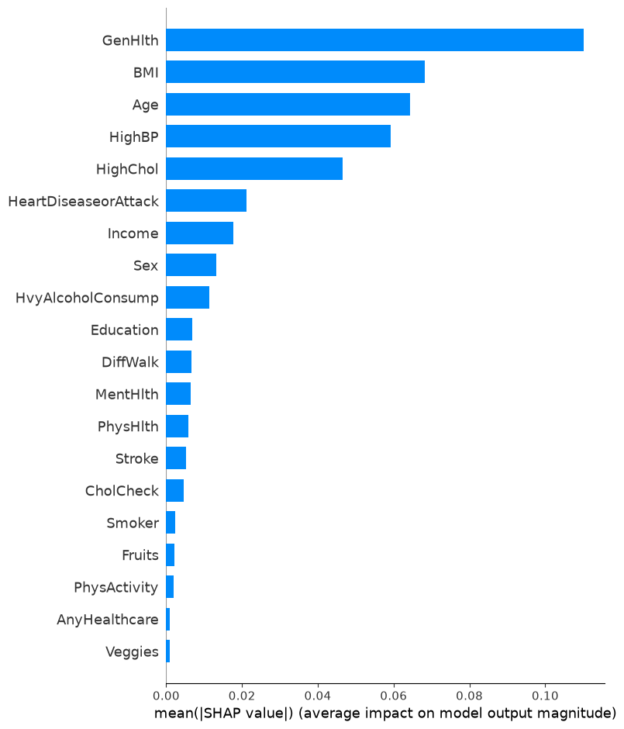
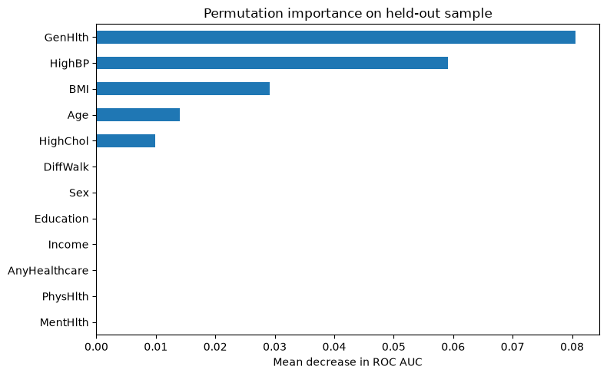
Global explanation: converging priorities
Tree: ROC-AUC drop after permutation
NN: mean |SHAP|, 40 test people
Agreement in priorities does not validate local explanations.
1 Data science / 5
Notes:
M
TID: 60 sekunder.
NN global Kernel SHAP fra celle17, 40 testpersoner. DT permutation importance fra celle12, 2.000 testpersoner, fem repeats, ROC-AUC. Metoder og udsnit er forskellige, så sammenlign rangorden, ikke søjlehøjde. Begge fremhæver GenHlth HighBP BMI Age HighChol. Ingen udført NN-permutation-importance i den uploadede NN: overskriften indeholder kun wrapper. Derfor kan vi ikke påstå global SHAP/PFI-validering inden for begge modeller.
Source: neural_network.ipynb, uploaded 19 Oct 2026. Saved outputs, not a new model run.
Source: decision_tree.ipynb, uploaded 19 Oct 2026. Saved outputs, not a new model run.

Slide 6
Error audit: high confidence can be wrong
Model / row | Actual label | Model score | Error
NN / 3439 | 0 | 0.9679 | False positive
NN / 66055 | 1 | 0.0069 | False negative
Tree / 30163 | 0 | 0.8526 | False positive
Tree / 67337 | 1 | 0.0584 | False negative
These cases have no saved local LIME or SHAP explanations.
Future work: explain these errors and compare error rates across groups.
1 Data science / 6
Notes:
L
TID: 60 sekunder.
Cases fra gemte error-audit-tabeller, ikke case57608. NN indeks3439 label0 score.967938: BMI72, GenHlth m.fl. ikke nødvendigt fuldt angivet. NN66055 label1 score.006861 BMI20, HighBP0 HighChol0 Age2. DT30163 label0 score.852626, BMI34 HighBP1 HighChol1. DT67337 label1 score.058439 BMI28 HighBP0 HighChol0. Ingen LIME/SHAP på disse fejl i notebooks: kan ikke konkludere hvilke bidrag forårsager fejlen. Næste test: forklar samme falske positiver og negativer, analyser alders/kønsgrupper.
Source: neural_network.ipynb, uploaded 19 Oct 2026. Saved outputs, not a new model run.
Source: decision_tree.ipynb, uploaded 19 Oct 2026. Saved outputs, not a new model run.

Slide 7
One shared test person
Reference | Person 57608
Actual label | 1: prediabetes or diabetes
BMI / age | 53 / 65–69 years
General health | Fair (GenHlth = 4)
Blood pressure / cholesterol | Both reported high
NN / tree score | 0.8854 / 0.8526
Exact tree path
GenHlth > 2.5
HighBP > 0.5
BMI > 31.5
HighChol > 0.5
Correctly classified by both models
1 Data science / 7
Notes:
V
TID: 50 sekunder.
Case57608 er en kvinde65–69 med BMI53, GenHlth4, HighBP1 HighChol1. Label1 betyder prædiabetes ELLER diabetes og skelner ikke. Begge modeller har korrekt positiv klassifikation. Reference-PDF nævnte en falsk positiv tree score85.3: det er en anden person, selv om scores kan være ens i samme blad. Træets eksakte vej fra celle14. Variable definitions: https://www.cdc.gov/brfss/annual_data/2015/pdf/codebook15_llcp.pdf ; https://archive.ics.uci.edu/dataset/891/cdc+diabetes+health+indicators
Source: neural_network.ipynb, uploaded 19 Oct 2026. Saved outputs, not a new model run.
Source: decision_tree.ipynb, uploaded 19 Oct 2026. Saved outputs, not a new model run.

Slide 8
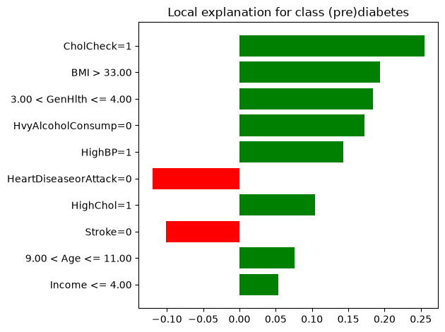
LIME: stable rankings, limited fidelity
Weighted Ridge surrogate
3,000 perturbations
10 selected features
Local R²: NN 0.479
Tree 0.450
20 NN runs: mean R² 0.465
Mean local error 12.31 %
Local Fidelity: 45 %
Repeated explanations can agree and still approximate the model poorly.
1 Data science / 8
Notes:
R
TID: 80 sekunder.
Figur NN-celle14. LIME begge: 3000 perturbations, 10 features, seed42, klasse1, quartile bins, binære features kategoriske. Standard surrogate er weighted Ridge alpha1 med intercept. LIME forklarer modelscore, ikke labels. NN R² .4785, DT .4503. 20NN-runs seeds0–19 giver R² .4654 ± .0122 og absolut lokal fejl .1231 ± .0141. Fire topfeatures er altid top5. Ridge kan give >1. DT-LIME tildeler eksempelvis CholCheck og HvyAlcoholConsump vægte selvom træet ikke bruger dem. Det er forklaringsartefakter. Methods: https://lime-ml.readthedocs.io/en/latest/lime.html ; https://github.com/marcotcr/lime/blob/master/lime/lime_base.py ; https://shap.readthedocs.io/en/latest/generated/shap.KernelExplainer.html
Source: neural_network.ipynb, uploaded 19 Oct 2026. Saved outputs, not a new model run.
Source: decision_tree.ipynb, uploaded 19 Oct 2026. Saved outputs, not a new model run.

Slide 9
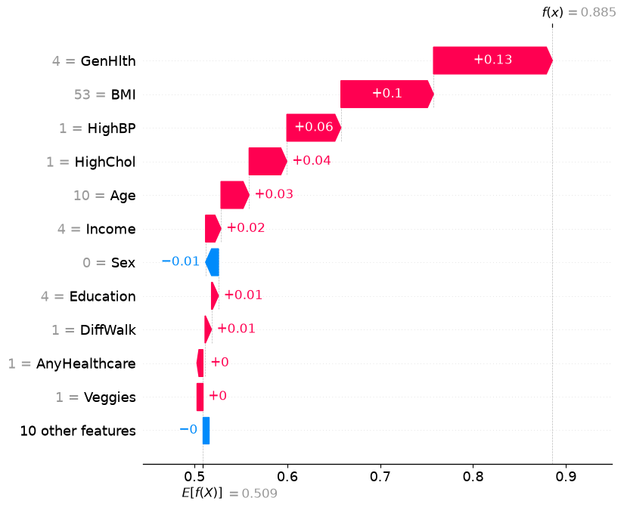
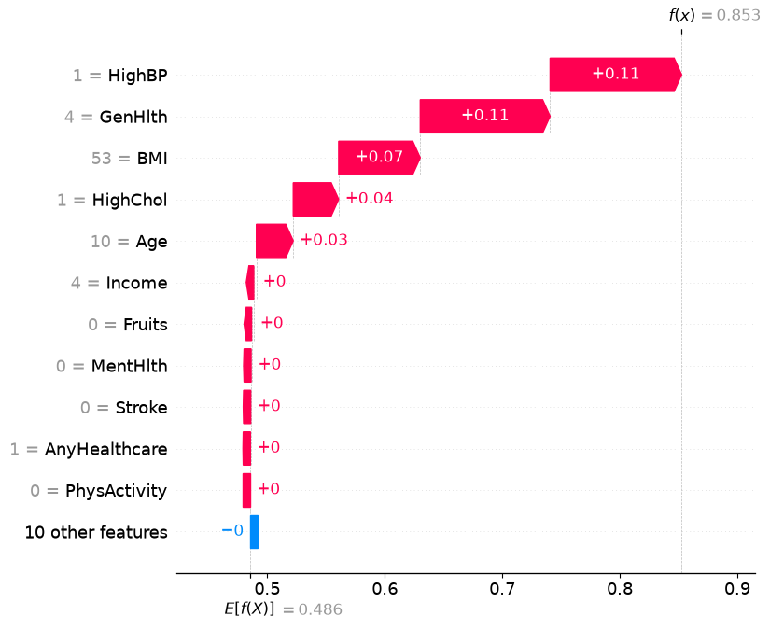
Kernel SHAP: the same person, two models
Neural network
Decision tree
50 background rows. 200 coalition samples. Additivity alone is not validation.
1 Data science / 9
Notes:
M
TID: 90 sekunder.
Originale lokale waterfall-figurer, NN18 og DT22. 50 træningspersoner som baggrund, nsamples200, identity link, seed42 lokalt. NN base ca.5092 + bidrag .3762 = .8854. DT base ca.4857 + .3669 = .8526. Netværk GenHlth .128003 BMI .099715 HighBP .058207. Træ HighBP .111928 GenHlth .110505 BMI .069431. Sum er en metodeegenskab, ikke selvstændig validering. Små bidrag fra helt ubrugte tree-features er estimationsartefakter. l1_reg er ikke angivet, version ikke gemt: nyere standard udvælger10 features. Nul betyder ikke nødvendigvis ingen modelbrug. Methods: https://lime-ml.readthedocs.io/en/latest/lime.html ; https://github.com/marcotcr/lime/blob/master/lime/lime_base.py ; https://shap.readthedocs.io/en/latest/generated/shap.KernelExplainer.html
Source: neural_network.ipynb, uploaded 19 Oct 2026. Saved outputs, not a new model run.
Source: decision_tree.ipynb, uploaded 19 Oct 2026. Saved outputs, not a new model run.

Slide 10
Technical decision and validation priorities
NN has the stronger observed test performance.
LIME fidelity is too limited for precise patient claims.
Next: clean validation split, uncertainty and subgroup error analysis.
Next: calibration, SHAP stability and exact tree-based checks.
1 Data science / 10
Notes:
L
TID: 60 sekunder.
Konklusion: NN har bedste observerede test-performance. Træet giver eksakt beslutningsvej. Ingen er klinisk valideret. Prioriteter er foreslået arbejde og endnu ikke udført. Kræv rent valideringssplit og bootstrap-CI på forskelle. Kalibrering i relevant population. Sammenlign Kernel SHAP mod Tree SHAP med samme baggrund og semantik. Øg baggrund og samples og gentag seeds. Subgruppeanalyse mangler. Stop efter dette slide ved 10 minutter.
Source: neural_network.ipynb, uploaded 19 Oct 2026. Saved outputs, not a new model run.
Source: decision_tree.ipynb, uploaded 19 Oct 2026. Saved outputs, not a new model run.

Slide 11
Q&A: likely technical questions
Question | Evidence-based answer
Why do LIME and SHAP disagree? | Different objectives, reference schemes and approximations. Agreement is not proof.
Why can an unused tree feature matter? | The fitted approximation can assign spurious contributions. Check the exact tree.
Does correct SHAP summation prove fidelity? | No. Additivity constrains the sum, not the accuracy of every attribution.
Q&A backup / 11
Notes:
BACKUP: uden for de 10 minutter.
Ved uenighed: adskil hvad koden faktisk gør fra hypoteser. Methods: https://lime-ml.readthedocs.io/en/latest/lime.html ; https://github.com/marcotcr/lime/blob/master/lime/lime_base.py ; https://shap.readthedocs.io/en/latest/generated/shap.KernelExplainer.html
Source: neural_network.ipynb, uploaded 19 Oct 2026. Saved outputs, not a new model run.
Source: decision_tree.ipynb, uploaded 19 Oct 2026. Saved outputs, not a new model run.

Slide 12
Reference person: all raw inputs (1/2)
Feature | Value | Meaning
HighBP | 1 | High blood pressure
HighChol | 1 | High cholesterol
CholCheck | 1 | Cholesterol check within 5 years
BMI | 53 | Body mass index
Smoker | 0 | Fewer than 100 cigarettes in lifetime
Stroke | 0 | No reported stroke
HeartDiseaseorAttack | 0 | No reported CHD or heart attack
PhysActivity | 0 | No leisure physical activity in past 30 days
Fruits | 0 | Fruit less than once per day
Veggies | 1 | Vegetables at least once per day
Q&A backup / 12
Notes:
V
BACKUP: uden for de 10 minutter.
Variable definitions: https://www.cdc.gov/brfss/annual_data/2015/pdf/codebook15_llcp.pdf ; https://archive.ics.uci.edu/dataset/891/cdc+diabetes+health+indicators
Source: neural_network.ipynb, uploaded 19 Oct 2026. Saved outputs, not a new model run.
Source: decision_tree.ipynb, uploaded 19 Oct 2026. Saved outputs, not a new model run.

Slide 13
Reference person: all raw inputs (2/2)
Feature | Value | Meaning
HvyAlcoholConsump | 0 | Below the high-consumption category
AnyHealthcare | 1 | Has healthcare coverage
NoDocbcCost | 1 | Cost prevented needed doctor visit
GenHlth | 4 | Fair self-reported health
MentHlth | 0 | 0 days of poor mental health in past 30 days
PhysHlth | 5 | 5 days of poor physical health in past 30 days
DiffWalk | 1 | Serious difficulty walking or climbing stairs
Sex / Age | 0 / 10 | Female / age 65–69
Education | 4 | High school graduate or GED
Income | 4 | Annual household income $20,000–<$25,000
Q&A backup / 13
Notes:
V
BACKUP: uden for de 10 minutter.
Variable definitions: https://www.cdc.gov/brfss/annual_data/2015/pdf/codebook15_llcp.pdf ; https://archive.ics.uci.edu/dataset/891/cdc+diabetes+health+indicators
Source: neural_network.ipynb, uploaded 19 Oct 2026. Saved outputs, not a new model run.
Source: decision_tree.ipynb, uploaded 19 Oct 2026. Saved outputs, not a new model run.

Slide 14
Model comparison and uncertainty
Held-out metric | Neural network | Decision tree
Accuracy | 75.21% | 72.68%
ROC-AUC | 0.830 | 0.795
Average precision | 0.805 | 0.752
Brier score | 0.167 | 0.182
False negatives | 1,397 / 7,069 | 1,574 / 7,069
False positives | 2,108 / 7,070 | 2,289 / 7,070
Q&A backup / 14
Notes:
V
BACKUP: uden for de 10 minutter.
Accuracy beregnes ud fra de gemte confusion matrices. Øvrige tal fra classification report. Ingen konfidensintervaller eller McNemar-test er udført. Den forskellige træningsmængde skal nævnes ved sammenligning. NN har færre vægt-fit-personer pga valideringssplit.
Source: neural_network.ipynb, uploaded 19 Oct 2026. Saved outputs, not a new model run.
Source: decision_tree.ipynb, uploaded 19 Oct 2026. Saved outputs, not a new model run.

