Slide 1



Qualifying Examination:
TOWARDS LEGAL INTEROPERABILITY IN INTERNATIONAL DATA SPACES
UNIVERSIDADE DO ESTADO DO RIO GRANDE DO NORTE
UNIVERSIDADE FEDERAL RURAL DO SEMI-ÁRIDO
PRÓ-REITORIA DE PESQUISA E PÓS-GRADUAÇÃO
PROGRAMA DE PÓS-GRADUAÇÃO EM CIÊNCIA DA COMPUTAÇÃO
MESTRADO ACADÊMICO EM CIÊNCIA DA COMPUTAÇÃO
MASTER'S CANDIDATE VICTOR BENOISTON JALES DE OLIVEIRA

Slide 2
Presentation Overview
Introduction;
Design Science Research (DSR) Methodology;
Systematic Literature Review;
Ontology Engineering;
Future Works;
Conclusions.

Slide 3
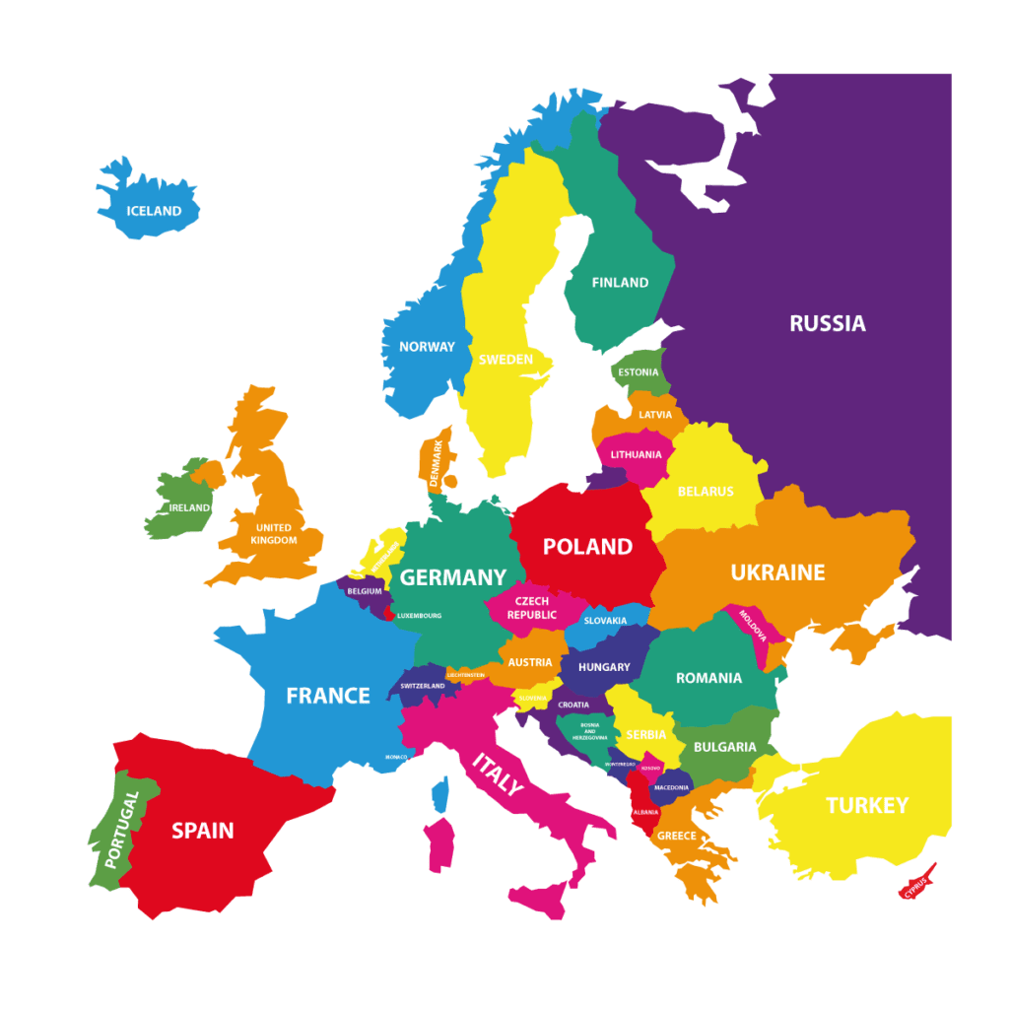
Introduction
Industry 4.0
Data Value
Sensitive Data
Industrial Data Spaces
Proposed by the Fraunhofer Institute
Dates in 2014
European Domain
27 Countries
What are International Data Spaces (IDS)?
"A secure, sovereign system of data sharing in which all participants can realize the full value of their data." (IDSA, 2019)
Source: Python Geographics

Slide 4
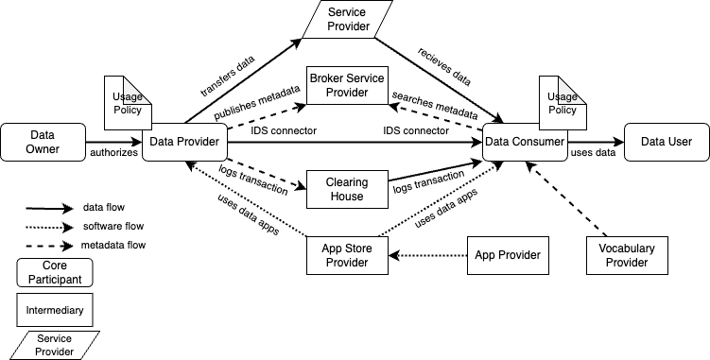
Source: Original Authorship

Slide 5
European Interoperability Framework
Legal Interoperability
Organizational Interoperability
Semantic Interoperability
Technical Interoperability
Interoperability Governance
Integrated Public Service Governance
Fundamental Layers
Recently Added (2024)

Slide 6
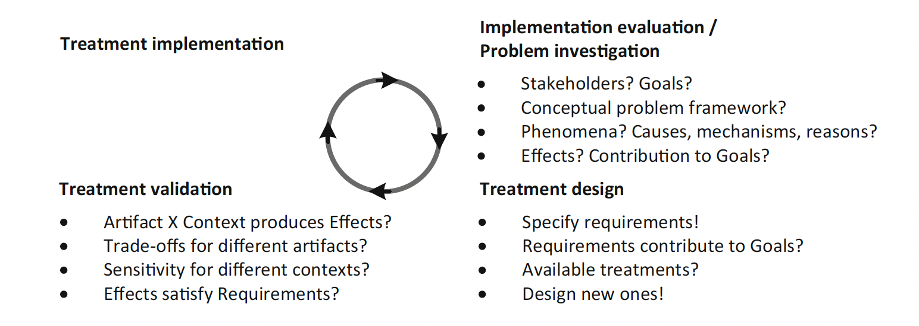
DSR Methodology
"Design Science Research (DSR) consists of a practical research methodology that introduces a composition of a problem, and guided by questions and goals, leads to a set of solutions, through stated methodologies." (WIERINGA, 2014).
Source: (Wieringa, 2014)

Slide 7
Research Questions
General Research Question: How to achieve legal interoperability in International Data Spaces?
General Conceptual Question: What is legal interoperability in IDS?
General Technical Question: How to effectively enforce legal interoperability in IDS?
General Practical Question: How does proper legal interoperability affect IDS-based ecosystems?

Slide 8
Research Goals
Prediction Goal: The prediction goal is not directly applicable to this research, however, the future implementation of proposed machine learning models may reach, at some level, the capability of inferring predictions.
Knowledge Goal: Identify the ongoing gaps, challenges, and opportunities in the literature regarding the legal interoperability layer when applied to IDS. The knowledge goal is directly aligned with the SLR
Artifact Design Goal: Develop an expandable and acceptable legal interoperability protocol for data exchange negotiation among countries grounded by different data exchange policies, allowing the unambiguous representation of policies that compose a service contract.
Instrument Design Goal: Develop a FAIR ontology, which works as a legal base for further application development (ontology-driven development).

Slide 9
Research Methodology
Systematic Literature Review
Ontology Engineering
Case Study
Focus Discussion Group (or Experts Opinion)

Slide 10
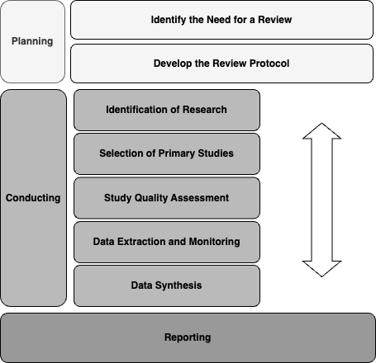
Systematic Literature Review
"A systematic literature review is a means of identifying, evaluating and interpreting all available research relevant to a particular research question, or topic area, or phenomenon of interest". (Kitchenham, 2004)
Research Questions:
RQ1. What is Legal Interoperability in Data Spaces?
RQ2. What is the Conceptual relationship between Data Sovereignty and Legal Interoperability regarding IDS?
RQ3. What is the current representation of legal moments in Data/Usage policies within IDS and related data ecosystems?
RQ4. What are the legal challenges within the IDS domain?
RQ5. Are there gaps and opportunities for research and development regarding the legal aspect of IDS?
Source: Original Authorship

Slide 11
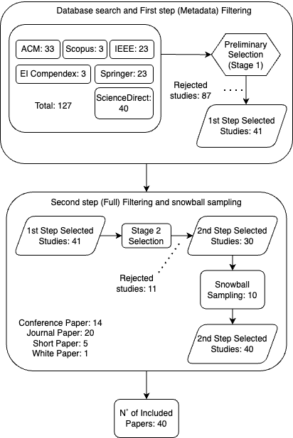
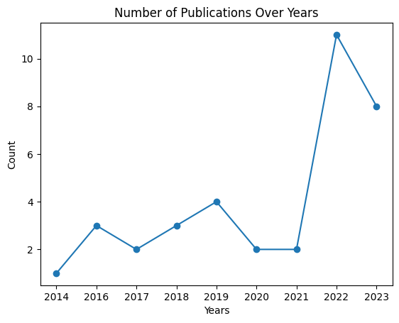
Conducting
Source: Original Authorship
Source: Original Authorship

Slide 12
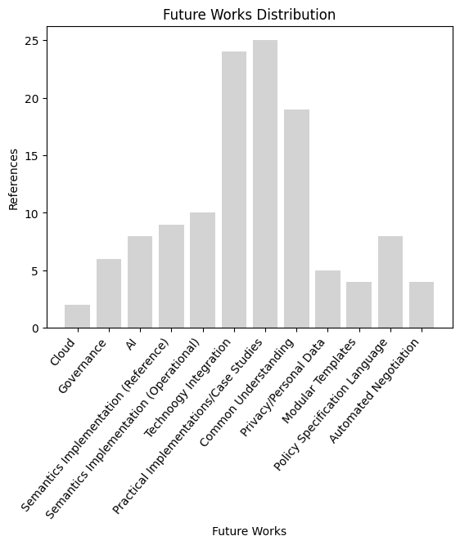
Future Works Distribution
Retrieved Legal Aspects
• Domains of Business (9 Aligned Papers).
• Personal/Non-Personal Data (7 Aligned Papers).
• Usage and Data Policies (7 Aligned Papers).
• Legal Interoperability Constraints (9 Aligned Papers).
• Smart Contracts/Contract Automation (7 Aligned Papers).
• Semantic Appeal (10 Aligned Papers).
• AI Usage in IDS (9 Aligned Papers).
• Cloud (8 Aligned Papers).
• IDS Usage in Open Spaces (4 Aligned Papers).
• Future Works Addressing Legal Aspects (15 Aligned Papers).
Source: Original Authorship

Slide 13
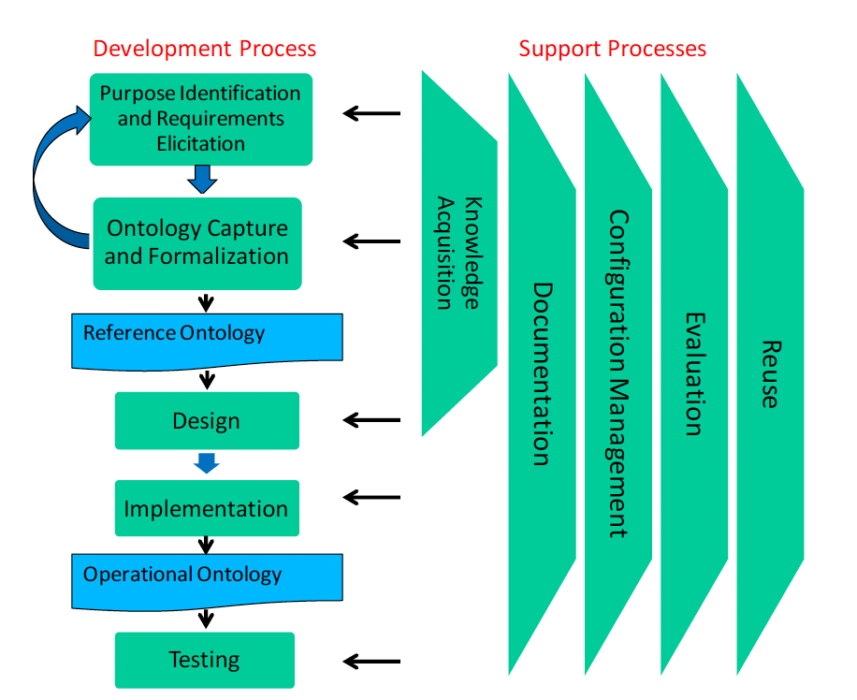
Ontology Engineering
Systematic Approach For Building Ontologies (SABiO)
Proposed as a result of observation regarding the lack of systematization of the available ontology engineering methodologies. (Falbo, 2014)
Source: (Falbo, 2014)

Slide 14
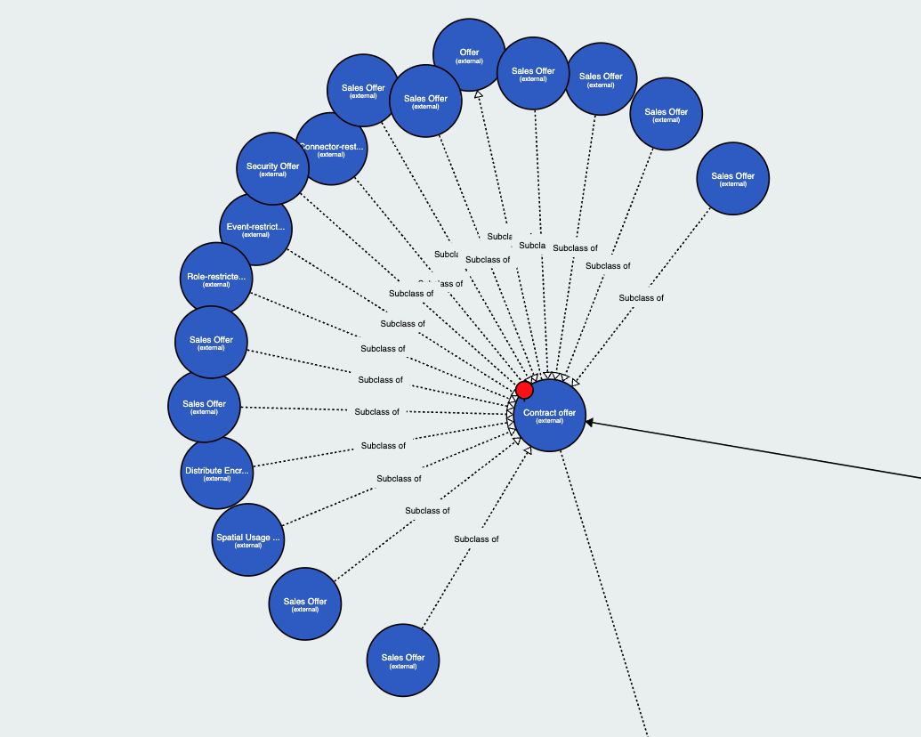
Ontological Foundation
Unified Foundational Ontology
UFO-A
Endurants
UFO-B
Perdurants
OntoUML
Graphical Representation of UFO
Service Contract Ontology
Legal Moments
UFO-L
Legal Entitlements and Legal Burdens/Lacks
Information Model
Lack of depth
Defined as a roadmap
Open Source
Source: (Bader et al., 2020)

Slide 15
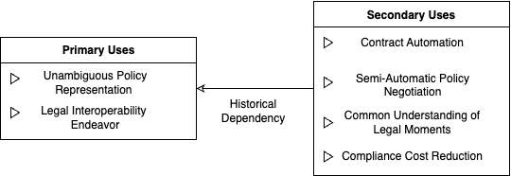
Ontology Requirements
Purpose: Provide a legal interoperability domain description in order to foster an unambiguous presentation of policies, i.e., service contracts, within IDS architecture.
Language: Reference ontology using OntoUML with further translation to Web Ontology Language (OWL).
Intended Uses:
Source: Original Authorship

Slide 16
Non-Functional Requirements
Design | Support for Natural Language (English)
Adaptation | Addresses the EIF
Design/Performance | Follow the FAIR Principles: Findable: It must have an open access. Accessible: It shall possess unique URIs. Interoperable: Use a formal and broadly applicable set of concepts and languages for representation. Reusable: Data meet domain-relevant accepted standards (ISO dictionary) and holds a clear and accessible usage license (MIT)
Design | UFO and SCO as foundational ontologies
Design | Available at an open GitHub Repository

Slide 17
Functional Requirements
Competency Questions Group 1: SCO and EIF Related.
CQ1: What are the legal entitlements of the service provider X? (GRIFFO et al., 2021)
CQ2: What are the legal burdens/lacks of the service provider X? (GRIFFO et al., 2021)
CQ3: What are the legal entitlements of the service consumer X? (GRIFFO et al., 2021)
CQ4: What are the legal burdens/lacks of the service consumer X? (GRIFFO et al., 2021)
CQ5: What are the interoperability barriers in the service contract X? (EIF)
CQ6: What contracts represent joint controllership? (EIF)
Competency Questions Group 2: IM and RAM Related.
CQ7: What are the data user's permissions and duties? (BADER et al., 2020)
CQ8: What contracts characterize data rent? (RAM)
cq9: What contracts characterize data purchase? (RAM)

Slide 18
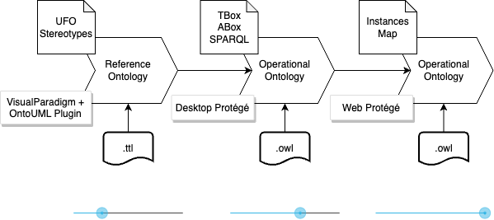
Lifecycle
Source: Original Authorship

Slide 19

We present..

Slide 20


Legal Interoperability Ontology for IDS (LegIOn-IDS)
Reference Ontology
The Reference Ontology must graphically describe the domain, employing high-level stereotypes (provided by UFO), and providing relationships amongst them.
Better understanding of the domain;
Graphical representation;
Provides an easier operationalization.
Tools for development

Slide 21
Legal Interoperability Ontology for IDS (LegIOn-IDS)
Main UFO stereotypes
Kind: Rigid concept that provides identity, does not require a relational dependency. One of the most used stereotypes.
Subkind: Rigid concept that does not provide identity (specialization), hence, require relational dependency (ambiguous documentation).
Relator: Existential dependency on their bearers, is a truth-maker. It must update the status of their involved individuals.
Quality: Provides identity (identity function)
Mode: Provides identity (identity function)
Category: Refactor stereotype, it does not provide identity, and is composed of different identity providers.

Slide 22
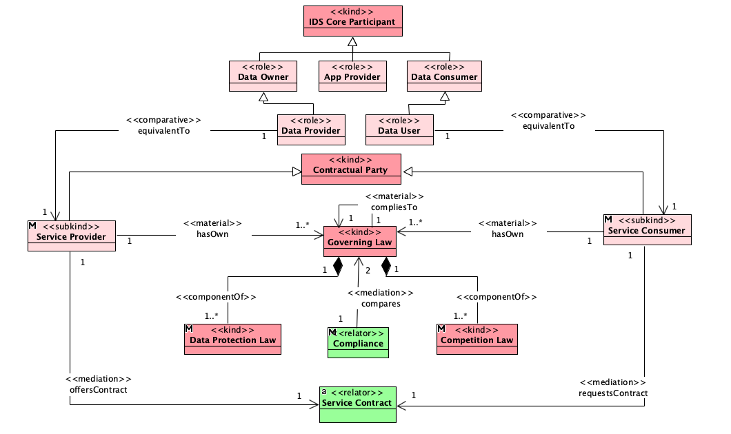
Reference Ontology (Main View)
Source: Original Authorship

Slide 23
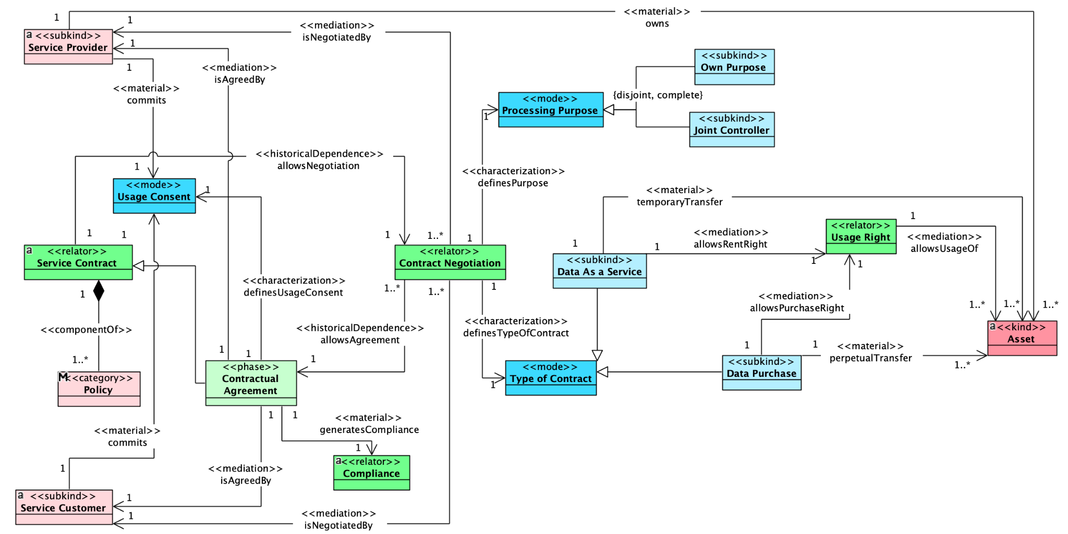
Reference Ontology (Service Contract View)
Source: Original Authorship

Slide 24
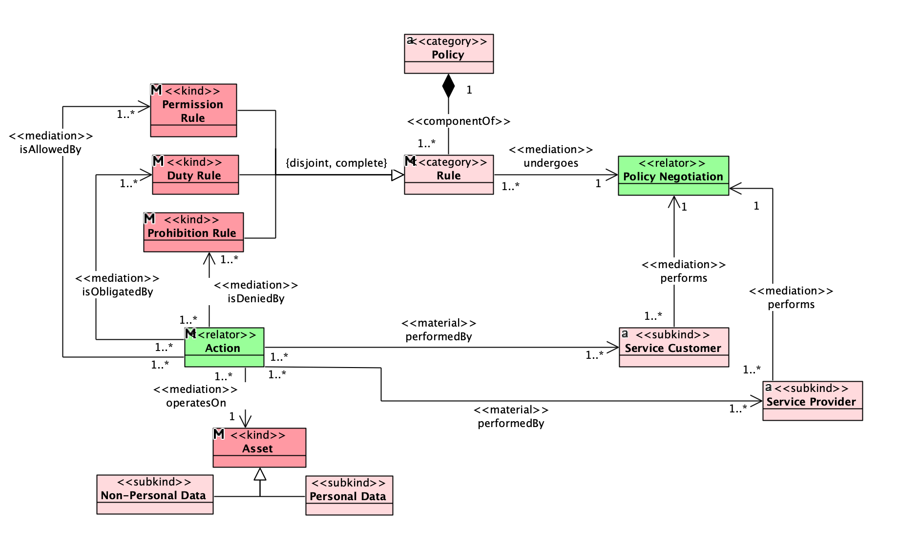
Reference Ontology (Policy View)
Source: Original Authorship

Slide 25
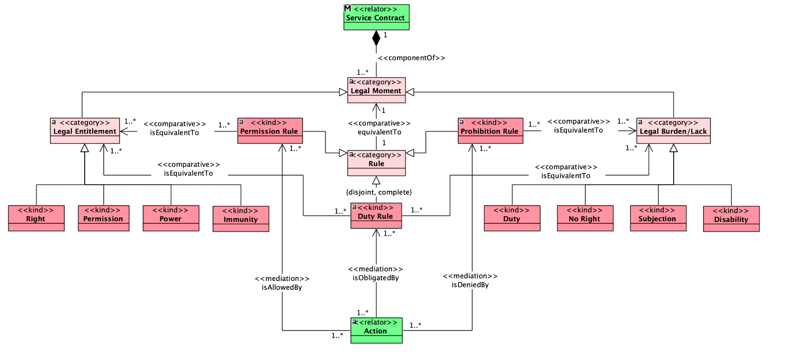
Reference Ontology (Legal Moments View)
Source: Original Authorship

Slide 26
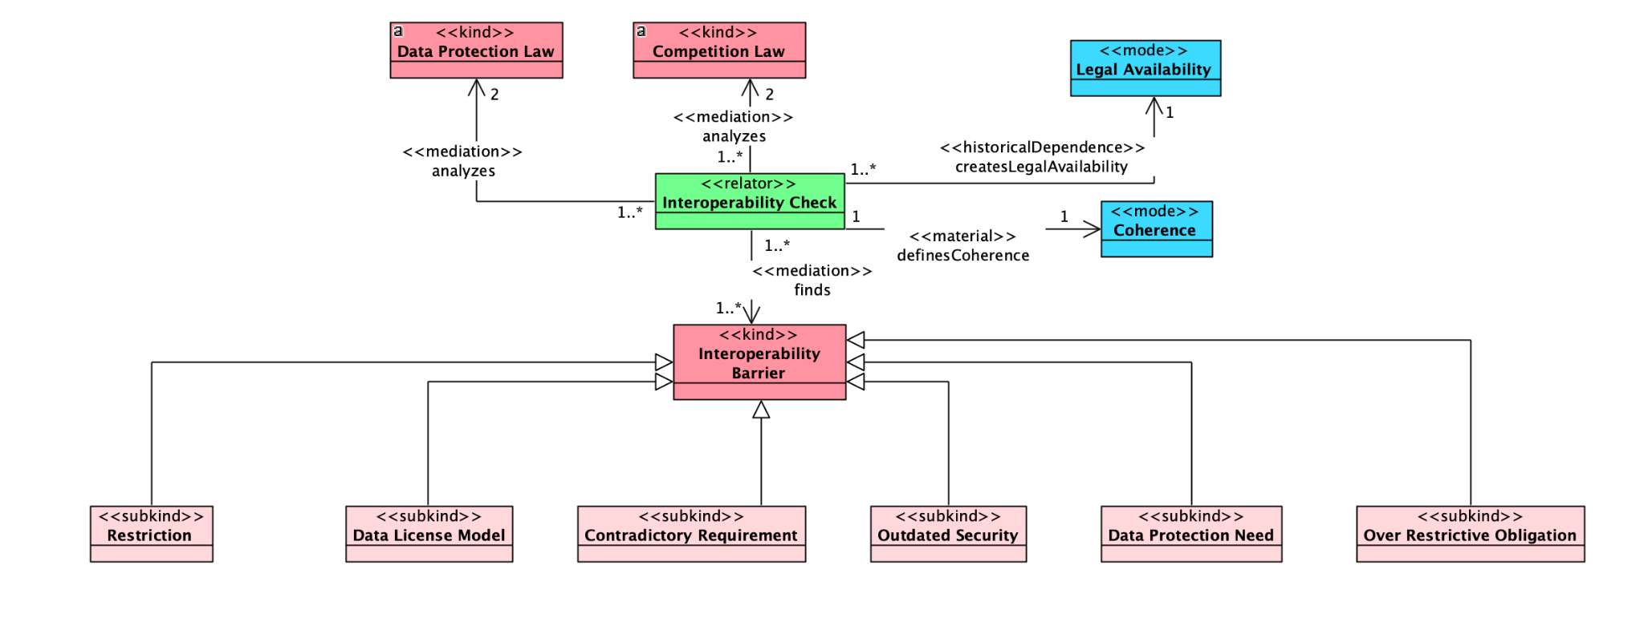
Reference Ontology (Legal Interoperability View)
Source: Original Authorship

Slide 27
Operational Ontology
The operational ontology must be able to represent the domain in a machine-readable way, and through a knowledge representation language, such as Web Ontology Language (OWL).
Disjointness;
Defined Classes;
Closing Axioms;
Instances.
Important Assumptions:
Disjointness among the Rules;
Equivalence of Rules and Legal Moments;
Kinds of Contract Inferencing the Types of data exchange;
Contractual metadata description (Data Properties);

Slide 28

Operational Ontology
Demonstration
Web

Slide 29

Ontology Documentation
As one of the FAIR principles, we provide a systematic documentation of LegIOn-IDS, as follows:
An Ontology Requirements Specification Document (ORSD);
A Glossary of Terms;
It also provides an ISO dictionary;
Retrieved from the SLR;
OWL Docs Documentation;
Conference Papers;
Source: Original Authorship

Slide 30
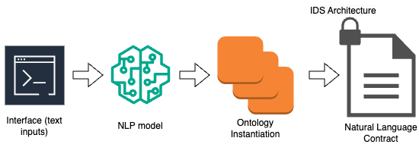
Next Steps
Ontology Validation
Ontology Evaluation
Focus Discussion Group or Experts Opinion
Machine Learning + Ontologies
Model for automated instantiation of ontology based on text documents (snippets extraction and classification) using Owlready2 - New step for verification proposition.
Utilizing NLP to instantiate the model of contract based on the ontology.
Source: Original Authorship

Slide 31
Next Steps
Development of a Large Language Model regarding legal aspects and interoperability within IDS architecture. The Ontology will ground the development of a RAG, fine-tuning the LLM.
Extra: OntoUML plugin pull requests (regarding .ttl serialization)

Slide 32
Conclusion
The project has mainly two approaches:
Bottom-up, in which, a machine learning model will be able to provide the textual classification of the given contract, and results in its legal moments, unambiguously representing it, in a machine readable way.
Top-bottom, lawyers could use the ontology to input the clauses of the contract, using the ontology as fundamental schema of relations, and through a machine learning model, generate a model of contract (fostering the data as a service and data purchase kinds of contract, at first).

Slide 33
Work submissions
Integrated data processing architecture applied to Educational Robotics Learning Objects. (Co-author).
Submitted in March, 2023. Currently under major revision.
Journal of Intelligent & Robotic Systems.
Towards Legal Interoperability in International Data Spaces.
Submitted in January, 2024. Accepted.
International Conference on Enterprise Information System (ICEIS).
Legal Interoperability Ontology for International Data Spaces - LegIOn-IDS.
Submitted in March, 2024. Under revision.
International Conference on Formal Ontology in Information Systems (FOIS).
Towards Legal Interoperability in International Data Spaces: A Systematic Literature Review.
Anticipated submission date: March, 2024. Due to.
Expert Systems With Application (Journal).
Understanding ASD: Design and Development of a Domain Ontology to Assist Professionals In Uderstanding Children Based on DSM-5. (Co-author).
Anticipated submission date: April, 2024. Due to.
International Conference on Formal Ontology in Information Systems (FOIS).
Amplified Intelligence Ontology. (Co-author)
Anticipated submission date: April, 2024. Due to.
International Conference on Formal Ontology in Information Systems (FOIS).

Slide 34
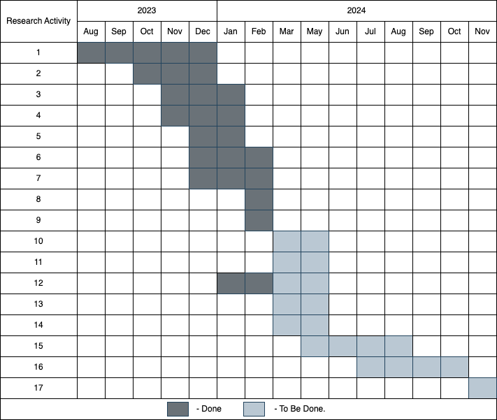
Research Agenda
1. Systematic Literature Review.
2. Purpose Identification and Requirements Elicitation.
3. Ontology Capture and Formalization.
4. Reference Ontology.
5. Design.
6. Implementation.
7. Operational Ontology.
8. Testing.
9. Documenting.
10. SHACL validation.
11. Validation with experts.
12. Text Classification Machine Learning Model.
13. Continuous Integration Instantiation System.
14. Python API.
15. Further Machine Learning Applications.
16. Dissertation Writing.
17. Dissertation Presentation.
Source: Original Authorship

Slide 35
Victor B. J. Oliveira victor.oliveira53295@alunos.ufersa.edu.br R. Francisco Mota, 572 Laboratório PPgCC - Bloco LCC UFERSA Bairro Pres. Costa e Silva, Mossoró - RN
Thanks!

