Slide 1
ACM PROGRAMMING COMPETITION TRON AI

Slide 2
TRON RULES
Each player will program their own Tron bot
Both bots will be randomly placed on the map
The bot must be moving at all times
The bot can only move up/down/left/right
The bot loses if it hits its own piece, opponent’s piece or a wall

Slide 3
BEGINNING OF GAME

Slide 4
TURN 1

Slide 5
TURN 2

Slide 6
TURN 3

Slide 7
TURN 4

Slide 8
TURN 5

Slide 9
TURN 6

Slide 10
TURN 7

Slide 11
TURN 8

Slide 12
TURN 9

Slide 13
TURN 10

Slide 14
TURN 11

Slide 15
TURN 12

Slide 16
TURN 13

Slide 17
PLAYER 2 (BLUE) LOSES

Slide 18
ANOTHER EXAMPLE

Slide 19
TURN 1

Slide 20
TURN 2

Slide 21
TURN 3

Slide 22
TURN 4

Slide 23
TURN 5

Slide 24
TIE!

Slide 25
BASIC STRATEGIES

Slide 26
RANDOM SELECTION

Slide 27
RANDOM SELECTION

Slide 28
RANDOM SELECTION

Slide 29
RANDOM SELECTION

Slide 30
RANDOM SELECTION

Slide 31
RANDOM SELECTION

Slide 32
RANDOM SELECTION

Slide 33
RANDOM SELECTION

Slide 34
RANDOM SELECTION

Slide 35
RANDOM SELECTION

Slide 36
PLAYER 1 (RED) LOSES

Slide 37
ORDERED SELECTION

Slide 38
ORDERED SELECTION

Slide 39
ORDERED SELECTION

Slide 40
ORDERED SELECTION

Slide 41
ORDERED SELECTION

Slide 42
ORDERED SELECTION

Slide 43
ORDERED SELECTION

Slide 44
ORDERED SELECTION

Slide 45
ORDERED SELECTION

Slide 46
ORDERED SELECTION

Slide 47
ORDERED SELECTION

Slide 48
ORDERED SELECTION

Slide 49
ORDERED SELECTION

Slide 50
ORDERED SELECTION

Slide 51
ORDERED SELECTION

Slide 52
ORDERED SELECTION

Slide 53
ORDERED SELECTION

Slide 54
ORDERED SELECTION

Slide 55
ORDERED SELECTION

Slide 56
ORDERED SELECTION

Slide 57
ORDERED SELECTION

Slide 58
ORDERED SELECTION

Slide 59
ORDERED SELECTION

Slide 60
ORDERED SELECTION

Slide 61
ORDERED SELECTION

Slide 62
ORDERED SELECTION

Slide 63
ORDERED SELECTION

Slide 64
ORDERED SELECTION

Slide 65
ORDERED SELECTION

Slide 66
ORDERED SELECTION

Slide 67
ORDERED SELECTION

Slide 68
ORDERED SELECTION

Slide 69
ORDERED SELECTION

Slide 70
ORDERED SELECTION

Slide 71
ORDERED SELECTION

Slide 72
ORDERED SELECTION

Slide 73
ORDERED SELECTION

Slide 74
ORDERED SELECTION

Slide 75
ORDERED SELECTION

Slide 76
ORDERED SELECTION

Slide 77
ORDERED SELECTION

Slide 78
ORDERED SELECTION

Slide 79
ORDERED SELECTION

Slide 80
ORDERED SELECTION

Slide 81
ORDERED SELECTION

Slide 82
ORDERED SELECTION

Slide 83
ORDERED SELECTION

Slide 84
ORDERED SELECTION

Slide 85
ORDERED SELECTION

Slide 86
ORDERED SELECTION

Slide 87
ORDERED SELECTION

Slide 88
ORDERED SELECTION

Slide 89
TIE!

Slide 90
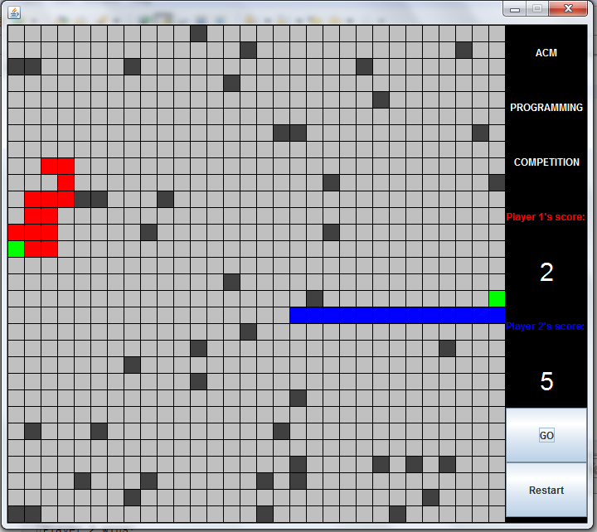
DEMO

Slide 91
HOW TO START PROGRAMMING?

Slide 92
DOWNLOAD THE PROJECT AND EXTRACT IT

Slide 93
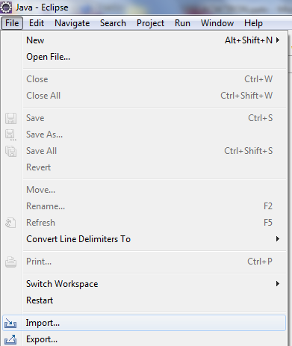
IMPORT PROJECT INTO ECLIPSE

Slide 94
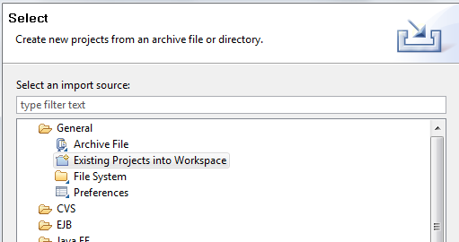
SELECT EXISTING PROJECTS

Slide 95
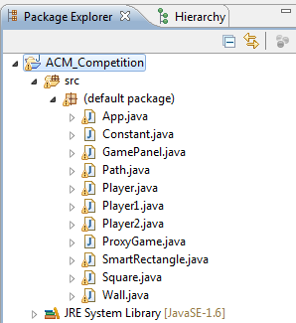
EXPAND ACM COMPETITION FOLDER

Slide 96
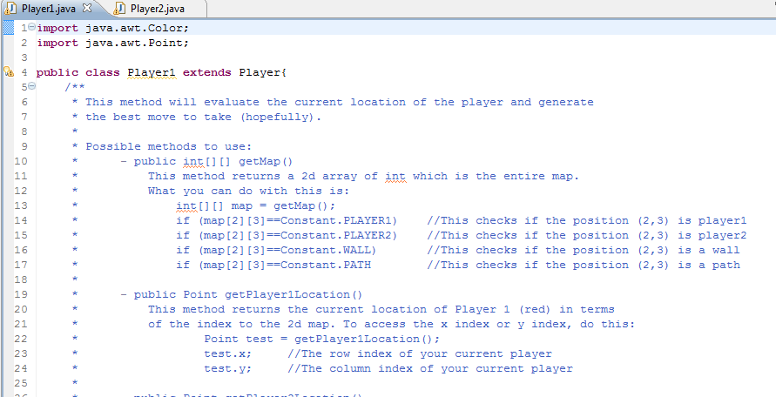
OPEN PLAYER1.JAVA OR PLAYER2.JAVA

Slide 97
IMPLEMENT YOUR OWN MOVE() METHOD
The move() method is the only method you need to edit.
The method should return one of the following:
Constant.UP
Constant.DOWN
Constant.LEFT
Constant.RIGHT

Slide 98
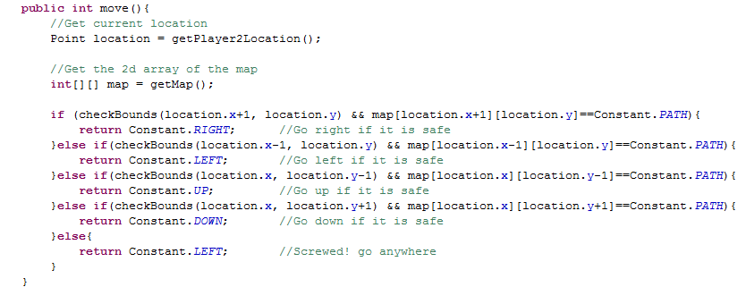
VERY SIMPLE ALGORITHM

Slide 99
MORE INFORMATION
Feel free to add as many variables or methods as you like
The getMap() method will return you a 2D int array which is a copy of the real array
This means that you can edit the content of the array without affecting the game
Do NOT edit any other classes!
You should only edit the Player1/Player2 class

Slide 100
QUESTIONS?

