Slide 1
Differential Privacy for Medical RAG Embeddings
Central vs. Local vs. Metric DP, a three-way comparison on medical embeddings
Victor Okoroafor, Ifeanyi Omonigho Odugo, Gopal Krishna, Niramay Roopesh Kolalle
Privacy-Preserving Methods for Data Science and Distributed Systems, University of Basel

Slide 2
Motivation: embeddings are not anonymisation
What happens when an adversary gets access to the embeddings?
89% of patient names recoverable. Morris et al. (2023) inverted dense embeddings of MIMIC-III clinical text back to identifiable content.
In a regulated health setting, storing embeddings is impractical without protection at the embedding layer.
Clinical documents
Encoder
Vector database
Retrieval
LLM answer
attack surface

Slide 3
Problem statement: three threat axes
Membership inference
Is a specific patient record in the corpus?
LiRA, TPR at 0.1% FPR
Embedding inversion
Reconstruct source text from a stored embedding?
ROUGE-L reconstruction fidelity
Utility degradation
Does protection break retrieval quality?
BERTScore F1 similarity

Slide 4
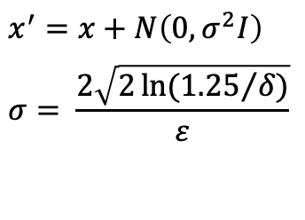
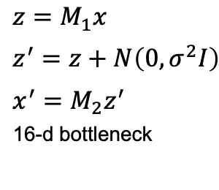
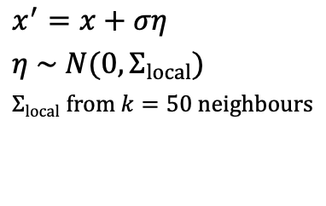
The three mechanisms
Central DP
Isotropic noise on the full 384-d embedding.
Local DP
Project to a 16-d bottleneck, add noise, then decode back.
Metric DP
Noise shaped to the local neighbourhood covariance.

Slide 5
Experimental setup
Dataset: ChatDoctor-HealthCareMagic, 5,000 rows (capped from 112k).
Encoder: all-MiniLM-L6-v2, 384-d Sentence-BERT, frozen.
Retrieval: FAISS nearest-neighbour index, simulates RAG.
Privacy sweep: ε ∈ {0.1, 1.0, 5.0, 10.0}, δ = 1e-5.
Repetitions: 5 noise realisations, seeds 0 to 4, mean ± 1 SD.
Baseline: ε = ∞, no noise, reference on every axis.

Slide 6
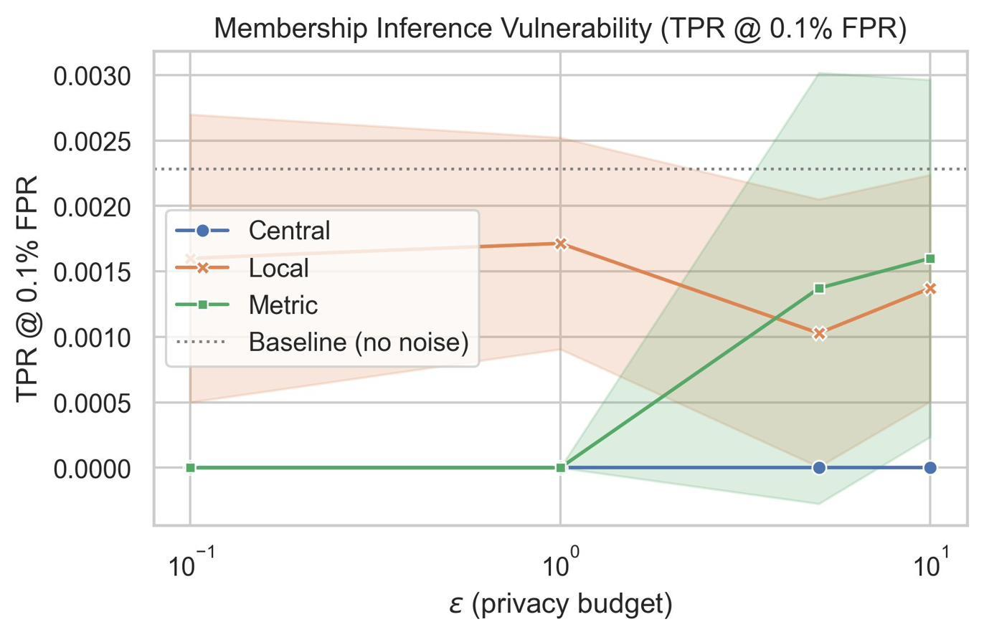
Membership inference: all three suppress leakage
Baseline TPR = 0.0017.
Central DP: TPR = 0.000 at every ε.
Local DP: TPR ≈ 0.001, well below baseline.
Metric DP: 0.000 at low ε, rising only to ≈ 0.0017 at ε = 10.
LiRA and an independent k-NN distance-ratio attack agree: near-zero TPR under Central DP.

Slide 7
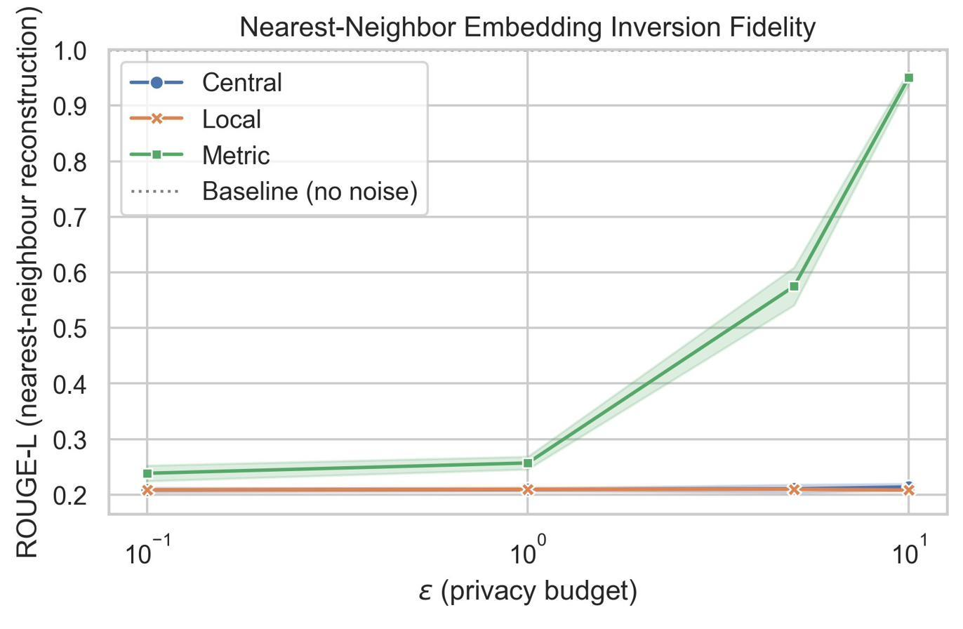
Embedding inversion: the headline privacy signal
Baseline ROUGE-L = 1.000.
Central and Local DP: drop to ≈ 0.21 and stay flat across all ε. The cliff.
Metric DP collapses: 0.238, 0.257, ≈ 0.58, 0.950 across ε = 0.1, 1, 5, 10.
At ε = 10, an adversary reconstructs 95% of the lexical content from the embedding alone.

Slide 8
The Metric DP failure mode
Safe at tight budgets, collapses at loose ones.
At ε = 0.1, Metric DP matches Central DP. At ε = 10, inversion ROUGE-L reaches 0.950.
Why: at large ε, the noise falls below the encoder's neighbourhood radius, and the Mahalanobis scaling no longer hides the point.
Novelty: prior work evaluated only low-ε regimes, so this failure was not previously documented.
ε | Inversion ROUGE-L | BERTScore F1
0.1 | 0.238 | 0.843
1.0 | 0.257 | 0.850
5.0 | ~0.575 | ~0.915
10.0 | 0.950 | 0.991

Slide 9
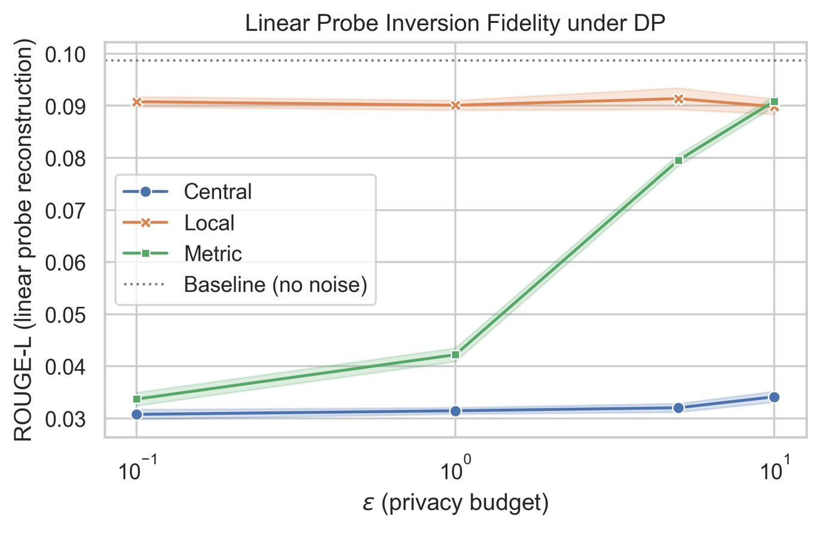
Linear probe inversion: a second, learned attack
A trained probe maps noisy embeddings to bag-of-words tokens. Lower scale, baseline ≈ 0.099.
Central DP: lowest and flat (≈ 0.031). Hardest to invert.
Local DP: highest (≈ 0.090). The bottleneck retains more token content.
Metric DP: rises with ε (0.034 to 0.091).
Confirms Metric's leak grows and Central is most resistant. It does not reproduce the 0.95 collapse.

Slide 10
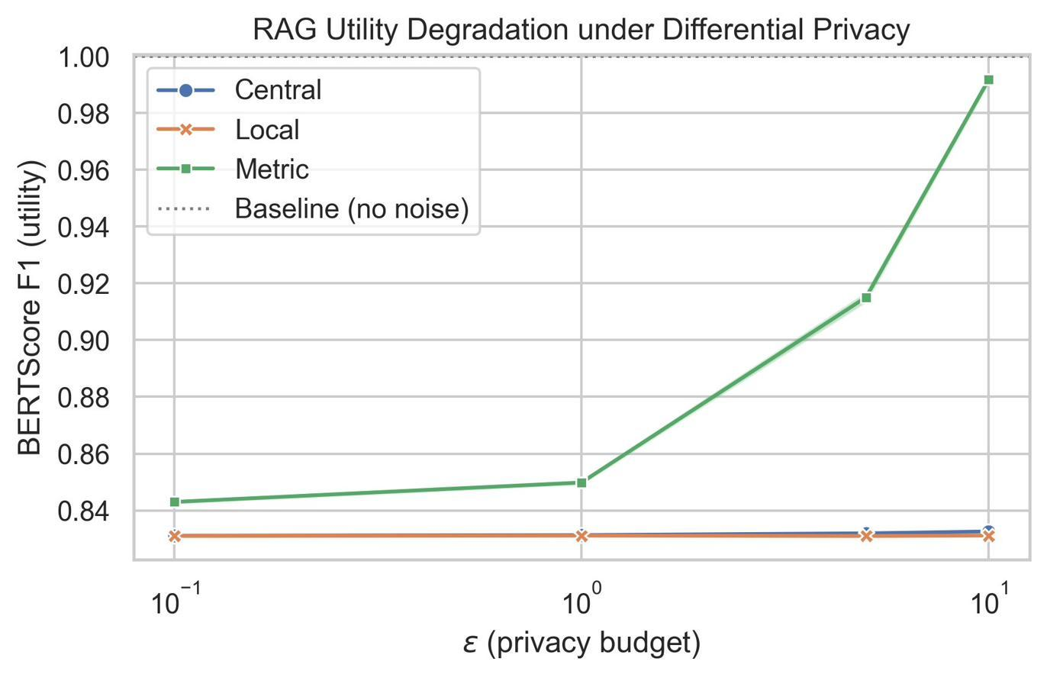
Utility: a flat curve, under 2% loss
Baseline F1 = 1.000.
Metric DP: utility rises with ε, 0.843 to 0.991.
Central and Local DP: flat at 0.831 to 0.833 across the whole range.
Under 2% utility loss from baseline, even at the strongest privacy budget.

Slide 11
The threshold effect: a threshold, not a tradeoff
Standard DP theory predicts a monotonic tradeoff: smaller ε, more noise, less utility.
Central and Local DP are ε-invariant across [0.1, 10] on all three metrics.
Interpretation: once Gaussian noise exceeds the encoder's neighbourhood radius, retrieval saturates at a fixed floor.
The expected tradeoff would only appear below ε = 0.1. Consistent with Du et al. (2023): a 16-d projection already suffices.

Slide 12
Three-way comparison: ε = 1.0 and ε = 10.0
Mechanism | BERT F1 (utility) | LiRA TPR @ 0.1% FPR | ROUGE-L (inversion)
Baseline (ε = ∞) | 1.000 | 0.0017 | 1.000
Central DP (ε = 1.0) | 0.831 | 0.000 | 0.209
Central DP (ε = 10.0) | 0.833 | 0.000 | 0.214
Local DP (ε = 1.0) | 0.831 | 0.001 | 0.210
Local DP (ε = 10.0) | 0.831 | 0.001 | 0.208
Metric DP (ε = 1.0) | 0.850 | 0.000 | 0.257
Metric DP (ε = 10.0) | 0.991 | 0.002 | 0.950
The highlighted row: near-baseline utility bought at the price of near-complete reconstruction.

Slide 13
Practical recommendation
Use Central DP for medical RAG. Inversion resistance ≈ 0.21 and zero MIA success across the full ε range, under 2% utility loss.
ε choice is operationally free within [0.1, 10]. Protection is ε-invariant, so there is no ε-tuning burden.
Never deploy Metric DP at ε ≥ 5 on sensitive corpora. Risk of text reconstruction is unacceptable under HIPAA or GDPR.
Clinically: at ε = 1.0, 1,000 membership queries identify zero patient records at 0.1% FPR. The unprotected baseline exposes about 2.

Slide 14
Limitations
LiRA adaptation. Logistic-regression shadow classifiers on raw embeddings; reported TPR is an approximate lower bound.
Single dataset. Results are on ChatDoctor-HealthCareMagic only; generalisation is untested.
Encoder is not private. The guarantee covers stored embeddings, not the public encoder. White-box threat model.
Metric DP bound. A practical local-Mahalanobis approximation; its formal guarantee is not established in the loose-ε regime where it fails.

Slide 15
Summary of findings
1. Central and Local DP provide ε-invariant protection. Strong inversion resistance and near-zero membership leakage at under 2% utility cost.
2. Metric DP collapses at weak privacy budgets. Inversion ROUGE-L 0.950 at ε = 10. First documented occurrence.
3. LiRA and k-NN agree. Two independent attacks confirm near-zero membership leakage under Central DP.

Slide 16
Why this matters beyond the course
Medical RAG is a live deployment problem. Clinical systems already store consultation text as embeddings.
HIPAA and GDPR compliance hinge on whether stored vectors can be inverted. We show they can be, unless protected correctly.
First empirical three-way comparison of Central, Local, and Metric DP for medical embeddings.
Target venue: PoPETs (Privacy Enhancing Technologies Symposium).

Slide 17
Future work
Stronger MIA baseline
A k-NN distance-ratio attack on raw embeddings within LiRA, for a tighter bound.
Vec2Text inversion
Sequence-level inversion to quantify recoverable semantic content beyond ROUGE-L.
DP-SGD encoder
Privatize the encoder itself to characterize the privacy cost and utility gain.

Slide 18
Thank you. Questions?
Repository: github.com/VictorChibueze-stud/med-rag-privacy-eval
Victor Okoroafor, Ifeanyi Omonigho Odugo, Gopal Krishna, Niramay Roopesh Kolalle

