Slide 1
20483B
Programming in C#

Slide 2

Welcome!
Thank you for joining us today.
We’ve worked together with Microsoft Learning Partners and Microsoft IT Academies to bring you a world-class learning experience, including:
Microsoft Certified Trainers + Instructors. Your instructor is a premier technical and instructional expert who meets ongoing certification requirements.
Customer Satisfaction Guarantee. Our Partners offer a satisfaction guarantee and we hold them accountable for it. At the end of class, please complete an evaluation of
today’s experience. We value your feedback!
Certification Benefits. After training, consider pursuing a Microsoft Certification, to help distinguish your technical expertise and experience. Ask your instructor about available exam promotions and discounts.
We wish you a great learning experience and ongoing career success!

Slide 3
Hello
Instructor: <Instructor Name>
<Title or other credentials, e.g. Microsoft Certified Trainer>
<Affiliation/Company>
<A few words about my technical and professional experience>
Notes:
Fill in the information on this slide and provide your own details.

Slide 4
Facilities
Class hours
Building hours
Parking
Restrooms
Meals
Phones
Messages
Smoking
Recycling

Slide 5
About This Course
Audience
Course Prerequisites
Course Objectives
What You Can Expect
Notes:
Audience
This training course teaches developers the programming skills that are required for developers to create both Windows 8 client and web applications by using the Visual C# language.
The developers targeted by this training are professional developers who have 3-6 months of experience creating software applications for a production environment and who have a basic understanding of Windows client application development. Students should have a minimum of the following experience:
3 months of experience creating .NET Framework applications.
1 month of experience using Visual Studio 2010 or Visual Studio 2012.
This course is not designed for students who are new to programming; it is targeted at professional developers with at least one month of experience programming in an object-oriented environment.
Course Prerequisites
This course is intended for experienced developers who already have programming experience in C, C++, JavaScript, Objective-C, Microsoft Visual Basic®, or Java and understand the concepts of object-oriented programming.
<More …>

Slide 6
Hidden Slide
Do not delete this slide
Notes:
Additionally, developers attending this course should already have gained some limited experience using Visual C# to complete basic programming tasks. More specifically, students should have hands-on experience using Visual C# that demonstrates their understanding of the following:
How to name, declare, initialize and assign values to variables within an application.
How to use:
Arithmetic operators to perform arithmetic calculations involving one or more variables.
Relational operators to test the relationship between two variables or expressions.
Logical operators to combine expressions that contain relational operators.
How to create the code syntax for simple programming statements using Visual C# language keywords and recognize syntax errors by using the Visual Studio IDE.
How to create a simple branching structure using an if statement.
How to create a simple looping structure using a for statement to iterate through a data array.
How to use the Visual Studio IDE to locate simple logic errors.
How to create a method that accepts arguments and returns a value of a specified type.
How to design and build a simple user interface by using standard controls from the Visual Studio toolbox.
How to connect to a SQL Server database and the basics of how to retrieve and store data.
How to sort data in a loop.
How to recognize the classes and methods used in a program.
Course Objectives
After completing this course, students will be able to:
Describe the core syntax and features of Visual C#.
Create methods, handle exceptions, and describe the monitoring requirements of large-scale applications.
Implement the basic structure and essential elements of a typical desktop application.
Create classes, define and implement interfaces, and create and use generic collections.
Use inheritance to create a class hierarchy and to extend a .NET Framework class.
Read and write data by using file input/output and streams, and serialize and deserialize data in different formats.
Create and use an entity data model for accessing a database and use LINQ to query data.
<More …>

Slide 7
Hidden Slide
Do not delete this slide
Notes:
Access and query remote data by using the types in the System.Net namespace and WCF Data Services.
Build a graphical user interface by using XAML.
Improve the throughput and response time of applications by using tasks and asynchronous operations.
Integrate unmanaged libraries and dynamic components into a Visual C# application.
Examine the metadata of types by using reflection, create and use custom attributes, generate code at runtime, and manage assembly versions.
Encrypt and decrypt data by using symmetric and asymmetric encryption.
What You Can Expect
In this course, students review the basics of Visual C# program structure, language syntax, and implementation details, and then consolidate their knowledge throughout the week as they build an application that incorporates several features of the .NET Framework 4.5.
At the end of the course, students should leave the class with a solid knowledge of Visual C# and how to use it to develop .NET Framework 4.5 applications.
This course uses Visual Studio 2012, running on Windows 8.

Slide 8
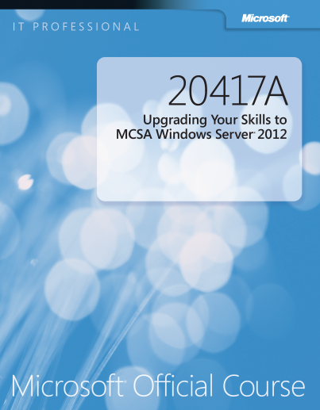
Your Course Materials
Designed to optimize your classroom learning experience.
And support you back on the job.
Microsoft Official Course Handbook
Organized by Modules
Includes Labs + Lab Answer Keys
Module Reviews + Takeaways—great for on-the-job reference
NOTE
This is an early-to-market edition of the course. Upon release of the next edition, you will be able to access the digital companion content at: microsoft.com/learning/companionmoc
Notes:
For courseware covering pre-release software:
The content of this course and its labs are based on a pre-release version of software. This course may not cover software features that are still in development, and software may be substantially changed prior to commercial release.
This course is provided as-is, to provide early insights and help students get a head start with new technologies. When the software is finalized for commercial release, the course will be updated with final graphics and a full editorial review. At this time, the students can download an updated version of the course companion content at the Microsoft Learning site.

Slide 9
Course Outline
Module 1: Review of Visual C# Syntax
Module 2: Creating Methods, Handling Exceptions, and Monitoring Applications
Module 3: Developing the Code for a Graphical Application
Module 4: Creating Classes and Implementing Type-Safe Collections
Module 5: Creating a Class Hierarchy by Using Inheritance
Module 6: Reading and Writing Local Data
Module 7: Accessing a Database

Slide 10
Course Outline (continued)
Module 8: Accessing Remote Data
Module 9: Designing the User Interface for a Graphical Application
Module 10: Improving Application Performance and Responsiveness
Module 11: Integrating with Unmanaged Code
Module 12: Creating Reusable Types and Assemblies
Module 13: Encrypting and Decrypting Data

Slide 11
Related Courses
20484A: Essentials of Developing Windows® Store Apps Using C#
20485A: Advanced Windows 8 Development using C#
See the full line of Microsoft Training and Certification resources at: http://www.microsoft.com/learning/

Slide 12
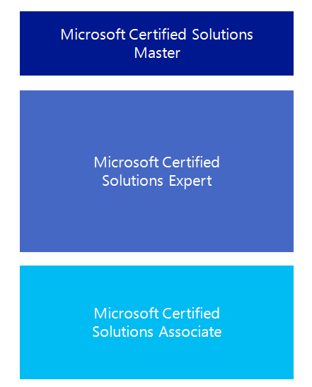

Microsoft Certification Program
Get trained. Get certified.
Get ahead.
Microsoft Certifications demonstrate you have the skills to design, deploy, and optimize the latest technology solutions.
Ask your Microsoft Learning Partner how you can prepare for certification.
Also see:
http://www.microsoft.com/learning/
certification

Slide 13

Preparing for the Labs
Your lab activities will be centered around the School of Fine Arts, a fictitious school for gifted children. You will build prototype and production versions of an application that enables teachers to enroll students in a class and to track students’ progress in the subjects that they study.
By working through the labs, you will learn how to create an interactive and scalable application by using Visual C# and the .NET Framework 4.5, with a rich user interface developed by using XAML.
To complete the labs, you will work in a virtual machine (VM) environment.

Slide 14

Virtual Machine Environment
Virtual Machine Name: | Use as:
20483-SEA-DEV11 | Windows 8 Development Computer
MSL-TMG1 | Gateway computer for accessing the Internet
Notes:
All modules use the same virtual machine for the labs. The demonstration and lab files are located on the E:\ drive, in folders named Mod01, Mod02, and so on up to Mod13.
In addition, each lab requires that the student run the MSL-TMG1 virtual machine. This virtual machine acts as a gateway, providing filtered access to the Internet. Students can start this virtual machine at the beginning of the first lab and leave it running until the end of the course.

Slide 15
Demonstration: Using Hyper-V Manager
In this demonstration, you will learn how to:
Open Hyper-V Manager
Navigate the various sections/panes within Hyper-V Manager
Virtual Machines, Snapshots, and Actions: Server-specific and VM-specific
Identify the VMs used in the labs for this course
Take a Snapshot and Apply a Snapshot
Connect to a VM
Start and log on to a VM
Switch between full screen and window modes
Revert to the previous Snapshot
Shut down a VM
When to use Shut Down or Turn off
Close Hyper-V Manager

