Slide 1
How do you invoke a method w/ callback?
public void SomeMethod(string s , SomeCallBack cb)
delegate void SomeCallBack(int i)
-------------------------------------------------------------------------
To Execute SomeMethod using Anonymous Method Syntax:
SomeMethod(“a”, delegate(int x) { ….})
To Execute SomeMethod using Lambda:
SomeMethod(“a”, (x)=>….)

Slide 2
Using Lambda to handle event
List<Student> classRoom = new List<Student>();
Student victor = new Student();
victor.Hungry += (sender,arg)=> Feed(sender);
classRoom.Add(Victor);

Slide 3
StringReader vs StreamReader
try
{
using (StreamReader sr = new StreamReader("Log.txt"))
{
string _line;
while ((_line = sr.ReadLine()) != null))
{
}
}
}
catch (FileNotFoundException e)
{
Console.WriteLine(e.ToString());
throw;
}
StringReader/Writer =>
Reads from String, write to StringBuilder
StreamReader/Writer =>
Reads from Stream, write to Stream

Slide 4
Thread Safety
public class Demo
{
static Demo _demo = null;
static object _lock = new Object();
public static Demo GetDemo {
get {
if (_demo == null)
{lock (_lock)
{if (_demo == null) _demo = new Demo();}
}
return _demo;
}
}
}

Slide 5
Async Method Definition
private async void GetData(string URL)
{
var sr = new StreamReader(new WebClient().OpenRead(URL));
var result = await sr.ReadLineAsync();
}

Slide 6
Lock(this) is Death(when method is public callable), use a private [static] if possible
The MSDN documentation says that
public class SomeObject
{
public void SomeOperation()
{
lock(this) //what if someone else is locking on this instance //of object? Better lock on private member
{
//Access instance variables
}
}
}
is "a problem if the instance can be accessed publicly".

Slide 7
String.Replace
using System;
public class Example
{
public static void Main()
{
String s = "aaa";
Console.WriteLine("The initial string: '{0}'", s);
s = s.Replace("a", "b").Replace("b", "c").Replace("c", "d");
Console.WriteLine("The final string: '{0}'", s);
}
}
// The example displays the following output:
// The initial string: 'aaa'
// The final string: 'ddd'

Slide 8
Regex Compiled Option Performs Better
var reg = new Regex("[SomePattern]", RegexOptions.Compiled);
reg.Match("[SomeInput]");

Slide 9
Including Line Number in Exceptions(pdb)
Update the platform target and conditional compilation symbols for each application configuration.
Create two application configurations based on the default Debug configuration.

Slide 10
Performance Counter Pairing
Base counter type | Performance counter types
AverageBase | AverageTimer32 AverageCount64
CounterMultiBase | CounterMultiTimer CounterMultiTimerInverse CounterMultiTimer100Ns CounterMultiTimer100NsInverse
RawBase | RawFraction
SampleBase | SampleFraction

Slide 11
To create a new category and set of performance counters programmatically
Create a collection of type CounterCreationDataCollection.
Create the counters you want to create as objects of type CounterCreationData and set their necessary properties.
Add the CounterCreationData objects to the collection by calling the collection's Add method.
Call the Create method on the PerformanceCounterCategory class and pass the collection to it.
https://technet.microsoft.com/en-us/library/security/5e3s61wf(v=vs.85).aspx

Slide 12
Message Integrity and Validity
HMACSHA256 <= message not altered in transit

Slide 13
Install Assembly to GAC?
Gacutil.exe /I
Create Windows Installer (.MSI)

Slide 14
Debug.Assert vs Trace.Assert?
Debug.Assert Only works when running Debug Builds
Trace.Assert works in All Build Configurations

Slide 15
DateTime.TryParse(dateString,DateTimeStyle)
Does not throw exception
DateTimeStyles member | Description
AdjustToUniversal | Parses s and, if necessary, converts it to UTC. If s includes a time zone offset, or if s contains no time zone information but styles includes the DateTimeStyles.AssumeLocal flag, the method parses the string, calls ToUniversalTime to convert the returned DateTime value to UTC, and sets the Kind property to DateTimeKind.Utc

Slide 16
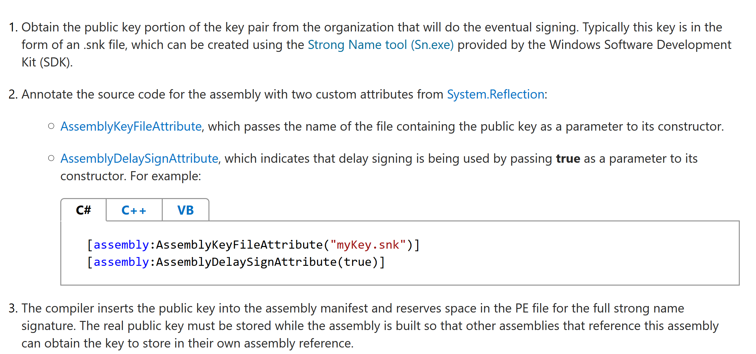
Delay Signing an Assembly

Slide 17
Load Another Assembly at runtime
Assembly.LoadFrom(“Test.dll”); // allow access to type in dll
Assembly.ReflectionOnlyLoad(byte[] filebytes); //metadaonly load
Assembly.ReflectionOnlyLoadFrom(string s);
//Load from file, metadataonly

Slide 18
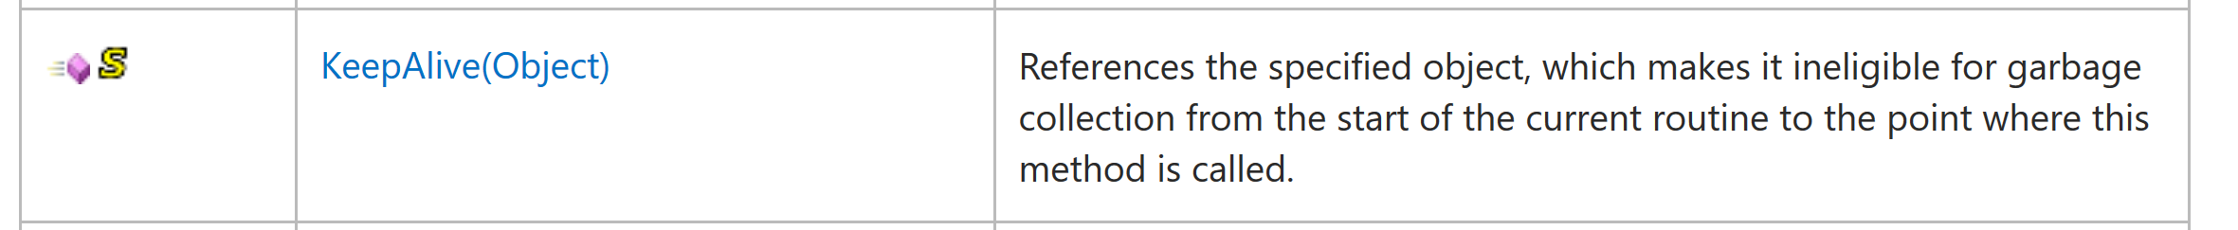
GC Methods
https://msdn.microsoft.com/en-us/library/system.gc.keepalive(v=vs.110).aspx

Slide 19
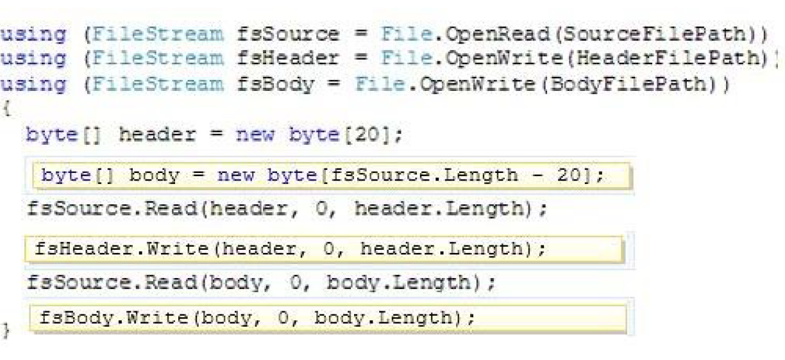
How to work with Stream

Slide 20
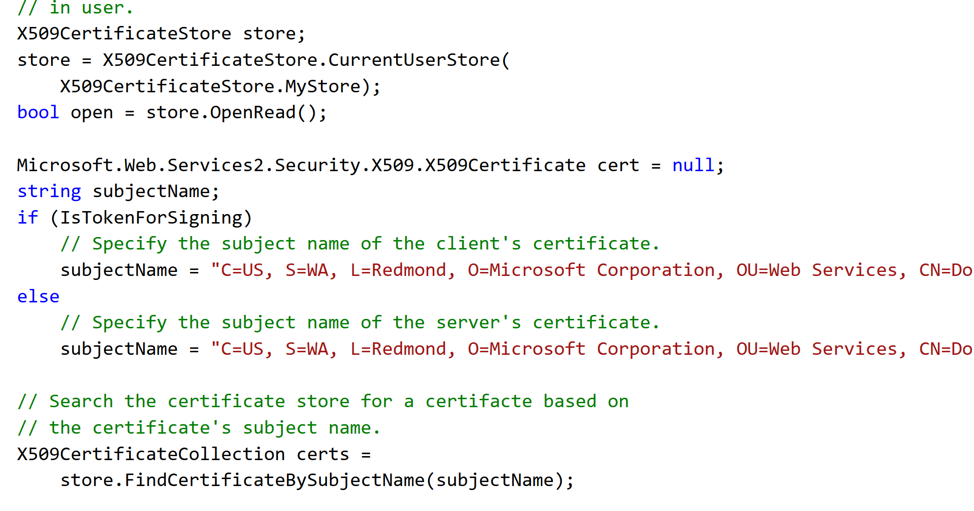
Find a Certificate from User Certificate Store

Slide 21
Indexer Property
Allows Object that contains Collections to be access by using [ ] notation, add following method:
public int this[string Key]

Slide 22
HashAlgo.ComputeHash()
Returns Computed Hash, also populate HashAlgo.Hash property.

Slide 23
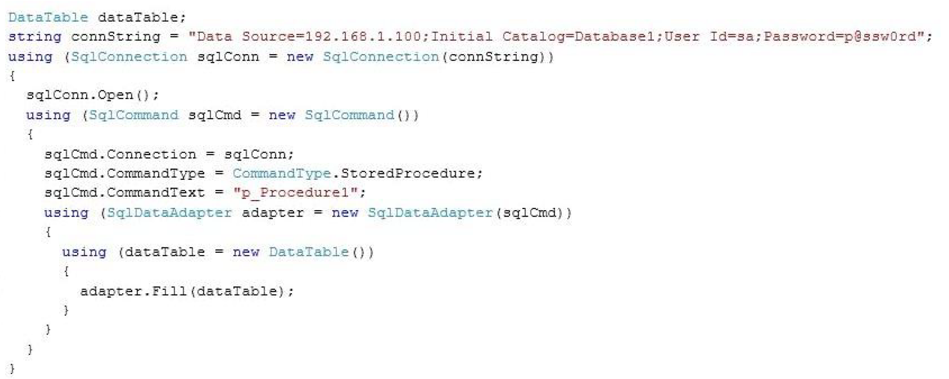
Using() { } – Auto Dispose Pattern
Using (var v = new Something())
{
} // invokes v.Dispose() in the finally

Slide 24
Raising Event
If there is no event handler attached, raising event causes “NullReferenceException”
If there are multiple event handler, the order of execution is not guaranteed.

Slide 25
What if you forget to call break in a switch?
Falls through to the default case.

Slide 26
ArrayList vs List<T>
ArrayList.Add Box data in to Object Type, thus when item is retrieved from ArrayList, it must be downcasted back to original datatype.
List<T> offers Add(T item) type strong method, its indexer is also type strong.

Slide 27
Sign Assembly with Strong Name
al.exe
Use attribute in AssemblyInfo.cs

Slide 28
PDB FILE
Program Database File, contains symbol to line number lookup. If file is present in the directory where is assembly is executing, line number will be printed along with stack trace.

Slide 29
Flush StremWriter type Object.

Slide 30
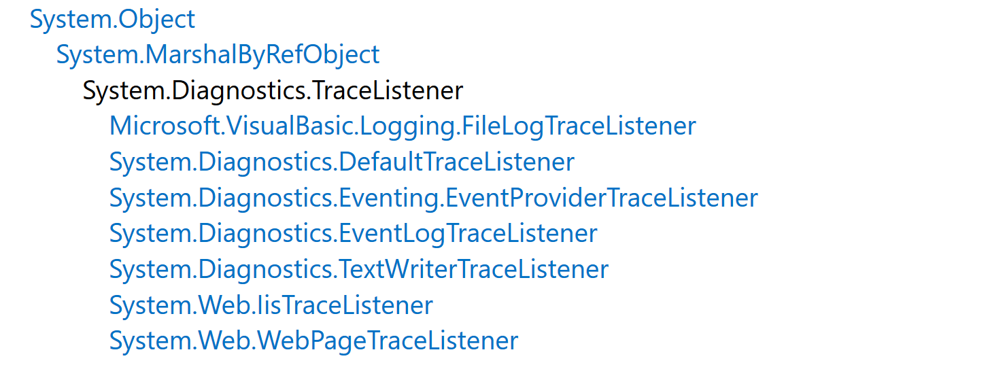
TraceListener

Slide 31
TaskFactory.FromAsync and TaskCompleteSource

