Slide 1
ORANGE BUSINESS · BECODE AI & DATA SCIENCE
Innovation Radar
Finding the opportunity spaces worth your attention —
before your competitors act on them.
Gunay Bayramova · Victor Courtois · Mahalakshmi Palanivel · Anna Diacofotaki
A two-week project
01
Notes:
OPENING — 30 seconds, do not read the slide. Say who you are, then land the one sentence: "Orange Business asked us to find emerging opportunity spaces before their competitors act on them. We built a system that reads the open web every day and hands you a ranked shortlist with the evidence attached." BeCode note: introduce the four of you by ROLE, not just name — the jury is assessing whether this was really a team project. Gunay: team lead. Victor: repo and tech lead. Mahalakshmi: data architect. Anna: documentation. Do NOT open the dashboard yet. The client said explicitly they care about the process behind it more than the screen.

Slide 2
THE BRIEF
Find the opportunity before the competitor does
What Orange Business asked for, in their words and ours
“
1
Automate the watching
Scan the open web continuously for competitor moves, new deployments, regulation and emerging technology — not a person reading news once a week.
Don't focus too much on the dashboard. Their perspective is more about a structured process to discover the opportunity space, and what is behind it.
— client feedback, QA session
2
Turn noise into structure
Not a feed of articles. Named opportunity spaces: Vertical × Use case × Technology.
3
Rank them
One score, so you argue about a shortlist of ten rather than scroll a list of six hundred.
4
Serve three audiences
Strategy, sales, and presales each need a different cut of the same evidence.
02
Notes:
This slide sets the contract for the whole talk. Read the quote out loud — it justifies why the next six slides are about the pipeline and not about the UI. If you only have 10 minutes: keep this slide. It is the cheapest way to show you listened. BeCode note: the jury wants evidence you scoped the problem rather than jumped to code. Mention that requirement 4 (three audiences) is the one you have only partly delivered — you will be honest about that on the limitations slide. Flagging it early makes the later honesty read as planned, not defensive.

Slide 3
IN ONE LINE
What we built
A shortlist you can act on, and a trail back to the evidence behind every line of it
750
30
100%
signals scanned
opportunity spaces
traceable
from 440 publications across 20 countries
each one backed by three or more independent sources that agree
every score walks back to the exact articles it was built from
Nothing on this radar is an opinion with a number attached. Every position and every score is built from named, dated, checkable sources.
03
Notes:
Three numbers, then the italic line — that line is the thesis of the whole project. Say it slowly. Be ready for the obvious challenge: "only 7 opportunities from 619 signals?" Answer it head-on rather than hoping nobody asks: the clustering threshold is deliberately strict (3+ signals above 0.82 cosine similarity), because a single article should never become an opportunity. You would rather show seven you can defend than fifty you cannot. You return to this on the limitations slide. BeCode note: "four computed in code, one judged by the model" is the single strongest engineering decision in the project. Do not let it go by in one breath.

Slide 4
THE PROCESS
From an article to an opportunity
Six stages. Only the first one searches on its own — everything after it follows fixed rules, the same way every time
1
Watch
2
Record
3
Group
Scans independent press, regulators and competitor announcements. Never an Orange-owned source.
Every article kept with its publisher, date, market and a summary. Nothing is discarded.
Articles about the same underlying story are grouped by meaning, not by matching keywords.
4
Filter
5
Score
6
Deliver
Checked against what Orange already sells, in the markets Orange already covers.
Five factors — four measured from the evidence, one judged — combined into one number.
A ranked shortlist, each opportunity linked back to the exact articles behind it.
Only the first stage makes its own choices. Everything that produces a number follows fixed rules — so the same evidence always gives the same answer.
04
Notes:
THE MOST IMPORTANT SLIDE IN THE DECK. Spend real time here. If you cut anything, do not cut this. Walk left to right once, one sentence per box. Then deliver the closing line as the design principle: an LLM where judgement is genuinely needed, plain code everywhere else. That is what makes the output reproducible. Anticipate: "why not let the agent do all of it?" Because a scoring step that is a model call is a scoring step you cannot reproduce, cannot audit, and cannot explain to a client who asks why one opportunity beat another. BeCode note: name the technologies out loud as you pass each box — Azure AI Foundry, Azure SQL, text-embedding-3-large, union-find clustering in Python. The jury is listening for whether you can explain your own stack.

Slide 5
WHY YOU CAN TRUST IT — 1
An opportunity needs corroboration, not a headline
One article is a story. Three independent outlets telling the same story is a signal you can act on
What the system does
What that buys you
Reads what each article is actually about, rather than which words it happens to use.
Groups together the ones telling the same underlying story.
Requires at least three independent articles before a group counts at all.
Only then writes it up as a named opportunity, from all of them at once.
Two outlets covering the same launch in completely different words still end up together — a keyword search would miss that entirely.
And it sets a floor on quality. Ten articles from one publication is one source with an opinion. Four articles from four publications is a market moving.
05
Notes:
Ten-minute version: MERGE this with slide 6 and give the pair 90 seconds. The line to land: "keyword matching would miss this — two articles about the same thing that share no words still end up in the same cluster, because we compare meaning, not text." Expect the question "why 0.82?" Honest answer: it was tuned by hand and it is strict. Say so. It is on the limitations slide as an open number, not a settled one. BeCode note: if asked, union-find is the standard disjoint-set structure — you build an edge list from the SQL similarity query and merge transitively, so A~B and B~C puts all three in one cluster.

Slide 6
WHY YOU CAN TRUST IT — 2
A gap is only a gap if Orange cannot already do it
Before anything is scored, each group is checked against what Orange already sells — and in which markets
Private 5G in a European port
Orange leads the Gartner Magic Quadrant for private mobile networks and runs the Port of Antwerp campus.
SKIPPED
The same story about a US carrier
Orange has no network operator presence in the United States — so this is a genuine market-entry question, not something already covered.
KEPT
Without this step the radar would spend its time flagging Orange's own product catalogue back at them.
06
Notes:
This is the slide that makes a client sit up, because it shows you understood THEIR business and not just the data problem. Deliver it as the two-line story it is: same technology, same use case, different geography, opposite answer. If the client is in the room, invite them to correct the capability list — it is a snapshot the team assembled from public sources, with a "last verified" date, and it is the part of the system that most needs their input. That turns a limitation into an ask, which is a much better position to be in. BeCode note: mention that the capability list lives in the agent prompt with a freshness check step, so it is versioned with the code rather than living in someone's head.

Slide 7
HOW THE SHORTLIST IS RANKED
Attractiveness, and what is inside it
Four of the five are measured directly from the evidence. The fifth is a judgement — and the tool labels it as one
COMPONENT
WEIGHT
HOW
WHAT IT MEASURES
How loud the market is
30%
measured
How much independent coverage the topic is generating right now
How many sources agree
20%
measured
Four outlets saying it beats one outlet saying it four times
Fit with Orange strategy
20%
judged
How well it lines up with your stated priorities. The one judgement call
How credible the sources are
15%
measured
A regulator or a wire service counts for more than a press release
How recent it is
15%
measured
This quarter matters more than eighteen months ago, on a sliding scale
Four fifths of every score is arithmetic you could re-run yourself. The remaining fifth is clearly marked as a judgement — so you always know which part is fact and which part is a view.
07
Notes:
Do not read the table. Point at the SOURCE column and say the closing line — that is the whole slide. Have the arithmetic ready if challenged. Worked example, OS-001: 0.30×81.2 + 0.20×83.0 + 0.15×54.2 + 0.15×86.8 + 0.20×70 = 76.1. Every stored score reproduces from these weights, all seven of them. We checked. Expect: "who chose the weights?" Honest answer: the team, from the original brief, and they are a starting point rather than a validated model. There is no ground truth to fit them against — nobody has told us which past opportunities turned into revenue. Say that plainly; it is a much better answer than pretending they are optimal. BeCode note: the tiering behind evidence quality is a 65-row source registry the team classified — regulators and wire services at tier 1, company press releases at tier 5.

Slide 8
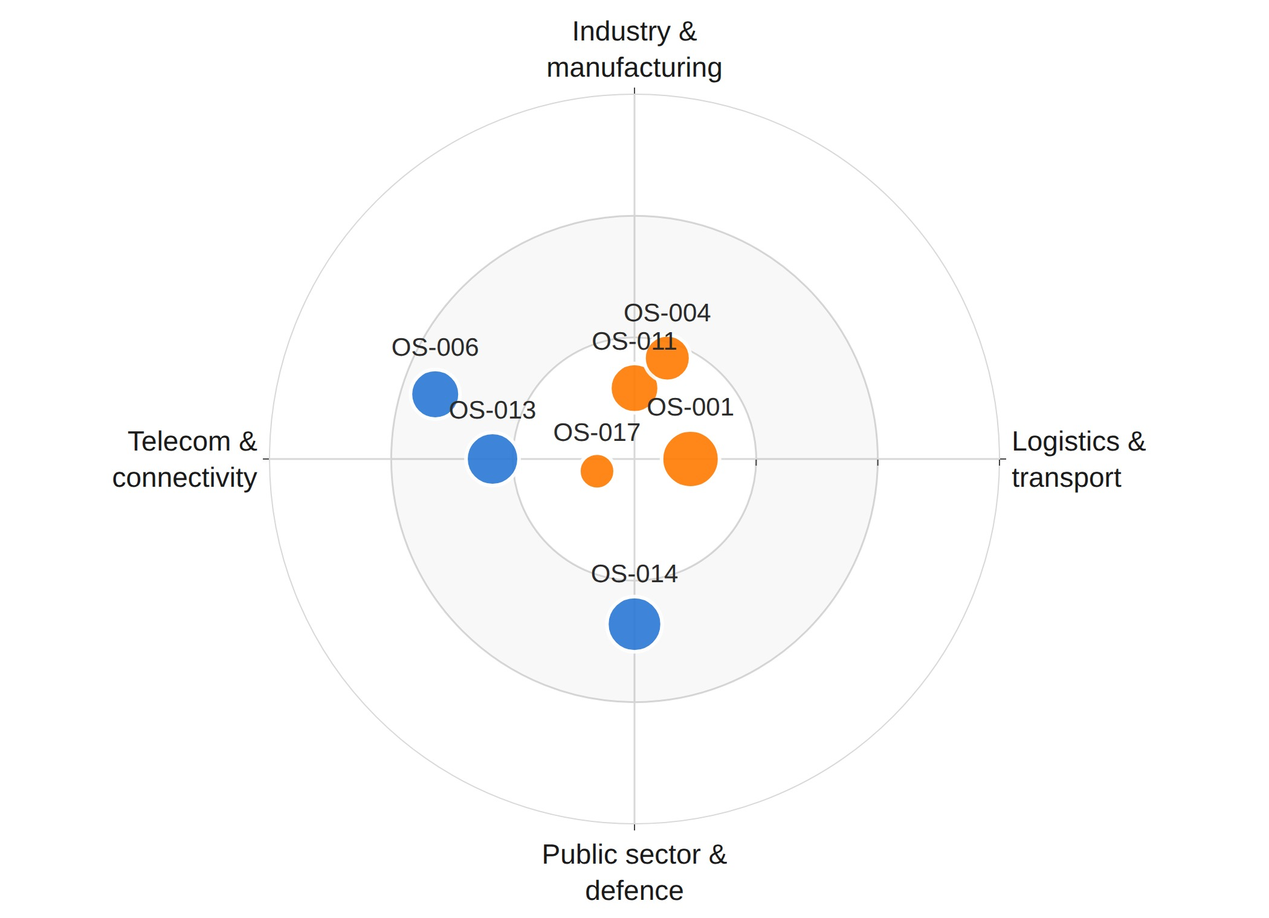
THE OUTPUT
Seven opportunity spaces, placed and ranked – the old one
Closer to the centre means act sooner. Bigger means a stronger case. Grouped by industry, so you can go straight to yours
Where to look first
The inner ring is what the evidence says is moving now. The outer rings are worth watching, not worth a meeting yet.
Filter to your world
Narrow to one industry, one technology or one time horizon, and the shortlist reshapes around what you actually own.
Then open the case
Each bubble is one opportunity space, labelled with its reference code. Click it for the full write-up, the recommended step, and every source behind it.
Now horizon
Next horizon
Later horizon
08
Notes:
This is where you switch to the live app if the room is warm and the wifi is working. Two minutes maximum, then come back to the deck. If you demo: click one bubble, land on the detail page, scroll to the supporting signals table, and open one source URL. That single click chain — bubble to article — is the entire value proposition made concrete. Rehearse it. Have a fallback. Screenshots are in this deck for exactly that reason. Never say "it normally works." BeCode note: the empty outer ring is not a bug. Nothing in the current data is slow-moving, and leaving the ring drawn says so.

Slide 9
WHAT ONE ROW ACTUALLY CONTAINS
One opportunity space, in full
OS-001 · Ports & Logistics × Automated port operations × Private 5G campus
76.1
Why this is hot now
Deutsche Telekom and Ericsson have deployed a live private 5G campus at the Port of Hamburg for real-time automation and autonomous logistics.
attractiveness
NOW horizon · Germany
6 articles, 5 sources
Why it matters to Orange
Orange has strong private 5G references — but its proven port footprint is Belgium. A rival now holds a marquee German port customer in an important European logistics hub.
Recommended next action
Within 30 days, open exploratory discussions with German port operators and at least one German mobile operator or systems integrator, to scope a joint private 5G pilot.
Behind this row: six linked articles, each with its publisher, date and URL. The score is not an opinion with a number attached to it.
09
Notes:
This is your strongest slide with a business audience. One concrete, real, checkable example beats any amount of architecture. Read the "why it matters" line as written — it names a real competitor, a real port and a real gap. That specificity is what separates this from a generic trend report. The "next action" field is worth calling out: every opportunity carries one concrete recommended step, because a radar that stops at "this is interesting" creates work rather than removing it. BeCode note: all three narrative fields are generated by the model from the clustered signals, under a prompt that forbids inventing facts not present in the sources. Say that — the jury will want to know where the prose came from.

Slide 10
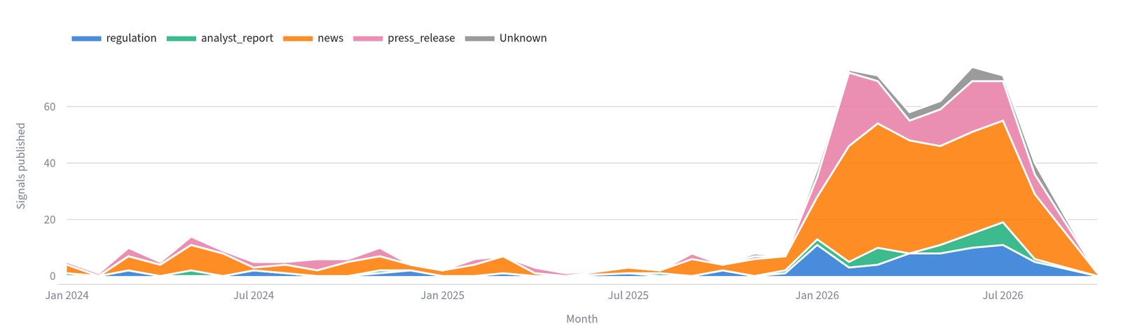
THE EVIDENCE UNDERNEATH
619 signals, and where they come from
Stacked by evidence type — a spike made of press releases means something very different from one made of regulator filings
619
signals
440
sources
20
countries
150
days median age
14
Notes:
APPENDIX — only if asked "how much did you actually collect?" or "where does this come from?" The point in one line: the growth through 2026 is real, but it is mostly news and press releases, with regulator filings growing underneath. That mix is exactly what the credibility factor scores. Be honest about the shape if you show it: the curve rises steeply in 2026 partly because the search brief asks for 2026 material. It is not a neutral measurement of what the world published, and the tool says so in a caption on the page. Volunteer that before anyone asks. BeCode note: 619 signals, 440 distinct publications, 20 countries, median age 150 days.

Slide 11
IF YOU WANTED THIS RUNNING
What it would take to run this for real
It is a working system, not a prototype. Here is the honest shape of operating it
Cadence
Ownership
Cost shape
It runs when someone starts it today. Put it on a weekly schedule and it becomes a standing brief rather than a one-off study.
Someone on your side keeps the capability list current — what Orange sells, where. That is perhaps an hour a month, and it is what keeps the filter honest.
Cost follows the number of searches, not the number of articles. Related articles are written up together, once, rather than one at a time.
The one thing we would build next
Memory between runs. Today each run is a fresh picture. Once it remembers the last one, it can tell you what is new this week and what is climbing — which is the difference between a study and a radar.
11
Notes:
Close the main deck on this. It moves the conversation from "look what we made" to "here is what it would take" — which is the question a client is actually holding. The highlighted box is the most important thing on the slide. Say it plainly: right now this is a very good snapshot. One more piece of work turns it into something that tells you what changed since last week, and that is where the real value sits for a standing intelligence function. Do not quote a price. If asked about cost, describe the shape — searches and a small number of write-ups per run — and offer to come back with a number. If the client asks "could our team run this?" the answer is yes: it runs on Azure, the search brief is a plain text file anyone can edit, and the repository is documented. BeCode note: this slide is the closest thing to a commercial proposal in the deck, and that is deliberate — the exercise was framed as a client engagement.

Slide 12
IF THIS CONTINUED
What we would do next
Ordered by what changes the output most, not by what is easiest
1
Close the vertical vocabulary
Validate the model's answer against a fixed list and reject off-list values, instead of asking politely in the prompt. Fixes the taxonomy at source.
2
Recompute scores after a merge
When two opportunities merge, the evidence set grows but the scores currently do not follow. One row in seven is affected today; at fifty it becomes systematic.
3
Real persona tagging
Add the join table back and have the model tag each opportunity, so the three audiences get a genuine cut rather than a rule of thumb.
4
Put the agent on a schedule
It runs on demand today. Daily or weekly collection is what turns this from a snapshot into a radar.
5
Tune clustering to land 10–20 spaces
The client said that is the range they would actually work with. That is a threshold to calibrate against, not a guess.
13
Notes:
Close on this rather than on limitations — you want the room's last technical impression to be forward-looking. If the client is present, item 5 is really a question for them: "you told us ten to twenty is the number you would work with. Is that still right?" Ending on a question they can answer makes this a conversation rather than a presentation. BeCode note: item 2 is a real defect you found by auditing your own output, not a feature request. Say that — finding your own bugs counts for more than not having any.

Slide 13
WHERE THE EDGES ARE
Honest limitations
Four things to know before you rely on it. Each one is a dial you can turn, not a flaw you are stuck with
Seven, not fifty — on purpose
We set the bar at three independent sources that agree. Lower it and you get more opportunities with thinner evidence behind each one. That is a dial, and it is yours to set — you told us ten to twenty is the range you would actually work with.
What we look for shapes what we find
The system searches the themes it was told to search. Add cybersecurity as a theme and cybersecurity opportunities appear. It is steerable by design, which means it needs steering.
The capability check needs your input
It compares each opportunity against what Orange already sells. We built that list from public sources and dated it. Keeping it current is the one thing only you can do.
The three team views are still rules of thumb
Strategy, sales and presales currently get sensible rules of thumb rather than a tailored cut. Making them real is one more build step, not a redesign.
None of these are hidden in a footnote. Every one of them is written into the tool itself, on a page called “How it works”.
10
Notes:
DO NOT SKIP THIS SLIDE, and do not apologise your way through it. With a client, honesty about limits is what makes everything else believable. Framing that works: "we could have shown you fifty opportunity spaces. We are showing you seven we can defend, and here is exactly why the other forty-three did not make it." Turn items 1 and 3 into questions for the room. "Is ten to twenty still the right number?" and "who on your side would own the capability list?" — that converts a limitation into a decision they get to make, which is a much stronger place to end up than defending a gap. Concrete example to have ready if pushed: eleven of our articles mention cybersecurity, and none of them formed a group of three, so there is no cybersecurity opportunity on the radar. That is our threshold, not an absence of activity in the market. BeCode note (if a coach is in the room): this is the slide that shows engineering judgement. A team that can name its own failure modes precisely is demonstrating more than a team with no failures to name. If you are short on time, cut the appendix, never this.

Slide 14
APPENDIX
Under the hood
Only if you want it. Everything from here on is how the system is built, rather than what it does for you.
13
Notes:
Do not walk into the appendix by default. Stop at the thank-you slide and take questions. Come here only if someone asks how it is built — then the next two slides answer it without you having to improvise. BeCode note: if a coach asks a technical question during Q&A, this is where you go. Having the depth ready but not forced on the client is the professional move, and the jury will notice you made that choice deliberately.

Slide 15
HOW IT IS BUILT
Everything on Azure, one system end to end
Agent → database → dashboard, with no service in between that has to stay in sync
Collection
Storage
Meaning
Interface
Azure AI Foundry agent
Bing grounding
strict JSON output
Azure SQL Database
signals · opportunity_spaces
plus a join table
text-embedding-3-large
VECTOR(1536) in-table
cosine similarity in SQL
Streamlit, six pages
live SQL, CSV fallback
so a demo never dies
Embeddings live in the signals table itself, so clustering and filtering are ordinary SQL — no second system to keep in sync.
15
Notes:
APPENDIX — only if someone asks how it is built. Do not volunteer this to a business audience. The closing line is the decision worth defending: we considered a separate vector database and chose not to, because one system you can query with plain SQL beats two systems that have to stay in agreement with each other. If asked about deployment: the app reads live Azure SQL when credentials are present and falls back to a committed snapshot otherwise, because the free Streamlit host cannot install the database driver. That fallback is why a demo works from any room, on any network. BeCode note: this is where the technical marks are. Be ready to name the pieces — Azure AI Foundry with Bing grounding for collection, text-embedding-3-large stored as VECTOR(1536) in the signals table, cosine similarity above 0.82 with union-find grouping in Python, minimum cluster size three, Azure SQL throughout, Streamlit for the interface.

