Slide 1
TastePolicy
Subjective Authority Infrastructure
for AI Agents
Your taste. Your rules. Any agent.
Notes:
Independent founder project. Evidence and assumptions as of 2026-10-29. No investor or financing commitment is implied.

Slide 2
The preference boundary
An agent can remember what you like
and still choose beyond your rules.
A recommendation needs context, a permitted action ceiling and a way to pause.
Notes:
Buyer hypothesis: travel/concierge agent teams that already propose places. IAM/tool permission and preference authority answer different questions.

Slide 3
Why now
Conversational apps create a distribution path
for user-controlled authority.
MCP apps and public directories exist. Agent adoption remains early.
Notes:
Sources: https://openai.com/index/introducing-apps-in-chatgpt/ and https://help.openai.com/en/articles/6825453-chatgpt-release-notes. https://hai.stanford.edu/ai-index/2026-ai-index-report/economy reports 88% organizational AI use but agent deployment in single digits across nearly all business functions. Platform availability is not TastePolicy adoption.

Slide 4
Qloo and TastePolicy
Qloo supplies cultural evidence.
TastePolicy applies explicit user boundaries.
ALLOW ASK REJECT UNAVAILABLE
Notes:
Qloo affinity is not authorization. Qloo owns the cultural graph. Written commercial/output rights and pricing are pending the official sales inquiry. See docs/company/qloo-commercial-and-data.md.

Slide 5
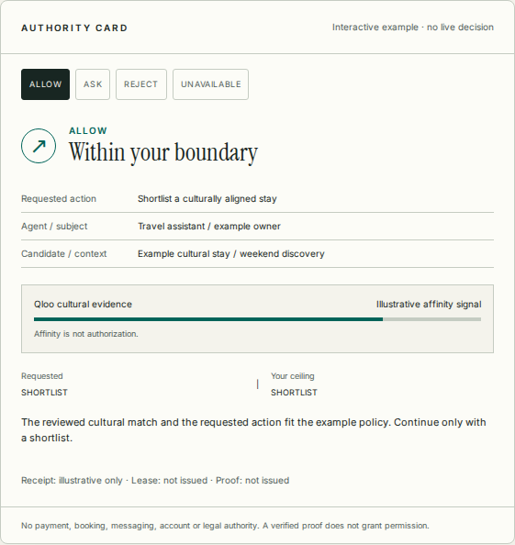
Product and developer path
A reviewed candidate gets a decision, receipt and bounded continuation.
REST, remote MCP and A2A share the authority services.
Illustrative website card. No live decision.
Notes:
Fresh production acceptance proves guided enrollment, owner workspace/project/environment/agent metadata, API credentials, SDK/A2A, export, lease/proof revocation and disposable-account deletion. Workspaces are single-owner; logical environments are not physical isolation. Stripe TEST implementation is merged but no provider checkout is commissioned. Verification is not authorization. Payment, booking and legal authority stay separate.

Slide 6
Engineering evidence
Production OAuth and real Qloo receipts
Independent SDK and A2A acceptance
Canonical origin: tastepolicy.vercel.app
Notes:
Latest fully commissioned release at preparation: main 4b58ff11c49c59141a2dad3d2aebd65d36d0d5d8, Vercel production dpl_4vtyd3S2F7z5B53gohM9vBJbxAQA. Exact-main Verify 40802738876, secret scan 40802738952, hosted acceptance 40803876959 and registry verification 40804041077 passed. Operations/benchmark/developer PR21 at 85c6b4e passed Verify 40802776822 and hosted acceptance 40802776853, then merged as main 165bb862cce6ee9f32e2bce2ba4f25f288020f86; its main/deployment checks remain pending. Official MCP Registry io.github.VictorCyberDev/tastepolicy@0.2.0 is active. No real TastePolicy ChatGPT/Claude tool invocation, OpenAI/Claude directory approval, npm publication or provider billing commissioning established.

Slide 7
Evaluation has exposed gaps
94 / 160 exact agreement
33 / 67 missed ASK
Ten operator-asserted people. 180 repeated judgments.
Notes:
Historical source docs/evaluation/wg-c-human-pilot-report.md. Unsafe autonomy 14/150; incorrect REJECT 2/10; UNAVAILABLE agreement 9/32; 20/180 unscorable. Synthetic-scenario judgments, not execution harms or population validation. New TasteBench v2: 525 synthetic component cases; deterministic evaluation subset 132 cases gives state policy 132/132, affinity only 102/132 and conservative rules 82/132. It is contract coverage, not live Qloo relevance, a generic LLM study, new human labels or a full-system competitive victory. See tastebench-v2-methodology.md. Separate actual ChatGPT browser observation: full written contract, sixteen preselected synthetic cases, 13/16 exact and one unsafe ALLOW; one run only, exact model identity not exposed, not independent replication or MCP commissioning.

Slide 8
First buyer and test price
Travel and concierge agent teams
One candidate flow before separate execution
Free developer usage. Pro USD49/month is an experiment.
Notes:
Sources: Cerbos developer USD25/month and production USD933/month; Oso Growth USD15/user/month; Authzed cloud USD2/hour, as researched in pricing-research.md. Units differ. Qloo commercial cost is unknown. Stripe TEST checkout/webhook code is merged, but provider account commissioning and live paid entitlement remain unproved. USD49 is an experiment.

Slide 9
Market scenario
100 paying workspaces at USD49/month
would produce USD58,800 annualized revenue.
Target, not traction. Jobs-to-team model remains unvalidated.
Notes:
BLS software developers outlook: 1,693,800 US developer jobs in 2024. Assume ten developers per team: 169,380 team equivalents. USD588 hypothetical annual price yields a USD99.60m broad proxy; an assumed ten-percent relevance yields USD9.96m. Jobs are not buyer companies. No measured TAM or contracted pipeline. See market-and-economics.json and the cited source.

Slide 10
Route to paid adoption
30 days: qualified interviews and design partners
60 days: scoped pilots and first price tests
90 days: retention evidence and ten paid targets
100 paid customers follows validated cohorts.
Notes:
Targets only. At an assumed 20% trial-to-paid conversion, 100 paying workspaces require 500 qualified trials. At 30% signup-to-trial: approximately 1,667 signups. At 5% visitor-to-signup: approximately 33,340 qualified visitors. No observed conversion, customers or revenue. No outreach sent from this package.

Slide 11
Defensibility and risk
Inspectable authority, revocation and commitments
Useful integrations and legitimate evaluation data
Qloo rights, buyer demand and held-out performance remain critical.
Notes:
Prompt/memory, Qloo recommendation, deterministic rules and operational authorization vendors are alternatives. No apples-to-apples competitive result exists. Apache source remains open. No patents, exclusive rights, compliance certifications or proprietary dataset monopoly claimed. See licensing-and-ip.md and security/operations.md.

Slide 12
Funding scenario
USD500,000 over 18 months
USD50,000 contingency reserve
Draft planning ask. Founder and legal decisions remain open.
Notes:
Budget hypothesis: USD275k product/engineering; USD75k provider/infrastructure/reliability; USD50k security/legal/privacy; USD50k discovery/distribution; USD50k reserve. USD450k over eighteen months gives USD25k monthly operating budget. No salaries or vendor quotes are approved. Milestones include written Qloo terms, expanded tenant controls, provider billing commissioning, real assistants/listings, historical recovery and deployed monitoring, independently labeled evaluation and a first paid cohort. No financing terms, corporate entity or cap table invented.

