Slide 1
TastePolicy
Subjective Authority Infrastructure
for AI Agents
Your taste. Your rules. Any agent.
Notes:
Independent founder project. Evidence and assumptions as of 2026-10-28. No investor or financing commitment is implied.

Slide 2
The preference boundary
An agent can remember what you like
and still choose beyond your rules.
A recommendation needs context, a permitted action ceiling and a way to pause.
Notes:
Buyer hypothesis: travel/concierge agent teams that already propose places. IAM/tool permission and preference authority answer different questions.

Slide 3
Why now
Conversational apps create a distribution path
for user-controlled authority.
MCP apps and public directories exist. Agent adoption remains early.
Notes:
Sources: https://openai.com/index/introducing-apps-in-chatgpt/ and https://help.openai.com/en/articles/6825453-chatgpt-release-notes. https://hai.stanford.edu/ai-index/2026-ai-index-report/economy reports 88% organizational AI use but agent deployment in single digits across nearly all business functions. Platform availability is not TastePolicy adoption.

Slide 4
Qloo and TastePolicy
Qloo supplies cultural evidence.
TastePolicy applies explicit user boundaries.
ALLOW ASK REJECT UNAVAILABLE
Notes:
Qloo affinity is not authorization. Qloo owns the cultural graph. Written commercial/output rights and pricing are pending the official sales inquiry. See docs/company/qloo-commercial-and-data.md.

Slide 5
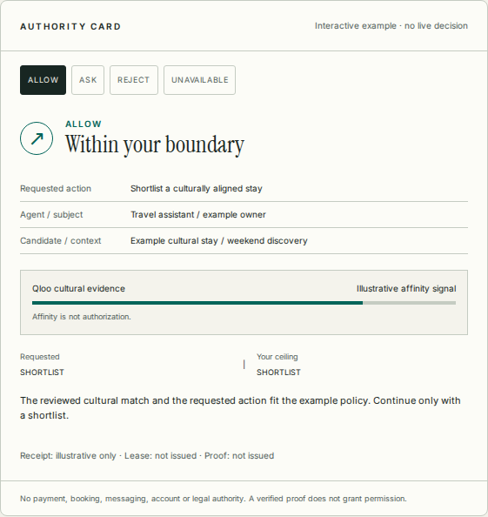
Product and developer path
A reviewed candidate gets a decision, receipt and bounded continuation.
REST, remote MCP and A2A share the authority services.
Illustrative website card. No live decision.
Notes:
Current production evidence proves fresh enrollment, SDK/A2A, export and deletion. New guided onboarding is in release verification. Organization/project/environment and billing paths remain unfinished. Verification is not authorization. Payment/booking/legal authority stays separate.

Slide 6
Engineering evidence
Production OAuth and real Qloo receipts
Independent SDK and A2A acceptance
Canonical origin: tastepolicy.vercel.app
Notes:
Canonical merged main c8da03c766c05e7f7d15ed618ba542d20dab232c, production dpl_CTk3Vr9drAKM87SM3EDJ1YNXCqQa. Hosted auth/OAuth10/10, independent SDK/A2A/export/deletion8/8. New company/MCP app PR17 exact head a94ee7790688e61eb6a9f4374fbafc2792ca0ea8 is not yet merged at deck preparation. No actual ChatGPT/Claude use, directory approval or npm publication established.

Slide 7
Evaluation has exposed gaps
94 / 160 exact agreement
33 / 67 missed ASK
Ten operator-asserted people. 180 repeated judgments.
Notes:
Source docs/evaluation/wg-c-human-pilot-report.md. Unsafe autonomy14/150, incorrect REJECT2/10, UNAVAILABLE agreement9/32.20/180 unscorable. These are synthetic-scenario judgments, not execution harms. No population safety or competitive-win claim. Current TasteBench24engineering cases do not establish a moat.

Slide 8
First buyer and test price
Travel and concierge agent teams
One candidate flow before separate execution
Free developer usage. Pro USD49/month is an experiment.
Notes:
Sources: https://www.cerbos.dev/pricing developer25/month production933/month; https://www.osohq.com/pricing Growth15/user/month; https://authzed.com/pricing cloud2/hour. Units differ. Qloo commercial cost is unknown. No working checkout or paid entitlement is claimed.

Slide 9
Market scenario
100 paying workspaces at USD49/month
would produce USD58,800 annualized revenue.
Target, not traction. Jobs-to-team model remains unvalidated.
Notes:
Source BLS https://www.bls.gov/ooh/computer-and-information-technology/software-developers.htm 1693800USdeveloperjobs2024. Assume10developers/team=169380team-equivalents. At588annualworkspaceprice broadproxy99.60m, relevance10%=9.96m. Jobs are not buyer companies. No measured TAM or contracted pipeline. See market-and-economics.json.

Slide 10
Route to paid adoption
30 days: qualified interviews and design partners
60 days: scoped pilots and first price tests
90 days: retention evidence and ten paid targets
100 paid customers follows validated cohorts.
Notes:
All targets. At20%trial-to-paid need500qualifiedtrials; at30%signup-to-trial need1667signups; at5%visitor-to-signup need33340qualifiedvisitors. No actual conversion, customer or revenue metrics claimed. No outreach sent from this package.

Slide 11
Defensibility and risk
Inspectable authority, revocation and commitments
Useful integrations and legitimate evaluation data
Qloo rights, buyer demand and held-out performance remain critical.
Notes:
Prompt/memory, Qloo recommendation, deterministic rules and operational authorization vendors are alternatives. No apples-to-apples competitive result exists. Apache source remains open. No patents, exclusive rights, compliance certifications or proprietary dataset monopoly claimed. See licensing-and-ip.md and security/operations.md.

Slide 12
Funding scenario
USD500,000 over 18 months
USD50,000 contingency reserve
Draft planning ask. Founder and legal decisions remain open.
Notes:
Budget hypothesis:275kproduct/engineering,75kprovider/infrastructure/reliability,50ksecurity/legal/privacy,50kdiscovery/distribution,50kreserve.450k/18=25kmonthlyoperatingbudget. No salaries/vendorquotes approved. Milestones: commercialQloocontract, multitenant/onboarding/billingsandbox, realassistants/listings, recovery/monitoring, heldoutevaluation, firstpaidcohort. No financingterms/corporateentity/captable invented.

