Slide 1
Conscience: A Novel Method of Minimizing COVID-19 Spread
Kehinde Adedara, David Wang, Mohammad Rashad, Victor Elujinmi

Slide 2
Background Knowledge
Small business owners are the most affected during the pandemic.
Schools and big organizations are turning to alternative innovations that will ensure the day – to – day activity continues while preventing's and practicing proper COVID-19 precautions for the employees.

Slide 3
CONSCIENCE
Conscience is a duo-application that incorporates a wearable air quality device with an application, hence helping users predict the likelihood of a COVID-19 encounter in a location.

Slide 4

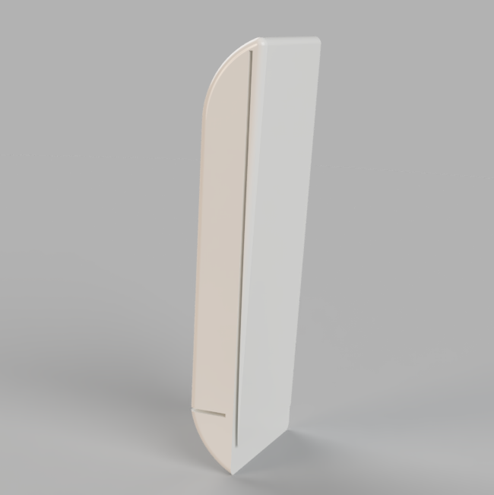



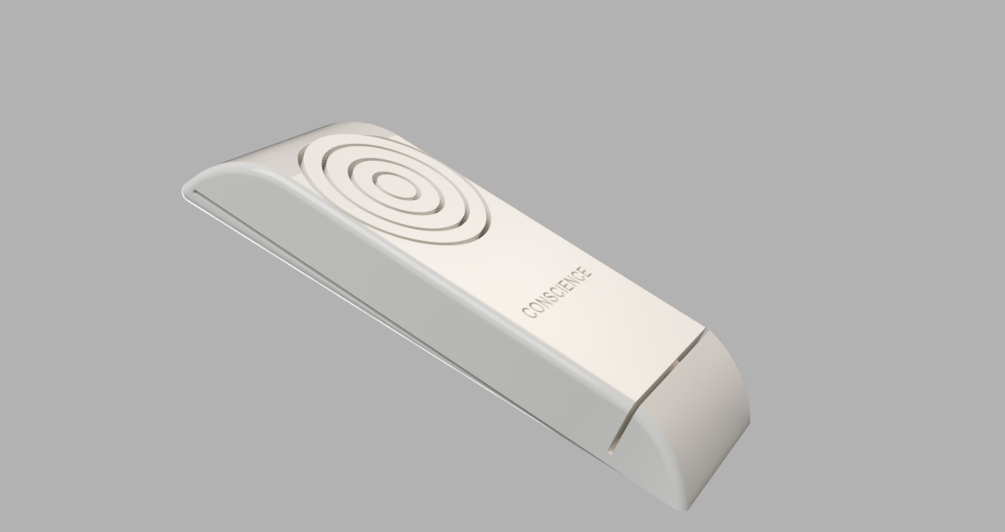
The Conscience device - The sensor senses and predicts polluted pathogens in the air. - Pathogens that can host and replicate COVID-19 SARS receptors

Slide 5
How does the device interact with the app?
Contains a Tracker, and a sensor
Every device have a Unique ID
Pairable via Bluetooth using ID as a password
Record User’s day-to-day movement
Alert Users if precaution needs to be taken based on the location.
It is encouraged to upload COVID-19 result so that other users will know if they need to be more careful.

Slide 6

- Raspberry Pi 0
- Built in RFID
- 3.5v Lipo battery
- Wireless charging compatibility
- Patent Air quality sensor
- Arduino Bluetooth adapter
- 3D printed shell casing

Slide 7

Users Privacy and Integrity
When users upload their Covid-19 result to the app, we verify the results.
If the users happen to test positive, as displayed in the document, the information will be disclosed, and other users will be advice to stay far away from the location.
We will respect the privacy of each users and documents, and personal information are not to be shared with other users.
*****we TRUST our users just as they put their TRUST is us*****

Slide 8
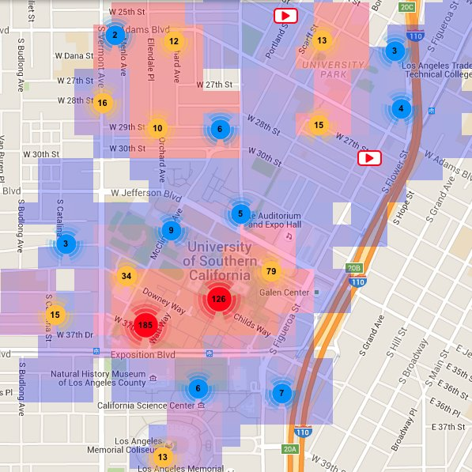
Benefit of large User Base
In the future, we can focus on being data oriented by automating a super machine learning model that can accurately predict what locations are clustered so that we can avoid this areas.
Locations on campus
Areas in a city
Areas in a building
Our goal is to make the device optional for future users.

Slide 9
WHO IS THIS FOR?
Other Organizations
Any other organization(s) interested in preventing spread
E.g. restaurants, cafes, airports, etc.
Schools
Students can see occupancy of buildings and last known positive tracing
Allows administrators to prevent spread
Workplace
Employees can see what buildings/places are safe
Employers are able to keep track of COVID-19 data to prevent spread

Slide 10


MARKET COMPETITION
COMPETITORS
COVIDWISE
Notifies users if they’ve been in contact with a carrier
Based in Virginia
HEALTHYLYNKED
Tracks worldwide data
Users self-report symptoms
COMPETITIVE ADVANTAGE
No other app tracks data of areas/buildings for schools and businesses
Our app tells the user what places they’ve been to
Notifies the user where and when they came in contact with a carrier

Slide 11
Mobile App Demo

