Slide 1
Chess of Champions
Ethan Luong, Eldin Vujic, Victor Fong
Group 28

Slide 2
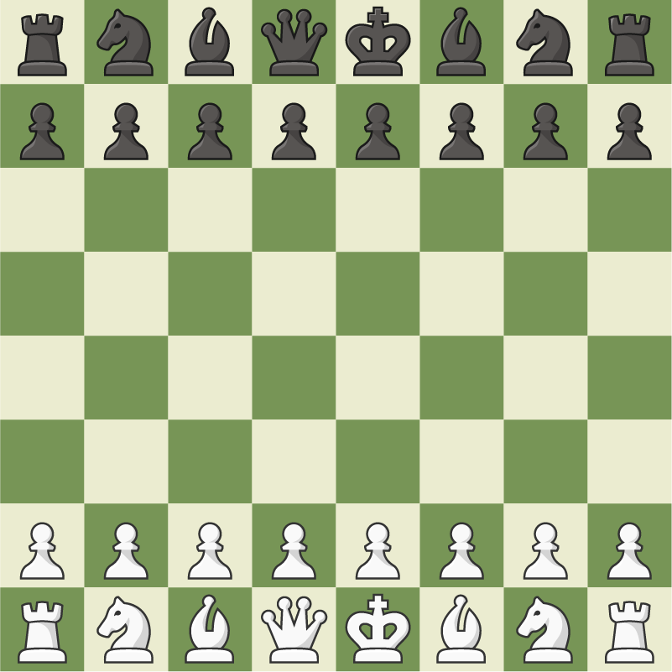
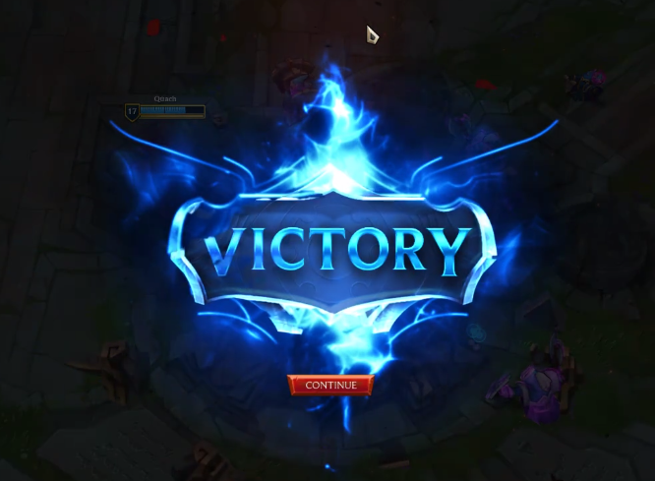
Project Overview
Chess of champions is an idea to incorporate elements of modern MOBA games into the traditional game of chess. The primary changes made will be to the board, the pieces, and the win condition. Another important part of this game is that players will be able to play against others online with the option to play casually or competitively.

Slide 3

Requirements
Our requirements are focused on…
Server stability
UI Usability
Longevity
Account data

Slide 4

Testing
Allow up to thousands of players to access the server at any given time.
Logging into a Game
Creating account
Buying Skins
Buy DLC
Access different menus
Log out of the game
Have different testing phases:
- Closed Alpha
- Closed Beta
- Open Beta
To test all of these test cases we will be using a AI testing service which will provide us information if the test either passed/failed. Which then our administrators will do the final check on the tests.

Slide 5

Project Design
Our product must be enjoyable, competitive, and provide players to socialize.
Anyone can play the game.
Easy to learn, but hard to master.
Our product must have adaptability, so the product must constantly be able push updates.
Our product must have reliability to ensure players don’t experience system crashes / No loss of their player data.
Must include optimal performance to ensure there is little to no lag to so that players are able to play the game smoothly.
Design Goals

Slide 6
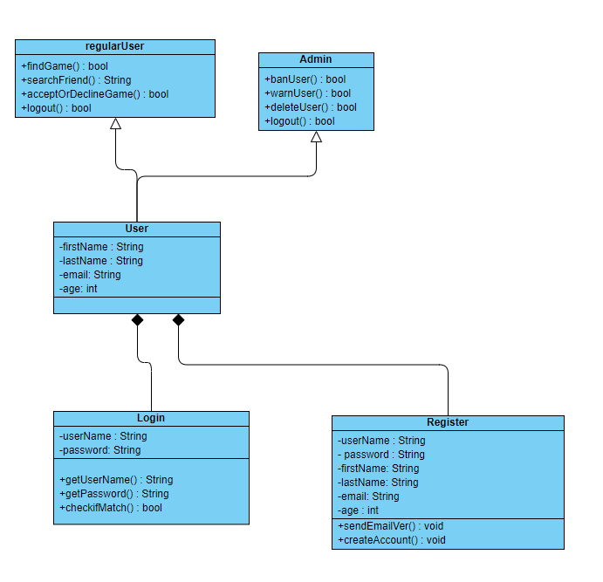
Project Design
Class Diagram - Login Menu
The Login Menu Class allows the user to log into the servers or create a account to access the servers.

Slide 7
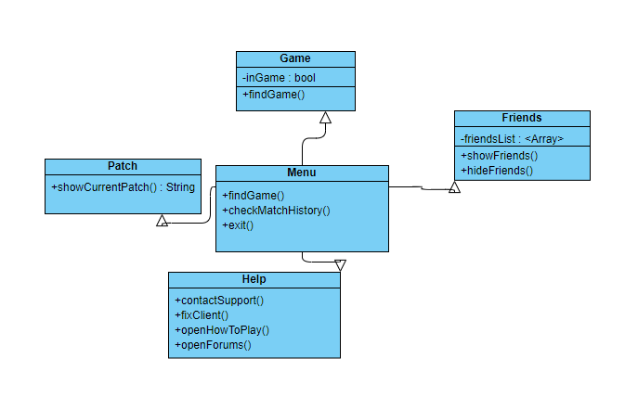
Project Design
Class Diagram - Main Menu Class
This main menu class is used to navigate throughout the game, whether it is finding a game, contacting support, figuring out the current patch, or accessing your friends list.

Slide 8
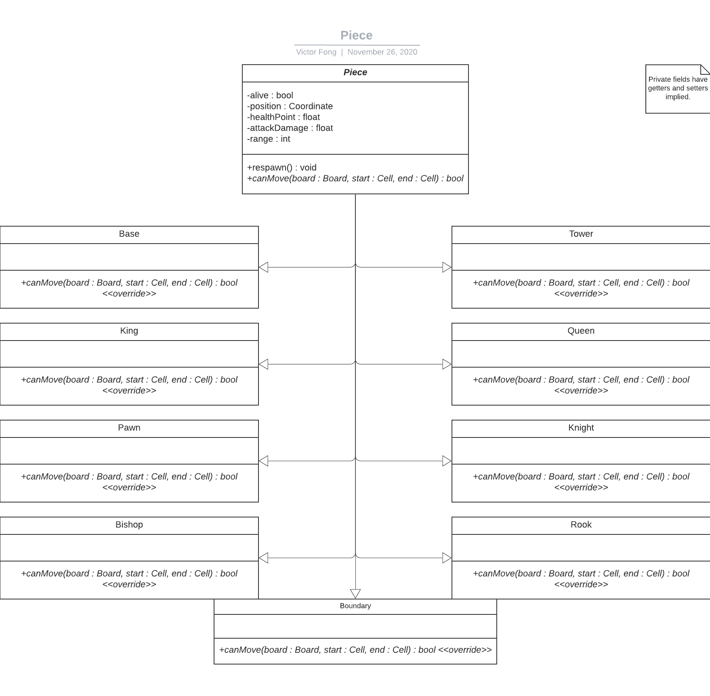
Project Design
Class Diagram - Piece Class
A Piece refers to any and all playable characters/pieces of the board, all of which extend the Piece class to implement their own specific functionalities.

Slide 9
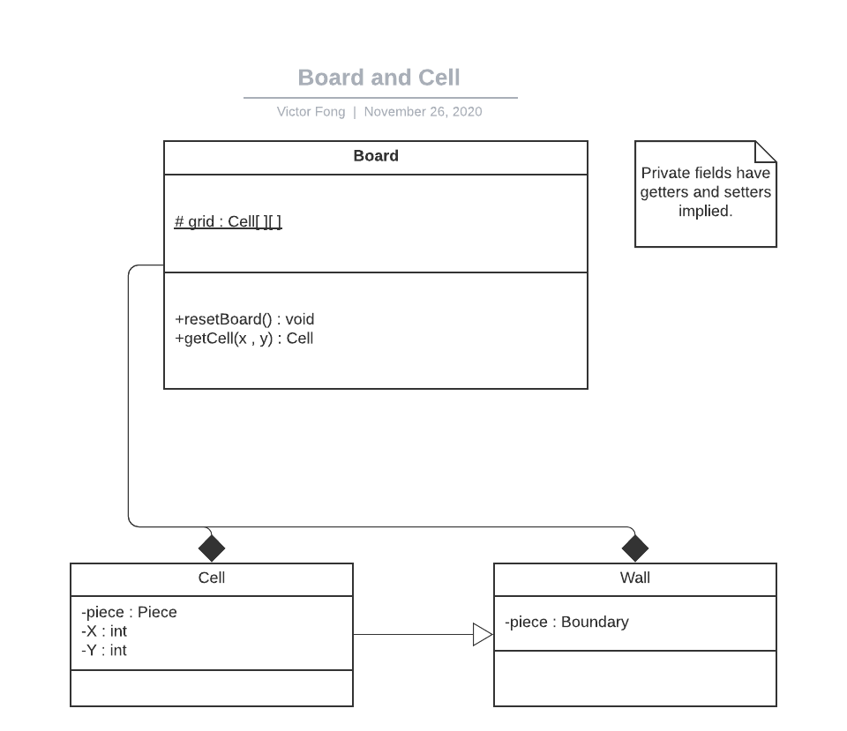
Project Design
Class Diagram - Board Class
The Board is the field in which pieces will battle upon, composed of a
8x8 +
4*(8x3) +
2*4 +
4 grid.

Slide 10
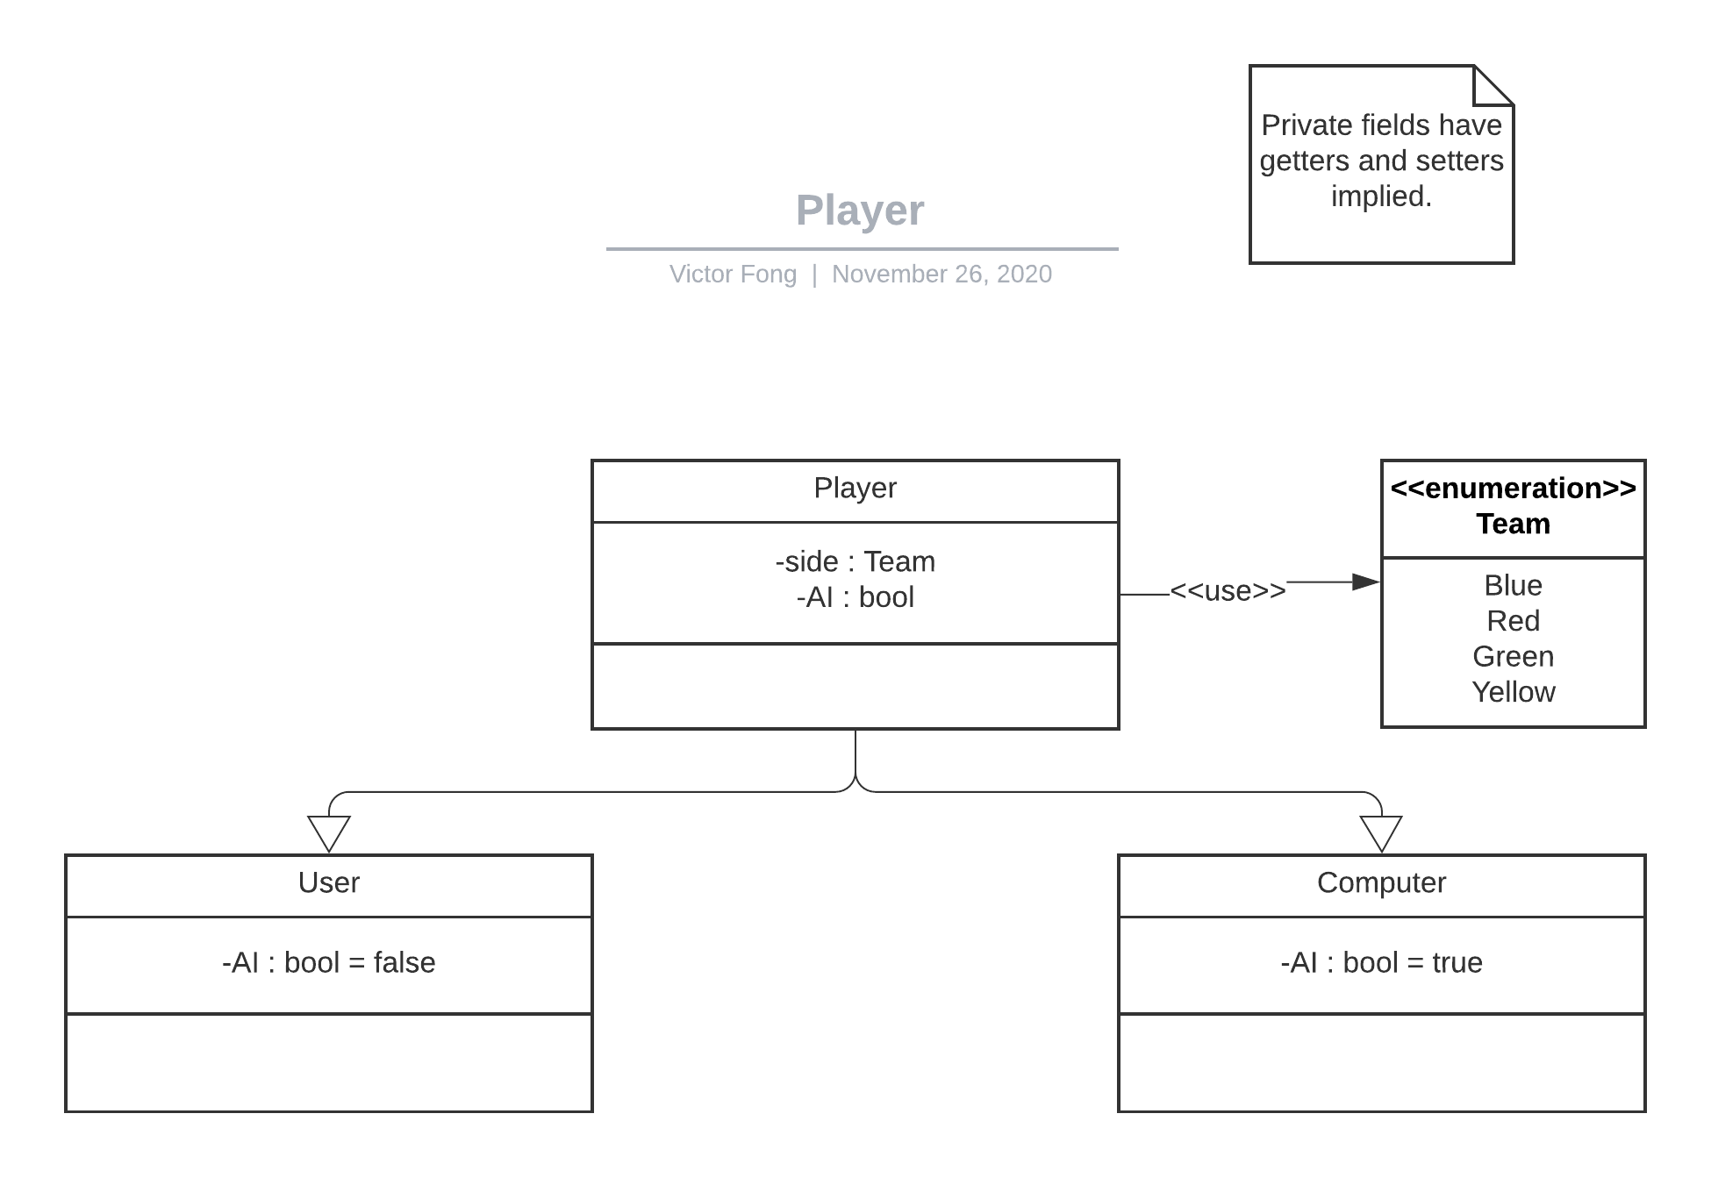
Project Design
Class Diagram - Player Class
A Player is any person or AI that can manipulate the pieces on the board. Aside from use of AI, this is typically a User.

Slide 11
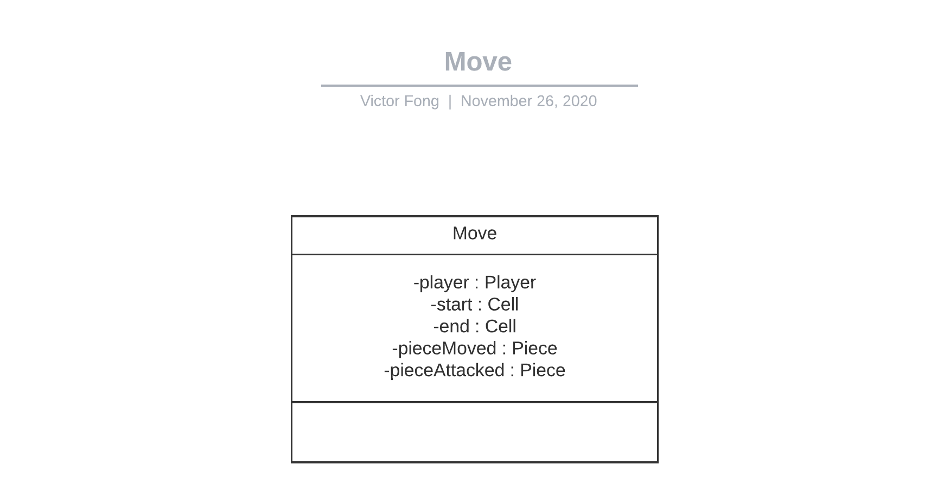
Project Design
Class Diagram - Move Class
A Move corresponds is an encapsulation of the information necessary to compute a given action that a player may want to accomplish during their turn.

Slide 12
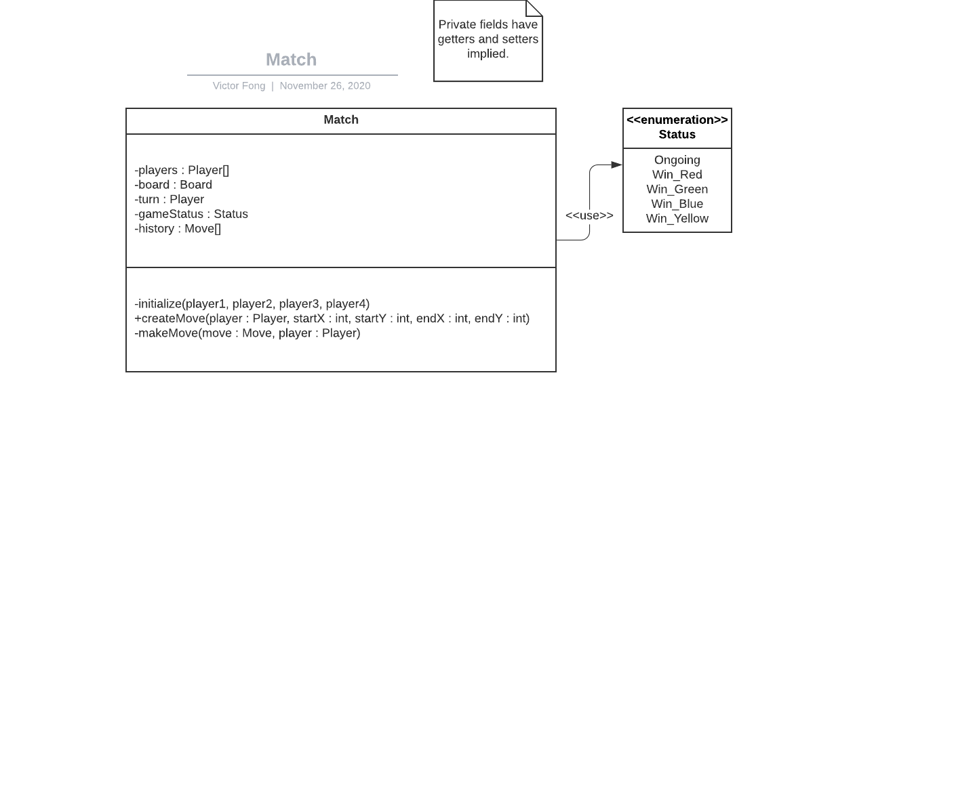
Project Design
Class Diagram - Match Class
The match is the active game that is played, serving as the interface for players to manipulate the board and its pieces.

Slide 13
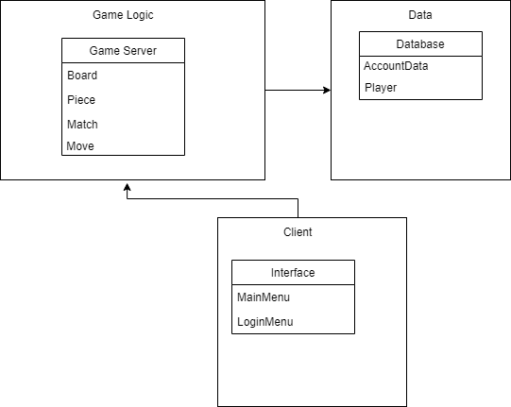
Subsystem Decomposition

