Slide 1



HISTORY, IMPACT, EVOLUTION & PRODUCTS.
TI-04
INTRODUCTION TO THE ENGLISH LANGUAGE
GALVAN COVARRUBIAS VICTOR MANUEL
MEZA ALVAREZ JUAN
PARRA SANCHEZ LESTAT
SANCHEZ PADILLA JOSE ROGELIO
VEGA SAUCEDA ALAN GUADALUPE

Slide 2

HISTORY (FEATURED EVENTS)
Founded on February 14th, 2005.
First uploaded video: “Me at the zoo”, on April 23th, 2005.
Google bought the company on November 13th, 2006.

Slide 3
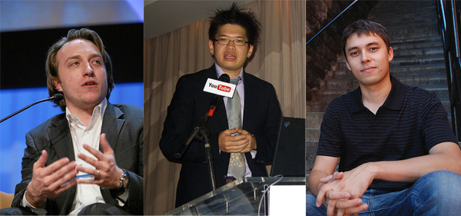
FOUNDATION FEBRUARY 14, 2005.
Youtube founders (from right to left): Chad Hurley, Steve Chen, Jawed Karim.

Slide 4
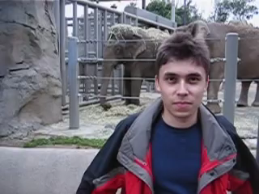
FIRST UPLOADED VIDEO APRIL 23, 2005.
Transcript of the video:
“All right, so here we are in front of the, uh, elephants, and the cool thing about these guys is that, is that they have really, really, really long, um, trunks, and that's, that's cool, and that's pretty much all there is to say. “

Slide 5
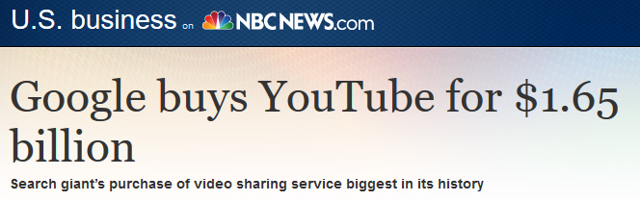

PURCHASED BY GOOGLE OCTOBER 9, 2006.
Purchased by Google for US$1.65 billion in stock, which was completed on November 13.

Slide 6

SOCIAL IMPACT OF YOUTUBE PROLIFERATION OF KNOWLEDGE
The Colombian Youtuber “Julio Profe” who uses the platform to teach math.

Slide 7


SOCIAL IMPACT OF YOUTUBE YOUTUBE AS A WAY TO GENERATE A POSITIVE CHANGE
The YouTubers Mr. Beast who uses his influence to help the environment.

Slide 8
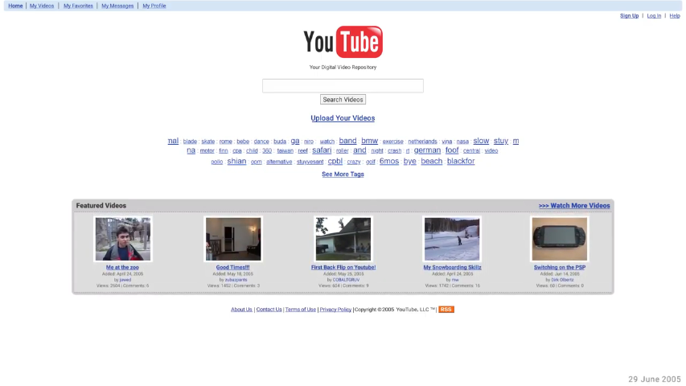
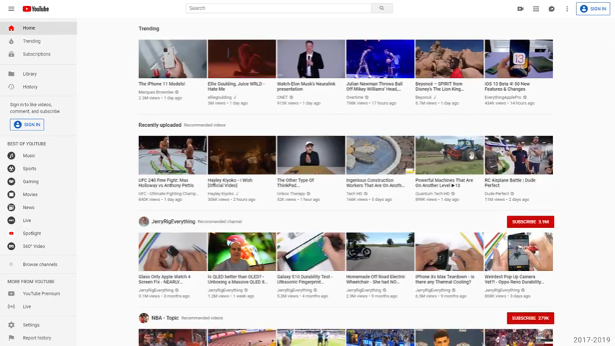
EVOLUTION JUNE 29, 2005 - NOW
Comparation of the YouTube main page since it was launched and today.

Slide 9



STAR PRODUCTS CHANNELS
Gaming
Cooking
Lifestyle
Pewdipie
Tasty
LuisitoComunica

Slide 10


STAR PRODUCTS SUBSCRIPTIONS
Launched in November 2014.
Add free videos.
Play downloaded videos without internet.
$11.99 per month (U.S. price).

Slide 11



THE FUTURE OF YOUTUBE WHAT IS THE FUTURE OF YOUTUBE?
“Youtube Kids, the risks of of turning the television into an improvissed babysitter.”
- The New Yorker
The copyright problems that affect the community of video uploaders.
The “trends” of the YouTube community that ressembles the content of a TV chain.

Slide 12
THANK YOU FOR YOUR ATTENTION!
TI-04
INTRODUCTION TO THE ENGLISH LANGUAGE
GALVAN COVARRUBIAS VICTOR MANUEL
MEZA ALVAREZ JUAN
PARRA SANCHEZ LESTAT
SANCHEZ PADILLA JOSE ROGELIO
VEGA SAUCEDA ALAN GUADALUPE

