Slide 1
Introw — Partner quick guide
Your portal to share deals, track progress, and access partner resources
English · For partners · 2026

Slide 2
What is Introw?
Introw is Factorial’s partner portal — where we collaborate day to day.
You can:
• Submit net-new sales opportunities
• Track and update deal progress across shared pipelines
• Review customer basics (plan · usage · renewals) when available
• Download enablement/content shared by Demand Gen + Partner Managers
Tip: Need full step-by-step detail? Keep the detailed guide handy as a companion.

Slide 3
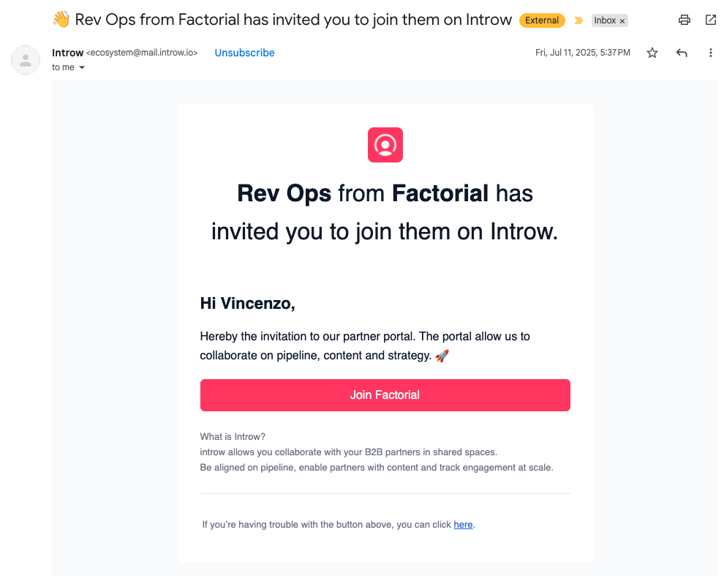
Log in
Your Partner Manager grants access first.
You’ll receive an email link — usually no separate sign-up.
If you can’t log in yet, contact your Partner Manager.
Open: partnerportal.factorial.co

Slide 4
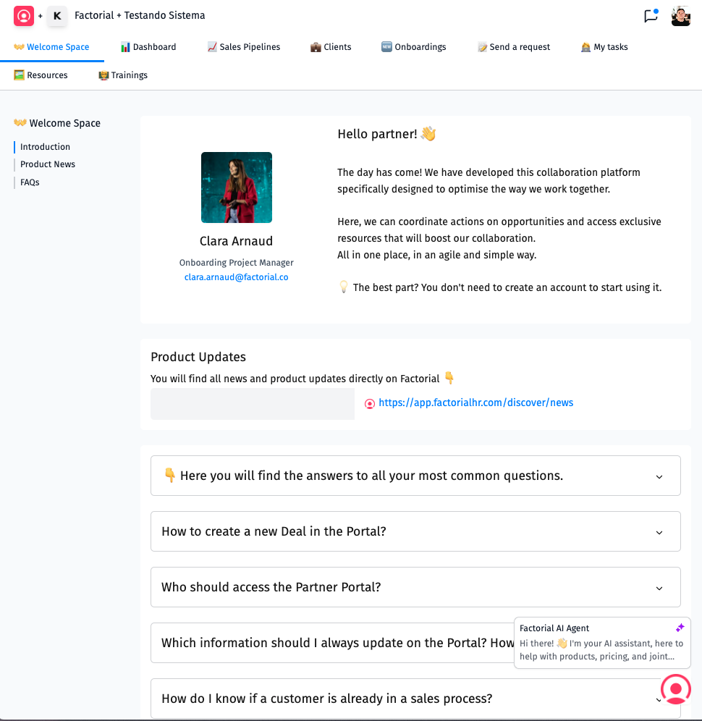
Portal navigation (tabs)
Welcome Space — quick links + Partner Manager contacts
Dashboard — monthly goals overview (tell your Partner Manager if something looks wrong)
Sales Pipelines — deals (new biz + CRM visibility)
Clients — customers + Upsell tracking
Onboardings — progress for Experts (availability may vary)
Send a request — partner requests
Resources — materials (CIAB, PDFs, training, launches)

Slide 5
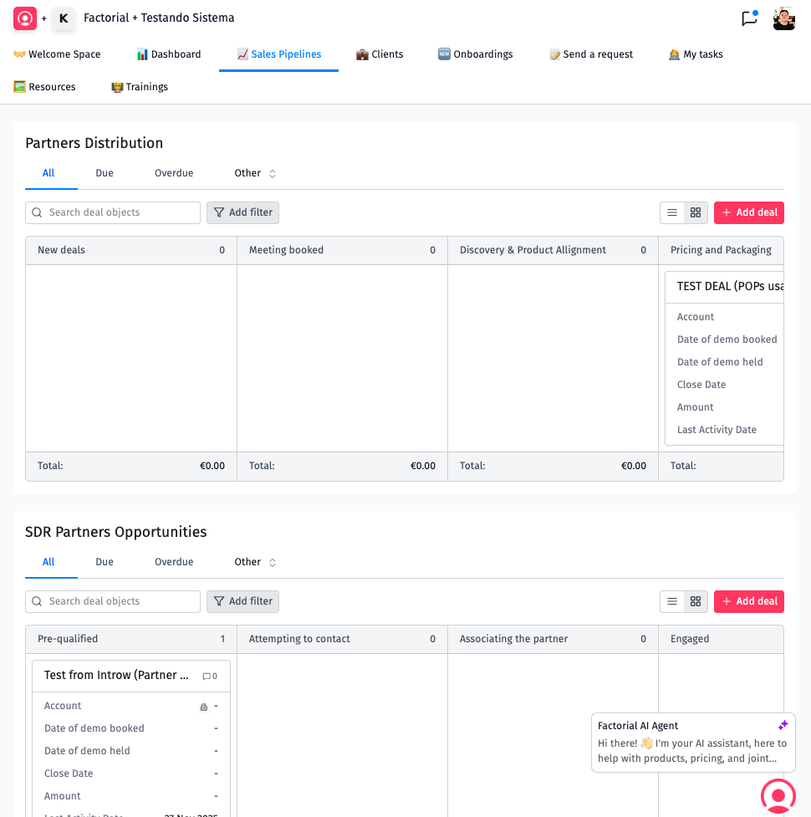
Sales Pipelines — the 3 views partners use most
SDR Partner Opportunities — early outreach until first demo booked
Partners Distribution — from first demo to Closed Won/Lost
Sales Pipeline — visibility when Factorial Sales is engaged (partner influence scenarios)

Slide 6
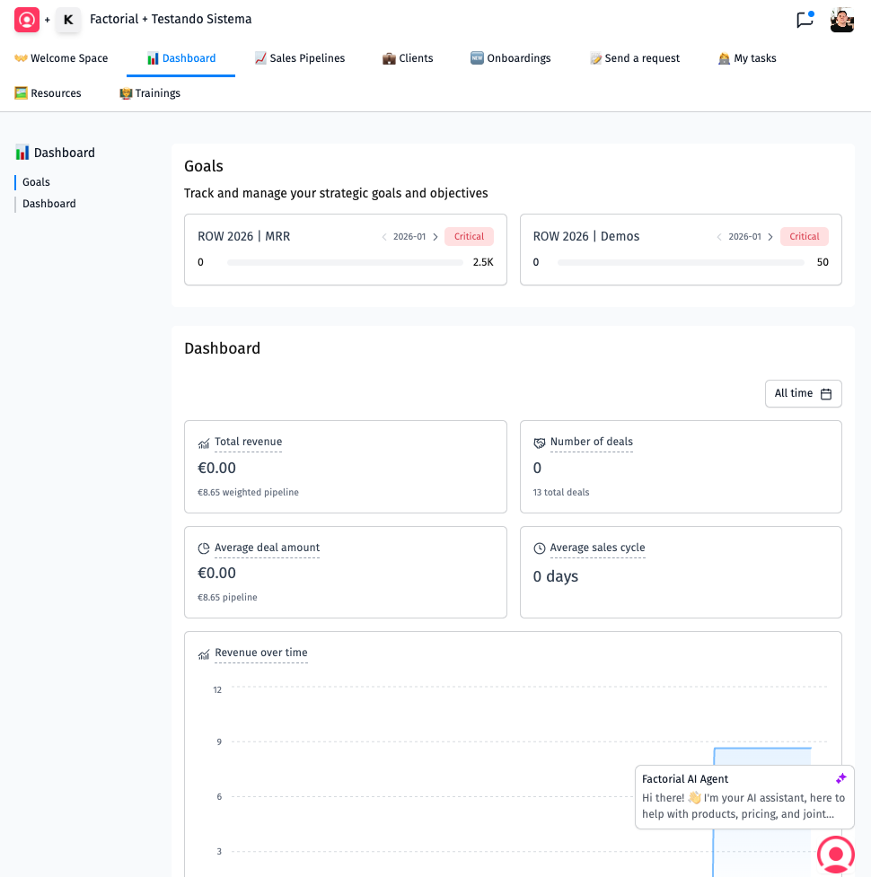
Dashboard (goals)
Use this as a lightweight monthly tracker for commercial + Demand Gen objectives.
If numbers look inconsistent, ping your Partner Manager.

Slide 7
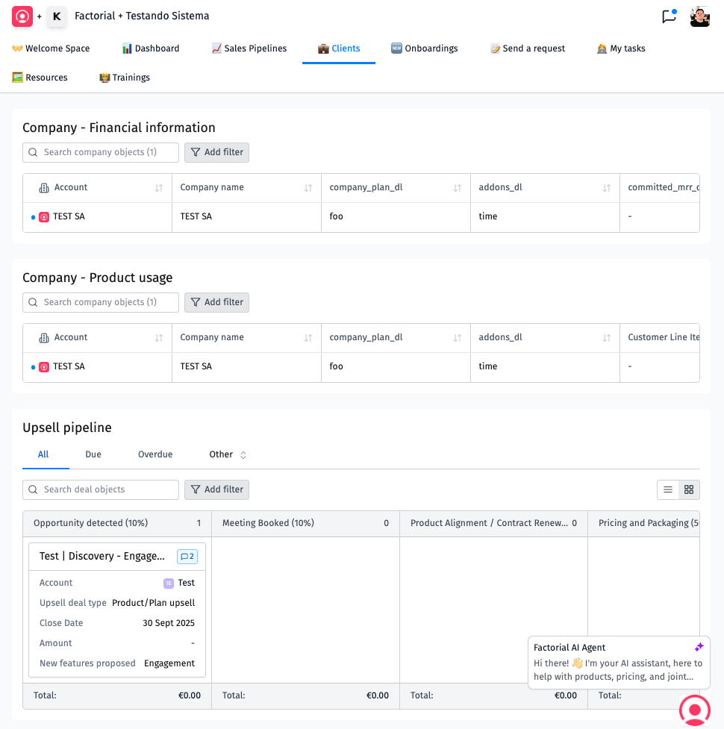
Clients
Primarily financial + adoption signals for accounts linked to partners.
Common fields: recurring revenue · renewal/discount timelines · seats · usage.
Upsell pipeline: tracks plan upgrades/contract changes surfaced as opportunities.
Note: some renewals/discount-expiry motions may auto-create.

Slide 8
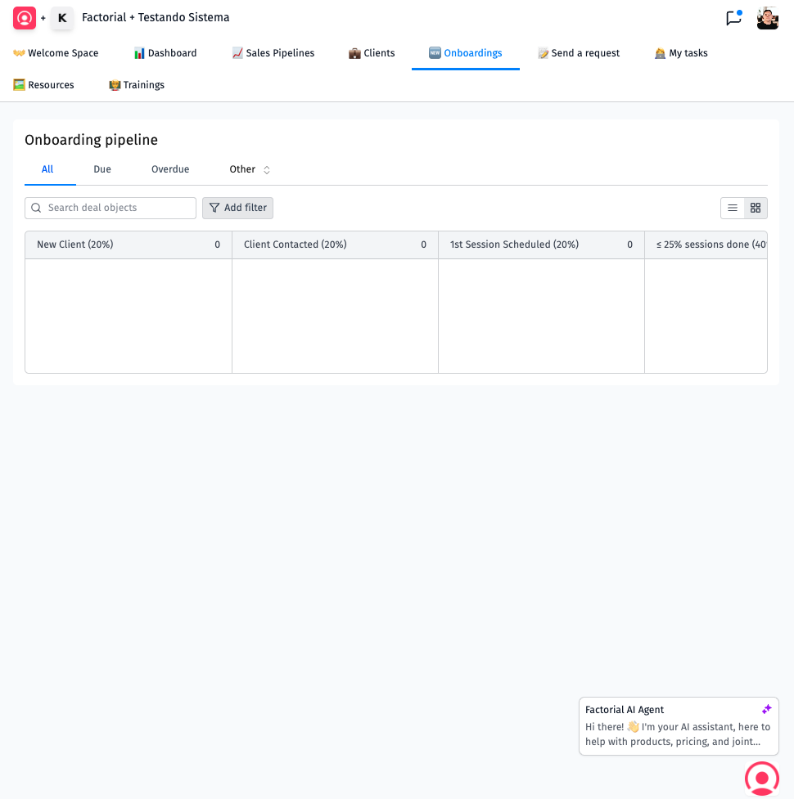
Onboardings
Shows onboarding progress between Expert partners and Factorial.
Track milestones, hours utilized, launch timings, and the Factorial point of contact.

Slide 9
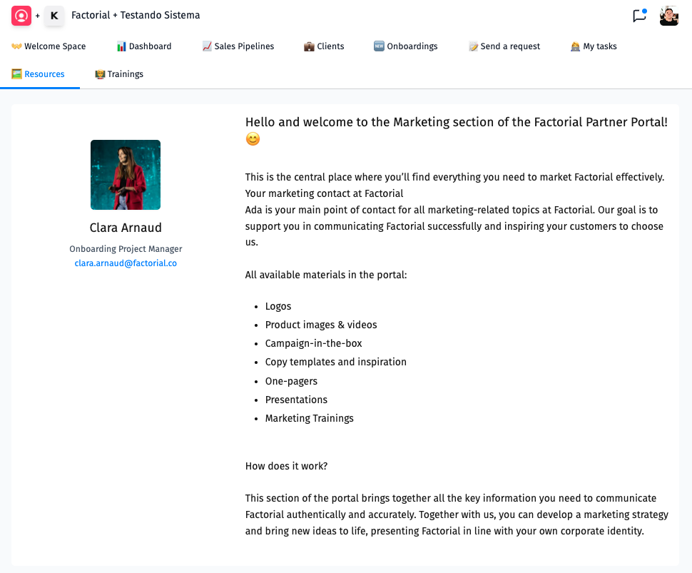
Resources
Curated Demand Gen + Partner Manager content to speed up execution.
Expect things like Campaign-in-a-Box, sequences, PDFs, training clips, launches.
Want something new? Tell your Partner Manager.

Slide 10
Submit a sales deal
The fastest workflow for partners registering a Factorial buying opportunity.

Slide 11
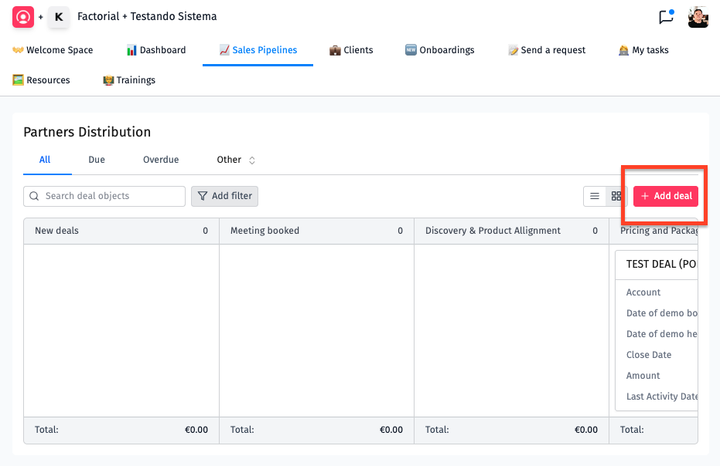
Step 1 — Go to Sales Pipelines
Pick the pipeline you’re working.
Click "+ Add deal" (top-right) to open the submission form.

Slide 12
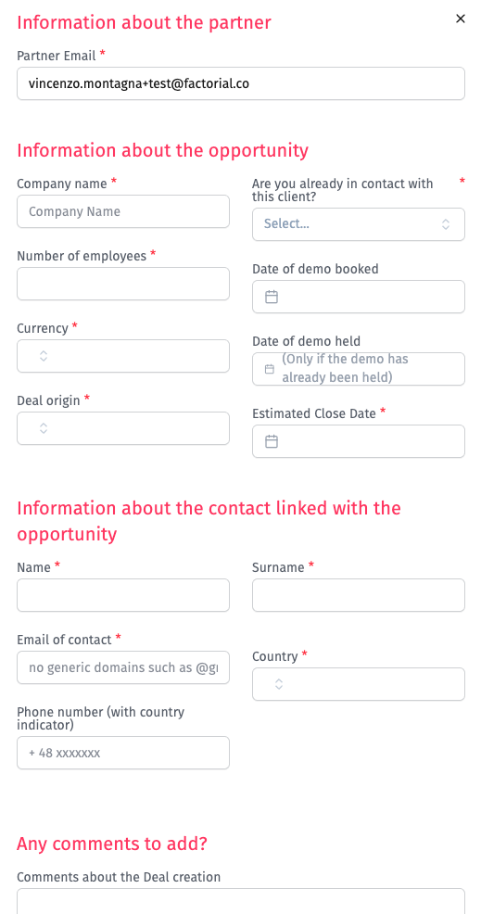
Step 2 — The deal form has 4 parts
Partner info (Uploader email)
Opportunity basics (company, size, currency, origin, timelines)
Main contact info (validated email domain)
Comments — context beats empty fields.

Slide 13
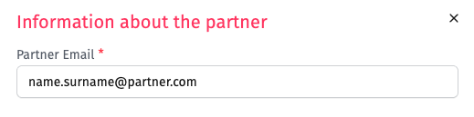
Step 3 — Rules that prevent friction
"Already in contact?" Yes for reseller/expert partners; No for referrals (Sales may engage).
Demo booked / demo held:
- Booked/Held only when real dates exist.
- Demo Held must be a past date.
Contact email:
- Must align with company domain.
- No generic inboxes (@gmail, @hotmail, etc.).
Phone numbers: include country code.
Estimated close date — best forecast; editable later.

Slide 14
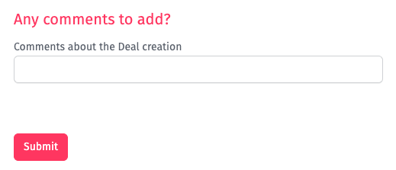
Step 4 — Submit
Deal creation commonly takes ~30 minutes while Factorial validates against CRM.
You should receive a confirmation email when it’s created.
If the company is already in an active sales cycle or is a customer, you’ll get a “not created” notice.

Slide 15
Manage deals in Introw
Partners Distribution · Upsell · Onboarding

Slide 16
Partners Distribution — Kanban basics
Cards move left→right until Closed Won 🏆 or Closed Lost ❌.
Stages (condensed): New → Meeting booked → Discovery & Product Alignment (after 1st demo) → Pricing & Packaging → Contracting (after draft sent) → Closed Pending Payment → Outcome.
Open a card to edit properties + log Activity for Factorial.

Slide 17
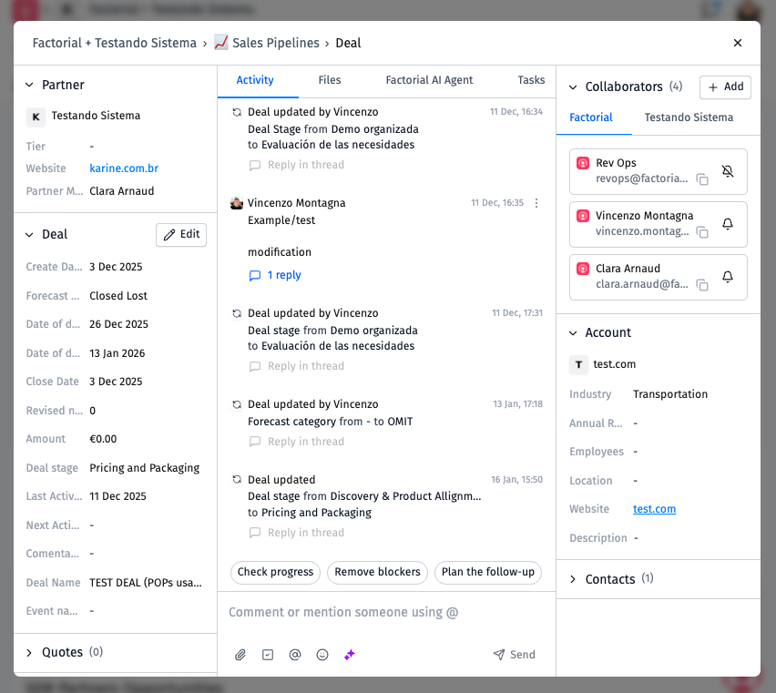
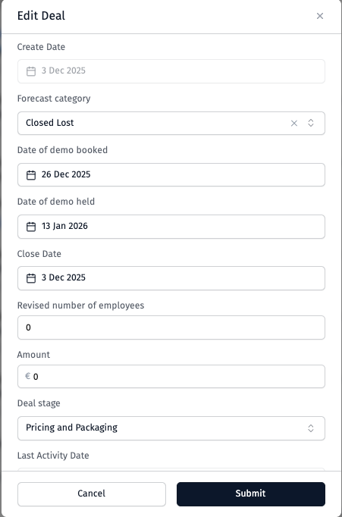
Inside the deal card
Edit highlights: demo dates (booked vs held), forecast, amount (expected MRR after discounts, exclude onboarding), employee count refresh.
Activity: add notes 24–48h after meaningful touchpoints (what happened + next step + date).
Collaborators / Account / Contacts help you see Factorial owners + CRM contacts.

Slide 18
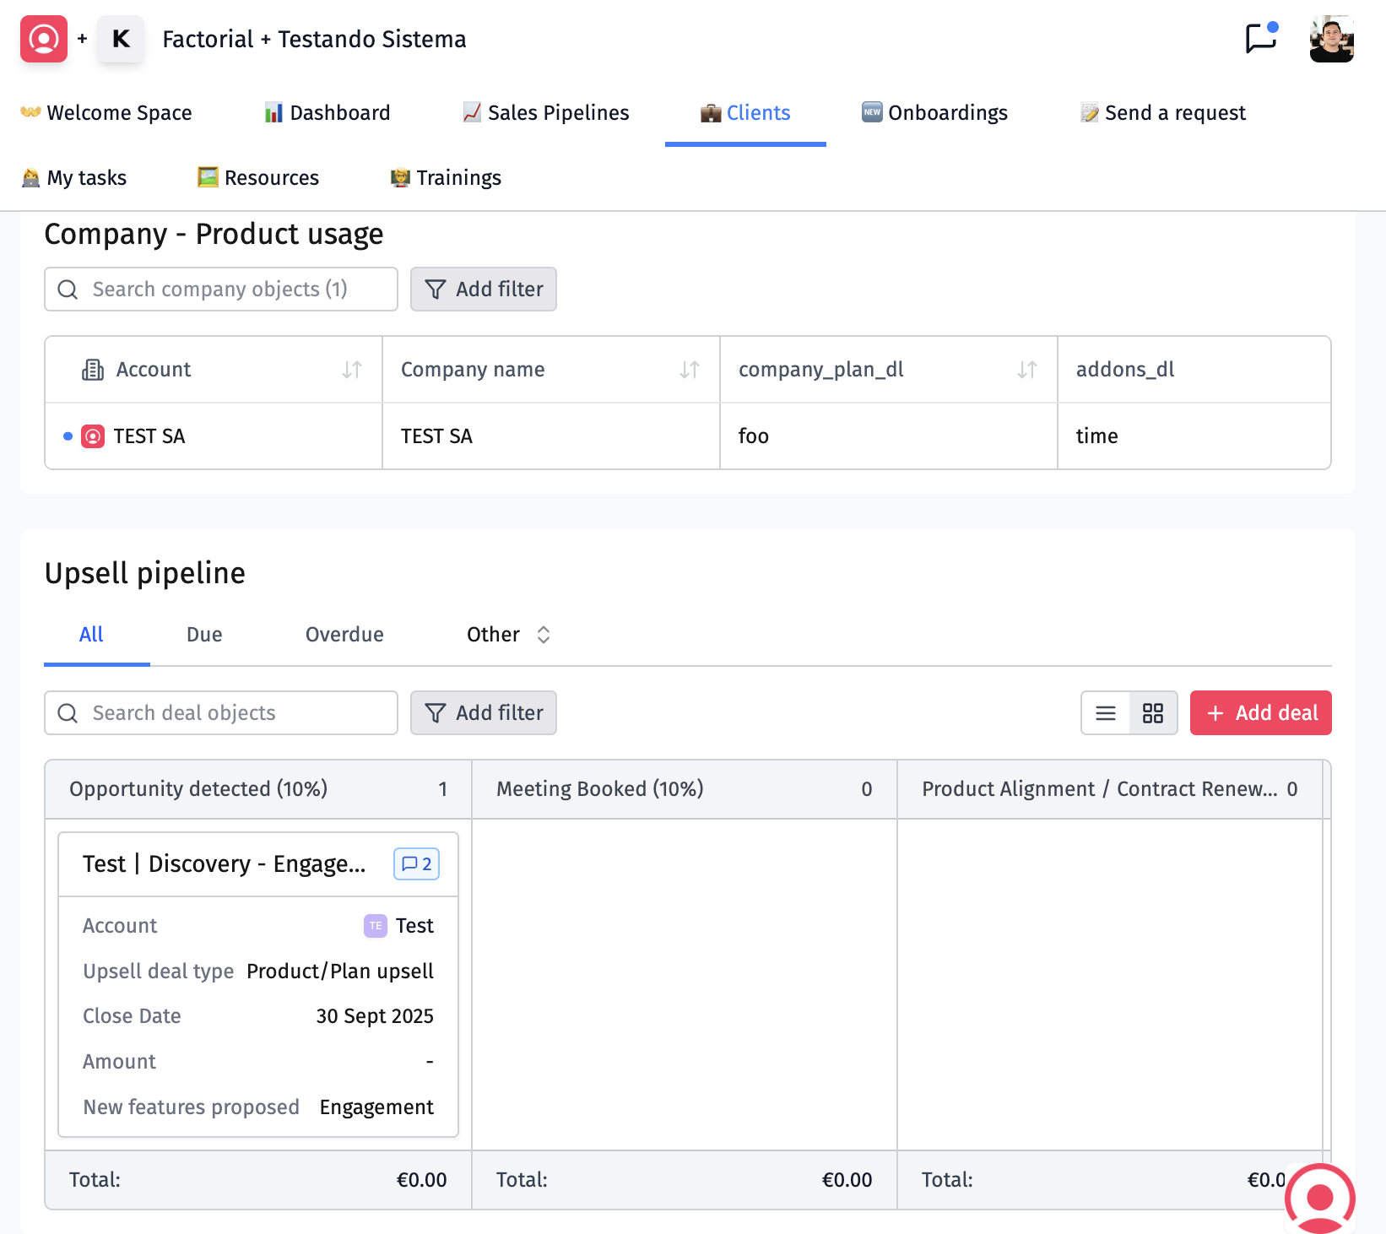
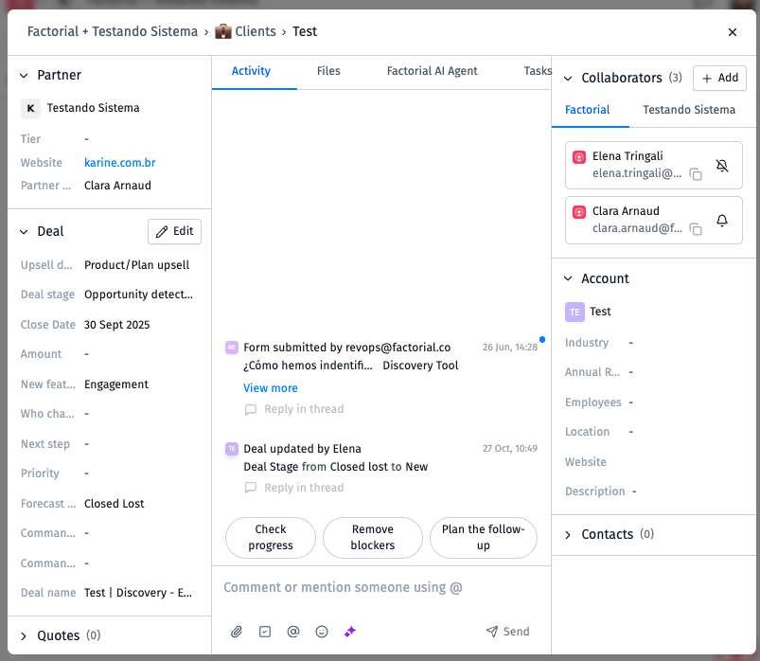
Upsell pipeline (Clients tab)
Kanban-style from Opportunity Detected → outcome.
Use "+ Add deal" for upsell submissions (company names must match Clients view).
Focus Upsell submissions on product expansion — some renewal/discount flows auto-create.
Properties examples: Upsell type, Next step, Priority, Charging model, Amount, Commando collaborator (when applicable).
Activity expectation matches sales deals: concise updates shortly after milestones.

Slide 19
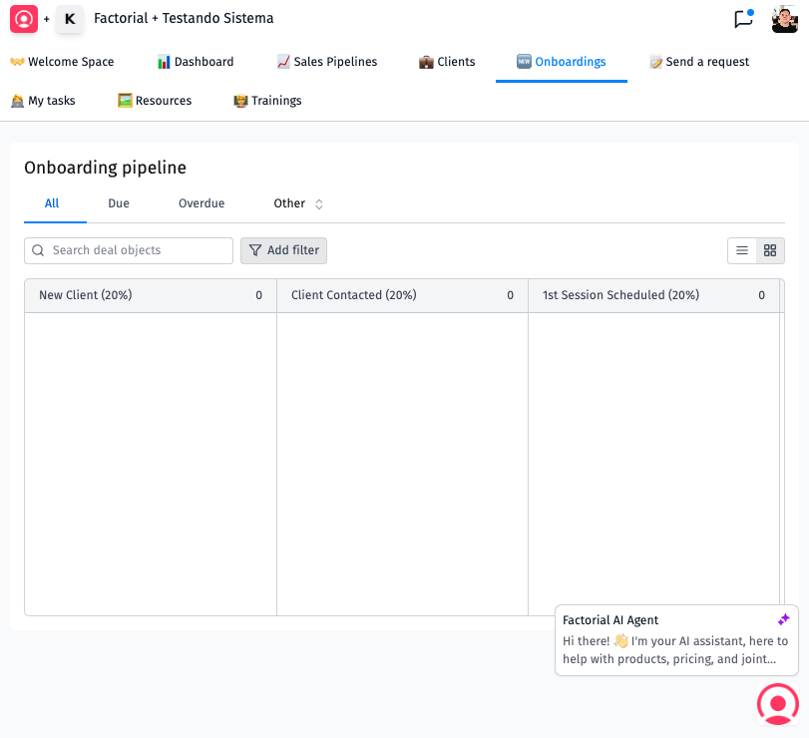
Onboarding pipeline
New onboardings typically start from Factorial; partners track milestones + launch timing.
Stages include progress buckets, pause states, outcomes (Completed variants · Failed).
Owners: Deal Owner on Factorial + Account Manager = Partner Manager; align Launch estimate with Close when active.
Use Activity to share customer signals + unblockers promptly.

Slide 20
Need help?
Questions, blockers, or feedback → start with your Partner Manager.
They route you to the right Factorial specialist quickly.
This quick guide summarizes the detailed onboarding deck.
Last update mirrored from Factorial guidance: January 2026.

