Slide 1
ST2AIM PROJECT · DEEP LEARNING
Teaching Computers to See
Cats vs. dogs image classification with a CNN
3,000 images · 1,043,905 parameters · 4 convolutional blocks · 4 models compared
Victor Haegeman — EFREI
Notes:
Good morning. I built a convolutional neural network that tells cats from dogs, trained it on 2,000 images, and then tested two ways of fixing the problem it ran into. I'll go through the data, the architecture, the training, the results, and the two improvements.

Slide 2
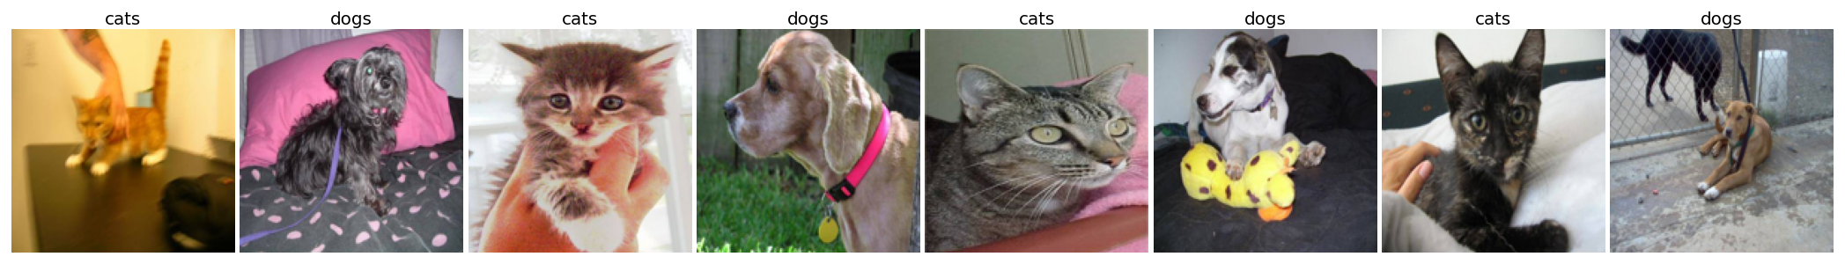
1
The data
IMAGES
CLASS BALANCE
INPUT TENSOR
3,000
50 / 50
150 × 150 × 3
1,500 cats · 1,500 dogs
random baseline = 0.500
resized, rescaled to [0,1]
Set | Source | Images | Batches / epoch | Purpose
Training | train/ — 80% | 1,600 | 16 | fit the weights
Validation | validation/ | 1,000 | 10 | monitor each epoch
Test | train/ — 20% | 400 | 4 | final score, used once
Why this is hard
Free poses, occlusions, humans in frame, variable lighting. Nothing is centred or normalised, unlike MNIST.
Notes:
Three thousand images, perfectly balanced, so a coin flip scores fifty percent — that's my baseline. Everything is resized to 150 by 150 in colour. I split the training folder 80/20, which gives 1,600 images to train on and 400 for the final test, and I keep the validation folder to watch each epoch. Note the bottom row: these are real photos, free poses, sometimes two animals or a human in the frame. This is much harder than MNIST.

Slide 3
2
Why a CNN, not a dense network
One 150 × 150 colour image
Local connectivity
67,500
each neuron sees a 3 × 3 window, not the whole image
input values → one dense layer of 1,000 neurons = 67.5 M parameters
Weight sharing
the same kernel slides everywhere → parameter count independent of image size
The four building blocks
Layer | What it does | Learnable weights
Conv2D | M kernels slide over the input, one feature map each | M × (K × K × C_in + 1)
ReLU | max(0, z) — the non-linearity; without it the stack collapses to one linear map | none
MaxPooling2D | keeps the max of each 2 × 2 window → halves height and width | none
Flatten + Dense | flattens the volume and classifies | n_in × n_out + n_out
Notes:
Why convolution at all? Flatten one image and you get 67,500 numbers. A single dense layer of a thousand neurons is already 67 million parameters, and you've thrown away which pixel was next to which. A CNN fixes that with local connectivity and weight sharing. The table is the four blocks I use: convolution learns the filters, ReLU adds the non-linearity, pooling shrinks the map and has no weights at all, and the dense head makes the decision.

Slide 4
3
Architecture and parameter count
Layer | Output | Params
Rescaling 1/255 | 150 × 150 × 3 | 0
Conv2D 32 @ 3×3 + ReLU | 148 × 148 × 32 | 896
MaxPooling 2×2 | 74 × 74 × 32 | 0
Conv2D 64 @ 3×3 + ReLU | 72 × 72 × 64 | 18,496
MaxPooling 2×2 | 36 × 36 × 64 | 0
Conv2D 128 @ 3×3 + ReLU | 34 × 34 × 128 | 73,856
MaxPooling 2×2 | 17 × 17 × 128 | 0
Conv2D 128 @ 3×3 + ReLU | 15 × 15 × 128 | 147,584
MaxPooling 2×2 | 7 × 7 × 128 | 0
Flatten | 6,272 | 0
Dense 128 + ReLU | 128 | 802,944
Dense 1 + sigmoid | 1 | 129
params = M × (K × K × C_in + 1)
block 2: 64 × (3 × 3 × 32 + 1) = 18,496
M = filters, K = kernel size, +1 = one bias per filter
TOTAL PARAMETERS
1,043,905
computed by hand, matches model.summary() exactly
77% sit in one dense layer
Dense(128) alone: 802,944 params.
All four conv blocks together: 240,832.
Weight sharing is what makes convolution cheap.
Notes:
Four blocks, as the brief asks: convolution, ReLU, pooling, four times, then a dense head. Filters go up, resolution goes down. I recomputed the parameters by hand with the course formula and I get 1,043,905 — exactly what Keras reports. And here's the interesting part: 77 percent of those parameters are in one single dense layer. The four convolutional blocks together are only 240,000. That's the weight-sharing argument, in numbers.

Slide 5
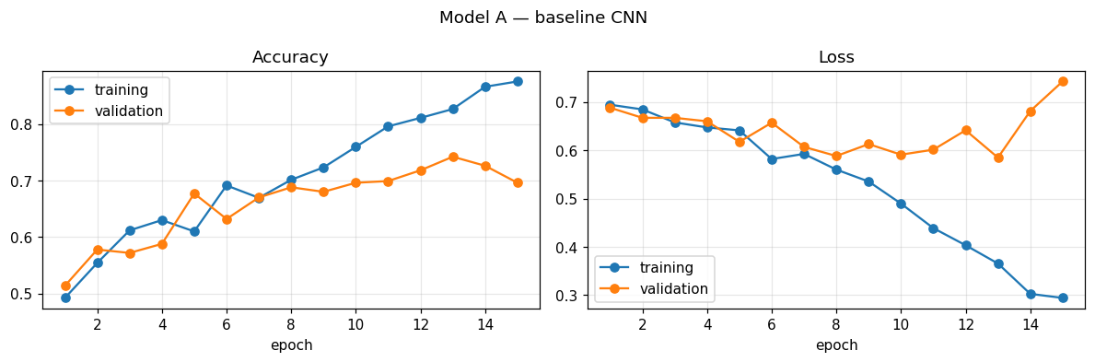
4
Training: the model memorises
AFTER 15 EPOCHS
0.875
training accuracy
0.696
validation accuracy
gap 0.179
The evidence
Three causes
Validation loss bottoms out at epoch 13
0.585
1,600 training images only
≈ 650 parameters per image
zero regularisation
…then climbs back to
0.743
Training loss over the same window
keeps falling
Notes:
Fifteen epochs, batches of a hundred — that's 16 batches per epoch, 240 weight updates total. And the curves tell the story. Training accuracy climbs to 0.875. Validation flattens at 0.70. But look at the loss on the right: validation loss bottoms out at epoch 13 and then climbs back up while training loss keeps falling. That divergence is the textbook signature of overfitting. It's not underfitting — if it were, both curves would be low and together. Three causes: too few images, a million parameters, and no regularisation at all.

Slide 6
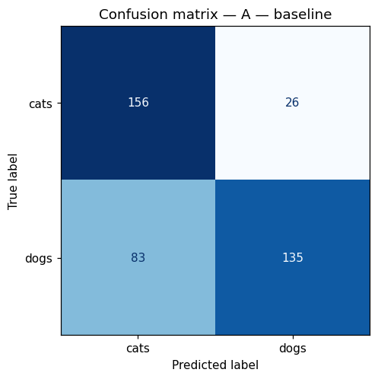
5
Test set: 400 unseen images
0.728
Accuracy
above the 0.500 baseline — it learned real features
0.839
Precision
when it says dog, it is right 84% of the time
0.619
Recall
but it misses 38% of the real dogs
0.712
F1-score
harmonic mean of the two
83 dogs classified as cats vs. 26 cats classified as dogs
The model is conservative on the dog class: at the slightest doubt it answers cat. Accuracy alone would have hidden this.
Notes:
On the 400 held-out images: 72.8 percent accuracy. Clearly better than chance, so it learned something real. But look at precision versus recall. When it says dog, it's right 84 percent of the time — but it only finds 62 percent of the actual dogs. Read the confusion matrix: 83 dogs misfiled as cats, against only 26 cats misfiled as dogs. The model is conservative about dogs: at the slightest doubt it answers cat. If I'd only reported accuracy, I'd have missed that entirely.

Slide 7
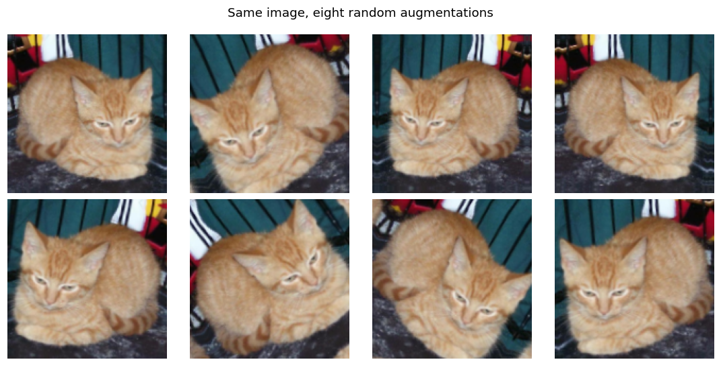
6
Fix 1 — Data augmentation
Flip · rotation ±10% · zoom ±10%, redrawn at every epoch
The network never sees the same image twice, so it cannot memorise.
Never applied to the test set
Keras augmentation layers are active in fit() and automatically inactive in predict(). The evaluation protocol is unchanged.
TRAIN / VAL GAP
TEST ACCURACY
RECALL ON DOGS
0.179 → 0.009
0.728 → 0.750
0.619 → 0.858
Notes:
First fix: augmentation. On the left, the same photo eight times — flipped, rotated, zoomed. A mirrored dog is still a dog, so the label survives. Crucially, Keras runs these layers during fit and switches them off during predict, so the test set is untouched — which is what the brief demands. The numbers: the gap collapses from 0.179 to 0.009, the curves are practically on top of each other. Accuracy goes to 0.750, and recall on dogs jumps from 0.62 to 0.86 — the conservative bias is gone.

Slide 8
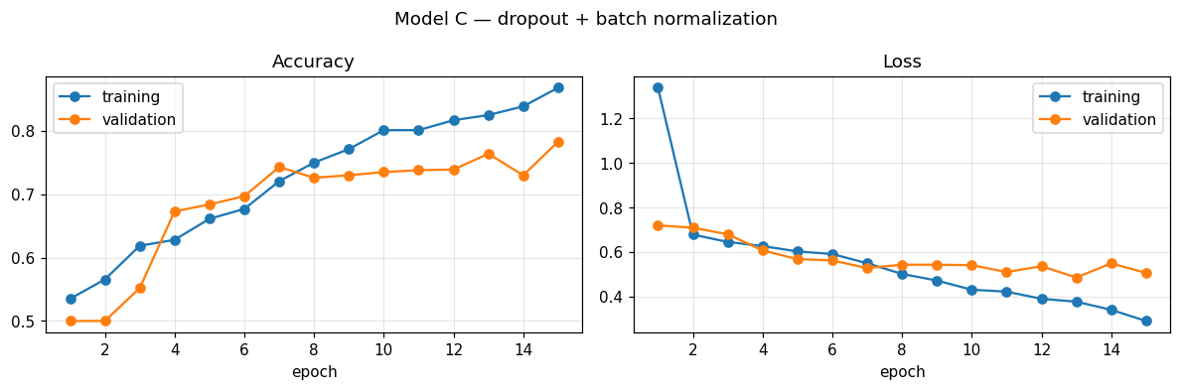
7
Fix 2 — Dropout + batch normalization
TEST ACCURACY
0.780
best of the three · F1 = 0.810 · gap 0.085
Dropout 0.5
Batch normalization
Half the dense units are switched off at each step → no unit can be relied on → distributed representation. Off at test time.
Each convolution output is normalised over the batch → stable, faster training, mild regularisation.
Bug worth reporting: with the default momentum = 0.99 and only 240 updates, the running statistics never converge — validation accuracy stayed pinned at exactly 0.500 while training ran fine. momentum = 0.9 fixes it.
Notes:
Second fix, tested separately as the brief requires: dropout plus batch normalization. Dropout kills half the dense units at every step so the network can't lean on any one of them. Batch norm normalises each convolution output over the batch. This is the best of the three: 78 percent accuracy, F1 of 0.81. And one bug worth telling you about: with Keras's default batch-norm momentum of 0.99 and only 240 weight updates in the whole run, the running statistics never converge — my validation accuracy was pinned at exactly 0.500 while training looked perfectly healthy. Dropping the momentum to 0.9 fixed it completely.

Slide 9
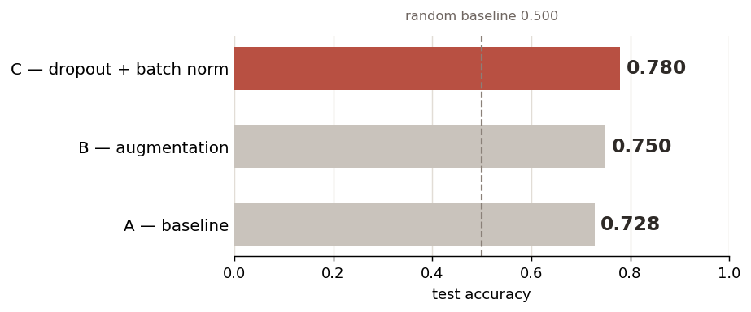
8
Three models, side by side
Model | Accuracy | Precision | Recall | F1 | Train / val gap
A — baseline CNN | 0.728 | 0.839 | 0.619 | 0.712 | 0.179
B — data augmentation | 0.750 | 0.730 | 0.858 | 0.789 | 0.009
C — dropout + batch norm | 0.780 | 0.766 | 0.858 | 0.810 | 0.085
Two levers, two profiles
Augmentation acts on the DATA and kills the gap. Dropout + batch norm act on the NETWORK and win on score.
Bonus — transfer learning
MobileNetV2 frozen, ImageNet weights, new head: ~1,300 trainable parameters instead of 1,043,905.
Notes:
Here's everything side by side. Model C wins on score, model B wins on the gap. That's the point I'd make: the two techniques attack the same problem from different sides — augmentation changes the data, dropout and batch norm change the network — so they're complementary, not competing. As a bonus I set up transfer learning with a frozen MobileNetV2: about 1,300 trainable parameters instead of a million.

Slide 10
What the numbers say
1
The limit is the data, not the architecture
1,600 images, ~650 parameters per image. Both fixes improved generalisation without adding a single filter.
2
Regularisation does not add intelligence
it removes the option to memorise — that alone moved the gap from 0.179 to 0.009.
3
Read the curves, not just the final number
a single batch-norm hyperparameter pinned validation at 0.500 while training looked healthy.
Next: combine both · fine-tune MobileNetV2 · EarlyStopping · train on the full 25,000-image set
Thank you — questions?
Notes:
Three things I take away. The limiting factor was the data, not the architecture — neither fix added a single filter and both improved generalisation. Regularisation doesn't make a model smarter, it removes its option to memorise. And you have to read the curves, not just the final number: one hyperparameter froze my validation at exactly 0.500 while training looked perfectly fine. Thank you — happy to take questions.

