Slide 1
Persistency Databases (via Entity Framework)

Slide 2
App
(Client)
(Location)
Web Service
(Data)
Data source

Slide 3
App
(Client)
(Location)
Web Service
(Data)
Entity Framework 6
Database

Slide 4
App
(Client)
(Location)
EF Core 2.0
Database

Slide 5
Web service
Database
EF 6
App
(Client)
EF Core 2.0

Slide 6
Entity Framework
Databases: Tables and Records (relational)
OOP: Classes and Objects (object-oriented)
ORM: Object/Relational Mapping

Slide 7
Model
(objects)
Database
(records)

Slide 8
Model
(objects)
Database
(records)
Model-first

Slide 9
Model
(objects)
Database
(records)
Database-first

Slide 10
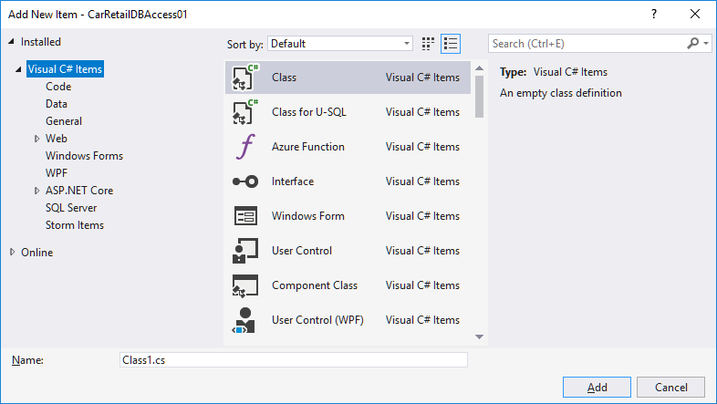

Slide 11
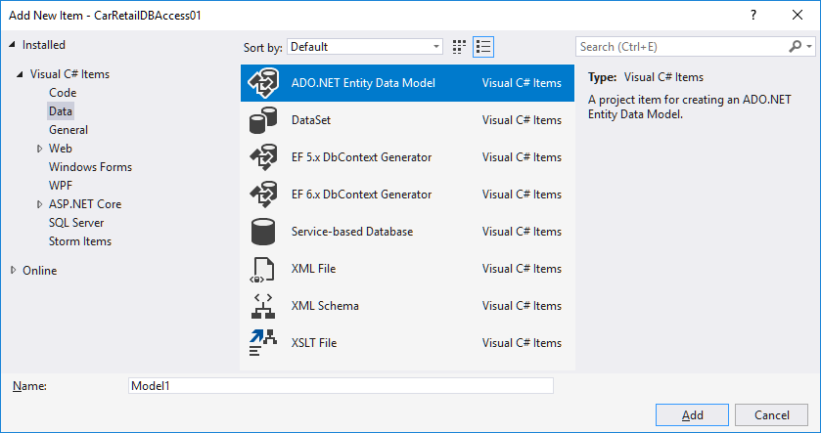

Slide 12
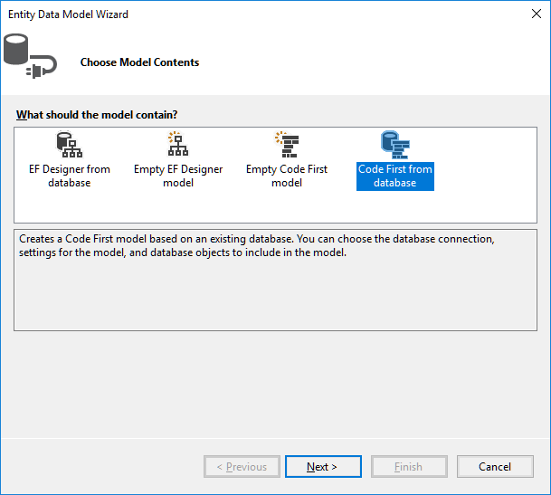
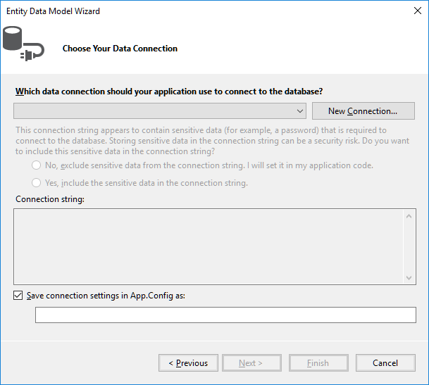
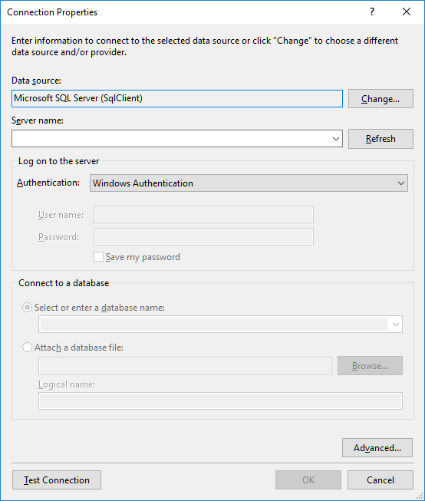
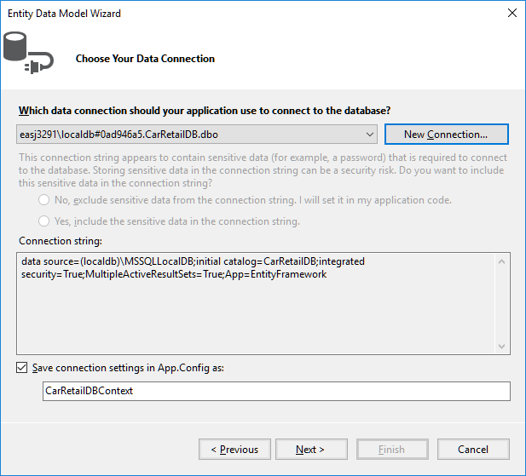
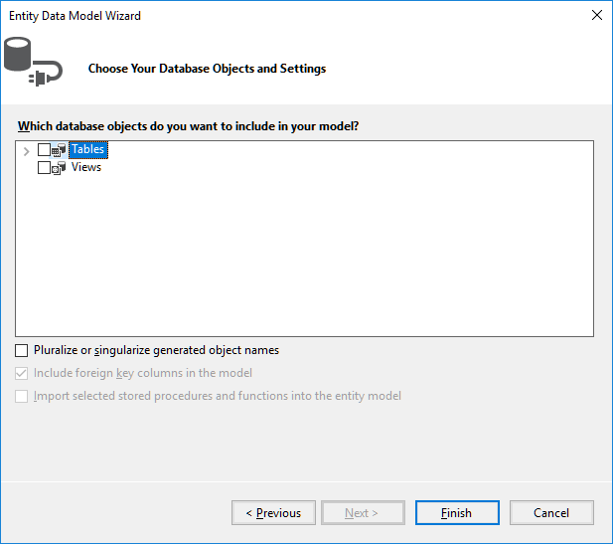

Slide 13
public partial class CarRetailDBContext : DbContext
{
public CarRetailDBContext() : base("name=CarRetailDBContext")
{
}
public virtual DbSet<Car> Cars { get; set; }
public virtual DbSet<Customer> Customers { get; set; }
protected override void OnModelCreating(DbModelBuilder modelBuilder)
{
…
}
}

Slide 14
using (var db = new CarRetailDBContext())
{
Console.WriteLine("All records in Car table:");
foreach (Car c in db.Cars)
{
Console.WriteLine(c);
}
}

Slide 15
Create
db.Cars.Add(new Car(4, "MN 1234",
80000, "Skoda", "Octavia“, 2013));
db.Cars.Add(new Car(5, "QR 3456",
30000, "VW", "Polo", 2009));
db.SaveChanges();

Slide 16
Read
Car c = db.Cars.Find(4);

Slide 17
Update
Car c = db.Cars.Find(4);
if (c != null)
{
c.Price = c.Price + 10000;
}
db.SaveChanges();

Slide 18
Delete
Car c = db.Cars.Find(4);
if (c != null)
{
db.Cars.Remove(4);
}
db.SaveChanges();

Slide 19
Query
var queryResult = from c in db.Cars
where c.Price > 70000 && c.Brand == "BMW"
select new {c.LicensePlate, c.Price};

Slide 20
Entity Framework Wrapper (EF Core 2.0)
 | Wrapper methods
Load | Task<List<T>> Load()
Create | Task Create(T obj)
Read | Task<T> Read(int key)
Update | Task Update(int key, T obj)
Delete | Task Delete(int key)

Slide 21
public interface IDataSource<T>
{
Task<List<T>> Load();
Task<int> Create(T obj);
Task<T> Read(int key);
Task Update(int key, T obj);
Task Delete(int key);
}

Slide 22
public class Catalog<T>
{
private IDataSource<T> _source;
…
public Catalog(IDataSource<T> source, …)
{
_source = source;
…
}
}

