Slide 1
Software Tools

Slide 2
Overall purpose
Write C# code as easily as possible
Write C# code of high quality
Write C# code in collaboration with other developers
Help us to obtain – and maintain – an overview of the entire body of code, including all the various units of code organisation
Translate our C# code into code that the computer can run directly
Help us find and fix errors in our code, both when the code is written (syntax errors) and executed (logic errors)

Slide 3

Tools
Extensions
Packages

Slide 4
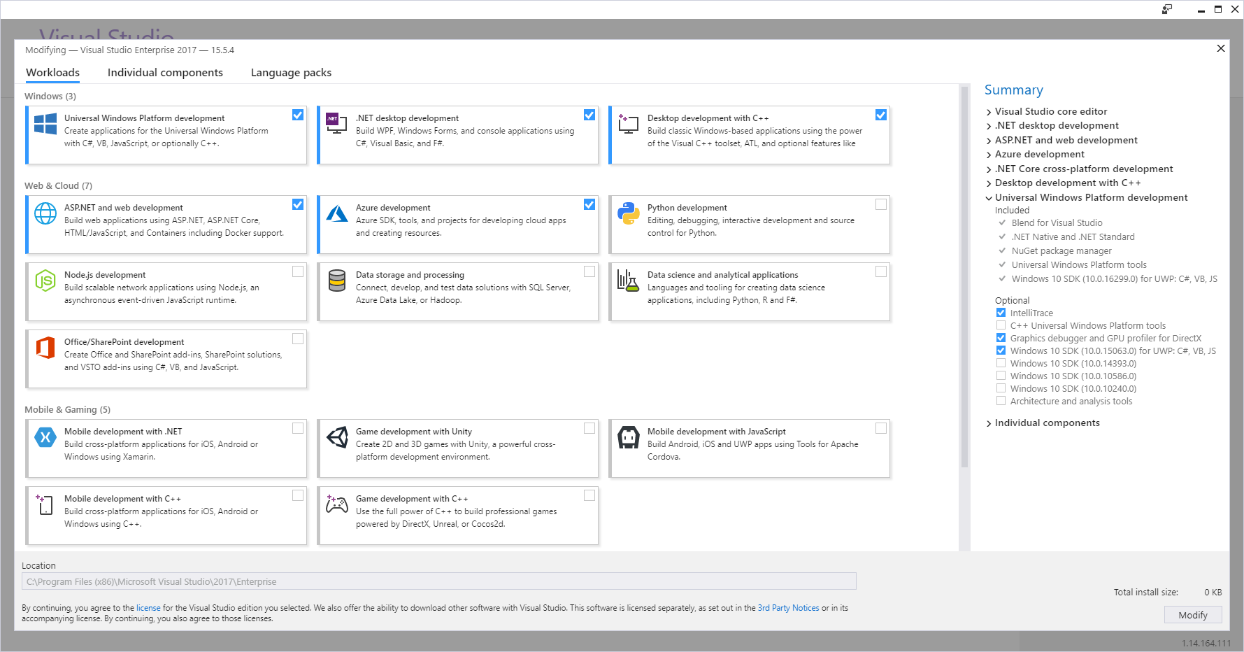
Tools | Get Tools and Features…

Slide 5
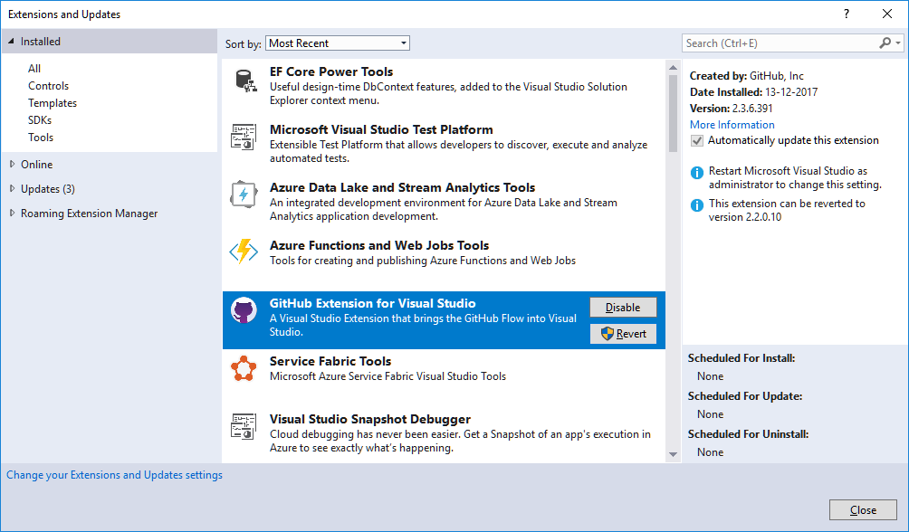
Tools | Extensions and Updates

Slide 6
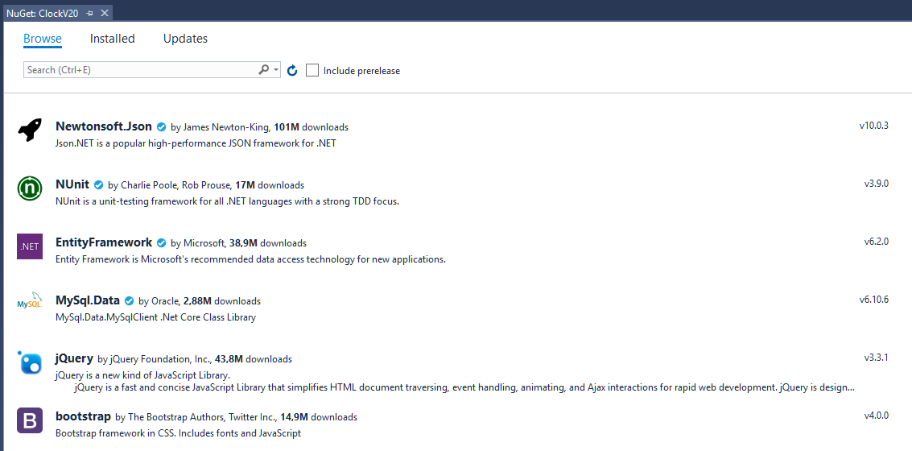
(Project) | Manage NuGet Packages…

Slide 7
Tools (Workloads)
Universal Windows Platform development
.NET Desktop development
Desktop development with C++

Slide 8
Extensions
Resharper Ultimate 2017.3.x (by Jetbrains)
GitHub Extension for Visual Studio 2.3.x (by GitHub)

Slide 9
NuGet Packages
Project-specific…

