Slide 1
Functions

Slide 2
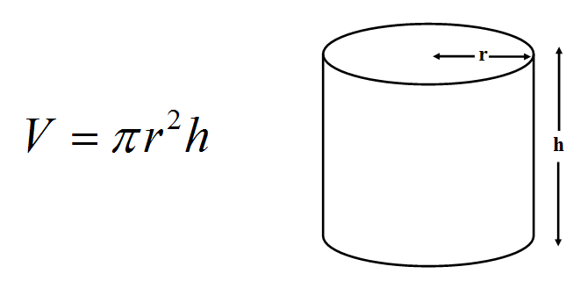

Slide 3
double h = 12.5;
double r = 8.2;
double v = Math.PI * r * r * h;

Slide 4
double h1 = 12.5;
double r1 = 8.2;
double h2 = 7.0;
double r2 = 17.3;
double v1 = Math.PI * r1 * r1 * h1;
double v2 = Math.PI * r2 * r2 * h2;

Slide 5
double CylinderVolume(double h, double r)
{
double v = Math.PI * r * r * h;
return v;
}

Slide 6
Name (chosen by you)
double CylinderVolume(double h, double r)
{
double v = Math.PI * r * r * h;
return v;
}

Slide 7
Parameters (type name, type name)
double CylinderVolume(double h, double r)
{
double v = Math.PI * r * r * h;
return v;
}

Slide 8
double CylinderVolume(double h, double r)
{
double v = Math.PI * r * r * h;
return v;
}
Logic

Slide 9
Return type
double CylinderVolume(double h, double r)
{
double v = Math.PI * r * r * h;
return v;
}
Return value

Slide 10
double h1 = 12.5;
double r1 = 8.2;
double h2 = 7.0;
double r2 = 17.3;
double v1 = CylinderVolume(h1, r1);
double v2 = CylinderVolume(h2, r2);

Slide 11
double v1 = CylinderVolume(12.5, 8.2);
double v2 = CylinderVolume(7.0, 17.3);

