Slide 1
Investigating Autonomous Systems Behavior in Russia and Ukraine using GRIP
Aviva Smith

Slide 2
Presentation Overview
Project Relevance
Topic + Methodology Review
GRIP Overview
Methology
Documentation Parameters
Pulling data from API using curl queries
Parsing .json files (file parsing, type data accessed, challenges)
Event Tags
Interesting Results
Future Work

Slide 3
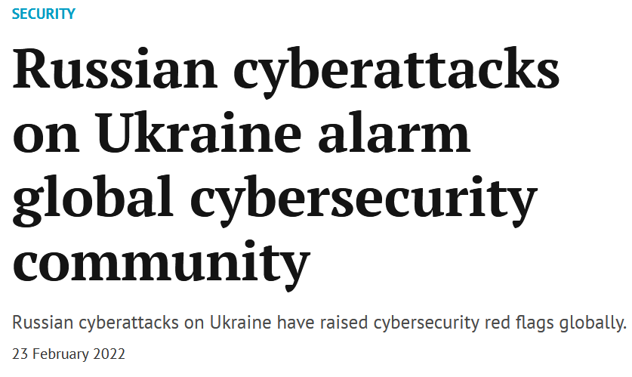
Project Relevance
Pre-invasion on Feb. 24, 2022, Russia allegedly launched several cyberattacks targeting Ukraine’s critical infrastructure
Upon further investigation, none of these alleged attacks could be definitively classified as BGP Hijacking Attacks, even if behavior was Suspicious.
Nature of attacks cannot always be proven malicious, even if behavior is suspicious
Possible Reasons:
Cyberattack could trigger military action on the part of Ukrainian alies
Russian motives possibly more focused on razing country to rebuild
Cyberattacks occurring, but not detected as focus on more espionage related activities

Slide 4
Topic + Methodology
Topic: Investigate BGP data from 2022 and determine if there was an increase in suspicious behavior of ASes in Ukraine and Russia pre-invasion
Learn how GRIP API works
Create notebook for interacting with GRIP API
Use CURL bindings to make an HTTP query to return data collected over last two months
Write python script to parse output (.json files)
Determine if data returned by query includes nationality information
Yes! Geographic Information returned by GRIP API
Graphically visualize notable trends (if any)
Bonus: Investigate behavior that constitutes increase in activity

Slide 5
GRIP
System that continuously monitors BGP data for attacks
From Route Views and RIPE RIS
Detects different types of attacks (MOAS, SUBMOAS, Defcon, NewEdge)
Tags attack events with labels
Information on ASN history, path, fat-finger, ASN type, blacklist, prefix, AS relationship, RPKI
Infers a risk level for the event

Slide 6
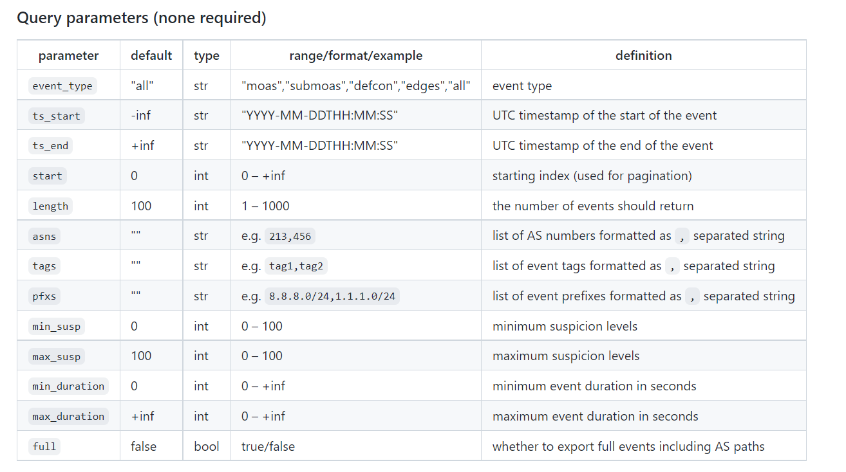
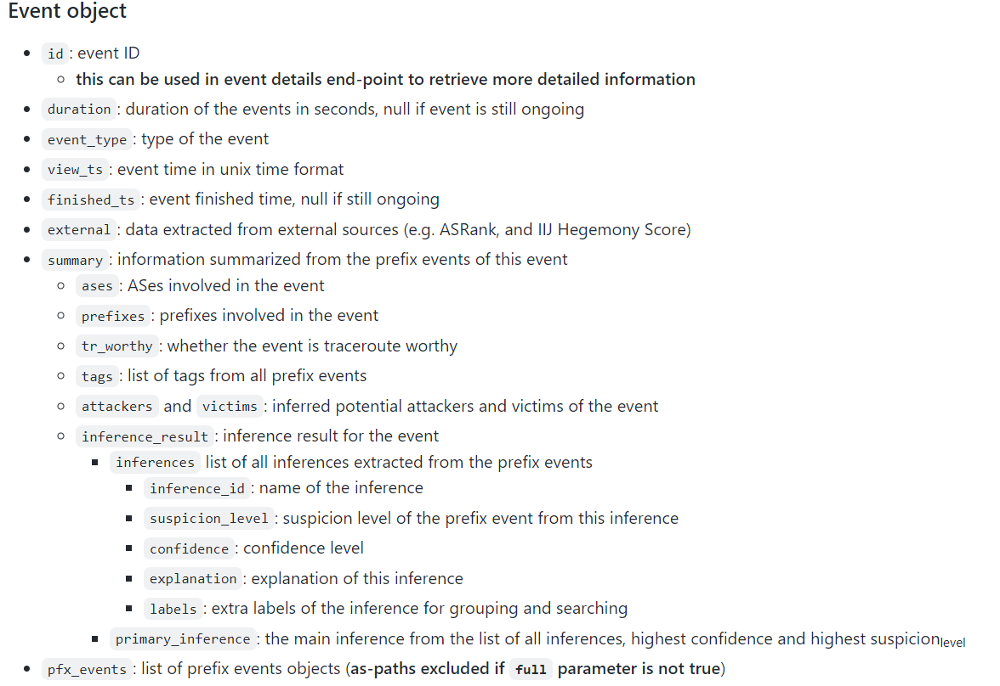
GRIP API Documentation Parameters
Access UI: GRIP - Global Routing Intelligence Platform (gatech.edu)
API Documentation: grip-api/api-spec.md at master · InetIntel/grip-api · GitHub

Slide 7
Pulling Data using Curl Queries
Curl URL Queries are constructed with the follow:
HTTP hosting API
Number of Events Queried
Start Date
End Date
Minimum Suspicious and Maximum Suspicion
Event Type
Example: MOAS EVENTS 2.01.22 -> 2.10.22
curl https://api.grip.inetintel.cc.gatech.edu/dev/json/events?length=100&start=0&ts_start=2022-02-01T19%3A03&ts_end=2022-02-10T19%3A03&min_susp=80&max_susp=100&event_type=moas
APIs for Running Curl Query with Good Formatting:
https://reqbin.com/req/c-g95rmxs0/curl-for-windows

Slide 8
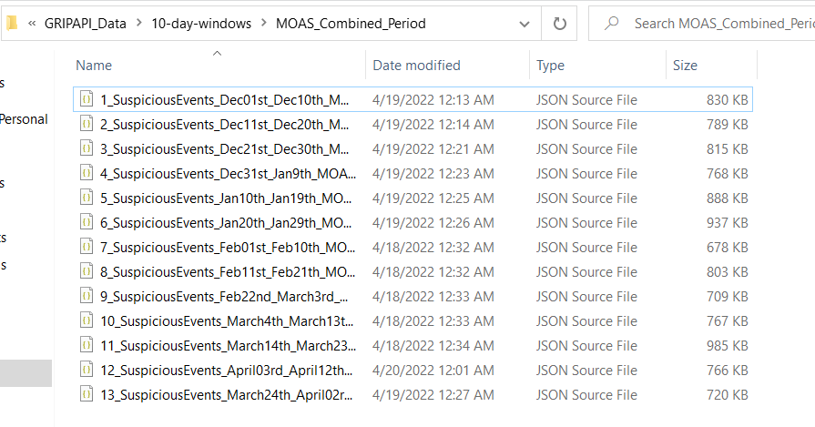
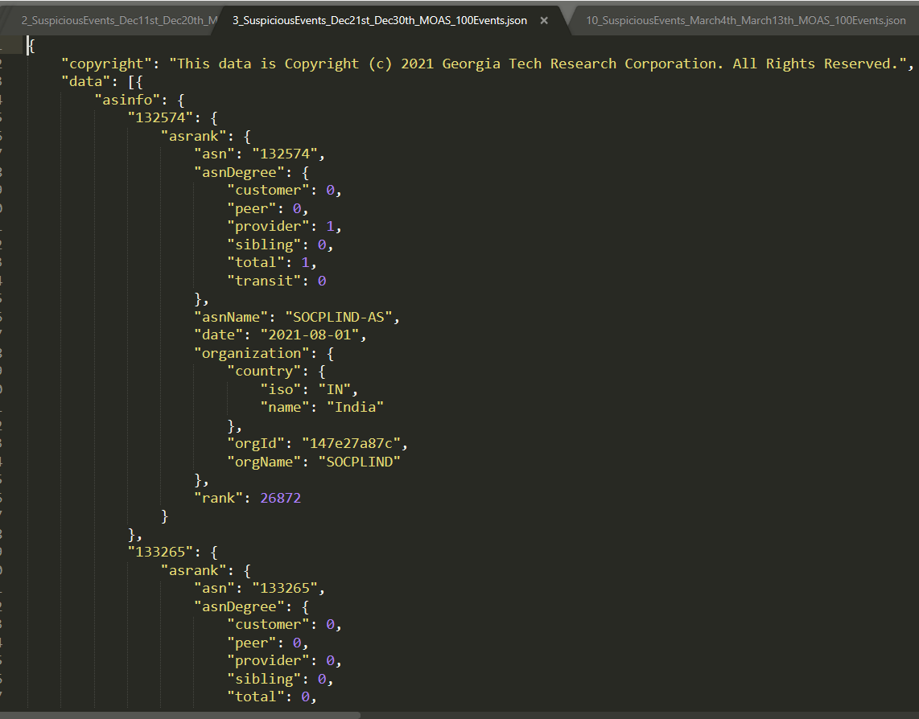
Parsing API Data
File Parsing
Saved .json files locally
Accessed files from Notebook
Accessed data according to metadata descriptions provided on API documentation
Brief Walkthrough of notebook
Challenges
A LOT of data available -> took time to parse through
Gaps in available information for even entry -> code optimized to handle this case
Investigating UI and API
What data is relevant to Ukraine-Russian conflict?

Slide 9
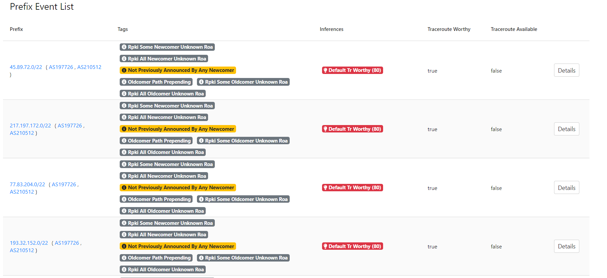
Tags
Tags are useful for investigating an event more closely. For example, a prefix with the tag “Not Previously Announced by Any Newcomer” could indicate that some new prefix yet to be explored is being advertised.

Slide 10
Review of Notebooks
MOAS_Ukraine_Russia_Exploration - Jupyter Notebook
SUBMOAS_Ukraine_Russia_Exploration - Jupyter Notebook

Slide 11
Project Takeaways
Based on although an increase in activity, no malicious activity launched by Russia or any other country against Ukraine has definitively detected -> Closer inspection required
More subMOAS activity than MOAS activity recorded in region
Super_pfx and Sub_prefix do not indicate especially malicious activity
Notable frequently occurring tags:
'some-newcomers-stub-ases’
'some-newcomer-announced-no-pfxs’
'all-origins-same-country’
'all-newcomer-announced-no-pfxs’
'not-previously-announced-by-any-newcomer’

Slide 12
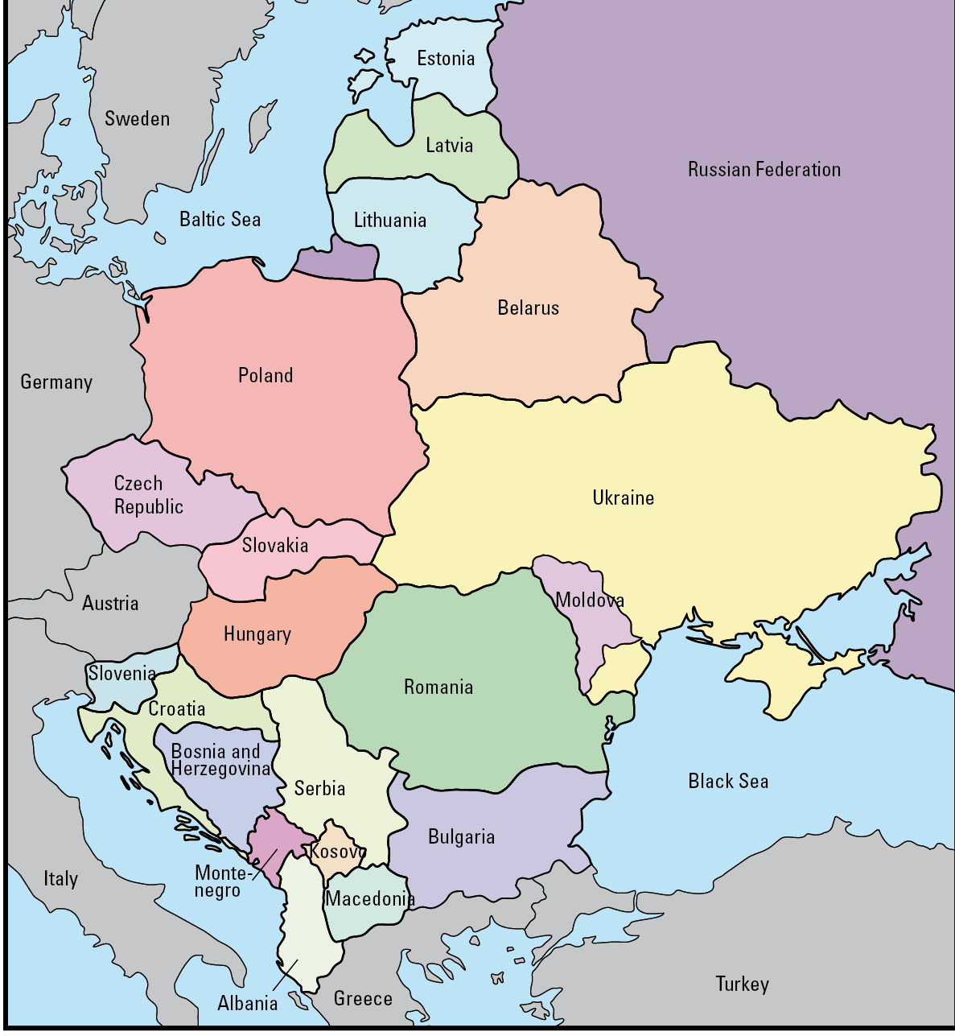
Remaining Work
Finish pulling data for December and January for subMOAS events
Take a closer look at the available tags, especially on subMOAS events to determine if malicious behavior is detected.
Investigate activity other countries in regions (Beleru, Romania, Poland, Moldova, Slovakia)
Investigate if especially suspicious prefixes were advertised in subMOAS data
Investigate relationship between organizations hosting ASes

