Slide 1



desafio_01
View in Power BI
Last data refresh:
6/12/2024 1:28:52 PM UTC
Downloaded at:
6/12/2024 1:30:16 PM UTC

Slide 2
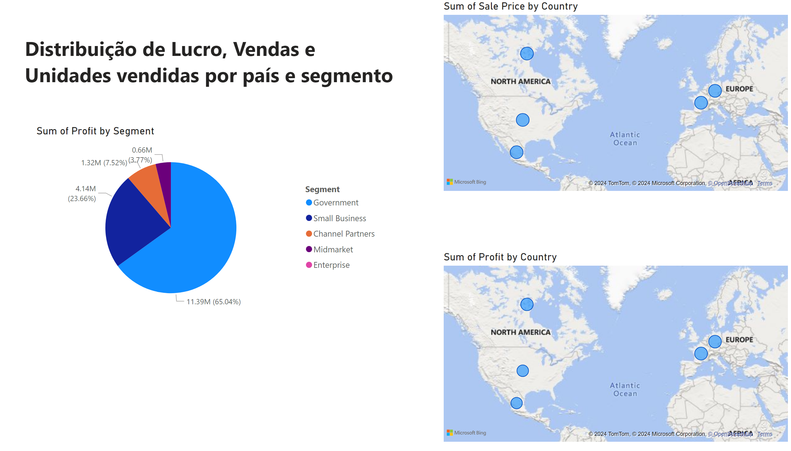
Página 3
Notes:
map
No alt text provided
map
No alt text provided
pieChart
No alt text provided
textbox
No alt text provided

